Slide 1
LOWER SIXTH ARTS
GEOGRAPHY
Further Study 1
Early Theories of Crustal Movements
Notes:
Good morning, class, and welcome to our geography lesson. I am your geography teacher, Mr Kamdem. Today we are starting Further Study 1: Early Theories of Crustal Movements.

Slide 2
CLASS INFO
Class, Chapter and Duration
Class | Lower Sixth Arts
Chapter | Module 2: Understanding and managing physical landscapes, geomorphological processes and hazards across the world in general and Cameroon in particular
Duration | 2 periods (2 × 50 minutes)
Notes:
This lesson is for Lower Sixth Arts. It belongs to Module 2: Understanding and managing physical landscapes, geomorphological processes and hazards across the world in general and Cameroon in particular. We shall need 2 periods to cover it.

Slide 3
IDENTIFICATION
Lesson Identification
Topic | The Development of the Earth's Structure
Sub-topic | Theories of Earth Structure and Resultant Landforms
Lesson | Further Study 1: Early Theories of Crustal Movements
Notions / Concepts | Isostasy, continental drift, Pangaea, Laurasia, Gondwanaland.
Syllabus focus | Isostasy; the theory of continental drift, its evidence, strengths and weaknesses.
Competence | Learners are able to explain the early theories of crustal movement and judge their evidence.
Notes:
Our topic is The Development of the Earth's Structure, and the sub-topic is Theories of Earth Structure and Resultant Landforms. The key notions we shall use today are: isostasy, continental drift, Pangaea, Laurasia, Gondwanaland. At the end, you should be able to do this: learners are able to explain the early theories of crustal movement and judge their evidence.

Slide 4

HOMEWORK CORRECTION
Correction of the Homework
Question (Lesson 2: Internal Structure of the Earth):
Look at a map of the world. Why do the coasts of Africa and South America look like pieces of a puzzle? Write two sentences.
Notes:
Before we start the new lesson, let us correct the homework I gave you at the end of Lesson 2: Internal Structure of the Earth. The question was: Look at a map of the world. Why do the coasts of Africa and South America look like pieces of a puzzle? Write two sentences. Take out your exercise books.

Slide 5
HOMEWORK CORRECTION
Correction: Possible Answer
The coasts of Africa and South America look like pieces of a puzzle because they were once joined in one continent (Gondwana/Pangaea). They later drifted apart as the Atlantic Ocean opened.
Notes:
Here is a good answer. The coasts of Africa and South America look like pieces of a puzzle because they were once joined in one continent (Gondwana/Pangaea). They later drifted apart as the Atlantic Ocean opened. Compare it with your own answer and correct your work in red.

Slide 6
LESSON PLAN
Lesson Plan
Correction of the homework
Objectives and recall
Real-life situation and action to take
Learning activities
Board summary
Evaluation, remediation and homework
Notes:
Here is the plan of our lesson today. First, we shall correct the homework. Then we shall look at the objectives and recall what you already know. After that, we shall study a situation from real life and the action to take, and do the learning activities. Finally, we shall copy the board summary, do the evaluation and the remediation, and I will give you the homework.

Slide 7
OBJECTIVES
Objectives
By the end of this lesson, you should be able to:
Explain isostasy.
Explain the theory of continental drift.
Give the evidence, strengths and weaknesses of the theory.
Notes:
By the end of this lesson, you should be able to do three things. Number 1: explain isostasy. Number 2: explain the theory of continental drift. Number 3: give the evidence, strengths and weaknesses of the theory.

Slide 8
PREVIOUS KNOWLEDGE
Previous Knowledge
The crust floats on the soft upper mantle.
The Earth has changed over millions of years.
Notes:
Let us first remember what you already know. The crust floats on the soft upper mantle. The Earth has changed over millions of years. Keep this in mind, because we shall build on it today.

Slide 9
REAL-LIFE SITUATION
Situation in Real Life
Djibrilla sees that the coast of West Africa and the coast of Brazil fit like two pieces of a puzzle. His teacher says that a German scientist had the same idea in 1912.
Notes:
Listen carefully to this situation from real life. Djibrilla sees that the coast of West Africa and the coast of Brazil fit like two pieces of a puzzle. His teacher says that a German scientist had the same idea in 1912. Think about it, because I am going to ask you some questions.

Slide 10
REAL-LIFE SITUATION
Situation: Question 1
What is the problem in the situation?
Notes:
Question 1: What is the problem in the situation? Think for a moment, then raise your hand to answer.

Slide 11
REAL-LIFE SITUATION
Answer
Djibrilla wonders if the continents were once joined.
Notes:
Good. Djibrilla wonders if the continents were once joined.

Slide 12
REAL-LIFE SITUATION
Situation: Question 2
Who was the scientist?
Notes:
Question 2: Who was the scientist? Think for a moment, then raise your hand to answer.

Slide 13
REAL-LIFE SITUATION
Answer
Alfred Wegener.
Notes:
Good. Alfred Wegener.

Slide 14
REAL-LIFE SITUATION
Situation: Question 3
What evidence can support the idea?
Notes:
Question 3: What evidence can support the idea? Think for a moment, then raise your hand to answer.

Slide 15
REAL-LIFE SITUATION
Possible Answer
The fit of the coasts, fossils and rocks.
Notes:
Good. The fit of the coasts, fossils and rocks.

Slide 16
ACTION TO TAKE
Action to Take
Understand how scientists built theories of the moving Earth from evidence.
Notes:
From this situation, the action we are working towards in this lesson is the following: understand how scientists built theories of the moving Earth from evidence.

Slide 17
JUSTIFICATION
Justification of the Lesson
This lesson helps us to understand how scientists first explained the movement of continents.
Notes:
Why is this lesson important for you? This lesson helps us to understand how scientists first explained the movement of continents.

Slide 18
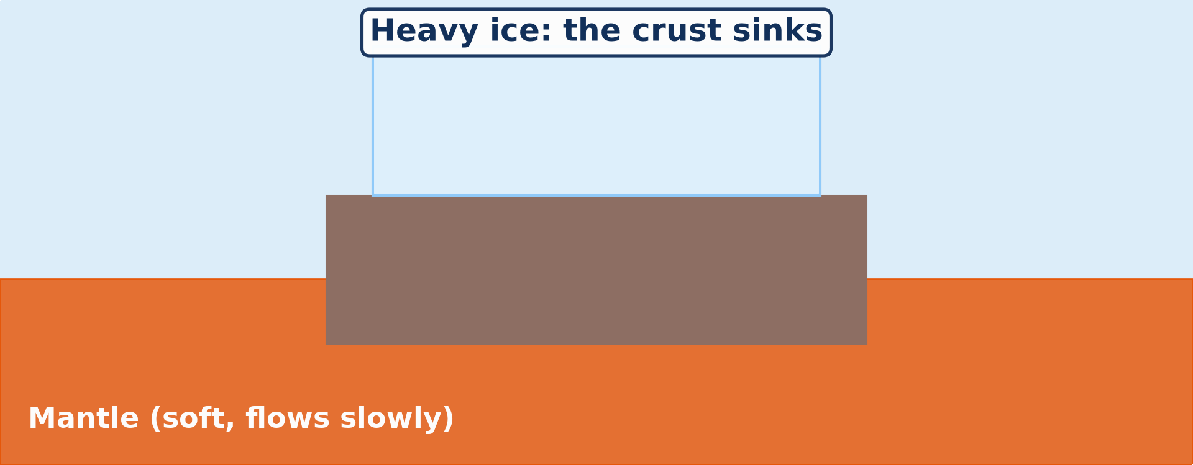
1. ISOSTASY
Activity 1
Animation: the crust sinks under ice and rises when it melts.
Notes:
Activity 1. Look carefully at this animation: animation: the crust sinks under ice and rises when it melts. Watch the animation to the end; it will play again.

Slide 19
1. ISOSTASY
Activity 1: Question
Why does the crust rise again when the ice melts?
Notes:
Here is the question for Activity 1: Why does the crust rise again when the ice melts? Take one minute to think and write your answer in your rough notebook.

Slide 20
1. ISOSTASY
Activity 1: Answer
The crust floats on the mantle; when the weight is removed, it rises (isostatic recovery).
Notes:
Let us check the answer together. The crust floats on the mantle; when the weight is removed, it rises (isostatic recovery).

Slide 21

2. CONTINENTAL DRIFT
Activity 2
Animation: closing the Atlantic Ocean.
Notes:
Activity 2. Look carefully at this animation: animation: closing the Atlantic Ocean. Watch the animation to the end; it will play again.

Slide 22
2. CONTINENTAL DRIFT
Activity 2: Question
What does the fit of Africa and South America suggest?
Notes:
Here is the question for Activity 2: What does the fit of Africa and South America suggest? Take one minute to think and write your answer in your rough notebook.

Slide 23
2. CONTINENTAL DRIFT
Activity 2: Answer
They were once joined in one landmass (Pangaea).
Notes:
Let us check the answer together. They were once joined in one landmass (Pangaea).

Slide 24
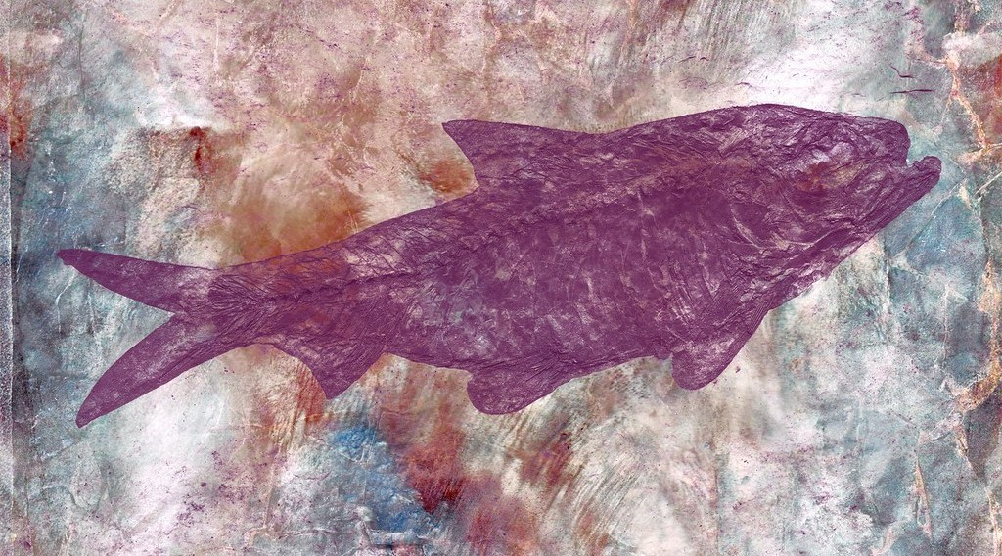
3. EVIDENCE: FOSSILS
Activity 3
A fossil in rock.
Notes:
Activity 3. Look carefully at this picture: a fossil in rock. Observe every detail before I ask the question.

Slide 25
3. EVIDENCE: FOSSILS
Activity 3: Question
The same fossils (Mesosaurus, Glossopteris) are found in Brazil and southern Africa. What does this prove?
Notes:
Here is the question for Activity 3: The same fossils (Mesosaurus, Glossopteris) are found in Brazil and southern Africa. What does this prove? Take one minute to think and write your answer in your rough notebook.

Slide 26
3. EVIDENCE: FOSSILS
Activity 3: Answer
The continents were joined when these plants and animals lived.
Notes:
Let us check the answer together. The continents were joined when these plants and animals lived.

Slide 27
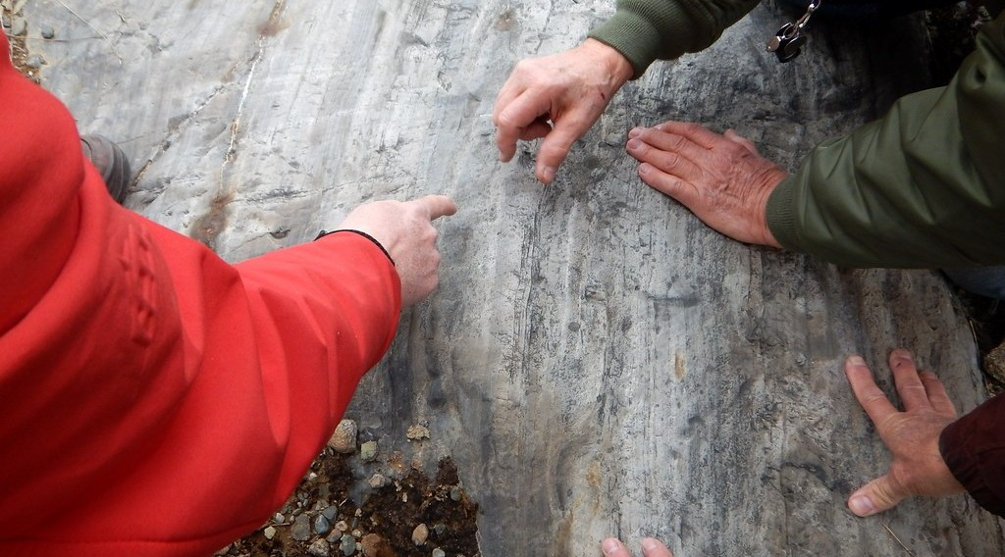
3. EVIDENCE: CLIMATE
Activity 4
Scratches left on rock by an old glacier (ice sheet).
Notes:
Activity 4. Look carefully at this picture: scratches left on rock by an old glacier (ice sheet). Observe every detail before I ask the question.

Slide 28
3. EVIDENCE: CLIMATE
Activity 4: Question
Marks of old ice sheets are found in India and Africa. What does this show?
Notes:
Here is the question for Activity 4: Marks of old ice sheets are found in India and Africa. What does this show? Take one minute to think and write your answer in your rough notebook.

Slide 29
3. EVIDENCE: CLIMATE
Activity 4: Answer
These lands were once near the South Pole and have drifted.
Notes:
Let us check the answer together. These lands were once near the South Pole and have drifted.

Slide 30

4. STRENGTHS AND WEAKNESSES
Activity 5
The plates of the Earth today.
Notes:
Activity 5. Look carefully at this diagram: the plates of the Earth today. Observe every detail before I ask the question.

Slide 31
4. STRENGTHS AND WEAKNESSES
Activity 5: Question
Wegener could not explain what moves the continents. Which later theory explained it?
Notes:
Here is the question for Activity 5: Wegener could not explain what moves the continents. Which later theory explained it? Take one minute to think and write your answer in your rough notebook.

Slide 32
4. STRENGTHS AND WEAKNESSES
Activity 5: Answer
The theory of plate tectonics (mantle convection currents).
Notes:
Let us check the answer together. The theory of plate tectonics (mantle convection currents).

Slide 33
BOARD SUMMARY
Board Summary
Topic: The Development of the Earth's Structure
Sub-topic: Theories of Earth Structure and Resultant Landforms
Further Study 1: Early Theories of Crustal Movements
Notes:
Now we are going to copy the board summary. Write the title and the headings neatly in your notebooks. I will give you enough time for each slide, so do not rush.

Slide 34
BOARD SUMMARY
1. Isostasy
Isostasy can be understood as follows:
Meaning: It is the state of balance of the lighter crust floating on the denser mantle, like wood floating on water. Thick crust sinks deeper, like mountains with deep roots.
Notes:
Let us copy Isostasy. Isostasy can be understood as follows. On this slide we have Meaning. Write each point on a new line, with the key term first, and explain it in your own words when we revise. When you finish, we go to the next slide.

Slide 35
BOARD SUMMARY
1. Isostasy (continued)
Isostatic equilibrium: When weight is added (ice sheets) the crust sinks; when it is removed (melting, erosion) the crust rises again. Scandinavia is still rising after the last ice age.
Notes:
We continue with Isostasy. On this slide we have Isostatic equilibrium. Write each point on a new line, with the key term first, and explain it in your own words when we revise.

Slide 36
BOARD SUMMARY
1. Isostasy
Illustration: isostasy
Notes:
Now draw this illustration in your notebook: isostasy. Give it a title and label it clearly.

Slide 37
BOARD SUMMARY
2. Theory of Continental Drift
Wegener's theory (1912) states that:
Splitting of landmasses: About 300 million years ago all continents formed one super-continent, Pangaea, surrounded by the ocean Panthalassa. It split into Laurasia in the north and Gondwana in the south.
Notes:
Let us copy Theory of Continental Drift. Wegener's theory (1912) states that. On this slide we have Splitting of landmasses. Write each point on a new line, with the key term first, and explain it in your own words when we revise. When you finish, we go to the next slide.

Slide 38
BOARD SUMMARY
2. Theory of Continental Drift (continued)
Drifting: The continents slowly drifted to their present positions. The Americas moved west and India moved north towards Asia.
Notes:
We continue with Theory of Continental Drift. On this slide we have Drifting. Write each point on a new line, with the key term first, and explain it in your own words when we revise.

Slide 39
BOARD SUMMARY
3. Evidence, Strengths and Weaknesses
The theory is supported and criticised as follows:
Evidence: The coasts of Africa and South America fit, and the same fossils (Mesosaurus, Glossopteris) are found on both.
Notes:
Let us copy Evidence, Strengths and Weaknesses. The theory is supported and criticised as follows. On this slide we have Evidence. Write each point on a new line, with the key term first, and explain it in your own words when we revise. When you finish, we go to the next slide.

Slide 40
BOARD SUMMARY
3. Evidence, Strengths and Weaknesses (continued)
Old glacial striations in India and Africa and similar rocks on both sides of the Atlantic also support it.
Strengths: It explained the fit of continents, the spread of fossils and old climates. It prepared the way for plate tectonics.
Notes:
We continue with Evidence, Strengths and Weaknesses. On this slide we have Strengths. Write each point on a new line, with the key term first, and explain it in your own words when we revise. When you finish, we go to the next slide.

Slide 41
BOARD SUMMARY
3. Evidence, Strengths and Weaknesses (continued)
Weaknesses: Wegener could not explain the force that moved the continents. He wrongly thought continents ploughed through the ocean floor.
Notes:
We continue with Evidence, Strengths and Weaknesses. On this slide we have Weaknesses. Write each point on a new line, with the key term first, and explain it in your own words when we revise.

Slide 42
FORMATIVE EVALUATION
Evaluation 1
What is isostasy?
Notes:
Now let us check what you have understood. Question 1: What is isostasy? Answer in your exercise book.

Slide 43
FORMATIVE EVALUATION
Expected Answer
The balance of the crust floating on the denser mantle.
Notes:
The expected answer is: the balance of the crust floating on the denser mantle. If you got it right, well done.

Slide 44
FORMATIVE EVALUATION
Evaluation 2
Give two pieces of evidence for continental drift.
Notes:
Now let us check what you have understood. Question 2: Give two pieces of evidence for continental drift. Answer in your exercise book.

Slide 45
FORMATIVE EVALUATION
Expected Answer
The jigsaw fit of the coasts and the same fossils on both sides of the Atlantic.
Notes:
The expected answer is: the jigsaw fit of the coasts and the same fossils on both sides of the Atlantic. If you got it right, well done.

Slide 46
REMEDIATION
Remediation
Fill in the blanks:
The supercontinent was called ______.
Its northern part was ______.
Its southern part was ______.
Notes:
For those who need more practice, fill in the blanks in your exercise book. The answers are: number 1, Pangaea; number 2, Laurasia; number 3, Gondwanaland.

Slide 47
HOMEWORK
Homework
Find the Mid-Atlantic Ridge on a map of the ocean floor in your atlas. Describe its position in one sentence.
Notes:
For your homework: Find the Mid-Atlantic Ridge on a map of the ocean floor in your atlas. Describe its position in one sentence. We shall correct it at the beginning of our next lesson.

Slide 48
NEXT LESSON
Next Lesson
Our next lesson will be on:
Further Study 2: Theory of Sea-Floor Spreading
Notes:
Our next lesson will be on Further Study 2: Theory of Sea-Floor Spreading. Thank you for your attention, and see you next time.

Slide 49
BILINGUAL GAME
Bilingual Game (Jeu Bilingue)
English | Français
Continental drift | La dérive des continents
Isostasy | L'isostasie
Supercontinent | Le supercontinent
Evidence | La preuve
Fossil | Le fossile
Ice sheet | L'inlandsis
Notes:
Let us play the bilingual game. I say a word in English, and you give me the French word. Then we do the reverse.

Slide 50
LOGBOOK
Official Logbook (1/2)
Module / Topic | The Development of the Earth's Structure
Lesson Title | Further Study 1: Early Theories of Crustal Movements
Expected Learning Outcomes | Explain isostasy. Explain the theory of continental drift. Give the evidence, strengths and weaknesses of the theory.
Competence | Learners are able to explain the early theories of crustal movement and judge their evidence.
Notes:
I record this information in the official logbook of the class after the lesson.

Slide 51
LOGBOOK
Official Logbook (2/2)
Matter Taught | Isostasy; Theory of Continental Drift; Evidence, Strengths and Weaknesses.
Evaluation | Formative evaluation and remediation exercise.
Homework | Find the Mid-Atlantic Ridge on a map of the ocean floor in your atlas. Describe its position in one sentence.
Enrolment / Present / Absent | ____ / ____ / ____
Achievement | To be completed after the lesson.
Notes:
I complete the second page of the logbook: the matter taught, the evaluation, the homework and the attendance.

Slide 52
TEACHER'S NOTE
Teacher's Note
Timing: Homework correction, plan, objectives 8 min | Recall, situation, action 10 min | 5 activities 30 min | Board summary (copying) 30 min | Evaluation, remediation 10 min | Homework, next lesson 5 min | Logbook 7 min
Activities 1 and 2 are animations (GIF): it plays automatically in slide-show mode.
Without the projector (Activity 1): put a piece of wood in water and press it down, then release it.
Without the projector (Activity 2): cut out the two continents from a paper map.
Without the projector (Activity 3): explain that the animal could not swim across an ocean.
Without the projector (Activity 4): describe marks left by glaciers on rocks.
Without the projector (Activity 5): draw the plates on a world sketch.
Notes:
This slide is for me, the teacher: it gives the timing of the lesson and what to do if the projector is not available.

Slide 53
REFERENCES
References
National Geography Syllabus, MINESEC/IGE/IP-SS, 2019 — Module 2 (Geomorphology).
Photo, Activity 3: “Marble Skin Fish Fossil” by Bold Frontiers, CC BY 2.0, via Flickr (https://www.flickr.com/photos/82955120@N05/14091612527)
Photo, Activity 4: “geoscience crowd sourcing” by subarcticmike, CC BY 2.0, via Flickr (https://www.flickr.com/photos/31856336@N03/37633979015)
Diagrams and animations: drawn for this lesson (Geography Department).
Notes:
These are the references and picture credits used to prepare this lesson.

