Slide 1
LOWER SIXTH ARTS
GEOGRAPHY
Lesson 26
Evapotranspiration
Notes:
Good morning, class, and welcome to our geography lesson. I am your geography teacher, Mr Kamdem. Today we are starting Lesson 26: Evapotranspiration.

Slide 2
CLASS INFO
Class, Chapter and Duration
Class | Lower Sixth Arts
Chapter | Module 1: Understanding and managing atmospheric and hydrological phenomena and hazards across the world in general and Cameroon in particular
Duration | 2 periods (2 × 50 minutes)
Notes:
This lesson is for Lower Sixth Arts. It belongs to Module 1: Understanding and managing atmospheric and hydrological phenomena and hazards across the world in general and Cameroon in particular. We shall need 2 periods to cover it.

Slide 3
IDENTIFICATION
Lesson Identification
Topic | The Drainage Basin Hydrological Cycle
Sub-topic | Components of the Drainage Basin Hydrological Cycle
Lesson | Lesson 26: Evapotranspiration
Notions / Concepts | Evaporation, transpiration, evapotranspiration, potential and actual evapotranspiration, evaporation pan, lysimeter.
Syllabus focus | Meaning, types, process, measurement, variations, factors and significance of evapotranspiration.
Competence | Learners are able to explain evapotranspiration, how it is measured and why it varies.
Notes:
Our topic is The Drainage Basin Hydrological Cycle, and the sub-topic is Components of the Drainage Basin Hydrological Cycle. The key notions we shall use today are: evaporation, transpiration, evapotranspiration, potential and actual evapotranspiration, evaporation pan, lysimeter. At the end, you should be able to do this: learners are able to explain evapotranspiration, how it is measured and why it varies.

Slide 4

HOMEWORK CORRECTION
Correction of the Homework
Question (Lesson 25: How Human Activities Affect the Hydrological Cycle):
Identify one place in your town that floods and suggest two solutions.
Notes:
Before we start the new lesson, let us correct the homework I gave you at the end of Lesson 25: How Human Activities Affect the Hydrological Cycle. The question was: Identify one place in your town that floods and suggest two solutions. Take out your exercise books.

Slide 5
HOMEWORK CORRECTION
Correction: Possible Answer
Example: a low area near the market floods after heavy rain because drains are blocked with rubbish. Solutions: clean and enlarge the drains, and stop building on the floodplain.
Notes:
Here is a good answer. Example: a low area near the market floods after heavy rain because drains are blocked with rubbish. Solutions: clean and enlarge the drains, and stop building on the floodplain. Compare it with your own answer and correct your work in red.

Slide 6
LESSON PLAN
Lesson Plan
Correction of the homework
Objectives and recall
Real-life situation and action to take
Learning activities
Board summary
Evaluation, remediation and homework
Notes:
Here is the plan of our lesson today. First, we shall correct the homework. Then we shall look at the objectives and recall what you already know. After that, we shall study a situation from real life and the action to take, and do the learning activities. Finally, we shall copy the board summary, do the evaluation and the remediation, and I will give you the homework.

Slide 7
OBJECTIVES
Objectives
By the end of this lesson, you should be able to:
Define evaporation, transpiration and evapotranspiration.
Distinguish potential and actual evapotranspiration.
Notes:
Take your time to copy this part; we will continue together.

Slide 8
OBJECTIVES
Objectives (continued)
Explain the factors and significance of evapotranspiration.
Notes:
By the end of this lesson, you should be able to do three things. Number 1: define evaporation, transpiration and evapotranspiration. Number 2: distinguish potential and actual evapotranspiration. Number 3: explain the factors and significance of evapotranspiration.

Slide 9
PREVIOUS KNOWLEDGE
Previous Knowledge
Evaporation takes in latent heat.
Evapotranspiration is an output of the drainage basin.
Notes:
Let us first remember what you already know. Evaporation takes in latent heat. Evapotranspiration is an output of the drainage basin. Keep this in mind, because we shall build on it today.

Slide 10
REAL-LIFE SITUATION
Situation in Real Life
In the dry season, the water of a pond in Garoua drops by about 1 cm every day even though nobody uses it. Around the pond, the leaves of the trees stay green.
Notes:
Listen carefully to this situation from real life. In the dry season, the water of a pond in Garoua drops by about 1 cm every day even though nobody uses it. Around the pond, the leaves of the trees stay green. Think about it, because I am going to ask you some questions.

Slide 11
REAL-LIFE SITUATION
Situation: Question 1
What is the problem in the situation?
Notes:
Question 1: What is the problem in the situation? Think for a moment, then raise your hand to answer.

Slide 12
REAL-LIFE SITUATION
Answer
The pond loses water every day.
Notes:
Good. The pond loses water every day.

Slide 13
REAL-LIFE SITUATION
Situation: Question 2
Where does the water go?
Notes:
Question 2: Where does the water go? Think for a moment, then raise your hand to answer.

Slide 14
REAL-LIFE SITUATION
Answer
Into the air by evaporation.
Notes:
Good. Into the air by evaporation.

Slide 15
REAL-LIFE SITUATION
Situation: Question 3
How do the trees lose water?
Notes:
Question 3: How do the trees lose water? Think for a moment, then raise your hand to answer.

Slide 16
REAL-LIFE SITUATION
Possible Answer
Through their leaves by transpiration.
Notes:
Good. Through their leaves by transpiration.

Slide 17
ACTION TO TAKE
Action to Take
Reduce water losses by evaporation in farming and water storage.
Notes:
From this situation, the action we are working towards in this lesson is the following: reduce water losses by evaporation in farming and water storage.

Slide 18
JUSTIFICATION
Justification of the Lesson
This lesson helps us to understand the main way water leaves the land, which matters for farming and water supply.
Notes:
Why is this lesson important for you? This lesson helps us to understand the main way water leaves the land, which matters for farming and water supply.

Slide 19
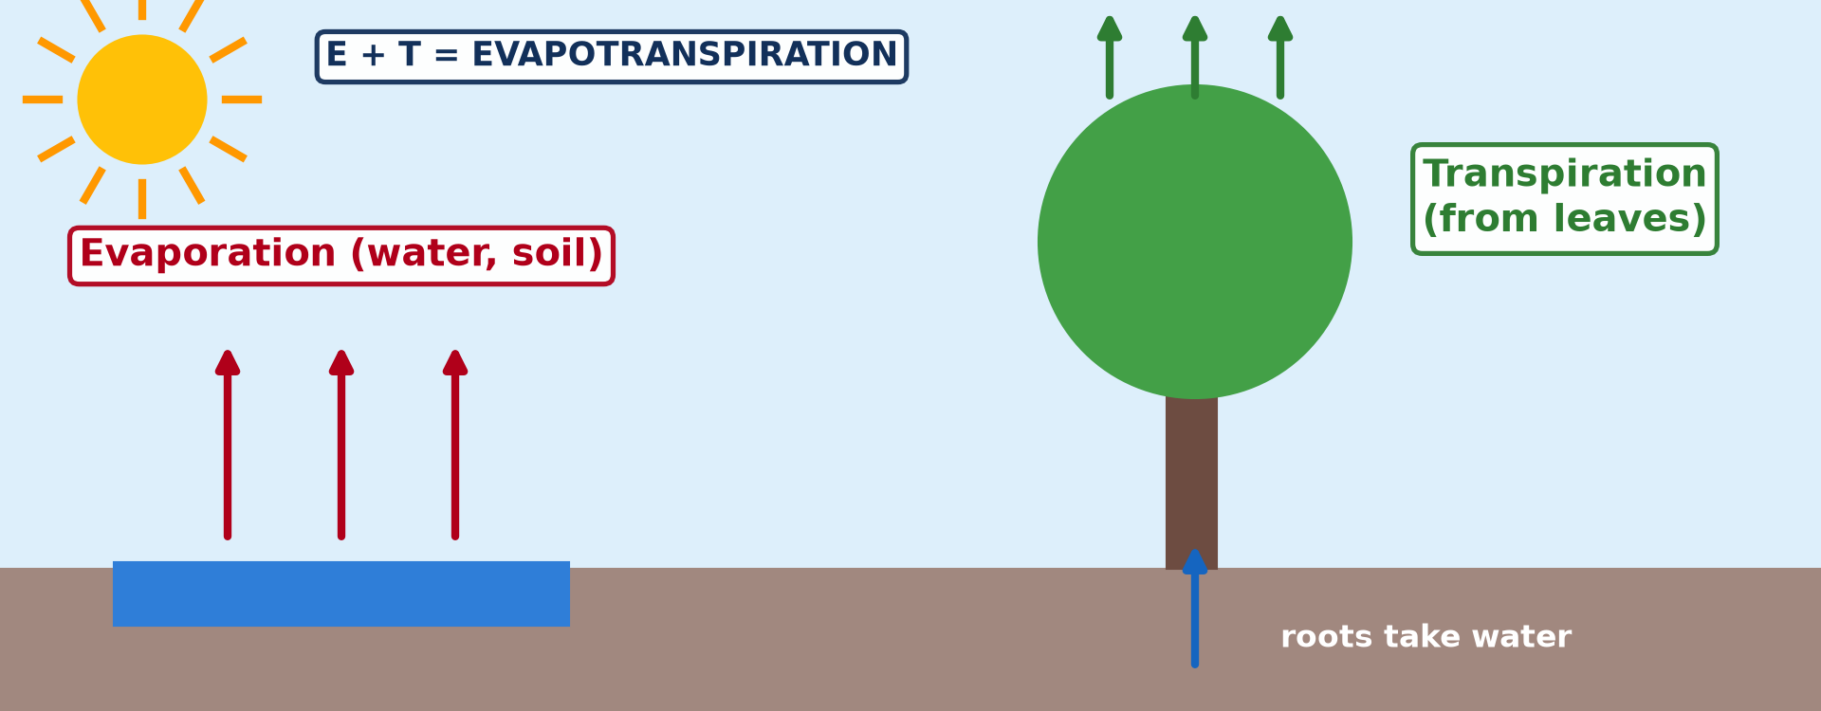
1. MEANING AND PROCESS
Activity 1
Evaporation and transpiration.
Notes:
Activity 1. Look carefully at this diagram: evaporation and transpiration. Observe every detail before I ask the question.

Slide 20
1. MEANING AND PROCESS
Activity 1: Question
What is the difference between evaporation and transpiration?
Notes:
Here is the question for Activity 1: What is the difference between evaporation and transpiration? Take one minute to think and write your answer in your rough notebook.

Slide 21
1. MEANING AND PROCESS
Activity 1: Answer
Evaporation is from water and soil; transpiration is from the leaves of plants.
Notes:
Let us check the answer together. Evaporation is from water and soil; transpiration is from the leaves of plants.

Slide 22
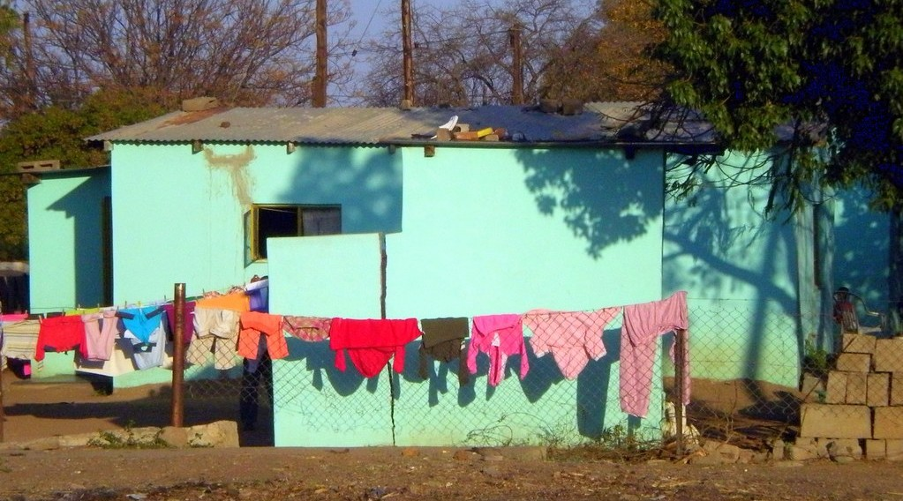
5. FACTORS: WEATHER
Activity 2
Clothes drying in the sun.
Notes:
Activity 2. Look carefully at this picture: clothes drying in the sun. Observe every detail before I ask the question.

Slide 23
5. FACTORS: WEATHER
Activity 2: Question
Which weather dries clothes fastest? Why?
Notes:
Here is the question for Activity 2: Which weather dries clothes fastest? Why? Take one minute to think and write your answer in your rough notebook.

Slide 24
5. FACTORS: WEATHER
Activity 2: Answer
Hot, dry, sunny and windy weather, which increases evaporation.
Notes:
Let us check the answer together. Hot, dry, sunny and windy weather, which increases evaporation.

Slide 25

4. SPACE-TIME VARIATIONS
Activity 3
A dense equatorial forest.
Notes:
Activity 3. Look carefully at this picture: a dense equatorial forest. Observe every detail before I ask the question.

Slide 26
4. SPACE-TIME VARIATIONS
Activity 3: Question
Why is evapotranspiration very high in the equatorial forest?
Notes:
Here is the question for Activity 3: Why is evapotranspiration very high in the equatorial forest? Take one minute to think and write your answer in your rough notebook.

Slide 27
4. SPACE-TIME VARIATIONS
Activity 3: Answer
High heat, much water and many leaves that transpire.
Notes:
Let us check the answer together. High heat, much water and many leaves that transpire.

Slide 28

2. TYPES: POTENTIAL AND ACTUAL
Activity 4
The dry Sahara desert.
Notes:
Activity 4. Look carefully at this picture: the dry Sahara desert. Observe every detail before I ask the question.

Slide 29
2. TYPES: POTENTIAL AND ACTUAL
Activity 4: Question
In the Sahara, potential evapotranspiration is very high, but actual evapotranspiration is very low. Why?
Notes:
Here is the question for Activity 4: In the Sahara, potential evapotranspiration is very high, but actual evapotranspiration is very low. Why? Take one minute to think and write your answer in your rough notebook.

Slide 30
2. TYPES: POTENTIAL AND ACTUAL
Activity 4: Answer
There is almost no water available to evaporate.
Notes:
Let us check the answer together. There is almost no water available to evaporate.

Slide 31

3. MEASUREMENT
Activity 5
A weather station where evaporation is measured.
Notes:
Activity 5. Look carefully at this picture: a weather station where evaporation is measured. Observe every detail before I ask the question.

Slide 32
3. MEASUREMENT
Activity 5: Question
Name one instrument used to measure evaporation.
Notes:
Here is the question for Activity 5: Name one instrument used to measure evaporation. Take one minute to think and write your answer in your rough notebook.

Slide 33
3. MEASUREMENT
Activity 5: Answer
An evaporation pan (also a lysimeter or evaporimeter).
Notes:
Let us check the answer together. An evaporation pan (also a lysimeter or evaporimeter).

Slide 34
BOARD SUMMARY
Board Summary
Topic: The Drainage Basin Hydrological Cycle
Sub-topic: Components of the Drainage Basin Hydrological Cycle
Lesson 26: Evapotranspiration
Notes:
Now we are going to copy the board summary. Write the title and the headings neatly in your notebooks. I will give you enough time for each slide, so do not rush.

Slide 35
BOARD SUMMARY
1. Meaning, Types and Process
Evapotranspiration can be understood as follows:
Evapotranspiration: It is the total loss of water to the atmosphere by evaporation from surfaces and by transpiration from plants.
Notes:
Let us copy Meaning, Types and Process. Evapotranspiration can be understood as follows. On this slide we have Evapotranspiration. Write each point on a new line, with the key term first, and explain it in your own words when we revise. When you finish, we go to the next slide.

Slide 36
BOARD SUMMARY
1. Meaning, Types and Process (continued)
Types: Potential evapotranspiration (PET) is the amount that would be lost if water were always available. Actual evapotranspiration (AET) is the amount really lost, which is lower when water is short.
Notes:
We continue with Meaning, Types and Process. On this slide we have Types. Write each point on a new line, with the key term first, and explain it in your own words when we revise. When you finish, we go to the next slide.

Slide 37
BOARD SUMMARY
1. Meaning, Types and Process (continued)
Process: Evaporation changes liquid water into vapour using the sun's energy. Transpiration is water taken by roots and lost through the stomata of leaves.
Notes:
We continue with Meaning, Types and Process. On this slide we have Process. Write each point on a new line, with the key term first, and explain it in your own words when we revise.

Slide 38
BOARD SUMMARY
1. Meaning, Types and Process
Illustration: evaporation and transpiration
Notes:
Now draw this illustration in your notebook: evaporation and transpiration. Give it a title and label it clearly.

Slide 39
BOARD SUMMARY
2. Measurement and Variations
Evapotranspiration is measured and varies as follows:
Measurement: Evaporation is measured with an evaporation pan or a Piche evaporimeter. Evapotranspiration can be measured with a lysimeter or calculated with formulas such as Thornthwaite's.
Notes:
Let us copy Measurement and Variations. Evapotranspiration is measured and varies as follows. On this slide we have Measurement. Write each point on a new line, with the key term first, and explain it in your own words when we revise. When you finish, we go to the next slide.

Slide 40
BOARD SUMMARY
2. Measurement and Variations (continued)
Space-time variations: It is high in hot, sunny, windy regions and in the dry season. It is low in cold regions and at night.
Notes:
We continue with Measurement and Variations. On this slide we have Space-time variations. Write each point on a new line, with the key term first, and explain it in your own words when we revise.

Slide 41
BOARD SUMMARY
3. Factors and Significance
The main factors and significance of evapotranspiration are:
Climatic factors: High temperature, sunshine, wind and low humidity increase evapotranspiration. This is why clothes dry fast on a hot, windy day.
Notes:
Let us copy Factors and Significance. The main factors and significance of evapotranspiration are. On this slide we have Climatic factors. Write each point on a new line, with the key term first, and explain it in your own words when we revise. When you finish, we go to the next slide.

Slide 42
BOARD SUMMARY
3. Factors and Significance (continued)
Surface factors: Available water, vegetation type, leaf area and soil colour also matter. Forests transpire much more than bare land.
Significance: It is the main output of the drainage basin and returns about two-thirds of rainfall to the air. It recycles moisture that feeds rainfall, as in the Congo forest.
Notes:
We continue with Factors and Significance. On this slide we have Surface factors and Significance. Write each point on a new line, with the key term first, and explain it in your own words when we revise.

Slide 43
FORMATIVE EVALUATION
Evaluation 1
Distinguish PET and AET.
Notes:
Now let us check what you have understood. Question 1: Distinguish PET and AET. Answer in your exercise book.

Slide 44
FORMATIVE EVALUATION
Expected Answer
PET assumes water is always available; AET is the real loss, limited by the water available.
Notes:
The expected answer is: pET assumes water is always available; AET is the real loss, limited by the water available. If you got it right, well done.

Slide 45
FORMATIVE EVALUATION
Evaluation 2
Give three factors of evapotranspiration.
Notes:
Now let us check what you have understood. Question 2: Give three factors of evapotranspiration. Answer in your exercise book.

Slide 46
FORMATIVE EVALUATION
Expected Answer
Temperature, wind, humidity (also sunshine, vegetation, soil water).
Notes:
The expected answer is: temperature, wind, humidity (also sunshine, vegetation, soil water). If you got it right, well done.

Slide 47
REMEDIATION
Remediation
Fill in the blanks:
Loss of water from leaves is ______.
Evaporation is measured with an evaporation ______.
In deserts, AET is ______ than PET.
Notes:
For those who need more practice, fill in the blanks in your exercise book. The answers are: number 1, transpiration; number 2, pan; number 3, lower.

Slide 48
HOMEWORK
Homework
Put the same amount of water in two cups, one in the sun and one in the shade. Measure after two days.
Notes:
For your homework: Put the same amount of water in two cups, one in the sun and one in the shade. Measure after two days. We shall correct it at the beginning of our next lesson.

Slide 49
NEXT LESSON
Next Lesson
Our next lesson will be on:
Lesson 27: Precipitation as the Input of the Drainage Basin
Notes:
Our next lesson will be on Lesson 27: Precipitation as the Input of the Drainage Basin. Thank you for your attention, and see you next time.

Slide 50
BILINGUAL GAME
Bilingual Game (Jeu Bilingue)
English | Français
Evaporation | L'évaporation
Transpiration | La transpiration
Evapotranspiration | L'évapotranspiration
Leaf | La feuille
Wind | Le vent
Measurement | La mesure
Notes:
Let us play the bilingual game. I say a word in English, and you give me the French word. Then we do the reverse.

Slide 51
LOGBOOK
Official Logbook (1/2)
Module / Topic | The Drainage Basin Hydrological Cycle
Lesson Title | Lesson 26: Evapotranspiration
Expected Learning Outcomes | Define evaporation, transpiration and evapotranspiration. Distinguish potential and actual evapotranspiration. Explain the factors and significance of evapotranspiration.
Competence | Learners are able to explain evapotranspiration, how it is measured and why it varies.
Notes:
I record this information in the official logbook of the class after the lesson.

Slide 52
LOGBOOK
Official Logbook (2/2)
Matter Taught | Meaning, Types and Process; Measurement and Variations; Factors and Significance.
Evaluation | Formative evaluation and remediation exercise.
Homework | Put the same amount of water in two cups, one in the sun and one in the shade. Measure after two days.
Enrolment / Present / Absent | ____ / ____ / ____
Achievement | To be completed after the lesson.
Notes:
I complete the second page of the logbook: the matter taught, the evaluation, the homework and the attendance.

Slide 53
TEACHER'S NOTE
Teacher's Note
Timing: Homework correction, plan, objectives 8 min | Recall, situation, action 10 min | 5 activities 30 min | Board summary (copying) 30 min | Evaluation, remediation 10 min | Homework, next lesson 5 min | Logbook 7 min
Without the projector (Activity 1): tie a plastic bag on a leafy branch: drops appear.
Without the projector (Activity 2): compare drying in the rainy and dry seasons.
Without the projector (Activity 3): mention forests near Kribi.
Without the projector (Activity 4): compare an empty and a full bucket in the sun.
Without the projector (Activity 5): describe a pan of water measured every day.
Notes:
This slide is for me, the teacher: it gives the timing of the lesson and what to do if the projector is not available.

Slide 54
REFERENCES
References
National Geography Syllabus, MINESEC/IGE/IP-SS, 2019 — Module 1 (Meteorology, Climatology & Hydrology).
Photo, Activity 2: “Bright Blue Home” by Clav, CC BY-NC-SA 2.0, via Flickr (https://www.flickr.com/photos/37005711@N00/2797194021)
Photo, Activity 3: “Amazon 11” by CIAT International Center for Tropical Agriculture, CC BY-SA 2.0, via Flickr (https://www.flickr.com/photos/38476503@N08/5641587148)
Photo, Activity 4: “Desert trekking in Merzouga” by Antonio Cinotti , CC BY-NC-ND 2.0, via Flickr (https://www.flickr.com/photos/46378751@N02/15331399979)
Photo, Activity 5: “Adelaide. Urrbrae. The weather station at the Waite campus of the Univ” by denisbin, CC BY-ND 2.0, via Flickr (https://www.flickr.com/photos/82134796@N03/49865994827)
Diagrams and animations: drawn for this lesson (Geography Department).
Notes:
These are the references and picture credits used to prepare this lesson.

