Slide 1
LOWER SIXTH ARTS
GEOGRAPHY
Lesson 32
Runoff
Notes:
Good morning, class, and welcome to our geography lesson. I am your geography teacher, Mr Kamdem. Today we are starting Lesson 32: Runoff.

Slide 2
CLASS INFO
Class, Chapter and Duration
Class | Lower Sixth Arts
Chapter | Module 1: Understanding and managing atmospheric and hydrological phenomena and hazards across the world in general and Cameroon in particular
Duration | 2 periods (2 × 50 minutes)
Notes:
This lesson is for Lower Sixth Arts. It belongs to Module 1: Understanding and managing atmospheric and hydrological phenomena and hazards across the world in general and Cameroon in particular. We shall need 2 periods to cover it.

Slide 3
IDENTIFICATION
Lesson Identification
Topic | The Drainage Basin Hydrological Cycle
Sub-topic | Components of the Drainage Basin Hydrological Cycle
Lesson | Lesson 32: Runoff
Notions / Concepts | Runoff, discharge, quick flow, base flow, velocity, cross-section, current meter.
Syllabus focus | Meaning, components, characteristics, measurement, factors and significance of runoff.
Competence | Learners are able to explain runoff, measure river discharge and explain what controls it.
Notes:
Our topic is The Drainage Basin Hydrological Cycle, and the sub-topic is Components of the Drainage Basin Hydrological Cycle. The key notions we shall use today are: runoff, discharge, quick flow, base flow, velocity, cross-section, current meter. At the end, you should be able to do this: learners are able to explain runoff, measure river discharge and explain what controls it.

Slide 4

HOMEWORK CORRECTION
Correction of the Homework
Question (Lesson 31: The Soil Moisture Budget):
With rainfall figures for your town, mark the wet and dry months and suggest a farming calendar.
Notes:
Before we start the new lesson, let us correct the homework I gave you at the end of Lesson 31: The Soil Moisture Budget. The question was: With rainfall figures for your town, mark the wet and dry months and suggest a farming calendar. Take out your exercise books.

Slide 5
HOMEWORK CORRECTION
Correction: Possible Answer
Garoua: wet months May–October, dry months November–April. Plant at the start of the rains (May–June) and harvest in October; irrigate or grow dry-season crops (muskwari) on residual moisture.
Notes:
Here is a good answer. Garoua: wet months May–October, dry months November–April. Plant at the start of the rains (May–June) and harvest in October; irrigate or grow dry-season crops (muskwari) on residual moisture. Compare it with your own answer and correct your work in red.

Slide 6
LESSON PLAN
Lesson Plan
Correction of the homework
Objectives and recall
Real-life situation and action to take
Learning activities
Board summary
Evaluation, remediation and homework
Notes:
Here is the plan of our lesson today. First, we shall correct the homework. Then we shall look at the objectives and recall what you already know. After that, we shall study a situation from real life and the action to take, and do the learning activities. Finally, we shall copy the board summary, do the evaluation and the remediation, and I will give you the homework.

Slide 7
OBJECTIVES
Objectives
By the end of this lesson, you should be able to:
Define runoff and its components.
Calculate river discharge.
Explain the factors and significance of runoff.
Notes:
By the end of this lesson, you should be able to do three things. Number 1: define runoff and its components. Number 2: calculate river discharge. Number 3: explain the factors and significance of runoff.

Slide 8
PREVIOUS KNOWLEDGE
Previous Knowledge
Water reaches rivers by overland flow, throughflow and base flow.
Runoff is an output of the basin.
Notes:
Let us first remember what you already know. Water reaches rivers by overland flow, throughflow and base flow. Runoff is an output of the basin. Keep this in mind, because we shall build on it today.

Slide 9
REAL-LIFE SITUATION
Situation in Real Life
Engineers at a river near Bertoua measure the width, depth and speed of the water every month. They want to know how much water passes each second before building a small power station.
Notes:
Listen carefully to this situation from real life. Engineers at a river near Bertoua measure the width, depth and speed of the water every month. They want to know how much water passes each second before building a small power station. Think about it, because I am going to ask you some questions.

Slide 10
REAL-LIFE SITUATION
Situation: Question 1
What is the problem in the situation?
Notes:
Question 1: What is the problem in the situation? Think for a moment, then raise your hand to answer.

Slide 11
REAL-LIFE SITUATION
Answer
Engineers need to know how much water the river carries.
Notes:
Good. Engineers need to know how much water the river carries.

Slide 12
REAL-LIFE SITUATION
Situation: Question 2
What is this amount called?
Notes:
Question 2: What is this amount called? Think for a moment, then raise your hand to answer.

Slide 13
REAL-LIFE SITUATION
Answer
The discharge.
Notes:
Good. The discharge.

Slide 14
REAL-LIFE SITUATION
Situation: Question 3
How can they calculate it?
Notes:
Question 3: How can they calculate it? Think for a moment, then raise your hand to answer.

Slide 15
REAL-LIFE SITUATION
Possible Answer
Cross-section area × velocity.
Notes:
Good. Cross-section area × velocity.

Slide 16
ACTION TO TAKE
Action to Take
Use river runoff wisely and reduce floods by good land use.
Notes:
From this situation, the action we are working towards in this lesson is the following: use river runoff wisely and reduce floods by good land use.

Slide 17
JUSTIFICATION
Justification of the Lesson
This lesson helps us to understand river flow, which is needed for water supply, dams and flood control.
Notes:
Why is this lesson important for you? This lesson helps us to understand river flow, which is needed for water supply, dams and flood control.

Slide 18

1. MEANING
Activity 1
A river full after rain.
Notes:
Activity 1. Look carefully at this picture: a river full after rain. Observe every detail before I ask the question.

Slide 19
1. MEANING
Activity 1: Question
What is runoff?
Notes:
Here is the question for Activity 1: What is runoff? Take one minute to think and write your answer in your rough notebook.

Slide 20
1. MEANING
Activity 1: Answer
The water that flows over and through the ground into rivers and back to the sea.
Notes:
Let us check the answer together. The water that flows over and through the ground into rivers and back to the sea.

Slide 21
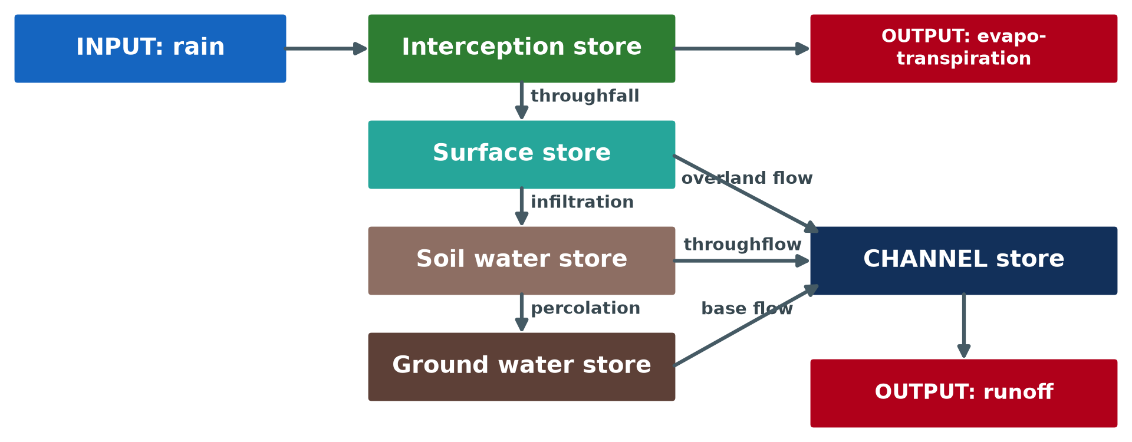
2. TYPES (COMPONENTS)
Activity 2
Flows that feed the channel.
Notes:
Activity 2. Look carefully at this diagram: flows that feed the channel. Observe every detail before I ask the question.

Slide 22
2. TYPES (COMPONENTS)
Activity 2: Question
Which flow keeps rivers flowing in the dry season?
Notes:
Here is the question for Activity 2: Which flow keeps rivers flowing in the dry season? Take one minute to think and write your answer in your rough notebook.

Slide 23
2. TYPES (COMPONENTS)
Activity 2: Answer
Base flow from ground water.
Notes:
Let us check the answer together. Base flow from ground water.

Slide 24
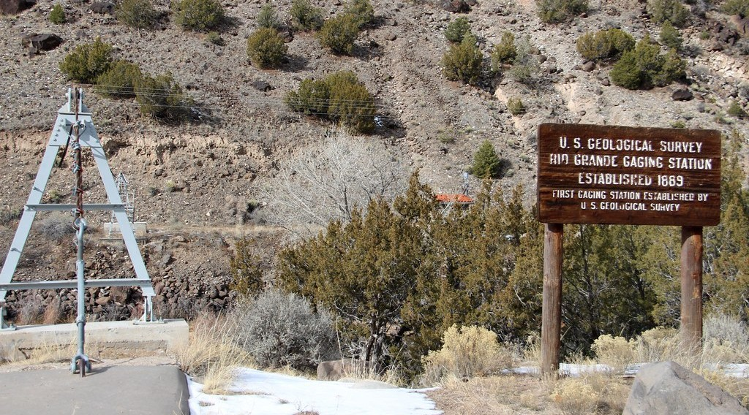
4. MEASUREMENT
Activity 3
A stream gauging station.
Notes:
Activity 3. Look carefully at this picture: a stream gauging station. Observe every detail before I ask the question.

Slide 25
4. MEASUREMENT
Activity 3: Question
A river section has an area of 20 m² and water flows at 2 m/s. What is the discharge?
Notes:
Here is the question for Activity 3: A river section has an area of 20 m² and water flows at 2 m/s. What is the discharge? Take one minute to think and write your answer in your rough notebook.

Slide 26
4. MEASUREMENT
Activity 3: Answer
20 × 2 = 40 m³/s (cumecs).
Notes:
Let us check the answer together. 20 × 2 = 40 m³/s (cumecs).

Slide 27

5. GENERAL FACTORS
Activity 4
A river in flood.
Notes:
Activity 4. Look carefully at this picture: a river in flood. Observe every detail before I ask the question.

Slide 28
5. GENERAL FACTORS
Activity 4: Question
Give three factors that increase runoff.
Notes:
Here is the question for Activity 4: Give three factors that increase runoff. Take one minute to think and write your answer in your rough notebook.

Slide 29
5. GENERAL FACTORS
Activity 4: Answer
Heavy rain, steep slopes, impermeable rock or towns (also saturated soil, bare land).
Notes:
Let us check the answer together. Heavy rain, steep slopes, impermeable rock or towns (also saturated soil, bare land).

Slide 30

6. SIGNIFICANCE
Activity 5
Fishing on the Wouri River.
Notes:
Activity 5. Look carefully at this picture: fishing on the Wouri River. Observe every detail before I ask the question.

Slide 31
6. SIGNIFICANCE
Activity 5: Question
Give two uses of river runoff for people.
Notes:
Here is the question for Activity 5: Give two uses of river runoff for people. Take one minute to think and write your answer in your rough notebook.

Slide 32
6. SIGNIFICANCE
Activity 5: Answer
Fishing, transport, water supply and hydro-electricity.
Notes:
Let us check the answer together. Fishing, transport, water supply and hydro-electricity.

Slide 33
BOARD SUMMARY
Board Summary
Topic: The Drainage Basin Hydrological Cycle
Sub-topic: Components of the Drainage Basin Hydrological Cycle
Lesson 32: Runoff
Notes:
Now we are going to copy the board summary. Write the title and the headings neatly in your notebooks. I will give you enough time for each slide, so do not rush.

Slide 34
BOARD SUMMARY
1. Meaning and Types of Runoff
Runoff can be understood as follows:
Runoff: It is all the water that flows from a drainage basin into rivers and out of the basin.
Notes:
Let us copy Meaning and Types of Runoff. Runoff can be understood as follows. On this slide we have Runoff. Write each point on a new line, with the key term first, and explain it in your own words when we revise. When you finish, we go to the next slide.

Slide 35
BOARD SUMMARY
1. Meaning and Types of Runoff (continued)
Components: Quick flow is made of overland flow and fast throughflow after rain. Base flow comes slowly from groundwater and keeps rivers flowing in the dry season.
Notes:
We continue with Meaning and Types of Runoff. On this slide we have Components. Write each point on a new line, with the key term first, and explain it in your own words when we revise.

Slide 36
BOARD SUMMARY
1. Meaning and Types of Runoff
Illustration: quick flow and base flow
Notes:
Now draw this illustration in your notebook: quick flow and base flow. Give it a title and label it clearly.

Slide 37
BOARD SUMMARY
2. Characteristics and Measurement
Runoff is described and measured as follows:
Characteristics: Runoff has a volume (discharge), a speed and a frequency. Discharge is measured in cubic metres per second (m³/s).
Notes:
Let us copy Characteristics and Measurement. Runoff is described and measured as follows. On this slide we have Characteristics. Write each point on a new line, with the key term first, and explain it in your own words when we revise. When you finish, we go to the next slide.

Slide 38
BOARD SUMMARY
2. Characteristics and Measurement (continued)
Measurement: Discharge = cross-section area × velocity. Velocity is measured with a flow meter or a float, and gauging stations record water levels continuously.
Notes:
We continue with Characteristics and Measurement. On this slide we have Measurement. Write each point on a new line, with the key term first, and explain it in your own words when we revise.

Slide 39
BOARD SUMMARY
3. General Factors of Runoff
Runoff depends on the following factors:
Climatic characteristics: Rainfall amount, intensity and duration and evapotranspiration control runoff. Heavy storms produce high runoff.
Notes:
Let us copy General Factors of Runoff. Runoff depends on the following factors. On this slide we have Climatic characteristics. Write each point on a new line, with the key term first, and explain it in your own words when we revise. When you finish, we go to the next slide.

Slide 40
BOARD SUMMARY
3. General Factors of Runoff (continued)
Basin and channel characteristics: Size, shape, slope, soil, rock and drainage density affect how fast water reaches the river. Steep, round basins on clay give rapid runoff.
Notes:
We continue with General Factors of Runoff. On this slide we have Basin and channel characteristics. Write each point on a new line, with the key term first, and explain it in your own words when we revise. When you finish, we go to the next slide.

Slide 41
BOARD SUMMARY
3. General Factors of Runoff (continued)
Land use: Forests reduce runoff, while farming, overgrazing and urbanisation increase it. Dams regulate it.
Notes:
We continue with General Factors of Runoff. On this slide we have Land use. Write each point on a new line, with the key term first, and explain it in your own words when we revise.

Slide 42
BOARD SUMMARY
4. Significance of Runoff
Runoff is important because:
In the hydrological cycle: It returns water from the land to the sea and balances the global cycle. It transports sediment and shapes valleys.
Notes:
Let us copy Significance of Runoff. Runoff is important because. On this slide we have In the hydrological cycle. Write each point on a new line, with the key term first, and explain it in your own words when we revise. When you finish, we go to the next slide.

Slide 43
BOARD SUMMARY
4. Significance of Runoff (continued)
For man: It supplies water for drinking, irrigation, hydro-electricity and transport. High runoff can cause floods and erosion.
Notes:
We continue with Significance of Runoff. On this slide we have For man. Write each point on a new line, with the key term first, and explain it in your own words when we revise.

Slide 44
FORMATIVE EVALUATION
Evaluation 1
How is river discharge calculated?
Notes:
Now let us check what you have understood. Question 1: How is river discharge calculated? Answer in your exercise book.

Slide 45
FORMATIVE EVALUATION
Expected Answer
Cross-section area × velocity.
Notes:
The expected answer is: cross-section area × velocity. If you got it right, well done.

Slide 46
FORMATIVE EVALUATION
Evaluation 2
Distinguish quick flow and base flow.
Notes:
Now let us check what you have understood. Question 2: Distinguish quick flow and base flow. Answer in your exercise book.

Slide 47
FORMATIVE EVALUATION
Expected Answer
Quick flow reaches the river soon after rain; base flow comes slowly from ground water.
Notes:
The expected answer is: quick flow reaches the river soon after rain; base flow comes slowly from ground water. If you got it right, well done.

Slide 48
REMEDIATION
Remediation
Fill in the blanks:
Discharge is measured in ______.
Water from the ground water that feeds rivers is ______ flow.
Discharge = area × ______.
Notes:
For those who need more practice, fill in the blanks in your exercise book. The answers are: number 1, m³/s (cumecs); number 2, base; number 3, velocity.

Slide 49
HOMEWORK
Homework
Measure the width, depth and float speed of a stream near you and calculate its discharge.
Notes:
For your homework: Measure the width, depth and float speed of a stream near you and calculate its discharge. We shall correct it at the beginning of our next lesson.

Slide 50
NEXT LESSON
Next Lesson
Our next lesson will be on:
Lesson 33: Storm Hydrographs
Notes:
Our next lesson will be on Lesson 33: Storm Hydrographs. Thank you for your attention, and see you next time.

Slide 51
BILINGUAL GAME
Bilingual Game (Jeu Bilingue)
English | Français
Runoff | L'écoulement
Discharge | Le débit
Velocity | La vitesse
Base flow | Le débit de base
Channel | Le chenal
Current meter | Le moulinet
Notes:
Let us play the bilingual game. I say a word in English, and you give me the French word. Then we do the reverse.

Slide 52
LOGBOOK
Official Logbook (1/2)
Module / Topic | The Drainage Basin Hydrological Cycle
Lesson Title | Lesson 32: Runoff
Expected Learning Outcomes | Define runoff and its components. Calculate river discharge. Explain the factors and significance of runoff.
Competence | Learners are able to explain runoff, measure river discharge and explain what controls it.
Notes:
I record this information in the official logbook of the class after the lesson.

Slide 53
LOGBOOK
Official Logbook (2/2)
Matter Taught | Meaning and Types of Runoff; Characteristics and Measurement; General Factors of Runoff; Significance of Runoff.
Evaluation | Formative evaluation and remediation exercise.
Homework | Measure the width, depth and float speed of a stream near you and calculate its discharge.
Enrolment / Present / Absent | ____ / ____ / ____
Achievement | To be completed after the lesson.
Notes:
I complete the second page of the logbook: the matter taught, the evaluation, the homework and the attendance.

Slide 54
TEACHER'S NOTE
Teacher's Note
Timing: Homework correction, plan, objectives 8 min | Recall, situation, action 10 min | 5 activities 30 min | Board summary (copying) 30 min | Evaluation, remediation 10 min | Homework, next lesson 5 min | Logbook 7 min
Without the projector (Activity 1): describe a stream after a storm.
Without the projector (Activity 2): describe a stream that never dries.
Without the projector (Activity 3): do the calculation on the board.
Without the projector (Activity 4): list climatic and basin factors.
Without the projector (Activity 5): list rivers used in Cameroon.
Notes:
This slide is for me, the teacher: it gives the timing of the lesson and what to do if the projector is not available.

Slide 55
REFERENCES
References
National Geography Syllabus, MINESEC/IGE/IP-SS, 2019 — Module 1 (Meteorology, Climatology & Hydrology).
Photo, Activity 1: “Parana River Floodplain, Northern Argentina (NASA, International Space” by NASA's Marshall Space Flight Center, CC BY-NC 2.0, via nasa (https://www.flickr.com/photos/28634332@N05/5684050889)
Photo, Activity 3: “Embudo Stream Gaging Station (Rio Arriba County, New Mexico)” by cmh2315fl, CC BY-NC 2.0, via Flickr (https://www.flickr.com/photos/21953562@N07/32142798192)
Photo, Activity 4: “Flood in Accra” by Stig Nygaard, CC BY 2.0, via Flickr (https://www.flickr.com/photos/10259776@N00/181742000)
Photo, Activity 5: “Fishing on the Wouri River” by Karlplatz, CC BY-NC-ND 2.0, via Flickr (https://www.flickr.com/photos/36973264@N00/3158348)
Diagrams and animations: drawn for this lesson (Geography Department).
Notes:
These are the references and picture credits used to prepare this lesson.

