Slide 1
LOWER SIXTH ARTS
GEOGRAPHY
Lesson 20
Micro-climates
Notes:
Good morning, class, and welcome to our geography lesson. I am your geography teacher, Mr Kamdem. Today we are starting Lesson 20: Micro-climates.

Slide 2
CLASS INFO
Class, Chapter and Duration
Class | Lower Sixth Arts
Chapter | Module 1: Understanding and managing atmospheric and hydrological phenomena and hazards across the world in general and Cameroon in particular
Duration | 2 periods (2 × 50 minutes)
Notes:
This lesson is for Lower Sixth Arts. It belongs to Module 1: Understanding and managing atmospheric and hydrological phenomena and hazards across the world in general and Cameroon in particular. We shall need 2 periods to cover it.

Slide 3
IDENTIFICATION
Lesson Identification
Topic | Climates
Sub-topic | Concept of Micro-climate
Lesson | Lesson 20: Micro-climates
Notions / Concepts | Micro-climate, urban climate, urban heat island, anthropogenic heat, evapotranspiration, urban canyon, lakeside climate, forest climate.
Syllabus focus | Meaning and classification of micro-climates; characteristics of urban climates; factors of the urban heat island.
Competence | Learners are able to explain micro-climates, especially why the centre of Garoua is hotter than its outskirts, and propose ways to reduce urban heat.
Notes:
Our topic is Climates, and the sub-topic is Concept of Micro-climate. The key notions we shall use today are: micro-climate, urban climate, urban heat island, anthropogenic heat, evapotranspiration, urban canyon, lakeside climate, forest climate. At the end, you should be able to do this: learners are able to explain micro-climates, especially why the centre of Garoua is hotter than its outskirts, and propose ways to reduce urban heat.

Slide 4

HOMEWORK CORRECTION
Correction of the Homework
Question (Further Study 1: Tropical Weather Disturbances):
Define a micro-climate.
Notes:
Before we start the new lesson, let us correct the homework I gave you at the end of Further Study 1: Tropical Weather Disturbances. The question was: Define a micro-climate. Take out your exercise books.

Slide 5
HOMEWORK CORRECTION
Correction: Possible Answer
A micro-climate is the climate of a small area that differs from the climate of the surrounding region.
Notes:
Here is a good answer. A micro-climate is the climate of a small area that differs from the climate of the surrounding region. Compare it with your own answer and correct your work in red.

Slide 6
LESSON PLAN
Lesson Plan
Correction of the homework
Objectives and recall
Real-life situation and action to take
Learning activities
Board summary
Evaluation, remediation and homework
Notes:
Here is the plan of our lesson today. First, we shall correct the homework. Then we shall look at the objectives and recall what you already know. After that, we shall study a situation from real life and the action to take, and do the learning activities. Finally, we shall copy the board summary, do the evaluation and the remediation, and I will give you the homework.

Slide 7
OBJECTIVES
Objectives
By the end of this lesson, you should be able to:
Define a micro-climate.
Classify micro-climates.
Describe the characteristics of urban climates.
Notes:
Take your time to copy this part; we will continue together.

Slide 8
OBJECTIVES
Objectives (continued)
Explain the factors of the urban heat island.
Notes:
By the end of this lesson, you should be able to do four things. Number 1: define a micro-climate. Number 2: classify micro-climates. Number 3: describe the characteristics of urban climates. Number 4: explain the factors of the urban heat island.

Slide 9
PREVIOUS KNOWLEDGE
Previous Knowledge
Tar and concrete absorb heat.
Plants cool the air by transpiration.
Climate is controlled by several factors.
Notes:
Let us first remember what you already know. Tar and concrete absorb heat. Plants cool the air by transpiration. Climate is controlled by several factors. Keep this in mind, because we shall build on it today.

Slide 10
REAL-LIFE SITUATION
Situation in Real Life
On a very hot May afternoon, you leave your family's compound in Roumdé Adjia, with many trees and bare ground, and take a moto-taxi to the Grand Marché in the centre of Garoua.
As you approach the market, the air becomes hotter and more suffocating; heat rises from the tarred roads and concrete buildings.
Notes:
Take your time to copy this part; we will continue together.

Slide 11
REAL-LIFE SITUATION
Situation in Real Life (continued)
You ask: "Why does such a short distance make such a big difference in temperature?"
Notes:
Listen carefully to this situation from real life. On a very hot May afternoon, you leave your family's compound in Roumdé Adjia, with many trees and bare ground, and take a moto-taxi to the Grand Marché in the centre of Garoua. As you approach the market, the air becomes hotter and more suffocating; heat rises from the tarred roads and concrete buildings. You ask: "Why does such a short distance make such a big difference in temperature?" Think about it, because I am going to ask you some questions.

Slide 12
REAL-LIFE SITUATION
Situation: Question 1
What is the problem in the situation?
Notes:
Question 1: What is the problem in the situation? Think for a moment, then raise your hand to answer.

Slide 13
REAL-LIFE SITUATION
Answer
The learner does not understand micro-climates and the urban heat island.
Notes:
Good. The learner does not understand micro-climates and the urban heat island.

Slide 14
REAL-LIFE SITUATION
Situation: Question 2
What is the climate of a small area called?
Notes:
Question 2: What is the climate of a small area called? Think for a moment, then raise your hand to answer.

Slide 15
REAL-LIFE SITUATION
Answer
A micro-climate.
Notes:
Good. A micro-climate.

Slide 16
REAL-LIFE SITUATION
Situation: Question 3
Why is the town centre hotter?
Notes:
Question 3: Why is the town centre hotter? Think for a moment, then raise your hand to answer.

Slide 17
REAL-LIFE SITUATION
Possible Answer
Tar, concrete, engines and few trees create an urban heat island.
Notes:
Good. Tar, concrete, engines and few trees create an urban heat island.

Slide 18
ACTION TO TAKE
Action to Take
Plant and protect trees and green spaces in town, and use light-coloured roofs.
Notes:
From this situation, the action we are working towards in this lesson is the following: plant and protect trees and green spaces in town, and use light-coloured roofs.

Slide 19
JUSTIFICATION
Justification of the Lesson
This lesson helps us to understand local differences of climate and to plan cooler, healthier towns.
Notes:
Why is this lesson important for you? This lesson helps us to understand local differences of climate and to plan cooler, healthier towns.

Slide 20
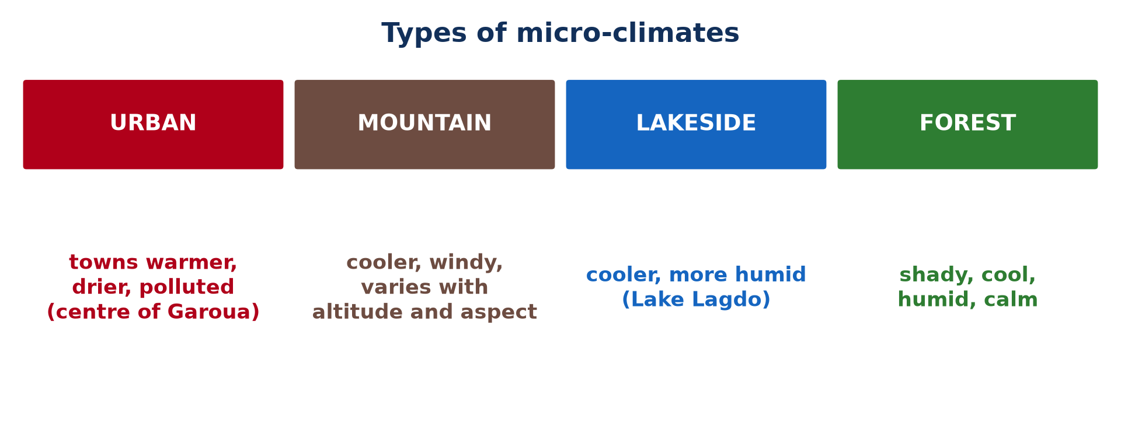
1. MEANING
Activity 1
Types of micro-climates.
Notes:
Activity 1. Look carefully at this picture: types of micro-climates. Observe every detail before I ask the question.

Slide 21
1. MEANING
Activity 1: Question
Give two types of micro-climates.
Notes:
Here is the question for Activity 1: Give two types of micro-climates. Take one minute to think and write your answer in your rough notebook.

Slide 22
1. MEANING
Activity 1: Answer
Urban, mountain, lakeside or forest micro-climates (any two).
Notes:
Let us check the answer together. Urban, mountain, lakeside or forest micro-climates (any two).

Slide 23
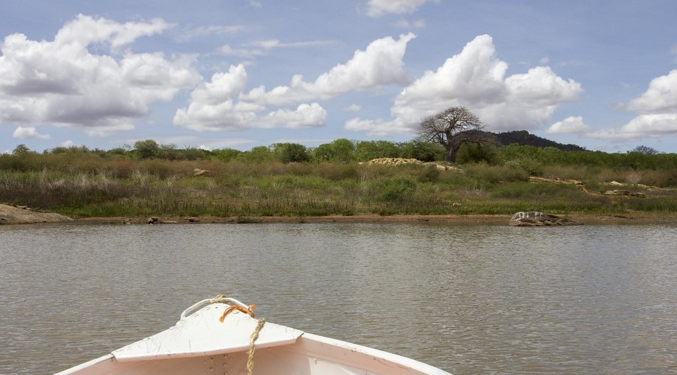
1. MEANING
Activity 2
A lakeside.
Notes:
Activity 2. Look carefully at this picture: a lakeside. Observe every detail before I ask the question.

Slide 24
1. MEANING
Activity 2: Question
Why is the air near Lake Lagdo cooler and more humid?
Notes:
Here is the question for Activity 2: Why is the air near Lake Lagdo cooler and more humid? Take one minute to think and write your answer in your rough notebook.

Slide 25
1. MEANING
Activity 2: Answer
The water evaporates and heats slowly.
Notes:
Let us check the answer together. The water evaporates and heats slowly.

Slide 26
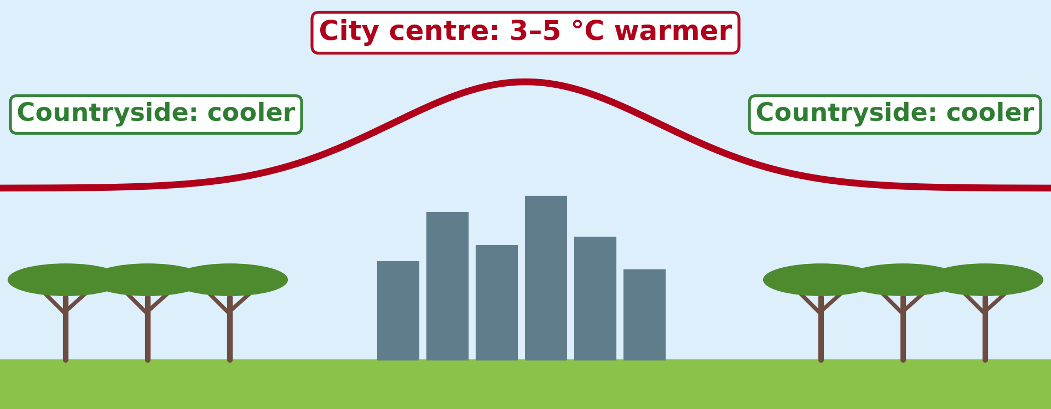
2. URBAN CLIMATE
Activity 3
The urban heat island.
Notes:
Activity 3. Look carefully at this diagram: the urban heat island. Observe every detail before I ask the question.

Slide 27
2. URBAN CLIMATE
Activity 3: Question
When is the urban heat island strongest?
Notes:
Here is the question for Activity 3: When is the urban heat island strongest? Take one minute to think and write your answer in your rough notebook.

Slide 28
2. URBAN CLIMATE
Activity 3: Answer
At night, when buildings and roads release stored heat.
Notes:
Let us check the answer together. At night, when buildings and roads release stored heat.

Slide 29

2. URBAN CLIMATE
Activity 4
A large city.
Notes:
Activity 4. Look carefully at this picture: a large city. Observe every detail before I ask the question.

Slide 30
2. URBAN CLIMATE
Activity 4: Question
Why is the air of a city drier?
Notes:
Here is the question for Activity 4: Why is the air of a city drier? Take one minute to think and write your answer in your rough notebook.

Slide 31
2. URBAN CLIMATE
Activity 4: Answer
There are fewer plants and less open water, so less evapotranspiration.
Notes:
Let us check the answer together. There are fewer plants and less open water, so less evapotranspiration.

Slide 32

3. FACTORS
Activity 5
A forest.
Notes:
Activity 5. Look carefully at this picture: a forest. Observe every detail before I ask the question.

Slide 33
3. FACTORS
Activity 5: Question
Why is it cooler under trees?
Notes:
Here is the question for Activity 5: Why is it cooler under trees? Take one minute to think and write your answer in your rough notebook.

Slide 34
3. FACTORS
Activity 5: Answer
Trees give shade and cool the air by transpiration.
Notes:
Let us check the answer together. Trees give shade and cool the air by transpiration.

Slide 35
BOARD SUMMARY
Board Summary
Topic: Climates
Sub-topic: Concept of Micro-climate
Lesson 20: Micro-climates
Notes:
Now we are going to copy the board summary. Write the title and the headings neatly in your notebooks. I will give you enough time for each slide, so do not rush.

Slide 36
BOARD SUMMARY
DEFINITIONS
The key terms of this lesson are defined as follows:
Micro-climate: It is the climate of a small area that differs from the climate of the surrounding region.
Notes:
Let us copy the definitions. The key terms of this lesson are defined as follows. On this slide we have Micro-climate. Write each point on a new line, with the key term first, and explain it in your own words when we revise. When you finish, we go to the next slide.

Slide 37
BOARD SUMMARY
DEFINITIONS (continued)
Urban heat island: It is the higher temperature of a town compared with the surrounding countryside.
Anthropogenic heat: It is the heat released by human activities (vehicles, machines, air conditioners).
Notes:
We continue with the definitions. On this slide we have Urban heat island and Anthropogenic heat. Write each point on a new line, with the key term first, and explain it in your own words when we revise. When you finish, we go to the next slide.

Slide 38
BOARD SUMMARY
DEFINITIONS (continued)
Evapotranspiration: It is the combined loss of water by evaporation and by plant transpiration.
Notes:
We continue with the definitions. On this slide we have Evapotranspiration. Write each point on a new line, with the key term first, and explain it in your own words when we revise.

Slide 39
BOARD SUMMARY
1. Meaning and Classification of Micro-climates
Micro-climates are classified as follows:
Urban climate: The climate of a town, warmer, drier and more polluted than the countryside.
Illustration: types of micro-climates
Notes:
Let us copy Meaning and Classification of Micro-climates. Micro-climates are classified as follows. Copy the point on Urban climate on the left, then draw the diagram on the right: types of micro-climates. Give it a title and label it clearly.

Slide 40
BOARD SUMMARY
1. Meaning and Classification of Micro-climates
Mountain climate: Conditions vary with altitude and with the side of the mountain.
Notes:
We continue with Meaning and Classification of Micro-climates. On this slide we have Mountain climate. Write each point on a new line, with the key term first, and explain it in your own words when we revise.

Slide 41
BOARD SUMMARY
1. Meaning and Classification of Micro-climates
Lakeside climate: Along a large lake such as Lake Lagdo, the air is cooler and more humid.
Illustration: a lakeside
Notes:
Copy the point on Lakeside climate on the left, then draw the diagram on the right: a lakeside. Give it a title and label it clearly.

Slide 42
BOARD SUMMARY
1. Meaning and Classification of Micro-climates
Forest climate: Inside a forest, the air is shady, cool, humid and calm.
Illustration: a forest
Notes:
Copy the point on Forest climate on the left, then draw the diagram on the right: a forest. Give it a title and label it clearly.

Slide 43
BOARD SUMMARY
2. Characteristics of Urban Climates
Compared with the countryside, towns have the following characteristics:
Higher temperatures: Towns are warmer, especially at night: this is the urban heat island.
Illustration: the urban heat island
Notes:
Let us copy Characteristics of Urban Climates. Compared with the countryside, towns have the following characteristics. Copy the point on Higher temperatures on the left, then draw the diagram on the right: the urban heat island. Give it a title and label it clearly.

Slide 44
BOARD SUMMARY
2. Characteristics of Urban Climates
Lower humidity: Fewer plants and less water mean less evapotranspiration and drier air.
Different winds: Buildings slow the wind or channel it along streets (canyon effect).
More pollution: Dust, smoke and gases from vehicles, generators and industries are concentrated.
Notes:
We continue with Characteristics of Urban Climates. On this slide we have Lower humidity, Different winds and More pollution. Write each point on a new line, with the key term first, and explain it in your own words when we revise.

Slide 45
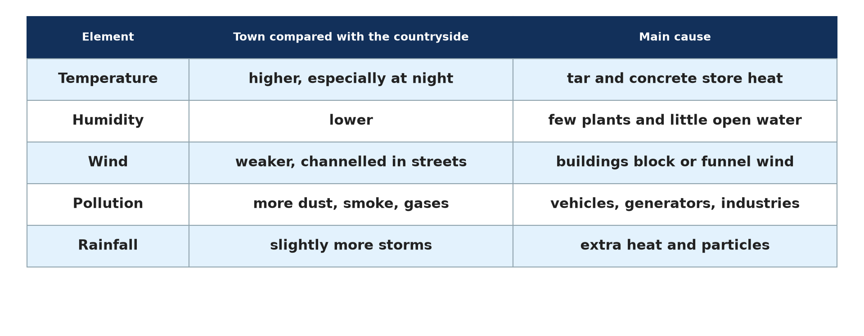
BOARD SUMMARY
2. Characteristics of Urban Climates
Slightly more rain: Extra heat and particles can trigger convectional storms over the city.
Illustration: town and countryside compared
Notes:
Copy the point on Slightly more rain on the left, then draw the diagram on the right: town and countryside compared. Give it a title and label it clearly.

Slide 46
BOARD SUMMARY
3. Factors of the Urban Heat Island
The urban heat island is caused by the following factors:
Surfaces: Tarred roads, concrete and bricks absorb solar energy by day and release it slowly at night.
Illustration: a large city
Notes:
Let us copy Factors of the Urban Heat Island. The urban heat island is caused by the following factors. Copy the point on Surfaces on the left, then draw the diagram on the right: a large city. Give it a title and label it clearly.

Slide 47
BOARD SUMMARY
3. Factors of the Urban Heat Island
Anthropogenic heat: Cars, moto-taxis, generators, air conditioners, factories and crowds release heat.
Reduced evapotranspiration: Few trees, gardens and open soils mean little natural cooling.
Notes:
We continue with Factors of the Urban Heat Island. On this slide we have Anthropogenic heat and Reduced evapotranspiration. Write each point on a new line, with the key term first, and explain it in your own words when we revise. When you finish, we go to the next slide.

Slide 48
BOARD SUMMARY
3. Factors of the Urban Heat Island (continued)
Urban geometry: Tall buildings and narrow streets form "urban canyons" that trap heat and block the wind.
Solutions: Trees, parks, light roofs and less traffic reduce urban heat.
Notes:
We continue with Factors of the Urban Heat Island. On this slide we have Urban geometry and Solutions. Write each point on a new line, with the key term first, and explain it in your own words when we revise.

Slide 49
FORMATIVE EVALUATION
Evaluation 1
What is the urban heat island, and give two of its causes in Garoua?
Notes:
Now let us check what you have understood. Question 1: What is the urban heat island, and give two of its causes in Garoua? Answer in your exercise book.

Slide 50
FORMATIVE EVALUATION
Expected Answer
The town is warmer than the countryside; causes: tar and concrete, heat from vehicles and generators, few trees (any two).
Notes:
The expected answer is: the town is warmer than the countryside; causes: tar and concrete, heat from vehicles and generators, few trees (any two). If you got it right, well done.

Slide 51
FORMATIVE EVALUATION
Evaluation 2
Give two differences between an urban climate and a rural climate.
Notes:
Now let us check what you have understood. Question 2: Give two differences between an urban climate and a rural climate. Answer in your exercise book.

Slide 52
FORMATIVE EVALUATION
Expected Answer
Towns are warmer, drier, less windy and more polluted (any two).
Notes:
The expected answer is: towns are warmer, drier, less windy and more polluted (any two). If you got it right, well done.

Slide 53
REMEDIATION
Remediation
Fill in the blanks:
The climate of a small area is a ______.
A town warmer than the countryside is an urban heat ______.
Heat from vehicles and machines is ______ heat.
Notes:
For those who need more practice, fill in the blanks in your exercise book. The answers are: number 1, micro-climate; number 2, island; number 3, anthropogenic.

Slide 54
HOMEWORK
Homework
State how temperature changes with altitude.
Notes:
For your homework: State how temperature changes with altitude. We shall correct it at the beginning of our next lesson.

Slide 55
NEXT LESSON
Next Lesson
Our next lesson will be on:
Lesson 21: Mountain Climates
Notes:
Our next lesson will be on Lesson 21: Mountain Climates. Thank you for your attention, and see you next time.

Slide 56
BILINGUAL GAME
Bilingual Game (Jeu Bilingue)
English | Français
Micro-climate | Le microclimat
Urban climate | Le climat urbain
Urban heat island | L'îlot de chaleur urbain
Pollution | La pollution
Evapotranspiration | L'évapotranspiration
Green space | L'espace vert
Notes:
Let us play the bilingual game. I say a word in English, and you give me the French word. Then we do the reverse.

Slide 57
LOGBOOK
Official Logbook (1/2)
Module / Topic | Climates
Lesson Title | Lesson 20: Micro-climates
Expected Learning Outcomes | Define a micro-climate. Classify micro-climates. Describe the characteristics of urban climates. Explain the factors of the urban heat island.
Competence | Learners are able to explain micro-climates, especially why the centre of Garoua is hotter than its outskirts, and propose ways to reduce urban heat.
Notes:
I record this information in the official logbook of the class after the lesson.

Slide 58
LOGBOOK
Official Logbook (2/2)
Matter Taught | DEFINITIONS; Meaning and Classification of Micro-climates; Characteristics of Urban Climates; Factors of the Urban Heat Island.
Evaluation | Formative evaluation and remediation exercise.
Homework | State how temperature changes with altitude.
Enrolment / Present / Absent | ____ / ____ / ____
Achievement | To be completed after the lesson.
Notes:
I complete the second page of the logbook: the matter taught, the evaluation, the homework and the attendance.

Slide 59
TEACHER'S NOTE
Teacher's Note
Timing: Homework correction, plan, objectives 8 min | Recall, situation, action 10 min | 5 activities 30 min | Board summary (copying) 30 min | Evaluation, remediation 10 min | Homework, next lesson 5 min | Logbook 7 min
Without the projector (Activity 1): list micro-climates around Garoua.
Without the projector (Activity 2): describe a lakeside.
Without the projector (Activity 3): draw the temperature profile.
Without the projector (Activity 4): compare a street and a garden.
Without the projector (Activity 5): stand in the sun and in the shade of a mango tree.
Notes:
This slide is for me, the teacher: it gives the timing of the lesson and what to do if the projector is not available.

Slide 60
REFERENCES
References
Geography Syllabus for Sixth Forms (Lower and Upper Sixth), MINESEC, 2019 — Module 1 (Meteorology, Climatology & Hydrology).
Teacher's course notes: Mr KAMDEM E., Meteorology and Climatology (LSA), GBHS Garoua, 2026.
Photo, Activity 2: “Lake Kamburu” by World Bank Photo Collection, CC BY-NC-ND 2.0, via Flickr (https://www.flickr.com/photos/10816734@N03/25644146245)
Photo, Activity 4: “Douala” by christing-O-, CC BY 2.0, via Flickr (https://www.flickr.com/photos/76187282@N00/7227535754)
Photo, Activity 5: “Amazon 11” by CIAT International Center for Tropical Agriculture, CC BY-SA 2.0, via Flickr (https://www.flickr.com/photos/38476503@N08/5641587148)
Diagrams and animations: drawn for this lesson (Geography Department).
Notes:
These are the references and picture credits used to prepare this lesson.

