Slide 1
FORM 1
GEOGRAPHY
Lesson 1
Geography: Meaning, Branches, Methods and Importance
Notes:
Good morning, class, and welcome to our geography lesson. I am your geography teacher, Mr Kamdem. Today we are starting Lesson 1: Geography: Meaning, Branches, Methods and Importance.

Slide 2
CLASS INFO
Class, Chapter and Duration
Class | Form 1
Chapter | Module 1: The Earth in the Universe
Duration | 2 periods (2 × 50 minutes)
Notes:
This lesson is for Form 1. It belongs to Module 1: The Earth in the Universe. We shall need 2 periods to cover it.

Slide 3
IDENTIFICATION
Lesson Identification
Topic | The Earth in the Universe
Sub-topic | Introduction to Geography
Lesson | Lesson 1: Geography: Meaning, Branches, Methods and Importance
Notions / Concepts | Geography, physical geography, human geography, practical geography, fieldwork.
Syllabus focus | Definition of geography; branches and sub-branches; methods; importance.
Competence | Learners are able to explain what geography studies and why it is useful in daily life.
Notes:
Our topic is The Earth in the Universe, and the sub-topic is Introduction to Geography. The key notions we shall use today are: geography, physical geography, human geography, practical geography, fieldwork. At the end, you should be able to do this: learners are able to explain what geography studies and why it is useful in daily life.

Slide 4

LESSON PLAN
Lesson Plan
Objectives and recall
Real-life situation and action to take
Learning activities
Board summary
Evaluation, remediation and homework
Notes:
Here is the plan of our lesson today. First, we shall look at the objectives and recall what you already know. After that, we shall study a situation from real life and the action to take, and do the learning activities. Finally, we shall copy the board summary, do the evaluation and the remediation, and I will give you the homework.

Slide 5
OBJECTIVES
Objectives
By the end of this lesson, you should be able to:
Define geography.
Identify the branches and sub-branches of geography.
Notes:
Take your time to copy this part; we will continue together.

Slide 6
OBJECTIVES
Objectives (continued)
Describe the methods and the importance of geography.
Notes:
By the end of this lesson, you should be able to do three things. Number 1: define geography. Number 2: identify the branches and sub-branches of geography. Number 3: describe the methods and the importance of geography.

Slide 7
PREVIOUS KNOWLEDGE
Previous Knowledge
We live on the Earth, with land, water and air around us.
People live in villages and towns and do different jobs.
Maps show where places are.
Notes:
Let us first remember what you already know. We live on the Earth, with land, water and air around us. People live in villages and towns and do different jobs. Maps show where places are. Keep this in mind, because we shall build on it today.

Slide 8
REAL-LIFE SITUATION
Situation in Real Life
On his first day in Form 1, Ibrahim sees "Geography" on his timetable.
His elder sister says that it is only about drawing maps, but his father says that it helps farmers, drivers and even the Mayor of Garoua.
"
Notes:
Listen carefully to this situation from real life. On his first day in Form 1, Ibrahim sees "Geography" on his timetable. His elder sister says that it is only about drawing maps, but his father says that it helps farmers, drivers and even the Mayor of Garoua. Ibrahim is confused and asks his teacher: "What does geography really study, and why is it useful?" Think about it, because I am going to ask you some questions.

Slide 9
REAL-LIFE SITUATION
Situation: Question 1
What is the problem in the situation?
Notes:
Question 1: What is the problem in the situation? Think for a moment, then raise your hand to answer.

Slide 10
REAL-LIFE SITUATION
Answer
Ibrahim does not know what geography studies and why it is useful.
Notes:
Good. Ibrahim does not know what geography studies and why it is useful.

Slide 11
REAL-LIFE SITUATION
Situation: Question 2
What does his sister think geography is?
Notes:
Question 2: What does his sister think geography is? Think for a moment, then raise your hand to answer.

Slide 12
REAL-LIFE SITUATION
Answer
She thinks it is only about drawing maps.
Notes:
Good. She thinks it is only about drawing maps.

Slide 13
REAL-LIFE SITUATION
Situation: Question 3
Who uses geography, according to his father?
Notes:
Question 3: Who uses geography, according to his father? Think for a moment, then raise your hand to answer.

Slide 14
REAL-LIFE SITUATION
Possible Answer
Farmers, drivers and the Mayor of Garoua.
Notes:
Good. Farmers, drivers and the Mayor of Garoua.

Slide 15
ACTION TO TAKE
Action to Take
Observe the land, the weather and the activities of people around you like a geographer.
Notes:
From this situation, the action we are working towards in this lesson is the following: observe the land, the weather and the activities of people around you like a geographer.

Slide 16
JUSTIFICATION
Justification of the Lesson
This lesson helps us to know what geography studies and why it is useful for our lives.
Notes:
Why is this lesson important for you? This lesson helps us to know what geography studies and why it is useful for our lives.

Slide 17

1. MEANING OF GEOGRAPHY
Activity 1
The Earth seen from space.
Notes:
Activity 1. Look carefully at this picture: the Earth seen from space. Observe every detail before I ask the question.

Slide 18
1. MEANING OF GEOGRAPHY
Activity 1: Question 1
The word geography comes from the Greek words "geo" and "graphein". What do these words mean?
Notes:
Here is the question for Activity 1: The word geography comes from the Greek words "geo" and "graphein". What do these words mean? Take one minute to think and write your answer in your rough notebook.

Slide 19
1. MEANING OF GEOGRAPHY
Activity 1: Answer 1
"Geo" means the Earth, and "graphein" means to describe.
Notes:
Let us check the answer together. "Geo" means the Earth, and "graphein" means to describe.

Slide 20
1. MEANING OF GEOGRAPHY
Activity 1: Question 2
So, what is geography?
Notes:
Here is the next question: So, what is geography? Take one minute to think and write your answer in your rough notebook.

Slide 21
1. MEANING OF GEOGRAPHY
Activity 1: Answer 2
Geography is the study and description of the Earth and of the people who live on it.
Notes:
Let us check the answer together. Geography is the study and description of the Earth and of the people who live on it.

Slide 22

2. BRANCHES OF GEOGRAPHY
Activity 2
Mount Cameroon.
Notes:
Activity 2. Look carefully at this picture: mount Cameroon. Observe every detail before I ask the question.

Slide 23
2. BRANCHES OF GEOGRAPHY
Activity 2: Question
Which branch of geography studies mountains, rivers, climate and soils?
Notes:
Here is the question for Activity 2: Which branch of geography studies mountains, rivers, climate and soils? Take one minute to think and write your answer in your rough notebook.

Slide 24
2. BRANCHES OF GEOGRAPHY
Activity 2: Answer
Physical geography.
Notes:
Let us check the answer together. Physical geography.

Slide 25

2. BRANCHES OF GEOGRAPHY
Activity 3
A busy market in Cameroon.
Notes:
Activity 3. Look carefully at this picture: a busy market in Cameroon. Observe every detail before I ask the question.

Slide 26
2. BRANCHES OF GEOGRAPHY
Activity 3: Question
Which branch of geography studies people, markets, towns and farming?
Notes:
Here is the question for Activity 3: Which branch of geography studies people, markets, towns and farming? Take one minute to think and write your answer in your rough notebook.

Slide 27
2. BRANCHES OF GEOGRAPHY
Activity 3: Answer
Human geography.
Notes:
Let us check the answer together. Human geography.

Slide 28
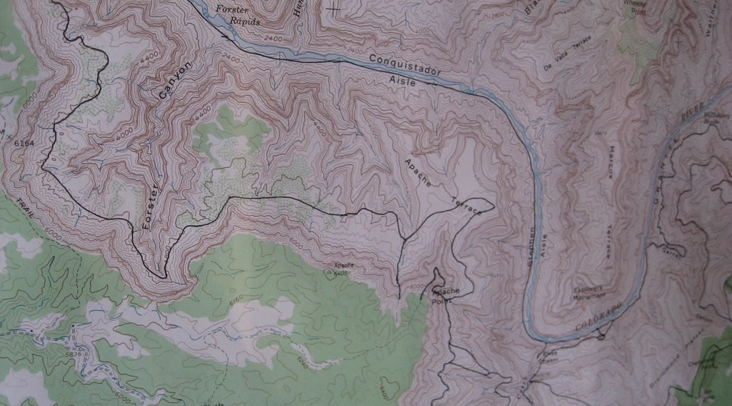
3. METHODS OF GEOGRAPHY
Activity 4
A geographer using a map in the field.
Notes:
Activity 4. Look carefully at this picture: a geographer using a map in the field. Observe every detail before I ask the question.

Slide 29
3. METHODS OF GEOGRAPHY
Activity 4: Question
How does a geographer collect information about a place?
Notes:
Here is the question for Activity 4: How does a geographer collect information about a place? Take one minute to think and write your answer in your rough notebook.

Slide 30
3. METHODS OF GEOGRAPHY
Activity 4: Answer
By observing and measuring in the field, and by asking people questions.
Notes:
Let us check the answer together. By observing and measuring in the field, and by asking people questions.

Slide 31

4. IMPORTANCE OF GEOGRAPHY
Activity 5
A cotton farm in the North.
Notes:
Activity 5. Look carefully at this picture: a cotton farm in the North. Observe every detail before I ask the question.

Slide 32
4. IMPORTANCE OF GEOGRAPHY
Activity 5: Question
How can geography help this farmer?
Notes:
Here is the question for Activity 5: How can geography help this farmer? Take one minute to think and write your answer in your rough notebook.

Slide 33
4. IMPORTANCE OF GEOGRAPHY
Activity 5: Answer
It helps him to know the seasons, the rainfall and the soils, so that he chooses the right crops and the right time to plant.
Notes:
Let us check the answer together. It helps him to know the seasons, the rainfall and the soils, so that he chooses the right crops and the right time to plant.

Slide 34
BOARD SUMMARY
Board Summary
Topic: The Earth in the Universe
Sub-topic: Introduction to Geography
Lesson 1: Geography: Meaning, Branches, Methods and Importance
Notes:
Now we are going to copy the board summary. Write the title and the headings neatly in your notebooks. I will give you enough time for each slide, so do not rush.

Slide 35
BOARD SUMMARY
DEFINITIONS
The key terms of this lesson are defined as follows:
Geography: It is the study of the Earth, its physical features and the activities of the people who live on it.
Notes:
Let us copy the definitions. The key terms of this lesson are defined as follows. On this slide we have Geography. Write each point on a new line, with the key term first, and explain it in your own words when we revise. When you finish, we go to the next slide.

Slide 36
BOARD SUMMARY
DEFINITIONS (continued)
Branch of geography: It is a main part of geography that studies one group of subjects.
Notes:
We continue with the definitions. On this slide we have Branch of geography. Write each point on a new line, with the key term first, and explain it in your own words when we revise.

Slide 37
BOARD SUMMARY
1. Branches and Sub-branches of Geography
Geography has three main branches:
Physical geography: It studies natural features such as relief, climate, rivers, soils and vegetation. Its sub-branches include geomorphology, climatology, hydrology, pedology and biogeography.
Illustration: Mount Cameroon, a physical feature
Notes:
Let us copy Branches and Sub-branches of Geography. Geography has three main branches. Copy the point on Physical geography on the left, then draw the diagram on the right: mount Cameroon, a physical feature. Give it a title and label it clearly.

Slide 38
BOARD SUMMARY
1. Branches and Sub-branches of Geography
Human geography: It studies people and their activities. Its sub-branches include population, settlement, economic and political geography.
Illustration: a market, a human activity
Notes:
Copy the point on Human geography on the left, then draw the diagram on the right: a market, a human activity. Give it a title and label it clearly.

Slide 39
BOARD SUMMARY
1. Branches and Sub-branches of Geography
Practical geography: It studies the tools of the geographer. Its sub-branches include map reading, statistics, fieldwork and remote sensing.
Illustration: map reading in the field
Notes:
Copy the point on Practical geography on the left, then draw the diagram on the right: map reading in the field. Give it a title and label it clearly.

Slide 40

BOARD SUMMARY
2. Methods of Geography
Geographers use the following methods:
Observation and fieldwork: Geographers go to the field to observe, measure and record what they see.
Illustration: the steps of fieldwork
Notes:
Let us copy Methods of Geography. Geographers use the following methods. Copy the point on Observation and fieldwork on the left, then draw the diagram on the right: the steps of fieldwork. Give it a title and label it clearly.

Slide 41
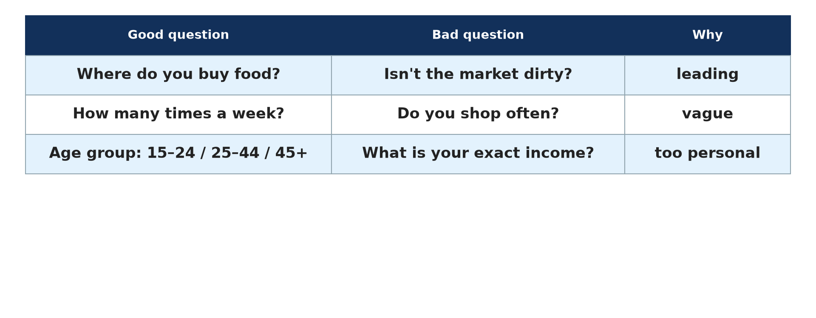
BOARD SUMMARY
2. Methods of Geography
Interviews and questionnaires: Geographers ask people questions to collect information on their lives and activities.
Illustration: a questionnaire
Notes:
Copy the point on Interviews and questionnaires on the left, then draw the diagram on the right: a questionnaire. Give it a title and label it clearly.

Slide 42
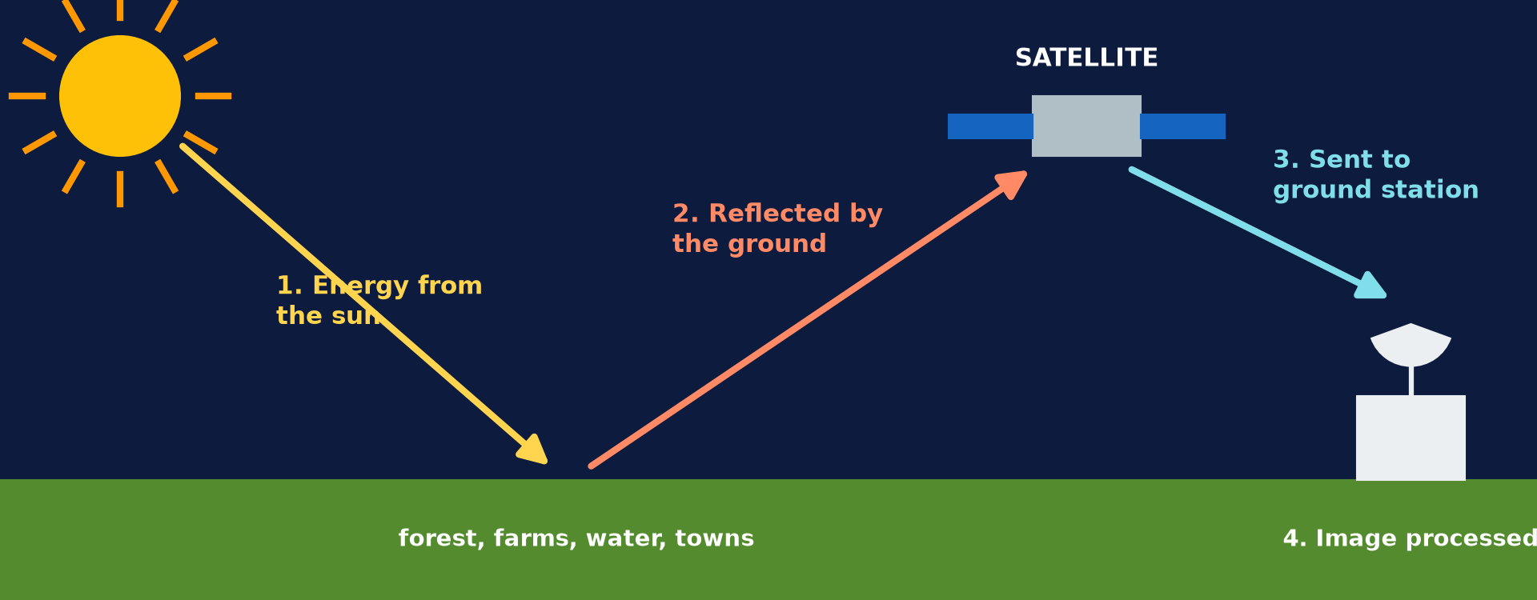
BOARD SUMMARY
2. Methods of Geography
Maps and photographs: Geographers use maps, photographs and satellite images to show and study places.
Illustration: a satellite image is taken from space
Notes:
Copy the point on Maps and photographs on the left, then draw the diagram on the right: a satellite image is taken from space. Give it a title and label it clearly.

Slide 43
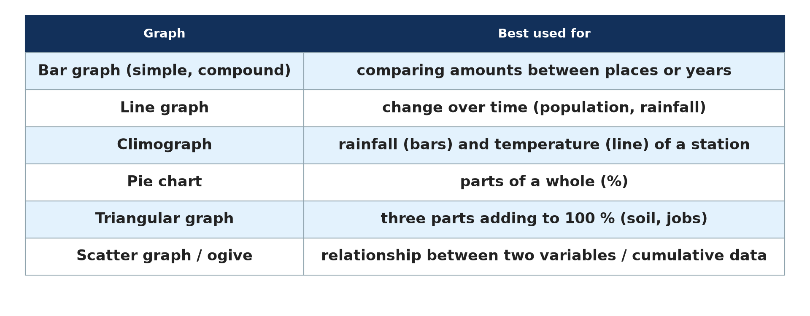
BOARD SUMMARY
2. Methods of Geography
Statistics and graphs: Geographers use numbers, tables and graphs to compare places and changes.
Illustration: types of graphs
Notes:
Copy the point on Statistics and graphs on the left, then draw the diagram on the right: types of graphs. Give it a title and label it clearly.

Slide 44
BOARD SUMMARY
3. Importance of Geography
Geography is important for the following reasons:
Daily life: It helps us to find places, read maps and understand the weather.
Farming: It helps farmers to know the seasons, the soils and the right crops.
Notes:
Let us copy Importance of Geography. Geography is important for the following reasons. On this slide we have Daily life and Farming. Write each point on a new line, with the key term first, and explain it in your own words when we revise. When you finish, we go to the next slide.

Slide 45
BOARD SUMMARY
3. Importance of Geography (continued)
Planning: It helps the government and councils to plan roads, schools and towns.
Environment: It teaches us to protect the land, water and forests.
Notes:
We continue with Importance of Geography. On this slide we have Planning and Environment. Write each point on a new line, with the key term first, and explain it in your own words when we revise.

Slide 46
FORMATIVE EVALUATION
Evaluation 1
Define geography.
Notes:
Now let us check what you have understood. Question 1: Define geography. Answer in your exercise book.

Slide 47
FORMATIVE EVALUATION
Expected Answer
It is the study of the Earth, its physical features and the activities of people on it.
Notes:
The expected answer is: it is the study of the Earth, its physical features and the activities of people on it. If you got it right, well done.

Slide 48
FORMATIVE EVALUATION
Evaluation 2
Name the three branches of geography.
Notes:
Now let us check what you have understood. Question 2: Name the three branches of geography. Answer in your exercise book.

Slide 49
FORMATIVE EVALUATION
Expected Answer
Physical, human and practical geography.
Notes:
The expected answer is: physical, human and practical geography. If you got it right, well done.

Slide 50
REMEDIATION
Remediation
Fill in the blanks:
"Geo" means the ______.
The study of relief and climate is ______ geography.
The study of population and towns is ______ geography.
Notes:
For those who need more practice, fill in the blanks in your exercise book. The answers are: number 1, Earth; number 2, physical; number 3, human.

Slide 51
HOMEWORK
Homework
Name the eight planets of the solar system.
Notes:
For your homework: Name the eight planets of the solar system. We shall correct it at the beginning of our next lesson.

Slide 52
NEXT LESSON
Next Lesson
Our next lesson will be on:
Lesson 2: Our Planet, the Earth
Notes:
Our next lesson will be on Lesson 2: Our Planet, the Earth. Thank you for your attention, and see you next time.

Slide 53
BILINGUAL GAME
Bilingual Game (Jeu Bilingue)
English | Français
Geography | La géographie
Branch | La branche
Map | La carte
Fieldwork | Le travail de terrain
Relief | Le relief
Population | La population
Notes:
Let us play the bilingual game. I say a word in English, and you give me the French word. Then we do the reverse.

Slide 54
LOGBOOK
Official Logbook (1/2)
Module / Topic | The Earth in the Universe
Lesson Title | Lesson 1: Geography: Meaning, Branches, Methods and Importance
Expected Learning Outcomes | Define geography. Identify the branches and sub-branches of geography. Describe the methods and the importance of geography.
Competence | Learners are able to explain what geography studies and why it is useful in daily life.
Notes:
I record this information in the official logbook of the class after the lesson.

Slide 55
LOGBOOK
Official Logbook (2/2)
Matter Taught | DEFINITIONS; Branches and Sub-branches of Geography; Methods of Geography; Importance of Geography.
Evaluation | Formative evaluation and remediation exercise.
Homework | Name the eight planets of the solar system.
Enrolment / Present / Absent | ____ / ____ / ____
Achievement | To be completed after the lesson.
Notes:
I complete the second page of the logbook: the matter taught, the evaluation, the homework and the attendance.

Slide 56
TEACHER'S NOTE
Teacher's Note
Timing: Homework correction, plan, objectives 8 min | Recall, situation, action 10 min | 5 activities 30 min | Board summary (copying) 30 min | Evaluation, remediation 10 min | Homework, next lesson 5 min | Logbook 7 min
Without the projector (Activity 1): write "geo" + "graphein" on the board.
Without the projector (Activity 2): name mountains and rivers of Cameroon.
Without the projector (Activity 3): describe the market of Garoua.
Without the projector (Activity 4): show a map of Cameroon.
Without the projector (Activity 5): ask learners how their parents choose when to plant.
Notes:
This slide is for me, the teacher: it gives the timing of the lesson and what to do if the projector is not available.

Slide 57
REFERENCES
References
Geography Syllabus, Forms I–V, MINESEC (2023) — Form 1, Module 1: The Earth in the Universe.
Photo, Activity 1: “Blue Marble, Eastern Hemisphere March 2014” by NASA Goddard Photo and Video, CC BY 2.0, via nasa (https://www.flickr.com/photos/24662369@N07/14990033062)
Photo, Activity 2: “Mount Cameroon” by John & Mel Kots, CC BY-NC-ND 2.0, via Flickr (https://www.flickr.com/photos/26745817@N00/2347261849)
Photo, Activity 3: “Sandga Market in Douala, Cameroon” by The Advocacy Project, CC BY-NC-SA 2.0, via Flickr (https://www.flickr.com/photos/42487558@N00/3636438732)
Photo, Activity 4: “Harvey Butchart's hiking map” by brewbooks, CC BY-SA 2.0, via Flickr (https://www.flickr.com/photos/93452909@N00/5289678354)
Photo, Activity 5: “Cotton Fields, U.S. 65, Tensas Parish, Louisiana (4)” by Ken Lund, CC BY-SA 2.0, via Flickr (https://www.flickr.com/photos/75683070@N00/3934873451)
Diagrams and animations: drawn for this lesson (Geography Department).
Notes:
These are the references and picture credits used to prepare this lesson.

