Slide 1
FORM 1
GEOGRAPHY
Lesson 12
Plate Movements
Notes:
Good morning, class, and welcome to our geography lesson. I am your geography teacher, Mr Kamdem. Today we are starting Lesson 12: Plate Movements.

Slide 2
CLASS INFO
Class, Chapter and Duration
Class | Form 1
Chapter | Module 3: Protection from the Wrath of Nature
Duration | 2 periods (2 × 50 minutes)
Notes:
This lesson is for Form 1. It belongs to Module 3: Protection from the Wrath of Nature. We shall need 2 periods to cover it.

Slide 3
IDENTIFICATION
Lesson Identification
Topic | Protection against the Wrath of Nature
Sub-topic | Movements of the Earth's Crust
Lesson | Lesson 12: Plate Movements
Notions / Concepts | Lithosphere, plate motion, tectonic movements.
Syllabus focus | Definition; types of plates; types of plate movements.
Competence | Learners are able to identify the plates on a world map and describe how they move.
Notes:
Our topic is Protection against the Wrath of Nature, and the sub-topic is Movements of the Earth's Crust. The key notions we shall use today are: lithosphere, plate motion, tectonic movements. At the end, you should be able to do this: learners are able to identify the plates on a world map and describe how they move.

Slide 4

HOMEWORK CORRECTION
Correction of the Homework
Question (Lesson 11: The Internal Structure of the Earth):
Name the two types of plates.
Notes:
Before we start the new lesson, let us correct the homework I gave you at the end of Lesson 11: The Internal Structure of the Earth. The question was: Name the two types of plates. Take out your exercise books.

Slide 5
HOMEWORK CORRECTION
Correction: Possible Answer
Continental plates and oceanic plates.
Notes:
Here is a good answer. Continental plates and oceanic plates. Compare it with your own answer and correct your work in red.

Slide 6
LESSON PLAN
Lesson Plan
Correction of the homework
Objectives and recall
Real-life situation and action to take
Learning activities
Board summary
Evaluation, remediation and homework
Notes:
Here is the plan of our lesson today. First, we shall correct the homework. Then we shall look at the objectives and recall what you already know. After that, we shall study a situation from real life and the action to take, and do the learning activities. Finally, we shall copy the board summary, do the evaluation and the remediation, and I will give you the homework.

Slide 7
OBJECTIVES
Objectives
By the end of this lesson, you should be able to:
Define a plate and plate movements.
Identify the types of plates and the major plates on a world map.
Describe the types of plate movements.
Notes:
By the end of this lesson, you should be able to do three things. Number 1: define a plate and plate movements. Number 2: identify the types of plates and the major plates on a world map. Number 3: describe the types of plate movements.

Slide 8
PREVIOUS KNOWLEDGE
Previous Knowledge
The Earth has a crust, a mantle and a core.
The mantle is very hot.
Earthquakes shake the ground.
Notes:
Let us first remember what you already know. The Earth has a crust, a mantle and a core. The mantle is very hot. Earthquakes shake the ground. Keep this in mind, because we shall build on it today.

Slide 9
REAL-LIFE SITUATION
Situation in Real Life
Aïssatou sees on a map that the coasts of Africa and South America fit together like pieces of a puzzle. She asks her teacher: "Were these continents once joined, and can the crust of the Earth move?"
Notes:
Listen carefully to this situation from real life. Aïssatou sees on a map that the coasts of Africa and South America fit together like pieces of a puzzle. She asks her teacher: "Were these continents once joined, and can the crust of the Earth move?" Think about it, because I am going to ask you some questions.

Slide 10
REAL-LIFE SITUATION
Situation: Question 1
What is the problem in the situation?
Notes:
Question 1: What is the problem in the situation? Think for a moment, then raise your hand to answer.

Slide 11
REAL-LIFE SITUATION
Answer
Aïssatou does not know why the continents fit together and whether the crust moves.
Notes:
Good. Aïssatou does not know why the continents fit together and whether the crust moves.

Slide 12
REAL-LIFE SITUATION
Situation: Question 2
What are the pieces of the crust called?
Notes:
Question 2: What are the pieces of the crust called? Think for a moment, then raise your hand to answer.

Slide 13
REAL-LIFE SITUATION
Answer
Plates.
Notes:
Good. Plates.

Slide 14
REAL-LIFE SITUATION
Situation: Question 3
Do the plates move quickly?
Notes:
Question 3: Do the plates move quickly? Think for a moment, then raise your hand to answer.

Slide 15
REAL-LIFE SITUATION
Possible Answer
No, very slowly, a few centimetres per year.
Notes:
Good. No, very slowly, a few centimetres per year.

Slide 16
ACTION TO TAKE
Action to Take
Locate earthquake and volcano zones on a map of plates.
Notes:
From this situation, the action we are working towards in this lesson is the following: locate earthquake and volcano zones on a map of plates.

Slide 17
JUSTIFICATION
Justification of the Lesson
This lesson helps us to understand the movements of the Earth's crust.
Notes:
Why is this lesson important for you? This lesson helps us to understand the movements of the Earth's crust.

Slide 18

1. MEANING
Activity 1
Animation: the continents fit like a puzzle.
Notes:
Activity 1. Look carefully at this animation: animation: the continents fit like a puzzle. Watch the animation to the end; it will play again.

Slide 19
1. MEANING
Activity 1: Question
What do the fitting coasts of Africa and South America suggest?
Notes:
Here is the question for Activity 1: What do the fitting coasts of Africa and South America suggest? Take one minute to think and write your answer in your rough notebook.

Slide 20
1. MEANING
Activity 1: Answer
That the continents were once joined and have moved apart.
Notes:
Let us check the answer together. That the continents were once joined and have moved apart.

Slide 21

2. TYPES OF PLATES
Activity 2
The crust broken into pieces.
Notes:
Activity 2. Look carefully at this diagram: the crust broken into pieces. Observe every detail before I ask the question.

Slide 22
2. TYPES OF PLATES
Activity 2: Question
On which plate is Cameroon?
Notes:
Here is the question for Activity 2: On which plate is Cameroon? Take one minute to think and write your answer in your rough notebook.

Slide 23
2. TYPES OF PLATES
Activity 2: Answer
On the African Plate.
Notes:
Let us check the answer together. On the African Plate.

Slide 24
2. TYPES OF PLATES
Activity 3
The crust broken into pieces.
Notes:
Activity 3. Look carefully at this diagram: the crust broken into pieces. Observe every detail before I ask the question.

Slide 25
2. TYPES OF PLATES
Activity 3: Question
Which plate lies mostly under an ocean?
Notes:
Here is the question for Activity 3: Which plate lies mostly under an ocean? Take one minute to think and write your answer in your rough notebook.

Slide 26
2. TYPES OF PLATES
Activity 3: Answer
The Pacific Plate.
Notes:
Let us check the answer together. The Pacific Plate.

Slide 27

3. TYPES OF MOVEMENTS
Activity 4
Animation: two plates moving.
Notes:
Activity 4. Look carefully at this animation: animation: two plates moving. Watch the animation to the end; it will play again.

Slide 28
3. TYPES OF MOVEMENTS
Activity 4: Question
In which ways can two plates move?
Notes:
Here is the question for Activity 4: In which ways can two plates move? Take one minute to think and write your answer in your rough notebook.

Slide 29
3. TYPES OF MOVEMENTS
Activity 4: Answer
They can move apart, move towards each other or slide past each other.
Notes:
Let us check the answer together. They can move apart, move towards each other or slide past each other.

Slide 30

3. TYPES OF MOVEMENTS
Activity 5
A long crack in the ground.
Notes:
Activity 5. Look carefully at this picture: a long crack in the ground. Observe every detail before I ask the question.

Slide 31
3. TYPES OF MOVEMENTS
Activity 5: Question
Which movement formed this long crack?
Notes:
Here is the question for Activity 5: Which movement formed this long crack? Take one minute to think and write your answer in your rough notebook.

Slide 32
3. TYPES OF MOVEMENTS
Activity 5: Answer
Two plates sliding past each other.
Notes:
Let us check the answer together. Two plates sliding past each other.

Slide 33
BOARD SUMMARY
Board Summary
Topic: Protection against the Wrath of Nature
Sub-topic: Movements of the Earth's Crust
Lesson 12: Plate Movements
Notes:
Now we are going to copy the board summary. Write the title and the headings neatly in your notebooks. I will give you enough time for each slide, so do not rush.

Slide 34
BOARD SUMMARY
DEFINITIONS
The key terms of this lesson are defined as follows:
Plate: It is a large piece of the lithosphere that moves slowly on the mantle.
Plate movement: It is the slow movement of plates, a few centimetres per year.
Notes:
Let us copy the definitions. The key terms of this lesson are defined as follows. On this slide we have Plate and Plate movement. Write each point on a new line, with the key term first, and explain it in your own words when we revise. When you finish, we go to the next slide.

Slide 35
BOARD SUMMARY
DEFINITIONS (continued)
Plate boundary: It is the line where two plates meet.
Notes:
We continue with the definitions. On this slide we have Plate boundary. Write each point on a new line, with the key term first, and explain it in your own words when we revise.

Slide 36
BOARD SUMMARY
1. Types of Plates
The types of plates, the major plates and the plate of Cameroon are the following:
Continental plates: They carry continents, like the African and Eurasian Plates.
Illustration: the major plates of the world
Notes:
Let us copy Types of Plates. The types of plates, the major plates and the plate of Cameroon are the following. Copy the point on Continental plates on the left, then draw the diagram on the right: the major plates of the world. Give it a title and label it clearly.

Slide 37
BOARD SUMMARY
1. Types of Plates
Oceanic plates: They lie under the oceans, like the Pacific Plate.
Major plates: The seven major plates are the African, Eurasian, North American, South American, Pacific, Indo-Australian and Antarctic Plates.
Cameroon: Cameroon is on the African Plate.
Notes:
We continue with Types of Plates. On this slide we have Oceanic plates, Major plates and Cameroon. Write each point on a new line, with the key term first, and explain it in your own words when we revise.

Slide 38
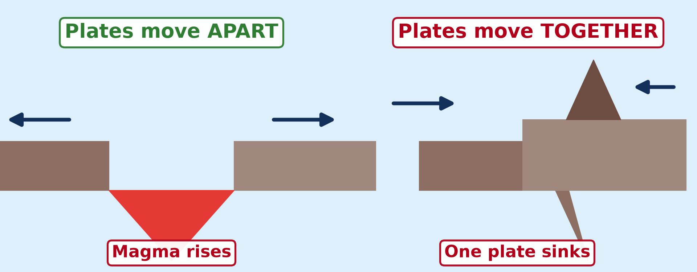
BOARD SUMMARY
2. Types of Plate Movements
Plate movements and their cause are the following:
Divergent movement: Plates move apart, and new crust forms between them.
Illustration: plates moving apart and together
Notes:
Let us copy Types of Plate Movements. Plate movements and their cause are the following. Copy the point on Divergent movement on the left, then draw the diagram on the right: plates moving apart and together. Give it a title and label it clearly.

Slide 39
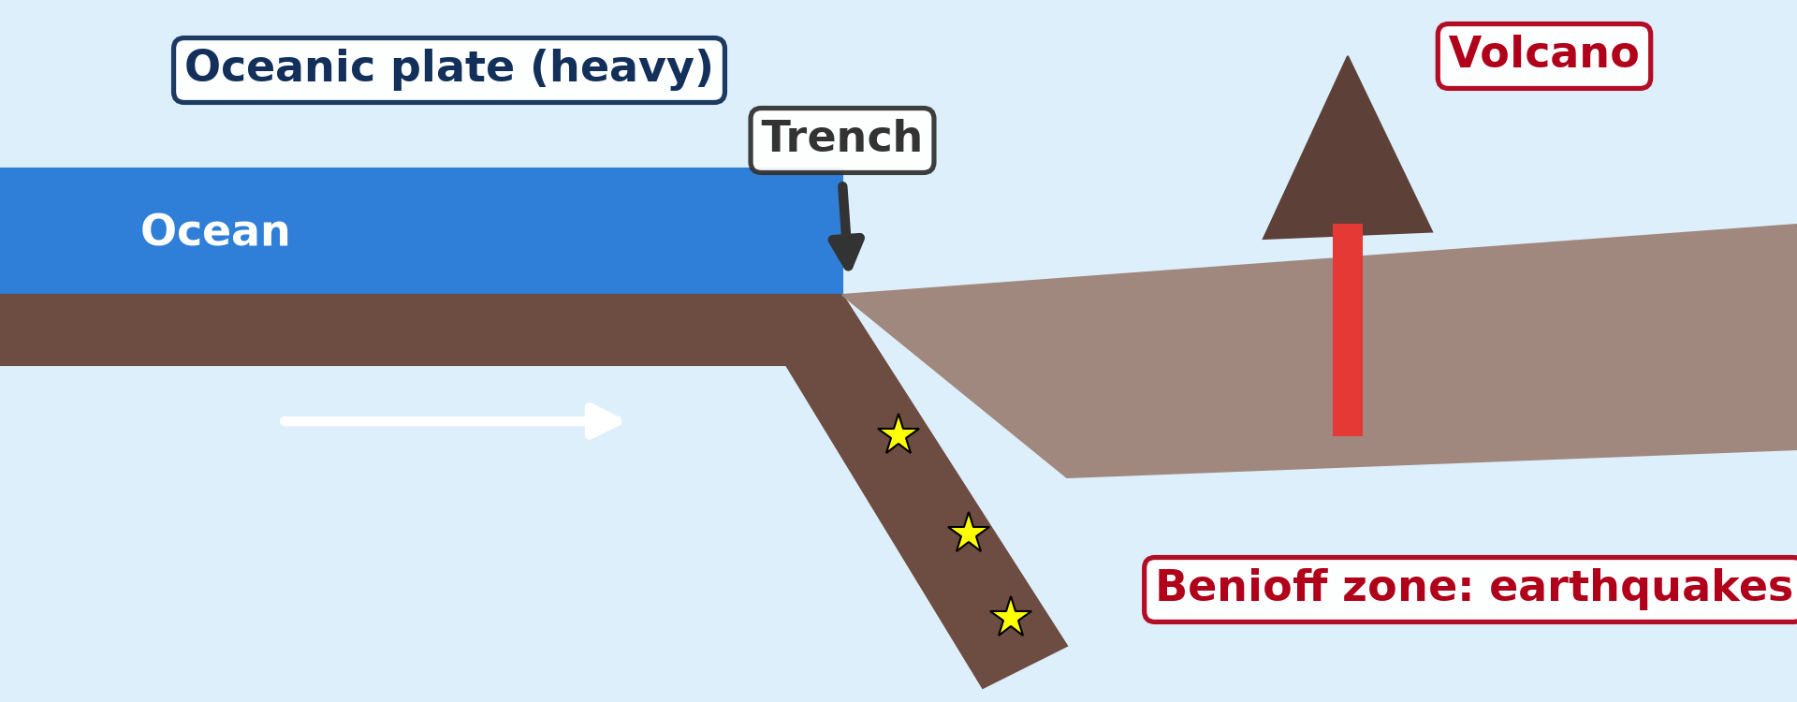
BOARD SUMMARY
2. Types of Plate Movements
Convergent movement: Plates move towards each other, and one may sink under the other.
Illustration: one plate sinks under the other
Notes:
Copy the point on Convergent movement on the left, then draw the diagram on the right: one plate sinks under the other. Give it a title and label it clearly.

Slide 40
BOARD SUMMARY
2. Types of Plate Movements
Transform movement: Plates slide past each other.
Illustration: plates sliding past each other
Notes:
Copy the point on Transform movement on the left, then draw the diagram on the right: plates sliding past each other. Give it a title and label it clearly.

Slide 41
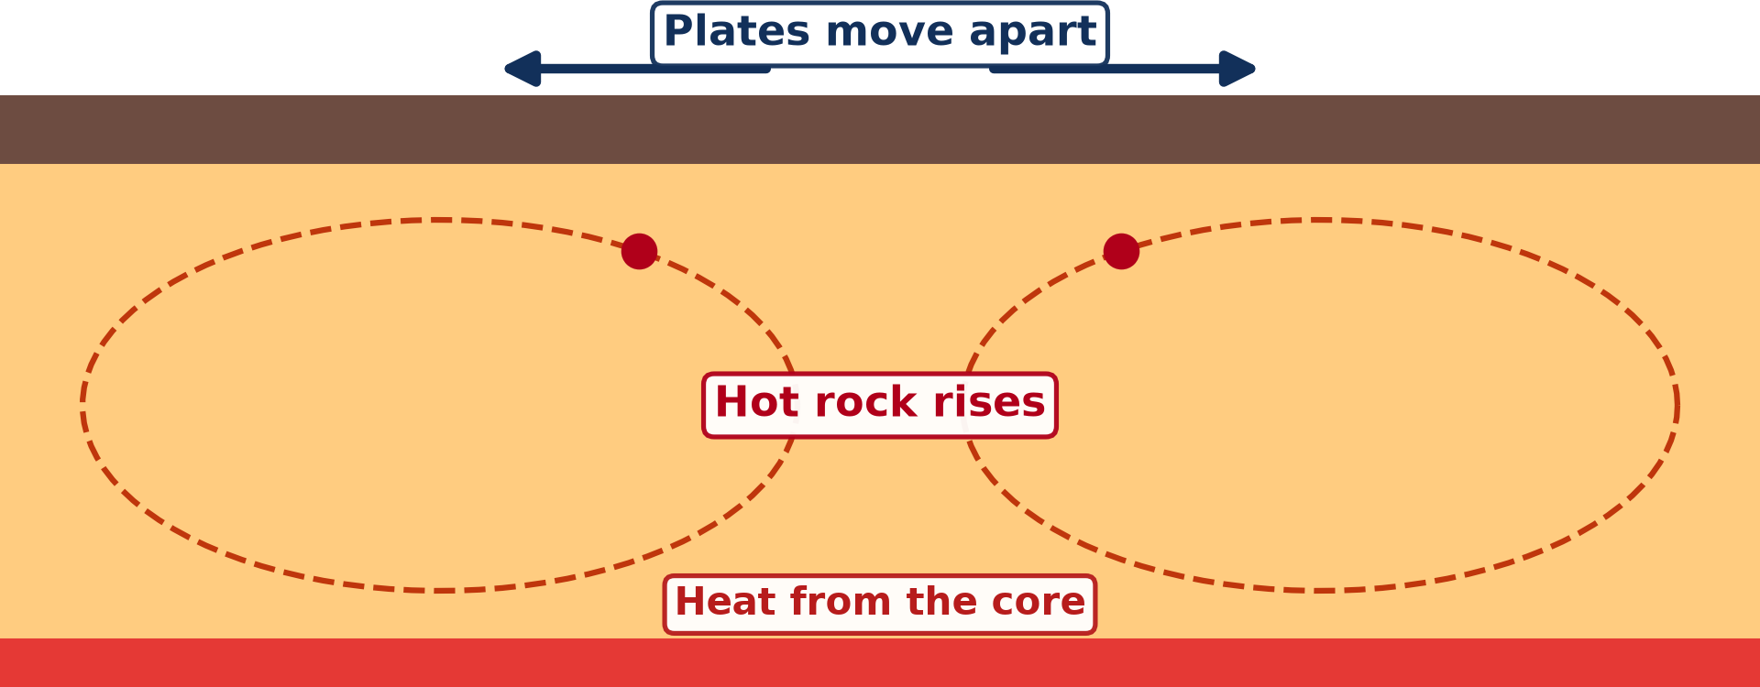
BOARD SUMMARY
2. Types of Plate Movements
Cause: Heat currents in the mantle move the plates.
Illustration: heat currents in the mantle
Notes:
Copy the point on Cause on the left, then draw the diagram on the right: heat currents in the mantle. Give it a title and label it clearly.

Slide 42
FORMATIVE EVALUATION
Evaluation 1
What is a plate?
Notes:
Now let us check what you have understood. Question 1: What is a plate? Answer in your exercise book.

Slide 43
FORMATIVE EVALUATION
Expected Answer
A large piece of the lithosphere that moves slowly.
Notes:
The expected answer is: a large piece of the lithosphere that moves slowly. If you got it right, well done.

Slide 44
FORMATIVE EVALUATION
Evaluation 2
Name the three types of plate movements.
Notes:
Now let us check what you have understood. Question 2: Name the three types of plate movements. Answer in your exercise book.

Slide 45
FORMATIVE EVALUATION
Expected Answer
Divergent, convergent and transform.
Notes:
The expected answer is: divergent, convergent and transform. If you got it right, well done.

Slide 46
REMEDIATION
Remediation
Fill in the blanks:
Cameroon is on the ______ Plate.
Plates moving apart is a ______ movement.
Plates are moved by heat in the ______.
Notes:
For those who need more practice, fill in the blanks in your exercise book. The answers are: number 1, African; number 2, divergent; number 3, mantle.

Slide 47
HOMEWORK
Homework
Give one consequence of an earthquake.
Notes:
For your homework: Give one consequence of an earthquake. We shall correct it at the beginning of our next lesson.

Slide 48
NEXT LESSON
Next Lesson
Our next lesson will be on:
Lesson 13: Consequences of the Instability of the Earth's Crust
Notes:
Our next lesson will be on Lesson 13: Consequences of the Instability of the Earth's Crust. Thank you for your attention, and see you next time.

Slide 49
BILINGUAL GAME
Bilingual Game (Jeu Bilingue)
English | Français
Plate | La plaque
Movement | Le mouvement
Boundary | La limite
Fault | La faille
Continent | Le continent
Map | La carte
Notes:
Let us play the bilingual game. I say a word in English, and you give me the French word. Then we do the reverse.

Slide 50
LOGBOOK
Official Logbook (1/2)
Module / Topic | Protection against the Wrath of Nature
Lesson Title | Lesson 12: Plate Movements
Expected Learning Outcomes | Define a plate and plate movements. Identify the types of plates and the major plates on a world map. Describe the types of plate movements.
Competence | Learners are able to identify the plates on a world map and describe how they move.
Notes:
I record this information in the official logbook of the class after the lesson.

Slide 51
LOGBOOK
Official Logbook (2/2)
Matter Taught | DEFINITIONS; Types of Plates; Types of Plate Movements.
Evaluation | Formative evaluation and remediation exercise.
Homework | Give one consequence of an earthquake.
Enrolment / Present / Absent | ____ / ____ / ____
Achievement | To be completed after the lesson.
Notes:
I complete the second page of the logbook: the matter taught, the evaluation, the homework and the attendance.

Slide 52
TEACHER'S NOTE
Teacher's Note
Timing: Homework correction, plan, objectives 8 min | Recall, situation, action 10 min | 5 activities 30 min | Board summary (copying) 30 min | Evaluation, remediation 10 min | Homework, next lesson 5 min | Logbook 7 min
Activities 1 and 4 are animations (GIF): it plays automatically in slide-show mode.
Without the projector (Activity 1): cut out a paper map.
Without the projector (Activity 2): draw the plates on a world map.
Without the projector (Activity 3): use an atlas.
Without the projector (Activity 4): move two books on the table.
Without the projector (Activity 5): describe a crack in the ground.
Notes:
This slide is for me, the teacher: it gives the timing of the lesson and what to do if the projector is not available.

Slide 53
REFERENCES
References
Geography Syllabus, Forms I–V, MINESEC (2023) — Form 1, Module 3: Protection from the Wrath of Nature.
Photo, Activity 5: “faultfind_48” by dsearls, CC BY-SA 2.0, via Flickr (https://www.flickr.com/photos/52614599@N00/15392616)
Diagrams and animations: drawn for this lesson (Geography Department).
Notes:
These are the references and picture credits used to prepare this lesson.

