Slide 1
FORM 2
GEOGRAPHY
Practical Work 1
Calculation of the Demographic Indices of Cameroon
Notes:
Good morning, class, and welcome to our geography lesson. I am your geography teacher, Mr Kamdem. Today we are starting Practical Work 1: Calculation of the Demographic Indices of Cameroon.

Slide 2
CLASS INFO
Class, Chapter and Duration
Class | Form 2
Chapter | Module 1: Man in his Environment
Duration | 2 periods (2 × 50 minutes)
Notes:
This lesson is for Form 2. It belongs to Module 1: Man in his Environment. We shall need 2 periods to cover it.

Slide 3
IDENTIFICATION
Lesson Identification
Topic | Man in his Environment
Sub-topic | The World's Population
Lesson | Practical Work 1: Calculation of the Demographic Indices of Cameroon
Notions / Concepts | Birth rate, death rate, natural growth rate.
Syllabus focus | Theoretical basis: recall of the definitions of birth rate, death rate and natural growth rate. Practical exercise: calculation of the indices (birth rate, death rate and natural increase) with concrete data.
Competence | Learners are able to calculate the birth rate, death rate and natural growth rate of a population.
Notes:
Our topic is Man in his Environment, and the sub-topic is The World's Population. The key notions we shall use today are: birth rate, death rate, natural growth rate. At the end, you should be able to do this: learners are able to calculate the birth rate, death rate and natural growth rate of a population.

Slide 4

HOMEWORK CORRECTION
Correction of the Homework
Question (Lesson 1: A Rapid Growth of the World's Population):
Write the formula of the birth rate.
Notes:
Before we start the new lesson, let us correct the homework I gave you at the end of Lesson 1: A Rapid Growth of the World's Population. The question was: Write the formula of the birth rate. Take out your exercise books.

Slide 5
HOMEWORK CORRECTION
Correction: Possible Answer
Birth rate = (births ÷ population) × 1,000, in ‰.
Notes:
Here is a good answer. Birth rate = (births ÷ population) × 1,000, in ‰. Compare it with your own answer and correct your work in red.

Slide 6
LESSON PLAN
Lesson Plan
Correction of the homework
Objectives and recall
Real-life situation and action to take
Learning activities
Board summary
Evaluation, remediation and homework
Notes:
Here is the plan of our lesson today. First, we shall correct the homework. Then we shall look at the objectives and recall what you already know. After that, we shall study a situation from real life and the action to take, and do the learning activities. Finally, we shall copy the board summary, do the evaluation and the remediation, and I will give you the homework.

Slide 7
OBJECTIVES
Objectives
By the end of this lesson, you should be able to:
Define birth rate, death rate and natural growth rate.
Calculate these rates from data.
Interpret the results for Cameroon.
Notes:
By the end of this lesson, you should be able to do three things. Number 1: define birth rate, death rate and natural growth rate. Number 2: calculate these rates from data. Number 3: interpret the results for Cameroon.

Slide 8
PREVIOUS KNOWLEDGE
Previous Knowledge
Births minus deaths gives natural growth.
The population of Cameroon is about 28 million.
A rate compares a number with the whole population.
Notes:
Let us first remember what you already know. Births minus deaths gives natural growth. The population of Cameroon is about 28 million. A rate compares a number with the whole population. Keep this in mind, because we shall build on it today.

Slide 9
REAL-LIFE SITUATION
Situation in Real Life
In one year, a town of 100,000 people records 3,500 births and 900 deaths. The Mayor asks the class: "How can you tell me, with numbers, how fast our town is growing?"
Notes:
Listen carefully to this situation from real life. In one year, a town of 100,000 people records 3,500 births and 900 deaths. The Mayor asks the class: "How can you tell me, with numbers, how fast our town is growing?" Think about it, because I am going to ask you some questions.

Slide 10
REAL-LIFE SITUATION
Situation: Question 1
What is the problem in the situation?
Notes:
Question 1: What is the problem in the situation? Think for a moment, then raise your hand to answer.

Slide 11
REAL-LIFE SITUATION
Answer
The Mayor does not know how to measure the growth of the town with numbers.
Notes:
Good. The Mayor does not know how to measure the growth of the town with numbers.

Slide 12
REAL-LIFE SITUATION
Situation: Question 2
What data do we have?
Notes:
Question 2: What data do we have? Think for a moment, then raise your hand to answer.

Slide 13
REAL-LIFE SITUATION
Answer
The population, the births and the deaths.
Notes:
Good. The population, the births and the deaths.

Slide 14
REAL-LIFE SITUATION
Situation: Question 3
What must we calculate?
Notes:
Question 3: What must we calculate? Think for a moment, then raise your hand to answer.

Slide 15
REAL-LIFE SITUATION
Possible Answer
The birth rate, the death rate and the natural growth rate.
Notes:
Good. The birth rate, the death rate and the natural growth rate.

Slide 16
ACTION TO TAKE
Action to Take
Always show the formula, the working and the unit in calculations.
Notes:
From this situation, the action we are working towards in this lesson is the following: always show the formula, the working and the unit in calculations.

Slide 17
JUSTIFICATION
Justification of the Lesson
This practical work helps us to measure how fast a population grows.
Notes:
Why is this lesson important for you? This practical work helps us to measure how fast a population grows.

Slide 18
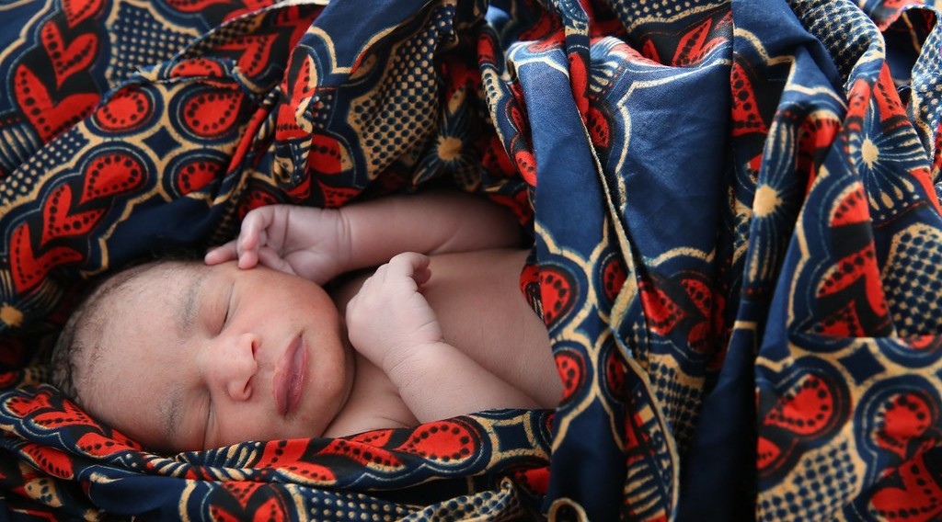
1. THEORETICAL BASIS
Activity 1
A newborn baby.
Notes:
Activity 1. Look carefully at this picture: a newborn baby. Observe every detail before I ask the question.

Slide 19
1. THEORETICAL BASIS
Activity 1: Question
How do we compare the births of a big town and a small town fairly?
Notes:
Here is the question for Activity 1: How do we compare the births of a big town and a small town fairly? Take one minute to think and write your answer in your rough notebook.

Slide 20
1. THEORETICAL BASIS
Activity 1: Answer
We count the births for every 1,000 people: this is the birth rate.
Notes:
Let us check the answer together. We count the births for every 1,000 people: this is the birth rate.

Slide 21
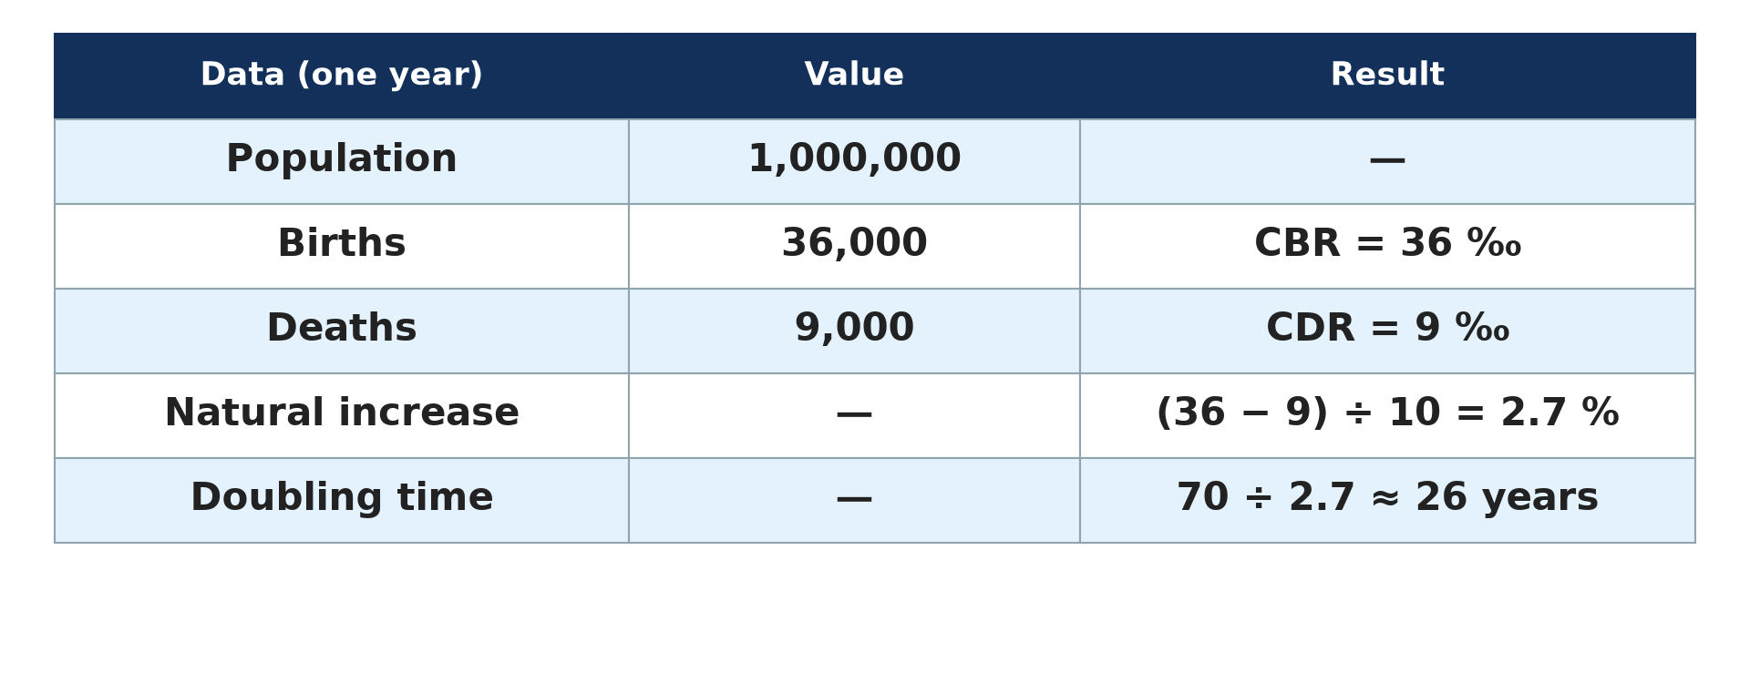
2. BIRTH RATE
Activity 2
Calculating indices.
Notes:
Activity 2. Look carefully at this diagram: calculating indices. Observe every detail before I ask the question.

Slide 22
2. BIRTH RATE
Activity 2: Question
A town of 100,000 people has 3,500 births. Calculate the birth rate.
Notes:
Here is the question for Activity 2: A town of 100,000 people has 3,500 births. Calculate the birth rate. Take one minute to think and write your answer in your rough notebook.

Slide 23
2. BIRTH RATE
Activity 2: Answer
(3,500 ÷ 100,000) × 1,000 = 35 ‰.
Notes:
Let us check the answer together. (3,500 ÷ 100,000) × 1,000 = 35 ‰.

Slide 24
2. DEATH RATE
Activity 3
Calculating indices.
Notes:
Activity 3. Look carefully at this diagram: calculating indices. Observe every detail before I ask the question.

Slide 25
2. DEATH RATE
Activity 3: Question
The same town has 900 deaths. Calculate the death rate.
Notes:
Here is the question for Activity 3: The same town has 900 deaths. Calculate the death rate. Take one minute to think and write your answer in your rough notebook.

Slide 26
2. DEATH RATE
Activity 3: Answer
(900 ÷ 100,000) × 1,000 = 9 ‰.
Notes:
Let us check the answer together. (900 ÷ 100,000) × 1,000 = 9 ‰.

Slide 27
2. NATURAL GROWTH RATE
Activity 4
Natural increase.
Notes:
Activity 4. Look carefully at this diagram: natural increase. Observe every detail before I ask the question.

Slide 28
2. NATURAL GROWTH RATE
Activity 4: Question
Calculate the natural growth rate in per cent.
Notes:
Here is the question for Activity 4: Calculate the natural growth rate in per cent. Take one minute to think and write your answer in your rough notebook.

Slide 29
2. NATURAL GROWTH RATE
Activity 4: Answer
(35 − 9) ÷ 10 = 2.6 %.
Notes:
Let us check the answer together. (35 − 9) ÷ 10 = 2.6 %.

Slide 30
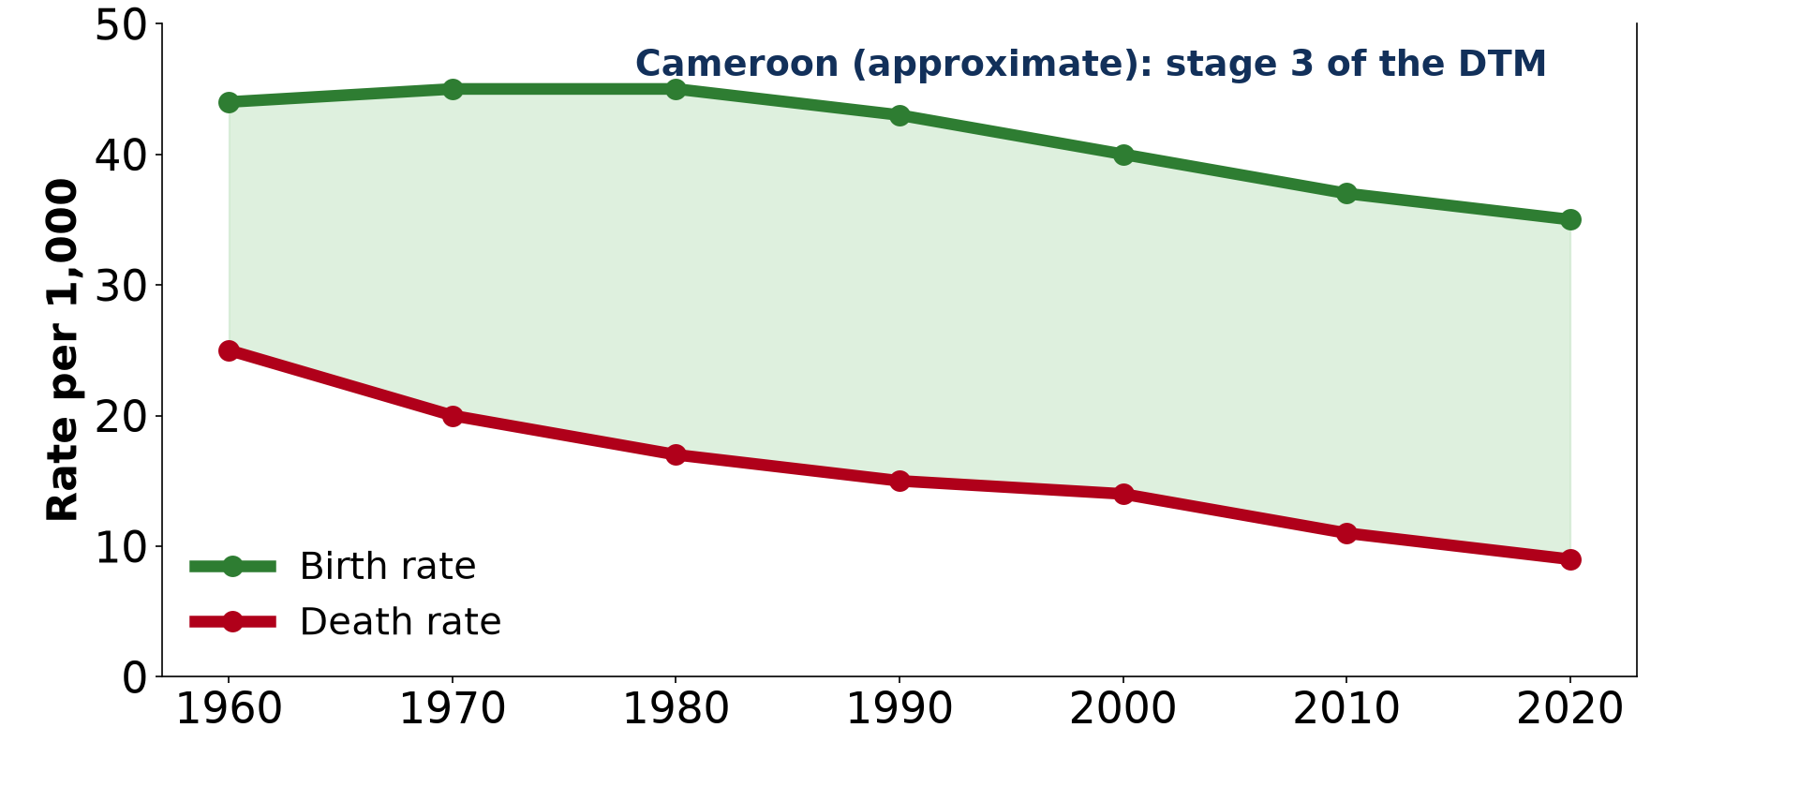
3. CAMEROON
Activity 5
Birth and death rates of Cameroon.
Notes:
Activity 5. Look carefully at this diagram: birth and death rates of Cameroon. Observe every detail before I ask the question.

Slide 31
3. CAMEROON
Activity 5: Question
Which rate has fallen faster in Cameroon: the birth rate or the death rate?
Notes:
Here is the question for Activity 5: Which rate has fallen faster in Cameroon: the birth rate or the death rate? Take one minute to think and write your answer in your rough notebook.

Slide 32
3. CAMEROON
Activity 5: Answer
The death rate, so the population grows quickly.
Notes:
Let us check the answer together. The death rate, so the population grows quickly.

Slide 33
BOARD SUMMARY
Board Summary
Topic: Man in his Environment
Sub-topic: The World's Population
Practical Work 1: Calculation of the Demographic Indices of Cameroon
Notes:
Now we are going to copy the board summary. Write the title and the headings neatly in your notebooks. I will give you enough time for each slide, so do not rush.

Slide 34
BOARD SUMMARY
DEFINITIONS
The key terms of this lesson are defined as follows:
Birth rate: It is the number of births per 1,000 people in one year.
Death rate: It is the number of deaths per 1,000 people in one year.
Notes:
Let us copy the definitions. The key terms of this lesson are defined as follows. On this slide we have Birth rate and Death rate. Write each point on a new line, with the key term first, and explain it in your own words when we revise. When you finish, we go to the next slide.

Slide 35
BOARD SUMMARY
DEFINITIONS (continued)
Natural growth rate: It is the difference between the birth rate and the death rate, given in per cent.
Notes:
We continue with the definitions. On this slide we have Natural growth rate. Write each point on a new line, with the key term first, and explain it in your own words when we revise.

Slide 36
BOARD SUMMARY
1. Formulas
The demographic indices are calculated with the following formulas:
Birth rate: Birth rate = (births ÷ population) × 1,000, in ‰.
Illustration: formulas and example
Notes:
Let us copy Formulas. The demographic indices are calculated with the following formulas. Copy the point on Birth rate on the left, then draw the diagram on the right: formulas and example. Give it a title and label it clearly.

Slide 37
BOARD SUMMARY
1. Formulas
Death rate: Death rate = (deaths ÷ population) × 1,000, in ‰.
Natural growth rate: Natural growth rate = (birth rate − death rate) ÷ 10, in %.
Notes:
We continue with Formulas. On this slide we have Death rate and Natural growth rate. Write each point on a new line, with the key term first, and explain it in your own words when we revise.

Slide 38
BOARD SUMMARY
2. Worked Example
For a town of 100,000 people with 3,500 births and 900 deaths:
Birth rate: (3,500 ÷ 100,000) × 1,000 = 35 ‰.
Death rate: (900 ÷ 100,000) × 1,000 = 9 ‰.
Notes:
Let us copy Worked Example. For a town of 100,000 people with 3,500 births and 900 deaths. On this slide we have Birth rate and Death rate. Write each point on a new line, with the key term first, and explain it in your own words when we revise. When you finish, we go to the next slide.

Slide 39
BOARD SUMMARY
2. Worked Example (continued)
Natural growth rate: (35 − 9) ÷ 10 = 2.6 % per year.
Notes:
We continue with Worked Example. On this slide we have Natural growth rate. Write each point on a new line, with the key term first, and explain it in your own words when we revise.

Slide 40
BOARD SUMMARY
3. The Case of Cameroon
The indices of Cameroon are the following (approximate):
Birth rate: It is about 35 ‰.
Illustration: birth and death rates of Cameroon
Notes:
Let us copy The Case of Cameroon. The indices of Cameroon are the following (approximate). Copy the point on Birth rate on the left, then draw the diagram on the right: birth and death rates of Cameroon. Give it a title and label it clearly.

Slide 41
BOARD SUMMARY
3. The Case of Cameroon
Death rate: It is about 9 ‰.
Natural growth rate: It is about 2.6 %, so the population of Cameroon grows quickly.
Notes:
We continue with The Case of Cameroon. On this slide we have Death rate and Natural growth rate. Write each point on a new line, with the key term first, and explain it in your own words when we revise.

Slide 42
FORMATIVE EVALUATION
Evaluation 1
A population of 50,000 has 2,000 births. Find the birth rate.
Notes:
Now let us check what you have understood. Question 1: A population of 50,000 has 2,000 births. Find the birth rate. Answer in your exercise book.

Slide 43
FORMATIVE EVALUATION
Expected Answer
(2,000 ÷ 50,000) × 1,000 = 40 ‰.
Notes:
The expected answer is: (2,000 ÷ 50,000) × 1,000 = 40 ‰. If you got it right, well done.

Slide 44
FORMATIVE EVALUATION
Evaluation 2
Birth rate 38 ‰, death rate 10 ‰. Find the natural growth rate.
Notes:
Now let us check what you have understood. Question 2: Birth rate 38 ‰, death rate 10 ‰. Find the natural growth rate. Answer in your exercise book.

Slide 45
FORMATIVE EVALUATION
Expected Answer
(38 − 10) ÷ 10 = 2.8 %.
Notes:
The expected answer is: (38 − 10) ÷ 10 = 2.8 %. If you got it right, well done.

Slide 46
REMEDIATION
Remediation
Fill in the blanks:
Birth and death rates are given per ______.
Natural growth rate is given in ______.
Birth rate minus death rate gives the natural ______ rate.
Notes:
For those who need more practice, fill in the blanks in your exercise book. The answers are: number 1, thousand (‰); number 2, per cent (%); number 3, growth.

Slide 47
HOMEWORK
Homework
Write the formula of population density.
Notes:
For your homework: Write the formula of population density. We shall correct it at the beginning of our next lesson.

Slide 48
NEXT LESSON
Next Lesson
Our next lesson will be on:
Lesson 2: The Uneven Distribution of the World's Population
Notes:
Our next lesson will be on Lesson 2: The Uneven Distribution of the World's Population. Thank you for your attention, and see you next time.

Slide 49
BILINGUAL GAME
Bilingual Game (Jeu Bilingue)
English | Français
Birth rate | Le taux de natalité
Death rate | Le taux de mortalité
Growth rate | Le taux d'accroissement
Calculation | Le calcul
Formula | La formule
Per thousand | Pour mille
Notes:
Let us play the bilingual game. I say a word in English, and you give me the French word. Then we do the reverse.

Slide 50
LOGBOOK
Official Logbook (1/2)
Module / Topic | Man in his Environment
Lesson Title | Practical Work 1: Calculation of the Demographic Indices of Cameroon
Expected Learning Outcomes | Define birth rate, death rate and natural growth rate. Calculate these rates from data. Interpret the results for Cameroon.
Competence | Learners are able to calculate the birth rate, death rate and natural growth rate of a population.
Notes:
I record this information in the official logbook of the class after the lesson.

Slide 51
LOGBOOK
Official Logbook (2/2)
Matter Taught | DEFINITIONS; Formulas; Worked Example; The Case of Cameroon.
Evaluation | Formative evaluation and remediation exercise.
Homework | Write the formula of population density.
Enrolment / Present / Absent | ____ / ____ / ____
Achievement | To be completed after the lesson.
Notes:
I complete the second page of the logbook: the matter taught, the evaluation, the homework and the attendance.

Slide 52
TEACHER'S NOTE
Teacher's Note
Timing: Homework correction, plan, objectives 8 min | Recall, situation, action 10 min | 5 activities 30 min | Board summary (copying) 30 min | Evaluation, remediation 10 min | Homework, next lesson 5 min | Logbook 7 min
Without the projector (Activity 1): write the definition on the board.
Without the projector (Activity 2): work it out on the board.
Without the projector (Activity 3): work it out on the board.
Without the projector (Activity 4): work it out on the board.
Without the projector (Activity 5): read the values of 2020.
Notes:
This slide is for me, the teacher: it gives the timing of the lesson and what to do if the projector is not available.

Slide 53
REFERENCES
References
Geography Syllabus, Forms I–V, MINESEC (2023) — Form 2, Module 1: Man in his Environment.
Photo, Activity 1: “Newborn baby rests” by World Bank Photo Collection, CC BY-NC-ND 2.0, via Flickr (https://www.flickr.com/photos/10816734@N03/19845580540)
Diagrams and animations: drawn for this lesson (Geography Department).
Notes:
These are the references and picture credits used to prepare this lesson.

