Slide 1
FORM 2
GEOGRAPHY
Lesson 3
Man in the Equatorial Zone
Notes:
Good morning, class, and welcome to our geography lesson. I am your geography teacher, Mr Kamdem. Today we are starting Lesson 3: Man in the Equatorial Zone.

Slide 2
CLASS INFO
Class, Chapter and Duration
Class | Form 2
Chapter | Module 1: Man in his Environment
Duration | 2 periods (2 × 50 minutes)
Notes:
This lesson is for Form 2. It belongs to Module 1: Man in his Environment. We shall need 2 periods to cover it.

Slide 3
IDENTIFICATION
Lesson Identification
Topic | Man in his Environment
Sub-topic | Exploitation of Resources in the Natural Environment
Lesson | Lesson 3: Man in the Equatorial Zone
Notions / Concepts | Resources, dense forest, shifting cultivation, bush fallowing.
Syllabus focus | Location; climatic characteristics; resources; exploitation of resources; problems faced; proposed solutions.
Competence | Learners are able to describe how people use the resources of the equatorial zone and solve its problems.
Notes:
Our topic is Man in his Environment, and the sub-topic is Exploitation of Resources in the Natural Environment. The key notions we shall use today are: resources, dense forest, shifting cultivation, bush fallowing. At the end, you should be able to do this: learners are able to describe how people use the resources of the equatorial zone and solve its problems.

Slide 4

HOMEWORK CORRECTION
Correction of the Homework
Question (Practical Work 2: Population Densities in Cameroon):
Name the natural zone that covers southern Cameroon.
Notes:
Before we start the new lesson, let us correct the homework I gave you at the end of Practical Work 2: Population Densities in Cameroon. The question was: Name the natural zone that covers southern Cameroon. Take out your exercise books.

Slide 5
HOMEWORK CORRECTION
Correction: Possible Answer
The equatorial zone (the forest zone).
Notes:
Here is a good answer. The equatorial zone (the forest zone). Compare it with your own answer and correct your work in red.

Slide 6
LESSON PLAN
Lesson Plan
Correction of the homework
Objectives and recall
Real-life situation and action to take
Learning activities
Board summary
Evaluation, remediation and homework
Notes:
Here is the plan of our lesson today. First, we shall correct the homework. Then we shall look at the objectives and recall what you already know. After that, we shall study a situation from real life and the action to take, and do the learning activities. Finally, we shall copy the board summary, do the evaluation and the remediation, and I will give you the homework.

Slide 7
OBJECTIVES
Objectives
By the end of this lesson, you should be able to:
Locate the equatorial zone and describe its climate.
Describe its resources and how they are exploited.
Notes:
Take your time to copy this part; we will continue together.

Slide 8
OBJECTIVES
Objectives (continued)
Explain the problems faced and propose solutions.
Notes:
By the end of this lesson, you should be able to do three things. Number 1: locate the equatorial zone and describe its climate. Number 2: describe its resources and how they are exploited. Number 3: explain the problems faced and propose solutions.

Slide 9
PREVIOUS KNOWLEDGE
Previous Knowledge
The equatorial region is hot and wet all year.
It has a thick forest.
Southern Cameroon is in the equatorial zone.
Notes:
Let us first remember what you already know. The equatorial region is hot and wet all year. It has a thick forest. Southern Cameroon is in the equatorial zone. Keep this in mind, because we shall build on it today.

Slide 10
REAL-LIFE SITUATION
Situation in Real Life
Near Sangmélima, a farmer clears a piece of forest, burns it and plants cassava. After three years the soil is poor, so he moves to a new place, while a timber company cuts big trees nearby. His son asks: "How can people live well in the forest without destroying it?"
Notes:
Listen carefully to this situation from real life. Near Sangmélima, a farmer clears a piece of forest, burns it and plants cassava. After three years the soil is poor, so he moves to a new place, while a timber company cuts big trees nearby. His son asks: "How can people live well in the forest without destroying it?" Think about it, because I am going to ask you some questions.

Slide 11
REAL-LIFE SITUATION
Situation: Question 1
What is the problem in the situation?
Notes:
Question 1: What is the problem in the situation? Think for a moment, then raise your hand to answer.

Slide 12
REAL-LIFE SITUATION
Answer
The son does not know how people can use the forest without destroying it.
Notes:
Good. The son does not know how people can use the forest without destroying it.

Slide 13
REAL-LIFE SITUATION
Situation: Question 2
What farming method does the farmer use?
Notes:
Question 2: What farming method does the farmer use? Think for a moment, then raise your hand to answer.

Slide 14
REAL-LIFE SITUATION
Answer
Shifting cultivation.
Notes:
Good. Shifting cultivation.

Slide 15
REAL-LIFE SITUATION
Situation: Question 3
Which other activity uses the forest?
Notes:
Question 3: Which other activity uses the forest? Think for a moment, then raise your hand to answer.

Slide 16
REAL-LIFE SITUATION
Possible Answer
Lumbering (timber).
Notes:
Good. Lumbering (timber).

Slide 17
ACTION TO TAKE
Action to Take
Use the forest wisely and replant trees.
Notes:
From this situation, the action we are working towards in this lesson is the following: use the forest wisely and replant trees.

Slide 18
JUSTIFICATION
Justification of the Lesson
This lesson helps us to understand how people live in the equatorial forest.
Notes:
Why is this lesson important for you? This lesson helps us to understand how people live in the equatorial forest.

Slide 19
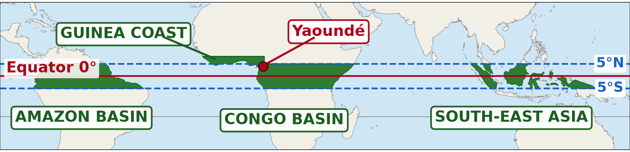
1. LOCATION
Activity 1
Some regions of the world.
Notes:
Activity 1. Look carefully at this diagram: some regions of the world. Observe every detail before I ask the question.

Slide 20
1. LOCATION
Activity 1: Question
Between which latitudes is the equatorial zone found?
Notes:
Here is the question for Activity 1: Between which latitudes is the equatorial zone found? Take one minute to think and write your answer in your rough notebook.

Slide 21
1. LOCATION
Activity 1: Answer
Between about 5° N and 5° S.
Notes:
Let us check the answer together. Between about 5° N and 5° S.

Slide 22

2. CLIMATE
Activity 2
The climate of Yaoundé.
Notes:
Activity 2. Look carefully at this diagram: the climate of Yaoundé. Observe every detail before I ask the question.

Slide 23
2. CLIMATE
Activity 2: Question
In how many months does it rain in Yaoundé?
Notes:
Here is the question for Activity 2: In how many months does it rain in Yaoundé? Take one minute to think and write your answer in your rough notebook.

Slide 24
2. CLIMATE
Activity 2: Answer
In almost every month of the year.
Notes:
Let us check the answer together. In almost every month of the year.

Slide 25

3. RESOURCES
Activity 3
Logs from the forest.
Notes:
Activity 3. Look carefully at this picture: logs from the forest. Observe every detail before I ask the question.

Slide 26
3. RESOURCES
Activity 3: Question
Which resource of the forest do you see here?
Notes:
Here is the question for Activity 3: Which resource of the forest do you see here? Take one minute to think and write your answer in your rough notebook.

Slide 27
3. RESOURCES
Activity 3: Answer
Timber.
Notes:
Let us check the answer together. Timber.

Slide 28

4. EXPLOITATION
Activity 4
A cleared and burnt plot.
Notes:
Activity 4. Look carefully at this picture: a cleared and burnt plot. Observe every detail before I ask the question.

Slide 29
4. EXPLOITATION
Activity 4: Question
Why does the farmer move to a new plot after a few years?
Notes:
Here is the question for Activity 4: Why does the farmer move to a new plot after a few years? Take one minute to think and write your answer in your rough notebook.

Slide 30
4. EXPLOITATION
Activity 4: Answer
The soil becomes poor, so he leaves it to rest (fallow) and clears a new plot.
Notes:
Let us check the answer together. The soil becomes poor, so he leaves it to rest (fallow) and clears a new plot.

Slide 31

5. PROBLEMS
Activity 5
A muddy road.
Notes:
Activity 5. Look carefully at this picture: a muddy road. Observe every detail before I ask the question.

Slide 32
5. PROBLEMS
Activity 5: Question
Why are roads a problem in the equatorial zone?
Notes:
Here is the question for Activity 5: Why are roads a problem in the equatorial zone? Take one minute to think and write your answer in your rough notebook.

Slide 33
5. PROBLEMS
Activity 5: Answer
Heavy rain makes earth roads muddy, so it is hard to transport goods.
Notes:
Let us check the answer together. Heavy rain makes earth roads muddy, so it is hard to transport goods.

Slide 34
BOARD SUMMARY
Board Summary
Topic: Man in his Environment
Sub-topic: Exploitation of Resources in the Natural Environment
Lesson 3: Man in the Equatorial Zone
Notes:
Now we are going to copy the board summary. Write the title and the headings neatly in your notebooks. I will give you enough time for each slide, so do not rush.

Slide 35
BOARD SUMMARY
DEFINITIONS
The key terms of this lesson are defined as follows:
Equatorial zone: It is the hot and wet zone around the Equator, covered by dense forest.
Shifting cultivation: It is farming a plot for a few years and moving to a new plot when the soil becomes poor.
Notes:
Let us copy the definitions. The key terms of this lesson are defined as follows. On this slide we have Equatorial zone and Shifting cultivation. Write each point on a new line, with the key term first, and explain it in your own words when we revise. When you finish, we go to the next slide.

Slide 36
BOARD SUMMARY
DEFINITIONS (continued)
Bush fallowing: It is leaving farmland to rest for some years so that it becomes fertile again.
Notes:
We continue with the definitions. On this slide we have Bush fallowing. Write each point on a new line, with the key term first, and explain it in your own words when we revise.

Slide 37
BOARD SUMMARY
1. Location
The equatorial zone is located as follows:
Latitudes: It lies between about 5° N and 5° S of the Equator.
Illustration: the equatorial regions of the world
Notes:
Let us copy Location. The equatorial zone is located as follows. Copy the point on Latitudes on the left, then draw the diagram on the right: the equatorial regions of the world. Give it a title and label it clearly.

Slide 38
BOARD SUMMARY
1. Location
Main areas: It covers the Congo Basin, the Amazon Basin, South-East Asia and southern Cameroon.
Notes:
We continue with Location. On this slide we have Main areas. Write each point on a new line, with the key term first, and explain it in your own words when we revise.

Slide 39
BOARD SUMMARY
2. Climatic Characteristics
The equatorial climate has the following characteristics:
Temperature: It is hot all year, about 25 °C to 27 °C.
Illustration: the climate of Yaoundé
Notes:
Let us copy Climatic Characteristics. The equatorial climate has the following characteristics. Copy the point on Temperature on the left, then draw the diagram on the right: the climate of Yaoundé. Give it a title and label it clearly.

Slide 40
BOARD SUMMARY
2. Climatic Characteristics
Rainfall: Rain is heavy, more than 1,500 mm a year, and falls in almost every month.
Humidity: The air is always humid.
Notes:
We continue with Climatic Characteristics. On this slide we have Rainfall and Humidity. Write each point on a new line, with the key term first, and explain it in your own words when we revise.

Slide 41

BOARD SUMMARY
3. Resources
The equatorial zone has the following resources:
Forest: It gives timber, fruits, medicines and game.
Illustration: the equatorial forest
Notes:
Let us copy Resources. The equatorial zone has the following resources. Copy the point on Forest on the left, then draw the diagram on the right: the equatorial forest. Give it a title and label it clearly.

Slide 42
BOARD SUMMARY
3. Resources
Farmland: It is used for food crops and cash crops.
Minerals: Oil, gold, iron and bauxite are found.
Water: Big rivers give fish, transport and hydro-electricity.
Notes:
We continue with Resources. On this slide we have Farmland, Minerals and Water. Write each point on a new line, with the key term first, and explain it in your own words when we revise.

Slide 43
BOARD SUMMARY
4. Exploitation of Resources
The resources are exploited in the following ways:
Shifting cultivation and bush fallowing: Farmers clear and burn a plot, grow cassava and plantains, then leave it to rest.
Illustration: a cleared plot
Notes:
Let us copy Exploitation of Resources. The resources are exploited in the following ways. Copy the point on Shifting cultivation and bush fallowing on the left, then draw the diagram on the right: a cleared plot. Give it a title and label it clearly.

Slide 44

BOARD SUMMARY
4. Exploitation of Resources
Plantations: Cocoa, coffee, oil palm and rubber are grown for export.
Illustration: cocoa
Notes:
Copy the point on Plantations on the left, then draw the diagram on the right: cocoa. Give it a title and label it clearly.

Slide 45
BOARD SUMMARY
4. Exploitation of Resources
Lumbering: Timber companies cut and export valuable trees.
Illustration: logs
Notes:
Copy the point on Lumbering on the left, then draw the diagram on the right: logs. Give it a title and label it clearly.

Slide 46
BOARD SUMMARY
4. Exploitation of Resources
Mining and gathering: People extract minerals and gather forest products.
Notes:
We continue with Exploitation of Resources. On this slide we have Mining and gathering. Write each point on a new line, with the key term first, and explain it in your own words when we revise.

Slide 47
BOARD SUMMARY
5. Problems Faced
People face the following problems:
Dense forest: It is difficult to clear and to cross.
Notes:
Let us copy Problems Faced. People face the following problems. On this slide we have Dense forest. Write each point on a new line, with the key term first, and explain it in your own words when we revise.

Slide 48
BOARD SUMMARY
5. Problems Faced
Heavy rain and bad roads: Earth roads become muddy and cut off villages.
Illustration: a muddy road
Notes:
Copy the point on Heavy rain and bad roads on the left, then draw the diagram on the right: a muddy road. Give it a title and label it clearly.

Slide 49
BOARD SUMMARY
5. Problems Faced
Poor soils: Heavy rain washes the minerals out of the soils.
Diseases: Malaria and other diseases are common.
Notes:
We continue with Problems Faced. On this slide we have Poor soils and Diseases. Write each point on a new line, with the key term first, and explain it in your own words when we revise.

Slide 50
BOARD SUMMARY
6. Proposed Solutions
The following solutions improve life:
Roads: Tarred roads open up the forest villages.
Notes:
Let us copy Proposed Solutions. The following solutions improve life. On this slide we have Roads. Write each point on a new line, with the key term first, and explain it in your own words when we revise.

Slide 51
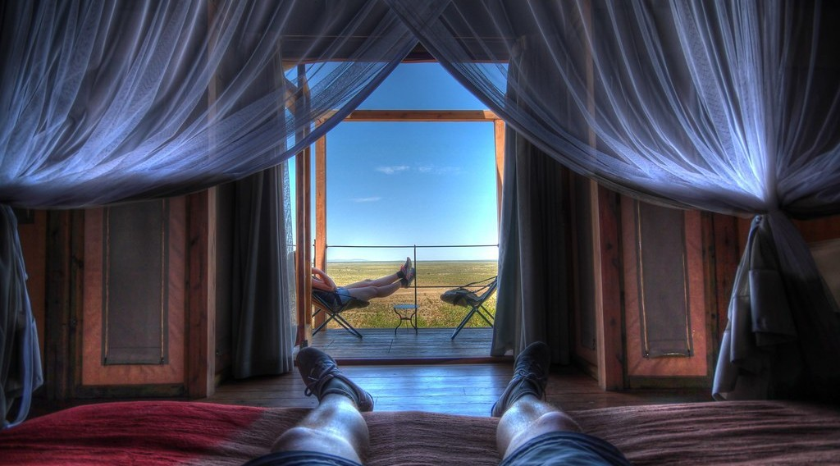
BOARD SUMMARY
6. Proposed Solutions
Health: Health centres and mosquito nets fight diseases.
Illustration: a mosquito net
Notes:
Copy the point on Health on the left, then draw the diagram on the right: a mosquito net. Give it a title and label it clearly.

Slide 52
BOARD SUMMARY
6. Proposed Solutions
Better farming: Fertilisers and improved seeds increase harvests.
Reforestation: People replant trees where the forest was cut.
Notes:
We continue with Proposed Solutions. On this slide we have Better farming and Reforestation. Write each point on a new line, with the key term first, and explain it in your own words when we revise.

Slide 53
FORMATIVE EVALUATION
Evaluation 1
Give two resources of the equatorial zone.
Notes:
Now let us check what you have understood. Question 1: Give two resources of the equatorial zone. Answer in your exercise book.

Slide 54
FORMATIVE EVALUATION
Expected Answer
Timber and farmland (cocoa).
Notes:
The expected answer is: timber and farmland (cocoa). If you got it right, well done.

Slide 55
FORMATIVE EVALUATION
Evaluation 2
What is bush fallowing?
Notes:
Now let us check what you have understood. Question 2: What is bush fallowing? Answer in your exercise book.

Slide 56
FORMATIVE EVALUATION
Expected Answer
Leaving land to rest for some years so that it becomes fertile again.
Notes:
The expected answer is: leaving land to rest for some years so that it becomes fertile again. If you got it right, well done.

Slide 57
REMEDIATION
Remediation
Fill in the blanks:
The equatorial zone is covered by a dense ______.
Moving from one farm to another is ______ cultivation.
Leaving land to rest is ______.
Notes:
For those who need more practice, fill in the blanks in your exercise book. The answers are: number 1, forest; number 2, shifting; number 3, fallowing.

Slide 58
HOMEWORK
Homework
Give two causes of deforestation in Cameroon.
Notes:
For your homework: Give two causes of deforestation in Cameroon. We shall correct it at the beginning of our next lesson.

Slide 59
NEXT LESSON
Next Lesson
Our next lesson will be on:
Further Study 1: Deforestation in Cameroon
Notes:
Our next lesson will be on Further Study 1: Deforestation in Cameroon. Thank you for your attention, and see you next time.

Slide 60
BILINGUAL GAME
Bilingual Game (Jeu Bilingue)
English | Français
Forest | La forêt
Timber | Le bois d'œuvre
Shifting cultivation | L'agriculture itinérante
Fallow | La jachère
Cocoa | Le cacao
Road | La route
Notes:
Let us play the bilingual game. I say a word in English, and you give me the French word. Then we do the reverse.

Slide 61
LOGBOOK
Official Logbook (1/2)
Module / Topic | Man in his Environment
Lesson Title | Lesson 3: Man in the Equatorial Zone
Expected Learning Outcomes | Locate the equatorial zone and describe its climate. Describe its resources and how they are exploited. Explain the problems faced and propose solutions.
Competence | Learners are able to describe how people use the resources of the equatorial zone and solve its problems.
Notes:
I record this information in the official logbook of the class after the lesson.

Slide 62
LOGBOOK
Official Logbook (2/2)
Matter Taught | DEFINITIONS; Location; Climatic Characteristics; Resources; Exploitation of Resources; Problems Faced; Proposed Solutions.
Evaluation | Formative evaluation and remediation exercise.
Homework | Give two causes of deforestation in Cameroon.
Enrolment / Present / Absent | ____ / ____ / ____
Achievement | To be completed after the lesson.
Notes:
I complete the second page of the logbook: the matter taught, the evaluation, the homework and the attendance.

Slide 63
TEACHER'S NOTE
Teacher's Note
Timing: Homework correction, plan, objectives 8 min | Recall, situation, action 10 min | 5 activities 30 min | Board summary (copying) 30 min | Evaluation, remediation 10 min | Homework, next lesson 5 min | Logbook 7 min
Without the projector (Activity 1): use the atlas.
Without the projector (Activity 2): write the data of Yaoundé.
Without the projector (Activity 3): list forest products.
Without the projector (Activity 4): describe the stages.
Without the projector (Activity 5): discuss problems of the South.
Notes:
This slide is for me, the teacher: it gives the timing of the lesson and what to do if the projector is not available.

Slide 64
REFERENCES
References
Geography Syllabus, Forms I–V, MINESEC (2023) — Form 2, Module 1: Man in his Environment.
Photo, Activity 3: “Logging truck, Cameroon” by World Resources, CC BY-NC-SA 2.0, via Flickr (https://www.flickr.com/photos/26107309@N05/4764354366)
Photo, Activity 4: “Slash and burn agriculture in the Amazon” by Matt-Zimmerman, CC BY 2.0, via Flickr (https://www.flickr.com/photos/16725630@N00/1524189000)
Photo, Activity 5: “Cameroon - UN Women's Gender Road Project” by UN Women Gallery, CC BY-NC-ND 2.0, via Flickr (https://www.flickr.com/photos/51431730@N04/40672356003)
Photo, board summary (Forest): “Amazon 11” by CIAT International Center for Tropical Agriculture, CC BY-SA 2.0, via Flickr (https://www.flickr.com/photos/38476503@N08/5641587148)
Photo, board summary (Plantations): “Farmer sun drying cocoa beans” by IITA Image Library, CC BY-NC 2.0, via Flickr (https://www.flickr.com/photos/45796762@N03/4598613756)
Photo, board summary (Health): “On Vacation in Africa” by orkomedix, CC BY-NC-SA 2.0, via Flickr (https://www.flickr.com/photos/30717090@N06/6741038415)
Notes:
Take your time to copy this part; we will continue together.

Slide 65
REFERENCES
References (continued)
Diagrams and animations: drawn for this lesson (Geography Department).
Notes:
These are the references and picture credits used to prepare this lesson.

