Slide 1
FORM 2
GEOGRAPHY
Further Study 5
Informal Sector Activities in African Cities
Notes:
Good morning, class, and welcome to our geography lesson. I am your geography teacher, Mr Kamdem. Today we are starting Further Study 5: Informal Sector Activities in African Cities.

Slide 2
CLASS INFO
Class, Chapter and Duration
Class | Form 2
Chapter | Module 2: Space Occupation
Duration | 2 periods (2 × 50 minutes)
Notes:
This lesson is for Form 2. It belongs to Module 2: Space Occupation. We shall need 2 periods to cover it.

Slide 3
IDENTIFICATION
Lesson Identification
Topic | Space Occupation
Sub-topic | Towns and Country Sides of Africa
Lesson | Further Study 5: Informal Sector Activities in African Cities
Notions / Concepts | Informal sector, small trade, self-employment, tax.
Syllabus focus | Types, general characteristics, importance and limitations of informal sector activities (small trades) in African cities.
Competence | Learners are able to describe the informal sector and judge its importance and its limits.
Notes:
Our topic is Space Occupation, and the sub-topic is Towns and Country Sides of Africa. The key notions we shall use today are: informal sector, small trade, self-employment, tax. At the end, you should be able to do this: learners are able to describe the informal sector and judge its importance and its limits.

Slide 4

HOMEWORK CORRECTION
Correction of the Homework
Question (Lesson 7: Towns in Africa):
List three informal activities in towns.
Notes:
Before we start the new lesson, let us correct the homework I gave you at the end of Lesson 7: Towns in Africa. The question was: List three informal activities in towns. Take out your exercise books.

Slide 5
HOMEWORK CORRECTION
Correction: Possible Answer
Moto-taxi driving, street selling and tailoring.
Notes:
Here is a good answer. Moto-taxi driving, street selling and tailoring. Compare it with your own answer and correct your work in red.

Slide 6
LESSON PLAN
Lesson Plan
Correction of the homework
Objectives and recall
Real-life situation and action to take
Learning activities
Board summary
Evaluation, remediation and homework
Notes:
Here is the plan of our lesson today. First, we shall correct the homework. Then we shall look at the objectives and recall what you already know. After that, we shall study a situation from real life and the action to take, and do the learning activities. Finally, we shall copy the board summary, do the evaluation and the remediation, and I will give you the homework.

Slide 7
OBJECTIVES
Objectives
By the end of this lesson, you should be able to:
Identify the types of informal activities.
Give their general characteristics.
Explain their importance and limitations.
Notes:
By the end of this lesson, you should be able to do three things. Number 1: identify the types of informal activities. Number 2: give their general characteristics. Number 3: explain their importance and limitations.

Slide 8
PREVIOUS KNOWLEDGE
Previous Knowledge
Many people in towns have small jobs.
Moto-taxis are common in Garoua.
The informal sector is not registered.
Notes:
Let us first remember what you already know. Many people in towns have small jobs. Moto-taxis are common in Garoua. The informal sector is not registered. Keep this in mind, because we shall build on it today.

Slide 9
REAL-LIFE SITUATION
Situation in Real Life
After failing to find an office job, Moussa buys a motorbike and becomes a moto-taxi driver in Garoua. He earns money every day, but after an accident he has no insurance to pay the hospital. He asks: "Is my small job a good solution or a trap?"
Notes:
Listen carefully to this situation from real life. After failing to find an office job, Moussa buys a motorbike and becomes a moto-taxi driver in Garoua. He earns money every day, but after an accident he has no insurance to pay the hospital. He asks: "Is my small job a good solution or a trap?" Think about it, because I am going to ask you some questions.

Slide 10
REAL-LIFE SITUATION
Situation: Question 1
What is the problem in the situation?
Notes:
Question 1: What is the problem in the situation? Think for a moment, then raise your hand to answer.

Slide 11
REAL-LIFE SITUATION
Answer
Moussa wonders whether his informal job is good for him, because it gives money but no protection.
Notes:
Good. Moussa wonders whether his informal job is good for him, because it gives money but no protection.

Slide 12
REAL-LIFE SITUATION
Situation: Question 2
What job does Moussa do?
Notes:
Question 2: What job does Moussa do? Think for a moment, then raise your hand to answer.

Slide 13
REAL-LIFE SITUATION
Answer
He is a moto-taxi driver.
Notes:
Good. He is a moto-taxi driver.

Slide 14
REAL-LIFE SITUATION
Situation: Question 3
Give one advantage and one limit of his job.
Notes:
Question 3: Give one advantage and one limit of his job. Think for a moment, then raise your hand to answer.

Slide 15
REAL-LIFE SITUATION
Possible Answer
He earns money every day; he has no insurance.
Notes:
Good. He earns money every day; he has no insurance.

Slide 16
ACTION TO TAKE
Action to Take
Encourage small traders to register and to save money.
Notes:
From this situation, the action we are working towards in this lesson is the following: encourage small traders to register and to save money.

Slide 17
JUSTIFICATION
Justification of the Lesson
This further study helps us to understand the small trades that feed many families.
Notes:
Why is this lesson important for you? This further study helps us to understand the small trades that feed many families.

Slide 18

1. TYPES
Activity 1
Moto-taxis.
Notes:
Activity 1. Look carefully at this picture: moto-taxis. Observe every detail before I ask the question.

Slide 19
1. TYPES
Activity 1: Question
To which type of informal activity do moto-taxis belong?
Notes:
Here is the question for Activity 1: To which type of informal activity do moto-taxis belong? Take one minute to think and write your answer in your rough notebook.

Slide 20
1. TYPES
Activity 1: Answer
Transport.
Notes:
Let us check the answer together. Transport.

Slide 21
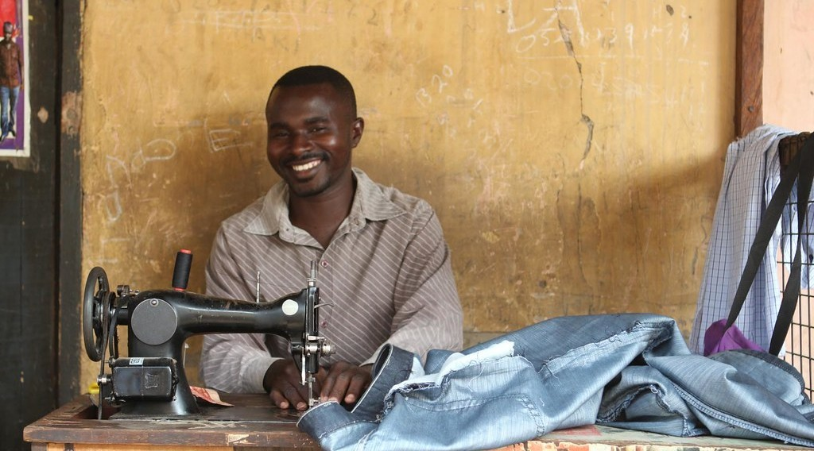
1. TYPES
Activity 2
A tailor at work.
Notes:
Activity 2. Look carefully at this picture: a tailor at work. Observe every detail before I ask the question.

Slide 22
1. TYPES
Activity 2: Question
To which type of informal activity does this tailor belong?
Notes:
Here is the question for Activity 2: To which type of informal activity does this tailor belong? Take one minute to think and write your answer in your rough notebook.

Slide 23
1. TYPES
Activity 2: Answer
Crafts (small workshops).
Notes:
Let us check the answer together. Crafts (small workshops).

Slide 24

2. CHARACTERISTICS
Activity 3
A street seller.
Notes:
Activity 3. Look carefully at this picture: a street seller. Observe every detail before I ask the question.

Slide 25
2. CHARACTERISTICS
Activity 3: Question
How much money does this seller need to start his business?
Notes:
Here is the question for Activity 3: How much money does this seller need to start his business? Take one minute to think and write your answer in your rough notebook.

Slide 26
2. CHARACTERISTICS
Activity 3: Answer
Very little: informal activities need small capital and little training.
Notes:
Let us check the answer together. Very little: informal activities need small capital and little training.

Slide 27

3. IMPORTANCE
Activity 4
A busy market.
Notes:
Activity 4. Look carefully at this picture: a busy market. Observe every detail before I ask the question.

Slide 28
3. IMPORTANCE
Activity 4: Question
Why do so many families depend on small trades?
Notes:
Here is the question for Activity 4: Why do so many families depend on small trades? Take one minute to think and write your answer in your rough notebook.

Slide 29
3. IMPORTANCE
Activity 4: Answer
They give jobs and daily income to people who cannot find other work.
Notes:
Let us check the answer together. They give jobs and daily income to people who cannot find other work.

Slide 30
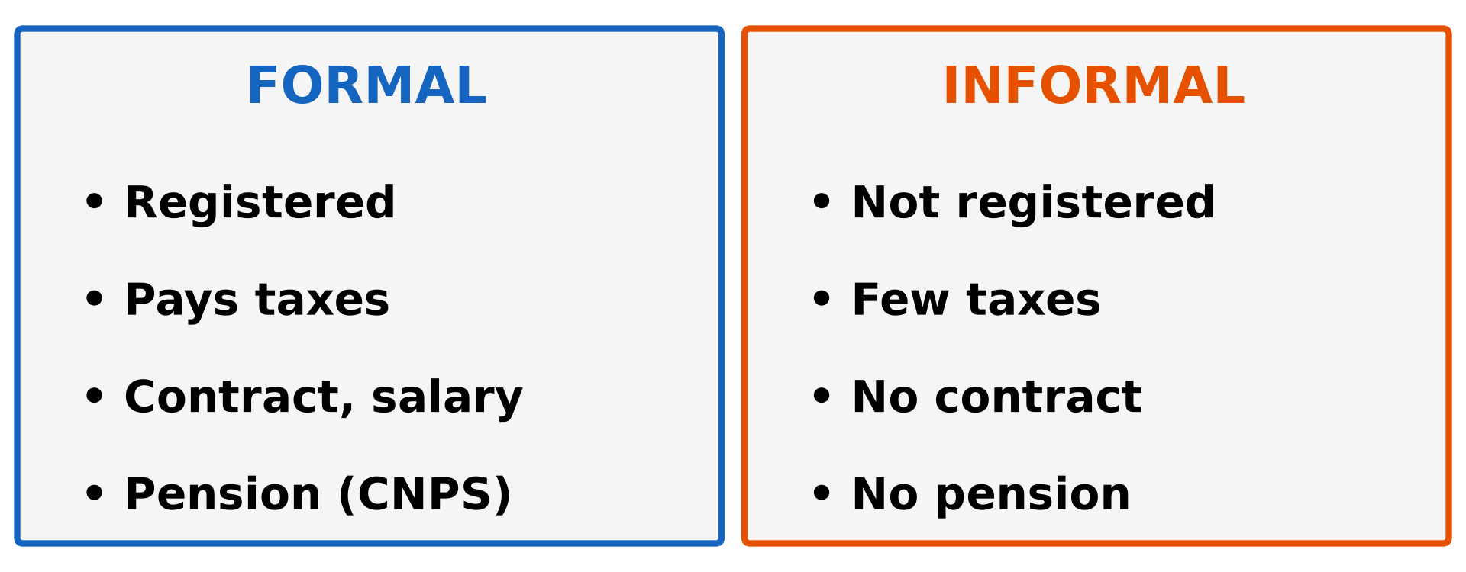
3. LIMITATIONS
Activity 5
Formal and informal sectors.
Notes:
Activity 5. Look carefully at this diagram: formal and informal sectors. Observe every detail before I ask the question.

Slide 31
3. LIMITATIONS
Activity 5: Question
What does the informal worker lack compared with the formal worker?
Notes:
Here is the question for Activity 5: What does the informal worker lack compared with the formal worker? Take one minute to think and write your answer in your rough notebook.

Slide 32
3. LIMITATIONS
Activity 5: Answer
A contract, a regular salary, insurance and a pension (CNPS).
Notes:
Let us check the answer together. A contract, a regular salary, insurance and a pension (CNPS).

Slide 33
BOARD SUMMARY
Board Summary
Topic: Space Occupation
Sub-topic: Towns and Country Sides of Africa
Further Study 5: Informal Sector Activities in African Cities
Notes:
Now we are going to copy the board summary. Write the title and the headings neatly in your notebooks. I will give you enough time for each slide, so do not rush.

Slide 34
BOARD SUMMARY
DEFINITIONS
The key terms of this lesson are defined as follows:
Informal sector: It is all the small economic activities that are not registered and do not pay taxes regularly.
Small trade: It is a small business run by one person or a family with little money.
Notes:
Let us copy the definitions. The key terms of this lesson are defined as follows. On this slide we have Informal sector and Small trade. Write each point on a new line, with the key term first, and explain it in your own words when we revise. When you finish, we go to the next slide.

Slide 35
BOARD SUMMARY
DEFINITIONS (continued)
Self-employment: It is working for oneself instead of working for an employer.
Notes:
We continue with the definitions. On this slide we have Self-employment. Write each point on a new line, with the key term first, and explain it in your own words when we revise.

Slide 36
BOARD SUMMARY
1. Types of Informal Activities
The main types of informal activities are the following:
Small trade: Street selling of food, fruits, clothes, fuel and phone credit.
Illustration: a street seller
Notes:
Let us copy Types of Informal Activities. The main types of informal activities are the following. Copy the point on Small trade on the left, then draw the diagram on the right: a street seller. Give it a title and label it clearly.

Slide 37
BOARD SUMMARY
1. Types of Informal Activities
Transport: Moto-taxis, clandestine taxis, push-carts and porters.
Illustration: moto-taxis
Notes:
Copy the point on Transport on the left, then draw the diagram on the right: moto-taxis. Give it a title and label it clearly.

Slide 38
BOARD SUMMARY
1. Types of Informal Activities
Crafts: Tailoring, carpentry, blacksmithing, pottery and hairdressing.
Illustration: a tailor
Notes:
Copy the point on Crafts on the left, then draw the diagram on the right: a tailor. Give it a title and label it clearly.

Slide 39
BOARD SUMMARY
1. Types of Informal Activities
Repairs: Repairing of cars, motorbikes, shoes, phones and radios.
Food services: Small restaurants (tourne-dos), roasted fish and maize, and drinks.
Notes:
We continue with Types of Informal Activities. On this slide we have Repairs and Food services. Write each point on a new line, with the key term first, and explain it in your own words when we revise.

Slide 40
BOARD SUMMARY
2. General Characteristics
Informal activities have the following characteristics:
Small capital: They need very little money to start.
No registration: They are not registered and pay few or no taxes.
Notes:
Let us copy General Characteristics. Informal activities have the following characteristics. On this slide we have Small capital and No registration. Write each point on a new line, with the key term first, and explain it in your own words when we revise. When you finish, we go to the next slide.

Slide 41
BOARD SUMMARY
2. General Characteristics (continued)
Little training: They are learnt on the job or by apprenticeship.
Family or self-employment: They are run by one person or a family, without a written contract.
Notes:
We continue with General Characteristics. On this slide we have Little training and Family or self-employment. Write each point on a new line, with the key term first, and explain it in your own words when we revise. When you finish, we go to the next slide.

Slide 42
BOARD SUMMARY
2. General Characteristics (continued)
Irregular income and place: Income changes every day, and many workers have no fixed place of work.
Notes:
We continue with General Characteristics. On this slide we have Irregular income and place. Write each point on a new line, with the key term first, and explain it in your own words when we revise.

Slide 43
BOARD SUMMARY
3. Importance of the Informal Sector
The informal sector is important for the following reasons:
Jobs: It employs most of the workers in African cities, especially young people.
Illustration: a busy market
Notes:
Let us copy Importance of the Informal Sector. The informal sector is important for the following reasons. Copy the point on Jobs on the left, then draw the diagram on the right: a busy market. Give it a title and label it clearly.

Slide 44
BOARD SUMMARY
3. Importance of the Informal Sector
Income: It gives daily income to families and reduces poverty.
Cheap goods and services: It provides food, transport and repairs at low prices.
Training: Apprentices learn a trade in workshops.
Notes:
We continue with Importance of the Informal Sector. On this slide we have Income, Cheap goods and services and Training. Write each point on a new line, with the key term first, and explain it in your own words when we revise. When you finish, we go to the next slide.

Slide 45
BOARD SUMMARY
3. Importance of the Informal Sector (continued)
Links with the countryside: Traders sell farm products from the villages in the town.
Notes:
We continue with Importance of the Informal Sector. On this slide we have Links with the countryside. Write each point on a new line, with the key term first, and explain it in your own words when we revise.

Slide 46
BOARD SUMMARY
4. Limitations of the Informal Sector
The informal sector has the following limitations:
No social protection: Workers have no insurance, no pension and no paid leave.
Illustration: formal and informal sectors
Notes:
Let us copy Limitations of the Informal Sector. The informal sector has the following limitations. Copy the point on No social protection on the left, then draw the diagram on the right: formal and informal sectors. Give it a title and label it clearly.

Slide 47
BOARD SUMMARY
4. Limitations of the Informal Sector
Low and irregular income: Incomes are small and change from day to day.
Loss of taxes: The state and the councils lose money because taxes are not paid.
Disorder and pollution: Streets become crowded, dirty and dangerous.
Notes:
We continue with Limitations of the Informal Sector. On this slide we have Low and irregular income, Loss of taxes and Disorder and pollution. Write each point on a new line, with the key term first, and explain it in your own words when we revise. When you finish, we go to the next slide.

Slide 48
BOARD SUMMARY
4. Limitations of the Informal Sector (continued)
Accidents and poor quality: Moto-taxi accidents are frequent, and some goods and services are of poor quality.
Notes:
We continue with Limitations of the Informal Sector. On this slide we have Accidents and poor quality. Write each point on a new line, with the key term first, and explain it in your own words when we revise.

Slide 49
FORMATIVE EVALUATION
Evaluation 1
Give two characteristics of informal activities.
Notes:
Now let us check what you have understood. Question 1: Give two characteristics of informal activities. Answer in your exercise book.

Slide 50
FORMATIVE EVALUATION
Expected Answer
Little capital and no registration.
Notes:
The expected answer is: little capital and no registration. If you got it right, well done.

Slide 51
FORMATIVE EVALUATION
Evaluation 2
Give one importance and one limitation.
Notes:
Now let us check what you have understood. Question 2: Give one importance and one limitation. Answer in your exercise book.

Slide 52
FORMATIVE EVALUATION
Expected Answer
It gives jobs; workers have no pension.
Notes:
The expected answer is: it gives jobs; workers have no pension. If you got it right, well done.

Slide 53
REMEDIATION
Remediation
Fill in the blanks:
Informal activities are not ______.
A moto-taxi driver works in the ______ sector.
Informal workers often have no ______.
Notes:
For those who need more practice, fill in the blanks in your exercise book. The answers are: number 1, registered; number 2, informal; number 3, pension (or insurance).

Slide 54
HOMEWORK
Homework
Name the headquarters of the North and Far North Regions.
Notes:
For your homework: Name the headquarters of the North and Far North Regions. We shall correct it at the beginning of our next lesson.

Slide 55
NEXT LESSON
Next Lesson
Our next lesson will be on:
Practical Work 4: Location of the Regional and Divisional Headquarters of Cameroon
Notes:
Our next lesson will be on Practical Work 4: Location of the Regional and Divisional Headquarters of Cameroon. Thank you for your attention, and see you next time.

Slide 56
BILINGUAL GAME
Bilingual Game (Jeu Bilingue)
English | Français
Informal sector | Le secteur informel
Small trade | Le petit commerce
Tax | L'impôt
Income | Le revenu
Craftsman | L'artisan
Pension | La retraite
Notes:
Let us play the bilingual game. I say a word in English, and you give me the French word. Then we do the reverse.

Slide 57
LOGBOOK
Official Logbook (1/2)
Module / Topic | Space Occupation
Lesson Title | Further Study 5: Informal Sector Activities in African Cities
Expected Learning Outcomes | Identify the types of informal activities. Give their general characteristics. Explain their importance and limitations.
Competence | Learners are able to describe the informal sector and judge its importance and its limits.
Notes:
I record this information in the official logbook of the class after the lesson.

Slide 58
LOGBOOK
Official Logbook (2/2)
Matter Taught | DEFINITIONS; Types of Informal Activities; General Characteristics; Importance of the Informal Sector; Limitations of the Informal Sector.
Evaluation | Formative evaluation and remediation exercise.
Homework | Name the headquarters of the North and Far North Regions.
Enrolment / Present / Absent | ____ / ____ / ____
Achievement | To be completed after the lesson.
Notes:
I complete the second page of the logbook: the matter taught, the evaluation, the homework and the attendance.

Slide 59
TEACHER'S NOTE
Teacher's Note
Timing: Homework correction, plan, objectives 8 min | Recall, situation, action 10 min | 5 activities 30 min | Board summary (copying) 30 min | Evaluation, remediation 10 min | Homework, next lesson 5 min | Logbook 7 min
Without the projector (Activity 1): list small trades.
Without the projector (Activity 2): name craftsmen of the quarter.
Without the projector (Activity 3): interview a seller.
Without the projector (Activity 4): discuss in groups.
Without the projector (Activity 5): compare with a civil servant.
Notes:
This slide is for me, the teacher: it gives the timing of the lesson and what to do if the projector is not available.

Slide 60
REFERENCES
References
Geography Syllabus, Forms I–V, MINESEC (2023) — Form 2, Module 2: Space Occupation.
Photo, Activity 1: “Cameroon - UN Women's Gender Road Project” by UN Women Gallery, CC BY-NC-ND 2.0, via Flickr (https://www.flickr.com/photos/51431730@N04/47586053052)
Photo, Activity 2: “A tailor of Wa” by 10b travelling / Carsten ten Brink, CC BY-NC-ND 2.0, via Flickr (https://www.flickr.com/photos/77334245@N00/8154947468)
Photo, Activity 3: “Roadside vendor roasts maize cobs for sale in Timau” by CIMMYT, CC BY-NC 2.0, via Flickr (https://www.flickr.com/photos/44760652@N05/25375356457)
Photo, Activity 4: “Sandga Market in Douala, Cameroon” by The Advocacy Project, CC BY-NC-SA 2.0, via Flickr (https://www.flickr.com/photos/42487558@N00/3636438732)
Diagrams and animations: drawn for this lesson (Geography Department).
Notes:
These are the references and picture credits used to prepare this lesson.

