Slide 1
FORM 2 TECHNICAL
GEOGRAPHY
Lesson 2 (Part 4)
The Tropical Grassland Region: Human Activities
Notes:
Good morning, class, and welcome to our geography lesson. I am your geography teacher, Mr Kamdem. Today we are starting Lesson 2 (Part 4): The Tropical Grassland Region: Human Activities.

Slide 2
CLASS INFO
Class, Chapter and Duration
Class | Form 2 Technical
Chapter | Economic Geography — Natural Regions: 2. The Tropical Grassland Region
Duration | 2 periods (2 × 50 minutes)
Notes:
This lesson is for Form 2 Technical. It belongs to Economic Geography — Natural Regions: 2. The Tropical Grassland Region. We shall need 2 periods to cover it.

Slide 3
IDENTIFICATION
Lesson Identification
Topic | Man in His Environment
Sub-topic | Natural Regions
Lesson | Lesson 2 (Part 4): The Tropical Grassland Region: Human Activities
Notions / Concepts | Crop farming, cash crop, food crop, livestock rearing, nomadic pastoralism, transhumance, hunting.
Syllabus focus | Human activities of the Tropical Grassland region: farming, livestock rearing, hunting, lumbering and others.
Competence | Learners are able to describe the work of farmers and herders around them and explain why herders move with their animals.
Notes:
Our topic is Man in His Environment, and the sub-topic is Natural Regions. The key notions we shall use today are: crop farming, cash crop, food crop, livestock rearing, nomadic pastoralism, transhumance, hunting. At the end, you should be able to do this: learners are able to describe the work of farmers and herders around them and explain why herders move with their animals.

Slide 4

HOMEWORK CORRECTION
Correction of the Homework
Question (Lesson 2 (Part 3): The Tropical Grassland Region: Types of Resources and Methods of Exploitation):
Define transhumance.
Notes:
Before we start the new lesson, let us correct the homework I gave you at the end of Lesson 2 (Part 3): The Tropical Grassland Region: Types of Resources and Methods of Exploitation. The question was: Define transhumance. Take out your exercise books.

Slide 5
HOMEWORK CORRECTION
Correction: Possible Answer
It is the seasonal movement of herders and their animals.
Notes:
Here is a good answer. It is the seasonal movement of herders and their animals. Compare it with your own answer and correct your work in red.

Slide 6
LESSON PLAN
Lesson Plan
Correction of the homework
Objectives and recall
Real-life situation and action to take
Learning activities
Board summary
Evaluation, remediation and homework
Notes:
Here is the plan of our lesson today. First, we shall correct the homework. Then we shall look at the objectives and recall what you already know. After that, we shall study a situation from real life and the action to take, and do the learning activities. Finally, we shall copy the board summary, do the evaluation and the remediation, and I will give you the homework.

Slide 7
OBJECTIVES
Objectives
By the end of this lesson, you should be able to:
Describe crop farming in the Tropical Grassland region.
Describe livestock rearing, including nomadic pastoralism and transhumance.
Notes:
Take your time to copy this part; we will continue together.

Slide 8
OBJECTIVES
Objectives (continued)
Describe hunting, fishing and wood cutting in the Tropical Grassland region.
Notes:
By the end of this lesson, you should be able to do three things. Number 1: describe crop farming in the Tropical Grassland region. Number 2: describe livestock rearing, including nomadic pastoralism and transhumance. Number 3: describe hunting, fishing and wood cutting in the Tropical Grassland region.

Slide 9
PREVIOUS KNOWLEDGE
Previous Knowledge
The resources of the savanna are pasture, farmland, wildlife, water and trees.
People exploit them by farming, livestock rearing, tourism, fishing and cutting trees.
Notes:
Let us first remember what you already know. The resources of the savanna are pasture, farmland, wildlife, water and trees. People exploit them by farming, livestock rearing, tourism, fishing and cutting trees. Keep this in mind, because we shall build on it today.

Slide 10
REAL-LIFE SITUATION
Situation in Real Life
Every year in November, Adamou, a Fulani herder, leaves his village near Garoua with his cattle.
He walks south for weeks and comes back when the rains return.
His classmate Paul thinks that Adamou is lost.
Notes:
Take your time to copy this part; we will continue together.

Slide 11
REAL-LIFE SITUATION
Situation in Real Life (continued)
"
Notes:
Listen carefully to this situation from real life. Every year in November, Adamou, a Fulani herder, leaves his village near Garoua with his cattle. He walks south for weeks and comes back when the rains return. His classmate Paul thinks that Adamou is lost. Paul asks: "Why does Adamou move with his cattle, and what other work do people do in the savanna?" Think about it, because I am going to ask you some questions.

Slide 12
REAL-LIFE SITUATION
Situation: Question 1
What is the problem in the situation?
Notes:
Question 1: What is the problem in the situation? Think for a moment, then raise your hand to answer.

Slide 13
REAL-LIFE SITUATION
Answer
Paul does not understand why the herder moves and what activities people do in the savanna.
Notes:
Good. Paul does not understand why the herder moves and what activities people do in the savanna.

Slide 14
REAL-LIFE SITUATION
Situation: Question 2
When does Adamou leave?
Notes:
Question 2: When does Adamou leave? Think for a moment, then raise your hand to answer.

Slide 15
REAL-LIFE SITUATION
Answer
In November, at the start of the dry season.
Notes:
Good. In November, at the start of the dry season.

Slide 16
REAL-LIFE SITUATION
Situation: Question 3
When does he come back?
Notes:
Question 3: When does he come back? Think for a moment, then raise your hand to answer.

Slide 17
REAL-LIFE SITUATION
Possible Answer
When the rains return.
Notes:
Good. When the rains return.

Slide 18
ACTION TO TAKE
Action to Take
Respect the work of farmers and herders and help them live in peace.
Notes:
From this situation, the action we are working towards in this lesson is the following: respect the work of farmers and herders and help them live in peace.

Slide 19
JUSTIFICATION
Justification of the Lesson
This lesson helps us to know the work of the people of the savanna.
Notes:
Why is this lesson important for you? This lesson helps us to know the work of the people of the savanna.

Slide 20

1. FARMING
Activity 1
Harvesting cotton.
Notes:
Activity 1. Look carefully at this picture: harvesting cotton. Observe every detail before I ask the question.

Slide 21
1. FARMING
Activity 1: Question
What do we call a crop that is grown to be sold?
Notes:
Here is the question for Activity 1: What do we call a crop that is grown to be sold? Take one minute to think and write your answer in your rough notebook.

Slide 22
1. FARMING
Activity 1: Answer
A cash crop.
Notes:
Let us check the answer together. A cash crop.

Slide 23

1. FARMING
Activity 2
A rice field.
Notes:
Activity 2. Look carefully at this picture: a rice field. Observe every detail before I ask the question.

Slide 24
1. FARMING
Activity 2: Question
How do farmers bring water to their fields in the dry savanna?
Notes:
Here is the question for Activity 2: How do farmers bring water to their fields in the dry savanna? Take one minute to think and write your answer in your rough notebook.

Slide 25
1. FARMING
Activity 2: Answer
By irrigation from rivers and dams.
Notes:
Let us check the answer together. By irrigation from rivers and dams.

Slide 26
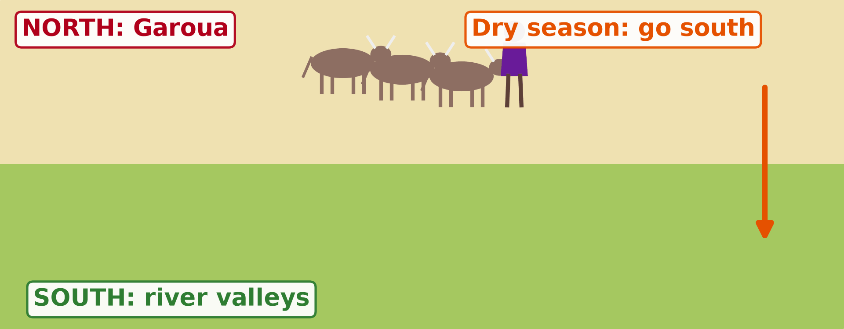
2. LIVESTOCK REARING
Activity 3
Animation: herders move with the seasons.
Notes:
Activity 3. Look carefully at this animation: animation: herders move with the seasons. Watch the animation to the end; it will play again.

Slide 27
2. LIVESTOCK REARING
Activity 3: Question
Where does the herder go in the dry season?
Notes:
Here is the question for Activity 3: Where does the herder go in the dry season? Take one minute to think and write your answer in your rough notebook.

Slide 28
2. LIVESTOCK REARING
Activity 3: Answer
To the south, where there is grass and water.
Notes:
Let us check the answer together. To the south, where there is grass and water.

Slide 29
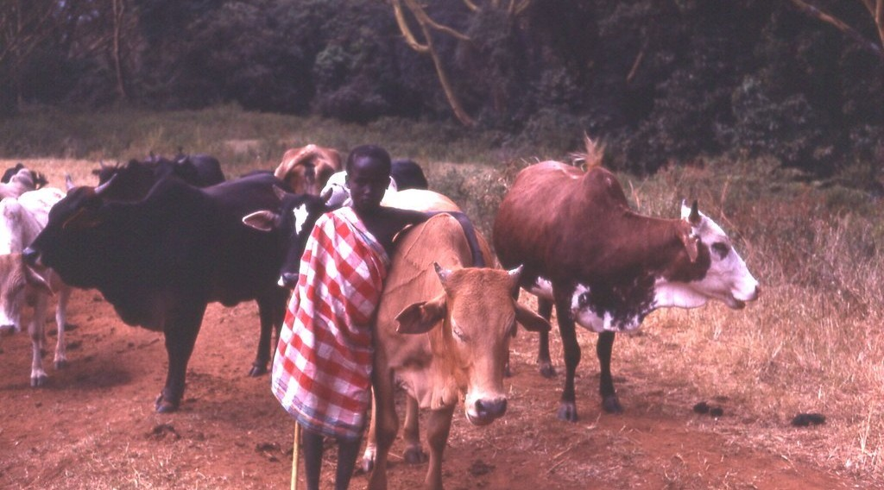
2. LIVESTOCK REARING
Activity 4
Herders with cattle.
Notes:
Activity 4. Look carefully at this picture: herders with cattle. Observe every detail before I ask the question.

Slide 30
2. LIVESTOCK REARING
Activity 4: Question
Why are cattle important for herders?
Notes:
Here is the question for Activity 4: Why are cattle important for herders? Take one minute to think and write your answer in your rough notebook.

Slide 31
2. LIVESTOCK REARING
Activity 4: Answer
They give milk, meat and money.
Notes:
Let us check the answer together. They give milk, meat and money.

Slide 32

3. OTHER ACTIVITIES
Activity 5
Fishermen.
Notes:
Activity 5. Look carefully at this picture: fishermen. Observe every detail before I ask the question.

Slide 33
3. OTHER ACTIVITIES
Activity 5: Question
Give one other activity of the people of the savanna.
Notes:
Here is the question for Activity 5: Give one other activity of the people of the savanna. Take one minute to think and write your answer in your rough notebook.

Slide 34
3. OTHER ACTIVITIES
Activity 5: Answer
Fishing (also hunting, tourism and cutting wood).
Notes:
Let us check the answer together. Fishing (also hunting, tourism and cutting wood).

Slide 35
BOARD SUMMARY
Board Summary
Topic: Man in His Environment
Sub-topic: Natural Regions
Lesson 2 (Part 4): The Tropical Grassland Region: Human Activities
Notes:
Now we are going to copy the board summary. Write the title and the headings neatly in your notebooks. I will give you enough time for each slide, so do not rush.

Slide 36
BOARD SUMMARY
DEFINITIONS
The key terms of this lesson are defined as follows:
Cash crop: It is a crop grown to be sold.
Transhumance: It is the seasonal movement of herders and their animals.
Notes:
Let us copy the definitions. The key terms of this lesson are defined as follows. On this slide we have Cash crop and Transhumance. Write each point on a new line, with the key term first, and explain it in your own words when we revise.

Slide 37
BOARD SUMMARY
1. Farming
Farming in the savanna has the following forms:
Food crops: Maize, sorghum, millet and groundnuts.
Notes:
Let us copy Farming. Farming in the savanna has the following forms. On this slide we have Food crops. Write each point on a new line, with the key term first, and explain it in your own words when we revise.

Slide 38
BOARD SUMMARY
1. Farming
Cash crops: Cotton, bought by SODECOTON.
Illustration: harvesting cotton
Notes:
Copy the point on Cash crops on the left, then draw the diagram on the right: harvesting cotton. Give it a title and label it clearly.

Slide 39
BOARD SUMMARY
1. Farming
Irrigated farming: Rice and onions near rivers and dams.
Illustration: a rice field
Notes:
Copy the point on Irrigated farming on the left, then draw the diagram on the right: a rice field. Give it a title and label it clearly.

Slide 40
BOARD SUMMARY
2. Livestock Rearing
Livestock rearing has the following forms:
Nomadic pastoralism: Herders move all the time with their animals.
Notes:
Let us copy Livestock Rearing. Livestock rearing has the following forms. On this slide we have Nomadic pastoralism. Write each point on a new line, with the key term first, and explain it in your own words when we revise.

Slide 41
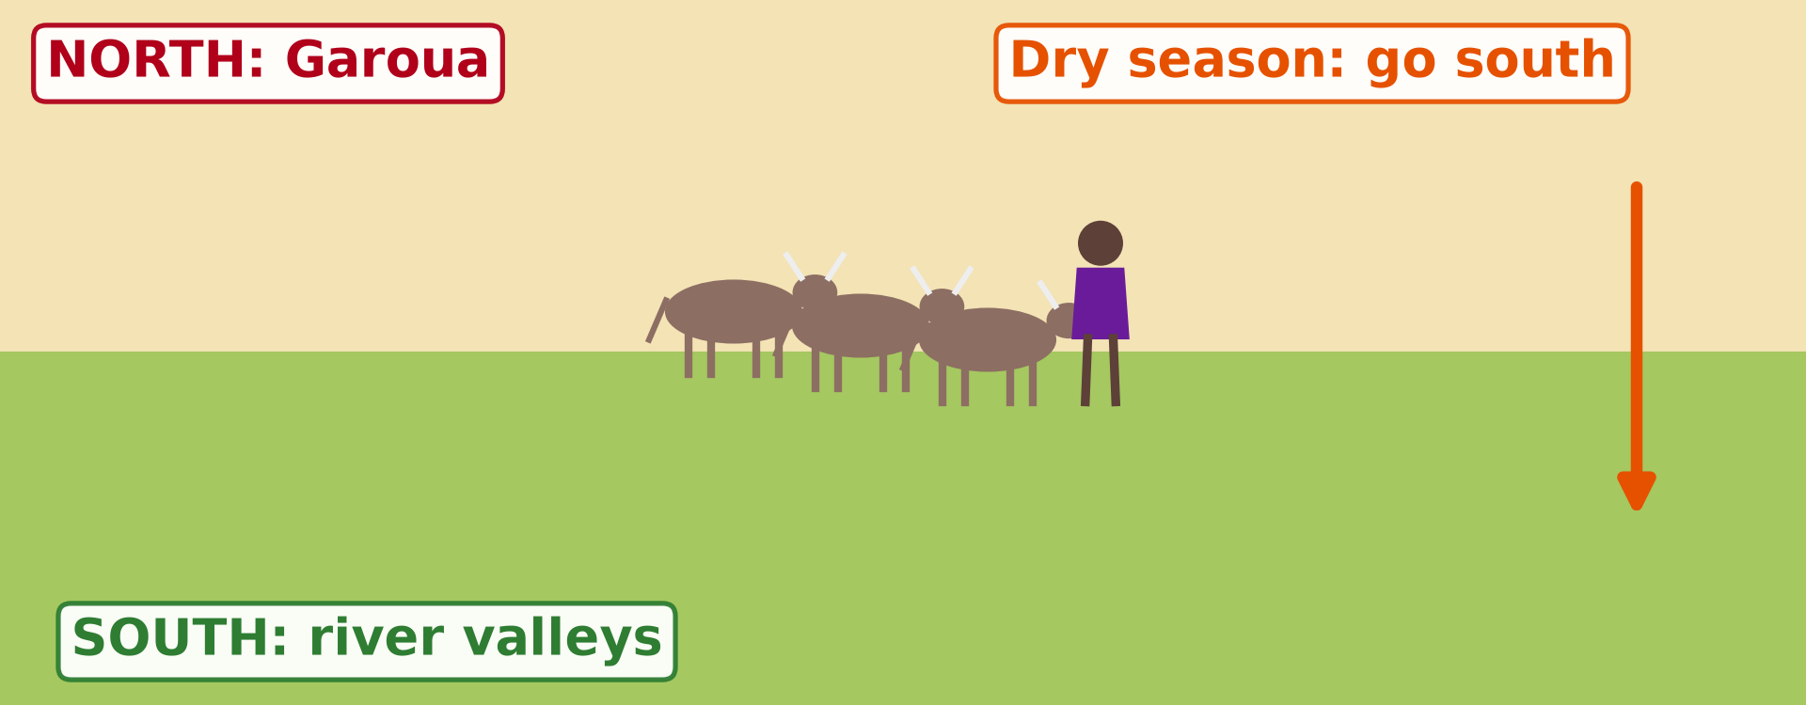
BOARD SUMMARY
2. Livestock Rearing
Transhumance: Herders move south in the dry season and return in the rainy season.
Illustration: transhumance
Notes:
Copy the point on Transhumance on the left, then draw the diagram on the right: transhumance. Give it a title and label it clearly.

Slide 42
BOARD SUMMARY
2. Livestock Rearing
Ranching: Animals are reared on large, fenced farms.
Notes:
We continue with Livestock Rearing. On this slide we have Ranching. Write each point on a new line, with the key term first, and explain it in your own words when we revise.

Slide 43
BOARD SUMMARY
3. Other Activities
People also carry out the following activities:
Hunting: Controlled hunting in hunting zones.
Notes:
Let us copy Other Activities. People also carry out the following activities. On this slide we have Hunting. Write each point on a new line, with the key term first, and explain it in your own words when we revise.

Slide 44
BOARD SUMMARY
3. Other Activities
Fishing: In the Benue and the Lagdo lake.
Illustration: fishing
Notes:
Copy the point on Fishing on the left, then draw the diagram on the right: fishing. Give it a title and label it clearly.

Slide 45
BOARD SUMMARY
3. Other Activities
Lumbering: Cutting wood for fuel and building.
Tourism: Visits to national parks.
Notes:
We continue with Other Activities. On this slide we have Lumbering and Tourism. Write each point on a new line, with the key term first, and explain it in your own words when we revise.

Slide 46
FORMATIVE EVALUATION
Evaluation 1
What is the difference between a food crop and a cash crop?
Notes:
Now let us check what you have understood. Question 1: What is the difference between a food crop and a cash crop? Answer in your exercise book.

Slide 47
FORMATIVE EVALUATION
Expected Answer
A food crop feeds the family; a cash crop is sold.
Notes:
The expected answer is: a food crop feeds the family; a cash crop is sold. If you got it right, well done.

Slide 48
FORMATIVE EVALUATION
Evaluation 2
What is transhumance?
Notes:
Now let us check what you have understood. Question 2: What is transhumance? Answer in your exercise book.

Slide 49
FORMATIVE EVALUATION
Expected Answer
The movement of herders with their animals between seasons.
Notes:
The expected answer is: the movement of herders with their animals between seasons. If you got it right, well done.

Slide 50
REMEDIATION
Remediation
Fill in the blanks:
Cotton is a ______ crop.
The movement of herders between seasons is called ______.
Bringing water to the fields is called ______.
Notes:
For those who need more practice, fill in the blanks in your exercise book. The answers are: number 1, cash; number 2, transhumance; number 3, irrigation.

Slide 51
HOMEWORK
Homework
Give two problems of the savanna.
Notes:
For your homework: Give two problems of the savanna. We shall correct it at the beginning of our next lesson.

Slide 52
NEXT LESSON
Next Lesson
Our next lesson will be on:
Lesson 2 (Part 5): The Tropical Grassland Region: Problems Faced and Attempted Solutions
Notes:
Our next lesson will be on Lesson 2 (Part 5): The Tropical Grassland Region: Problems Faced and Attempted Solutions. Thank you for your attention, and see you next time.

Slide 53
BILINGUAL GAME
Bilingual Game (Jeu Bilingue)
English | Français
Cash crop | La culture de rente
Food crop | La culture vivrière
Herder | L'éleveur
Cattle | Les bovins
Transhumance | La transhumance
Nomadic | Nomade
Hunting | La chasse
Firewood | Le bois de chauffe
Notes:
Let us play the bilingual game. I say a word in English, and you give me the French word. Then we do the reverse.

Slide 54
LOGBOOK
Official Logbook (1/2)
Module / Topic | Man in His Environment
Lesson Title | Lesson 2 (Part 4): The Tropical Grassland Region: Human Activities
Expected Learning Outcomes | Describe crop farming in the Tropical Grassland region. Describe livestock rearing, including nomadic pastoralism and transhumance. Describe hunting, fishing and wood cutting in the Tropical Grassland region.
Competence | Learners are able to describe the work of farmers and herders around them and explain why herders move with their animals.
Notes:
I record this information in the official logbook of the class after the lesson.

Slide 55
LOGBOOK
Official Logbook (2/2)
Matter Taught | DEFINITIONS; Farming; Livestock Rearing; Other Activities.
Evaluation | Formative evaluation and remediation exercise.
Homework | Give two problems of the savanna.
Enrolment / Present / Absent | ____ / ____ / ____
Achievement | To be completed after the lesson.
Notes:
I complete the second page of the logbook: the matter taught, the evaluation, the homework and the attendance.

Slide 56
TEACHER'S NOTE
Teacher's Note
Timing: Homework correction, plan, objectives 8 min | Recall, situation, action 10 min | 5 activities 30 min | Board summary (copying) 30 min | Evaluation, remediation 10 min | Homework, next lesson 5 min | Logbook 7 min
SODECOTON buys the cotton of North Cameroon; SEMRY manages the irrigated rice fields of Yagoua.
Activity 3 is an animation (GIF): it plays automatically in slide-show mode.
Without the projector (Activity 1): name cash crops of the North.
Without the projector (Activity 2): describe rice fields near Lagdo.
Without the projector (Activity 3): draw arrows on a map.
Without the projector (Activity 4): ask about cattle markets.
Without the projector (Activity 5): list jobs of the area.
Notes:
This slide is for me, the teacher: it gives the timing of the lesson and what to do if the projector is not available.

Slide 57
REFERENCES
References
Harmonised Progression Sheet, Economic Geography (5051), Form 2.
Class textbook: The major biomes of the world (tropical grassland).
Photo, Activity 1: “Cotton harvest” by CIFOR, CC BY-NC-ND 2.0, via Flickr (https://www.flickr.com/photos/45423546@N07/35706862552)
Photo, Activity 2: “Irrigated rice fields in Sefula, Zambia. Photo by Kate Longley, 2013.” by WorldFish, CC BY-NC-ND 2.0, via Flickr (https://www.flickr.com/photos/61545321@N06/8608804590)
Photo, Activity 4: “Young Maasai herder, Kenya, 1979” by gbaku, CC BY-SA 2.0, via Flickr (https://www.flickr.com/photos/72105154@N00/482990998)
Photo, Activity 5: “Fishermen, Lake Tana” by A.Davey, CC BY 2.0, via Flickr (https://www.flickr.com/photos/40595948@N00/2260748777)
Diagrams and animations: drawn for this lesson (Geography Department).
Notes:
These are the references and picture credits used to prepare this lesson.

