Slide 1
FORM 2 TECHNICAL
GEOGRAPHY
Lesson 5 (Part 3)
The Sectors of the Economy: The Primary Sector (Definition and Examples)
Notes:
Good morning, class, and welcome to our geography lesson. I am your geography teacher, Mr Kamdem. Today we are starting Lesson 5 (Part 3): The Sectors of the Economy: The Primary Sector (Definition and Examples).

Slide 2
CLASS INFO
Class, Chapter and Duration
Class | Form 2 Technical
Chapter | Economic Geography — Sectors of the Economy
Duration | 2 periods (2 × 50 minutes)
Notes:
This lesson is for Form 2 Technical. It belongs to Economic Geography — Sectors of the Economy. We shall need 2 periods to cover it.

Slide 3
IDENTIFICATION
Lesson Identification
Topic | Economic Activities
Sub-topic | Sectors of the Economy
Lesson | Lesson 5 (Part 3): The Sectors of the Economy: The Primary Sector (Definition and Examples)
Notions / Concepts | Primary sector, agriculture, livestock rearing, fishing, forestry, mining.
Syllabus focus | Definition and examples of the primary sector, with examples from Cameroon.
Competence | Learners are able to identify primary activities around them and explain their importance for food and exports.
Notes:
Our topic is Economic Activities, and the sub-topic is Sectors of the Economy. The key notions we shall use today are: primary sector, agriculture, livestock rearing, fishing, forestry, mining. At the end, you should be able to do this: learners are able to identify primary activities around them and explain their importance for food and exports.

Slide 4

HOMEWORK CORRECTION
Correction of the Homework
Question (Lesson 5 (Part 2): The Sectors of the Economy: Formal and Informal Sectors of the Economy):
Give three primary activities.
Notes:
Before we start the new lesson, let us correct the homework I gave you at the end of Lesson 5 (Part 2): The Sectors of the Economy: Formal and Informal Sectors of the Economy. The question was: Give three primary activities. Take out your exercise books.

Slide 5
HOMEWORK CORRECTION
Correction: Possible Answer
Farming, fishing and mining.
Notes:
Here is a good answer. Farming, fishing and mining. Compare it with your own answer and correct your work in red.

Slide 6
LESSON PLAN
Lesson Plan
Correction of the homework
Objectives and recall
Real-life situation and action to take
Learning activities
Board summary
Evaluation, remediation and homework
Notes:
Here is the plan of our lesson today. First, we shall correct the homework. Then we shall look at the objectives and recall what you already know. After that, we shall study a situation from real life and the action to take, and do the learning activities. Finally, we shall copy the board summary, do the evaluation and the remediation, and I will give you the homework.

Slide 7
OBJECTIVES
Objectives
By the end of this lesson, you should be able to:
Define the primary sector.
Name the main primary activities.
Give examples of primary activities in Cameroon and explain their importance.
Notes:
By the end of this lesson, you should be able to do three things. Number 1: define the primary sector. Number 2: name the main primary activities. Number 3: give examples of primary activities in Cameroon and explain their importance.

Slide 8
PREVIOUS KNOWLEDGE
Previous Knowledge
The formal sector is registered and pays taxes; the informal sector is not registered.
Both sectors exist in primary, secondary and tertiary activities.
Notes:
Let us first remember what you already know. The formal sector is registered and pays taxes; the informal sector is not registered. Both sectors exist in primary, secondary and tertiary activities. Keep this in mind, because we shall build on it today.

Slide 9
REAL-LIFE SITUATION
Situation in Real Life
In the Garoua market, Rahila sees maize from Pitoa, fish from the Lagdo lake, beef from the Adamawa and firewood from the bush. Her mother says: "All these come from nature." Rahila asks: "What do we call the work of taking things from nature?"
Notes:
Listen carefully to this situation from real life. In the Garoua market, Rahila sees maize from Pitoa, fish from the Lagdo lake, beef from the Adamawa and firewood from the bush. Her mother says: "All these come from nature." Rahila asks: "What do we call the work of taking things from nature?" Think about it, because I am going to ask you some questions.

Slide 10
REAL-LIFE SITUATION
Situation: Question 1
What is the problem in the situation?
Notes:
Question 1: What is the problem in the situation? Think for a moment, then raise your hand to answer.

Slide 11
REAL-LIFE SITUATION
Answer
Rahila does not know the name of the sector that takes products from nature.
Notes:
Good. Rahila does not know the name of the sector that takes products from nature.

Slide 12
REAL-LIFE SITUATION
Situation: Question 2
Where does the fish come from?
Notes:
Question 2: Where does the fish come from? Think for a moment, then raise your hand to answer.

Slide 13
REAL-LIFE SITUATION
Answer
From the Lagdo lake.
Notes:
Good. From the Lagdo lake.

Slide 14
REAL-LIFE SITUATION
Situation: Question 3
Where does the beef come from?
Notes:
Question 3: Where does the beef come from? Think for a moment, then raise your hand to answer.

Slide 15
REAL-LIFE SITUATION
Possible Answer
From the Adamawa.
Notes:
Good. From the Adamawa.

Slide 16
ACTION TO TAKE
Action to Take
Respect farmers, herders and fishermen, who feed the nation.
Notes:
From this situation, the action we are working towards in this lesson is the following: respect farmers, herders and fishermen, who feed the nation.

Slide 17
JUSTIFICATION
Justification of the Lesson
This lesson helps us to know the jobs that take products from nature.
Notes:
Why is this lesson important for you? This lesson helps us to know the jobs that take products from nature.

Slide 18
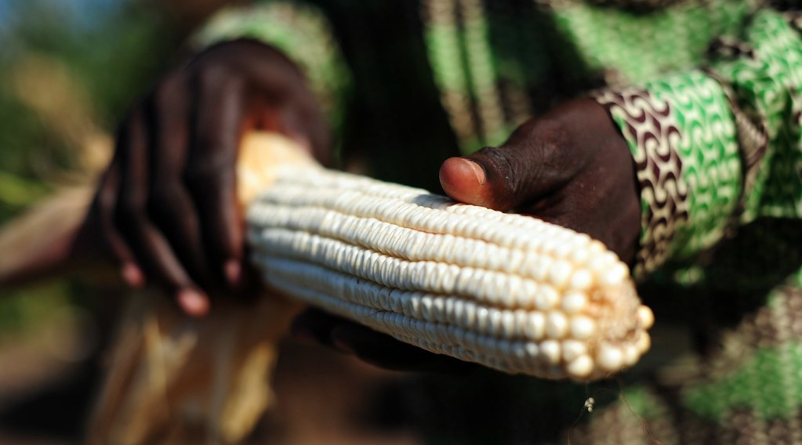
DEFINITION
Activity 1
A maize farmer.
Notes:
Activity 1. Look carefully at this picture: a maize farmer. Observe every detail before I ask the question.

Slide 19
DEFINITION
Activity 1: Question
The farmer takes food from nature. Which sector is this?
Notes:
Here is the question for Activity 1: The farmer takes food from nature. Which sector is this? Take one minute to think and write your answer in your rough notebook.

Slide 20
DEFINITION
Activity 1: Answer
The primary sector.
Notes:
Let us check the answer together. The primary sector.

Slide 21

EXAMPLES
Activity 2
A cattle market.
Notes:
Activity 2. Look carefully at this picture: a cattle market. Observe every detail before I ask the question.

Slide 22
EXAMPLES
Activity 2: Question
Which region of Cameroon rears many cattle?
Notes:
Here is the question for Activity 2: Which region of Cameroon rears many cattle? Take one minute to think and write your answer in your rough notebook.

Slide 23
EXAMPLES
Activity 2: Answer
The Adamawa (also the North).
Notes:
Let us check the answer together. The Adamawa (also the North).

Slide 24

EXAMPLES
Activity 3
A fish market.
Notes:
Activity 3. Look carefully at this picture: a fish market. Observe every detail before I ask the question.

Slide 25
EXAMPLES
Activity 3: Question
Name one place where people fish in Cameroon.
Notes:
Here is the question for Activity 3: Name one place where people fish in Cameroon. Take one minute to think and write your answer in your rough notebook.

Slide 26
EXAMPLES
Activity 3: Answer
The Lagdo lake (also the sea at Kribi).
Notes:
Let us check the answer together. The Lagdo lake (also the sea at Kribi).

Slide 27

EXAMPLES
Activity 4
Logs.
Notes:
Activity 4. Look carefully at this picture: logs. Observe every detail before I ask the question.

Slide 28
EXAMPLES
Activity 4: Question
Which primary product comes from the forest?
Notes:
Here is the question for Activity 4: Which primary product comes from the forest? Take one minute to think and write your answer in your rough notebook.

Slide 29
EXAMPLES
Activity 4: Answer
Timber (wood).
Notes:
Let us check the answer together. Timber (wood).

Slide 30
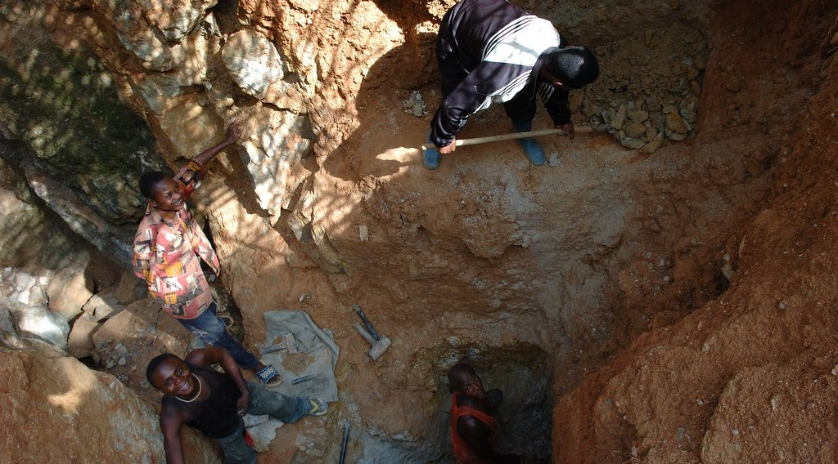
EXAMPLES
Activity 5
People digging.
Notes:
Activity 5. Look carefully at this picture: people digging. Observe every detail before I ask the question.

Slide 31
EXAMPLES
Activity 5: Question
What do we call taking minerals from the ground?
Notes:
Here is the question for Activity 5: What do we call taking minerals from the ground? Take one minute to think and write your answer in your rough notebook.

Slide 32
EXAMPLES
Activity 5: Answer
Mining.
Notes:
Let us check the answer together. Mining.

Slide 33
BOARD SUMMARY
Board Summary
Topic: Economic Activities
Sub-topic: Sectors of the Economy
Lesson 5 (Part 3): The Sectors of the Economy: The Primary Sector (Definition and Examples)
Notes:
Now we are going to copy the board summary. Write the title and the headings neatly in your notebooks. I will give you enough time for each slide, so do not rush.

Slide 34
BOARD SUMMARY
DEFINITIONS
The key terms of this lesson are defined as follows:
Primary sector: It is made of activities that take resources directly from nature.
Notes:
Let us copy the definitions. The key terms of this lesson are defined as follows. On this slide we have Primary sector. Write each point on a new line, with the key term first, and explain it in your own words when we revise.

Slide 35
BOARD SUMMARY
Examples of Primary Activities
The primary sector includes the following activities:
Farming: Maize, cotton and onions in the North.
Illustration: a maize farmer
Notes:
Let us copy Examples of Primary Activities. The primary sector includes the following activities. Copy the point on Farming on the left, then draw the diagram on the right: a maize farmer. Give it a title and label it clearly.

Slide 36
BOARD SUMMARY
Examples of Primary Activities
Livestock rearing: Cattle in the North and the Adamawa.
Illustration: a cattle market
Notes:
Copy the point on Livestock rearing on the left, then draw the diagram on the right: a cattle market. Give it a title and label it clearly.

Slide 37
BOARD SUMMARY
Examples of Primary Activities
Fishing: In the Lagdo lake and at sea.
Forestry: Timber from the forests of the South and East.
Notes:
We continue with Examples of Primary Activities. On this slide we have Fishing and Forestry. Write each point on a new line, with the key term first, and explain it in your own words when we revise.

Slide 38
BOARD SUMMARY
Examples of Primary Activities
Mining: Oil near Kribi, gold in the East and limestone at Figuil.
Illustration: gold mining
Notes:
Copy the point on Mining on the left, then draw the diagram on the right: gold mining. Give it a title and label it clearly.

Slide 39
BOARD SUMMARY
Examples of Primary Activities
Hunting and gathering: Game, honey and shea nuts.
Notes:
We continue with Examples of Primary Activities. On this slide we have Hunting and gathering. Write each point on a new line, with the key term first, and explain it in your own words when we revise.

Slide 40
FORMATIVE EVALUATION
Evaluation 1
What is the primary sector?
Notes:
Now let us check what you have understood. Question 1: What is the primary sector? Answer in your exercise book.

Slide 41
FORMATIVE EVALUATION
Expected Answer
The sector that takes products from nature.
Notes:
The expected answer is: the sector that takes products from nature. If you got it right, well done.

Slide 42
FORMATIVE EVALUATION
Evaluation 2
Give three primary activities.
Notes:
Now let us check what you have understood. Question 2: Give three primary activities. Answer in your exercise book.

Slide 43
FORMATIVE EVALUATION
Expected Answer
Farming, fishing and mining (also rearing, forestry).
Notes:
The expected answer is: farming, fishing and mining (also rearing, forestry). If you got it right, well done.

Slide 44
REMEDIATION
Remediation
Fill in the blanks:
Taking products from nature is the ______ sector.
Taking minerals from the ground is called ______.
Cutting trees for timber is called ______.
Notes:
For those who need more practice, fill in the blanks in your exercise book. The answers are: number 1, primary; number 2, mining; number 3, forestry (lumbering).

Slide 45
HOMEWORK
Homework
Name one factory of Garoua and its product.
Notes:
For your homework: Name one factory of Garoua and its product. We shall correct it at the beginning of our next lesson.

Slide 46
NEXT LESSON
Next Lesson
Our next lesson will be on:
Lesson 5 (Part 4): The Sectors of the Economy: The Secondary Sector (Definition and Examples)
Notes:
Our next lesson will be on Lesson 5 (Part 4): The Sectors of the Economy: The Secondary Sector (Definition and Examples). Thank you for your attention, and see you next time.

Slide 47
BILINGUAL GAME
Bilingual Game (Jeu Bilingue)
English | Français
Agriculture | L'agriculture
Fishing | La pêche
Livestock rearing | L'élevage
Forestry | L'exploitation forestière
Mining | L'exploitation minière
Crude oil | Le pétrole brut
Timber | Le bois d'œuvre
Export | L'exportation
Notes:
Let us play the bilingual game. I say a word in English, and you give me the French word. Then we do the reverse.

Slide 48
LOGBOOK
Official Logbook (1/2)
Module / Topic | Economic Activities
Lesson Title | Lesson 5 (Part 3): The Sectors of the Economy: The Primary Sector (Definition and Examples)
Expected Learning Outcomes | Define the primary sector. Name the main primary activities. Give examples of primary activities in Cameroon and explain their importance.
Competence | Learners are able to identify primary activities around them and explain their importance for food and exports.
Notes:
I record this information in the official logbook of the class after the lesson.

Slide 49
LOGBOOK
Official Logbook (2/2)
Matter Taught | DEFINITIONS; Examples of Primary Activities.
Evaluation | Formative evaluation and remediation exercise.
Homework | Name one factory of Garoua and its product.
Enrolment / Present / Absent | ____ / ____ / ____
Achievement | To be completed after the lesson.
Notes:
I complete the second page of the logbook: the matter taught, the evaluation, the homework and the attendance.

Slide 50
TEACHER'S NOTE
Teacher's Note
Timing: Homework correction, plan, objectives 8 min | Recall, situation, action 10 min | 5 activities 30 min | Board summary (copying) 30 min | Evaluation, remediation 10 min | Homework, next lesson 5 min | Logbook 7 min
Without the projector (Activity 1): name farmers in the family.
Without the projector (Activity 2): describe a cattle market.
Without the projector (Activity 3): name fish sold in Garoua.
Without the projector (Activity 4): name wooden objects.
Without the projector (Activity 5): name minerals.
Notes:
This slide is for me, the teacher: it gives the timing of the lesson and what to do if the projector is not available.

Slide 51
REFERENCES
References
Harmonised Progression Sheet, Economic Geography (5051), Form 2.
Photo, Activity 1: “Ghana 15” by CIAT International Center for Tropical Agriculture, CC BY-NC-SA 2.0, via Flickr (https://www.flickr.com/photos/38476503@N08/5207540264)
Photo, Activity 2: “Discussing the price” by 10b travelling / Carsten ten Brink, CC BY-NC-ND 2.0, via Flickr (https://www.flickr.com/photos/77334245@N00/7313656038)
Photo, Activity 3: “Kenyan food, farming and landscapes” by CGIAR Climate, CC BY-NC-SA 2.0, via Flickr (https://www.flickr.com/photos/55227776@N04/14310899853)
Photo, Activity 4: “Logging truck, Cameroon” by World Resources, CC BY-NC-SA 2.0, via Flickr (https://www.flickr.com/photos/26107309@N05/4764354366)
Photo, Activity 5: “Mining in Kailo” by Julien Harneis, CC BY-SA 2.0, via Flickr (https://www.flickr.com/photos/16935515@N00/1872000955)
Diagrams and animations: drawn for this lesson (Geography Department).
Notes:
These are the references and picture credits used to prepare this lesson.

