Slide 1
FORM 2 TECHNICAL
GEOGRAPHY
Lesson 6 (Part 2)
Africa: Climate, Soils and Relief of Africa
Notes:
Good morning, class, and welcome to our geography lesson. I am your geography teacher, Mr Kamdem. Today we are starting Lesson 6 (Part 2): Africa: Climate, Soils and Relief of Africa.

Slide 2
CLASS INFO
Class, Chapter and Duration
Class | Form 2 Technical
Chapter | Economic Geography — Africa
Duration | 2 periods (2 × 50 minutes)
Notes:
This lesson is for Form 2 Technical. It belongs to Economic Geography — Africa. We shall need 2 periods to cover it.

Slide 3
IDENTIFICATION
Lesson Identification
Topic | Regional Geography
Sub-topic | Africa
Lesson | Lesson 6 (Part 2): Africa: Climate, Soils and Relief of Africa
Notions / Concepts | Climatic zone, relief, plateau, basin, Rift Valley, fold mountains, volcanic mountains, ferrallitic and ferruginous soils.
Syllabus focus | Climate, soils and relief of Africa.
Competence | Learners are able to relate the climate and relief of a place in Africa to the activities that people practise there.
Notes:
Our topic is Regional Geography, and the sub-topic is Africa. The key notions we shall use today are: climatic zone, relief, plateau, basin, Rift Valley, fold mountains, volcanic mountains, ferrallitic and ferruginous soils. At the end, you should be able to do this: learners are able to relate the climate and relief of a place in Africa to the activities that people practise there.

Slide 4

HOMEWORK CORRECTION
Correction of the Homework
Question (Lesson 6 (Part 1): Africa: Introduction (Location and Physical Characteristics)):
Name three climates of Africa.
Notes:
Before we start the new lesson, let us correct the homework I gave you at the end of Lesson 6 (Part 1): Africa: Introduction (Location and Physical Characteristics). The question was: Name three climates of Africa. Take out your exercise books.

Slide 5
HOMEWORK CORRECTION
Correction: Possible Answer
Equatorial, tropical (savanna) and desert.
Notes:
Here is a good answer. Equatorial, tropical (savanna) and desert. Compare it with your own answer and correct your work in red.

Slide 6
LESSON PLAN
Lesson Plan
Correction of the homework
Objectives and recall
Real-life situation and action to take
Learning activities
Board summary
Evaluation, remediation and homework
Notes:
Here is the plan of our lesson today. First, we shall correct the homework. Then we shall look at the objectives and recall what you already know. After that, we shall study a situation from real life and the action to take, and do the learning activities. Finally, we shall copy the board summary, do the evaluation and the remediation, and I will give you the homework.

Slide 7
OBJECTIVES
Objectives
By the end of this lesson, you should be able to:
Describe the main climatic zones of Africa.
Describe the main relief features of Africa.
Notes:
Take your time to copy this part; we will continue together.

Slide 8
OBJECTIVES
Objectives (continued)
Describe the main soils of Africa.
Notes:
By the end of this lesson, you should be able to do three things. Number 1: describe the main climatic zones of Africa. Number 2: describe the main relief features of Africa. Number 3: describe the main soils of Africa.

Slide 9
PREVIOUS KNOWLEDGE
Previous Knowledge
Africa lies between 37°N and 35°S, and the Equator crosses its middle.
It is a plateau continent, with Kilimanjaro as its highest point and the Nile as its longest river.
Notes:
Let us first remember what you already know. Africa lies between 37°N and 35°S, and the Equator crosses its middle. It is a plateau continent, with Kilimanjaro as its highest point and the Nile as its longest river. Keep this in mind, because we shall build on it today.

Slide 10
REAL-LIFE SITUATION
Situation in Real Life
Douala gets about 4,000 mm of rain per year, Garoua about 1,000 mm and Maroua about 800 mm. On the Adamawa plateau, the air is cooler than in Garoua. Nadia asks: "Why do the climate, the relief and the soils change so much across Africa?"
Notes:
Listen carefully to this situation from real life. Douala gets about 4,000 mm of rain per year, Garoua about 1,000 mm and Maroua about 800 mm. On the Adamawa plateau, the air is cooler than in Garoua. Nadia asks: "Why do the climate, the relief and the soils change so much across Africa?" Think about it, because I am going to ask you some questions.

Slide 11
REAL-LIFE SITUATION
Situation: Question 1
What is the problem in the situation?
Notes:
Question 1: What is the problem in the situation? Think for a moment, then raise your hand to answer.

Slide 12
REAL-LIFE SITUATION
Answer
Nadia does not know the climates, relief and soils of Africa.
Notes:
Good. Nadia does not know the climates, relief and soils of Africa.

Slide 13
REAL-LIFE SITUATION
Situation: Question 2
Which town is the wettest?
Notes:
Question 2: Which town is the wettest? Think for a moment, then raise your hand to answer.

Slide 14
REAL-LIFE SITUATION
Answer
Douala.
Notes:
Good. Douala.

Slide 15
REAL-LIFE SITUATION
Situation: Question 3
Why is the Adamawa cooler?
Notes:
Question 3: Why is the Adamawa cooler? Think for a moment, then raise your hand to answer.

Slide 16
REAL-LIFE SITUATION
Possible Answer
It is high (altitude).
Notes:
Good. It is high (altitude).

Slide 17
ACTION TO TAKE
Action to Take
Use the fertile soils of Africa carefully and protect them.
Notes:
From this situation, the action we are working towards in this lesson is the following: use the fertile soils of Africa carefully and protect them.

Slide 18
JUSTIFICATION
Justification of the Lesson
This lesson helps us to know the climate, relief and soils of Africa.
Notes:
Why is this lesson important for you? This lesson helps us to know the climate, relief and soils of Africa.

Slide 19

1. CLIMATE
Activity 1
The climates of Africa.
Notes:
Activity 1. Look carefully at this diagram: the climates of Africa. Observe every detail before I ask the question.

Slide 20
1. CLIMATE
Activity 1: Question
Which climate is found around the Equator?
Notes:
Here is the question for Activity 1: Which climate is found around the Equator? Take one minute to think and write your answer in your rough notebook.

Slide 21
1. CLIMATE
Activity 1: Answer
The equatorial climate.
Notes:
Let us check the answer together. The equatorial climate.

Slide 22

1. CLIMATE
Activity 2
Tea in the highlands of Kenya.
Notes:
Activity 2. Look carefully at this picture: tea in the highlands of Kenya. Observe every detail before I ask the question.

Slide 23
1. CLIMATE
Activity 2: Question
Why are highlands near the Equator cool?
Notes:
Here is the question for Activity 2: Why are highlands near the Equator cool? Take one minute to think and write your answer in your rough notebook.

Slide 24
1. CLIMATE
Activity 2: Answer
The higher the land, the cooler the air.
Notes:
Let us check the answer together. The higher the land, the cooler the air.

Slide 25
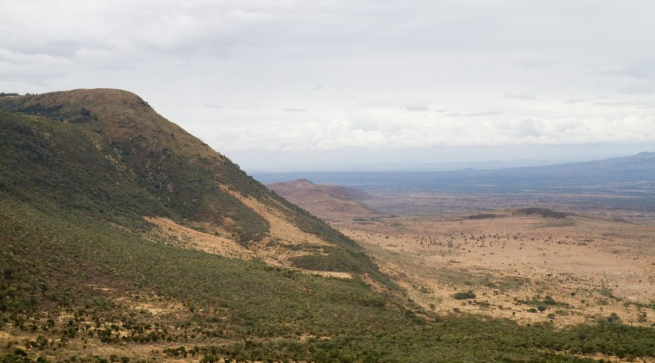
2. RELIEF
Activity 3
A long valley in East Africa.
Notes:
Activity 3. Look carefully at this picture: a long valley in East Africa. Observe every detail before I ask the question.

Slide 26
2. RELIEF
Activity 3: Question
What is this long valley of East Africa called?
Notes:
Here is the question for Activity 3: What is this long valley of East Africa called? Take one minute to think and write your answer in your rough notebook.

Slide 27
2. RELIEF
Activity 3: Answer
The Great Rift Valley.
Notes:
Let us check the answer together. The Great Rift Valley.

Slide 28
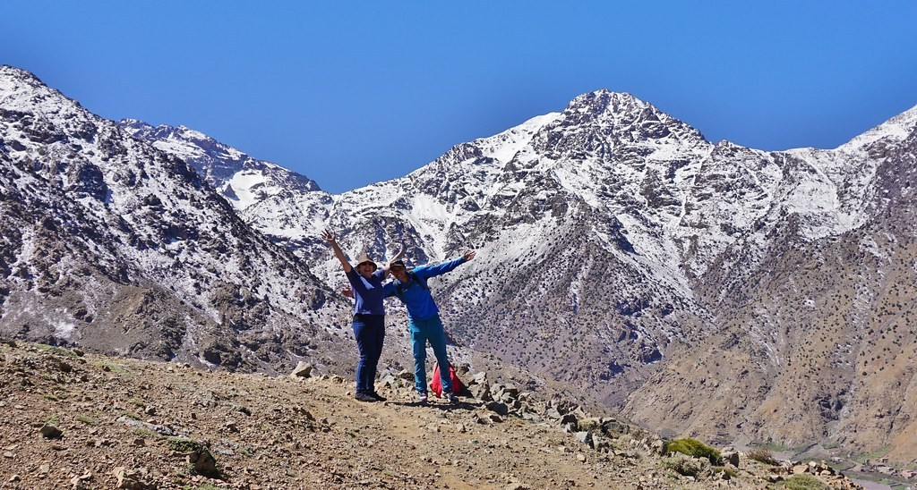
2. RELIEF
Activity 4
Mountains of North Africa.
Notes:
Activity 4. Look carefully at this picture: mountains of North Africa. Observe every detail before I ask the question.

Slide 29
2. RELIEF
Activity 4: Question
Name these fold mountains of North Africa.
Notes:
Here is the question for Activity 4: Name these fold mountains of North Africa. Take one minute to think and write your answer in your rough notebook.

Slide 30
2. RELIEF
Activity 4: Answer
The Atlas Mountains.
Notes:
Let us check the answer together. The Atlas Mountains.

Slide 31
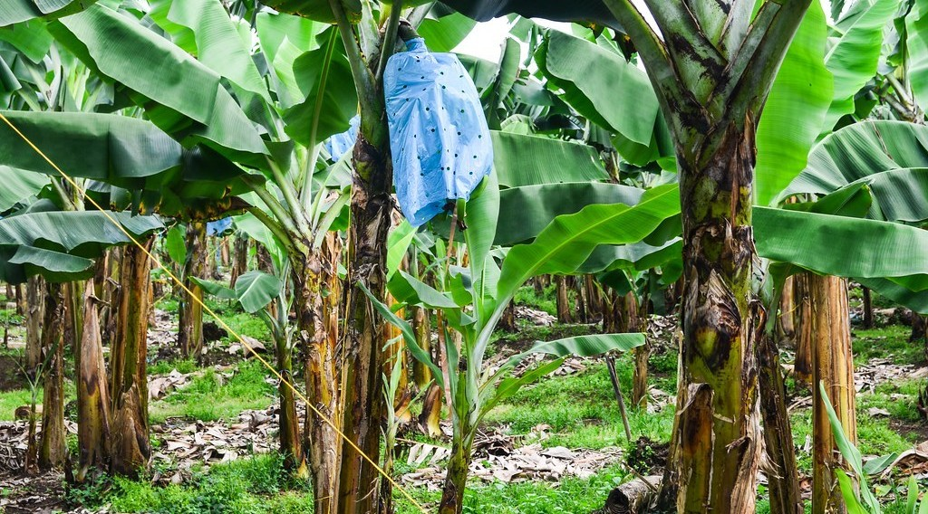
3. SOILS
Activity 5
Mount Cameroon.
Notes:
Activity 5. Look carefully at this picture: mount Cameroon. Observe every detail before I ask the question.

Slide 32
3. SOILS
Activity 5: Question
Why are the soils near Mount Cameroon so fertile?
Notes:
Here is the question for Activity 5: Why are the soils near Mount Cameroon so fertile? Take one minute to think and write your answer in your rough notebook.

Slide 33
3. SOILS
Activity 5: Answer
They come from volcanic rocks.
Notes:
Let us check the answer together. They come from volcanic rocks.

Slide 34
BOARD SUMMARY
Board Summary
Topic: Regional Geography
Sub-topic: Africa
Lesson 6 (Part 2): Africa: Climate, Soils and Relief of Africa
Notes:
Now we are going to copy the board summary. Write the title and the headings neatly in your notebooks. I will give you enough time for each slide, so do not rush.

Slide 35
BOARD SUMMARY
DEFINITIONS
The key terms of this lesson are defined as follows:
Relief: It is the shape of the land: mountains, plateaux, valleys and plains.
Notes:
Let us copy the definitions. The key terms of this lesson are defined as follows. On this slide we have Relief. Write each point on a new line, with the key term first, and explain it in your own words when we revise.

Slide 36
BOARD SUMMARY
1. Climate
Africa has the following main climates:
Equatorial: Hot and wet all year, in the Congo Basin.
Illustration: the climates of Africa
Notes:
Let us copy Climate. Africa has the following main climates. Copy the point on Equatorial on the left, then draw the diagram on the right: the climates of Africa. Give it a title and label it clearly.

Slide 37
BOARD SUMMARY
1. Climate
Tropical (savanna): A wet and a dry season, as in Garoua.
Desert: Very dry, in the Sahara and the Kalahari.
Mediterranean: Hot, dry summers and wet winters, at the north and south tips.
Notes:
We continue with Climate. On this slide we have Tropical (savanna), Desert and Mediterranean. Write each point on a new line, with the key term first, and explain it in your own words when we revise. When you finish, we go to the next slide.

Slide 38
BOARD SUMMARY
1. Climate (continued)
Mountain: Cool, on high land such as the Adamawa and East Africa.
Notes:
We continue with Climate. On this slide we have Mountain. Write each point on a new line, with the key term first, and explain it in your own words when we revise.

Slide 39
BOARD SUMMARY
2. Relief
Africa has the following relief features:
Plateaux: High plateaux cover most of Africa.
Notes:
Let us copy Relief. Africa has the following relief features. On this slide we have Plateaux. Write each point on a new line, with the key term first, and explain it in your own words when we revise.

Slide 40
BOARD SUMMARY
2. Relief
Fold mountains: The Atlas in the north and the Cape Ranges in the south.
Illustration: the Atlas Mountains
Notes:
Copy the point on Fold mountains on the left, then draw the diagram on the right: the Atlas Mountains. Give it a title and label it clearly.

Slide 41
BOARD SUMMARY
2. Relief
Volcanic mountains: Kilimanjaro and Mount Cameroon.
Notes:
We continue with Relief. On this slide we have Volcanic mountains. Write each point on a new line, with the key term first, and explain it in your own words when we revise.

Slide 42
BOARD SUMMARY
2. Relief
Rift Valley: A long valley from the Red Sea to Mozambique.
Illustration: the Rift Valley
Notes:
Copy the point on Rift Valley on the left, then draw the diagram on the right: the Rift Valley. Give it a title and label it clearly.

Slide 43
BOARD SUMMARY
2. Relief
Basins: The Congo, Chad and Kalahari basins.
Notes:
We continue with Relief. On this slide we have Basins. Write each point on a new line, with the key term first, and explain it in your own words when we revise.

Slide 44
BOARD SUMMARY
3. Soils
Africa has the following main soils:
Ferrallitic soils: Red, leached soils in the forest.
Ferruginous soils: Red soils of the savanna.
Desert soils: Sandy, stony and poor soils.
Notes:
Let us copy Soils. Africa has the following main soils. On this slide we have Ferrallitic soils, Ferruginous soils and Desert soils. Write each point on a new line, with the key term first, and explain it in your own words when we revise.

Slide 45
BOARD SUMMARY
3. Soils
Volcanic soils: Very fertile, near Mount Cameroon.
Illustration: Mount Cameroon
Notes:
Copy the point on Volcanic soils on the left, then draw the diagram on the right: mount Cameroon. Give it a title and label it clearly.

Slide 46
BOARD SUMMARY
3. Soils
Alluvial soils: Fertile soils in river valleys, like the Nile.
Notes:
We continue with Soils. On this slide we have Alluvial soils. Write each point on a new line, with the key term first, and explain it in your own words when we revise.

Slide 47
FORMATIVE EVALUATION
Evaluation 1
Why is Nairobi cool though it is near the Equator?
Notes:
Now let us check what you have understood. Question 1: Why is Nairobi cool though it is near the Equator? Answer in your exercise book.

Slide 48
FORMATIVE EVALUATION
Expected Answer
Because it is high.
Notes:
The expected answer is: because it is high. If you got it right, well done.

Slide 49
FORMATIVE EVALUATION
Evaluation 2
Why are the soils of Mount Cameroon fertile?
Notes:
Now let us check what you have understood. Question 2: Why are the soils of Mount Cameroon fertile? Answer in your exercise book.

Slide 50
FORMATIVE EVALUATION
Expected Answer
They come from volcanic rocks.
Notes:
The expected answer is: they come from volcanic rocks. If you got it right, well done.

Slide 51
REMEDIATION
Remediation
Fill in the blanks:
Around the Equator, the climate is ______.
The long valley of East Africa is the Great ______ Valley.
Soils made from volcano rocks are ______ soils.
Notes:
For those who need more practice, fill in the blanks in your exercise book. The answers are: number 1, equatorial; number 2, Rift; number 3, volcanic.

Slide 52
HOMEWORK
Homework
Name three big rivers of Africa.
Notes:
For your homework: Name three big rivers of Africa. We shall correct it at the beginning of our next lesson.

Slide 53
NEXT LESSON
Next Lesson
Our next lesson will be on:
Lesson 6 (Part 3): Africa: Vegetation and Drainage of Africa
Notes:
Our next lesson will be on Lesson 6 (Part 3): Africa: Vegetation and Drainage of Africa. Thank you for your attention, and see you next time.

Slide 54
BILINGUAL GAME
Bilingual Game (Jeu Bilingue)
English | Français
Climate | Le climat
Relief | Le relief
Plateau | Le plateau
Basin | La cuvette (le bassin)
Rift Valley | La vallée du Rift
Volcano | Le volcan
Fertile | Fertile
Altitude | L'altitude
Notes:
Let us play the bilingual game. I say a word in English, and you give me the French word. Then we do the reverse.

Slide 55
LOGBOOK
Official Logbook (1/2)
Module / Topic | Regional Geography
Lesson Title | Lesson 6 (Part 2): Africa: Climate, Soils and Relief of Africa
Expected Learning Outcomes | Describe the main climatic zones of Africa. Describe the main relief features of Africa. Describe the main soils of Africa.
Competence | Learners are able to relate the climate and relief of a place in Africa to the activities that people practise there.
Notes:
I record this information in the official logbook of the class after the lesson.

Slide 56
LOGBOOK
Official Logbook (2/2)
Matter Taught | DEFINITIONS; Climate; Relief; Soils.
Evaluation | Formative evaluation and remediation exercise.
Homework | Name three big rivers of Africa.
Enrolment / Present / Absent | ____ / ____ / ____
Achievement | To be completed after the lesson.
Notes:
I complete the second page of the logbook: the matter taught, the evaluation, the homework and the attendance.

Slide 57
TEACHER'S NOTE
Teacher's Note
Timing: Homework correction, plan, objectives 8 min | Recall, situation, action 10 min | 5 activities 30 min | Board summary (copying) 30 min | Evaluation, remediation 10 min | Homework, next lesson 5 min | Logbook 7 min
Without the projector (Activity 1): draw climate belts.
Without the projector (Activity 2): compare Garoua and Ngaoundéré.
Without the projector (Activity 3): show it on a map.
Without the projector (Activity 4): show them on a map.
Without the projector (Activity 5): name crops of the South-West.
Notes:
This slide is for me, the teacher: it gives the timing of the lesson and what to do if the projector is not available.

Slide 58
REFERENCES
References
Harmonised Progression Sheet, Economic Geography (5051), Form 2.
Photo, Activity 2: “Carlo in the tea” by luigig, CC BY 2.0, via Flickr (https://www.flickr.com/photos/51035803402@N01/3175986747)
Photo, Activity 3: “Great Rift Valley” by GSAPP_SIDL, CC BY-NC-ND 2.0, via Flickr (https://www.flickr.com/photos/77974798@N04/7341392488)
Photo, Activity 4: “The Hills Are Alive - Morocco - Atlas Mountains - Mar 2018” by Gareth1953 All Right Now, CC BY 2.0, via Flickr (https://www.flickr.com/photos/40837632@N05/46588301775)
Photo, Activity 5: “20131110-DSC_4372” by jbdodane, CC BY-NC 2.0, via Flickr (https://www.flickr.com/photos/27998473@N02/11288779044)
Diagrams and animations: drawn for this lesson (Geography Department).
Notes:
These are the references and picture credits used to prepare this lesson.

