Slide 1
FORM 4
GEOGRAPHY
Lesson 7
The Internal Structure of the Earth
Notes:
Good morning, class, and welcome to our geography lesson. I am your geography teacher, Mr Kamdem. Today we are starting Lesson 7: The Internal Structure of the Earth.

Slide 2
CLASS INFO
Class, Chapter and Duration
Class | Form 4
Chapter | The Structure of the Earth: Building Processes and Impacts on Man — Internal Structure of the Earth
Duration | 50 minutes
Notes:
This lesson is for Form 4. It belongs to The Structure of the Earth: Building Processes and Impacts on Man — Internal Structure of the Earth. We shall need 50 minutes to cover it.

Slide 3
IDENTIFICATION
Lesson Identification
Topic | The Structure of the Earth: Building Processes and Impacts on Man
Sub-topic | Internal Structure of the Earth
Lesson | Lesson 7: The Internal Structure of the Earth
Notions / Concepts | Crust, mantle, core.
Syllabus focus | Illustrations: circular and cross-sectional views; brief description of the main layers.
Competence | Learners are able to draw and describe the layers of the Earth, and to explain why the inside of the Earth is hot.
Notes:
Our topic is The Structure of the Earth: Building Processes and Impacts on Man, and the sub-topic is Internal Structure of the Earth. The key notions we shall use today are: crust, mantle, core. At the end, you should be able to do this: learners are able to draw and describe the layers of the Earth, and to explain why the inside of the Earth is hot.

Slide 4

HOMEWORK CORRECTION
Correction of the Homework
Question (Lesson 6: The Revolution of the Earth):
Name the four main layers of the Earth.
Notes:
Before we start the new lesson, let us correct the homework I gave you at the end of Lesson 6: The Revolution of the Earth. The question was: Name the four main layers of the Earth. Take out your exercise books.

Slide 5
HOMEWORK CORRECTION
Correction: Possible Answer
The crust, the mantle, the outer core and the inner core.
Notes:
Here is a good answer. The crust, the mantle, the outer core and the inner core. Compare it with your own answer and correct your work in red.

Slide 6
LESSON PLAN
Lesson Plan
Correction of the homework
Objectives and recall
Real-life situation and action to take
Learning activities
Board summary
Evaluation, remediation and homework
Notes:
Here is the plan of our lesson today. First, we shall correct the homework. Then we shall look at the objectives and recall what you already know. After that, we shall study a situation from real life and the action to take, and do the learning activities. Finally, we shall copy the board summary, do the evaluation and the remediation, and I will give you the homework.

Slide 7
OBJECTIVES
Objectives
By the end of this lesson, you should be able to:
Draw the circular and the cross-sectional views of the structure of the Earth.
Name the main layers of the Earth.
Notes:
Take your time to copy this part; we will continue together.

Slide 8
OBJECTIVES
Objectives (continued)
Describe each layer briefly: thickness, state and composition.
Notes:
By the end of this lesson, you should be able to do three things. Number 1: draw the circular and the cross-sectional views of the structure of the Earth. Number 2: name the main layers of the Earth. Number 3: describe each layer briefly: thickness, state and composition.

Slide 9
PREVIOUS KNOWLEDGE
Previous Knowledge
The Earth is an oblate spheroid with a radius of about 6,370 km.
Revolution causes the seasons.
The Earth is one of the planets of the solar system.
Notes:
Let us first remember what you already know. The Earth is an oblate spheroid with a radius of about 6,370 km. Revolution causes the seasons. The Earth is one of the planets of the solar system. Keep this in mind, because we shall build on it today.

Slide 10
REAL-LIFE SITUATION
Situation in Real Life
Workers dig a deep well in Garoua. First they dig through red soil, then they reach very hard rock and must stop. Amadou asks: "What would we find if we could dig down to the centre of the Earth?"
Notes:
Listen carefully to this situation from real life. Workers dig a deep well in Garoua. First they dig through red soil, then they reach very hard rock and must stop. Amadou asks: "What would we find if we could dig down to the centre of the Earth?" Think about it, because I am going to ask you some questions.

Slide 11
REAL-LIFE SITUATION
Situation: Question 1
What is the problem in the situation?
Notes:
Question 1: What is the problem in the situation? Think for a moment, then raise your hand to answer.

Slide 12
REAL-LIFE SITUATION
Answer
Amadou does not know what is inside the Earth, under the rock.
Notes:
Good. Amadou does not know what is inside the Earth, under the rock.

Slide 13
REAL-LIFE SITUATION
Situation: Question 2
What did the workers find under the soil?
Notes:
Question 2: What did the workers find under the soil? Think for a moment, then raise your hand to answer.

Slide 14
REAL-LIFE SITUATION
Answer
Very hard rock.
Notes:
Good. Very hard rock.

Slide 15
REAL-LIFE SITUATION
Situation: Question 3
Can people dig to the centre of the Earth?
Notes:
Question 3: Can people dig to the centre of the Earth? Think for a moment, then raise your hand to answer.

Slide 16
REAL-LIFE SITUATION
Possible Answer
No: it is about 6,370 km deep and far too hot.
Notes:
Good. No: it is about 6,370 km deep and far too hot.

Slide 17
ACTION TO TAKE
Action to Take
Use models such as an egg or an onion to explain the layers of the Earth.
Notes:
From this situation, the action we are working towards in this lesson is the following: use models such as an egg or an onion to explain the layers of the Earth.

Slide 18
JUSTIFICATION
Justification of the Lesson
This lesson helps us to know the layers inside the Earth.
Notes:
Why is this lesson important for you? This lesson helps us to know the layers inside the Earth.

Slide 19

1. ILLUSTRATIONS
Activity 1
The layers of the Earth.
Notes:
Activity 1. Look carefully at this diagram: the layers of the Earth. Observe every detail before I ask the question.

Slide 20
1. ILLUSTRATIONS
Activity 1: Question 1
How many main layers does the Earth have?
Notes:
Here is the question for Activity 1: How many main layers does the Earth have? Take one minute to think and write your answer in your rough notebook.

Slide 21
1. ILLUSTRATIONS
Activity 1: Answer 1
Four: crust, mantle, outer core and inner core.
Notes:
Let us check the answer together. Four: crust, mantle, outer core and inner core.

Slide 22
1. ILLUSTRATIONS
Activity 1: Question 2
Which layer is in the centre?
Notes:
Here is the next question: Which layer is in the centre? Take one minute to think and write your answer in your rough notebook.

Slide 23
1. ILLUSTRATIONS
Activity 1: Answer 2
The inner core.
Notes:
Let us check the answer together. The inner core.

Slide 24

2. THE MAIN LAYERS
Activity 2
People dig a big pit in the ground.
Notes:
Activity 2. Look carefully at this picture: people dig a big pit in the ground. Observe every detail before I ask the question.

Slide 25
2. THE MAIN LAYERS
Activity 2: Question
When we dig a well, which layer of the Earth do we reach?
Notes:
Here is the question for Activity 2: When we dig a well, which layer of the Earth do we reach? Take one minute to think and write your answer in your rough notebook.

Slide 26
2. THE MAIN LAYERS
Activity 2: Answer
Only the crust, the thin outer layer.
Notes:
Let us check the answer together. Only the crust, the thin outer layer.

Slide 27
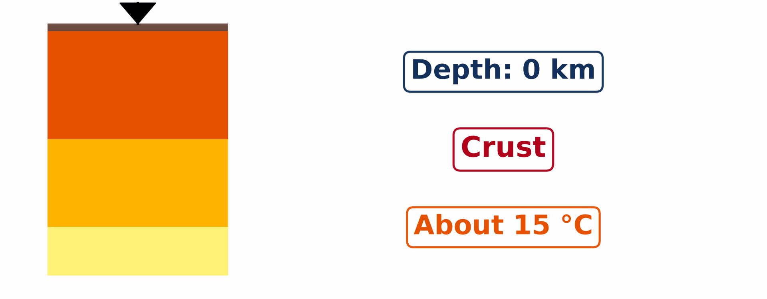
2. THE MAIN LAYERS
Activity 3
Animation: a journey to the centre of the Earth.
Notes:
Activity 3. Look carefully at this animation: animation: a journey to the centre of the Earth. Watch the animation to the end; it will play again.

Slide 28
2. THE MAIN LAYERS
Activity 3: Question
What happens to the temperature as we go deeper into the Earth?
Notes:
Here is the question for Activity 3: What happens to the temperature as we go deeper into the Earth? Take one minute to think and write your answer in your rough notebook.

Slide 29
2. THE MAIN LAYERS
Activity 3: Answer
It rises, to about 6,000 °C at the centre.
Notes:
Let us check the answer together. It rises, to about 6,000 °C at the centre.

Slide 30
BOARD SUMMARY
Board Summary
Topic: The Structure of the Earth: Building Processes and Impacts on Man
Sub-topic: Internal Structure of the Earth
Lesson 7: The Internal Structure of the Earth
Notes:
Now we are going to copy the board summary. Write the title and the headings neatly in your notebooks. I will give you enough time for each slide, so do not rush.

Slide 31
BOARD SUMMARY
DEFINITIONS
The key terms of this lesson are defined as follows:
Crust: It is the thin, solid outer layer of the Earth, on which we live.
Mantle: It is the thick layer of very hot rock between the crust and the core.
Notes:
Let us copy the definitions. The key terms of this lesson are defined as follows. On this slide we have Crust and Mantle. Write each point on a new line, with the key term first, and explain it in your own words when we revise. When you finish, we go to the next slide.

Slide 32
BOARD SUMMARY
DEFINITIONS (continued)
Core: It is the central part of the Earth, made mainly of iron and nickel.
Notes:
We continue with the definitions. On this slide we have Core. Write each point on a new line, with the key term first, and explain it in your own words when we revise.

Slide 33
BOARD SUMMARY
1. Illustrations of the Structure of the Earth
The structure of the Earth is illustrated in two ways:
Circular view: The layers form circles, one inside the other, like the layers of an onion.
Illustration: the layers of the Earth (circular view)
Notes:
Let us copy Illustrations of the Structure of the Earth. The structure of the Earth is illustrated in two ways. Copy the point on Circular view on the left, then draw the diagram on the right: the layers of the Earth (circular view). Give it a title and label it clearly.

Slide 34
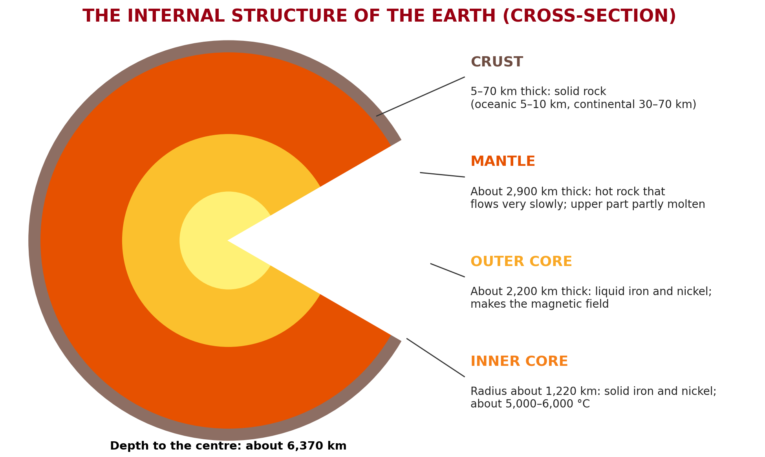
BOARD SUMMARY
1. Illustrations of the Structure of the Earth
Cross-sectional view: A cut through the Earth shows the crust, the mantle, the outer core and the inner core from the surface to the centre.
Illustration: the internal structure of the Earth (cross-section)
Notes:
Copy the point on Cross-sectional view on the left, then draw the diagram on the right: the internal structure of the Earth (cross-section). Give it a title and label it clearly.

Slide 35
BOARD SUMMARY
2. Brief Description of the Main Layers
The main layers of the Earth are described as follows:
The crust: It is 5 to 10 km thick under the oceans and 30 to 70 km thick under the continents. It is made of solid rock.
Notes:
Let us copy Brief Description of the Main Layers. The main layers of the Earth are described as follows. On this slide we have The crust. Write each point on a new line, with the key term first, and explain it in your own words when we revise. When you finish, we go to the next slide.

Slide 36
BOARD SUMMARY
2. Brief Description of the Main Layers (continued)
The mantle: It is about 2,900 km thick and made of very hot rock. Its upper part is partly molten and flows very slowly.
The outer core: It is about 2,200 km thick and made of liquid iron and nickel.
Notes:
We continue with Brief Description of the Main Layers. On this slide we have The mantle and The outer core. Write each point on a new line, with the key term first, and explain it in your own words when we revise.

Slide 37
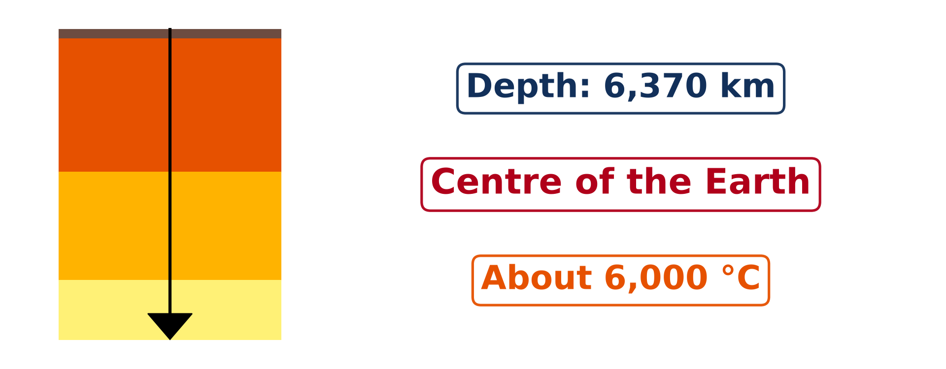
BOARD SUMMARY
2. Brief Description of the Main Layers
The inner core: It is a solid ball of iron and nickel with a radius of about 1,220 km. Its temperature is about 5,000 to 6,000 °C.
Illustration: the centre of the Earth
Notes:
Copy the point on The inner core on the left, then draw the diagram on the right: the centre of the Earth. Give it a title and label it clearly.

Slide 38
FORMATIVE EVALUATION
Evaluation 1
Name the layer on which we live.
Notes:
Now let us check what you have understood. Question 1: Name the layer on which we live. Answer in your exercise book.

Slide 39
FORMATIVE EVALUATION
Expected Answer
The crust.
Notes:
The expected answer is: the crust. If you got it right, well done.

Slide 40
FORMATIVE EVALUATION
Evaluation 2
Why is the inner core solid though it is very hot?
Notes:
Now let us check what you have understood. Question 2: Why is the inner core solid though it is very hot? Answer in your exercise book.

Slide 41
FORMATIVE EVALUATION
Expected Answer
Because of the enormous pressure.
Notes:
The expected answer is: because of the enormous pressure. If you got it right, well done.

Slide 42
REMEDIATION
Remediation
Fill in the blanks:
The thin outer layer of the Earth is the ______.
The layer under the crust is the ______.
The outer core is made of ______ iron.
Notes:
For those who need more practice, fill in the blanks in your exercise book. The answers are: number 1, crust; number 2, mantle; number 3, liquid.

Slide 43
HOMEWORK
Homework
Name the three types of rocks.
Notes:
For your homework: Name the three types of rocks. We shall correct it at the beginning of our next lesson.

Slide 44
NEXT LESSON
Next Lesson
Our next lesson will be on:
Lesson 8: Rocks
Notes:
Our next lesson will be on Lesson 8: Rocks. Thank you for your attention, and see you next time.

Slide 45
BILINGUAL GAME
Bilingual Game (Jeu Bilingue)
English | Français
Crust | L'écorce / la croûte
Mantle | Le manteau
Core | Le noyau
Layer | La couche
Cross-section | La coupe
Pressure | La pression
Iron | Le fer
Magnetic field | Le champ magnétique
Notes:
Let us play the bilingual game. I say a word in English, and you give me the French word. Then we do the reverse.

Slide 46
LOGBOOK
Official Logbook (1/2)
Module / Topic | The Structure of the Earth: Building Processes and Impacts on Man
Lesson Title | Lesson 7: The Internal Structure of the Earth
Expected Learning Outcomes | Draw the circular and the cross-sectional views of the structure of the Earth. Name the main layers of the Earth. Describe each layer briefly: thickness, state and composition.
Competence | Learners are able to draw and describe the layers of the Earth, and to explain why the inside of the Earth is hot.
Notes:
I record this information in the official logbook of the class after the lesson.

Slide 47
LOGBOOK
Official Logbook (2/2)
Matter Taught | DEFINITIONS; Illustrations of the Structure of the Earth; Brief Description of the Main Layers.
Evaluation | Formative evaluation and remediation exercise.
Homework | Name the three types of rocks.
Enrolment / Present / Absent | ____ / ____ / ____
Achievement | To be completed after the lesson.
Notes:
I complete the second page of the logbook: the matter taught, the evaluation, the homework and the attendance.

Slide 48
TEACHER'S NOTE
Teacher's Note
Timing: Homework correction, plan, objectives 4 min | Recall, situation, action 6 min | 3 activities 12 min | Board summary (copying) 15 min | Evaluation, remediation 5 min | Homework, next lesson 3 min | Logbook 5 min
Activity 3 is an animation (GIF): it plays automatically in slide-show mode.
Without the projector (Activity 1): cut a boiled egg or an onion: shell, white, yolk.
Without the projector (Activity 2): ask learners how deep the wells of their area are.
Without the projector (Activity 3): write the depth and temperature of each layer on the board.
Notes:
This slide is for me, the teacher: it gives the timing of the lesson and what to do if the projector is not available.

Slide 49
REFERENCES
References
National Geography Syllabus (MINESEC), Form 4 — The Structure of the Earth: Building Processes and Impacts on Man.
Teacher's lesson notes (Form 4), checked and corrected where necessary.
Photo, Activity 2: “Laterite soil bricks in Richard Rebello's farm” by India Water Portal, CC BY-NC-SA 2.0, via Flickr (https://www.flickr.com/photos/21623815@N03/10720461943)
Diagrams and animations: drawn for this lesson (Geography Department).
Notes:
These are the references and picture credits used to prepare this lesson.

