Slide 1
FORM 4
GEOGRAPHY
Lesson 19
The Upper Course of a River
Notes:
Good morning, class, and welcome to our geography lesson. I am your geography teacher, Mr Kamdem. Today we are starting Lesson 19: The Upper Course of a River.

Slide 2
CLASS INFO
Class, Chapter and Duration
Class | Form 4
Chapter | Denudation Processes, Landforms and Impacts on Man — The Work of Rivers on the Landscape and Impacts on Man
Duration | 50 minutes
Notes:
This lesson is for Form 4. It belongs to Denudation Processes, Landforms and Impacts on Man — The Work of Rivers on the Landscape and Impacts on Man. We shall need 50 minutes to cover it.

Slide 3
IDENTIFICATION
Lesson Identification
Topic | Denudation Processes, Landforms and Impacts on Man
Sub-topic | The Work of Rivers on the Landscape and Impacts on Man
Lesson | Lesson 19: The Upper Course of a River
Notions / Concepts | V-shaped valley, waterfalls, rapids, cataracts, potholes.
Syllabus focus | Main characteristics and processes of the upper course; landforms of the upper course.
Competence | Learners are able to recognise the landforms of the upper course, such as waterfalls and gorges, and to explain their value and dangers.
Notes:
Our topic is Denudation Processes, Landforms and Impacts on Man, and the sub-topic is The Work of Rivers on the Landscape and Impacts on Man. The key notions we shall use today are: v-shaped valley, waterfalls, rapids, cataracts, potholes. At the end, you should be able to do this: learners are able to recognise the landforms of the upper course, such as waterfalls and gorges, and to explain their value and dangers.

Slide 4

HOMEWORK CORRECTION
Correction of the Homework
Question (Lesson 18: Action of Rivers on the Landscape):
Name two landforms of the upper course of a river.
Notes:
Before we start the new lesson, let us correct the homework I gave you at the end of Lesson 18: Action of Rivers on the Landscape. The question was: Name two landforms of the upper course of a river. Take out your exercise books.

Slide 5
HOMEWORK CORRECTION
Correction: Possible Answer
The V-shaped valley and the waterfall (also gorges, rapids and potholes).
Notes:
Here is a good answer. The V-shaped valley and the waterfall (also gorges, rapids and potholes). Compare it with your own answer and correct your work in red.

Slide 6
LESSON PLAN
Lesson Plan
Correction of the homework
Objectives and recall
Real-life situation and action to take
Learning activities
Board summary
Evaluation, remediation and homework
Notes:
Here is the plan of our lesson today. First, we shall correct the homework. Then we shall look at the objectives and recall what you already know. After that, we shall study a situation from real life and the action to take, and do the learning activities. Finally, we shall copy the board summary, do the evaluation and the remediation, and I will give you the homework.

Slide 7
OBJECTIVES
Objectives
By the end of this lesson, you should be able to:
Describe the main characteristics and processes of the upper course.
Explain the formation of the landforms of the upper course.
Notes:
Take your time to copy this part; we will continue together.

Slide 8
OBJECTIVES
Objectives (continued)
Give examples of these landforms in Cameroon.
Notes:
By the end of this lesson, you should be able to do three things. Number 1: describe the main characteristics and processes of the upper course. Number 2: explain the formation of the landforms of the upper course. Number 3: give examples of these landforms in Cameroon.

Slide 9
PREVIOUS KNOWLEDGE
Previous Knowledge
The long profile is steep near the source.
Vertical erosion is dominant in the upper course.
Rivers erode by hydraulic action, abrasion, attrition and solution.
Notes:
Let us first remember what you already know. The long profile is steep near the source. Vertical erosion is dominant in the upper course. Rivers erode by hydraulic action, abrasion, attrition and solution. Keep this in mind, because we shall build on it today.

Slide 10
REAL-LIFE SITUATION
Situation in Real Life
Near Ngaoundéré, the Vina River falls over a cliff of hard rock. The water is fast and noisy, and the valley sides are steep, while the Benue at Garoua is wide and slow. Bouba asks: "Why is the valley so different near the source, and how did this waterfall form?"
Notes:
Listen carefully to this situation from real life. Near Ngaoundéré, the Vina River falls over a cliff of hard rock. The water is fast and noisy, and the valley sides are steep, while the Benue at Garoua is wide and slow. Bouba asks: "Why is the valley so different near the source, and how did this waterfall form?" Think about it, because I am going to ask you some questions.

Slide 11
REAL-LIFE SITUATION
Situation: Question 1
What is the problem in the situation?
Notes:
Question 1: What is the problem in the situation? Think for a moment, then raise your hand to answer.

Slide 12
REAL-LIFE SITUATION
Answer
Bouba does not know why the upper course of a river looks so different and how waterfalls form.
Notes:
Good. Bouba does not know why the upper course of a river looks so different and how waterfalls form.

Slide 13
REAL-LIFE SITUATION
Situation: Question 2
Describe the water of the Vina River.
Notes:
Question 2: Describe the water of the Vina River. Think for a moment, then raise your hand to answer.

Slide 14
REAL-LIFE SITUATION
Answer
Fast and noisy.
Notes:
Good. Fast and noisy.

Slide 15
REAL-LIFE SITUATION
Situation: Question 3
Describe the valley sides.
Notes:
Question 3: Describe the valley sides. Think for a moment, then raise your hand to answer.

Slide 16
REAL-LIFE SITUATION
Possible Answer
They are steep.
Notes:
Good. They are steep.

Slide 17
ACTION TO TAKE
Action to Take
Use the waterfalls of our region for tourism and energy while respecting safety.
Notes:
From this situation, the action we are working towards in this lesson is the following: use the waterfalls of our region for tourism and energy while respecting safety.

Slide 18
JUSTIFICATION
Justification of the Lesson
This lesson helps us to know the landforms of the upper course.
Notes:
Why is this lesson important for you? This lesson helps us to know the landforms of the upper course.

Slide 19
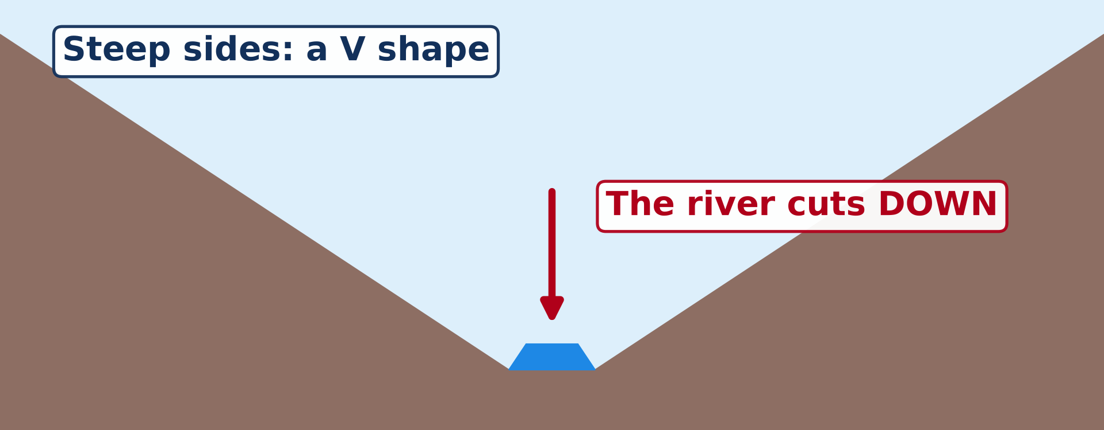
2. LANDFORMS OF THE UPPER COURSE
Activity 1
A valley in the upper course.
Notes:
Activity 1. Look carefully at this diagram: a valley in the upper course. Observe every detail before I ask the question.

Slide 20
2. LANDFORMS OF THE UPPER COURSE
Activity 1: Question 1
What is the shape of this valley?
Notes:
Here is the question for Activity 1: What is the shape of this valley? Take one minute to think and write your answer in your rough notebook.

Slide 21
2. LANDFORMS OF THE UPPER COURSE
Activity 1: Answer 1
A V shape.
Notes:
Let us check the answer together. A V shape.

Slide 22
2. LANDFORMS OF THE UPPER COURSE
Activity 1: Question 2
Why does it have this shape?
Notes:
Here is the next question: Why does it have this shape? Take one minute to think and write your answer in your rough notebook.

Slide 23
2. LANDFORMS OF THE UPPER COURSE
Activity 1: Answer 2
The river cuts down into its bed.
Notes:
Let us check the answer together. The river cuts down into its bed.

Slide 24
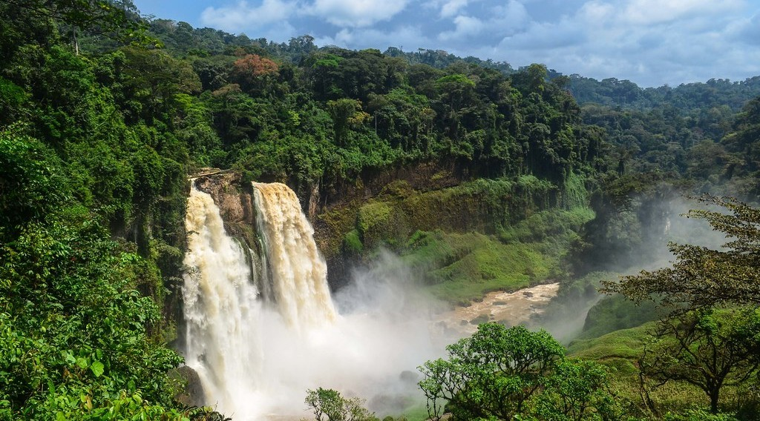
2. LANDFORMS OF THE UPPER COURSE
Activity 2
A waterfall.
Notes:
Activity 2. Look carefully at this picture: a waterfall. Observe every detail before I ask the question.

Slide 25
2. LANDFORMS OF THE UPPER COURSE
Activity 2: Question
Why does a waterfall form?
Notes:
Here is the question for Activity 2: Why does a waterfall form? Take one minute to think and write your answer in your rough notebook.

Slide 26
2. LANDFORMS OF THE UPPER COURSE
Activity 2: Answer
The river flows from hard rock onto soft rock that is worn away faster.
Notes:
Let us check the answer together. The river flows from hard rock onto soft rock that is worn away faster.

Slide 27
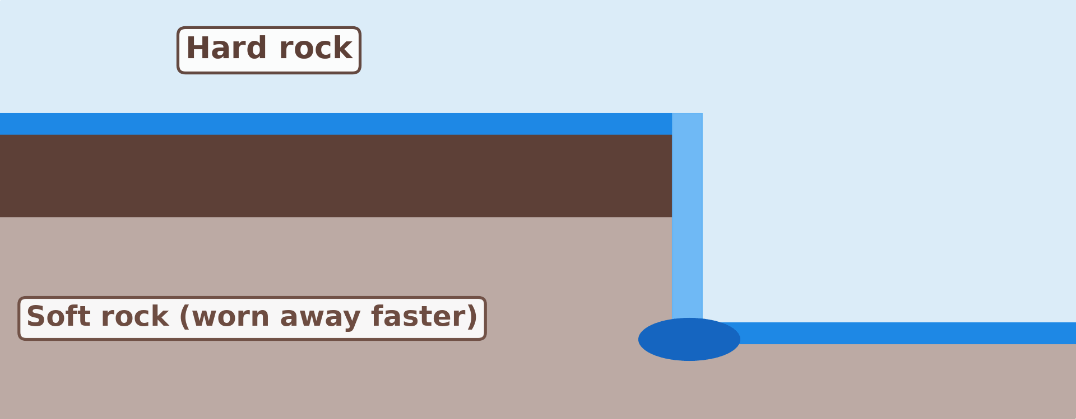
2. LANDFORMS OF THE UPPER COURSE
Activity 3
Animation: a waterfall moves back.
Notes:
Activity 3. Look carefully at this animation: animation: a waterfall moves back. Watch the animation to the end; it will play again.

Slide 28
2. LANDFORMS OF THE UPPER COURSE
Activity 3: Question
What does the waterfall leave behind as it moves back over many years?
Notes:
Here is the question for Activity 3: What does the waterfall leave behind as it moves back over many years? Take one minute to think and write your answer in your rough notebook.

Slide 29
2. LANDFORMS OF THE UPPER COURSE
Activity 3: Answer
A gorge.
Notes:
Let us check the answer together. A gorge.

Slide 30
BOARD SUMMARY
Board Summary
Topic: Denudation Processes, Landforms and Impacts on Man
Sub-topic: The Work of Rivers on the Landscape and Impacts on Man
Lesson 19: The Upper Course of a River
Notes:
Now we are going to copy the board summary. Write the title and the headings neatly in your notebooks. I will give you enough time for each slide, so do not rush.

Slide 31
BOARD SUMMARY
DEFINITIONS
The key terms of this lesson are defined as follows:
Upper course: It is the part of a river near its source, in the highlands.
Vertical erosion: It is the downward cutting of a river into its bed.
Notes:
Let us copy the definitions. The key terms of this lesson are defined as follows. On this slide we have Upper course and Vertical erosion. Write each point on a new line, with the key term first, and explain it in your own words when we revise.

Slide 32
BOARD SUMMARY
1. Main Characteristics and Processes of the Upper Course
The upper course has the following characteristics and processes:
Steep slope: The river is near its source in the highlands, so its slope is steep.
Fast water: The water flows fast and is noisy, but the channel is narrow and shallow.
Notes:
Let us copy Main Characteristics and Processes of the Upper Course. The upper course has the following characteristics and processes. On this slide we have Steep slope and Fast water. Write each point on a new line, with the key term first, and explain it in your own words when we revise. When you finish, we go to the next slide.

Slide 33
BOARD SUMMARY
1. Main Characteristics and Processes of the Upper Course (continued)
Big load: The river carries large stones and boulders, mainly rolled along its bed.
Vertical erosion: The river cuts down into its bed by hydraulic action and abrasion.
Notes:
We continue with Main Characteristics and Processes of the Upper Course. On this slide we have Big load and Vertical erosion. Write each point on a new line, with the key term first, and explain it in your own words when we revise.

Slide 34
BOARD SUMMARY
2. Landforms of the Upper Course
The upper course has the following landforms:
V-shaped valley: The river cuts down while weathering wears back the sides, giving a narrow, steep-sided valley.
Illustration: a V-shaped valley
Notes:
Let us copy Landforms of the Upper Course. The upper course has the following landforms. Copy the point on V-shaped valley on the left, then draw the diagram on the right: a V-shaped valley. Give it a title and label it clearly.

Slide 35
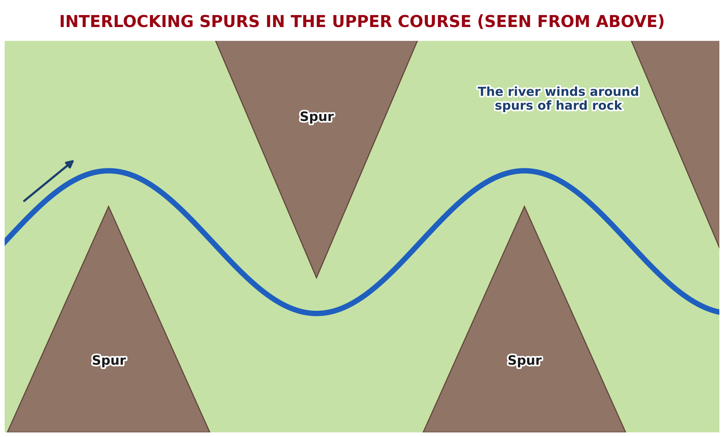
BOARD SUMMARY
2. Landforms of the Upper Course
Interlocking spurs: They are ridges of hard rock around which the river winds.
Illustration: interlocking spurs
Notes:
Copy the point on Interlocking spurs on the left, then draw the diagram on the right: interlocking spurs. Give it a title and label it clearly.

Slide 36
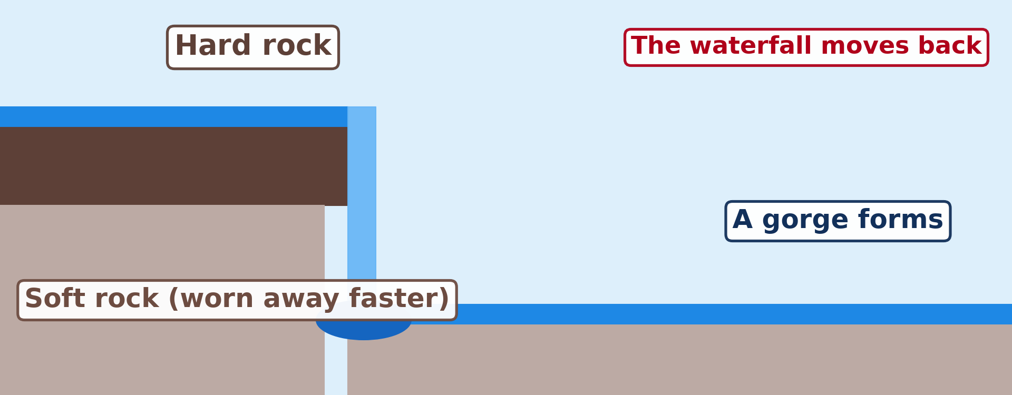
BOARD SUMMARY
2. Landforms of the Upper Course
Waterfall: It forms where a river falls over a band of hard rock lying on soft rock, as at the Vina and Tello Falls.
Illustration: formation of a waterfall
Notes:
Copy the point on Waterfall on the left, then draw the diagram on the right: formation of a waterfall. Give it a title and label it clearly.

Slide 37
BOARD SUMMARY
2. Landforms of the Upper Course
Gorge: It is a deep, narrow, steep-sided valley left as a waterfall moves back, as at the Kola Gorges near Guider.
Rapids (cataracts): They are stretches of fast, rough water where hard and soft rocks alternate on the river bed.
Notes:
We continue with Landforms of the Upper Course. On this slide we have Gorge and Rapids (cataracts). Write each point on a new line, with the key term first, and explain it in your own words when we revise. When you finish, we go to the next slide.

Slide 38
BOARD SUMMARY
2. Landforms of the Upper Course (continued)
Potholes: They are round holes drilled in the river bed by stones swirled by the water.
Notes:
We continue with Landforms of the Upper Course. On this slide we have Potholes. Write each point on a new line, with the key term first, and explain it in your own words when we revise.

Slide 39
FORMATIVE EVALUATION
Evaluation 1
What is the main work of a river in its upper course?
Notes:
Now let us check what you have understood. Question 1: What is the main work of a river in its upper course? Answer in your exercise book.

Slide 40
FORMATIVE EVALUATION
Expected Answer
It cuts down (vertical erosion).
Notes:
The expected answer is: it cuts down (vertical erosion). If you got it right, well done.

Slide 41
FORMATIVE EVALUATION
Evaluation 2
How does a gorge form?
Notes:
Now let us check what you have understood. Question 2: How does a gorge form? Answer in your exercise book.

Slide 42
FORMATIVE EVALUATION
Expected Answer
The waterfall moves back and leaves a deep, narrow valley.
Notes:
The expected answer is: the waterfall moves back and leaves a deep, narrow valley. If you got it right, well done.

Slide 43
REMEDIATION
Remediation
Fill in the blanks:
In the upper course, the valley is ______-shaped.
A river falling over a cliff forms a ______.
Notes:
Take your time to copy this part; we will continue together.

Slide 44
REMEDIATION
Remediation (continued)
The deep valley below a waterfall is a ______.
Notes:
For those who need more practice, fill in the blanks in your exercise book. The answers are: number 1, V; number 2, waterfall; number 3, gorge.

Slide 45
HOMEWORK
Homework
Define a meander.
Notes:
For your homework: Define a meander. We shall correct it at the beginning of our next lesson.

Slide 46
NEXT LESSON
Next Lesson
Our next lesson will be on:
Lesson 20: The Middle Course of a River
Notes:
Our next lesson will be on Lesson 20: The Middle Course of a River. Thank you for your attention, and see you next time.

Slide 47
BILINGUAL GAME
Bilingual Game (Jeu Bilingue)
English | Français
Waterfall | La chute d'eau / la cascade
Gorge | La gorge
Rapids | Les rapides
Pothole | La marmite de géant
Spur | L'éperon
V-shaped valley | La vallée en V
Plunge pool | La fosse de plongée
Hard rock | La roche dure
Notes:
Let us play the bilingual game. I say a word in English, and you give me the French word. Then we do the reverse.

Slide 48
LOGBOOK
Official Logbook (1/2)
Module / Topic | Denudation Processes, Landforms and Impacts on Man
Lesson Title | Lesson 19: The Upper Course of a River
Expected Learning Outcomes | Describe the main characteristics and processes of the upper course. Explain the formation of the landforms of the upper course. Give examples of these landforms in Cameroon.
Competence | Learners are able to recognise the landforms of the upper course, such as waterfalls and gorges, and to explain their value and dangers.
Notes:
I record this information in the official logbook of the class after the lesson.

Slide 49
LOGBOOK
Official Logbook (2/2)
Matter Taught | DEFINITIONS; Main Characteristics and Processes of the Upper Course; Landforms of the Upper Course.
Evaluation | Formative evaluation and remediation exercise.
Homework | Define a meander.
Enrolment / Present / Absent | ____ / ____ / ____
Achievement | To be completed after the lesson.
Notes:
I complete the second page of the logbook: the matter taught, the evaluation, the homework and the attendance.

Slide 50
TEACHER'S NOTE
Teacher's Note
Timing: Homework correction, plan, objectives 4 min | Recall, situation, action 6 min | 3 activities 12 min | Board summary (copying) 15 min | Evaluation, remediation 5 min | Homework, next lesson 3 min | Logbook 5 min
Activity 3 is an animation (GIF): it plays automatically in slide-show mode.
Without the projector (Activity 1): draw a V on the board.
Without the projector (Activity 2): describe the Vina or Tello Falls.
Without the projector (Activity 3): draw the waterfall at three dates.
Notes:
This slide is for me, the teacher: it gives the timing of the lesson and what to do if the projector is not available.

Slide 51
REFERENCES
References
National Geography Syllabus (MINESEC), Form 4 — Denudation Processes, Landforms and Impacts on Man.
Teacher's lesson notes (Form 4), checked and corrected where necessary.
Photo, Activity 2: “Ekom-Nkam waterfall” by jbdodane, CC BY-NC 2.0, via Flickr (https://www.flickr.com/photos/27998473@N02/11291226526)
Diagrams and animations: drawn for this lesson (Geography Department).
Notes:
These are the references and picture credits used to prepare this lesson.

