Slide 1
FORM 4
GEOGRAPHY
Lesson 20
The Middle Course of a River
Notes:
Good morning, class, and welcome to our geography lesson. I am your geography teacher, Mr Kamdem. Today we are starting Lesson 20: The Middle Course of a River.

Slide 2
CLASS INFO
Class, Chapter and Duration
Class | Form 4
Chapter | Denudation Processes, Landforms and Impacts on Man — The Work of Rivers on the Landscape and Impacts on Man
Duration | 50 minutes
Notes:
This lesson is for Form 4. It belongs to Denudation Processes, Landforms and Impacts on Man — The Work of Rivers on the Landscape and Impacts on Man. We shall need 50 minutes to cover it.

Slide 3
IDENTIFICATION
Lesson Identification
Topic | Denudation Processes, Landforms and Impacts on Man
Sub-topic | The Work of Rivers on the Landscape and Impacts on Man
Lesson | Lesson 20: The Middle Course of a River
Notions / Concepts | Open V-shaped valley, meanders, river cliffs, slip-off slopes.
Syllabus focus | Main characteristics and processes of the middle course; landforms of the middle course.
Competence | Learners are able to recognise the landforms of the middle course and to choose safe places to build or farm along a winding river.
Notes:
Our topic is Denudation Processes, Landforms and Impacts on Man, and the sub-topic is The Work of Rivers on the Landscape and Impacts on Man. The key notions we shall use today are: open V-shaped valley, meanders, river cliffs, slip-off slopes. At the end, you should be able to do this: learners are able to recognise the landforms of the middle course and to choose safe places to build or farm along a winding river.

Slide 4

HOMEWORK CORRECTION
Correction of the Homework
Question (Lesson 19: The Upper Course of a River):
Define a meander.
Notes:
Before we start the new lesson, let us correct the homework I gave you at the end of Lesson 19: The Upper Course of a River. The question was: Define a meander. Take out your exercise books.

Slide 5
HOMEWORK CORRECTION
Correction: Possible Answer
It is a large bend in a river.
Notes:
Here is a good answer. It is a large bend in a river. Compare it with your own answer and correct your work in red.

Slide 6
LESSON PLAN
Lesson Plan
Correction of the homework
Objectives and recall
Real-life situation and action to take
Learning activities
Board summary
Evaluation, remediation and homework
Notes:
Here is the plan of our lesson today. First, we shall correct the homework. Then we shall look at the objectives and recall what you already know. After that, we shall study a situation from real life and the action to take, and do the learning activities. Finally, we shall copy the board summary, do the evaluation and the remediation, and I will give you the homework.

Slide 7
OBJECTIVES
Objectives
By the end of this lesson, you should be able to:
Describe the main characteristics and processes of the middle course.
Explain how a river transports its load.
Notes:
Take your time to copy this part; we will continue together.

Slide 8
OBJECTIVES
Objectives (continued)
Explain the formation of meanders, river cliffs and slip-off slopes.
Notes:
By the end of this lesson, you should be able to do three things. Number 1: describe the main characteristics and processes of the middle course. Number 2: explain how a river transports its load. Number 3: explain the formation of meanders, river cliffs and slip-off slopes.

Slide 9
PREVIOUS KNOWLEDGE
Previous Knowledge
The upper course has steep slopes and vertical erosion.
Waterfalls form where hard rock lies on soft rock.
In the middle course, the gradient is gentler.
Notes:
Let us first remember what you already know. The upper course has steep slopes and vertical erosion. Waterfalls form where hard rock lies on soft rock. In the middle course, the gradient is gentler. Keep this in mind, because we shall build on it today.

Slide 10
REAL-LIFE SITUATION
Situation in Real Life
From the Benue Bridge in Garoua, Adama sees that the river makes big bends. On the outside of each bend the bank is steep and falls into the water, while on the inside there is a gentle beach of sand. He asks: "Why is one bank steep and the other gentle?"
Notes:
Listen carefully to this situation from real life. From the Benue Bridge in Garoua, Adama sees that the river makes big bends. On the outside of each bend the bank is steep and falls into the water, while on the inside there is a gentle beach of sand. He asks: "Why is one bank steep and the other gentle?" Think about it, because I am going to ask you some questions.

Slide 11
REAL-LIFE SITUATION
Situation: Question 1
What is the problem in the situation?
Notes:
Question 1: What is the problem in the situation? Think for a moment, then raise your hand to answer.

Slide 12
REAL-LIFE SITUATION
Answer
Adama does not understand why the two banks of a bend are different.
Notes:
Good. Adama does not understand why the two banks of a bend are different.

Slide 13
REAL-LIFE SITUATION
Situation: Question 2
Describe the outside of the bend.
Notes:
Question 2: Describe the outside of the bend. Think for a moment, then raise your hand to answer.

Slide 14
REAL-LIFE SITUATION
Answer
The bank is steep.
Notes:
Good. The bank is steep.

Slide 15
REAL-LIFE SITUATION
Situation: Question 3
Describe the inside of the bend.
Notes:
Question 3: Describe the inside of the bend. Think for a moment, then raise your hand to answer.

Slide 16
REAL-LIFE SITUATION
Possible Answer
It is a gentle beach of sand.
Notes:
Good. It is a gentle beach of sand.

Slide 17
ACTION TO TAKE
Action to Take
Avoid building on the outside of river bends where banks are eroded.
Notes:
From this situation, the action we are working towards in this lesson is the following: avoid building on the outside of river bends where banks are eroded.

Slide 18
JUSTIFICATION
Justification of the Lesson
This lesson helps us to know the landforms of the middle course.
Notes:
Why is this lesson important for you? This lesson helps us to know the landforms of the middle course.

Slide 19
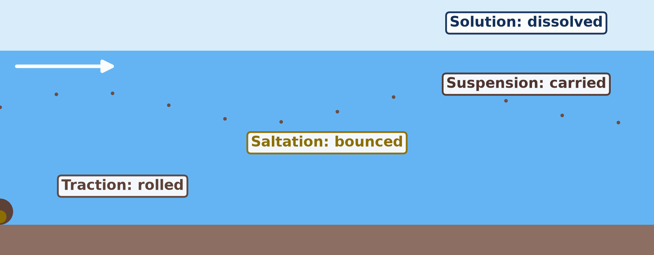
1. CHARACTERISTICS AND PROCESSES
Activity 1
Animation: how a river carries its load.
Notes:
Activity 1. Look carefully at this animation: animation: how a river carries its load. Watch the animation to the end; it will play again.

Slide 20
1. CHARACTERISTICS AND PROCESSES
Activity 1: Question
How does the river carry the big stones along its bed?
Notes:
Here is the question for Activity 1: How does the river carry the big stones along its bed? Take one minute to think and write your answer in your rough notebook.

Slide 21
1. CHARACTERISTICS AND PROCESSES
Activity 1: Answer
It rolls them: this is traction.
Notes:
Let us check the answer together. It rolls them: this is traction.

Slide 22

2. LANDFORMS OF THE MIDDLE COURSE
Activity 2
A river with big bends.
Notes:
Activity 2. Look carefully at this picture: a river with big bends. Observe every detail before I ask the question.

Slide 23
2. LANDFORMS OF THE MIDDLE COURSE
Activity 2: Question
What do we call these big bends of a river?
Notes:
Here is the question for Activity 2: What do we call these big bends of a river? Take one minute to think and write your answer in your rough notebook.

Slide 24
2. LANDFORMS OF THE MIDDLE COURSE
Activity 2: Answer
Meanders.
Notes:
Let us check the answer together. Meanders.

Slide 25
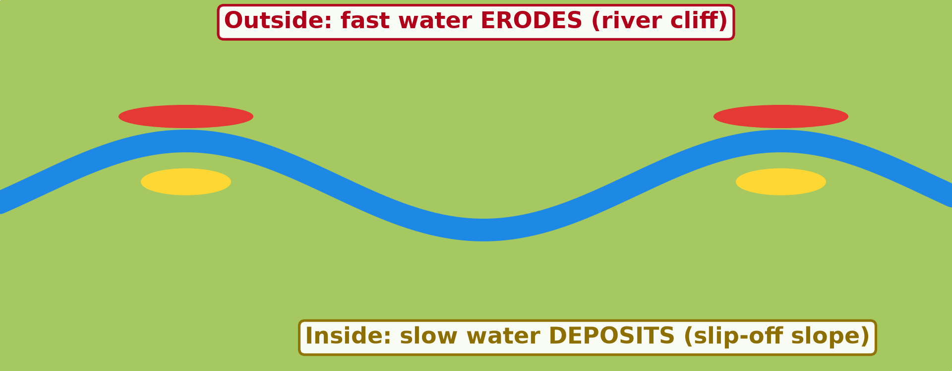
2. LANDFORMS OF THE MIDDLE COURSE
Activity 3
Animation: erosion and deposition in a meander.
Notes:
Activity 3. Look carefully at this animation: animation: erosion and deposition in a meander. Watch the animation to the end; it will play again.

Slide 26
2. LANDFORMS OF THE MIDDLE COURSE
Activity 3: Question 1
On which side of the bend does the water erode?
Notes:
Here is the question for Activity 3: On which side of the bend does the water erode? Take one minute to think and write your answer in your rough notebook.

Slide 27
2. LANDFORMS OF THE MIDDLE COURSE
Activity 3: Answer 1
On the outside.
Notes:
Let us check the answer together. On the outside.

Slide 28
2. LANDFORMS OF THE MIDDLE COURSE
Activity 3: Question 2
On which side does it deposit?
Notes:
Here is the next question: On which side does it deposit? Take one minute to think and write your answer in your rough notebook.

Slide 29
2. LANDFORMS OF THE MIDDLE COURSE
Activity 3: Answer 2
On the inside.
Notes:
Let us check the answer together. On the inside.

Slide 30
BOARD SUMMARY
Board Summary
Topic: Denudation Processes, Landforms and Impacts on Man
Sub-topic: The Work of Rivers on the Landscape and Impacts on Man
Lesson 20: The Middle Course of a River
Notes:
Now we are going to copy the board summary. Write the title and the headings neatly in your notebooks. I will give you enough time for each slide, so do not rush.

Slide 31
BOARD SUMMARY
DEFINITIONS
The key terms of this lesson are defined as follows:
Middle course: It is the part of a river between the upper and the lower course, where the slope becomes gentle.
Lateral erosion: It is the sideways cutting of a river into its banks.
Notes:
Let us copy the definitions. The key terms of this lesson are defined as follows. On this slide we have Middle course and Lateral erosion. Write each point on a new line, with the key term first, and explain it in your own words when we revise.

Slide 32
BOARD SUMMARY
1. Main Characteristics and Processes of the Middle Course
A) Characteristics
The middle course has the following characteristics:
Gentle slope: The slope becomes gentle, and the water flows more smoothly.
Wider valley: The valley is wider and more open, with a flat floor.
Notes:
Let us copy Characteristics. The middle course has the following characteristics. On this slide we have Gentle slope and Wider valley. Write each point on a new line, with the key term first, and explain it in your own words when we revise. When you finish, we go to the next slide.

Slide 33
BOARD SUMMARY
1. Main Characteristics and Processes of the Middle Course
A) Characteristics (continued)
More water: Tributaries have joined the river, so its volume and load are bigger.
Lateral erosion: The river cuts sideways into its banks more than downwards.
Notes:
We continue with Characteristics. On this slide we have More water and Lateral erosion. Write each point on a new line, with the key term first, and explain it in your own words when we revise.

Slide 34
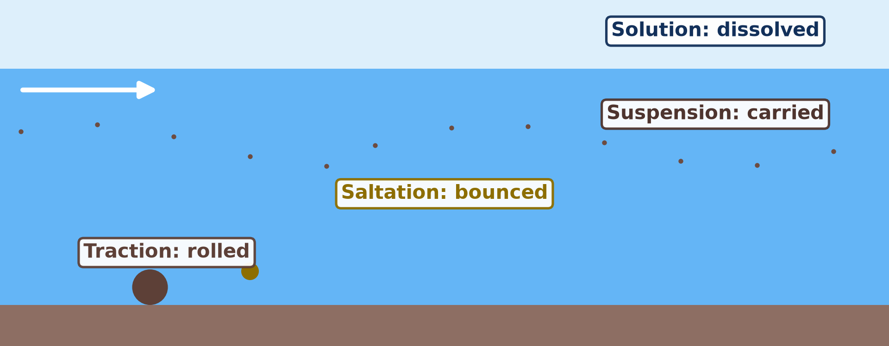
BOARD SUMMARY
1. Main Characteristics and Processes of the Middle Course
B) Transport of the Load
The river carries its load in the following ways:
Traction: Large stones are rolled along the bed.
Illustration: how a river transports its load
Notes:
Let us copy Transport of the Load. The river carries its load in the following ways. Copy the point on Traction on the left, then draw the diagram on the right: how a river transports its load. Give it a title and label it clearly.

Slide 35
BOARD SUMMARY
1. Main Characteristics and Processes of the Middle Course
B) Transport of the Load
Saltation: Small stones and sand bounce along the bed.
Suspension: Fine mud and clay are carried in the water, which looks brown.
Solution: Dissolved minerals are carried invisibly in the water.
Notes:
We continue with Transport of the Load. On this slide we have Saltation, Suspension and Solution. Write each point on a new line, with the key term first, and explain it in your own words when we revise.

Slide 36
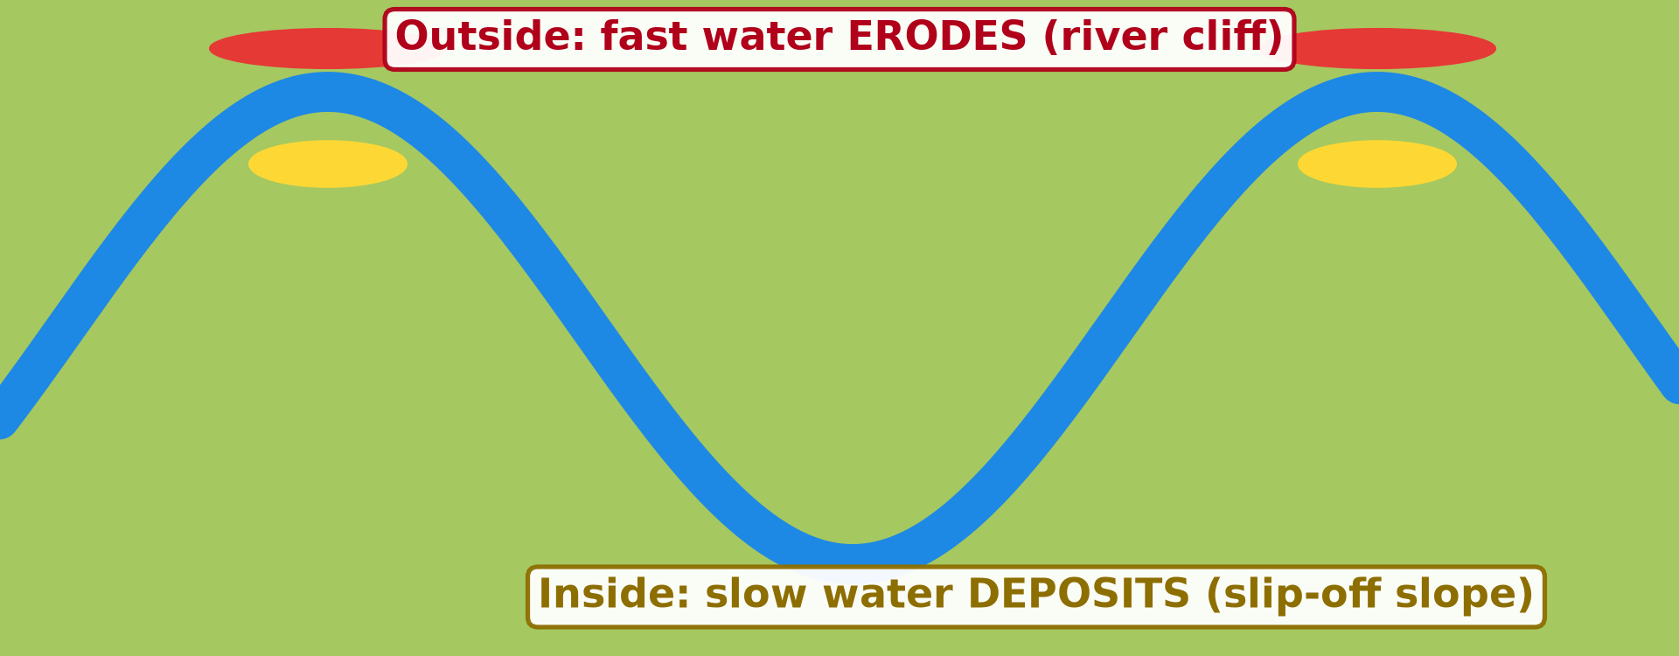
BOARD SUMMARY
2. Landforms of the Middle Course
The middle course has the following landforms:
Meander: It is a large bend in a river, formed by erosion on the outside and deposition on the inside of the bend.
Illustration: a meander
Notes:
Let us copy Landforms of the Middle Course. The middle course has the following landforms. Copy the point on Meander on the left, then draw the diagram on the right: a meander. Give it a title and label it clearly.

Slide 37
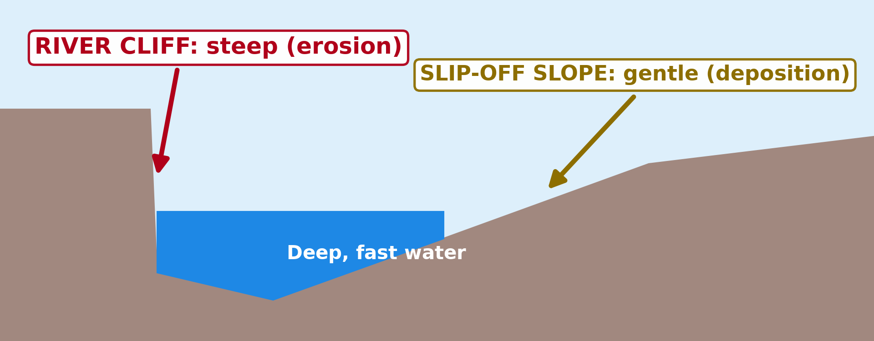
BOARD SUMMARY
2. Landforms of the Middle Course
River cliff: It is a steep bank on the outside of a bend, where the fast, deep water erodes.
Illustration: river cliff and slip-off slope
Notes:
Copy the point on River cliff on the left, then draw the diagram on the right: river cliff and slip-off slope. Give it a title and label it clearly.

Slide 38
BOARD SUMMARY
2. Landforms of the Middle Course
Slip-off slope: It is a gentle bank on the inside of a bend, where the slow water deposits sand and gravel.
Open V-shaped valley: The valley becomes wider, with gentler sides and a narrow flat floor.
Notes:
We continue with Landforms of the Middle Course. On this slide we have Slip-off slope and Open V-shaped valley. Write each point on a new line, with the key term first, and explain it in your own words when we revise.

Slide 39
FORMATIVE EVALUATION
Evaluation 1
What is a meander?
Notes:
Now let us check what you have understood. Question 1: What is a meander? Answer in your exercise book.

Slide 40
FORMATIVE EVALUATION
Expected Answer
A big bend in a river.
Notes:
The expected answer is: a big bend in a river. If you got it right, well done.

Slide 41
FORMATIVE EVALUATION
Evaluation 2
Why is the outside of a bend steep?
Notes:
Now let us check what you have understood. Question 2: Why is the outside of a bend steep? Answer in your exercise book.

Slide 42
FORMATIVE EVALUATION
Expected Answer
The fast water erodes it.
Notes:
The expected answer is: the fast water erodes it. If you got it right, well done.

Slide 43
REMEDIATION
Remediation
Fill in the blanks:
A big bend in a river is a ______.
The steep bank on the outside is a river ______.
The gentle bank on the inside is a slip-off ______.
Notes:
For those who need more practice, fill in the blanks in your exercise book. The answers are: number 1, meander; number 2, cliff; number 3, slope.

Slide 44
HOMEWORK
Homework
Name two landforms of the lower course of a river.
Notes:
For your homework: Name two landforms of the lower course of a river. We shall correct it at the beginning of our next lesson.

Slide 45
NEXT LESSON
Next Lesson
Our next lesson will be on:
Lesson 21: The Lower Course of a River
Notes:
Our next lesson will be on Lesson 21: The Lower Course of a River. Thank you for your attention, and see you next time.

Slide 46
BILINGUAL GAME
Bilingual Game (Jeu Bilingue)
English | Français
Meander | Le méandre
River cliff | La rive concave / falaise de méandre
Slip-off slope | La rive convexe
Lateral erosion | L'érosion latérale
Suspension | La suspension
Saltation | La saltation
Traction | Le charriage / la traction
Sandbank | Le banc de sable
Notes:
Let us play the bilingual game. I say a word in English, and you give me the French word. Then we do the reverse.

Slide 47
LOGBOOK
Official Logbook (1/2)
Module / Topic | Denudation Processes, Landforms and Impacts on Man
Lesson Title | Lesson 20: The Middle Course of a River
Expected Learning Outcomes | Describe the main characteristics and processes of the middle course. Explain how a river transports its load. Explain the formation of meanders, river cliffs and slip-off slopes.
Competence | Learners are able to recognise the landforms of the middle course and to choose safe places to build or farm along a winding river.
Notes:
I record this information in the official logbook of the class after the lesson.

Slide 48
LOGBOOK
Official Logbook (2/2)
Matter Taught | DEFINITIONS; Characteristics; Transport of the Load; Landforms of the Middle Course.
Evaluation | Formative evaluation and remediation exercise.
Homework | Name two landforms of the lower course of a river.
Enrolment / Present / Absent | ____ / ____ / ____
Achievement | To be completed after the lesson.
Notes:
I complete the second page of the logbook: the matter taught, the evaluation, the homework and the attendance.

Slide 49
TEACHER'S NOTE
Teacher's Note
Timing: Homework correction, plan, objectives 4 min | Recall, situation, action 6 min | 3 activities 12 min | Board summary (copying) 15 min | Evaluation, remediation 5 min | Homework, next lesson 3 min | Logbook 5 min
Activities 1 and 3 are animations (GIF): it plays automatically in slide-show mode.
Without the projector (Activity 1): roll a stone along a table.
Without the projector (Activity 2): draw a winding river on the board.
Without the projector (Activity 3): mark the fast and slow water on the drawing.
Notes:
This slide is for me, the teacher: it gives the timing of the lesson and what to do if the projector is not available.

Slide 50
REFERENCES
References
National Geography Syllabus (MINESEC), Form 4 — Denudation Processes, Landforms and Impacts on Man.
Teacher's lesson notes (Form 4), checked and corrected where necessary.
Photo, Activity 2: “Ox-bow” by colinjackson1972, CC BY-NC 2.0, via Flickr (https://www.flickr.com/photos/8253719@N04/2329293239)
Diagrams and animations: drawn for this lesson (Geography Department).
Notes:
These are the references and picture credits used to prepare this lesson.

