Slide 1
FORM 4
GEOGRAPHY
Lesson 25
Main Depositional Features of Wave Action
Notes:
Good morning, class, and welcome to our geography lesson. I am your geography teacher, Mr Kamdem. Today we are starting Lesson 25: Main Depositional Features of Wave Action.

Slide 2
CLASS INFO
Class, Chapter and Duration
Class | Form 4
Chapter | Denudation Processes, Landforms and Impacts on Man — Wave Action along the Coast and Impacts on Man
Duration | 50 minutes
Notes:
This lesson is for Form 4. It belongs to Denudation Processes, Landforms and Impacts on Man — Wave Action along the Coast and Impacts on Man. We shall need 50 minutes to cover it.

Slide 3
IDENTIFICATION
Lesson Identification
Topic | Denudation Processes, Landforms and Impacts on Man
Sub-topic | Wave Action along the Coast and Impacts on Man
Lesson | Lesson 25: Main Depositional Features of Wave Action
Notions / Concepts | Beach, spits, bars, tombolos, longshore drift.
Syllabus focus | Major depositional process (longshore drift); depositional features.
Competence | Learners are able to explain how beaches and spits are built, and why sand moves along a coast.
Notes:
Our topic is Denudation Processes, Landforms and Impacts on Man, and the sub-topic is Wave Action along the Coast and Impacts on Man. The key notions we shall use today are: beach, spits, bars, tombolos, longshore drift. At the end, you should be able to do this: learners are able to explain how beaches and spits are built, and why sand moves along a coast.

Slide 4

HOMEWORK CORRECTION
Correction of the Homework
Question (Lesson 24: Main Erosional Processes and Features of Wave Action):
Name two depositional features of waves.
Notes:
Before we start the new lesson, let us correct the homework I gave you at the end of Lesson 24: Main Erosional Processes and Features of Wave Action. The question was: Name two depositional features of waves. Take out your exercise books.

Slide 5
HOMEWORK CORRECTION
Correction: Possible Answer
The beach and the spit (also bars and tombolos).
Notes:
Here is a good answer. The beach and the spit (also bars and tombolos). Compare it with your own answer and correct your work in red.

Slide 6
LESSON PLAN
Lesson Plan
Correction of the homework
Objectives and recall
Real-life situation and action to take
Learning activities
Board summary
Evaluation, remediation and homework
Notes:
Here is the plan of our lesson today. First, we shall correct the homework. Then we shall look at the objectives and recall what you already know. After that, we shall study a situation from real life and the action to take, and do the learning activities. Finally, we shall copy the board summary, do the evaluation and the remediation, and I will give you the homework.

Slide 7
OBJECTIVES
Objectives
By the end of this lesson, you should be able to:
Explain longshore drift.
Explain the formation of beaches, spits, bars and tombolos.
Give examples of these features.
Notes:
By the end of this lesson, you should be able to do three things. Number 1: explain longshore drift. Number 2: explain the formation of beaches, spits, bars and tombolos. Number 3: give examples of these features.

Slide 8
PREVIOUS KNOWLEDGE
Previous Knowledge
Constructive waves build beaches.
Waves erode rocky coasts and form cliffs, caves, arches and stacks.
The swash goes up the beach; the backwash goes down.
Notes:
Let us first remember what you already know. Constructive waves build beaches. Waves erode rocky coasts and form cliffs, caves, arches and stacks. The swash goes up the beach; the backwash goes down. Keep this in mind, because we shall build on it today.

Slide 9
REAL-LIFE SITUATION
Situation in Real Life
In Kribi, Maïmouna builds a sandcastle. The waves reach the beach at an angle, and after an hour some sand of her castle has moved along the beach. Further on, a long strip of sand sticks out into the sea. She asks: "How do waves move the sand, and what do they build with it?"
Notes:
Listen carefully to this situation from real life. In Kribi, Maïmouna builds a sandcastle. The waves reach the beach at an angle, and after an hour some sand of her castle has moved along the beach. Further on, a long strip of sand sticks out into the sea. She asks: "How do waves move the sand, and what do they build with it?" Think about it, because I am going to ask you some questions.

Slide 10
REAL-LIFE SITUATION
Situation: Question 1
What is the problem in the situation?
Notes:
Question 1: What is the problem in the situation? Think for a moment, then raise your hand to answer.

Slide 11
REAL-LIFE SITUATION
Answer
Maïmouna does not know how waves move sand along the coast and what features they build.
Notes:
Good. Maïmouna does not know how waves move sand along the coast and what features they build.

Slide 12
REAL-LIFE SITUATION
Situation: Question 2
How do the waves reach the beach?
Notes:
Question 2: How do the waves reach the beach? Think for a moment, then raise your hand to answer.

Slide 13
REAL-LIFE SITUATION
Answer
At an angle.
Notes:
Good. At an angle.

Slide 14
REAL-LIFE SITUATION
Situation: Question 3
What happened to the sand of her castle?
Notes:
Question 3: What happened to the sand of her castle? Think for a moment, then raise your hand to answer.

Slide 15
REAL-LIFE SITUATION
Possible Answer
It moved along the beach.
Notes:
Good. It moved along the beach.

Slide 16
ACTION TO TAKE
Action to Take
Protect beaches by not removing sand from them.
Notes:
From this situation, the action we are working towards in this lesson is the following: protect beaches by not removing sand from them.

Slide 17
JUSTIFICATION
Justification of the Lesson
This lesson helps us to know the landforms made when waves drop sand.
Notes:
Why is this lesson important for you? This lesson helps us to know the landforms made when waves drop sand.

Slide 18
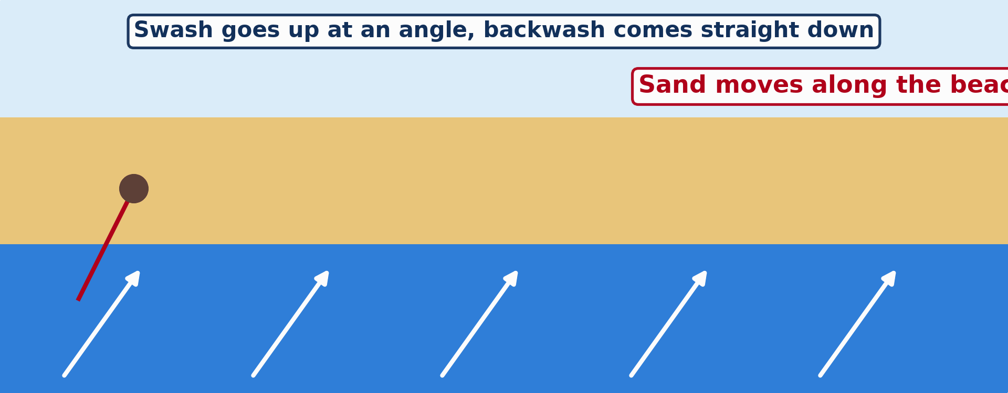
1. MAJOR DEPOSITIONAL PROCESS
Activity 1
Animation: longshore drift.
Notes:
Activity 1. Look carefully at this animation: animation: longshore drift. Watch the animation to the end; it will play again.

Slide 19
1. MAJOR DEPOSITIONAL PROCESS
Activity 1: Question 1
How does the swash push the sand?
Notes:
Here is the question for Activity 1: How does the swash push the sand? Take one minute to think and write your answer in your rough notebook.

Slide 20
1. MAJOR DEPOSITIONAL PROCESS
Activity 1: Answer 1
Up the beach at an angle.
Notes:
Let us check the answer together. Up the beach at an angle.

Slide 21
1. MAJOR DEPOSITIONAL PROCESS
Activity 1: Question 2
How does the backwash bring it back?
Notes:
Here is the next question: How does the backwash bring it back? Take one minute to think and write your answer in your rough notebook.

Slide 22
1. MAJOR DEPOSITIONAL PROCESS
Activity 1: Answer 2
Straight down the beach.
Notes:
Let us check the answer together. Straight down the beach.

Slide 23

2. DEPOSITIONAL FEATURES
Activity 2
A long strip of sand joined to the land.
Notes:
Activity 2. Look carefully at this picture: a long strip of sand joined to the land. Observe every detail before I ask the question.

Slide 24
2. DEPOSITIONAL FEATURES
Activity 2: Question
This strip of sand is joined to the land at one end. What is it called?
Notes:
Here is the question for Activity 2: This strip of sand is joined to the land at one end. What is it called? Take one minute to think and write your answer in your rough notebook.

Slide 25
2. DEPOSITIONAL FEATURES
Activity 2: Answer
A spit.
Notes:
Let us check the answer together. A spit.

Slide 26
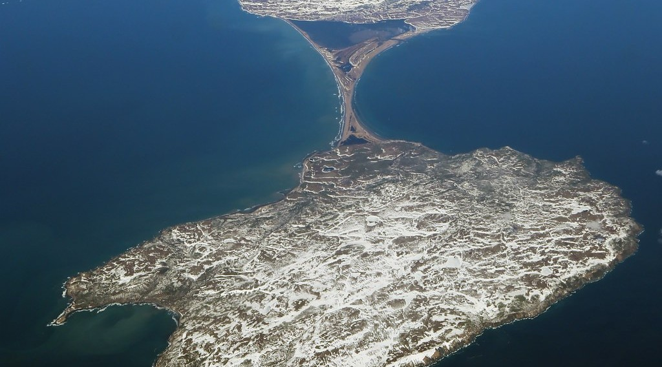
2. DEPOSITIONAL FEATURES
Activity 3
An island joined to the land by sand.
Notes:
Activity 3. Look carefully at this picture: an island joined to the land by sand. Observe every detail before I ask the question.

Slide 27
2. DEPOSITIONAL FEATURES
Activity 3: Question
What do we call a strip of sand that joins an island to the land?
Notes:
Here is the question for Activity 3: What do we call a strip of sand that joins an island to the land? Take one minute to think and write your answer in your rough notebook.

Slide 28
2. DEPOSITIONAL FEATURES
Activity 3: Answer
A tombolo.
Notes:
Let us check the answer together. A tombolo.

Slide 29
BOARD SUMMARY
Board Summary
Topic: Denudation Processes, Landforms and Impacts on Man
Sub-topic: Wave Action along the Coast and Impacts on Man
Lesson 25: Main Depositional Features of Wave Action
Notes:
Now we are going to copy the board summary. Write the title and the headings neatly in your notebooks. I will give you enough time for each slide, so do not rush.

Slide 30
BOARD SUMMARY
DEFINITIONS
The key terms of this lesson are defined as follows:
Longshore drift: It is the movement of sand and pebbles along the coast by waves.
Wave deposition: It is the dropping of sand and pebbles by waves when they lose energy.
Notes:
Let us copy the definitions. The key terms of this lesson are defined as follows. On this slide we have Longshore drift and Wave deposition. Write each point on a new line, with the key term first, and explain it in your own words when we revise.

Slide 31
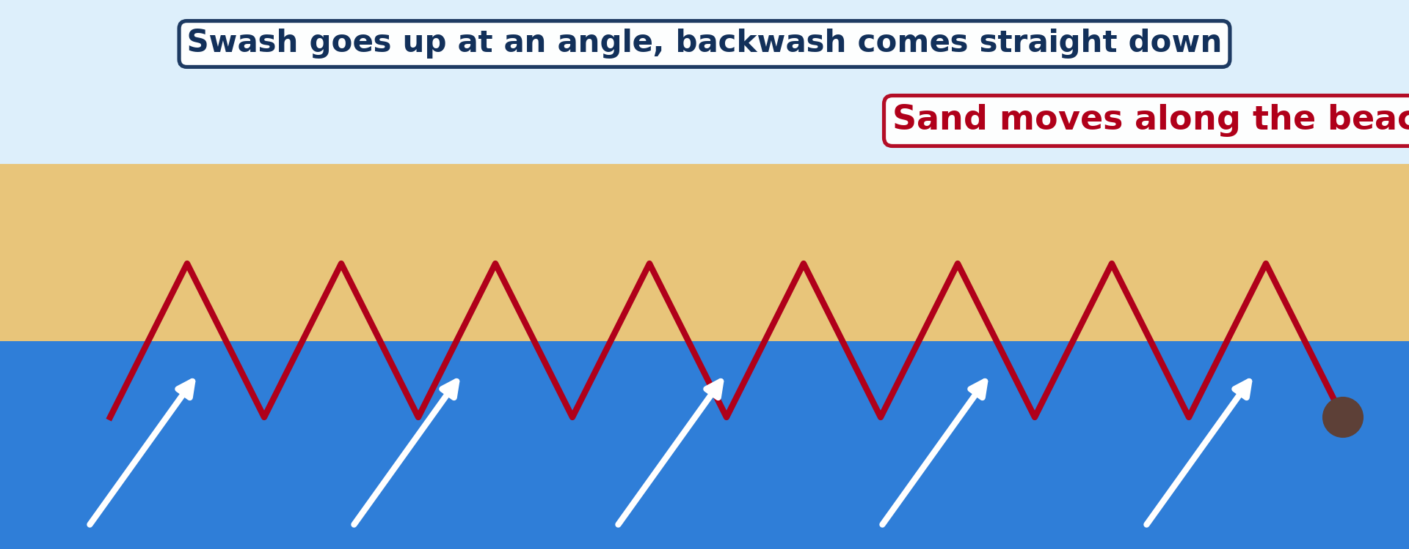
BOARD SUMMARY
1. Major Depositional Process: Longshore Drift
Longshore drift takes place in the following steps:
Step 1: The wind makes the waves reach the beach at an angle.
Illustration: longshore drift
Notes:
Let us copy Major Depositional Process: Longshore Drift. Longshore drift takes place in the following steps. Copy the point on Step 1 on the left, then draw the diagram on the right: longshore drift. Give it a title and label it clearly.

Slide 32
BOARD SUMMARY
1. Major Depositional Process: Longshore Drift
Step 2: The swash pushes sand and pebbles up the beach at the same angle.
Step 3: The backwash brings them straight back down the slope of the beach.
Step 4: This is repeated many times, so the sand moves along the beach in zigzags.
Notes:
We continue with Major Depositional Process: Longshore Drift. On this slide we have Step 2, Step 3 and Step 4. Write each point on a new line, with the key term first, and explain it in your own words when we revise.

Slide 33
BOARD SUMMARY
2. Depositional Features
Wave deposition forms the following features:
Beach: It is a gentle slope of sand and pebbles between low and high tide, like the beaches of Kribi.
Notes:
Let us copy Depositional Features. Wave deposition forms the following features. On this slide we have Beach. Write each point on a new line, with the key term first, and explain it in your own words when we revise.

Slide 34
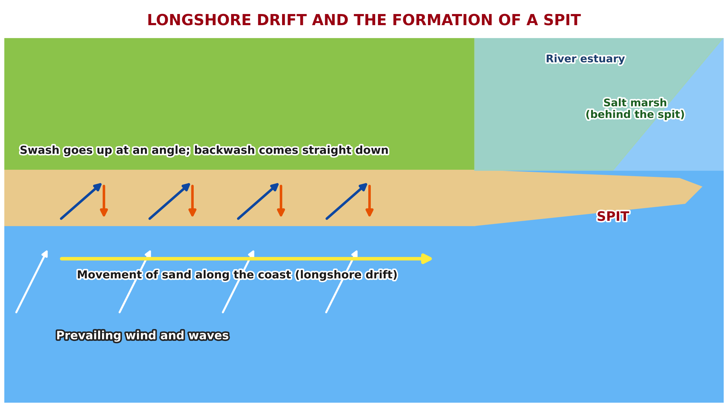
BOARD SUMMARY
2. Depositional Features
Spit: It is a long strip of sand joined to the land at one end, built by longshore drift where the coast changes direction.
Illustration: the formation of a spit
Notes:
Copy the point on Spit on the left, then draw the diagram on the right: the formation of a spit. Give it a title and label it clearly.

Slide 35
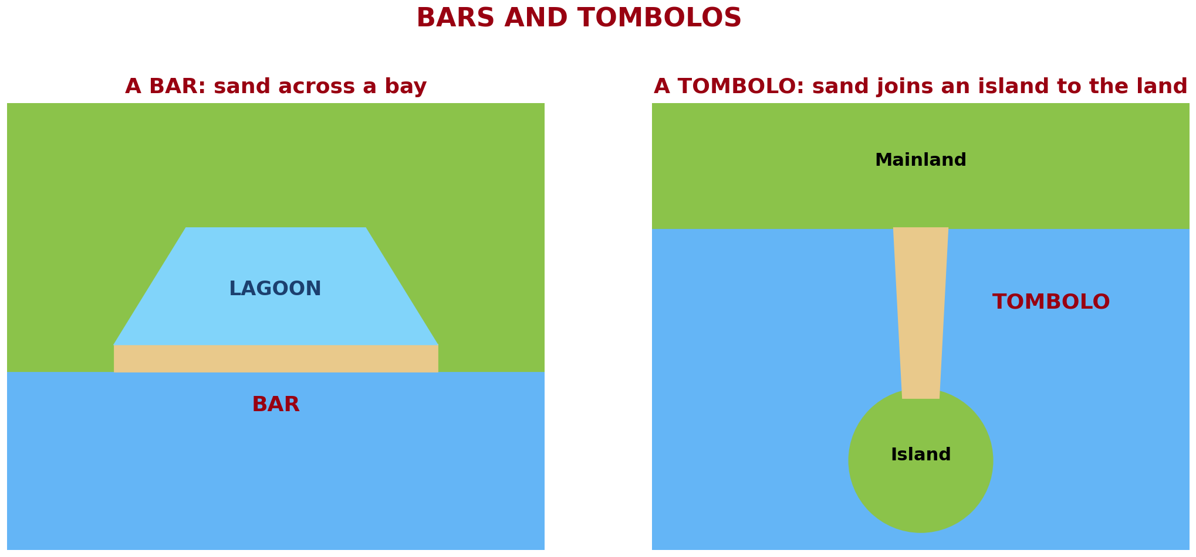
BOARD SUMMARY
2. Depositional Features
Bar: It is a strip of sand that grows across a bay and may enclose a lagoon.
Illustration: a bar and a tombolo
Notes:
Copy the point on Bar on the left, then draw the diagram on the right: a bar and a tombolo. Give it a title and label it clearly.

Slide 36
BOARD SUMMARY
2. Depositional Features
Tombolo: It is a strip of sand that joins an island to the mainland.
Illustration: a tombolo
Notes:
Copy the point on Tombolo on the left, then draw the diagram on the right: a tombolo. Give it a title and label it clearly.

Slide 37
FORMATIVE EVALUATION
Evaluation 1
What is longshore drift?
Notes:
Now let us check what you have understood. Question 1: What is longshore drift? Answer in your exercise book.

Slide 38
FORMATIVE EVALUATION
Expected Answer
The movement of sand along the beach by waves.
Notes:
The expected answer is: the movement of sand along the beach by waves. If you got it right, well done.

Slide 39
FORMATIVE EVALUATION
Evaluation 2
What is the difference between a spit and a bar?
Notes:
Now let us check what you have understood. Question 2: What is the difference between a spit and a bar? Answer in your exercise book.

Slide 40
FORMATIVE EVALUATION
Expected Answer
A spit is joined at one end; a bar closes a bay.
Notes:
The expected answer is: a spit is joined at one end; a bar closes a bay. If you got it right, well done.

Slide 41
REMEDIATION
Remediation
Fill in the blanks:
The movement of sand along the beach is ______ drift.
A strip of sand joined at one end is a ______.
Notes:
Take your time to copy this part; we will continue together.

Slide 42
REMEDIATION
Remediation (continued)
Sand joining an island to the land is a ______.
Notes:
For those who need more practice, fill in the blanks in your exercise book. The answers are: number 1, longshore; number 2, spit; number 3, tombolo.

Slide 43
HOMEWORK
Homework
Name the two main sea ports of Cameroon.
Notes:
For your homework: Name the two main sea ports of Cameroon. We shall correct it at the beginning of our next lesson.

Slide 44
NEXT LESSON
Next Lesson
Our next lesson will be on:
Lesson 26: Impact of Wave Action on Human Development along Coastal Areas
Notes:
Our next lesson will be on Lesson 26: Impact of Wave Action on Human Development along Coastal Areas. Thank you for your attention, and see you next time.

Slide 45
BILINGUAL GAME
Bilingual Game (Jeu Bilingue)
English | Français
Longshore drift | La dérive littorale
Beach | La plage
Spit | La flèche littorale
Bar | Le cordon littoral
Lagoon | La lagune
Tombolo | Le tombolo
Sand | Le sable
Pebble | Le galet
Notes:
Let us play the bilingual game. I say a word in English, and you give me the French word. Then we do the reverse.

Slide 46
LOGBOOK
Official Logbook (1/2)
Module / Topic | Denudation Processes, Landforms and Impacts on Man
Lesson Title | Lesson 25: Main Depositional Features of Wave Action
Expected Learning Outcomes | Explain longshore drift. Explain the formation of beaches, spits, bars and tombolos. Give examples of these features.
Competence | Learners are able to explain how beaches and spits are built, and why sand moves along a coast.
Notes:
I record this information in the official logbook of the class after the lesson.

Slide 47
LOGBOOK
Official Logbook (2/2)
Matter Taught | DEFINITIONS; Major Depositional Process: Longshore Drift; Depositional Features.
Evaluation | Formative evaluation and remediation exercise.
Homework | Name the two main sea ports of Cameroon.
Enrolment / Present / Absent | ____ / ____ / ____
Achievement | To be completed after the lesson.
Notes:
I complete the second page of the logbook: the matter taught, the evaluation, the homework and the attendance.

Slide 48
TEACHER'S NOTE
Teacher's Note
Timing: Homework correction, plan, objectives 4 min | Recall, situation, action 6 min | 3 activities 12 min | Board summary (copying) 15 min | Evaluation, remediation 5 min | Homework, next lesson 3 min | Logbook 5 min
Activity 1 is an animation (GIF): it plays automatically in slide-show mode.
Without the projector (Activity 1): draw zigzag arrows along a beach.
Without the projector (Activity 2): draw a spit at a river mouth.
Without the projector (Activity 3): draw an island and a strip of sand.
Notes:
This slide is for me, the teacher: it gives the timing of the lesson and what to do if the projector is not available.

Slide 49
REFERENCES
References
National Geography Syllabus (MINESEC), Form 4 — Denudation Processes, Landforms and Impacts on Man.
Teacher's lesson notes (Form 4), checked and corrected where necessary.
Photo, Activity 2: “Coastal defences no longer being maintained - Why? Spurn Head, Yorkshi” by Richard Allaway, CC BY 2.0, via Flickr (https://www.flickr.com/photos/16287002@N00/6605676971)
Photo, Activity 3: “2017_04_10_lhr-ewr_083” by dsearls, CC BY 2.0, via Flickr (https://www.flickr.com/photos/52614599@N00/33953233846)
Diagrams and animations: drawn for this lesson (Geography Department).
Notes:
These are the references and picture credits used to prepare this lesson.

