Slide 1
FORM 4
GEOGRAPHY
Lesson 32
Weather Elements: Atmospheric Temperatures
Notes:
Good morning, class, and welcome to our geography lesson. I am your geography teacher, Mr Kamdem. Today we are starting Lesson 32: Weather Elements: Atmospheric Temperatures.

Slide 2
CLASS INFO
Class, Chapter and Duration
Class | Form 4
Chapter | Module 3: Weather and Climate — Adaptation to Climatic Excesses
Duration | 50 minutes
Notes:
This lesson is for Form 4. It belongs to Module 3: Weather and Climate — Adaptation to Climatic Excesses. We shall need 50 minutes to cover it.

Slide 3
IDENTIFICATION
Lesson Identification
Topic | The Earth-Atmosphere System
Sub-topic | Measurement of Weather Elements
Lesson | Lesson 32: Weather Elements: Atmospheric Temperatures
Notions / Concepts | Temperature, thermometer, Stevenson screen.
Syllabus focus | Meaning of atmospheric temperature; measurement and presentation; siting of the Stevenson screen.
Competence | Learners are able to measure the temperature of the air correctly and calculate daily means and ranges.
Notes:
Our topic is The Earth-Atmosphere System, and the sub-topic is Measurement of Weather Elements. The key notions we shall use today are: temperature, thermometer, Stevenson screen. At the end, you should be able to do this: learners are able to measure the temperature of the air correctly and calculate daily means and ranges.

Slide 4

HOMEWORK CORRECTION
Correction of the Homework
Question (Lesson 31: Weather and Climate):
Name the instrument that records the maximum and minimum temperatures.
Notes:
Before we start the new lesson, let us correct the homework I gave you at the end of Lesson 31: Weather and Climate. The question was: Name the instrument that records the maximum and minimum temperatures. Take out your exercise books.

Slide 5
HOMEWORK CORRECTION
Correction: Possible Answer
Six's thermometer.
Notes:
Here is a good answer. Six's thermometer. Compare it with your own answer and correct your work in red.

Slide 6
LESSON PLAN
Lesson Plan
Correction of the homework
Objectives and recall
Real-life situation and action to take
Learning activities
Board summary
Evaluation, remediation and homework
Notes:
Here is the plan of our lesson today. First, we shall correct the homework. Then we shall look at the objectives and recall what you already know. After that, we shall study a situation from real life and the action to take, and do the learning activities. Finally, we shall copy the board summary, do the evaluation and the remediation, and I will give you the homework.

Slide 7
OBJECTIVES
Objectives
By the end of this lesson, you should be able to:
Define atmospheric temperature.
Describe how temperature is measured and calculate mean and range.
Notes:
Take your time to copy this part; we will continue together.

Slide 8
OBJECTIVES
Objectives (continued)
Describe the Stevenson screen and the rules for siting it.
Notes:
By the end of this lesson, you should be able to do three things. Number 1: define atmospheric temperature. Number 2: describe how temperature is measured and calculate mean and range. Number 3: describe the Stevenson screen and the rules for siting it.

Slide 9
PREVIOUS KNOWLEDGE
Previous Knowledge
Weather is the condition of the atmosphere at a given time; climate is the average over 30 years.
Each weather element has its instrument, unit and isoline.
Temperature is measured with a thermometer, in °C.
Notes:
Let us first remember what you already know. Weather is the condition of the atmosphere at a given time; climate is the average over 30 years. Each weather element has its instrument, unit and isoline. Temperature is measured with a thermometer, in °C. Keep this in mind, because we shall build on it today.

Slide 10
REAL-LIFE SITUATION
Situation in Real Life
Ali puts his thermometer in the sun on the concrete and reads 45 °C. Bouba hangs his in the shade of a tree and reads 36 °C. They ask: "Which reading is correct, and how do weather stations measure the true temperature of the air?"
Notes:
Listen carefully to this situation from real life. Ali puts his thermometer in the sun on the concrete and reads 45 °C. Bouba hangs his in the shade of a tree and reads 36 °C. They ask: "Which reading is correct, and how do weather stations measure the true temperature of the air?" Think about it, because I am going to ask you some questions.

Slide 11
REAL-LIFE SITUATION
Situation: Question 1
What is the problem in the situation?
Notes:
Question 1: What is the problem in the situation? Think for a moment, then raise your hand to answer.

Slide 12
REAL-LIFE SITUATION
Answer
The two boys get different temperatures and do not know how to measure the air temperature correctly.
Notes:
Good. The two boys get different temperatures and do not know how to measure the air temperature correctly.

Slide 13
REAL-LIFE SITUATION
Situation: Question 2
Which reading is higher?
Notes:
Question 2: Which reading is higher? Think for a moment, then raise your hand to answer.

Slide 14
REAL-LIFE SITUATION
Answer
Ali's reading in the sun (45 °C).
Notes:
Good. Ali's reading in the sun (45 °C).

Slide 15
REAL-LIFE SITUATION
Situation: Question 3
Why is it higher?
Notes:
Question 3: Why is it higher? Think for a moment, then raise your hand to answer.

Slide 16
REAL-LIFE SITUATION
Possible Answer
The Sun and the hot concrete heat the thermometer directly.
Notes:
Good. The Sun and the hot concrete heat the thermometer directly.

Slide 17
ACTION TO TAKE
Action to Take
Measure temperatures correctly in the shade, not in the Sun.
Notes:
From this situation, the action we are working towards in this lesson is the following: measure temperatures correctly in the shade, not in the Sun.

Slide 18
JUSTIFICATION
Justification of the Lesson
This lesson helps us to measure the temperature of the air correctly.
Notes:
Why is this lesson important for you? This lesson helps us to measure the temperature of the air correctly.

Slide 19
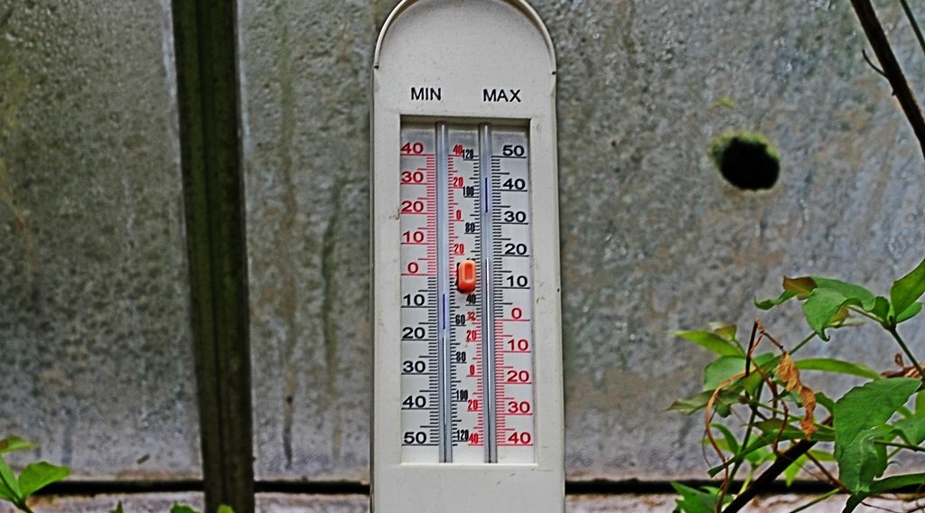
1. MEASUREMENT
Activity 1
A special thermometer.
Notes:
Activity 1. Look carefully at this picture: a special thermometer. Observe every detail before I ask the question.

Slide 20
1. MEASUREMENT
Activity 1: Question
This thermometer has two sides. What does it record?
Notes:
Here is the question for Activity 1: This thermometer has two sides. What does it record? Take one minute to think and write your answer in your rough notebook.

Slide 21
1. MEASUREMENT
Activity 1: Answer
The maximum and the minimum temperatures of the day.
Notes:
Let us check the answer together. The maximum and the minimum temperatures of the day.

Slide 22
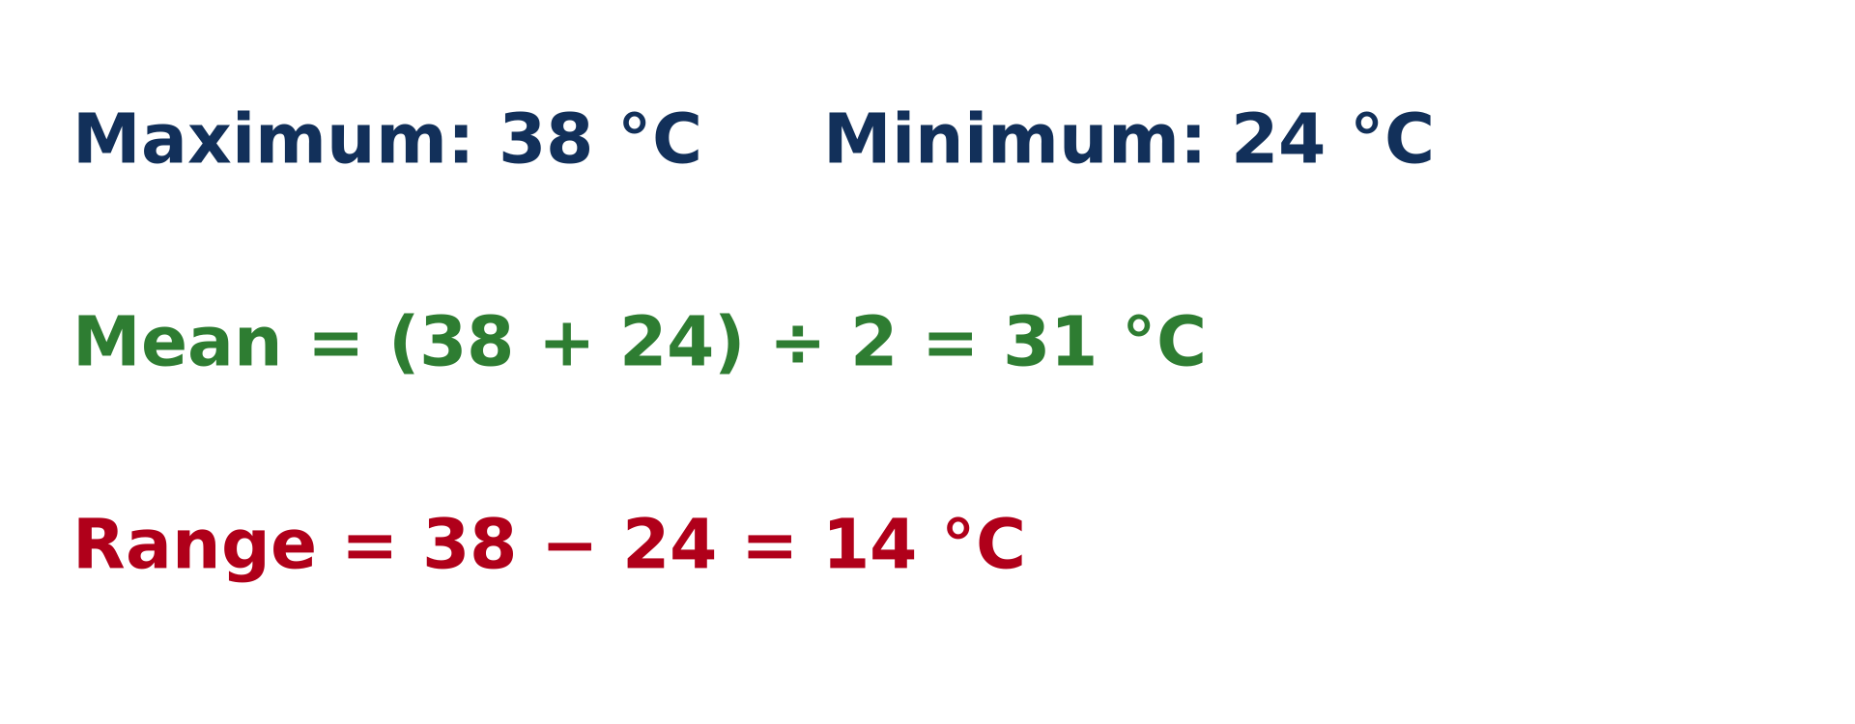
2. PRESENTATION
Activity 2
Calculating with temperatures.
Notes:
Activity 2. Look carefully at this diagram: calculating with temperatures. Observe every detail before I ask the question.

Slide 23
2. PRESENTATION
Activity 2: Question 1
The maximum is 38 °C and the minimum is 24 °C. What is the mean temperature?
Notes:
Here is the question for Activity 2: The maximum is 38 °C and the minimum is 24 °C. What is the mean temperature? Take one minute to think and write your answer in your rough notebook.

Slide 24
2. PRESENTATION
Activity 2: Answer 1
(38 + 24) ÷ 2 = 31 °C.
Notes:
Let us check the answer together. (38 + 24) ÷ 2 = 31 °C.

Slide 25
2. PRESENTATION
Activity 2: Question 2
What is the daily range?
Notes:
Here is the next question: What is the daily range? Take one minute to think and write your answer in your rough notebook.

Slide 26
2. PRESENTATION
Activity 2: Answer 2
38 − 24 = 14 °C.
Notes:
Let us check the answer together. 38 − 24 = 14 °C.

Slide 27

3. SITING OF THE STEVENSON SCREEN
Activity 3
A white wooden box.
Notes:
Activity 3. Look carefully at this picture: a white wooden box. Observe every detail before I ask the question.

Slide 28
3. SITING OF THE STEVENSON SCREEN
Activity 3: Question
Why is this box painted white?
Notes:
Here is the question for Activity 3: Why is this box painted white? Take one minute to think and write your answer in your rough notebook.

Slide 29
3. SITING OF THE STEVENSON SCREEN
Activity 3: Answer
White reflects the rays of the Sun, so the thermometers inside measure the air in the shade.
Notes:
Let us check the answer together. White reflects the rays of the Sun, so the thermometers inside measure the air in the shade.

Slide 30
BOARD SUMMARY
Board Summary
Topic: The Earth-Atmosphere System
Sub-topic: Measurement of Weather Elements
Lesson 32: Weather Elements: Atmospheric Temperatures
Notes:
Now we are going to copy the board summary. Write the title and the headings neatly in your notebooks. I will give you enough time for each slide, so do not rush.

Slide 31
BOARD SUMMARY
DEFINITIONS
The key terms of this lesson are defined as follows:
Atmospheric temperature: It is the degree of hotness or coldness of the air, measured in °C.
Notes:
Let us copy the definitions. The key terms of this lesson are defined as follows. On this slide we have Atmospheric temperature. Write each point on a new line, with the key term first, and explain it in your own words when we revise. When you finish, we go to the next slide.

Slide 32
BOARD SUMMARY
DEFINITIONS (continued)
Mean daily temperature: It is the average of the maximum and the minimum temperatures of a day.
Daily range of temperature: It is the difference between the maximum and the minimum temperatures of a day.
Notes:
We continue with the definitions. On this slide we have Mean daily temperature and Daily range of temperature. Write each point on a new line, with the key term first, and explain it in your own words when we revise.

Slide 33
BOARD SUMMARY
1. Measurement of Temperature
Temperature is measured as follows:
Ordinary thermometer: It shows the temperature of the air at the moment it is read.
Notes:
Let us copy Measurement of Temperature. Temperature is measured as follows. On this slide we have Ordinary thermometer. Write each point on a new line, with the key term first, and explain it in your own words when we revise.

Slide 34
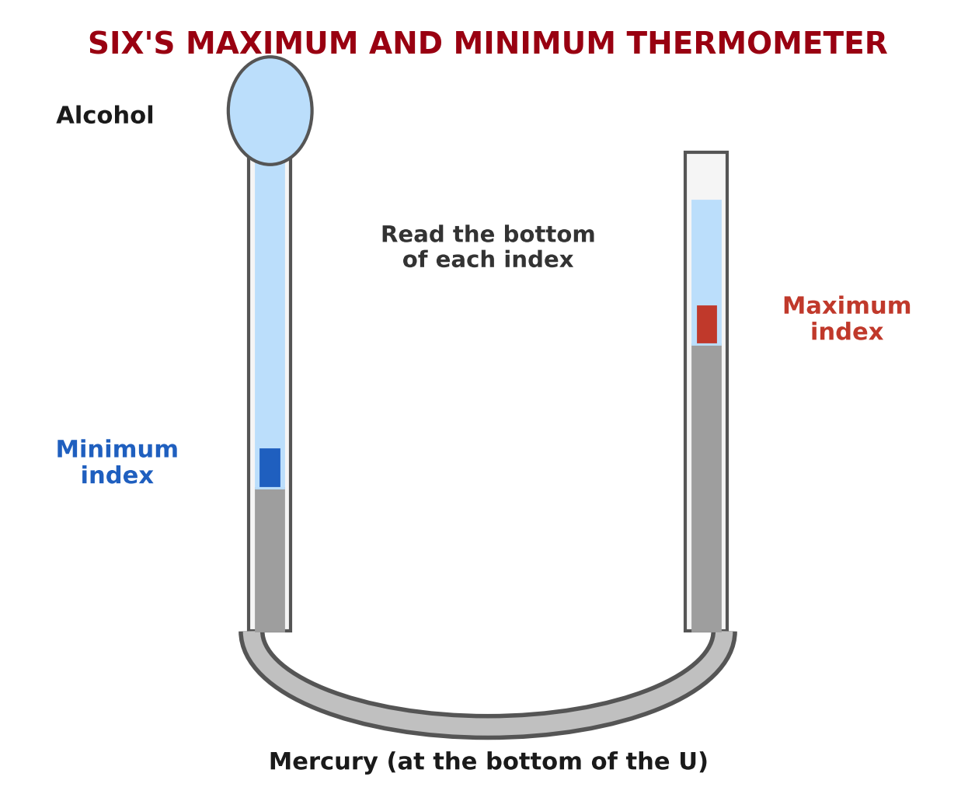
BOARD SUMMARY
1. Measurement of Temperature
Six's thermometer: It records the maximum and the minimum temperatures with two small indexes.
Illustration: Six's thermometer
Notes:
Copy the point on Six's thermometer on the left, then draw the diagram on the right: six's thermometer. Give it a title and label it clearly.

Slide 35
BOARD SUMMARY
1. Measurement of Temperature
Time of reading: Readings are taken every day at the same time, and the indexes are then reset.
Notes:
We continue with Measurement of Temperature. On this slide we have Time of reading. Write each point on a new line, with the key term first, and explain it in your own words when we revise.

Slide 36
BOARD SUMMARY
2. Presentation of Temperature
Temperature data are presented as follows:
Mean daily temperature: (maximum + minimum) ÷ 2, for example (38 + 24) ÷ 2 = 31 °C.
Illustration: mean and range
Notes:
Let us copy Presentation of Temperature. Temperature data are presented as follows. Copy the point on Mean daily temperature on the left, then draw the diagram on the right: mean and range. Give it a title and label it clearly.

Slide 37
BOARD SUMMARY
2. Presentation of Temperature
Daily range: maximum − minimum, for example 38 − 24 = 14 °C.
Mean monthly and annual temperature: They are the averages of the daily means over a month or a year.
Graphs and maps: Temperatures are shown on line graphs and on maps with isotherms.
Notes:
We continue with Presentation of Temperature. On this slide we have Daily range, Mean monthly and annual temperature and Graphs and maps. Write each point on a new line, with the key term first, and explain it in your own words when we revise.

Slide 38
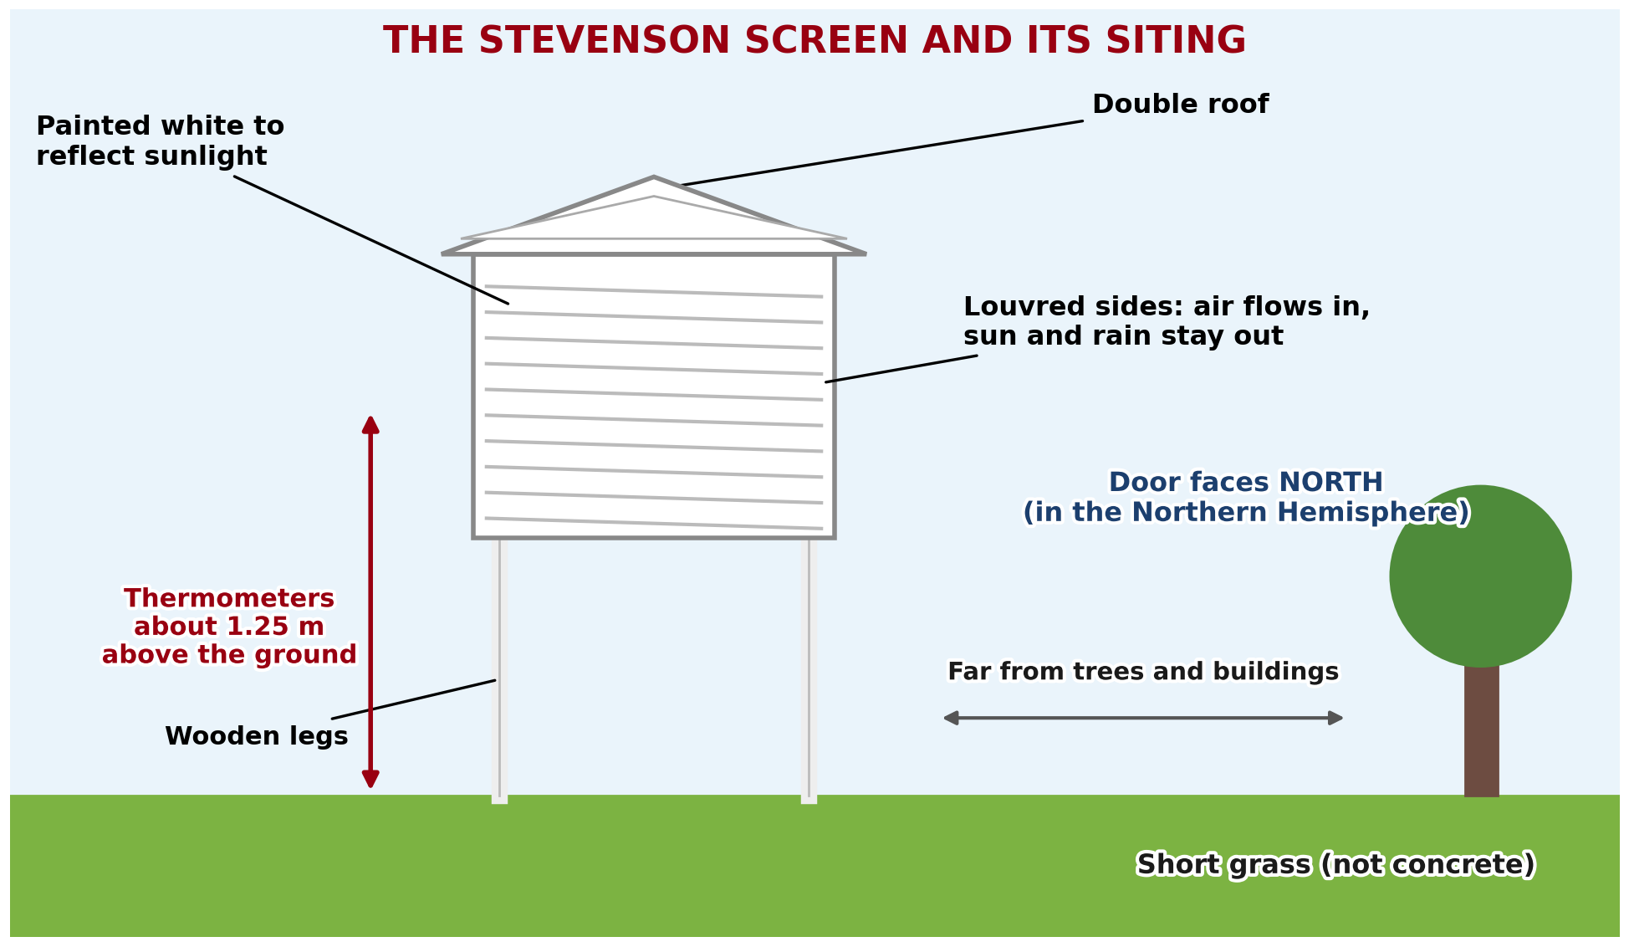
BOARD SUMMARY
3. Siting of the Stevenson Screen
The Stevenson screen is built and placed as follows:
White colour: It is painted white to reflect the rays of the Sun.
Illustration: the Stevenson screen and its siting
Notes:
Let us copy Siting of the Stevenson Screen. The Stevenson screen is built and placed as follows. Copy the point on White colour on the left, then draw the diagram on the right: the Stevenson screen and its siting. Give it a title and label it clearly.

Slide 39
BOARD SUMMARY
3. Siting of the Stevenson Screen
Louvred sides: Its slatted sides let air flow in freely but keep out sun and rain.
Height: It stands on legs so that the thermometers are about 1.2 m above the ground.
Notes:
We continue with Siting of the Stevenson Screen. On this slide we have Louvred sides and Height. Write each point on a new line, with the key term first, and explain it in your own words when we revise. When you finish, we go to the next slide.

Slide 40
BOARD SUMMARY
3. Siting of the Stevenson Screen (continued)
Open site on grass: It is placed on short grass, far from trees, buildings and concrete.
Door facing north: In the Northern Hemisphere, its door faces north so that the Sun does not shine on the thermometers when it is opened.
Notes:
We continue with Siting of the Stevenson Screen. On this slide we have Open site on grass and Door facing north. Write each point on a new line, with the key term first, and explain it in your own words when we revise.

Slide 41
FORMATIVE EVALUATION
Evaluation 1
Maximum 34 °C, minimum 20 °C. What is the mean?
Notes:
Now let us check what you have understood. Question 1: Maximum 34 °C, minimum 20 °C. What is the mean? Answer in your exercise book.

Slide 42
FORMATIVE EVALUATION
Expected Answer
27 °C.
Notes:
The expected answer is: 27 °C. If you got it right, well done.

Slide 43
FORMATIVE EVALUATION
Evaluation 2
Why is the Stevenson screen painted white?
Notes:
Now let us check what you have understood. Question 2: Why is the Stevenson screen painted white? Answer in your exercise book.

Slide 44
FORMATIVE EVALUATION
Expected Answer
To reflect the sunlight.
Notes:
The expected answer is: to reflect the sunlight. If you got it right, well done.

Slide 45
REMEDIATION
Remediation
Fill in the blanks:
The highest and lowest temperatures are recorded by the ______ thermometer.
Mean = (maximum + minimum) ÷ ______.
Thermometers are kept in a ______ screen.
Notes:
For those who need more practice, fill in the blanks in your exercise book. The answers are: number 1, Six's; number 2, 2; number 3, Stevenson.

Slide 46
HOMEWORK
Homework
Name the instrument that measures air pressure.
Notes:
For your homework: Name the instrument that measures air pressure. We shall correct it at the beginning of our next lesson.

Slide 47
NEXT LESSON
Next Lesson
Our next lesson will be on:
Lesson 33: Weather Elements: Humidity, Wind, Pressure and Sunshine
Notes:
Our next lesson will be on Lesson 33: Weather Elements: Humidity, Wind, Pressure and Sunshine. Thank you for your attention, and see you next time.

Slide 48
BILINGUAL GAME
Bilingual Game (Jeu Bilingue)
English | Français
Temperature | La température
Maximum | Le maximum
Minimum | Le minimum
Range | L'amplitude
Mean | La moyenne
Stevenson screen | L'abri météorologique
Shade | L'ombre
Isotherm | L'isotherme
Notes:
Let us play the bilingual game. I say a word in English, and you give me the French word. Then we do the reverse.

Slide 49
LOGBOOK
Official Logbook (1/2)
Module / Topic | The Earth-Atmosphere System
Lesson Title | Lesson 32: Weather Elements: Atmospheric Temperatures
Expected Learning Outcomes | Define atmospheric temperature. Describe how temperature is measured and calculate mean and range. Describe the Stevenson screen and the rules for siting it.
Competence | Learners are able to measure the temperature of the air correctly and calculate daily means and ranges.
Notes:
I record this information in the official logbook of the class after the lesson.

Slide 50
LOGBOOK
Official Logbook (2/2)
Matter Taught | DEFINITIONS; Measurement of Temperature; Presentation of Temperature; Siting of the Stevenson Screen.
Evaluation | Formative evaluation and remediation exercise.
Homework | Name the instrument that measures air pressure.
Enrolment / Present / Absent | ____ / ____ / ____
Achievement | To be completed after the lesson.
Notes:
I complete the second page of the logbook: the matter taught, the evaluation, the homework and the attendance.

Slide 51
TEACHER'S NOTE
Teacher's Note
Timing: Homework correction, plan, objectives 4 min | Recall, situation, action 6 min | 3 activities 12 min | Board summary (copying) 15 min | Evaluation, remediation 5 min | Homework, next lesson 3 min | Logbook 5 min
Without the projector (Activity 1): draw a U-shaped thermometer.
Without the projector (Activity 2): write the numbers on the board.
Without the projector (Activity 3): compare a white shirt and a black shirt in the sun.
Notes:
This slide is for me, the teacher: it gives the timing of the lesson and what to do if the projector is not available.

Slide 52
REFERENCES
References
National Geography Syllabus (MINESEC), Form 4 — Module 3: Weather and Climate.
Teacher's lesson notes (f4.docx), checked and corrected where necessary.
WMO Guide to Instruments and Methods of Observation (WMO-No. 8).
Photo, Activity 1: “maximum minimum thermometer” by Leo Reynolds, CC BY-NC-SA 2.0, via Flickr (https://www.flickr.com/photos/49968232@N00/7928521796)
Photo, Activity 3: “Adelaide. Urrbrae. The weather station at the Waite campus of the Univ” by denisbin, CC BY-ND 2.0, via Flickr (https://www.flickr.com/photos/82134796@N03/49865994827)
Diagrams and animations: drawn for this lesson (Geography Department).
Notes:
These are the references and picture credits used to prepare this lesson.

