Slide 1
FORM 4
GEOGRAPHY
Lesson 37
Local Winds
Notes:
Good morning, class, and welcome to our geography lesson. I am your geography teacher, Mr Kamdem. Today we are starting Lesson 37: Local Winds.

Slide 2
CLASS INFO
Class, Chapter and Duration
Class | Form 4
Chapter | Module 3: Weather and Climate — Adaptation to Climatic Excesses
Duration | 50 minutes
Notes:
This lesson is for Form 4. It belongs to Module 3: Weather and Climate — Adaptation to Climatic Excesses. We shall need 50 minutes to cover it.

Slide 3
IDENTIFICATION
Lesson Identification
Topic | The Earth-Atmosphere System
Sub-topic | Pressure and Winds
Lesson | Lesson 37: Local Winds
Notions / Concepts | Land and sea breezes, monsoon, mountain and valley winds.
Syllabus focus | Definition of local winds; types of local winds.
Competence | Learners are able to explain the daily change of winds at the coast and in the mountains, and to use this knowledge for fishing, farming or building.
Notes:
Our topic is The Earth-Atmosphere System, and the sub-topic is Pressure and Winds. The key notions we shall use today are: land and sea breezes, monsoon, mountain and valley winds. At the end, you should be able to do this: learners are able to explain the daily change of winds at the coast and in the mountains, and to use this knowledge for fishing, farming or building.

Slide 4

HOMEWORK CORRECTION
Correction of the Homework
Question (Lesson 36: Pressure Belts and Planetary Winds):
Name the wind that blows from the sea to the land by day.
Notes:
Before we start the new lesson, let us correct the homework I gave you at the end of Lesson 36: Pressure Belts and Planetary Winds. The question was: Name the wind that blows from the sea to the land by day. Take out your exercise books.

Slide 5
HOMEWORK CORRECTION
Correction: Possible Answer
The sea breeze.
Notes:
Here is a good answer. The sea breeze. Compare it with your own answer and correct your work in red.

Slide 6
LESSON PLAN
Lesson Plan
Correction of the homework
Objectives and recall
Real-life situation and action to take
Learning activities
Board summary
Evaluation, remediation and homework
Notes:
Here is the plan of our lesson today. First, we shall correct the homework. Then we shall look at the objectives and recall what you already know. After that, we shall study a situation from real life and the action to take, and do the learning activities. Finally, we shall copy the board summary, do the evaluation and the remediation, and I will give you the homework.

Slide 7
OBJECTIVES
Objectives
By the end of this lesson, you should be able to:
Define a local wind.
Explain land and sea breezes.
Explain mountain and valley breezes.
Explain the monsoon.
Notes:
By the end of this lesson, you should be able to do four things. Number 1: define a local wind. Number 2: explain land and sea breezes. Number 3: explain mountain and valley breezes. Number 4: explain the monsoon.

Slide 8
PREVIOUS KNOWLEDGE
Previous Knowledge
Pressure belts are zones of high or low pressure around the Earth.
Planetary winds blow from high to low pressure, like the Trade Winds.
The rotation of the Earth deflects winds (Ferrel's law).
Notes:
Let us first remember what you already know. Pressure belts are zones of high or low pressure around the Earth. Planetary winds blow from high to low pressure, like the Trade Winds. The rotation of the Earth deflects winds (Ferrel's law). Keep this in mind, because we shall build on it today.

Slide 9
REAL-LIFE SITUATION
Situation in Real Life
In Kribi, fishermen leave the beach very early, before sunrise, and come back in the afternoon. They say that the wind pushes their canoes out to sea in the morning and back to land later. A pupil asks: "Why does the wind change direction between night and day?"
Notes:
Listen carefully to this situation from real life. In Kribi, fishermen leave the beach very early, before sunrise, and come back in the afternoon. They say that the wind pushes their canoes out to sea in the morning and back to land later. A pupil asks: "Why does the wind change direction between night and day?" Think about it, because I am going to ask you some questions.

Slide 10
REAL-LIFE SITUATION
Situation: Question 1
What is the problem in the situation?
Notes:
Question 1: What is the problem in the situation? Think for a moment, then raise your hand to answer.

Slide 11
REAL-LIFE SITUATION
Answer
The pupil does not know why the wind on the coast changes direction between night and day.
Notes:
Good. The pupil does not know why the wind on the coast changes direction between night and day.

Slide 12
REAL-LIFE SITUATION
Situation: Question 2
When do the fishermen leave?
Notes:
Question 2: When do the fishermen leave? Think for a moment, then raise your hand to answer.

Slide 13
REAL-LIFE SITUATION
Answer
Very early, before sunrise.
Notes:
Good. Very early, before sunrise.

Slide 14
REAL-LIFE SITUATION
Situation: Question 3
When do they come back?
Notes:
Question 3: When do they come back? Think for a moment, then raise your hand to answer.

Slide 15
REAL-LIFE SITUATION
Possible Answer
In the afternoon.
Notes:
Good. In the afternoon.

Slide 16
ACTION TO TAKE
Action to Take
Fishermen use the land breeze at night and the sea breeze by day.
Notes:
From this situation, the action we are working towards in this lesson is the following: fishermen use the land breeze at night and the sea breeze by day.

Slide 17
JUSTIFICATION
Justification of the Lesson
This lesson helps us to know winds that blow over small areas.
Notes:
Why is this lesson important for you? This lesson helps us to know winds that blow over small areas.

Slide 18

1. LAND AND SEA BREEZES
Activity 1
Animation: the sea breeze by day.
Notes:
Activity 1. Look carefully at this animation: animation: the sea breeze by day. Watch the animation to the end; it will play again.

Slide 19
1. LAND AND SEA BREEZES
Activity 1: Question
By day, does the wind blow from the sea or from the land?
Notes:
Here is the question for Activity 1: By day, does the wind blow from the sea or from the land? Take one minute to think and write your answer in your rough notebook.

Slide 20
1. LAND AND SEA BREEZES
Activity 1: Answer
From the sea: this is the sea breeze.
Notes:
Let us check the answer together. From the sea: this is the sea breeze.

Slide 21

1. LAND AND SEA BREEZES
Activity 2
Fishermen in canoes.
Notes:
Activity 2. Look carefully at this picture: fishermen in canoes. Observe every detail before I ask the question.

Slide 22
1. LAND AND SEA BREEZES
Activity 2: Question
Why do fishermen leave early in the morning?
Notes:
Here is the question for Activity 2: Why do fishermen leave early in the morning? Take one minute to think and write your answer in your rough notebook.

Slide 23
1. LAND AND SEA BREEZES
Activity 2: Answer
The land breeze pushes their canoes out to sea.
Notes:
Let us check the answer together. The land breeze pushes their canoes out to sea.

Slide 24
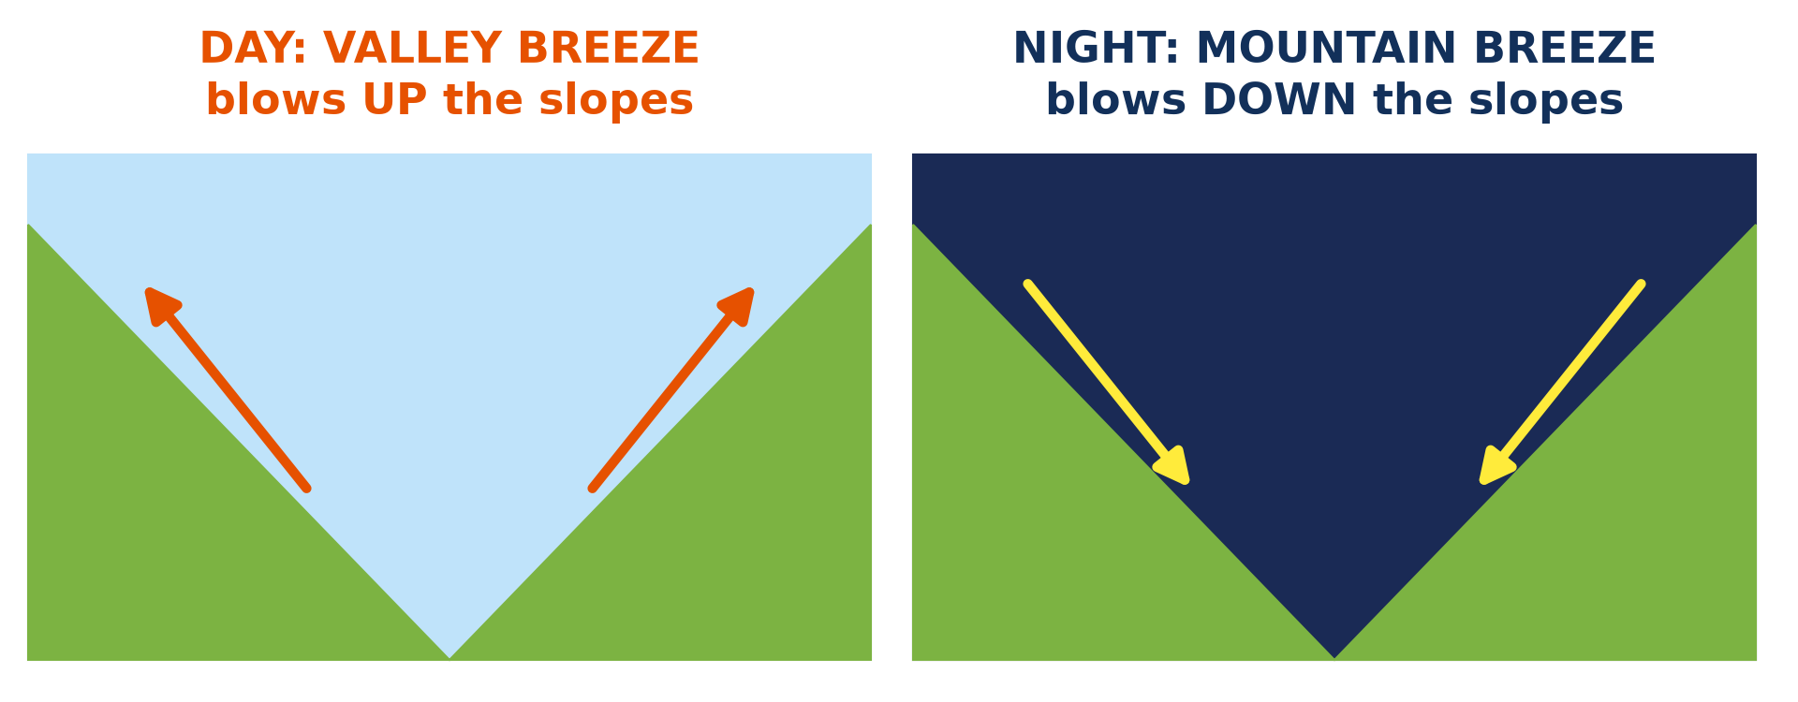
2. MOUNTAIN AND VALLEY WINDS
Activity 3
Winds in a mountain valley.
Notes:
Activity 3. Look carefully at this diagram: winds in a mountain valley. Observe every detail before I ask the question.

Slide 25
2. MOUNTAIN AND VALLEY WINDS
Activity 3: Question
Which wind blows up the slopes by day?
Notes:
Here is the question for Activity 3: Which wind blows up the slopes by day? Take one minute to think and write your answer in your rough notebook.

Slide 26
2. MOUNTAIN AND VALLEY WINDS
Activity 3: Answer
The valley breeze.
Notes:
Let us check the answer together. The valley breeze.

Slide 27
BOARD SUMMARY
Board Summary
Topic: The Earth-Atmosphere System
Sub-topic: Pressure and Winds
Lesson 37: Local Winds
Notes:
Now we are going to copy the board summary. Write the title and the headings neatly in your notebooks. I will give you enough time for each slide, so do not rush.

Slide 28
BOARD SUMMARY
DEFINITIONS
The key terms of this lesson are defined as follows:
Local wind: It is a wind that blows over a small area for a short time, caused by local differences in temperature and pressure.
Monsoon: It is a seasonal wind that changes direction between summer and winter.
Notes:
Let us copy the definitions. The key terms of this lesson are defined as follows. On this slide we have Local wind and Monsoon. Write each point on a new line, with the key term first, and explain it in your own words when we revise.

Slide 29
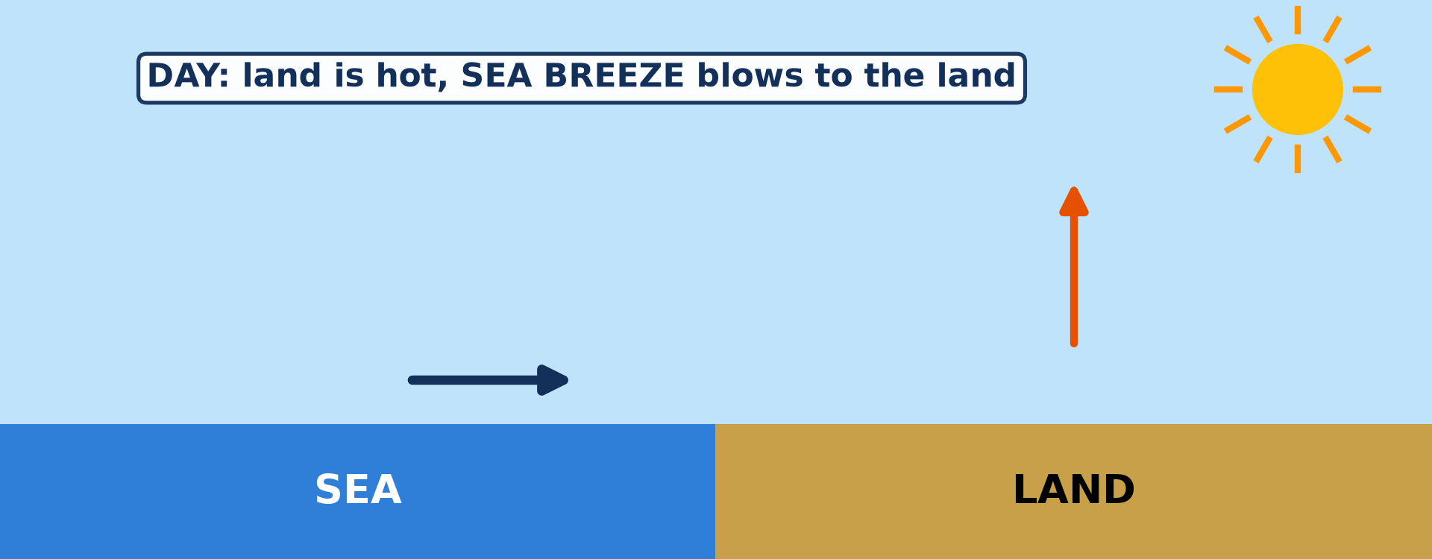
BOARD SUMMARY
1. Land and Sea Breezes
Land and sea breezes and their use are the following:
Sea breeze: By day the land heats faster than the sea, so cool air blows from the sea to the land.
Illustration: the sea breeze
Notes:
Let us copy Land and Sea Breezes. Land and sea breezes and their use are the following. Copy the point on Sea breeze on the left, then draw the diagram on the right: the sea breeze. Give it a title and label it clearly.

Slide 30
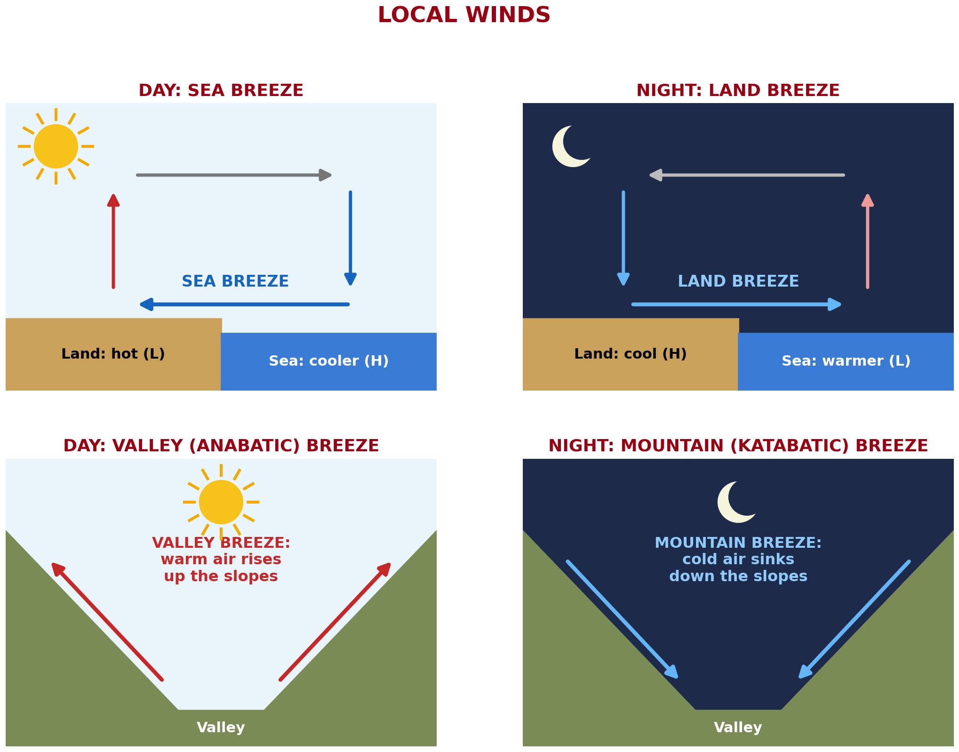
BOARD SUMMARY
1. Land and Sea Breezes
Land breeze: At night the land cools faster than the sea, so air blows from the land to the sea.
Illustration: land and sea, valley and mountain breezes
Notes:
Copy the point on Land breeze on the left, then draw the diagram on the right: land and sea, valley and mountain breezes. Give it a title and label it clearly.

Slide 31
BOARD SUMMARY
1. Land and Sea Breezes
Use: Fishermen go out with the land breeze and return with the sea breeze.
Notes:
We continue with Land and Sea Breezes. On this slide we have Use. Write each point on a new line, with the key term first, and explain it in your own words when we revise.

Slide 32
BOARD SUMMARY
2. Mountain and Valley Winds
Mountain and valley winds and their effect are the following:
Valley (anabatic) breeze: By day the slopes are heated, so warm air rises up the slopes from the valley.
Illustration: valley and mountain breezes
Notes:
Let us copy Mountain and Valley Winds. Mountain and valley winds and their effect are the following. Copy the point on Valley (anabatic) breeze on the left, then draw the diagram on the right: valley and mountain breezes. Give it a title and label it clearly.

Slide 33
BOARD SUMMARY
2. Mountain and Valley Winds
Mountain (katabatic) breeze: At night cold, heavy air flows down the slopes into the valley.
Effect: Cold air collects in valleys at night and can form fog or frost.
Notes:
We continue with Mountain and Valley Winds. On this slide we have Mountain (katabatic) breeze and Effect. Write each point on a new line, with the key term first, and explain it in your own words when we revise.

Slide 34
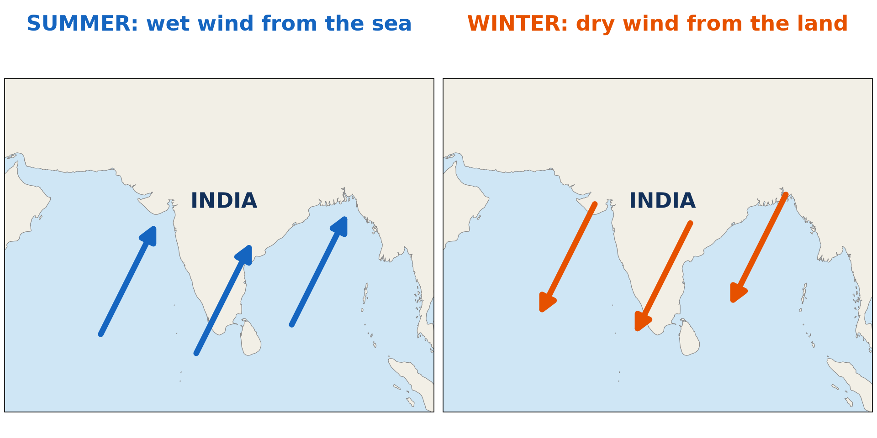
BOARD SUMMARY
3. The Monsoon
The summer and winter monsoons and their main areas are the following:
Summer monsoon: The land is hotter than the sea, so moist wind blows from the sea to the land and brings heavy rain.
Illustration: the monsoon
Notes:
Let us copy The Monsoon. The summer and winter monsoons and their main areas are the following. Copy the point on Summer monsoon on the left, then draw the diagram on the right: the monsoon. Give it a title and label it clearly.

Slide 35
BOARD SUMMARY
3. The Monsoon
Winter monsoon: The land is colder than the sea, so dry wind blows from the land to the sea.
Examples: The monsoon is strongest in India and South-East Asia, and West Africa has a south-west monsoon in the rainy season.
Notes:
We continue with The Monsoon. On this slide we have Winter monsoon and Examples. Write each point on a new line, with the key term first, and explain it in your own words when we revise.

Slide 36
FORMATIVE EVALUATION
Evaluation 1
Why does the sea breeze blow by day?
Notes:
Now let us check what you have understood. Question 1: Why does the sea breeze blow by day? Answer in your exercise book.

Slide 37
FORMATIVE EVALUATION
Expected Answer
The land heats faster than the sea.
Notes:
The expected answer is: the land heats faster than the sea. If you got it right, well done.

Slide 38
FORMATIVE EVALUATION
Evaluation 2
Which wind blows down the slopes at night?
Notes:
Now let us check what you have understood. Question 2: Which wind blows down the slopes at night? Answer in your exercise book.

Slide 39
FORMATIVE EVALUATION
Expected Answer
The mountain breeze.
Notes:
The expected answer is: the mountain breeze. If you got it right, well done.

Slide 40
REMEDIATION
Remediation
Fill in the blanks:
By day, the ______ breeze blows from the sea.
At night, the ______ breeze blows from the land.
Notes:
Take your time to copy this part; we will continue together.

Slide 41
REMEDIATION
Remediation (continued)
The wind that blows up the slopes by day is the ______ breeze.
Notes:
For those who need more practice, fill in the blanks in your exercise book. The answers are: number 1, sea; number 2, land; number 3, valley.

Slide 42
HOMEWORK
Homework
Give two factors of temperature.
Notes:
For your homework: Give two factors of temperature. We shall correct it at the beginning of our next lesson.

Slide 43
NEXT LESSON
Next Lesson
Our next lesson will be on:
Lesson 38: Factors of Temperature
Notes:
Our next lesson will be on Lesson 38: Factors of Temperature. Thank you for your attention, and see you next time.

Slide 44
BILINGUAL GAME
Bilingual Game (Jeu Bilingue)
English | Français
Local wind | Le vent local
Sea breeze | La brise de mer
Land breeze | La brise de terre
Valley breeze | La brise de vallée
Mountain breeze | La brise de montagne
Monsoon | La mousson
Slope | La pente
Coast | La côte
Notes:
Let us play the bilingual game. I say a word in English, and you give me the French word. Then we do the reverse.

Slide 45
LOGBOOK
Official Logbook (1/2)
Module / Topic | The Earth-Atmosphere System
Lesson Title | Lesson 37: Local Winds
Expected Learning Outcomes | Define a local wind. Explain land and sea breezes. Explain mountain and valley breezes. Explain the monsoon.
Competence | Learners are able to explain the daily change of winds at the coast and in the mountains, and to use this knowledge for fishing, farming or building.
Notes:
I record this information in the official logbook of the class after the lesson.

Slide 46
LOGBOOK
Official Logbook (2/2)
Matter Taught | DEFINITIONS; Land and Sea Breezes; Mountain and Valley Winds; The Monsoon.
Evaluation | Formative evaluation and remediation exercise.
Homework | Give two factors of temperature.
Enrolment / Present / Absent | ____ / ____ / ____
Achievement | To be completed after the lesson.
Notes:
I complete the second page of the logbook: the matter taught, the evaluation, the homework and the attendance.

Slide 47
TEACHER'S NOTE
Teacher's Note
Timing: Homework correction, plan, objectives 4 min | Recall, situation, action 6 min | 3 activities 12 min | Board summary (copying) 15 min | Evaluation, remediation 5 min | Homework, next lesson 3 min | Logbook 5 min
Activity 1 is an animation (GIF): it plays automatically in slide-show mode.
Without the projector (Activity 1): draw the land and the sea with arrows.
Without the projector (Activity 2): describe the beach at Kribi at dawn.
Without the projector (Activity 3): draw a V-shaped valley with arrows.
Notes:
This slide is for me, the teacher: it gives the timing of the lesson and what to do if the projector is not available.

Slide 48
REFERENCES
References
National Geography Syllabus (MINESEC), Form 4 — Module 3: Weather and Climate.
Teacher's lesson notes (f4.docx), checked and corrected where necessary.
Photo, Activity 2: “Fishermen, Lake Tana” by A.Davey, CC BY 2.0, via Flickr (https://www.flickr.com/photos/40595948@N00/2260748777)
Diagrams and animations: drawn for this lesson (Geography Department).
Notes:
These are the references and picture credits used to prepare this lesson.

