Slide 1
FORM 2 TECHNICAL
GEOGRAPHY
Lesson 3 (Part 2)
The Desert Regions: Characteristics (Climate)
Notes:
Good morning, class, and welcome to our geography lesson. I am your geography teacher, Mr Kamdem. Today we are starting Lesson 3 (Part 2): The Desert Regions: Characteristics (Climate).

Slide 2
CLASS INFO
Class, Chapter and Duration
Class | Form 2 Technical
Chapter | Economic Geography — Natural Regions: 3. Desert Regions
Duration | 2 periods (2 × 50 minutes)
Notes:
This lesson is for Form 2 Technical. It belongs to Economic Geography — Natural Regions: 3. Desert Regions. We shall need 2 periods to cover it.

Slide 3
IDENTIFICATION
Lesson Identification
Topic | Man in His Environment
Sub-topic | Natural Regions
Lesson | Lesson 3 (Part 2): The Desert Regions: Characteristics (Climate)
Notions / Concepts | Aridity, diurnal temperature range, relative humidity, sandstorm, Harmattan, Sirocco, Khamsin.
Syllabus focus | Characteristics of the climate of hot deserts, with the example of Aswan (Egypt).
Competence | Learners are able to protect themselves from extreme heat and dust, and to explain why desert nights are cold.
Notes:
Our topic is Man in His Environment, and the sub-topic is Natural Regions. The key notions we shall use today are: aridity, diurnal temperature range, relative humidity, sandstorm, Harmattan, Sirocco, Khamsin. At the end, you should be able to do this: learners are able to protect themselves from extreme heat and dust, and to explain why desert nights are cold.

Slide 4

HOMEWORK CORRECTION
Correction of the Homework
Question (Lesson 3 (Part 1): The Desert Regions: Location, Types and Characteristics):
Think about the hottest days of March in Garoua. Are the nights also very hot, or cooler? Write two sentences about the difference between day and night.
Notes:
Before we start the new lesson, let us correct the homework I gave you at the end of Lesson 3 (Part 1): The Desert Regions: Location, Types and Characteristics. The question was: Think about the hottest days of March in Garoua. Are the nights also very hot, or cooler? Write two sentences about the difference between day and night. Take out your exercise books.

Slide 5
HOMEWORK CORRECTION
Correction: Possible Answer
In March the days in Garoua are very hot, often above 40 °C. The nights are cooler, because the heat escapes at night when the sky is clear.
Notes:
Here is a good answer. In March the days in Garoua are very hot, often above 40 °C. The nights are cooler, because the heat escapes at night when the sky is clear. Compare it with your own answer and correct your work in red.

Slide 6
LESSON PLAN
Lesson Plan
Correction of the homework
Objectives and recall
Real-life situation and action to take
Learning activities
Board summary
Evaluation, remediation and homework
Notes:
Here is the plan of our lesson today. First, we shall correct the homework. Then we shall look at the objectives and recall what you already know. After that, we shall study a situation from real life and the action to take, and do the learning activities. Finally, we shall copy the board summary, do the evaluation and the remediation, and I will give you the homework.

Slide 7
OBJECTIVES
Objectives
By the end of this lesson, you should be able to:
Describe the rainfall of hot deserts.
Describe the temperatures of hot deserts and explain the large daily range.
Notes:
Take your time to copy this part; we will continue together.

Slide 8
OBJECTIVES
Objectives (continued)
Describe the winds and humidity of hot deserts.
Notes:
By the end of this lesson, you should be able to do three things. Number 1: describe the rainfall of hot deserts. Number 2: describe the temperatures of hot deserts and explain the large daily range. Number 3: describe the winds and humidity of hot deserts.

Slide 9
PREVIOUS KNOWLEDGE
Previous Knowledge
Hot deserts lie between 15° and 30° north and south of the Equator.
They are caused by dry trade winds, cold ocean currents, distance from the sea and rain shadow.
There are sandy (erg), stony (reg) and rocky (hamada) deserts.
Notes:
Let us first remember what you already know. Hot deserts lie between 15° and 30° north and south of the Equator. They are caused by dry trade winds, cold ocean currents, distance from the sea and rain shadow. There are sandy (erg), stony (reg) and rocky (hamada) deserts. Keep this in mind, because we shall build on it today.

Slide 10
REAL-LIFE SITUATION
Situation in Real Life
Oumarou, a lorry driver from Garoua, crosses the Sahara. In the day, the metal of his lorry is too hot to touch, but at night he needs a blanket. Oumarou asks: "Why is the desert so hot by day and so cold at night?"
Notes:
Listen carefully to this situation from real life. Oumarou, a lorry driver from Garoua, crosses the Sahara. In the day, the metal of his lorry is too hot to touch, but at night he needs a blanket. Oumarou asks: "Why is the desert so hot by day and so cold at night?" Think about it, because I am going to ask you some questions.

Slide 11
REAL-LIFE SITUATION
Situation: Question 1
What is the problem in the situation?
Notes:
Question 1: What is the problem in the situation? Think for a moment, then raise your hand to answer.

Slide 12
REAL-LIFE SITUATION
Answer
Oumarou does not understand the great difference between day and night in the desert.
Notes:
Good. Oumarou does not understand the great difference between day and night in the desert.

Slide 13
REAL-LIFE SITUATION
Situation: Question 2
How is the day?
Notes:
Question 2: How is the day? Think for a moment, then raise your hand to answer.

Slide 14
REAL-LIFE SITUATION
Answer
Very hot.
Notes:
Good. Very hot.

Slide 15
REAL-LIFE SITUATION
Situation: Question 3
How is the night?
Notes:
Question 3: How is the night? Think for a moment, then raise your hand to answer.

Slide 16
REAL-LIFE SITUATION
Possible Answer
Cold.
Notes:
Good. Cold.

Slide 17
ACTION TO TAKE
Action to Take
Protect yourself from heat and sandstorms in dry areas.
Notes:
From this situation, the action we are working towards in this lesson is the following: protect yourself from heat and sandstorms in dry areas.

Slide 18
JUSTIFICATION
Justification of the Lesson
This lesson helps us to understand the climate of the desert.
Notes:
Why is this lesson important for you? This lesson helps us to understand the climate of the desert.

Slide 19

1. RAINFALL
Activity 1
Rainfall of Aswan and Garoua.
Notes:
Activity 1. Look carefully at this diagram: rainfall of Aswan and Garoua. Observe every detail before I ask the question.

Slide 20
1. RAINFALL
Activity 1: Question
Which town gets almost no rain: Aswan or Garoua?
Notes:
Here is the question for Activity 1: Which town gets almost no rain: Aswan or Garoua? Take one minute to think and write your answer in your rough notebook.

Slide 21
1. RAINFALL
Activity 1: Answer
Aswan (about 2 mm per year).
Notes:
Let us check the answer together. Aswan (about 2 mm per year).

Slide 22
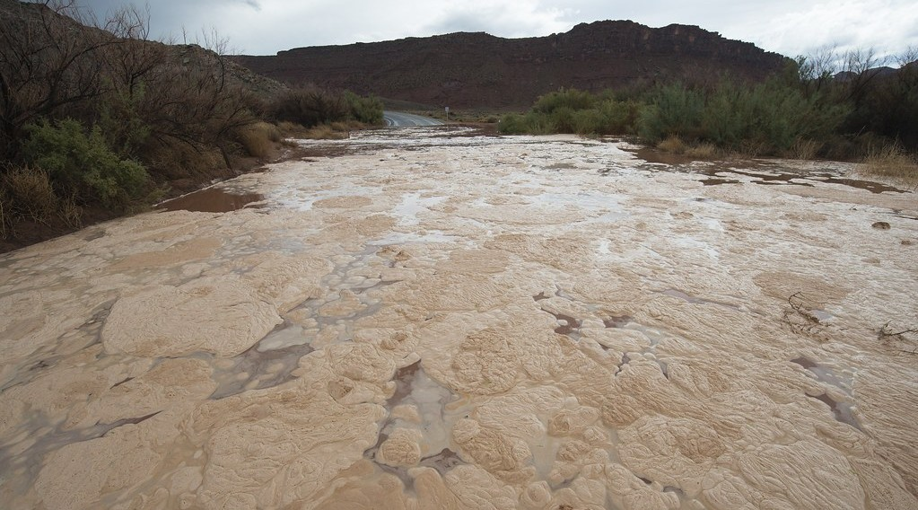
1. RAINFALL
Activity 2
A sudden flood in a dry valley.
Notes:
Activity 2. Look carefully at this picture: a sudden flood in a dry valley. Observe every detail before I ask the question.

Slide 23
1. RAINFALL
Activity 2: Question
What does this sudden flood show about desert rain?
Notes:
Here is the question for Activity 2: What does this sudden flood show about desert rain? Take one minute to think and write your answer in your rough notebook.

Slide 24
1. RAINFALL
Activity 2: Answer
The rain is rare and irregular, but can be very heavy.
Notes:
Let us check the answer together. The rain is rare and irregular, but can be very heavy.

Slide 25
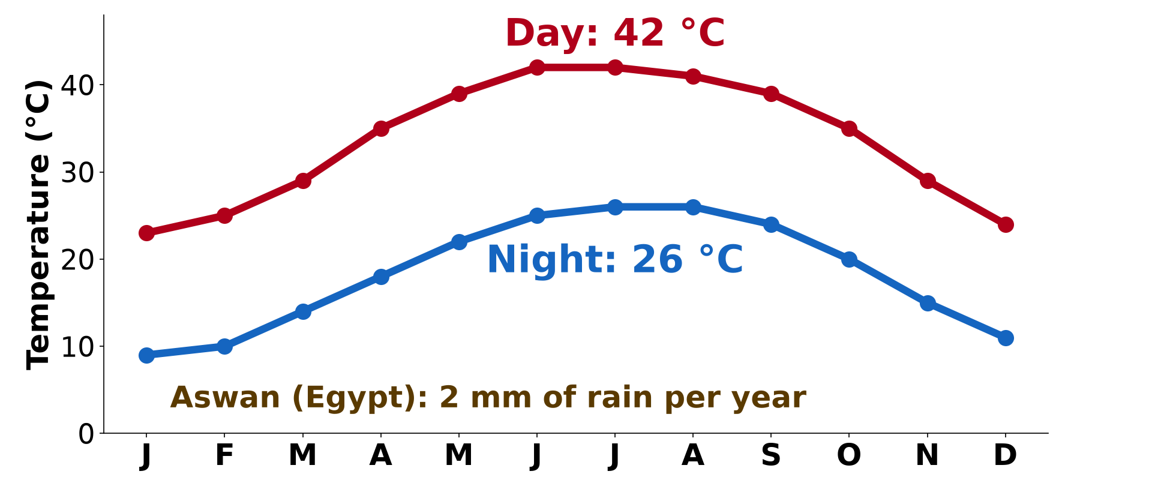
2. TEMPERATURE
Activity 3
Day and night temperatures of Aswan.
Notes:
Activity 3. Look carefully at this diagram: day and night temperatures of Aswan. Observe every detail before I ask the question.

Slide 26
2. TEMPERATURE
Activity 3: Question
What is the difference between day and night in July?
Notes:
Here is the question for Activity 3: What is the difference between day and night in July? Take one minute to think and write your answer in your rough notebook.

Slide 27
2. TEMPERATURE
Activity 3: Answer
42 − 26 = 16 °C.
Notes:
Let us check the answer together. 42 − 26 = 16 °C.

Slide 28
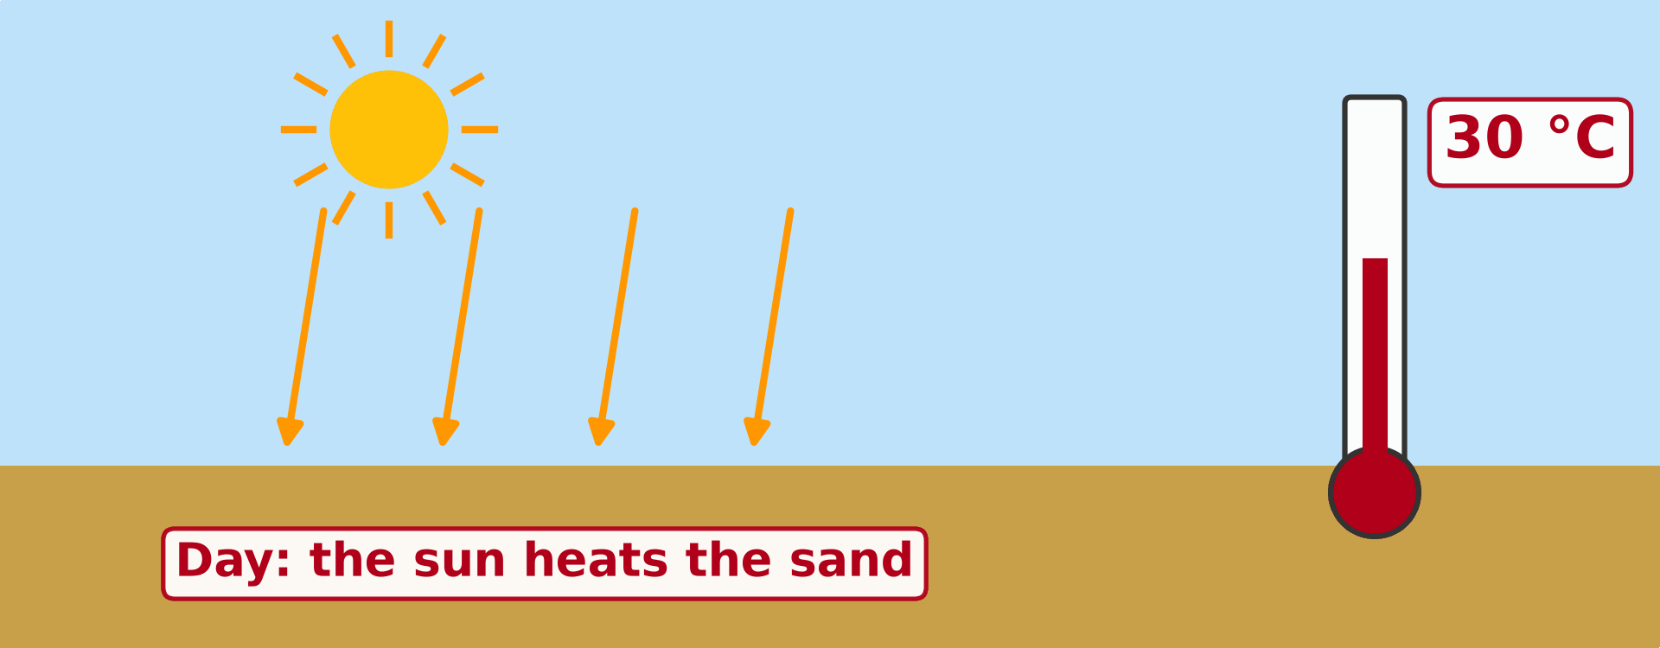
2. TEMPERATURE
Activity 4
Animation: the desert at night.
Notes:
Activity 4. Look carefully at this animation: animation: the desert at night. Watch the animation to the end; it will play again.

Slide 29
2. TEMPERATURE
Activity 4: Question
Why does the desert become cold at night?
Notes:
Here is the question for Activity 4: Why does the desert become cold at night? Take one minute to think and write your answer in your rough notebook.

Slide 30
2. TEMPERATURE
Activity 4: Answer
There are no clouds, so the heat escapes.
Notes:
Let us check the answer together. There are no clouds, so the heat escapes.

Slide 31

3. WINDS
Activity 5
A sandstorm.
Notes:
Activity 5. Look carefully at this picture: a sandstorm. Observe every detail before I ask the question.

Slide 32
3. WINDS
Activity 5: Question
What is this?
Notes:
Here is the question for Activity 5: What is this? Take one minute to think and write your answer in your rough notebook.

Slide 33
3. WINDS
Activity 5: Answer
A sandstorm.
Notes:
Let us check the answer together. A sandstorm.

Slide 34
BOARD SUMMARY
Board Summary
Topic: Man in His Environment
Sub-topic: Natural Regions
Lesson 3 (Part 2): The Desert Regions: Characteristics (Climate)
Notes:
Now we are going to copy the board summary. Write the title and the headings neatly in your notebooks. I will give you enough time for each slide, so do not rush.

Slide 35
BOARD SUMMARY
DEFINITIONS
The key terms of this lesson are defined as follows:
Daily range of temperature: It is the difference between the day and the night temperatures.
Notes:
Let us copy the definitions. The key terms of this lesson are defined as follows. On this slide we have Daily range of temperature. Write each point on a new line, with the key term first, and explain it in your own words when we revise.

Slide 36
BOARD SUMMARY
1. Rainfall
Desert rainfall has the following characteristics:
Very little rain: Less than 250 mm per year.
Illustration: rainfall of Aswan and Garoua
Notes:
Let us copy Rainfall. Desert rainfall has the following characteristics. Copy the point on Very little rain on the left, then draw the diagram on the right: rainfall of Aswan and Garoua. Give it a title and label it clearly.

Slide 37
BOARD SUMMARY
1. Rainfall
Irregular rain: It may not rain for years.
Sudden storms: Rare storms cause floods in dry valleys.
Notes:
We continue with Rainfall. On this slide we have Irregular rain and Sudden storms. Write each point on a new line, with the key term first, and explain it in your own words when we revise.

Slide 38
BOARD SUMMARY
2. Temperature
Desert temperatures have the following characteristics:
Very hot days: Often more than 40 °C in summer.
Illustration: temperatures of Aswan
Notes:
Let us copy Temperature. Desert temperatures have the following characteristics. Copy the point on Very hot days on the left, then draw the diagram on the right: temperatures of Aswan. Give it a title and label it clearly.

Slide 39
BOARD SUMMARY
2. Temperature
Cold nights: The heat escapes because there are no clouds.
Large daily range: Often 15 to 20 °C.
Notes:
We continue with Temperature. On this slide we have Cold nights and Large daily range. Write each point on a new line, with the key term first, and explain it in your own words when we revise.

Slide 40
BOARD SUMMARY
3. Winds and Humidity
The air of the desert has the following characteristics:
Dry air: The humidity is very low.
Hot, dry winds: Winds such as the Harmattan.
Notes:
Let us copy Winds and Humidity. The air of the desert has the following characteristics. On this slide we have Dry air and Hot, dry winds. Write each point on a new line, with the key term first, and explain it in your own words when we revise.

Slide 41
BOARD SUMMARY
3. Winds and Humidity
Sandstorms: Strong winds lift sand and dust.
Illustration: a sandstorm
Notes:
Copy the point on Sandstorms on the left, then draw the diagram on the right: a sandstorm. Give it a title and label it clearly.

Slide 42
FORMATIVE EVALUATION
Evaluation 1
Why is the desert cold at night?
Notes:
Now let us check what you have understood. Question 1: Why is the desert cold at night? Answer in your exercise book.

Slide 43
FORMATIVE EVALUATION
Expected Answer
There are no clouds, so the heat escapes.
Notes:
The expected answer is: there are no clouds, so the heat escapes. If you got it right, well done.

Slide 44
FORMATIVE EVALUATION
Evaluation 2
Name one hot, dry wind from the Sahara.
Notes:
Now let us check what you have understood. Question 2: Name one hot, dry wind from the Sahara. Answer in your exercise book.

Slide 45
FORMATIVE EVALUATION
Expected Answer
The Harmattan (or the Sirocco).
Notes:
The expected answer is: the Harmattan (or the Sirocco). If you got it right, well done.

Slide 46
REMEDIATION
Remediation
Fill in the blanks:
Hot deserts get less than ______ mm of rain per year.
The difference between day and night temperature is the daily temperature ______.
Notes:
Take your time to copy this part; we will continue together.

Slide 47
REMEDIATION
Remediation (continued)
A strong wind full of sand is a ______.
Notes:
For those who need more practice, fill in the blanks in your exercise book. The answers are: number 1, 250; number 2, range; number 3, sandstorm.

Slide 48
HOMEWORK
Homework
Look at a cactus, an acacia or a date palm near your home or in a picture. Write down one way in which it is adapted to lack of water.
Notes:
For your homework: Look at a cactus, an acacia or a date palm near your home or in a picture. Write down one way in which it is adapted to lack of water. We shall correct it at the beginning of our next lesson.

Slide 49
NEXT LESSON
Next Lesson
Our next lesson will be on:
Lesson 3 (Part 3): The Desert Regions: Characteristics (Soils and Vegetation)
Notes:
Our next lesson will be on Lesson 3 (Part 3): The Desert Regions: Characteristics (Soils and Vegetation). Thank you for your attention, and see you next time.

Slide 50
BILINGUAL GAME
Bilingual Game (Jeu Bilingue)
English | Français
Rainfall | Les précipitations
Humidity | L'humidité
Temperature range | L'amplitude thermique
Day | Le jour
Night | La nuit
Sandstorm | La tempête de sable
Dry | Sec
Heat | La chaleur
Notes:
Let us play the bilingual game. I say a word in English, and you give me the French word. Then we do the reverse.

Slide 51
LOGBOOK
Official Logbook (1/2)
Module / Topic | Man in His Environment
Lesson Title | Lesson 3 (Part 2): The Desert Regions: Characteristics (Climate)
Expected Learning Outcomes | Describe the rainfall of hot deserts. Describe the temperatures of hot deserts and explain the large daily range. Describe the winds and humidity of hot deserts.
Competence | Learners are able to protect themselves from extreme heat and dust, and to explain why desert nights are cold.
Notes:
I record this information in the official logbook of the class after the lesson.

Slide 52
LOGBOOK
Official Logbook (2/2)
Matter Taught | DEFINITIONS; Rainfall; Temperature; Winds and Humidity.
Evaluation | Formative evaluation and remediation exercise.
Homework | Look at a cactus, an acacia or a date palm near your home or in a picture. Write down one way in which it is adapted to lack of water.
Enrolment / Present / Absent | ____ / ____ / ____
Achievement | To be completed after the lesson.
Notes:
I complete the second page of the logbook: the matter taught, the evaluation, the homework and the attendance.

Slide 53
TEACHER'S NOTE
Teacher's Note
Timing: Homework correction, plan, objectives 8 min | Recall, situation, action 10 min | 5 activities 30 min | Board summary (copying) 30 min | Evaluation, remediation 10 min | Homework, next lesson 5 min | Logbook 7 min
Aswan data (approximate normals): July day 42 °C, night 26 °C; January day 23 °C, night 9 °C; rainfall about 1–2 mm per year.
Activity 4 is an animation (GIF): it plays automatically in slide-show mode.
Without the projector (Activity 1): write the numbers on the board.
Without the projector (Activity 2): describe a sudden storm.
Without the projector (Activity 3): write the temperatures on the board.
Without the projector (Activity 4): compare a clear night and a cloudy night.
Without the projector (Activity 5): describe a dusty day.
Notes:
This slide is for me, the teacher: it gives the timing of the lesson and what to do if the projector is not available.

Slide 54
REFERENCES
References
Harmonised Progression Sheet, Economic Geography (5051), Form 2.
Class textbook: The major biomes of the world (hot deserts).
Aswan climate normals: NOAA 1991–2020 (via Wikipedia, "Aswan").
Photo, Activity 2: “Flooding on the road to Delicate Arch Overlook” by ArchesNPS, Public domain 1.0, via Flickr (https://www.flickr.com/photos/72578886@N08/8083724580)
Photo, Activity 5: “Sandstorm at Camp Bastion, Afghanistan” by Defence Images, CC BY-NC 2.0, via Flickr (https://www.flickr.com/photos/48399297@N04/10343833885)
Diagrams and animations: drawn for this lesson (Geography Department).
Notes:
These are the references and picture credits used to prepare this lesson.

