Slide 1
FORM 2 TECHNICAL
GEOGRAPHY
Lesson 4 (Part 1)
The Temperate Region: Location, Types and Characteristics (Climate)
Notes:
Good morning, class, and welcome to our geography lesson. I am your geography teacher, Mr Kamdem. Today we are starting Lesson 4 (Part 1): The Temperate Region: Location, Types and Characteristics (Climate).

Slide 2
CLASS INFO
Class, Chapter and Duration
Class | Form 2 Technical
Chapter | Economic Geography — Natural Regions: 4. The Temperate Region
Duration | 2 periods (2 × 50 minutes)
Notes:
This lesson is for Form 2 Technical. It belongs to Economic Geography — Natural Regions: 4. The Temperate Region. We shall need 2 periods to cover it.

Slide 3
IDENTIFICATION
Lesson Identification
Topic | Man in His Environment
Sub-topic | Natural Regions
Lesson | Lesson 4 (Part 1): The Temperate Region: Location, Types and Characteristics (Climate)
Notions / Concepts | Temperate region, seasons, westerlies, Mediterranean climate, oceanic climate, continental climate.
Syllabus focus | Location and types of temperate regions; characteristics of the temperate climate.
Competence | Learners are able to explain why countries like France or England have four seasons and to prepare for a trip to a temperate country.
Notes:
Our topic is Man in His Environment, and the sub-topic is Natural Regions. The key notions we shall use today are: temperate region, seasons, westerlies, Mediterranean climate, oceanic climate, continental climate. At the end, you should be able to do this: learners are able to explain why countries like France or England have four seasons and to prepare for a trip to a temperate country.

Slide 4

HOMEWORK CORRECTION
Correction of the Homework
Question (Lesson 3 (Part 5): The Desert Regions: Human Activities (Farming around Oases)):
Look at a world map in your atlas. Find two countries located between 30° and 60° north of the Equator, and write their names.
Notes:
Before we start the new lesson, let us correct the homework I gave you at the end of Lesson 3 (Part 5): The Desert Regions: Human Activities (Farming around Oases). The question was: Look at a world map in your atlas. Find two countries located between 30° and 60° north of the Equator, and write their names. Take out your exercise books.

Slide 5
HOMEWORK CORRECTION
Correction: Possible Answer
Examples: France, Italy, Germany, the United Kingdom, the USA, Japan and China all lie between 30° and 60° N.
Notes:
Here is a good answer. Examples: France, Italy, Germany, the United Kingdom, the USA, Japan and China all lie between 30° and 60° N. Compare it with your own answer and correct your work in red.

Slide 6
LESSON PLAN
Lesson Plan
Correction of the homework
Objectives and recall
Real-life situation and action to take
Learning activities
Board summary
Evaluation, remediation and homework
Notes:
Here is the plan of our lesson today. First, we shall correct the homework. Then we shall look at the objectives and recall what you already know. After that, we shall study a situation from real life and the action to take, and do the learning activities. Finally, we shall copy the board summary, do the evaluation and the remediation, and I will give you the homework.

Slide 7
OBJECTIVES
Objectives
By the end of this lesson, you should be able to:
Locate the temperate regions of the world.
Name the four seasons of the temperate region.
Notes:
Take your time to copy this part; we will continue together.

Slide 8
OBJECTIVES
Objectives (continued)
Describe the three main types of temperate climate.
Notes:
By the end of this lesson, you should be able to do three things. Number 1: locate the temperate regions of the world. Number 2: name the four seasons of the temperate region. Number 3: describe the three main types of temperate climate.

Slide 9
PREVIOUS KNOWLEDGE
Previous Knowledge
Hot deserts lie between 15° and 30° north and south of the Equator.
People farm in the desert thanks to oases and irrigation.
Beyond the deserts, towards the poles, the climate becomes cooler.
Notes:
Let us first remember what you already know. Hot deserts lie between 15° and 30° north and south of the Equator. People farm in the desert thanks to oases and irrigation. Beyond the deserts, towards the poles, the climate becomes cooler. Keep this in mind, because we shall build on it today.

Slide 10
REAL-LIFE SITUATION
Situation in Real Life
Aïssatou's brother is going to study in France in January. He packs only T-shirts and sandals, but his mother says: "You need a thick coat, gloves and closed shoes. It is winter there." He asks: "Why is it cold in France when it is hot in Garoua?"
Notes:
Listen carefully to this situation from real life. Aïssatou's brother is going to study in France in January. He packs only T-shirts and sandals, but his mother says: "You need a thick coat, gloves and closed shoes. It is winter there." He asks: "Why is it cold in France when it is hot in Garoua?" Think about it, because I am going to ask you some questions.

Slide 11
REAL-LIFE SITUATION
Situation: Question 1
What is the problem in the situation?
Notes:
Question 1: What is the problem in the situation? Think for a moment, then raise your hand to answer.

Slide 12
REAL-LIFE SITUATION
Answer
The brother does not know the climate of the temperate region.
Notes:
Good. The brother does not know the climate of the temperate region.

Slide 13
REAL-LIFE SITUATION
Situation: Question 2
What did he pack?
Notes:
Question 2: What did he pack? Think for a moment, then raise your hand to answer.

Slide 14
REAL-LIFE SITUATION
Answer
T-shirts and sandals.
Notes:
Good. T-shirts and sandals.

Slide 15
REAL-LIFE SITUATION
Situation: Question 3
What season is it in France in January?
Notes:
Question 3: What season is it in France in January? Think for a moment, then raise your hand to answer.

Slide 16
REAL-LIFE SITUATION
Possible Answer
Winter.
Notes:
Good. Winter.

Slide 17
ACTION TO TAKE
Action to Take
Compare the climate of temperate lands with the climate of Garoua.
Notes:
From this situation, the action we are working towards in this lesson is the following: compare the climate of temperate lands with the climate of Garoua.

Slide 18
JUSTIFICATION
Justification of the Lesson
This lesson helps us to know where the temperate regions are and their seasons.
Notes:
Why is this lesson important for you? This lesson helps us to know where the temperate regions are and their seasons.

Slide 19
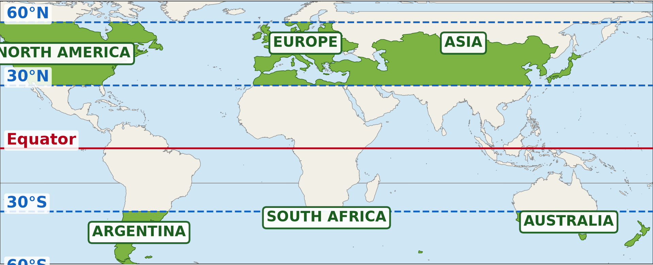
1. LOCATION
Activity 1
The temperate regions of the world.
Notes:
Activity 1. Look carefully at this diagram: the temperate regions of the world. Observe every detail before I ask the question.

Slide 20
1. LOCATION
Activity 1: Question
Between which latitudes are the temperate regions?
Notes:
Here is the question for Activity 1: Between which latitudes are the temperate regions? Take one minute to think and write your answer in your rough notebook.

Slide 21
1. LOCATION
Activity 1: Answer
Between 30° and 60° north and south of the Equator.
Notes:
Let us check the answer together. Between 30° and 60° north and south of the Equator.

Slide 22

2. TYPES
Activity 2
The climate of London.
Notes:
Activity 2. Look carefully at this diagram: the climate of London. Observe every detail before I ask the question.

Slide 23
2. TYPES
Activity 2: Question
Does it rain in every month in London?
Notes:
Here is the question for Activity 2: Does it rain in every month in London? Take one minute to think and write your answer in your rough notebook.

Slide 24
2. TYPES
Activity 2: Answer
Yes, it rains in every month.
Notes:
Let us check the answer together. Yes, it rains in every month.

Slide 25
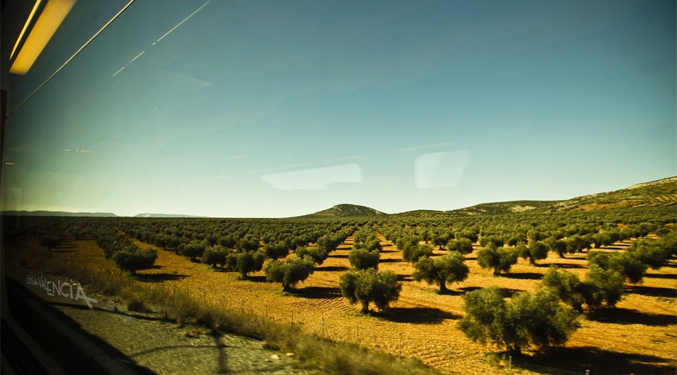
2. TYPES
Activity 3
A sunny coast in summer.
Notes:
Activity 3. Look carefully at this picture: a sunny coast in summer. Observe every detail before I ask the question.

Slide 26
2. TYPES
Activity 3: Question
Which temperate climate has hot, dry summers and mild, wet winters?
Notes:
Here is the question for Activity 3: Which temperate climate has hot, dry summers and mild, wet winters? Take one minute to think and write your answer in your rough notebook.

Slide 27
2. TYPES
Activity 3: Answer
The Mediterranean climate.
Notes:
Let us check the answer together. The Mediterranean climate.

Slide 28

3. CLIMATE
Activity 4
The seasons.
Notes:
Activity 4. Look carefully at this diagram: the seasons. Observe every detail before I ask the question.

Slide 29
3. CLIMATE
Activity 4: Question
How many seasons does the temperate region have?
Notes:
Here is the question for Activity 4: How many seasons does the temperate region have? Take one minute to think and write your answer in your rough notebook.

Slide 30
3. CLIMATE
Activity 4: Answer
Four: spring, summer, autumn and winter.
Notes:
Let us check the answer together. Four: spring, summer, autumn and winter.

Slide 31
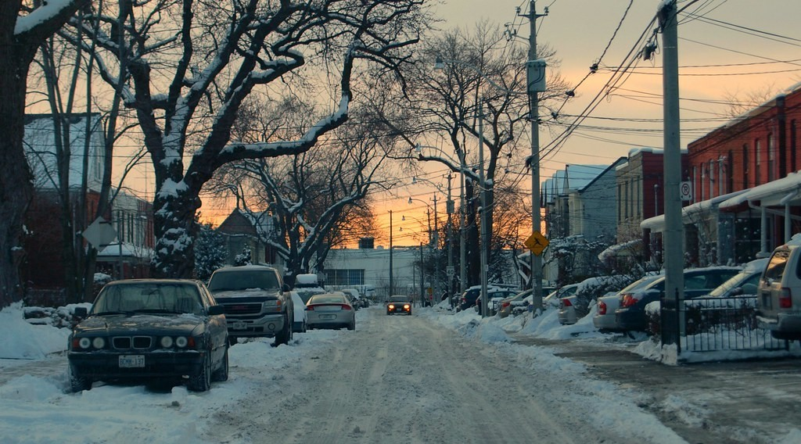
3. CLIMATE
Activity 5
A street in winter.
Notes:
Activity 5. Look carefully at this picture: a street in winter. Observe every detail before I ask the question.

Slide 32
3. CLIMATE
Activity 5: Question
What covers the street in winter?
Notes:
Here is the question for Activity 5: What covers the street in winter? Take one minute to think and write your answer in your rough notebook.

Slide 33
3. CLIMATE
Activity 5: Answer
Snow.
Notes:
Let us check the answer together. Snow.

Slide 34
BOARD SUMMARY
Board Summary
Topic: Man in His Environment
Sub-topic: Natural Regions
Lesson 4 (Part 1): The Temperate Region: Location, Types and Characteristics (Climate)
Notes:
Now we are going to copy the board summary. Write the title and the headings neatly in your notebooks. I will give you enough time for each slide, so do not rush.

Slide 35
BOARD SUMMARY
DEFINITIONS
The key terms of this lesson are defined as follows:
Temperate region: It is the region with mild temperatures and four seasons, between 30° and 60° N and S.
Notes:
Let us copy the definitions. The key terms of this lesson are defined as follows. On this slide we have Temperate region. Write each point on a new line, with the key term first, and explain it in your own words when we revise.

Slide 36
BOARD SUMMARY
1. Location
The temperate regions are found in the following areas:
Northern Hemisphere: Europe, North America, China and Japan.
Illustration: the temperate regions
Notes:
Let us copy Location. The temperate regions are found in the following areas. Copy the point on Northern Hemisphere on the left, then draw the diagram on the right: the temperate regions. Give it a title and label it clearly.

Slide 37
BOARD SUMMARY
1. Location
Southern Hemisphere: South Africa, southern Australia, New Zealand and Argentina.
Notes:
We continue with Location. On this slide we have Southern Hemisphere. Write each point on a new line, with the key term first, and explain it in your own words when we revise.

Slide 38
BOARD SUMMARY
2. Types
There are three main types of temperate climate:
Mediterranean: Hot, dry summers and mild, wet winters.
Illustration: a Mediterranean coast
Notes:
Let us copy Types. There are three main types of temperate climate. Copy the point on Mediterranean on the left, then draw the diagram on the right: a Mediterranean coast. Give it a title and label it clearly.

Slide 39
BOARD SUMMARY
2. Types
Cool temperate western margin: Mild and rainy all year, like London.
Illustration: the climate of London
Notes:
Copy the point on Cool temperate western margin on the left, then draw the diagram on the right: the climate of London. Give it a title and label it clearly.

Slide 40
BOARD SUMMARY
2. Types
Cool temperate continental: Warm summers and very cold winters, like Moscow.
Notes:
We continue with Types. On this slide we have Cool temperate continental. Write each point on a new line, with the key term first, and explain it in your own words when we revise.

Slide 41
BOARD SUMMARY
3. Characteristics of the Climate
The temperate climate has the following characteristics:
Four seasons: Spring, summer, autumn and winter.
Illustration: the four seasons
Notes:
Let us copy Characteristics of the Climate. The temperate climate has the following characteristics. Copy the point on Four seasons on the left, then draw the diagram on the right: the four seasons. Give it a title and label it clearly.

Slide 42
BOARD SUMMARY
3. Characteristics of the Climate
Mild temperatures: Warm summers and cool or cold winters.
Rain: Rain falls in all seasons in most places.
Snow: Snow falls in winter in cold areas.
Notes:
We continue with Characteristics of the Climate. On this slide we have Mild temperatures, Rain and Snow. Write each point on a new line, with the key term first, and explain it in your own words when we revise.

Slide 43
FORMATIVE EVALUATION
Evaluation 1
Name the four seasons of the temperate region.
Notes:
Now let us check what you have understood. Question 1: Name the four seasons of the temperate region. Answer in your exercise book.

Slide 44
FORMATIVE EVALUATION
Expected Answer
Spring, summer, autumn and winter.
Notes:
The expected answer is: spring, summer, autumn and winter. If you got it right, well done.

Slide 45
FORMATIVE EVALUATION
Evaluation 2
Give one characteristic of the Mediterranean climate.
Notes:
Now let us check what you have understood. Question 2: Give one characteristic of the Mediterranean climate. Answer in your exercise book.

Slide 46
FORMATIVE EVALUATION
Expected Answer
Hot, dry summers (and mild, wet winters).
Notes:
The expected answer is: hot, dry summers (and mild, wet winters). If you got it right, well done.

Slide 47
REMEDIATION
Remediation
Fill in the blanks:
The temperate region is between 30° and ______.
The cold season is called ______.
Hot, dry summers are found in the ______ climate.
Notes:
For those who need more practice, fill in the blanks in your exercise book. The answers are: number 1, 60°; number 2, winter; number 3, Mediterranean.

Slide 48
HOMEWORK
Homework
Find a picture of a European forest in autumn in your textbook or on television. Describe the colour of the leaves and say what happens to them in winter.
Notes:
For your homework: Find a picture of a European forest in autumn in your textbook or on television. Describe the colour of the leaves and say what happens to them in winter. We shall correct it at the beginning of our next lesson.

Slide 49
NEXT LESSON
Next Lesson
Our next lesson will be on:
Lesson 4 (Part 2): The Temperate Region: Characteristics (Soils and Vegetation)
Notes:
Our next lesson will be on Lesson 4 (Part 2): The Temperate Region: Characteristics (Soils and Vegetation). Thank you for your attention, and see you next time.

Slide 50
BILINGUAL GAME
Bilingual Game (Jeu Bilingue)
English | Français
Temperate | Tempéré
Spring | Le printemps
Summer | L'été
Autumn | L'automne
Winter | L'hiver
Snow | La neige
Westerlies | Les vents d'ouest
Mediterranean | Méditerranéen
Notes:
Let us play the bilingual game. I say a word in English, and you give me the French word. Then we do the reverse.

Slide 51
LOGBOOK
Official Logbook (1/2)
Module / Topic | Man in His Environment
Lesson Title | Lesson 4 (Part 1): The Temperate Region: Location, Types and Characteristics (Climate)
Expected Learning Outcomes | Locate the temperate regions of the world. Name the four seasons of the temperate region. Describe the three main types of temperate climate.
Competence | Learners are able to explain why countries like France or England have four seasons and to prepare for a trip to a temperate country.
Notes:
I record this information in the official logbook of the class after the lesson.

Slide 52
LOGBOOK
Official Logbook (2/2)
Matter Taught | DEFINITIONS; Location; Types; Characteristics of the Climate.
Evaluation | Formative evaluation and remediation exercise.
Homework | Find a picture of a European forest in autumn in your textbook or on television. Describe the colour of the leaves and say what happens to them in winter.
Enrolment / Present / Absent | ____ / ____ / ____
Achievement | To be completed after the lesson.
Notes:
I complete the second page of the logbook: the matter taught, the evaluation, the homework and the attendance.

Slide 53
TEACHER'S NOTE
Teacher's Note
Timing: Homework correction, plan, objectives 8 min | Recall, situation, action 10 min | 5 activities 30 min | Board summary (copying) 30 min | Evaluation, remediation 10 min | Homework, next lesson 5 min | Logbook 7 min
London data (approximate normals): January 5 °C, July 19 °C, about 600 mm of rain spread over the year.
Without the projector (Activity 1): draw the lines on the board.
Without the projector (Activity 2): write London's rainfall.
Without the projector (Activity 3): name Mediterranean countries.
Without the projector (Activity 4): write the four seasons.
Without the projector (Activity 5): describe ice from a fridge.
Notes:
This slide is for me, the teacher: it gives the timing of the lesson and what to do if the projector is not available.

Slide 54
REFERENCES
References
Harmonised Progression Sheet, Economic Geography (5051), Form 2.
Class textbook: The major biomes of the world (temperate regions).
London climate normals: Met Office (via Wikipedia, "Climate of London").
Photo, Activity 3: “Oro Mediterraneo / Mediterranean Gold” by Cristy Valencia, CC BY 2.0, via Flickr (https://www.flickr.com/photos/24522216@N03/5927925845)
Photo, Activity 5: “Toronto Winter Maintenance Budget” by MSVG, CC BY 2.0, via Flickr (https://www.flickr.com/photos/13907834@N00/5336969301)
Diagrams and animations: drawn for this lesson (Geography Department).
Notes:
These are the references and picture credits used to prepare this lesson.

