Slide 1
FORM 2 TECHNICAL
GEOGRAPHY
Lesson 4 (Part 3)
The Temperate Region: Human Activities (Farming)
Notes:
Good morning, class, and welcome to our geography lesson. I am your geography teacher, Mr Kamdem. Today we are starting Lesson 4 (Part 3): The Temperate Region: Human Activities (Farming).

Slide 2
CLASS INFO
Class, Chapter and Duration
Class | Form 2 Technical
Chapter | Economic Geography — Natural Regions: 4. The Temperate Region
Duration | 2 periods (2 × 50 minutes)
Notes:
This lesson is for Form 2 Technical. It belongs to Economic Geography — Natural Regions: 4. The Temperate Region. We shall need 2 periods to cover it.

Slide 3
IDENTIFICATION
Lesson Identification
Topic | Man in His Environment
Sub-topic | Natural Regions
Lesson | Lesson 4 (Part 3): The Temperate Region: Human Activities (Farming)
Notions / Concepts | Mixed farming, dairy farming, extensive grain farming, ranching, Mediterranean farming, mechanisation.
Syllabus focus | Farming in the temperate region.
Competence | Learners are able to explain where the imported flour, milk and meat sold in Garoua come from, and how they are produced.
Notes:
Our topic is Man in His Environment, and the sub-topic is Natural Regions. The key notions we shall use today are: mixed farming, dairy farming, extensive grain farming, ranching, Mediterranean farming, mechanisation. At the end, you should be able to do this: learners are able to explain where the imported flour, milk and meat sold in Garoua come from, and how they are produced.

Slide 4

HOMEWORK CORRECTION
Correction of the Homework
Question (Lesson 4 (Part 2): The Temperate Region: Characteristics (Soils and Vegetation)):
Find the names of three food products imported into Cameroon from temperate countries (for example wheat flour, milk or apples).
Notes:
Before we start the new lesson, let us correct the homework I gave you at the end of Lesson 4 (Part 2): The Temperate Region: Characteristics (Soils and Vegetation). The question was: Find the names of three food products imported into Cameroon from temperate countries (for example wheat flour, milk or apples). Take out your exercise books.

Slide 5
HOMEWORK CORRECTION
Correction: Possible Answer
Examples: wheat flour (from France or Canada), powdered milk (from Europe), apples (from France or South Africa), frozen chicken and onions (from Europe).
Notes:
Here is a good answer. Examples: wheat flour (from France or Canada), powdered milk (from Europe), apples (from France or South Africa), frozen chicken and onions (from Europe). Compare it with your own answer and correct your work in red.

Slide 6
LESSON PLAN
Lesson Plan
Correction of the homework
Objectives and recall
Real-life situation and action to take
Learning activities
Board summary
Evaluation, remediation and homework
Notes:
Here is the plan of our lesson today. First, we shall correct the homework. Then we shall look at the objectives and recall what you already know. After that, we shall study a situation from real life and the action to take, and do the learning activities. Finally, we shall copy the board summary, do the evaluation and the remediation, and I will give you the homework.

Slide 7
OBJECTIVES
Objectives
By the end of this lesson, you should be able to:
Describe the main types of farming in the temperate region.
Give examples of countries for each type of farming.
Notes:
Take your time to copy this part; we will continue together.

Slide 8
OBJECTIVES
Objectives (continued)
Explain why temperate farming is very productive.
Notes:
By the end of this lesson, you should be able to do three things. Number 1: describe the main types of farming in the temperate region. Number 2: give examples of countries for each type of farming. Number 3: explain why temperate farming is very productive.

Slide 9
PREVIOUS KNOWLEDGE
Previous Knowledge
The temperate region has deciduous forests, coniferous forests, Mediterranean vegetation and grasslands.
Its brown forest soils and chernozems are very fertile.
Notes:
Let us first remember what you already know. The temperate region has deciduous forests, coniferous forests, Mediterranean vegetation and grasslands. Its brown forest soils and chernozems are very fertile. Keep this in mind, because we shall build on it today.

Slide 10
REAL-LIFE SITUATION
Situation in Real Life
In a shop in Garoua, Blaise sees wheat flour from France, milk powder from the Netherlands and olive oil from Spain. Blaise asks: "How do these countries produce so much food?"
Notes:
Listen carefully to this situation from real life. In a shop in Garoua, Blaise sees wheat flour from France, milk powder from the Netherlands and olive oil from Spain. Blaise asks: "How do these countries produce so much food?" Think about it, because I am going to ask you some questions.

Slide 11
REAL-LIFE SITUATION
Situation: Question 1
What is the problem in the situation?
Notes:
Question 1: What is the problem in the situation? Think for a moment, then raise your hand to answer.

Slide 12
REAL-LIFE SITUATION
Answer
Blaise does not know the types of farming in the temperate region.
Notes:
Good. Blaise does not know the types of farming in the temperate region.

Slide 13
REAL-LIFE SITUATION
Situation: Question 2
Name one product from France.
Notes:
Question 2: Name one product from France. Think for a moment, then raise your hand to answer.

Slide 14
REAL-LIFE SITUATION
Answer
Wheat flour.
Notes:
Good. Wheat flour.

Slide 15
REAL-LIFE SITUATION
Situation: Question 3
Name one product from the Netherlands.
Notes:
Question 3: Name one product from the Netherlands. Think for a moment, then raise your hand to answer.

Slide 16
REAL-LIFE SITUATION
Possible Answer
Milk powder.
Notes:
Good. Milk powder.

Slide 17
ACTION TO TAKE
Action to Take
Learn from modern farming methods to improve our own farms.
Notes:
From this situation, the action we are working towards in this lesson is the following: learn from modern farming methods to improve our own farms.

Slide 18
JUSTIFICATION
Justification of the Lesson
This lesson helps us to know how farmers work in the temperate region.
Notes:
Why is this lesson important for you? This lesson helps us to know how farmers work in the temperate region.

Slide 19

1. TYPES OF FARMING
Activity 1
Crops and animals on one farm.
Notes:
Activity 1. Look carefully at this picture: crops and animals on one farm. Observe every detail before I ask the question.

Slide 20
1. TYPES OF FARMING
Activity 1: Question
What is this type of farming called?
Notes:
Here is the question for Activity 1: What is this type of farming called? Take one minute to think and write your answer in your rough notebook.

Slide 21
1. TYPES OF FARMING
Activity 1: Answer
Mixed farming.
Notes:
Let us check the answer together. Mixed farming.

Slide 22
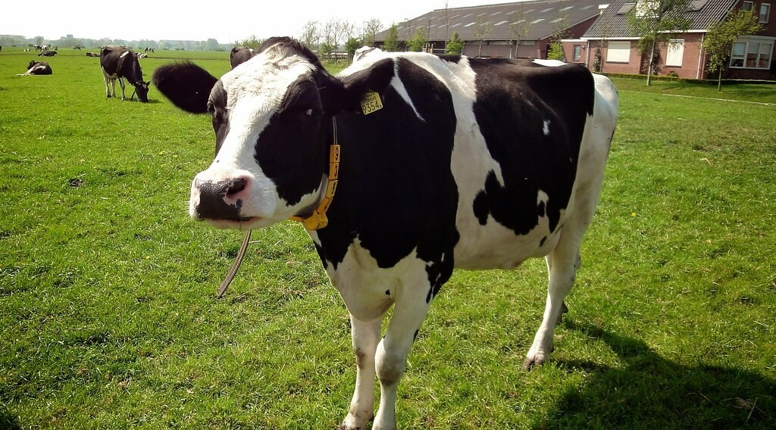
1. TYPES OF FARMING
Activity 2
Cows reared for milk.
Notes:
Activity 2. Look carefully at this picture: cows reared for milk. Observe every detail before I ask the question.

Slide 23
1. TYPES OF FARMING
Activity 2: Question
What is the rearing of cows for milk called?
Notes:
Here is the question for Activity 2: What is the rearing of cows for milk called? Take one minute to think and write your answer in your rough notebook.

Slide 24
1. TYPES OF FARMING
Activity 2: Answer
Dairy farming.
Notes:
Let us check the answer together. Dairy farming.

Slide 25

1. TYPES OF FARMING
Activity 3
A machine harvests wheat.
Notes:
Activity 3. Look carefully at this picture: a machine harvests wheat. Observe every detail before I ask the question.

Slide 26
1. TYPES OF FARMING
Activity 3: Question
Why can one farmer in Canada grow so much wheat?
Notes:
Here is the question for Activity 3: Why can one farmer in Canada grow so much wheat? Take one minute to think and write your answer in your rough notebook.

Slide 27
1. TYPES OF FARMING
Activity 3: Answer
He uses big machines on a huge farm.
Notes:
Let us check the answer together. He uses big machines on a huge farm.

Slide 28
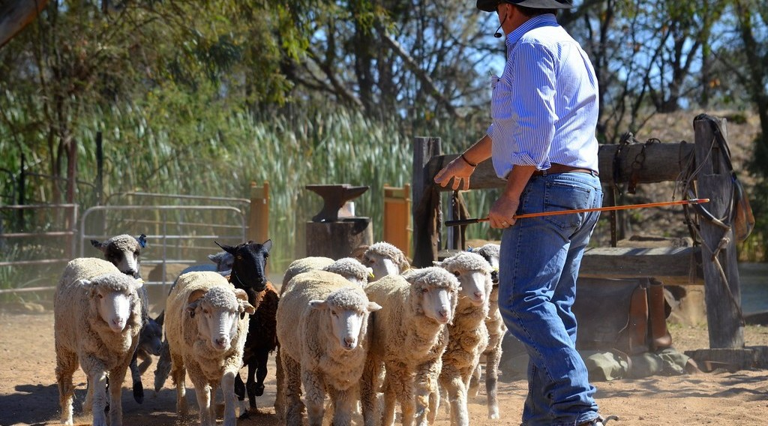
1. TYPES OF FARMING
Activity 4
Sheep on a huge farm.
Notes:
Activity 4. Look carefully at this picture: sheep on a huge farm. Observe every detail before I ask the question.

Slide 29
1. TYPES OF FARMING
Activity 4: Question
What are huge animal farms called?
Notes:
Here is the question for Activity 4: What are huge animal farms called? Take one minute to think and write your answer in your rough notebook.

Slide 30
1. TYPES OF FARMING
Activity 4: Answer
Ranches.
Notes:
Let us check the answer together. Ranches.

Slide 31
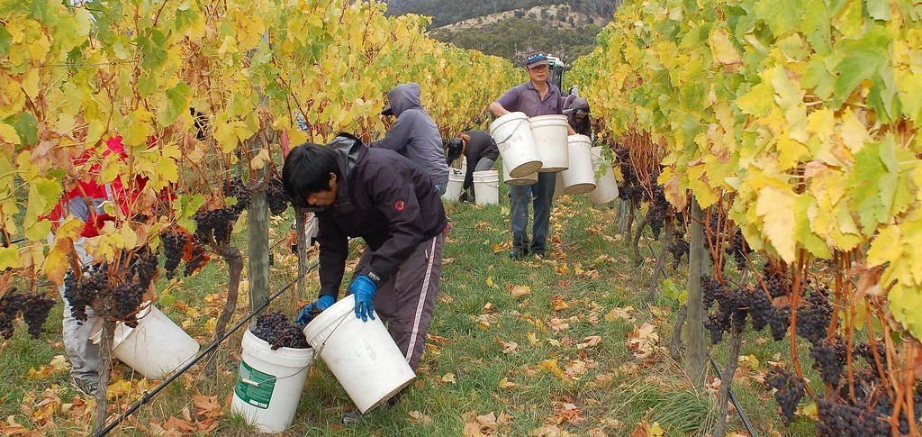
1. TYPES OF FARMING
Activity 5
A vineyard.
Notes:
Activity 5. Look carefully at this picture: a vineyard. Observe every detail before I ask the question.

Slide 32
1. TYPES OF FARMING
Activity 5: Question
Name one crop of Mediterranean farming.
Notes:
Here is the question for Activity 5: Name one crop of Mediterranean farming. Take one minute to think and write your answer in your rough notebook.

Slide 33
1. TYPES OF FARMING
Activity 5: Answer
Grapes (also olives and oranges).
Notes:
Let us check the answer together. Grapes (also olives and oranges).

Slide 34
BOARD SUMMARY
Board Summary
Topic: Man in His Environment
Sub-topic: Natural Regions
Lesson 4 (Part 3): The Temperate Region: Human Activities (Farming)
Notes:
Now we are going to copy the board summary. Write the title and the headings neatly in your notebooks. I will give you enough time for each slide, so do not rush.

Slide 35
BOARD SUMMARY
DEFINITIONS
The key terms of this lesson are defined as follows:
Mixed farming: It is growing crops and rearing animals on the same farm.
Mechanisation: It is the use of machines on farms.
Notes:
Let us copy the definitions. The key terms of this lesson are defined as follows. On this slide we have Mixed farming and Mechanisation. Write each point on a new line, with the key term first, and explain it in your own words when we revise.

Slide 36
BOARD SUMMARY
Farming in the Temperate Region
The main types of farming are the following:
Mixed farming: Crops and animals in Western Europe.
Illustration: mixed farming
Notes:
Let us copy Farming in the Temperate Region. The main types of farming are the following. Copy the point on Mixed farming on the left, then draw the diagram on the right: mixed farming. Give it a title and label it clearly.

Slide 37
BOARD SUMMARY
Farming in the Temperate Region
Dairy farming: Milk, butter and cheese in the Netherlands and Denmark.
Illustration: dairy farming
Notes:
Copy the point on Dairy farming on the left, then draw the diagram on the right: dairy farming. Give it a title and label it clearly.

Slide 38
BOARD SUMMARY
Farming in the Temperate Region
Wheat farming: Huge wheat farms with machines in Canada and Ukraine.
Illustration: harvesting wheat
Notes:
Copy the point on Wheat farming on the left, then draw the diagram on the right: harvesting wheat. Give it a title and label it clearly.

Slide 39
BOARD SUMMARY
Farming in the Temperate Region
Ranching: Cattle and sheep on huge farms in Australia and Argentina.
Notes:
We continue with Farming in the Temperate Region. On this slide we have Ranching. Write each point on a new line, with the key term first, and explain it in your own words when we revise.

Slide 40
BOARD SUMMARY
Farming in the Temperate Region
Mediterranean farming: Grapes, olives and oranges in Spain and Italy.
Illustration: a vineyard
Notes:
Copy the point on Mediterranean farming on the left, then draw the diagram on the right: a vineyard. Give it a title and label it clearly.

Slide 41
BOARD SUMMARY
Farming in the Temperate Region
Why it is productive: Machines, fertilisers and good seeds give high yields.
Notes:
We continue with Farming in the Temperate Region. On this slide we have Why it is productive. Write each point on a new line, with the key term first, and explain it in your own words when we revise.

Slide 42
FORMATIVE EVALUATION
Evaluation 1
What is mixed farming?
Notes:
Now let us check what you have understood. Question 1: What is mixed farming? Answer in your exercise book.

Slide 43
FORMATIVE EVALUATION
Expected Answer
Growing crops and rearing animals on the same farm.
Notes:
The expected answer is: growing crops and rearing animals on the same farm. If you got it right, well done.

Slide 44
FORMATIVE EVALUATION
Evaluation 2
Why do temperate farmers produce a lot?
Notes:
Now let us check what you have understood. Question 2: Why do temperate farmers produce a lot? Answer in your exercise book.

Slide 45
FORMATIVE EVALUATION
Expected Answer
They use machines, good seeds and fertilisers.
Notes:
The expected answer is: they use machines, good seeds and fertilisers. If you got it right, well done.

Slide 46
REMEDIATION
Remediation
Fill in the blanks:
Rearing cows for milk is ______ farming.
A very large farm for animals is a ______.
Wheat is harvested by a big ______.
Notes:
For those who need more practice, fill in the blanks in your exercise book. The answers are: number 1, dairy; number 2, ranch; number 3, machine (combine harvester).

Slide 47
HOMEWORK
Homework
Ask an adult who has lived or travelled in Europe what difficulties people face in winter. Write down two of them.
Notes:
For your homework: Ask an adult who has lived or travelled in Europe what difficulties people face in winter. Write down two of them. We shall correct it at the beginning of our next lesson.

Slide 48
NEXT LESSON
Next Lesson
Our next lesson will be on:
Lesson 4 (Part 4): The Temperate Region: Problems Faced and Adaptations
Notes:
Our next lesson will be on Lesson 4 (Part 4): The Temperate Region: Problems Faced and Adaptations. Thank you for your attention, and see you next time.

Slide 49
BILINGUAL GAME
Bilingual Game (Jeu Bilingue)
English | Français
Mixed farming | La polyculture-élevage
Dairy farming | L'élevage laitier
Wheat | Le blé
Ranch | Le ranch
Tractor | Le tracteur
Cooperative | La coopérative
Fertiliser | L'engrais
Grape | Le raisin
Notes:
Let us play the bilingual game. I say a word in English, and you give me the French word. Then we do the reverse.

Slide 50
LOGBOOK
Official Logbook (1/2)
Module / Topic | Man in His Environment
Lesson Title | Lesson 4 (Part 3): The Temperate Region: Human Activities (Farming)
Expected Learning Outcomes | Describe the main types of farming in the temperate region. Give examples of countries for each type of farming. Explain why temperate farming is very productive.
Competence | Learners are able to explain where the imported flour, milk and meat sold in Garoua come from, and how they are produced.
Notes:
I record this information in the official logbook of the class after the lesson.

Slide 51
LOGBOOK
Official Logbook (2/2)
Matter Taught | DEFINITIONS; Farming in the Temperate Region.
Evaluation | Formative evaluation and remediation exercise.
Homework | Ask an adult who has lived or travelled in Europe what difficulties people face in winter. Write down two of them.
Enrolment / Present / Absent | ____ / ____ / ____
Achievement | To be completed after the lesson.
Notes:
I complete the second page of the logbook: the matter taught, the evaluation, the homework and the attendance.

Slide 52
TEACHER'S NOTE
Teacher's Note
Timing: Homework correction, plan, objectives 8 min | Recall, situation, action 10 min | 5 activities 30 min | Board summary (copying) 30 min | Evaluation, remediation 10 min | Homework, next lesson 5 min | Logbook 7 min
Without the projector (Activity 1): describe a farm with crops and animals.
Without the projector (Activity 2): name milk products.
Without the projector (Activity 3): compare with a hoe.
Without the projector (Activity 4): compare with herding in the North.
Without the projector (Activity 5): name fruits from Europe.
Notes:
This slide is for me, the teacher: it gives the timing of the lesson and what to do if the projector is not available.

Slide 53
REFERENCES
References
Harmonised Progression Sheet, Economic Geography (5051), Form 2.
Class textbook: The major biomes of the world (temperate regions).
Photo, Activity 1: “Timid” by tricky (rick harrison), CC BY-NC-SA 2.0, via Flickr (https://www.flickr.com/photos/81851211@N00/205287304)
Photo, Activity 2: “Koe 9354” by ednl, CC BY 2.0, via Flickr (https://www.flickr.com/photos/31392863@N04/5640329871)
Photo, Activity 3: “John Deere Combine” by SnoShuu, CC BY-NC-ND 2.0, via Flickr (https://www.flickr.com/photos/85888233@N00/2776467094)
Photo, Activity 4: “The Flock” by seefit, CC BY 2.0, via Flickr (https://www.flickr.com/photos/76574551@N00/20928299362)
Photo, Activity 5: “Stefano Lubiana Wines Tasmania harvest panorama” by stefano lubiana wines, CC BY 2.0, via Flickr (https://www.flickr.com/photos/50979249@N06/4688372740)
Diagrams and animations: drawn for this lesson (Geography Department).
Notes:
These are the references and picture credits used to prepare this lesson.

