Slide 1
FORM 2 TECHNICAL
GEOGRAPHY
Lesson 5 (Part 2)
The Sectors of the Economy: Formal and Informal Sectors of the Economy
Notes:
Good morning, class, and welcome to our geography lesson. I am your geography teacher, Mr Kamdem. Today we are starting Lesson 5 (Part 2): The Sectors of the Economy: Formal and Informal Sectors of the Economy.

Slide 2
CLASS INFO
Class, Chapter and Duration
Class | Form 2 Technical
Chapter | Economic Geography — Sectors of the Economy
Duration | 2 periods (2 × 50 minutes)
Notes:
This lesson is for Form 2 Technical. It belongs to Economic Geography — Sectors of the Economy. We shall need 2 periods to cover it.

Slide 3
IDENTIFICATION
Lesson Identification
Topic | Economic Activities
Sub-topic | Sectors of the Economy
Lesson | Lesson 5 (Part 2): The Sectors of the Economy: Formal and Informal Sectors of the Economy
Notions / Concepts | Formal sector, informal sector, taxes, social security (CNPS), registration.
Syllabus focus | The formal and informal sectors of the economy: definitions, characteristics, advantages and problems.
Competence | Learners are able to tell whether a job around them belongs to the formal or informal sector and explain the advantages of registering a business.
Notes:
Our topic is Economic Activities, and the sub-topic is Sectors of the Economy. The key notions we shall use today are: formal sector, informal sector, taxes, social security (CNPS), registration. At the end, you should be able to do this: learners are able to tell whether a job around them belongs to the formal or informal sector and explain the advantages of registering a business.

Slide 4

HOMEWORK CORRECTION
Correction of the Homework
Question (Lesson 5 (Part 1): The Sectors of the Economy: Introduction, Definitions and Key Concepts):
Notes:
Take your time to copy this part; we will continue together.

Slide 5
HOMEWORK CORRECTION
Correction of the Homework (continued)
Observe two workers in your area: one who works for a registered company and one who works alone in the street (for example a moto-taxi driver). Write one difference between them.
Notes:
Before we start the new lesson, let us correct the homework I gave you at the end of Lesson 5 (Part 1): The Sectors of the Economy: Introduction, Definitions and Key Concepts. The question was: Observe two workers in your area: one who works for a registered company and one who works alone in the street (for example a moto-taxi driver). Write one difference between them. Take out your exercise books.

Slide 6
HOMEWORK CORRECTION
Correction: Possible Answer
Example: a SODECOTON worker has a contract, a monthly salary and CNPS insurance, while a moto-taxi driver works alone, earns money daily and has no contract or pension.
Notes:
Here is a good answer. Example: a SODECOTON worker has a contract, a monthly salary and CNPS insurance, while a moto-taxi driver works alone, earns money daily and has no contract or pension. Compare it with your own answer and correct your work in red.

Slide 7
LESSON PLAN
Lesson Plan
Correction of the homework
Objectives and recall
Real-life situation and action to take
Learning activities
Board summary
Evaluation, remediation and homework
Notes:
Here is the plan of our lesson today. First, we shall correct the homework. Then we shall look at the objectives and recall what you already know. After that, we shall study a situation from real life and the action to take, and do the learning activities. Finally, we shall copy the board summary, do the evaluation and the remediation, and I will give you the homework.

Slide 8
OBJECTIVES
Objectives
By the end of this lesson, you should be able to:
Define the formal and the informal sectors.
Give the characteristics of each sector.
Give examples of each sector in Cameroon.
Notes:
By the end of this lesson, you should be able to do three things. Number 1: define the formal and the informal sectors. Number 2: give the characteristics of each sector. Number 3: give examples of each sector in Cameroon.

Slide 9
PREVIOUS KNOWLEDGE
Previous Knowledge
The economy has four sectors: primary, secondary, tertiary and quaternary.
The primary sector extracts, the secondary transforms, the tertiary serves and the quaternary researches.
Notes:
Let us first remember what you already know. The economy has four sectors: primary, secondary, tertiary and quaternary. The primary sector extracts, the secondary transforms, the tertiary serves and the quaternary researches. Keep this in mind, because we shall build on it today.

Slide 10
REAL-LIFE SITUATION
Situation in Real Life
Mr Bello works in a bank in Garoua: he has a contract and a salary every month. His neighbour Moussa is a moto-taxi driver: he has no contract, and his money changes every day. Moussa's son asks: "Why are the two jobs so different?"
Notes:
Listen carefully to this situation from real life. Mr Bello works in a bank in Garoua: he has a contract and a salary every month. His neighbour Moussa is a moto-taxi driver: he has no contract, and his money changes every day. Moussa's son asks: "Why are the two jobs so different?" Think about it, because I am going to ask you some questions.

Slide 11
REAL-LIFE SITUATION
Situation: Question 1
What is the problem in the situation?
Notes:
Question 1: What is the problem in the situation? Think for a moment, then raise your hand to answer.

Slide 12
REAL-LIFE SITUATION
Answer
The son does not know the difference between the formal and the informal sectors.
Notes:
Good. The son does not know the difference between the formal and the informal sectors.

Slide 13
REAL-LIFE SITUATION
Situation: Question 2
Where does Mr Bello work?
Notes:
Question 2: Where does Mr Bello work? Think for a moment, then raise your hand to answer.

Slide 14
REAL-LIFE SITUATION
Answer
In a bank.
Notes:
Good. In a bank.

Slide 15
REAL-LIFE SITUATION
Situation: Question 3
What is Moussa's job?
Notes:
Question 3: What is Moussa's job? Think for a moment, then raise your hand to answer.

Slide 16
REAL-LIFE SITUATION
Possible Answer
Moto-taxi driver.
Notes:
Good. Moto-taxi driver.

Slide 17
ACTION TO TAKE
Action to Take
Encourage small workers to register their work and join the CNPS.
Notes:
From this situation, the action we are working towards in this lesson is the following: encourage small workers to register their work and join the CNPS.

Slide 18
JUSTIFICATION
Justification of the Lesson
This lesson helps us to know the difference between the formal and the informal sector.
Notes:
Why is this lesson important for you? This lesson helps us to know the difference between the formal and the informal sector.

Slide 19
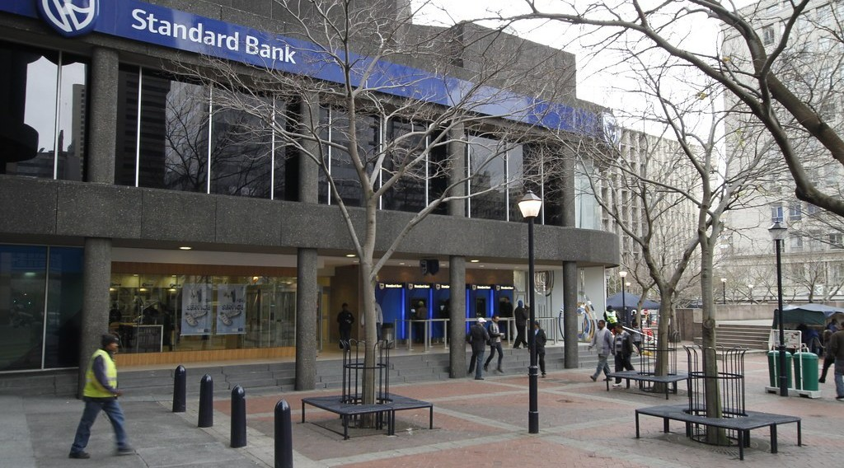
1. FORMAL SECTOR
Activity 1
A bank.
Notes:
Activity 1. Look carefully at this picture: a bank. Observe every detail before I ask the question.

Slide 20
1. FORMAL SECTOR
Activity 1: Question
The bank is registered and pays taxes. Which sector is it?
Notes:
Here is the question for Activity 1: The bank is registered and pays taxes. Which sector is it? Take one minute to think and write your answer in your rough notebook.

Slide 21
1. FORMAL SECTOR
Activity 1: Answer
The formal sector.
Notes:
Let us check the answer together. The formal sector.

Slide 22

1. FORMAL SECTOR
Activity 2
Factory workers.
Notes:
Activity 2. Look carefully at this picture: factory workers. Observe every detail before I ask the question.

Slide 23
1. FORMAL SECTOR
Activity 2: Question
How are these workers paid?
Notes:
Here is the question for Activity 2: How are these workers paid? Take one minute to think and write your answer in your rough notebook.

Slide 24
1. FORMAL SECTOR
Activity 2: Answer
They receive a salary every month.
Notes:
Let us check the answer together. They receive a salary every month.

Slide 25

2. INFORMAL SECTOR
Activity 3
Moto-taxis.
Notes:
Activity 3. Look carefully at this picture: moto-taxis. Observe every detail before I ask the question.

Slide 26
2. INFORMAL SECTOR
Activity 3: Question
Is the moto-taxi driver usually registered?
Notes:
Here is the question for Activity 3: Is the moto-taxi driver usually registered? Take one minute to think and write your answer in your rough notebook.

Slide 27
2. INFORMAL SECTOR
Activity 3: Answer
No: it is the informal sector.
Notes:
Let us check the answer together. No: it is the informal sector.

Slide 28

2. INFORMAL SECTOR
Activity 4
A street seller.
Notes:
Activity 4. Look carefully at this picture: a street seller. Observe every detail before I ask the question.

Slide 29
2. INFORMAL SECTOR
Activity 4: Question
Why is it easy to start work in the informal sector?
Notes:
Here is the question for Activity 4: Why is it easy to start work in the informal sector? Take one minute to think and write your answer in your rough notebook.

Slide 30
2. INFORMAL SECTOR
Activity 4: Answer
It needs little money and no papers.
Notes:
Let us check the answer together. It needs little money and no papers.

Slide 31
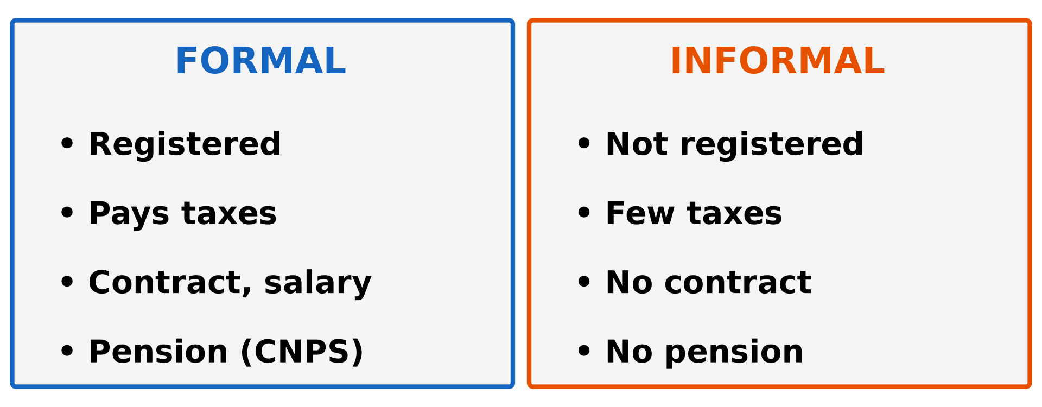
2. INFORMAL SECTOR
Activity 5
Formal and informal sectors.
Notes:
Activity 5. Look carefully at this diagram: formal and informal sectors. Observe every detail before I ask the question.

Slide 32
2. INFORMAL SECTOR
Activity 5: Question
Which sector gives workers a pension?
Notes:
Here is the question for Activity 5: Which sector gives workers a pension? Take one minute to think and write your answer in your rough notebook.

Slide 33
2. INFORMAL SECTOR
Activity 5: Answer
The formal sector.
Notes:
Let us check the answer together. The formal sector.

Slide 34
BOARD SUMMARY
Board Summary
Topic: Economic Activities
Sub-topic: Sectors of the Economy
Lesson 5 (Part 2): The Sectors of the Economy: Formal and Informal Sectors of the Economy
Notes:
Now we are going to copy the board summary. Write the title and the headings neatly in your notebooks. I will give you enough time for each slide, so do not rush.

Slide 35
BOARD SUMMARY
DEFINITIONS
The key terms of this lesson are defined as follows:
Formal sector: It is made of registered activities that pay taxes.
Informal sector: It is made of small activities that are not registered.
Notes:
Let us copy the definitions. The key terms of this lesson are defined as follows. On this slide we have Formal sector and Informal sector. Write each point on a new line, with the key term first, and explain it in your own words when we revise.

Slide 36
BOARD SUMMARY
1. The Formal Sector
The formal sector has the following characteristics:
Registered: Businesses are registered and pay taxes.
Illustration: a bank
Notes:
Let us copy The Formal Sector. The formal sector has the following characteristics. Copy the point on Registered on the left, then draw the diagram on the right: a bank. Give it a title and label it clearly.

Slide 37
BOARD SUMMARY
1. The Formal Sector
Contracts and salaries: Workers have contracts and monthly salaries.
Social security: Workers are insured by the CNPS and get a pension.
Examples: Banks, SODECOTON, CICAM, schools and hospitals.
Notes:
We continue with The Formal Sector. On this slide we have Contracts and salaries, Social security and Examples. Write each point on a new line, with the key term first, and explain it in your own words when we revise.

Slide 38
BOARD SUMMARY
2. The Informal Sector
The informal sector has the following characteristics:
Not registered: Workers pay few or no taxes.
Illustration: moto-taxis
Notes:
Let us copy The Informal Sector. The informal sector has the following characteristics. Copy the point on Not registered on the left, then draw the diagram on the right: moto-taxis. Give it a title and label it clearly.

Slide 39
BOARD SUMMARY
2. The Informal Sector
No contract: Income changes every day.
Small capital: It needs little money to start.
Notes:
We continue with The Informal Sector. On this slide we have No contract and Small capital. Write each point on a new line, with the key term first, and explain it in your own words when we revise.

Slide 40
BOARD SUMMARY
2. The Informal Sector
Examples: Moto-taxis, street sellers, tailors and mechanics.
Illustration: a street seller
Notes:
Copy the point on Examples on the left, then draw the diagram on the right: a street seller. Give it a title and label it clearly.

Slide 41
FORMATIVE EVALUATION
Evaluation 1
What is the informal sector?
Notes:
Now let us check what you have understood. Question 1: What is the informal sector? Answer in your exercise book.

Slide 42
FORMATIVE EVALUATION
Expected Answer
Small activities that are not registered.
Notes:
The expected answer is: small activities that are not registered. If you got it right, well done.

Slide 43
FORMATIVE EVALUATION
Evaluation 2
Give one characteristic of the formal sector.
Notes:
Now let us check what you have understood. Question 2: Give one characteristic of the formal sector. Answer in your exercise book.

Slide 44
FORMATIVE EVALUATION
Expected Answer
Workers have contracts and monthly salaries (or it is registered and pays taxes).
Notes:
The expected answer is: workers have contracts and monthly salaries (or it is registered and pays taxes). If you got it right, well done.

Slide 45
REMEDIATION
Remediation
Fill in the blanks:
Work that is registered and pays taxes is the ______ sector.
A moto-taxi driver usually works in the ______ sector.
Notes:
Take your time to copy this part; we will continue together.

Slide 46
REMEDIATION
Remediation (continued)
Money paid after a worker stops working is a ______.
Notes:
For those who need more practice, fill in the blanks in your exercise book. The answers are: number 1, formal; number 2, informal; number 3, pension.

Slide 47
HOMEWORK
Homework
List four products of farming, fishing, forestry or mining found in the Garoua market, and say where each comes from.
Notes:
For your homework: List four products of farming, fishing, forestry or mining found in the Garoua market, and say where each comes from. We shall correct it at the beginning of our next lesson.

Slide 48
NEXT LESSON
Next Lesson
Our next lesson will be on:
Lesson 5 (Part 3): The Sectors of the Economy: The Primary Sector (Definition and Examples)
Notes:
Our next lesson will be on Lesson 5 (Part 3): The Sectors of the Economy: The Primary Sector (Definition and Examples). Thank you for your attention, and see you next time.

Slide 49
BILINGUAL GAME
Bilingual Game (Jeu Bilingue)
English | Français
Formal sector | Le secteur formel
Informal sector | Le secteur informel
Tax | L'impôt
Salary | Le salaire
Contract | Le contrat
Pension | La retraite (pension)
Street seller | Le vendeur ambulant
Registration | L'immatriculation
Notes:
Let us play the bilingual game. I say a word in English, and you give me the French word. Then we do the reverse.

Slide 50
LOGBOOK
Official Logbook (1/2)
Module / Topic | Economic Activities
Lesson Title | Lesson 5 (Part 2): The Sectors of the Economy: Formal and Informal Sectors of the Economy
Expected Learning Outcomes | Define the formal and the informal sectors. Give the characteristics of each sector. Give examples of each sector in Cameroon.
Competence | Learners are able to tell whether a job around them belongs to the formal or informal sector and explain the advantages of registering a business.
Notes:
I record this information in the official logbook of the class after the lesson.

Slide 51
LOGBOOK
Official Logbook (2/2)
Matter Taught | DEFINITIONS; The Formal Sector; The Informal Sector.
Evaluation | Formative evaluation and remediation exercise.
Homework | List four products of farming, fishing, forestry or mining found in the Garoua market, and say where each comes from.
Enrolment / Present / Absent | ____ / ____ / ____
Achievement | To be completed after the lesson.
Notes:
I complete the second page of the logbook: the matter taught, the evaluation, the homework and the attendance.

Slide 52
TEACHER'S NOTE
Teacher's Note
Timing: Homework correction, plan, objectives 8 min | Recall, situation, action 10 min | 5 activities 30 min | Board summary (copying) 30 min | Evaluation, remediation 10 min | Homework, next lesson 5 min | Logbook 7 min
CNPS: Caisse Nationale de Prévoyance Sociale (national social insurance fund). About 9 workers out of 10 in Cameroon work in the informal sector.
Without the projector (Activity 1): name registered companies in Garoua.
Without the projector (Activity 2): ask about a salary.
Without the projector (Activity 3): count moto-taxis.
Without the projector (Activity 4): list small trades.
Without the projector (Activity 5): draw two columns.
Notes:
This slide is for me, the teacher: it gives the timing of the lesson and what to do if the projector is not available.

Slide 53
REFERENCES
References
Harmonised Progression Sheet, Economic Geography (5051), Form 2.
Institut National de la Statistique (INS), Enquêtes sur l'Emploi et le Secteur Informel (EESI).
Photo, Activity 1: “Thibault Square, Cape Town” by World Bank Photo Collection, CC BY-NC-ND 2.0, via Flickr (https://www.flickr.com/photos/10816734@N03/7825576852)
Photo, Activity 2: “Photo by USAID East Africa” by U.S. Agency for International Development, CC0 1.0, via rawpixel (https://www.rawpixel.com/image/4051097/image-public-domain-person-building)
Photo, Activity 3: “Cameroon - UN Women's Gender Road Project” by UN Women Gallery, CC BY-NC-ND 2.0, via Flickr (https://www.flickr.com/photos/51431730@N04/47586053052)
Photo, Activity 4: “Roadside vendor roasts maize cobs for sale in Timau” by CIMMYT, CC BY-NC 2.0, via Flickr (https://www.flickr.com/photos/44760652@N05/25375356457)
Diagrams and animations: drawn for this lesson (Geography Department).
Notes:
These are the references and picture credits used to prepare this lesson.

