Slide 1
FORM 2 TECHNICAL
GEOGRAPHY
Lesson 6 (Part 1)
Africa: Introduction (Location and Physical Characteristics)
Notes:
Good morning, class, and welcome to our geography lesson. I am your geography teacher, Mr Kamdem. Today we are starting Lesson 6 (Part 1): Africa: Introduction (Location and Physical Characteristics).

Slide 2
CLASS INFO
Class, Chapter and Duration
Class | Form 2 Technical
Chapter | Economic Geography — Africa
Duration | 2 periods (2 × 50 minutes)
Notes:
This lesson is for Form 2 Technical. It belongs to Economic Geography — Africa. We shall need 2 periods to cover it.

Slide 3
IDENTIFICATION
Lesson Identification
Topic | Regional Geography
Sub-topic | Africa
Lesson | Lesson 6 (Part 1): Africa: Introduction (Location and Physical Characteristics)
Notions / Concepts | Continent, location, extreme points, Strait of Gibraltar, Suez Canal, plateau continent.
Syllabus focus | Introduction to Africa: location, size and general physical characteristics.
Competence | Learners are able to locate Africa and Cameroon on a world map and describe the position of Africa in relation to other continents.
Notes:
Our topic is Regional Geography, and the sub-topic is Africa. The key notions we shall use today are: continent, location, extreme points, Strait of Gibraltar, Suez Canal, plateau continent. At the end, you should be able to do this: learners are able to locate Africa and Cameroon on a world map and describe the position of Africa in relation to other continents.

Slide 4

HOMEWORK CORRECTION
Correction of the Homework
Question (Lesson 5 (Part 6): The Sectors of the Economy: The Quaternary Sector (Definition and Examples)):
On a map of Africa in your atlas, find Cameroon and name the four oceans and seas that surround Africa.
Notes:
Before we start the new lesson, let us correct the homework I gave you at the end of Lesson 5 (Part 6): The Sectors of the Economy: The Quaternary Sector (Definition and Examples). The question was: On a map of Africa in your atlas, find Cameroon and name the four oceans and seas that surround Africa. Take out your exercise books.

Slide 5
HOMEWORK CORRECTION
Correction: Possible Answer
Africa is surrounded by the Atlantic Ocean (west), the Indian Ocean (east), the Mediterranean Sea (north) and the Red Sea (north-east).
Notes:
Here is a good answer. Africa is surrounded by the Atlantic Ocean (west), the Indian Ocean (east), the Mediterranean Sea (north) and the Red Sea (north-east). Compare it with your own answer and correct your work in red.

Slide 6
LESSON PLAN
Lesson Plan
Correction of the homework
Objectives and recall
Real-life situation and action to take
Learning activities
Board summary
Evaluation, remediation and homework
Notes:
Here is the plan of our lesson today. First, we shall correct the homework. Then we shall look at the objectives and recall what you already know. After that, we shall study a situation from real life and the action to take, and do the learning activities. Finally, we shall copy the board summary, do the evaluation and the remediation, and I will give you the homework.

Slide 7
OBJECTIVES
Objectives
By the end of this lesson, you should be able to:
Locate Africa using latitudes, longitudes, oceans and seas.
Give the size and the extreme points of Africa.
Notes:
Take your time to copy this part; we will continue together.

Slide 8
OBJECTIVES
Objectives (continued)
Describe the general physical characteristics of Africa.
Notes:
By the end of this lesson, you should be able to do three things. Number 1: locate Africa using latitudes, longitudes, oceans and seas. Number 2: give the size and the extreme points of Africa. Number 3: describe the general physical characteristics of Africa.

Slide 9
PREVIOUS KNOWLEDGE
Previous Knowledge
The economy has four sectors: primary, secondary, tertiary and quaternary.
Most Africans work in the primary sector.
Today we begin the study of our continent, Africa.
Notes:
Let us first remember what you already know. The economy has four sectors: primary, secondary, tertiary and quaternary. Most Africans work in the primary sector. Today we begin the study of our continent, Africa. Keep this in mind, because we shall build on it today.

Slide 10
REAL-LIFE SITUATION
Situation in Real Life
During a football tournament, a boy from Brazil asks Kevin: "Where exactly is Africa? Is it a country or a continent? Which seas are around it?" Kevin cannot answer well. He asks his teacher: "How can I describe where Africa is and what it looks like?"
Notes:
Listen carefully to this situation from real life. During a football tournament, a boy from Brazil asks Kevin: "Where exactly is Africa? Is it a country or a continent? Which seas are around it?" Kevin cannot answer well. He asks his teacher: "How can I describe where Africa is and what it looks like?" Think about it, because I am going to ask you some questions.

Slide 11
REAL-LIFE SITUATION
Situation: Question 1
What is the problem in the situation?
Notes:
Question 1: What is the problem in the situation? Think for a moment, then raise your hand to answer.

Slide 12
REAL-LIFE SITUATION
Answer
Kevin cannot describe the location and the physical features of Africa.
Notes:
Good. Kevin cannot describe the location and the physical features of Africa.

Slide 13
REAL-LIFE SITUATION
Situation: Question 2
Is Africa a country or a continent?
Notes:
Question 2: Is Africa a country or a continent? Think for a moment, then raise your hand to answer.

Slide 14
REAL-LIFE SITUATION
Answer
A continent.
Notes:
Good. A continent.

Slide 15
REAL-LIFE SITUATION
Situation: Question 3
Name one ocean around Africa.
Notes:
Question 3: Name one ocean around Africa. Think for a moment, then raise your hand to answer.

Slide 16
REAL-LIFE SITUATION
Possible Answer
The Atlantic Ocean (or the Indian Ocean).
Notes:
Good. The Atlantic Ocean (or the Indian Ocean).

Slide 17
ACTION TO TAKE
Action to Take
Know the map of Africa and the place of Cameroon in it.
Notes:
From this situation, the action we are working towards in this lesson is the following: know the map of Africa and the place of Cameroon in it.

Slide 18
JUSTIFICATION
Justification of the Lesson
This lesson helps us to know where Africa is and what its land looks like.
Notes:
Why is this lesson important for you? This lesson helps us to know where Africa is and what its land looks like.

Slide 19

1. LOCATION
Activity 1
Africa and the seas around it.
Notes:
Activity 1. Look carefully at this diagram: africa and the seas around it. Observe every detail before I ask the question.

Slide 20
1. LOCATION
Activity 1: Question
Which ocean lies to the west of Africa?
Notes:
Here is the question for Activity 1: Which ocean lies to the west of Africa? Take one minute to think and write your answer in your rough notebook.

Slide 21
1. LOCATION
Activity 1: Answer
The Atlantic Ocean.
Notes:
Let us check the answer together. The Atlantic Ocean.

Slide 22
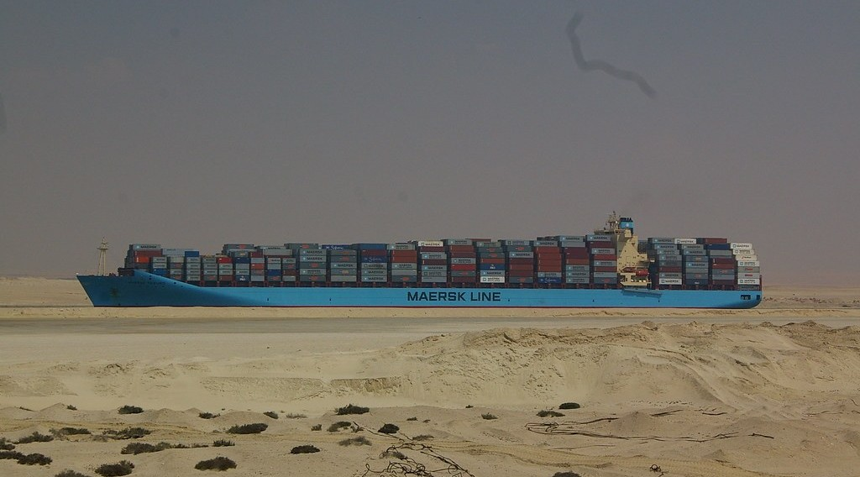
1. LOCATION
Activity 2
A canal between two seas.
Notes:
Activity 2. Look carefully at this picture: a canal between two seas. Observe every detail before I ask the question.

Slide 23
1. LOCATION
Activity 2: Question
The Suez Canal separates Africa from which continent?
Notes:
Here is the question for Activity 2: The Suez Canal separates Africa from which continent? Take one minute to think and write your answer in your rough notebook.

Slide 24
1. LOCATION
Activity 2: Answer
Asia.
Notes:
Let us check the answer together. Asia.

Slide 25
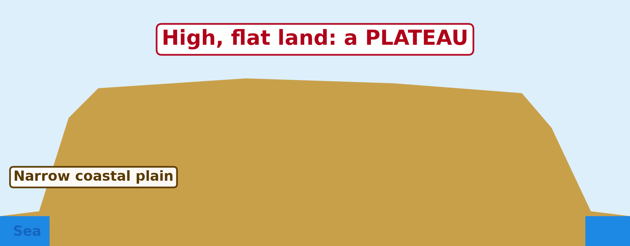
2. PHYSICAL CHARACTERISTICS
Activity 3
The high land of Africa.
Notes:
Activity 3. Look carefully at this diagram: the high land of Africa. Observe every detail before I ask the question.

Slide 26
2. PHYSICAL CHARACTERISTICS
Activity 3: Question
What do we call high, flat land like most of Africa?
Notes:
Here is the question for Activity 3: What do we call high, flat land like most of Africa? Take one minute to think and write your answer in your rough notebook.

Slide 27
2. PHYSICAL CHARACTERISTICS
Activity 3: Answer
A plateau.
Notes:
Let us check the answer together. A plateau.

Slide 28

2. PHYSICAL CHARACTERISTICS
Activity 4
The highest mountain of Africa.
Notes:
Activity 4. Look carefully at this picture: the highest mountain of Africa. Observe every detail before I ask the question.

Slide 29
2. PHYSICAL CHARACTERISTICS
Activity 4: Question
What is the name of the highest mountain of Africa?
Notes:
Here is the question for Activity 4: What is the name of the highest mountain of Africa? Take one minute to think and write your answer in your rough notebook.

Slide 30
2. PHYSICAL CHARACTERISTICS
Activity 4: Answer
Kilimanjaro (5,895 m).
Notes:
Let us check the answer together. Kilimanjaro (5,895 m).

Slide 31
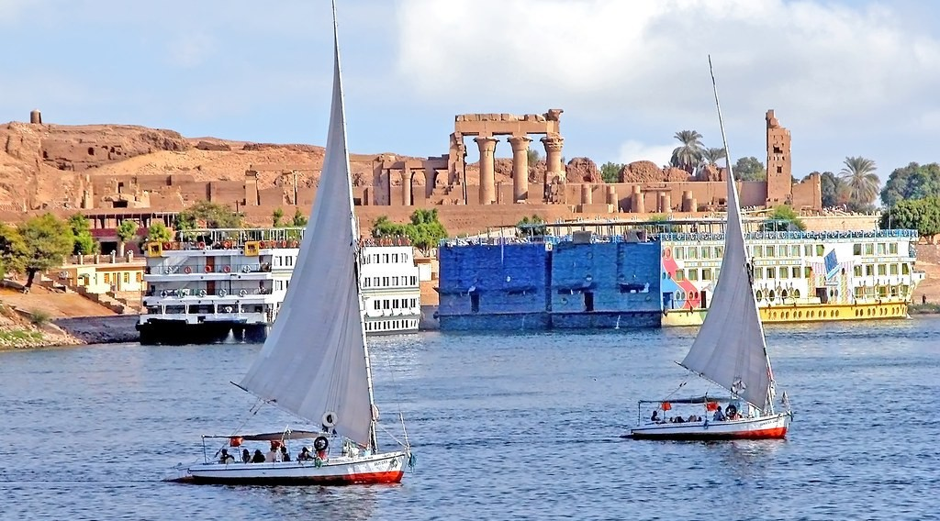
2. PHYSICAL CHARACTERISTICS
Activity 5
The longest river of Africa.
Notes:
Activity 5. Look carefully at this picture: the longest river of Africa. Observe every detail before I ask the question.

Slide 32
2. PHYSICAL CHARACTERISTICS
Activity 5: Question
What is the longest river of Africa?
Notes:
Here is the question for Activity 5: What is the longest river of Africa? Take one minute to think and write your answer in your rough notebook.

Slide 33
2. PHYSICAL CHARACTERISTICS
Activity 5: Answer
The Nile.
Notes:
Let us check the answer together. The Nile.

Slide 34
BOARD SUMMARY
Board Summary
Topic: Regional Geography
Sub-topic: Africa
Lesson 6 (Part 1): Africa: Introduction (Location and Physical Characteristics)
Notes:
Now we are going to copy the board summary. Write the title and the headings neatly in your notebooks. I will give you enough time for each slide, so do not rush.

Slide 35
BOARD SUMMARY
DEFINITIONS
The key terms of this lesson are defined as follows:
Continent: It is a very large mass of land.
Plateau: It is a large area of high, flat land.
Notes:
Let us copy the definitions. The key terms of this lesson are defined as follows. On this slide we have Continent and Plateau. Write each point on a new line, with the key term first, and explain it in your own words when we revise.

Slide 36
BOARD SUMMARY
1. Location
Africa is located as follows:
Latitudes: From about 37° N to 35° S, crossed by the Equator.
Illustration: Africa and the seas around it
Notes:
Let us copy Location. Africa is located as follows. Copy the point on Latitudes on the left, then draw the diagram on the right: africa and the seas around it. Give it a title and label it clearly.

Slide 37
BOARD SUMMARY
1. Location
Longitudes: From about 17° W to 51° E.
Oceans and seas: Atlantic Ocean, Indian Ocean, Mediterranean Sea and Red Sea.
Size: About 30 million km², the second largest continent.
Notes:
We continue with Location. On this slide we have Longitudes, Oceans and seas and Size. Write each point on a new line, with the key term first, and explain it in your own words when we revise. When you finish, we go to the next slide.

Slide 38
BOARD SUMMARY
1. Location (continued)
Cameroon: In Central Africa, on the Gulf of Guinea.
Notes:
We continue with Location. On this slide we have Cameroon. Write each point on a new line, with the key term first, and explain it in your own words when we revise.

Slide 39
BOARD SUMMARY
2. Physical Characteristics
Africa has the following physical characteristics:
A high plateau: Most of Africa is a high plateau.
Illustration: the plateau of Africa
Notes:
Let us copy Physical Characteristics. Africa has the following physical characteristics. Copy the point on A high plateau on the left, then draw the diagram on the right: the plateau of Africa. Give it a title and label it clearly.

Slide 40
BOARD SUMMARY
2. Physical Characteristics
High mountains: Kilimanjaro (5,895 m) is the highest.
Illustration: Kilimanjaro
Notes:
Copy the point on High mountains on the left, then draw the diagram on the right: kilimanjaro. Give it a title and label it clearly.

Slide 41
BOARD SUMMARY
2. Physical Characteristics
Rift Valley: A long valley in East Africa.
Big rivers and lakes: The Nile, the Congo, the Niger and Lake Victoria.
Few coastal plains: The coasts are smooth, with few bays.
Notes:
We continue with Physical Characteristics. On this slide we have Rift Valley, Big rivers and lakes and Few coastal plains. Write each point on a new line, with the key term first, and explain it in your own words when we revise.

Slide 42
FORMATIVE EVALUATION
Evaluation 1
Name the four seas and oceans around Africa.
Notes:
Now let us check what you have understood. Question 1: Name the four seas and oceans around Africa. Answer in your exercise book.

Slide 43
FORMATIVE EVALUATION
Expected Answer
Atlantic, Indian, Mediterranean and Red Sea.
Notes:
The expected answer is: atlantic, Indian, Mediterranean and Red Sea. If you got it right, well done.

Slide 44
FORMATIVE EVALUATION
Evaluation 2
What is the highest mountain of Africa?
Notes:
Now let us check what you have understood. Question 2: What is the highest mountain of Africa? Answer in your exercise book.

Slide 45
FORMATIVE EVALUATION
Expected Answer
Kilimanjaro.
Notes:
The expected answer is: kilimanjaro. If you got it right, well done.

Slide 46
REMEDIATION
Remediation
Fill in the blanks:
Africa is a ______, not a country.
The longest river of Africa is the ______.
High, flat land is called a ______.
Notes:
For those who need more practice, fill in the blanks in your exercise book. The answers are: number 1, continent; number 2, Nile; number 3, plateau.

Slide 47
HOMEWORK
Homework
Compare the climate of Douala, Garoua and Maroua. Which town is the wettest, and which is the driest? Ask an adult or use your textbook.
Notes:
For your homework: Compare the climate of Douala, Garoua and Maroua. Which town is the wettest, and which is the driest? Ask an adult or use your textbook. We shall correct it at the beginning of our next lesson.

Slide 48
NEXT LESSON
Next Lesson
Our next lesson will be on:
Lesson 6 (Part 2): Africa: Climate, Soils and Relief of Africa
Notes:
Our next lesson will be on Lesson 6 (Part 2): Africa: Climate, Soils and Relief of Africa. Thank you for your attention, and see you next time.

Slide 49
BILINGUAL GAME
Bilingual Game (Jeu Bilingue)
English | Français
Continent | Le continent
Ocean | L'océan
Sea | La mer
Strait | Le détroit
Canal | Le canal
Plateau | Le plateau
Coastline | Le littoral
Harbour | Le port naturel
Notes:
Let us play the bilingual game. I say a word in English, and you give me the French word. Then we do the reverse.

Slide 50
LOGBOOK
Official Logbook (1/2)
Module / Topic | Regional Geography
Lesson Title | Lesson 6 (Part 1): Africa: Introduction (Location and Physical Characteristics)
Expected Learning Outcomes | Locate Africa using latitudes, longitudes, oceans and seas. Give the size and the extreme points of Africa. Describe the general physical characteristics of Africa.
Competence | Learners are able to locate Africa and Cameroon on a world map and describe the position of Africa in relation to other continents.
Notes:
I record this information in the official logbook of the class after the lesson.

Slide 51
LOGBOOK
Official Logbook (2/2)
Matter Taught | DEFINITIONS; Location; Physical Characteristics.
Evaluation | Formative evaluation and remediation exercise.
Homework | Compare the climate of Douala, Garoua and Maroua. Which town is the wettest, and which is the driest? Ask an adult or use your textbook.
Enrolment / Present / Absent | ____ / ____ / ____
Achievement | To be completed after the lesson.
Notes:
I complete the second page of the logbook: the matter taught, the evaluation, the homework and the attendance.

Slide 52
TEACHER'S NOTE
Teacher's Note
Timing: Homework correction, plan, objectives 8 min | Recall, situation, action 10 min | 5 activities 30 min | Board summary (copying) 30 min | Evaluation, remediation 10 min | Homework, next lesson 5 min | Logbook 7 min
Without the projector (Activity 1): draw Africa on the board.
Without the projector (Activity 2): show the Suez Canal on a map.
Without the projector (Activity 3): describe the Adamawa plateau.
Without the projector (Activity 4): compare with Mount Cameroon.
Without the projector (Activity 5): show the Nile on a map.
Notes:
This slide is for me, the teacher: it gives the timing of the lesson and what to do if the projector is not available.

Slide 53
REFERENCES
References
Harmonised Progression Sheet, Economic Geography (5051), Form 2.
Photo, Activity 2: “MV Maersk Taikung” by tim.md, CC BY-NC-ND 2.0, via Flickr (https://www.flickr.com/photos/50299151@N00/3252980648)
Photo, Activity 4: “Kilimanjaro” by ian 1602, CC BY-NC 2.0, via Flickr (https://www.flickr.com/photos/98181641@N00/2179855841)
Photo, Activity 5: “Egypt-5B-023 - Approaching Aswan” by archer10 (Dennis), CC BY-SA 2.0, via Flickr (https://www.flickr.com/photos/22490717@N02/2217394088)
Diagrams and animations: drawn for this lesson (Geography Department).
Notes:
These are the references and picture credits used to prepare this lesson.

