Slide 1
FORM 1
GEOGRAPHY
Practical Work 1
Representation of the Earth's Shape and Size
Notes:
Good morning, class, and welcome to our geography lesson. I am your geography teacher, Mr Kamdem. Today we are starting Practical Work 1: Representation of the Earth's Shape and Size.

Slide 2
CLASS INFO
Class, Chapter and Duration
Class | Form 1
Chapter | Module 1: The Earth in the Universe
Duration | 2 periods (2 × 50 minutes)
Notes:
This lesson is for Form 1. It belongs to Module 1: The Earth in the Universe. We shall need 2 periods to cover it.

Slide 3
IDENTIFICATION
Lesson Identification
Topic | The Earth in the Universe
Sub-topic | The Earth: A Planet of the Solar System
Lesson | Practical Work 1: Representation of the Earth's Shape and Size
Notions / Concepts | Globe, world map, projection, title, key, scale, cardinal points, grid lines.
Syllabus focus | Theoretical basis: forms of representation of the Earth's shape (globe, world map, projections). Practical exercise: identification of the marginal information on maps (title, key, scale, cardinal points, grid lines, latitudes and longitudes, orientation). Contextualisation: read the scale of a map and calculate distances between places.
Competence | Learners are able to identify the marginal information of a map and calculate distances with a scale.
Notes:
Our topic is The Earth in the Universe, and the sub-topic is The Earth: A Planet of the Solar System. The key notions we shall use today are: globe, world map, projection, title, key, scale, cardinal points, grid lines. At the end, you should be able to do this: learners are able to identify the marginal information of a map and calculate distances with a scale.

Slide 4

HOMEWORK CORRECTION
Correction of the Homework
Question (Lesson 2: Our Planet, the Earth):
Name three ways of representing the Earth.
Notes:
Before we start the new lesson, let us correct the homework I gave you at the end of Lesson 2: Our Planet, the Earth. The question was: Name three ways of representing the Earth. Take out your exercise books.

Slide 5
HOMEWORK CORRECTION
Correction: Possible Answer
The globe, the world map and map projections.
Notes:
Here is a good answer. The globe, the world map and map projections. Compare it with your own answer and correct your work in red.

Slide 6
LESSON PLAN
Lesson Plan
Correction of the homework
Objectives and recall
Real-life situation and action to take
Learning activities
Board summary
Evaluation, remediation and homework
Notes:
Here is the plan of our lesson today. First, we shall correct the homework. Then we shall look at the objectives and recall what you already know. After that, we shall study a situation from real life and the action to take, and do the learning activities. Finally, we shall copy the board summary, do the evaluation and the remediation, and I will give you the homework.

Slide 7
OBJECTIVES
Objectives
By the end of this lesson, you should be able to:
Identify the forms of representation of the Earth.
Identify the marginal information on a map.
Notes:
Take your time to copy this part; we will continue together.

Slide 8
OBJECTIVES
Objectives (continued)
Calculate real distances using the scale.
Notes:
By the end of this lesson, you should be able to do three things. Number 1: identify the forms of representation of the Earth. Number 2: identify the marginal information on a map. Number 3: calculate real distances using the scale.

Slide 9
PREVIOUS KNOWLEDGE
Previous Knowledge
The Earth is round like a ball.
Maps show places on a flat surface.
Latitudes and longitudes help us to locate places.
Notes:
Let us first remember what you already know. The Earth is round like a ball. Maps show places on a flat surface. Latitudes and longitudes help us to locate places. Keep this in mind, because we shall build on it today.

Slide 10
REAL-LIFE SITUATION
Situation in Real Life
Mariam wants to know how far Garoua is from Maroua. On her map, the two towns are 6 cm apart. She asks her father: "How can I change these 6 centimetres into the real distance in kilometres?"
Notes:
Listen carefully to this situation from real life. Mariam wants to know how far Garoua is from Maroua. On her map, the two towns are 6 cm apart. She asks her father: "How can I change these 6 centimetres into the real distance in kilometres?" Think about it, because I am going to ask you some questions.

Slide 11
REAL-LIFE SITUATION
Situation: Question 1
What is the problem in the situation?
Notes:
Question 1: What is the problem in the situation? Think for a moment, then raise your hand to answer.

Slide 12
REAL-LIFE SITUATION
Answer
Mariam does not know how to change a distance on the map into a real distance.
Notes:
Good. Mariam does not know how to change a distance on the map into a real distance.

Slide 13
REAL-LIFE SITUATION
Situation: Question 2
Which part of the map helps her?
Notes:
Question 2: Which part of the map helps her? Think for a moment, then raise your hand to answer.

Slide 14
REAL-LIFE SITUATION
Answer
The scale.
Notes:
Good. The scale.

Slide 15
REAL-LIFE SITUATION
Situation: Question 3
What else is written around a map?
Notes:
Question 3: What else is written around a map? Think for a moment, then raise your hand to answer.

Slide 16
REAL-LIFE SITUATION
Possible Answer
The title, the key, the north arrow and the grid lines.
Notes:
Good. The title, the key, the north arrow and the grid lines.

Slide 17
ACTION TO TAKE
Action to Take
Always read the title, the key and the scale before using a map.
Notes:
From this situation, the action we are working towards in this lesson is the following: always read the title, the key and the scale before using a map.

Slide 18
JUSTIFICATION
Justification of the Lesson
This practical work helps us to read maps correctly and to calculate real distances.
Notes:
Why is this lesson important for you? This practical work helps us to read maps correctly and to calculate real distances.

Slide 19
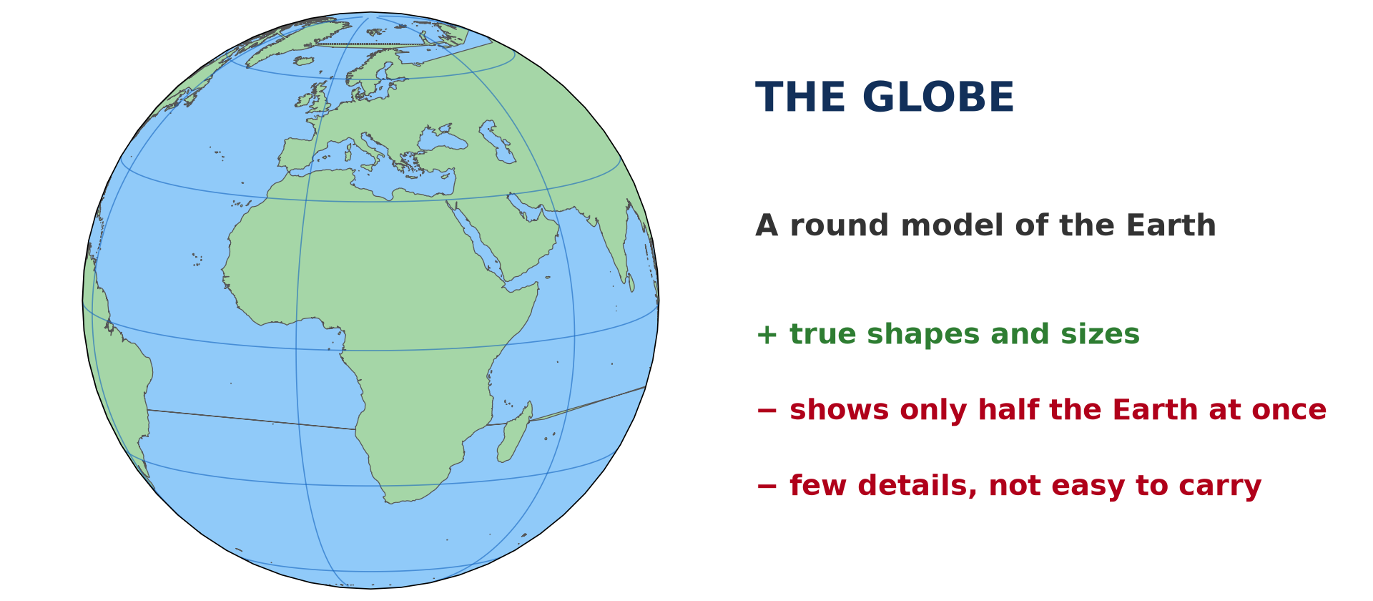
1. FORMS OF REPRESENTATION
Activity 1
A round model of the Earth.
Notes:
Activity 1. Look carefully at this diagram: a round model of the Earth. Observe every detail before I ask the question.

Slide 20
1. FORMS OF REPRESENTATION
Activity 1: Question
What is this round model of the Earth called?
Notes:
Here is the question for Activity 1: What is this round model of the Earth called? Take one minute to think and write your answer in your rough notebook.

Slide 21
1. FORMS OF REPRESENTATION
Activity 1: Answer
It is a globe.
Notes:
Let us check the answer together. It is a globe.

Slide 22
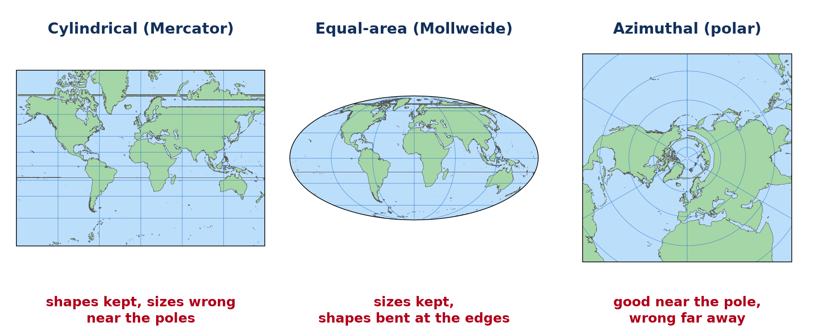
1. FORMS OF REPRESENTATION
Activity 2
The Earth drawn on flat surfaces.
Notes:
Activity 2. Look carefully at this diagram: the Earth drawn on flat surfaces. Observe every detail before I ask the question.

Slide 23
1. FORMS OF REPRESENTATION
Activity 2: Question 1
Compare these three world maps. Are the shapes of the continents the same?
Notes:
Here is the question for Activity 2: Compare these three world maps. Are the shapes of the continents the same? Take one minute to think and write your answer in your rough notebook.

Slide 24
1. FORMS OF REPRESENTATION
Activity 2: Answer 1
No, the shapes and sizes of the continents change from one map to another.
Notes:
Let us check the answer together. No, the shapes and sizes of the continents change from one map to another.

Slide 25
1. FORMS OF REPRESENTATION
Activity 2: Question 2
Why are they different?
Notes:
Here is the next question: Why are they different? Take one minute to think and write your answer in your rough notebook.

Slide 26
1. FORMS OF REPRESENTATION
Activity 2: Answer 2
Because the round Earth is drawn on a flat surface in different ways, called projections.
Notes:
Let us check the answer together. Because the round Earth is drawn on a flat surface in different ways, called projections.

Slide 27

2. MARGINAL INFORMATION
Activity 3
A map and the information around it.
Notes:
Activity 3. Look carefully at this diagram: a map and the information around it. Observe every detail before I ask the question.

Slide 28
2. MARGINAL INFORMATION
Activity 3: Question
Name the elements written around this map.
Notes:
Here is the question for Activity 3: Name the elements written around this map. Take one minute to think and write your answer in your rough notebook.

Slide 29
2. MARGINAL INFORMATION
Activity 3: Answer
The title, the key, the scale, the north arrow, the frame and the grid lines.
Notes:
Let us check the answer together. The title, the key, the scale, the north arrow, the frame and the grid lines.

Slide 30
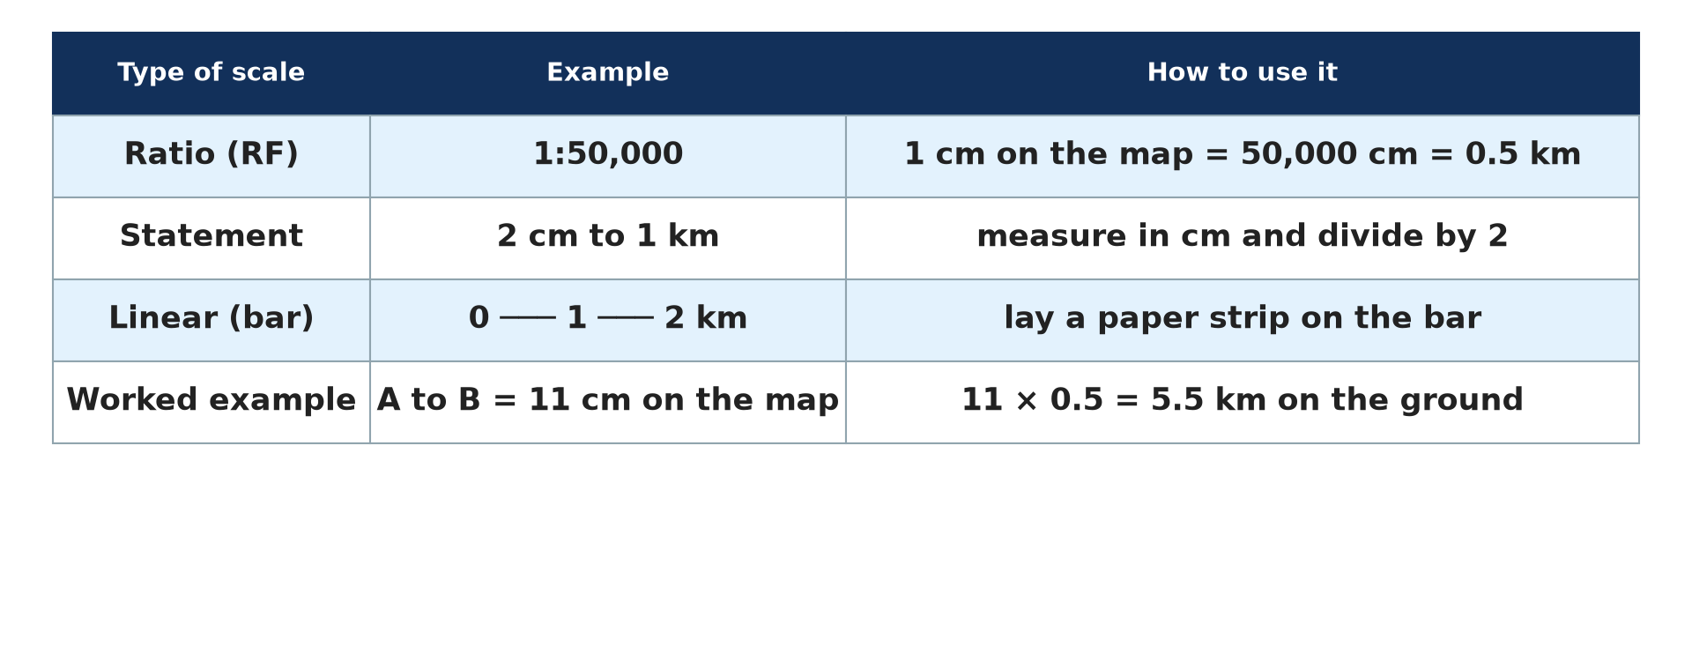
3. READING THE SCALE
Activity 4
Ways of writing the scale of a map.
Notes:
Activity 4. Look carefully at this diagram: ways of writing the scale of a map. Observe every detail before I ask the question.

Slide 31
3. READING THE SCALE
Activity 4: Question
What does the scale "1 cm to 25 km" mean?
Notes:
Here is the question for Activity 4: What does the scale "1 cm to 25 km" mean? Take one minute to think and write your answer in your rough notebook.

Slide 32
3. READING THE SCALE
Activity 4: Answer
One centimetre on the map represents 25 kilometres on the ground.
Notes:
Let us check the answer together. One centimetre on the map represents 25 kilometres on the ground.

Slide 33

3. CALCULATING DISTANCES
Activity 5
A map of Cameroon.
Notes:
Activity 5. Look carefully at this diagram: a map of Cameroon. Observe every detail before I ask the question.

Slide 34
3. CALCULATING DISTANCES
Activity 5: Question
With a scale of 1 cm to 25 km, Garoua and Maroua are 6 cm apart. What is the real distance?
Notes:
Here is the question for Activity 5: With a scale of 1 cm to 25 km, Garoua and Maroua are 6 cm apart. What is the real distance? Take one minute to think and write your answer in your rough notebook.

Slide 35
3. CALCULATING DISTANCES
Activity 5: Answer
6 × 25 = 150 km.
Notes:
Let us check the answer together. 6 × 25 = 150 km.

Slide 36
BOARD SUMMARY
Board Summary
Topic: The Earth in the Universe
Sub-topic: The Earth: A Planet of the Solar System
Practical Work 1: Representation of the Earth's Shape and Size
Notes:
Now we are going to copy the board summary. Write the title and the headings neatly in your notebooks. I will give you enough time for each slide, so do not rush.

Slide 37
BOARD SUMMARY
DEFINITIONS
The key terms of this lesson are defined as follows:
Globe: It is a round model of the Earth.
Map: It is a drawing of the Earth or part of it on a flat surface.
Notes:
Let us copy the definitions. The key terms of this lesson are defined as follows. On this slide we have Globe and Map. Write each point on a new line, with the key term first, and explain it in your own words when we revise. When you finish, we go to the next slide.

Slide 38
BOARD SUMMARY
DEFINITIONS (continued)
Projection: It is a method of drawing the round Earth on a flat map.
Notes:
We continue with the definitions. On this slide we have Projection. Write each point on a new line, with the key term first, and explain it in your own words when we revise.

Slide 39
BOARD SUMMARY
1. Forms of Representation of the Earth
The Earth is represented in the following forms:
The globe: It shows the true shape and sizes of the continents. However, it shows only half of the Earth at once and few details.
Illustration: the globe
Notes:
Let us copy Forms of Representation of the Earth. The Earth is represented in the following forms. Copy the point on The globe on the left, then draw the diagram on the right: the globe. Give it a title and label it clearly.

Slide 40
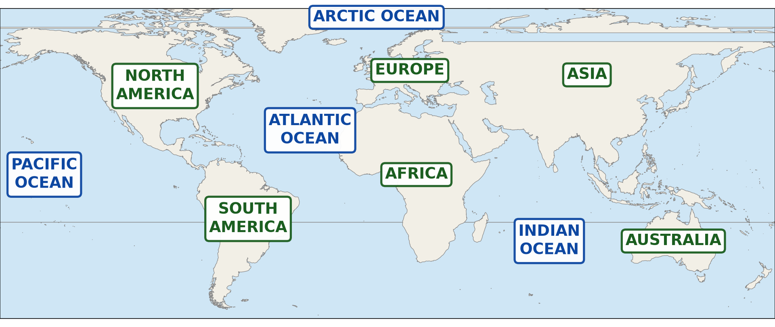
BOARD SUMMARY
1. Forms of Representation of the Earth
The world map: It shows the whole Earth at once on a flat surface. It is easy to carry and shows many details.
Illustration: a world map
Notes:
Copy the point on The world map on the left, then draw the diagram on the right: a world map. Give it a title and label it clearly.

Slide 41
BOARD SUMMARY
1. Forms of Representation of the Earth
Map projections: Each projection keeps some shapes or sizes and changes others. Examples are cylindrical, equal-area and azimuthal projections.
Illustration: three map projections
Notes:
Copy the point on Map projections on the left, then draw the diagram on the right: three map projections. Give it a title and label it clearly.

Slide 42
BOARD SUMMARY
2. Marginal Information on Maps
A map has the following marginal information:
Title: It tells what the map shows and where.
Notes:
Let us copy Marginal Information on Maps. A map has the following marginal information. On this slide we have Title. Write each point on a new line, with the key term first, and explain it in your own words when we revise.

Slide 43

BOARD SUMMARY
2. Marginal Information on Maps
Key (legend): It explains the signs, lines and colours used on the map.
Illustration: signs explained in a key
Notes:
Copy the point on Key (legend) on the left, then draw the diagram on the right: signs explained in a key. Give it a title and label it clearly.

Slide 44
BOARD SUMMARY
2. Marginal Information on Maps
Scale: It shows the relation between a distance on the map and the real distance on the ground.
Illustration: ways of writing a scale
Notes:
Copy the point on Scale on the left, then draw the diagram on the right: ways of writing a scale. Give it a title and label it clearly.

Slide 45
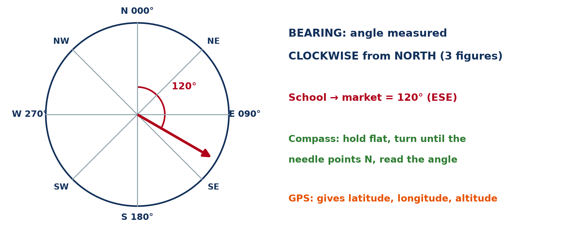
BOARD SUMMARY
2. Marginal Information on Maps
Cardinal points and north arrow: They show the directions: north, south, east and west.
Illustration: the cardinal points
Notes:
Copy the point on Cardinal points and north arrow on the left, then draw the diagram on the right: the cardinal points. Give it a title and label it clearly.

Slide 46
BOARD SUMMARY
2. Marginal Information on Maps
Grid lines, latitudes and longitudes: They help us to locate places on the map.
Illustration: grid lines on a map of Cameroon
Notes:
Copy the point on Grid lines, latitudes and longitudes on the left, then draw the diagram on the right: grid lines on a map of Cameroon. Give it a title and label it clearly.

Slide 47
BOARD SUMMARY
3. Reading the Scale and Calculating Distances
We calculate a real distance as follows:
Step 1: We measure the distance between the two places on the map with a ruler.
Step 2: We multiply the map distance by the value of the scale.
Step 3: We write the answer in kilometres.
Notes:
Let us copy Reading the Scale and Calculating Distances. We calculate a real distance as follows. On this slide we have Step 1, Step 2 and Step 3. Write each point on a new line, with the key term first, and explain it in your own words when we revise. When you finish, we go to the next slide.

Slide 48
BOARD SUMMARY
3. Reading the Scale and Calculating Distances (continued)
Example: With a scale of 1 cm to 25 km, 6 cm on the map equals 6 × 25 = 150 km.
Notes:
We continue with Reading the Scale and Calculating Distances. On this slide we have Example. Write each point on a new line, with the key term first, and explain it in your own words when we revise.

Slide 49
FORMATIVE EVALUATION
Evaluation 1
Name four elements of the marginal information of a map.
Notes:
Now let us check what you have understood. Question 1: Name four elements of the marginal information of a map. Answer in your exercise book.

Slide 50
FORMATIVE EVALUATION
Expected Answer
The title, the key, the scale and the north arrow.
Notes:
The expected answer is: the title, the key, the scale and the north arrow. If you got it right, well done.

Slide 51
FORMATIVE EVALUATION
Evaluation 2
On a map of 1 cm to 10 km, two towns are 4.5 cm apart. Find the real distance.
Notes:
Now let us check what you have understood. Question 2: On a map of 1 cm to 10 km, two towns are 4.5 cm apart. Find the real distance. Answer in your exercise book.

Slide 52
FORMATIVE EVALUATION
Expected Answer
4.5 × 10 = 45 km.
Notes:
The expected answer is: 4.5 × 10 = 45 km. If you got it right, well done.

Slide 53
REMEDIATION
Remediation
Fill in the blanks:
A round model of the Earth is a ______.
The part of a map that explains the signs is the ______.
The part of a map used to calculate distances is the ______.
Notes:
For those who need more practice, fill in the blanks in your exercise book. The answers are: number 1, globe; number 2, key; number 3, scale.

Slide 54
HOMEWORK
Homework
Give the latitude of the Equator.
Notes:
For your homework: Give the latitude of the Equator. We shall correct it at the beginning of our next lesson.

Slide 55
NEXT LESSON
Next Lesson
Our next lesson will be on:
Practical Work 2: Locate a Place on a Map
Notes:
Our next lesson will be on Practical Work 2: Locate a Place on a Map. Thank you for your attention, and see you next time.

Slide 56
BILINGUAL GAME
Bilingual Game (Jeu Bilingue)
English | Français
Globe | Le globe
Map | La carte
Title | Le titre
Key | La légende
Scale | L'échelle
North arrow | La flèche du nord
Notes:
Let us play the bilingual game. I say a word in English, and you give me the French word. Then we do the reverse.

Slide 57
LOGBOOK
Official Logbook (1/2)
Module / Topic | The Earth in the Universe
Lesson Title | Practical Work 1: Representation of the Earth's Shape and Size
Expected Learning Outcomes | Identify the forms of representation of the Earth. Identify the marginal information on a map. Calculate real distances using the scale.
Competence | Learners are able to identify the marginal information of a map and calculate distances with a scale.
Notes:
I record this information in the official logbook of the class after the lesson.

Slide 58
LOGBOOK
Official Logbook (2/2)
Matter Taught | DEFINITIONS; Forms of Representation of the Earth; Marginal Information on Maps; Reading the Scale and Calculating Distances.
Evaluation | Formative evaluation and remediation exercise.
Homework | Give the latitude of the Equator.
Enrolment / Present / Absent | ____ / ____ / ____
Achievement | To be completed after the lesson.
Notes:
I complete the second page of the logbook: the matter taught, the evaluation, the homework and the attendance.

Slide 59
TEACHER'S NOTE
Teacher's Note
Timing: Homework correction, plan, objectives 8 min | Recall, situation, action 10 min | 5 activities 30 min | Board summary (copying) 30 min | Evaluation, remediation 10 min | Homework, next lesson 5 min | Logbook 7 min
Without the projector (Activity 1): show a globe or a ball.
Without the projector (Activity 2): peel an orange and flatten the peel.
Without the projector (Activity 3): draw a frame with these elements.
Without the projector (Activity 4): write the scale on the board.
Without the projector (Activity 5): write the calculation on the board.
Notes:
This slide is for me, the teacher: it gives the timing of the lesson and what to do if the projector is not available.

Slide 60
REFERENCES
References
Geography Syllabus, Forms I–V, MINESEC (2023) — Form 1, Module 1: The Earth in the Universe.
Diagrams and animations: drawn for this lesson (Geography Department).
Notes:
These are the references and picture credits used to prepare this lesson.

