Slide 1
FORM 1
GEOGRAPHY
Lesson 13
Consequences of the Instability of the Earth's Crust
Notes:
Good morning, class, and welcome to our geography lesson. I am your geography teacher, Mr Kamdem. Today we are starting Lesson 13: Consequences of the Instability of the Earth's Crust.

Slide 2
CLASS INFO
Class, Chapter and Duration
Class | Form 1
Chapter | Module 3: Protection from the Wrath of Nature
Duration | 2 periods (2 × 50 minutes)
Notes:
This lesson is for Form 1. It belongs to Module 3: Protection from the Wrath of Nature. We shall need 2 periods to cover it.

Slide 3
IDENTIFICATION
Lesson Identification
Topic | Protection against the Wrath of Nature
Sub-topic | Movements of the Earth's Crust
Lesson | Lesson 13: Consequences of the Instability of the Earth's Crust
Notions / Concepts | Crustal instability, volcanism, earthquake.
Syllabus focus | Earthquakes; volcanism (definition and consequences).
Competence | Learners are able to explain earthquakes and volcanoes and their consequences for people.
Notes:
Our topic is Protection against the Wrath of Nature, and the sub-topic is Movements of the Earth's Crust. The key notions we shall use today are: crustal instability, volcanism, earthquake. At the end, you should be able to do this: learners are able to explain earthquakes and volcanoes and their consequences for people.

Slide 4

HOMEWORK CORRECTION
Correction of the Homework
Question (Lesson 12: Plate Movements):
Give one consequence of an earthquake.
Notes:
Before we start the new lesson, let us correct the homework I gave you at the end of Lesson 12: Plate Movements. The question was: Give one consequence of an earthquake. Take out your exercise books.

Slide 5
HOMEWORK CORRECTION
Correction: Possible Answer
Buildings collapse (also loss of life, tsunamis and landslides).
Notes:
Here is a good answer. Buildings collapse (also loss of life, tsunamis and landslides). Compare it with your own answer and correct your work in red.

Slide 6
LESSON PLAN
Lesson Plan
Correction of the homework
Objectives and recall
Real-life situation and action to take
Learning activities
Board summary
Evaluation, remediation and homework
Notes:
Here is the plan of our lesson today. First, we shall correct the homework. Then we shall look at the objectives and recall what you already know. After that, we shall study a situation from real life and the action to take, and do the learning activities. Finally, we shall copy the board summary, do the evaluation and the remediation, and I will give you the homework.

Slide 7
OBJECTIVES
Objectives
By the end of this lesson, you should be able to:
Define an earthquake and volcanism.
Give the consequences of earthquakes.
Give the consequences of volcanism.
Notes:
By the end of this lesson, you should be able to do three things. Number 1: define an earthquake and volcanism. Number 2: give the consequences of earthquakes. Number 3: give the consequences of volcanism.

Slide 8
PREVIOUS KNOWLEDGE
Previous Knowledge
The crust is broken into plates.
Plates move slowly.
The mantle contains very hot rock.
Notes:
Let us first remember what you already know. The crust is broken into plates. Plates move slowly. The mantle contains very hot rock. Keep this in mind, because we shall build on it today.

Slide 9
REAL-LIFE SITUATION
Situation in Real Life
In 1999, Mount Cameroon erupted, and lava cut the road near Bakingili. In 1986, gas from Lake Nyos killed about 1,700 people in their sleep. A pupil in Buea asks: "Why does the Earth do this, and what other damage can it cause?"
Notes:
Listen carefully to this situation from real life. In 1999, Mount Cameroon erupted, and lava cut the road near Bakingili. In 1986, gas from Lake Nyos killed about 1,700 people in their sleep. A pupil in Buea asks: "Why does the Earth do this, and what other damage can it cause?" Think about it, because I am going to ask you some questions.

Slide 10
REAL-LIFE SITUATION
Situation: Question 1
What is the problem in the situation?
Notes:
Question 1: What is the problem in the situation? Think for a moment, then raise your hand to answer.

Slide 11
REAL-LIFE SITUATION
Answer
The pupil does not understand why volcanoes and gases cause damage and deaths.
Notes:
Good. The pupil does not understand why volcanoes and gases cause damage and deaths.

Slide 12
REAL-LIFE SITUATION
Situation: Question 2
What did the lava of Mount Cameroon do?
Notes:
Question 2: What did the lava of Mount Cameroon do? Think for a moment, then raise your hand to answer.

Slide 13
REAL-LIFE SITUATION
Answer
It cut the road near Bakingili.
Notes:
Good. It cut the road near Bakingili.

Slide 14
REAL-LIFE SITUATION
Situation: Question 3
What killed people at Lake Nyos?
Notes:
Question 3: What killed people at Lake Nyos? Think for a moment, then raise your hand to answer.

Slide 15
REAL-LIFE SITUATION
Possible Answer
Poisonous gas from the lake.
Notes:
Good. Poisonous gas from the lake.

Slide 16
ACTION TO TAKE
Action to Take
Learn and follow safety rules for earthquakes and volcanic eruptions.
Notes:
From this situation, the action we are working towards in this lesson is the following: learn and follow safety rules for earthquakes and volcanic eruptions.

Slide 17
JUSTIFICATION
Justification of the Lesson
This lesson helps us to know the dangers of earthquakes and volcanoes.
Notes:
Why is this lesson important for you? This lesson helps us to know the dangers of earthquakes and volcanoes.

Slide 18
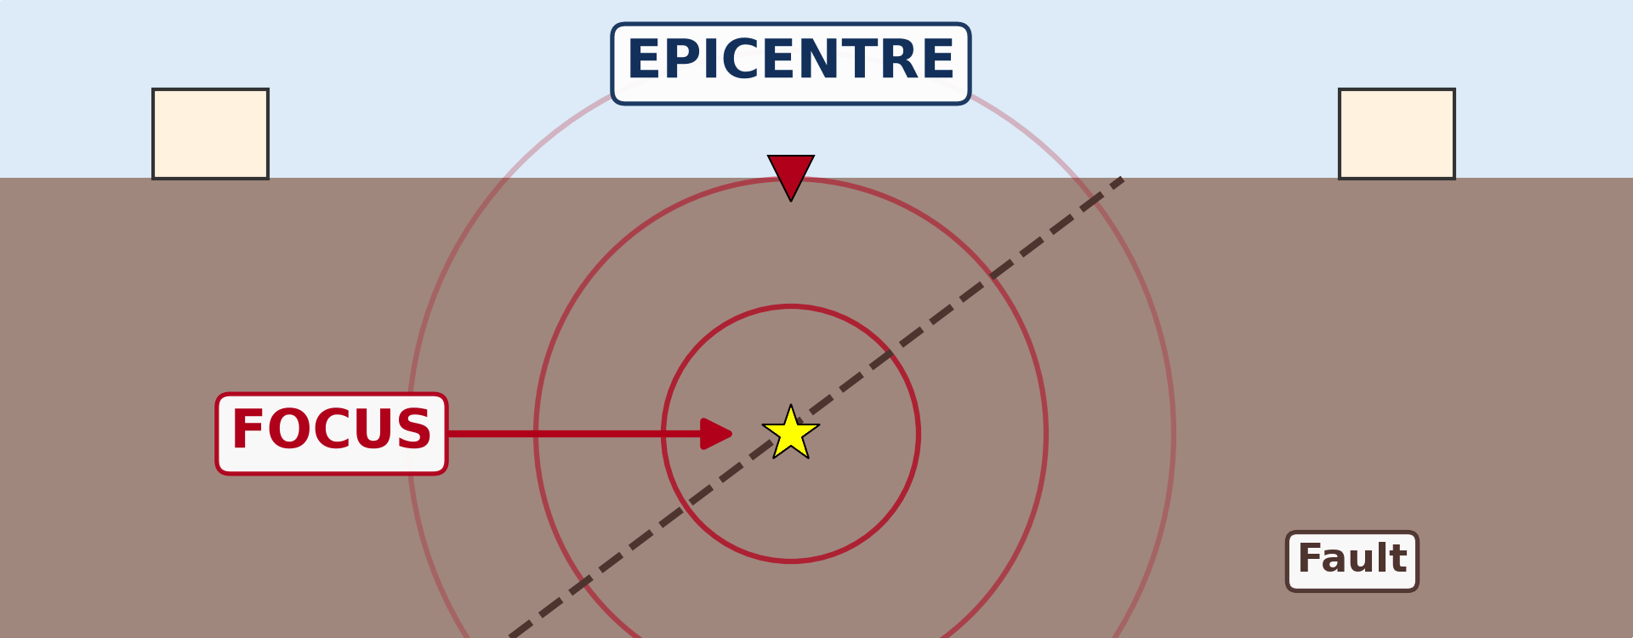
1. EARTHQUAKES
Activity 1
Animation: the ground shakes.
Notes:
Activity 1. Look carefully at this animation: animation: the ground shakes. Watch the animation to the end; it will play again.

Slide 19
1. EARTHQUAKES
Activity 1: Question
What makes the ground shake suddenly?
Notes:
Here is the question for Activity 1: What makes the ground shake suddenly? Take one minute to think and write your answer in your rough notebook.

Slide 20
1. EARTHQUAKES
Activity 1: Answer
The sudden movement of plates in the crust: it is an earthquake.
Notes:
Let us check the answer together. The sudden movement of plates in the crust: it is an earthquake.

Slide 21

1. EARTHQUAKES
Activity 2
Buildings after the ground shook.
Notes:
Activity 2. Look carefully at this picture: buildings after the ground shook. Observe every detail before I ask the question.

Slide 22
1. EARTHQUAKES
Activity 2: Question
What happens to buildings during a strong earthquake?
Notes:
Here is the question for Activity 2: What happens to buildings during a strong earthquake? Take one minute to think and write your answer in your rough notebook.

Slide 23
1. EARTHQUAKES
Activity 2: Answer
They crack and collapse, and people inside can die.
Notes:
Let us check the answer together. They crack and collapse, and people inside can die.

Slide 24

2. VOLCANISM
Activity 3
A mountain with an opening at the top.
Notes:
Activity 3. Look carefully at this diagram: a mountain with an opening at the top. Observe every detail before I ask the question.

Slide 25
2. VOLCANISM
Activity 3: Question
What comes out of a volcano?
Notes:
Here is the question for Activity 3: What comes out of a volcano? Take one minute to think and write your answer in your rough notebook.

Slide 26
2. VOLCANISM
Activity 3: Answer
Lava, ash, rocks and gases.
Notes:
Let us check the answer together. Lava, ash, rocks and gases.

Slide 27

2. VOLCANISM
Activity 4
A lava flow.
Notes:
Activity 4. Look carefully at this picture: a lava flow. Observe every detail before I ask the question.

Slide 28
2. VOLCANISM
Activity 4: Question
What damage can lava cause?
Notes:
Here is the question for Activity 4: What damage can lava cause? Take one minute to think and write your answer in your rough notebook.

Slide 29
2. VOLCANISM
Activity 4: Answer
It burns and buries houses, farms and roads.
Notes:
Let us check the answer together. It burns and buries houses, farms and roads.

Slide 30

2. VOLCANISM
Activity 5
Tea on volcanic soil.
Notes:
Activity 5. Look carefully at this picture: tea on volcanic soil. Observe every detail before I ask the question.

Slide 31
2. VOLCANISM
Activity 5: Question
Why do farmers like the soils around Mount Cameroon?
Notes:
Here is the question for Activity 5: Why do farmers like the soils around Mount Cameroon? Take one minute to think and write your answer in your rough notebook.

Slide 32
2. VOLCANISM
Activity 5: Answer
Volcanic soils are very fertile.
Notes:
Let us check the answer together. Volcanic soils are very fertile.

Slide 33
BOARD SUMMARY
Board Summary
Topic: Protection against the Wrath of Nature
Sub-topic: Movements of the Earth's Crust
Lesson 13: Consequences of the Instability of the Earth's Crust
Notes:
Now we are going to copy the board summary. Write the title and the headings neatly in your notebooks. I will give you enough time for each slide, so do not rush.

Slide 34
BOARD SUMMARY
DEFINITIONS
The key terms of this lesson are defined as follows:
Earthquake: It is a sudden shaking of the ground.
Volcanism: It is the coming out of magma, gases and ash from inside the Earth through the crust.
Notes:
Let us copy the definitions. The key terms of this lesson are defined as follows. On this slide we have Earthquake and Volcanism. Write each point on a new line, with the key term first, and explain it in your own words when we revise. When you finish, we go to the next slide.

Slide 35
BOARD SUMMARY
DEFINITIONS (continued)
Lava: It is melted rock that comes out on the surface.
Notes:
We continue with the definitions. On this slide we have Lava. Write each point on a new line, with the key term first, and explain it in your own words when we revise.

Slide 36
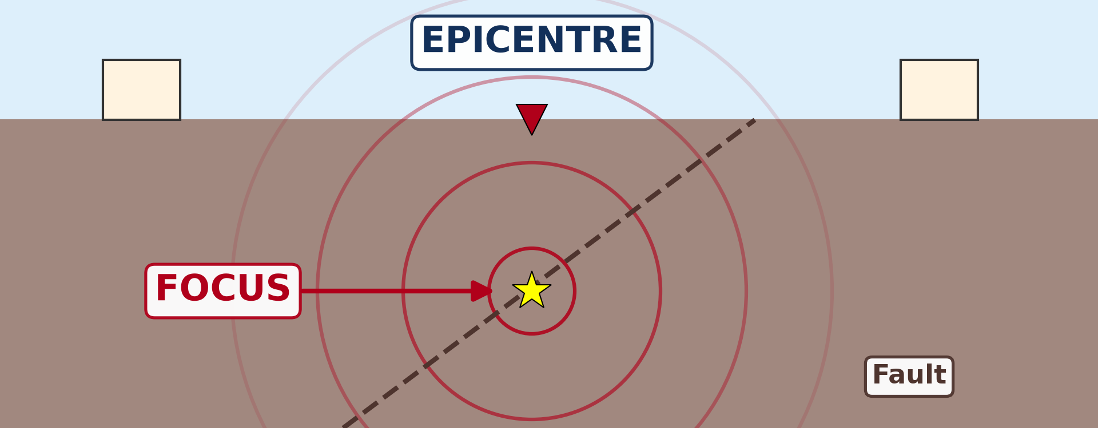
BOARD SUMMARY
1. Earthquakes
Earthquakes have the following cause and consequences:
Cause: Earthquakes are caused mainly by the sudden movement of plates.
Illustration: an earthquake
Notes:
Let us copy Earthquakes. Earthquakes have the following cause and consequences. Copy the point on Cause on the left, then draw the diagram on the right: an earthquake. Give it a title and label it clearly.

Slide 37
BOARD SUMMARY
1. Earthquakes
Destruction: They destroy buildings, roads and bridges.
Illustration: buildings destroyed by an earthquake
Notes:
Copy the point on Destruction on the left, then draw the diagram on the right: buildings destroyed by an earthquake. Give it a title and label it clearly.

Slide 38
BOARD SUMMARY
1. Earthquakes
Loss of life: People die under collapsed buildings.
Notes:
We continue with Earthquakes. On this slide we have Loss of life. Write each point on a new line, with the key term first, and explain it in your own words when we revise.

Slide 39
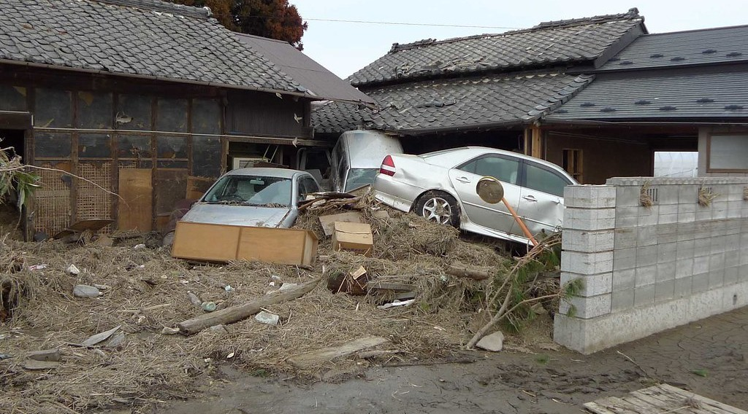
BOARD SUMMARY
1. Earthquakes
Tsunamis: Earthquakes under the sea cause giant waves that flood coasts.
Illustration: a tsunami
Notes:
Copy the point on Tsunamis on the left, then draw the diagram on the right: a tsunami. Give it a title and label it clearly.

Slide 40
BOARD SUMMARY
1. Earthquakes
Landslides and fires: The shaking causes landslides and fires from broken gas and electric lines.
Notes:
We continue with Earthquakes. On this slide we have Landslides and fires. Write each point on a new line, with the key term first, and explain it in your own words when we revise.

Slide 41
BOARD SUMMARY
2. Volcanism
A) Negative Consequences
Lava flows: Lava burns and buries houses, farms and roads, as on Mount Cameroon in 1999.
Illustration: a lava flow
Notes:
Let us copy Negative Consequences. Copy the point on Lava flows on the left, then draw the diagram on the right: a lava flow. Give it a title and label it clearly.

Slide 42

BOARD SUMMARY
2. Volcanism
A) Negative Consequences
Poisonous gases: Gases kill people and animals, as at Lake Nyos in 1986.
Illustration: Lake Nyos
Notes:
Copy the point on Poisonous gases on the left, then draw the diagram on the right: lake Nyos. Give it a title and label it clearly.

Slide 43
BOARD SUMMARY
2. Volcanism
A) Negative Consequences
Ash: Ash covers crops and makes breathing difficult.
Notes:
We continue with Negative Consequences. On this slide we have Ash. Write each point on a new line, with the key term first, and explain it in your own words when we revise.

Slide 44
BOARD SUMMARY
2. Volcanism
B) Positive Consequences
Fertile soils: Volcanic soils are very fertile, as around Mount Cameroon.
Illustration: tea on volcanic soil
Notes:
Let us copy Positive Consequences. Copy the point on Fertile soils on the left, then draw the diagram on the right: tea on volcanic soil. Give it a title and label it clearly.

Slide 45

BOARD SUMMARY
2. Volcanism
B) Positive Consequences
Tourism: Volcanoes attract tourists, like Mount Cameroon.
Illustration: Mount Cameroon
Notes:
Copy the point on Tourism on the left, then draw the diagram on the right: mount Cameroon. Give it a title and label it clearly.

Slide 46

BOARD SUMMARY
2. Volcanism
B) Positive Consequences
Energy: The heat of volcanoes produces geothermal electricity.
Illustration: a geothermal power station
Notes:
Copy the point on Energy on the left, then draw the diagram on the right: a geothermal power station. Give it a title and label it clearly.

Slide 47
BOARD SUMMARY
2. Volcanism
B) Positive Consequences
Building materials: Volcanic rocks such as basalt are used for building.
Notes:
We continue with Positive Consequences. On this slide we have Building materials. Write each point on a new line, with the key term first, and explain it in your own words when we revise.

Slide 48
FORMATIVE EVALUATION
Evaluation 1
What causes earthquakes?
Notes:
Now let us check what you have understood. Question 1: What causes earthquakes? Answer in your exercise book.

Slide 49
FORMATIVE EVALUATION
Expected Answer
The sudden movement of plates.
Notes:
The expected answer is: the sudden movement of plates. If you got it right, well done.

Slide 50
FORMATIVE EVALUATION
Evaluation 2
Give one negative and one positive consequence of volcanism.
Notes:
Now let us check what you have understood. Question 2: Give one negative and one positive consequence of volcanism. Answer in your exercise book.

Slide 51
FORMATIVE EVALUATION
Expected Answer
Negative: lava destroys farms. Positive: fertile soils.
Notes:
The expected answer is: negative: lava destroys farms. Positive: fertile soils. If you got it right, well done.

Slide 52
REMEDIATION
Remediation
Fill in the blanks:
A sudden shaking of the ground is an ______.
Melted rock that comes out of a volcano is ______.
Notes:
Take your time to copy this part; we will continue together.

Slide 53
REMEDIATION
Remediation (continued)
The active volcano of Cameroon is Mount ______.
Notes:
For those who need more practice, fill in the blanks in your exercise book. The answers are: number 1, earthquake; number 2, lava; number 3, Cameroon.

Slide 54
HOMEWORK
Homework
Give one rule to follow during an earthquake.
Notes:
For your homework: Give one rule to follow during an earthquake. We shall correct it at the beginning of our next lesson.

Slide 55
NEXT LESSON
Next Lesson
Our next lesson will be on:
Further Study 2: What to Do in Case of an Earthquake or a Volcanic Eruption
Notes:
Our next lesson will be on Further Study 2: What to Do in Case of an Earthquake or a Volcanic Eruption. Thank you for your attention, and see you next time.

Slide 56
BILINGUAL GAME
Bilingual Game (Jeu Bilingue)
English | Français
Earthquake | Le tremblement de terre
Volcano | Le volcan
Lava | La lave
Ash | La cendre
Gas | Le gaz
Eruption | L'éruption
Notes:
Let us play the bilingual game. I say a word in English, and you give me the French word. Then we do the reverse.

Slide 57
LOGBOOK
Official Logbook (1/2)
Module / Topic | Protection against the Wrath of Nature
Lesson Title | Lesson 13: Consequences of the Instability of the Earth's Crust
Expected Learning Outcomes | Define an earthquake and volcanism. Give the consequences of earthquakes. Give the consequences of volcanism.
Competence | Learners are able to explain earthquakes and volcanoes and their consequences for people.
Notes:
I record this information in the official logbook of the class after the lesson.

Slide 58
LOGBOOK
Official Logbook (2/2)
Matter Taught | DEFINITIONS; Earthquakes; Negative Consequences; Positive Consequences.
Evaluation | Formative evaluation and remediation exercise.
Homework | Give one rule to follow during an earthquake.
Enrolment / Present / Absent | ____ / ____ / ____
Achievement | To be completed after the lesson.
Notes:
I complete the second page of the logbook: the matter taught, the evaluation, the homework and the attendance.

Slide 59
TEACHER'S NOTE
Teacher's Note
Timing: Homework correction, plan, objectives 8 min | Recall, situation, action 10 min | 5 activities 30 min | Board summary (copying) 30 min | Evaluation, remediation 10 min | Homework, next lesson 5 min | Logbook 7 min
Activity 1 is an animation (GIF): it plays automatically in slide-show mode.
Without the projector (Activity 1): shake a table with objects on it.
Without the projector (Activity 2): describe earthquake damage.
Without the projector (Activity 3): draw a volcano.
Without the projector (Activity 4): describe the 1999 eruption.
Without the projector (Activity 5): name crops of Buea.
Notes:
This slide is for me, the teacher: it gives the timing of the lesson and what to do if the projector is not available.

Slide 60
REFERENCES
References
Geography Syllabus, Forms I–V, MINESEC (2023) — Form 1, Module 3: Protection from the Wrath of Nature.
Photo, Activity 2: “Collapsed buildings in earthquake-hit Chautara, Nepal” by DFID - UK Department for International Development, CC BY 2.0, via Flickr (https://www.flickr.com/photos/14214150@N02/16693413433)
Photo, Activity 4: “Lava flow over road” by J. N. Stuart, CC BY-NC-ND 2.0, via Flickr (https://www.flickr.com/photos/21786539@N03/3387263273)
Photo, Activity 5: “Carlo in the tea” by luigig, CC BY 2.0, via Flickr (https://www.flickr.com/photos/51035803402@N01/3175986747)
Photo, board summary (Tsunamis): “Tsunami damage” by robertodevido, CC BY-NC-ND 2.0, via Flickr (https://www.flickr.com/photos/63082042@N00/5531541425)
Photo, board summary (Poisonous gases): “Lake Nyos, Cameroon” by jbdodane, CC BY-NC 2.0, via Flickr (https://www.flickr.com/photos/27998473@N02/11584073056)
Notes:
Take your time to copy this part; we will continue together.

Slide 61
REFERENCES
References (continued)
Photo, board summary (Tourism): “Mount Cameroon” by John & Mel Kots, CC BY-NC-ND 2.0, via Flickr (https://www.flickr.com/photos/26745817@N00/2347261849)
Photo, board summary (Energy): “Global Geothermal Alliance Stakeholder Meeting and Site Tour, 15-16 Ju” by International Renewable Energy Agency (IRENA), CC BY-NC-SA 2.0, via Flickr (https://www.flickr.com/photos/127932406@N06/18856399410)
Diagrams and animations: drawn for this lesson (Geography Department).
Notes:
These are the references and picture credits used to prepare this lesson.

