Slide 1
FORM 2 TECHNICAL
GEOGRAPHY
Lesson 3 (Part 4)
The Desert Regions: Problems Faced and Adaptations
Notes:
Good morning, class, and welcome to our geography lesson. I am your geography teacher, Mr Kamdem. Today we are starting Lesson 3 (Part 4): The Desert Regions: Problems Faced and Adaptations.

Slide 2
CLASS INFO
Class, Chapter and Duration
Class | Form 2 Technical
Chapter | Economic Geography — Natural Regions: 3. Desert Regions
Duration | 2 periods (2 × 50 minutes)
Notes:
This lesson is for Form 2 Technical. It belongs to Economic Geography — Natural Regions: 3. Desert Regions. We shall need 2 periods to cover it.

Slide 3
IDENTIFICATION
Lesson Identification
Topic | Man in His Environment
Sub-topic | Natural Regions
Lesson | Lesson 3 (Part 4): The Desert Regions: Problems Faced and Adaptations
Notions / Concepts | Aridity, nomadism, adaptation, foggara, desalination, camel.
Syllabus focus | Problems faced by people in hot deserts and their adaptations.
Competence | Learners are able to save water and protect themselves from heat and dust, as desert people do.
Notes:
Our topic is Man in His Environment, and the sub-topic is Natural Regions. The key notions we shall use today are: aridity, nomadism, adaptation, foggara, desalination, camel. At the end, you should be able to do this: learners are able to save water and protect themselves from heat and dust, as desert people do.

Slide 4

HOMEWORK CORRECTION
Correction of the Homework
Question (Lesson 3 (Part 3): The Desert Regions: Characteristics (Soils and Vegetation)):
Give two problems of people in hot deserts.
Notes:
Before we start the new lesson, let us correct the homework I gave you at the end of Lesson 3 (Part 3): The Desert Regions: Characteristics (Soils and Vegetation). The question was: Give two problems of people in hot deserts. Take out your exercise books.

Slide 5
HOMEWORK CORRECTION
Correction: Possible Answer
Lack of water and sandstorms (also extreme temperatures).
Notes:
Here is a good answer. Lack of water and sandstorms (also extreme temperatures). Compare it with your own answer and correct your work in red.

Slide 6
LESSON PLAN
Lesson Plan
Correction of the homework
Objectives and recall
Real-life situation and action to take
Learning activities
Board summary
Evaluation, remediation and homework
Notes:
Here is the plan of our lesson today. First, we shall correct the homework. Then we shall look at the objectives and recall what you already know. After that, we shall study a situation from real life and the action to take, and do the learning activities. Finally, we shall copy the board summary, do the evaluation and the remediation, and I will give you the homework.

Slide 7
OBJECTIVES
Objectives
By the end of this lesson, you should be able to:
Identify the problems faced by people living in hot deserts.
Describe the traditional adaptations of desert people.
Notes:
Take your time to copy this part; we will continue together.

Slide 8
OBJECTIVES
Objectives (continued)
Describe the modern adaptations used in deserts.
Notes:
By the end of this lesson, you should be able to do three things. Number 1: identify the problems faced by people living in hot deserts. Number 2: describe the traditional adaptations of desert people. Number 3: describe the modern adaptations used in deserts.

Slide 9
PREVIOUS KNOWLEDGE
Previous Knowledge
Desert vegetation is scarce: cacti, thorny bushes and date palms in oases.
Plants store water, reduce water loss and have long roots.
Desert soils are sandy or stony, salty and poor in humus.
Notes:
Let us first remember what you already know. Desert vegetation is scarce: cacti, thorny bushes and date palms in oases. Plants store water, reduce water loss and have long roots. Desert soils are sandy or stony, salty and poor in humus. Keep this in mind, because we shall build on it today.

Slide 10
REAL-LIFE SITUATION
Situation in Real Life
A Tuareg family lives in the Sahara, in Niger. Their well is dry, and there is no grass for their camels and goats. The father asks: "How can my family survive in this hard place?"
Notes:
Listen carefully to this situation from real life. A Tuareg family lives in the Sahara, in Niger. Their well is dry, and there is no grass for their camels and goats. The father asks: "How can my family survive in this hard place?" Think about it, because I am going to ask you some questions.

Slide 11
REAL-LIFE SITUATION
Situation: Question 1
What is the problem in the situation?
Notes:
Question 1: What is the problem in the situation? Think for a moment, then raise your hand to answer.

Slide 12
REAL-LIFE SITUATION
Answer
The family lacks water and grass and must adapt to survive.
Notes:
Good. The family lacks water and grass and must adapt to survive.

Slide 13
REAL-LIFE SITUATION
Situation: Question 2
Where does the family live?
Notes:
Question 2: Where does the family live? Think for a moment, then raise your hand to answer.

Slide 14
REAL-LIFE SITUATION
Answer
In the Sahara, in Niger.
Notes:
Good. In the Sahara, in Niger.

Slide 15
REAL-LIFE SITUATION
Situation: Question 3
What animals do they have?
Notes:
Question 3: What animals do they have? Think for a moment, then raise your hand to answer.

Slide 16
REAL-LIFE SITUATION
Possible Answer
Camels and goats.
Notes:
Good. Camels and goats.

Slide 17
ACTION TO TAKE
Action to Take
Learn from desert peoples how to save water and adapt to heat.
Notes:
From this situation, the action we are working towards in this lesson is the following: learn from desert peoples how to save water and adapt to heat.

Slide 18
JUSTIFICATION
Justification of the Lesson
This lesson helps us to know the problems of desert people and how they live.
Notes:
Why is this lesson important for you? This lesson helps us to know the problems of desert people and how they live.

Slide 19

1. PROBLEMS FACED
Activity 1
A well in the desert.
Notes:
Activity 1. Look carefully at this picture: a well in the desert. Observe every detail before I ask the question.

Slide 20
1. PROBLEMS FACED
Activity 1: Question
What is the biggest problem in the desert?
Notes:
Here is the question for Activity 1: What is the biggest problem in the desert? Take one minute to think and write your answer in your rough notebook.

Slide 21
1. PROBLEMS FACED
Activity 1: Answer
The lack of water.
Notes:
Let us check the answer together. The lack of water.

Slide 22
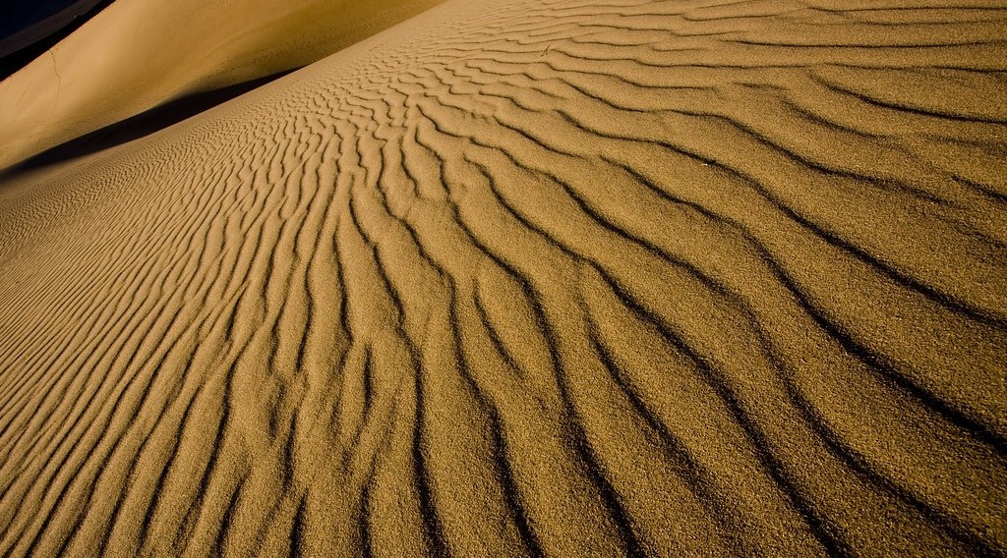
1. PROBLEMS FACED
Activity 2
Moving sand.
Notes:
Activity 2. Look carefully at this picture: moving sand. Observe every detail before I ask the question.

Slide 23
1. PROBLEMS FACED
Activity 2: Question
What can moving sand cover?
Notes:
Here is the question for Activity 2: What can moving sand cover? Take one minute to think and write your answer in your rough notebook.

Slide 24
1. PROBLEMS FACED
Activity 2: Answer
Roads, wells and fields.
Notes:
Let us check the answer together. Roads, wells and fields.

Slide 25
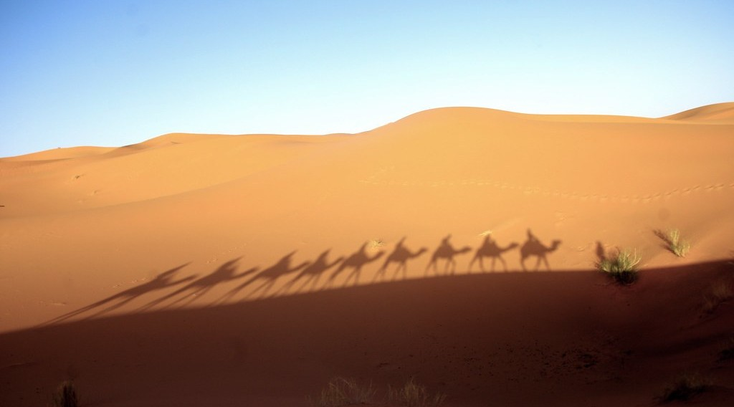
2. ADAPTATIONS
Activity 3
Camels.
Notes:
Activity 3. Look carefully at this picture: camels. Observe every detail before I ask the question.

Slide 26
2. ADAPTATIONS
Activity 3: Question
Why is the camel called the "ship of the desert"?
Notes:
Here is the question for Activity 3: Why is the camel called the "ship of the desert"? Take one minute to think and write your answer in your rough notebook.

Slide 27
2. ADAPTATIONS
Activity 3: Answer
It can walk for days without water and carry heavy loads.
Notes:
Let us check the answer together. It can walk for days without water and carry heavy loads.

Slide 28
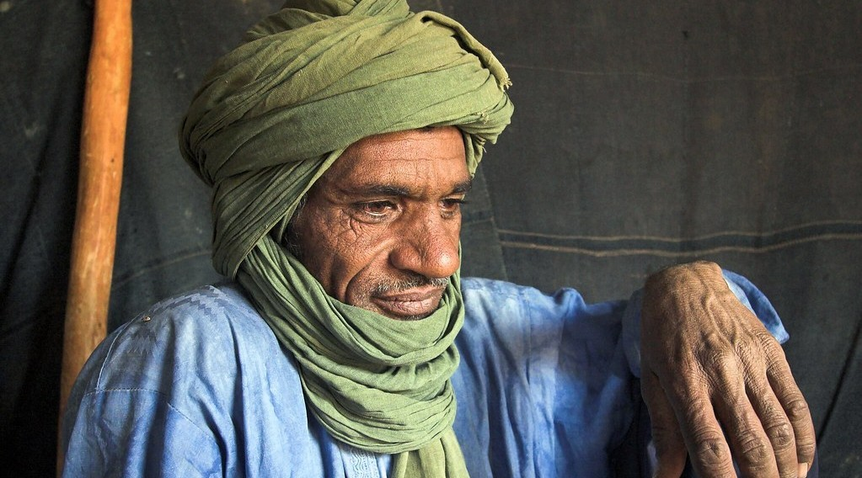
2. ADAPTATIONS
Activity 4
Tuareg people.
Notes:
Activity 4. Look carefully at this picture: tuareg people. Observe every detail before I ask the question.

Slide 29
2. ADAPTATIONS
Activity 4: Question
Why do desert people wear long, loose clothes and a turban?
Notes:
Here is the question for Activity 4: Why do desert people wear long, loose clothes and a turban? Take one minute to think and write your answer in your rough notebook.

Slide 30
2. ADAPTATIONS
Activity 4: Answer
To protect the body from the sun and the sand.
Notes:
Let us check the answer together. To protect the body from the sun and the sand.

Slide 31
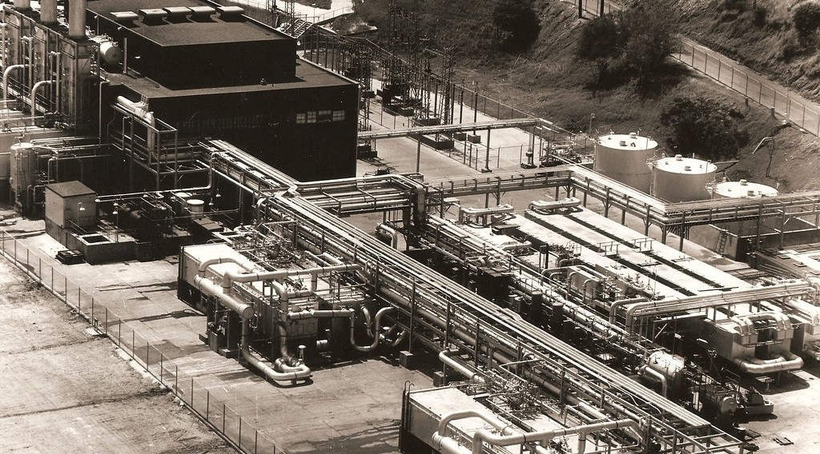
2. ADAPTATIONS
Activity 5
A water plant by the sea.
Notes:
Activity 5. Look carefully at this picture: a water plant by the sea. Observe every detail before I ask the question.

Slide 32
2. ADAPTATIONS
Activity 5: Question
How do rich desert countries get drinking water from the sea?
Notes:
Here is the question for Activity 5: How do rich desert countries get drinking water from the sea? Take one minute to think and write your answer in your rough notebook.

Slide 33
2. ADAPTATIONS
Activity 5: Answer
They remove the salt from sea water.
Notes:
Let us check the answer together. They remove the salt from sea water.

Slide 34
BOARD SUMMARY
Board Summary
Topic: Man in His Environment
Sub-topic: Natural Regions
Lesson 3 (Part 4): The Desert Regions: Problems Faced and Adaptations
Notes:
Now we are going to copy the board summary. Write the title and the headings neatly in your notebooks. I will give you enough time for each slide, so do not rush.

Slide 35
BOARD SUMMARY
DEFINITIONS
The key terms of this lesson are defined as follows:
Adaptation: It is the way people change their way of life to live in an environment.
Nomad: It is a person who moves from place to place with his animals.
Notes:
Let us copy the definitions. The key terms of this lesson are defined as follows. On this slide we have Adaptation and Nomad. Write each point on a new line, with the key term first, and explain it in your own words when we revise.

Slide 36
BOARD SUMMARY
1. Problems Faced
People in hot deserts face the following problems:
Lack of water: Wells and rivers are few.
Illustration: a desert well
Notes:
Let us copy Problems Faced. People in hot deserts face the following problems. Copy the point on Lack of water on the left, then draw the diagram on the right: a desert well. Give it a title and label it clearly.

Slide 37
BOARD SUMMARY
1. Problems Faced
Extreme temperatures: Very hot days and cold nights.
Notes:
We continue with Problems Faced. On this slide we have Extreme temperatures. Write each point on a new line, with the key term first, and explain it in your own words when we revise.

Slide 38
BOARD SUMMARY
1. Problems Faced
Sandstorms and moving sand: They bury roads, wells and fields.
Illustration: moving sand
Notes:
Copy the point on Sandstorms and moving sand on the left, then draw the diagram on the right: moving sand. Give it a title and label it clearly.

Slide 39
BOARD SUMMARY
1. Problems Faced
Poor soils: Few crops can grow.
Isolation: Towns are far apart.
Notes:
We continue with Problems Faced. On this slide we have Poor soils and Isolation. Write each point on a new line, with the key term first, and explain it in your own words when we revise.

Slide 40
BOARD SUMMARY
2. Adaptations
People adapt in the following ways:
Nomadism: Nomads move with camels and goats to find water and grass.
Illustration: camels
Notes:
Let us copy Adaptations. People adapt in the following ways. Copy the point on Nomadism on the left, then draw the diagram on the right: camels. Give it a title and label it clearly.

Slide 41
BOARD SUMMARY
2. Adaptations
Clothes: Long, loose clothes and turbans.
Illustration: Tuareg people
Notes:
Copy the point on Clothes on the left, then draw the diagram on the right: tuareg people. Give it a title and label it clearly.

Slide 42
BOARD SUMMARY
2. Adaptations
Houses: Thick mud walls and small windows keep houses cool.
Water: Deep wells, boreholes and desalination.
Irrigation: Farming in oases and along rivers.
Notes:
We continue with Adaptations. On this slide we have Houses, Water and Irrigation. Write each point on a new line, with the key term first, and explain it in your own words when we revise.

Slide 43
FORMATIVE EVALUATION
Evaluation 1
Give two problems of desert people.
Notes:
Now let us check what you have understood. Question 1: Give two problems of desert people. Answer in your exercise book.

Slide 44
FORMATIVE EVALUATION
Expected Answer
Lack of water and sandstorms.
Notes:
The expected answer is: lack of water and sandstorms. If you got it right, well done.

Slide 45
FORMATIVE EVALUATION
Evaluation 2
Why is the camel useful in the desert?
Notes:
Now let us check what you have understood. Question 2: Why is the camel useful in the desert? Answer in your exercise book.

Slide 46
FORMATIVE EVALUATION
Expected Answer
It walks for days without water and carries heavy loads.
Notes:
The expected answer is: it walks for days without water and carries heavy loads. If you got it right, well done.

Slide 47
REMEDIATION
Remediation
Fill in the blanks:
A person who moves with his animals is a ______.
The "ship of the desert" is the ______.
Removing salt from sea water is called ______.
Notes:
For those who need more practice, fill in the blanks in your exercise book. The answers are: number 1, nomad; number 2, camel; number 3, desalination.

Slide 48
HOMEWORK
Homework
Define an oasis.
Notes:
For your homework: Define an oasis. We shall correct it at the beginning of our next lesson.

Slide 49
NEXT LESSON
Next Lesson
Our next lesson will be on:
Lesson 3 (Part 5): The Desert Regions: Human Activities (Farming around Oases)
Notes:
Our next lesson will be on Lesson 3 (Part 5): The Desert Regions: Human Activities (Farming around Oases). Thank you for your attention, and see you next time.

Slide 50
BILINGUAL GAME
Bilingual Game (Jeu Bilingue)
English | Français
Water | L'eau
Well | Le puits
Camel | Le dromadaire
Nomad | Le nomade
Adaptation | L'adaptation
Turban | Le turban
Desalination | Le dessalement
Heatstroke | Le coup de chaleur
Notes:
Let us play the bilingual game. I say a word in English, and you give me the French word. Then we do the reverse.

Slide 51
LOGBOOK
Official Logbook (1/2)
Module / Topic | Man in His Environment
Lesson Title | Lesson 3 (Part 4): The Desert Regions: Problems Faced and Adaptations
Expected Learning Outcomes | Identify the problems faced by people living in hot deserts. Describe the traditional adaptations of desert people. Describe the modern adaptations used in deserts.
Competence | Learners are able to save water and protect themselves from heat and dust, as desert people do.
Notes:
I record this information in the official logbook of the class after the lesson.

Slide 52
LOGBOOK
Official Logbook (2/2)
Matter Taught | DEFINITIONS; Problems Faced; Adaptations.
Evaluation | Formative evaluation and remediation exercise.
Homework | Define an oasis.
Enrolment / Present / Absent | ____ / ____ / ____
Achievement | To be completed after the lesson.
Notes:
I complete the second page of the logbook: the matter taught, the evaluation, the homework and the attendance.

Slide 53
TEACHER'S NOTE
Teacher's Note
Timing: Homework correction, plan, objectives 8 min | Recall, situation, action 10 min | 5 activities 30 min | Board summary (copying) 30 min | Evaluation, remediation 10 min | Homework, next lesson 5 min | Logbook 7 min
Without the projector (Activity 1): describe a dry well.
Without the projector (Activity 2): describe sand after a windy day.
Without the projector (Activity 3): describe a camel.
Without the projector (Activity 4): describe the clothes of herders in the North.
Without the projector (Activity 5): taste salty water.
Notes:
This slide is for me, the teacher: it gives the timing of the lesson and what to do if the projector is not available.

Slide 54
REFERENCES
References
Harmonised Progression Sheet, Economic Geography (5051), Form 2.
Class textbook: The major biomes of the world (hot deserts).
Photo, Activity 1: “Well in the desert” by Focx Photography, CC BY-SA 2.0, via Flickr (https://www.flickr.com/photos/30780900@N02/4117141154)
Photo, Activity 2: “Mesquite Flat Dunes at Sunrise, Death Valley National Park, California” by Raj Hanchanahal Photography, CC BY-NC-ND 2.0, via Flickr (https://www.flickr.com/photos/32684709@N03/3873091107)
Photo, Activity 3: “Merzouga desert, Morocco” by Mycroyance, CC BY-ND 2.0, via Flickr (https://www.flickr.com/photos/91155980@N07/13157027505)
Photo, Activity 4: “my neighbor” by Emilia Tjernström [Arriving at the horizon], CC BY-NC-SA 2.0, via Flickr (https://www.flickr.com/photos/60614633@N00/502315074)
Photo, Activity 5: “Desalinization plant at Guantanamo Bay, Cuba” by U.S. Navy Seabee Museum, CC BY 2.0, via Flickr (https://www.flickr.com/photos/60248384@N05/6847412393)
Notes:
Take your time to copy this part; we will continue together.

Slide 55
REFERENCES
References (continued)
Diagrams and animations: drawn for this lesson (Geography Department).
Notes:
These are the references and picture credits used to prepare this lesson.

