Slide 1
FORM 2 TECHNICAL
GEOGRAPHY
Lesson 3 (Part 5)
The Desert Regions: Human Activities (Farming around Oases)
Notes:
Good morning, class, and welcome to our geography lesson. I am your geography teacher, Mr Kamdem. Today we are starting Lesson 3 (Part 5): The Desert Regions: Human Activities (Farming around Oases).

Slide 2
CLASS INFO
Class, Chapter and Duration
Class | Form 2 Technical
Chapter | Economic Geography — Natural Regions: 3. Desert Regions
Duration | 2 periods (2 × 50 minutes)
Notes:
This lesson is for Form 2 Technical. It belongs to Economic Geography — Natural Regions: 3. Desert Regions. We shall need 2 periods to cover it.

Slide 3
IDENTIFICATION
Lesson Identification
Topic | Man in His Environment
Sub-topic | Natural Regions
Lesson | Lesson 3 (Part 5): The Desert Regions: Human Activities (Farming around Oases)
Notions / Concepts | Oasis, water table, irrigation, shaduf, foggara, borehole, date palm.
Syllabus focus | Formation of oases and farming around oases; irrigation in hot deserts.
Competence | Learners are able to explain how water can be brought to crops in the dry season and use water carefully in farming.
Notes:
Our topic is Man in His Environment, and the sub-topic is Natural Regions. The key notions we shall use today are: oasis, water table, irrigation, shaduf, foggara, borehole, date palm. At the end, you should be able to do this: learners are able to explain how water can be brought to crops in the dry season and use water carefully in farming.

Slide 4

HOMEWORK CORRECTION
Correction of the Homework
Question (Lesson 3 (Part 4): The Desert Regions: Problems Faced and Adaptations):
Define an oasis.
Notes:
Before we start the new lesson, let us correct the homework I gave you at the end of Lesson 3 (Part 4): The Desert Regions: Problems Faced and Adaptations. The question was: Define an oasis. Take out your exercise books.

Slide 5
HOMEWORK CORRECTION
Correction: Possible Answer
It is a green, fertile place in a desert where water is found.
Notes:
Here is a good answer. It is a green, fertile place in a desert where water is found. Compare it with your own answer and correct your work in red.

Slide 6
LESSON PLAN
Lesson Plan
Correction of the homework
Objectives and recall
Real-life situation and action to take
Learning activities
Board summary
Evaluation, remediation and homework
Notes:
Here is the plan of our lesson today. First, we shall correct the homework. Then we shall look at the objectives and recall what you already know. After that, we shall study a situation from real life and the action to take, and do the learning activities. Finally, we shall copy the board summary, do the evaluation and the remediation, and I will give you the homework.

Slide 7
OBJECTIVES
Objectives
By the end of this lesson, you should be able to:
Explain how an oasis is formed.
Describe the crops grown in oases.
Describe the methods of irrigation used in deserts.
Notes:
Take your time to copy this part; we will continue together.

Slide 8
OBJECTIVES
Objectives (continued)
Identify the problems of oasis farming.
Notes:
By the end of this lesson, you should be able to do four things. Number 1: explain how an oasis is formed. Number 2: describe the crops grown in oases. Number 3: describe the methods of irrigation used in deserts. Number 4: identify the problems of oasis farming.

Slide 9
PREVIOUS KNOWLEDGE
Previous Knowledge
Desert people face lack of water, extreme temperatures, sandstorms and poor soils.
They adapt through nomadism, camels, clothing, housing and wells.
Notes:
Let us first remember what you already know. Desert people face lack of water, extreme temperatures, sandstorms and poor soils. They adapt through nomadism, camels, clothing, housing and wells. Keep this in mind, because we shall build on it today.

Slide 10
REAL-LIFE SITUATION
Situation in Real Life
In the middle of the Sahara, travellers see a green place with tall palm trees and gardens, while all around there is only sand. Musa asks: "How can crops grow in the middle of the desert?"
Notes:
Listen carefully to this situation from real life. In the middle of the Sahara, travellers see a green place with tall palm trees and gardens, while all around there is only sand. Musa asks: "How can crops grow in the middle of the desert?" Think about it, because I am going to ask you some questions.

Slide 11
REAL-LIFE SITUATION
Situation: Question 1
What is the problem in the situation?
Notes:
Question 1: What is the problem in the situation? Think for a moment, then raise your hand to answer.

Slide 12
REAL-LIFE SITUATION
Answer
Musa does not know how farming is possible in the desert.
Notes:
Good. Musa does not know how farming is possible in the desert.

Slide 13
REAL-LIFE SITUATION
Situation: Question 2
What did the travellers see?
Notes:
Question 2: What did the travellers see? Think for a moment, then raise your hand to answer.

Slide 14
REAL-LIFE SITUATION
Answer
Palm trees and gardens.
Notes:
Good. Palm trees and gardens.

Slide 15
REAL-LIFE SITUATION
Situation: Question 3
What is around this green place?
Notes:
Question 3: What is around this green place? Think for a moment, then raise your hand to answer.

Slide 16
REAL-LIFE SITUATION
Possible Answer
Only sand.
Notes:
Good. Only sand.

Slide 17
ACTION TO TAKE
Action to Take
Use irrigation water carefully so that it lasts.
Notes:
From this situation, the action we are working towards in this lesson is the following: use irrigation water carefully so that it lasts.

Slide 18
JUSTIFICATION
Justification of the Lesson
This lesson helps us to know how people farm in the desert.
Notes:
Why is this lesson important for you? This lesson helps us to know how people farm in the desert.

Slide 19
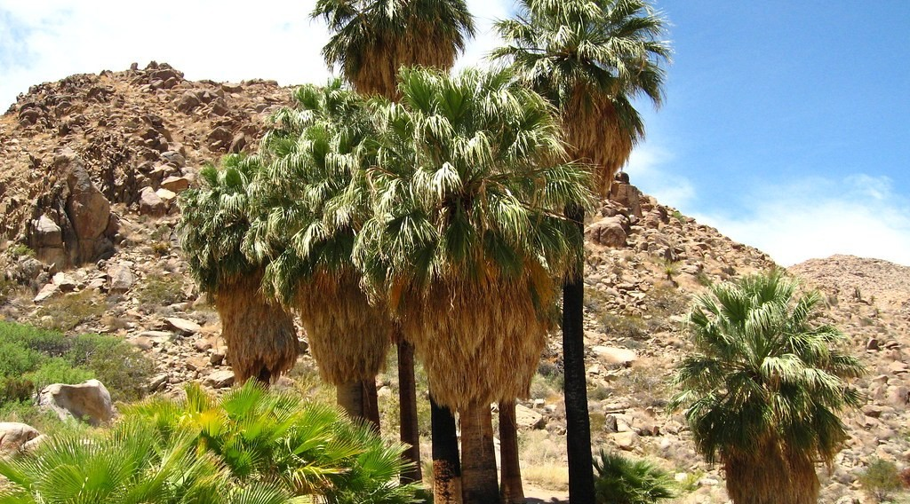
1. OASES
Activity 1
A green place in the desert.
Notes:
Activity 1. Look carefully at this picture: a green place in the desert. Observe every detail before I ask the question.

Slide 20
1. OASES
Activity 1: Question
What do we call this green place in the desert?
Notes:
Here is the question for Activity 1: What do we call this green place in the desert? Take one minute to think and write your answer in your rough notebook.

Slide 21
1. OASES
Activity 1: Answer
An oasis.
Notes:
Let us check the answer together. An oasis.

Slide 22
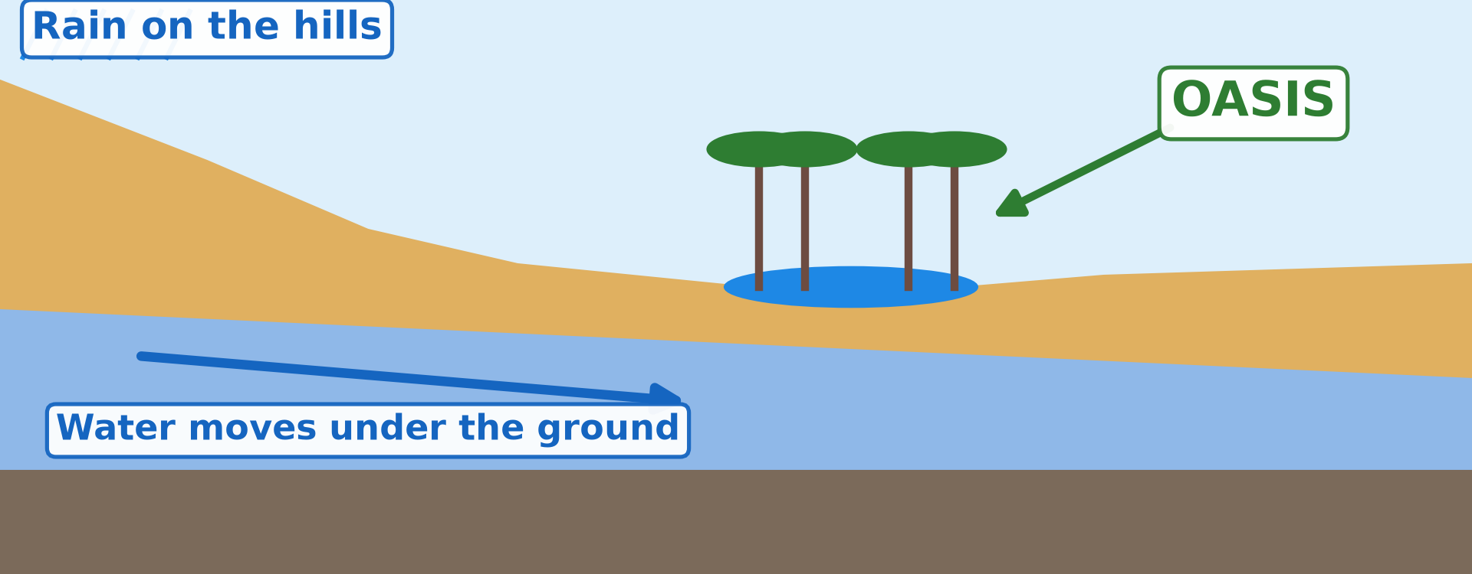
1. OASES
Activity 2
How an oasis is formed.
Notes:
Activity 2. Look carefully at this diagram: how an oasis is formed. Observe every detail before I ask the question.

Slide 23
1. OASES
Activity 2: Question
Where does the water of the oasis come from?
Notes:
Here is the question for Activity 2: Where does the water of the oasis come from? Take one minute to think and write your answer in your rough notebook.

Slide 24
1. OASES
Activity 2: Answer
From rain on far hills that moves under the ground.
Notes:
Let us check the answer together. From rain on far hills that moves under the ground.

Slide 25
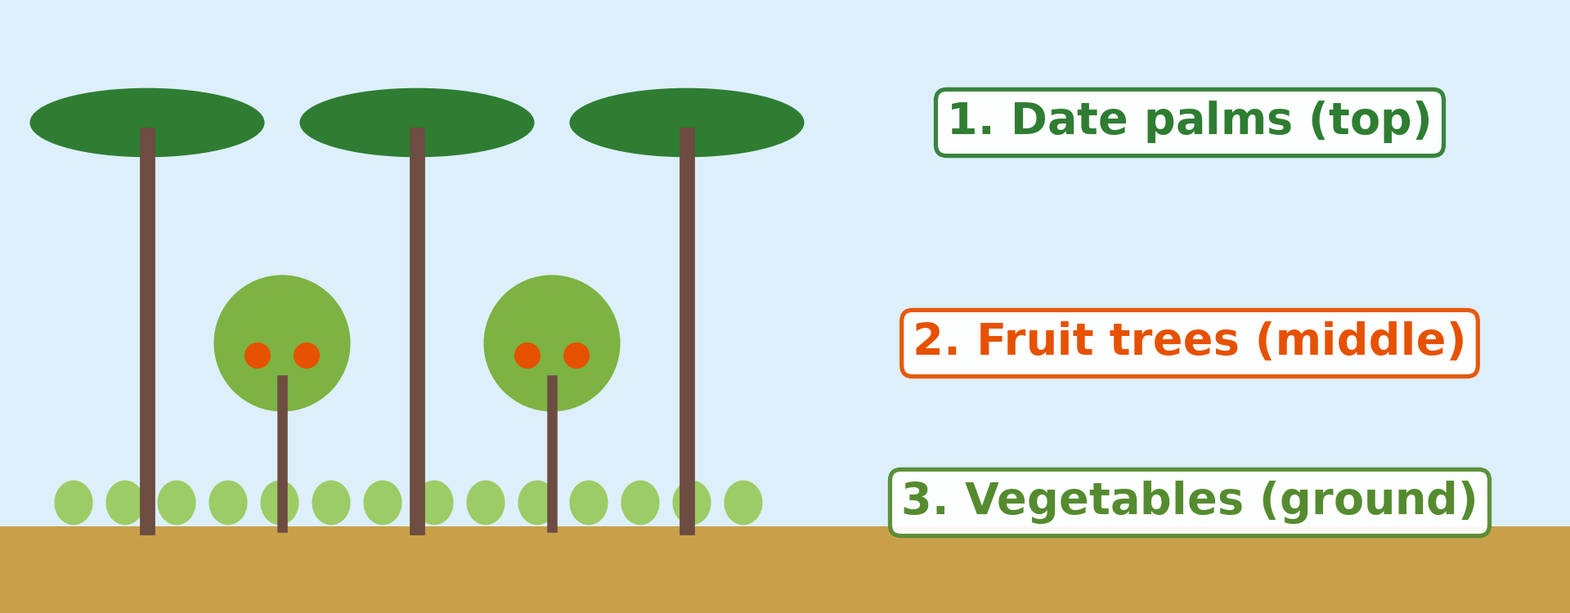
2. OASIS FARMING
Activity 3
Layers of crops in an oasis.
Notes:
Activity 3. Look carefully at this diagram: layers of crops in an oasis. Observe every detail before I ask the question.

Slide 26
2. OASIS FARMING
Activity 3: Question
Why do farmers grow crops under the palms?
Notes:
Here is the question for Activity 3: Why do farmers grow crops under the palms? Take one minute to think and write your answer in your rough notebook.

Slide 27
2. OASIS FARMING
Activity 3: Answer
The palms give shade and keep the soil wet.
Notes:
Let us check the answer together. The palms give shade and keep the soil wet.

Slide 28
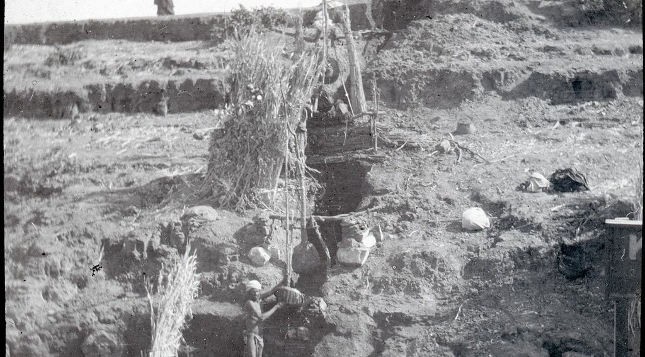
3. IRRIGATION
Activity 4
Lifting water.
Notes:
Activity 4. Look carefully at this picture: lifting water. Observe every detail before I ask the question.

Slide 29
3. IRRIGATION
Activity 4: Question
What does this farmer use to lift water?
Notes:
Here is the question for Activity 4: What does this farmer use to lift water? Take one minute to think and write your answer in your rough notebook.

Slide 30
3. IRRIGATION
Activity 4: Answer
A shaduf.
Notes:
Let us check the answer together. A shaduf.

Slide 31

3. IRRIGATION
Activity 5
Modern irrigation.
Notes:
Activity 5. Look carefully at this picture: modern irrigation. Observe every detail before I ask the question.

Slide 32
3. IRRIGATION
Activity 5: Question
Where do modern farmers get water in the desert?
Notes:
Here is the question for Activity 5: Where do modern farmers get water in the desert? Take one minute to think and write your answer in your rough notebook.

Slide 33
3. IRRIGATION
Activity 5: Answer
From deep wells (boreholes).
Notes:
Let us check the answer together. From deep wells (boreholes).

Slide 34
BOARD SUMMARY
Board Summary
Topic: Man in His Environment
Sub-topic: Natural Regions
Lesson 3 (Part 5): The Desert Regions: Human Activities (Farming around Oases)
Notes:
Now we are going to copy the board summary. Write the title and the headings neatly in your notebooks. I will give you enough time for each slide, so do not rush.

Slide 35
BOARD SUMMARY
DEFINITIONS
The key terms of this lesson are defined as follows:
Oasis: It is a green, fertile place in a desert where water is found.
Irrigation: It is bringing water to crops.
Notes:
Let us copy the definitions. The key terms of this lesson are defined as follows. On this slide we have Oasis and Irrigation. Write each point on a new line, with the key term first, and explain it in your own words when we revise.

Slide 36
BOARD SUMMARY
1. Formation of Oases
Oases are formed as follows:
Rain on far hills: Rain sinks into the rocks.
Illustration: how an oasis forms
Notes:
Let us copy Formation of Oases. Oases are formed as follows. Copy the point on Rain on far hills on the left, then draw the diagram on the right: how an oasis forms. Give it a title and label it clearly.

Slide 37
BOARD SUMMARY
1. Formation of Oases
Underground water: The water moves under the desert.
Water at the surface: It comes up in a low place and forms an oasis.
Notes:
We continue with Formation of Oases. On this slide we have Underground water and Water at the surface. Write each point on a new line, with the key term first, and explain it in your own words when we revise.

Slide 38
BOARD SUMMARY
2. Farming around Oases
Oasis farming has the following characteristics:
Date palms: The top layer gives dates and shade.
Illustration: crops in an oasis
Notes:
Let us copy Farming around Oases. Oasis farming has the following characteristics. Copy the point on Date palms on the left, then draw the diagram on the right: crops in an oasis. Give it a title and label it clearly.

Slide 39
BOARD SUMMARY
2. Farming around Oases
Fruit trees: The middle layer gives oranges, figs and olives.
Vegetables and cereals: The lower layer gives wheat, barley and vegetables.
Animals: Goats, camels and sheep.
Notes:
We continue with Farming around Oases. On this slide we have Fruit trees, Vegetables and cereals and Animals. Write each point on a new line, with the key term first, and explain it in your own words when we revise.

Slide 40
BOARD SUMMARY
3. Irrigation in Deserts
Water is brought to crops in the following ways:
Shaduf: A pole with a bucket lifts water.
Illustration: a shaduf
Notes:
Let us copy Irrigation in Deserts. Water is brought to crops in the following ways. Copy the point on Shaduf on the left, then draw the diagram on the right: a shaduf. Give it a title and label it clearly.

Slide 41
BOARD SUMMARY
3. Irrigation in Deserts
Wells and boreholes: Pumps lift underground water.
Dams and canals: The Aswan Dam stores Nile water for the fields.
Notes:
We continue with Irrigation in Deserts. On this slide we have Wells and boreholes and Dams and canals. Write each point on a new line, with the key term first, and explain it in your own words when we revise.

Slide 42
BOARD SUMMARY
3. Irrigation in Deserts
Modern sprinklers: Centre-pivot machines water large fields.
Illustration: modern irrigation
Notes:
Copy the point on Modern sprinklers on the left, then draw the diagram on the right: modern irrigation. Give it a title and label it clearly.

Slide 43
FORMATIVE EVALUATION
Evaluation 1
What is an oasis?
Notes:
Now let us check what you have understood. Question 1: What is an oasis? Answer in your exercise book.

Slide 44
FORMATIVE EVALUATION
Expected Answer
A green place in the desert where there is water.
Notes:
The expected answer is: a green place in the desert where there is water. If you got it right, well done.

Slide 45
FORMATIVE EVALUATION
Evaluation 2
Name two ways to get water in an oasis.
Notes:
Now let us check what you have understood. Question 2: Name two ways to get water in an oasis. Answer in your exercise book.

Slide 46
FORMATIVE EVALUATION
Expected Answer
Wells and the shaduf (or pumps).
Notes:
The expected answer is: wells and the shaduf (or pumps). If you got it right, well done.

Slide 47
REMEDIATION
Remediation
Fill in the blanks:
A green place with water in the desert is an ______.
The top layer of an oasis garden is the date ______.
Notes:
Take your time to copy this part; we will continue together.

Slide 48
REMEDIATION
Remediation (continued)
A pole with a bucket for lifting water is a ______.
Notes:
For those who need more practice, fill in the blanks in your exercise book. The answers are: number 1, oasis; number 2, palm; number 3, shaduf.

Slide 49
HOMEWORK
Homework
Name the four seasons of the temperate region.
Notes:
For your homework: Name the four seasons of the temperate region. We shall correct it at the beginning of our next lesson.

Slide 50
NEXT LESSON
Next Lesson
Our next lesson will be on:
Lesson 4 (Part 1): The Temperate Region: Location, Types and Characteristics (Climate)
Notes:
Our next lesson will be on Lesson 4 (Part 1): The Temperate Region: Location, Types and Characteristics (Climate). Thank you for your attention, and see you next time.

Slide 51
BILINGUAL GAME
Bilingual Game (Jeu Bilingue)
English | Français
Oasis | L'oasis
Date | La datte
Irrigation | L'irrigation
Borehole | Le forage
Spring | La source
Water table | La nappe phréatique
Pump | La pompe
Dam | Le barrage
Notes:
Let us play the bilingual game. I say a word in English, and you give me the French word. Then we do the reverse.

Slide 52
LOGBOOK
Official Logbook (1/2)
Module / Topic | Man in His Environment
Lesson Title | Lesson 3 (Part 5): The Desert Regions: Human Activities (Farming around Oases)
Expected Learning Outcomes | Explain how an oasis is formed. Describe the crops grown in oases. Describe the methods of irrigation used in deserts. Identify the problems of oasis farming.
Competence | Learners are able to explain how water can be brought to crops in the dry season and use water carefully in farming.
Notes:
I record this information in the official logbook of the class after the lesson.

Slide 53
LOGBOOK
Official Logbook (2/2)
Matter Taught | DEFINITIONS; Formation of Oases; Farming around Oases; Irrigation in Deserts.
Evaluation | Formative evaluation and remediation exercise.
Homework | Name the four seasons of the temperate region.
Enrolment / Present / Absent | ____ / ____ / ____
Achievement | To be completed after the lesson.
Notes:
I complete the second page of the logbook: the matter taught, the evaluation, the homework and the attendance.

Slide 54
TEACHER'S NOTE
Teacher's Note
Timing: Homework correction, plan, objectives 8 min | Recall, situation, action 10 min | 5 activities 30 min | Board summary (copying) 30 min | Evaluation, remediation 10 min | Homework, next lesson 5 min | Logbook 7 min
Without the projector (Activity 1): describe a green place in a dry area.
Without the projector (Activity 2): draw water under the sand.
Without the projector (Activity 3): draw three layers.
Without the projector (Activity 4): describe a bucket on a pole.
Without the projector (Activity 5): describe a borehole.
Notes:
This slide is for me, the teacher: it gives the timing of the lesson and what to do if the projector is not available.

Slide 55
REFERENCES
References
Harmonised Progression Sheet, Economic Geography (5051), Form 2.
Class textbook: The major biomes of the world (hot deserts).
Photo, Activity 1: “49 Palms Oasis; Twentynine Palms, CA” by Joshua Tree National Park, Public domain 1.0, via Flickr (https://www.flickr.com/photos/115357548@N08/12525367563)
Photo, Activity 4: “A Shadoof” by 10b travelling / Carsten ten Brink, CC BY-NC-ND 2.0, via Flickr (https://www.flickr.com/photos/77334245@N00/5908489998)
Photo, Activity 5: “Mid-West Agriculture” by Djof, CC BY-NC-SA 2.0, via Flickr (https://www.flickr.com/photos/10787942@N00/147222315)
Diagrams and animations: drawn for this lesson (Geography Department).
Notes:
These are the references and picture credits used to prepare this lesson.

