Slide 1
FORM 2 TECHNICAL
GEOGRAPHY
Lesson 6 (Part 3)
Africa: Vegetation and Drainage of Africa
Notes:
Good morning, class, and welcome to our geography lesson. I am your geography teacher, Mr Kamdem. Today we are starting Lesson 6 (Part 3): Africa: Vegetation and Drainage of Africa.

Slide 2
CLASS INFO
Class, Chapter and Duration
Class | Form 2 Technical
Chapter | Economic Geography — Africa
Duration | 2 periods (2 × 50 minutes)
Notes:
This lesson is for Form 2 Technical. It belongs to Economic Geography — Africa. We shall need 2 periods to cover it.

Slide 3
IDENTIFICATION
Lesson Identification
Topic | Regional Geography
Sub-topic | Africa
Lesson | Lesson 6 (Part 3): Africa: Vegetation and Drainage of Africa
Notions / Concepts | Vegetation zone, drainage, river basin, mouth, delta, waterfall, inland drainage.
Syllabus focus | Vegetation and drainage of Africa.
Competence | Learners are able to name the main vegetation zones, rivers and lakes of Africa and explain how people use rivers and lakes.
Notes:
Our topic is Regional Geography, and the sub-topic is Africa. The key notions we shall use today are: vegetation zone, drainage, river basin, mouth, delta, waterfall, inland drainage. At the end, you should be able to do this: learners are able to name the main vegetation zones, rivers and lakes of Africa and explain how people use rivers and lakes.

Slide 4

HOMEWORK CORRECTION
Correction of the Homework
Question (Lesson 6 (Part 2): Africa: Climate, Soils and Relief of Africa):
Name three big rivers of Africa.
Notes:
Before we start the new lesson, let us correct the homework I gave you at the end of Lesson 6 (Part 2): Africa: Climate, Soils and Relief of Africa. The question was: Name three big rivers of Africa. Take out your exercise books.

Slide 5
HOMEWORK CORRECTION
Correction: Possible Answer
The Nile, the Congo and the Niger (also the Zambezi).
Notes:
Here is a good answer. The Nile, the Congo and the Niger (also the Zambezi). Compare it with your own answer and correct your work in red.

Slide 6
LESSON PLAN
Lesson Plan
Correction of the homework
Objectives and recall
Real-life situation and action to take
Learning activities
Board summary
Evaluation, remediation and homework
Notes:
Here is the plan of our lesson today. First, we shall correct the homework. Then we shall look at the objectives and recall what you already know. After that, we shall study a situation from real life and the action to take, and do the learning activities. Finally, we shall copy the board summary, do the evaluation and the remediation, and I will give you the homework.

Slide 7
OBJECTIVES
Objectives
By the end of this lesson, you should be able to:
Describe the main vegetation zones of Africa.
Name the main rivers and lakes of Africa and locate them.
Notes:
Take your time to copy this part; we will continue together.

Slide 8
OBJECTIVES
Objectives (continued)
Explain the importance of African rivers and lakes.
Notes:
By the end of this lesson, you should be able to do three things. Number 1: describe the main vegetation zones of Africa. Number 2: name the main rivers and lakes of Africa and locate them. Number 3: explain the importance of African rivers and lakes.

Slide 9
PREVIOUS KNOWLEDGE
Previous Knowledge
The climatic zones of Africa are repeated north and south of the Equator.
Africa has plateaux, basins, mountains and the Great Rift Valley.
Its soils include ferrallitic, ferruginous, desert, volcanic and alluvial soils.
Notes:
Let us first remember what you already know. The climatic zones of Africa are repeated north and south of the Equator. Africa has plateaux, basins, mountains and the Great Rift Valley. Its soils include ferrallitic, ferruginous, desert, volcanic and alluvial soils. Keep this in mind, because we shall build on it today.

Slide 10
REAL-LIFE SITUATION
Situation in Real Life
Lake Chad, north of Cameroon, is much smaller today than sixty years ago, and many fishermen and farmers have lost their work. Mariam asks: "What are the vegetation, the rivers and the lakes of Africa, and why is Lake Chad shrinking?"
Notes:
Listen carefully to this situation from real life. Lake Chad, north of Cameroon, is much smaller today than sixty years ago, and many fishermen and farmers have lost their work. Mariam asks: "What are the vegetation, the rivers and the lakes of Africa, and why is Lake Chad shrinking?" Think about it, because I am going to ask you some questions.

Slide 11
REAL-LIFE SITUATION
Situation: Question 1
What is the problem in the situation?
Notes:
Question 1: What is the problem in the situation? Think for a moment, then raise your hand to answer.

Slide 12
REAL-LIFE SITUATION
Answer
Mariam does not know the vegetation and drainage of Africa and why Lake Chad is shrinking.
Notes:
Good. Mariam does not know the vegetation and drainage of Africa and why Lake Chad is shrinking.

Slide 13
REAL-LIFE SITUATION
Situation: Question 2
What happened to Lake Chad?
Notes:
Question 2: What happened to Lake Chad? Think for a moment, then raise your hand to answer.

Slide 14
REAL-LIFE SITUATION
Answer
It has become much smaller.
Notes:
Good. It has become much smaller.

Slide 15
REAL-LIFE SITUATION
Situation: Question 3
Who lost their work?
Notes:
Question 3: Who lost their work? Think for a moment, then raise your hand to answer.

Slide 16
REAL-LIFE SITUATION
Possible Answer
Fishermen and farmers.
Notes:
Good. Fishermen and farmers.

Slide 17
ACTION TO TAKE
Action to Take
Protect the forests, rivers and lakes of Africa.
Notes:
From this situation, the action we are working towards in this lesson is the following: protect the forests, rivers and lakes of Africa.

Slide 18
JUSTIFICATION
Justification of the Lesson
This lesson helps us to know the vegetation, rivers and lakes of Africa.
Notes:
Why is this lesson important for you? This lesson helps us to know the vegetation, rivers and lakes of Africa.

Slide 19

1. VEGETATION
Activity 1
The vegetation of Africa.
Notes:
Activity 1. Look carefully at this diagram: the vegetation of Africa. Observe every detail before I ask the question.

Slide 20
1. VEGETATION
Activity 1: Question
Which vegetation covers most of Africa?
Notes:
Here is the question for Activity 1: Which vegetation covers most of Africa? Take one minute to think and write your answer in your rough notebook.

Slide 21
1. VEGETATION
Activity 1: Answer
The savanna.
Notes:
Let us check the answer together. The savanna.

Slide 22

1. VEGETATION
Activity 2
A thick forest.
Notes:
Activity 2. Look carefully at this picture: a thick forest. Observe every detail before I ask the question.

Slide 23
1. VEGETATION
Activity 2: Question
Why is the forest so thick near the Equator?
Notes:
Here is the question for Activity 2: Why is the forest so thick near the Equator? Take one minute to think and write your answer in your rough notebook.

Slide 24
1. VEGETATION
Activity 2: Answer
It is hot and wet all year.
Notes:
Let us check the answer together. It is hot and wet all year.

Slide 25
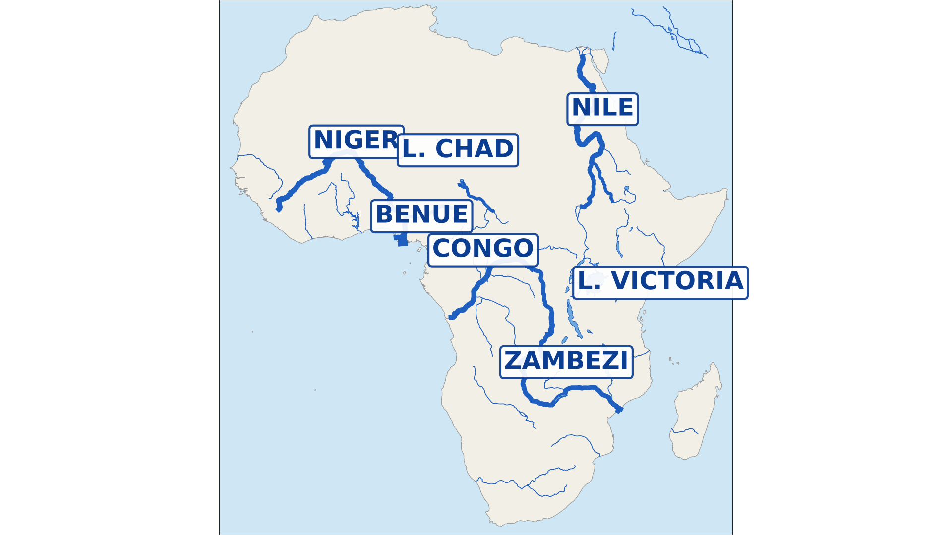
2. DRAINAGE
Activity 3
The rivers and lakes of Africa.
Notes:
Activity 3. Look carefully at this diagram: the rivers and lakes of Africa. Observe every detail before I ask the question.

Slide 26
2. DRAINAGE
Activity 3: Question
Name two big rivers of Africa.
Notes:
Here is the question for Activity 3: Name two big rivers of Africa. Take one minute to think and write your answer in your rough notebook.

Slide 27
2. DRAINAGE
Activity 3: Answer
The Nile and the Congo (also the Niger and the Zambezi).
Notes:
Let us check the answer together. The Nile and the Congo (also the Niger and the Zambezi).

Slide 28

2. DRAINAGE
Activity 4
The Benue.
Notes:
Activity 4. Look carefully at this picture: the Benue. Observe every detail before I ask the question.

Slide 29
2. DRAINAGE
Activity 4: Question
The Benue flows through Garoua. Which big river does it join?
Notes:
Here is the question for Activity 4: The Benue flows through Garoua. Which big river does it join? Take one minute to think and write your answer in your rough notebook.

Slide 30
2. DRAINAGE
Activity 4: Answer
The Niger.
Notes:
Let us check the answer together. The Niger.

Slide 31

2. DRAINAGE
Activity 5
Lake Chad.
Notes:
Activity 5. Look carefully at this picture: lake Chad. Observe every detail before I ask the question.

Slide 32
2. DRAINAGE
Activity 5: Question
Give one reason why Lake Chad is shrinking.
Notes:
Here is the question for Activity 5: Give one reason why Lake Chad is shrinking. Take one minute to think and write your answer in your rough notebook.

Slide 33
2. DRAINAGE
Activity 5: Answer
Less rain (drought) and too much water taken for irrigation.
Notes:
Let us check the answer together. Less rain (drought) and too much water taken for irrigation.

Slide 34
BOARD SUMMARY
Board Summary
Topic: Regional Geography
Sub-topic: Africa
Lesson 6 (Part 3): Africa: Vegetation and Drainage of Africa
Notes:
Now we are going to copy the board summary. Write the title and the headings neatly in your notebooks. I will give you enough time for each slide, so do not rush.

Slide 35
BOARD SUMMARY
DEFINITIONS
The key terms of this lesson are defined as follows:
Vegetation: It is the plants that grow naturally in an area.
Drainage: It is the rivers and lakes of an area.
Notes:
Let us copy the definitions. The key terms of this lesson are defined as follows. On this slide we have Vegetation and Drainage. Write each point on a new line, with the key term first, and explain it in your own words when we revise.

Slide 36
BOARD SUMMARY
1. Vegetation
Africa has the following vegetation zones:
Equatorial forest: Thick evergreen forest in the Congo Basin.
Illustration: the vegetation of Africa
Notes:
Let us copy Vegetation. Africa has the following vegetation zones. Copy the point on Equatorial forest on the left, then draw the diagram on the right: the vegetation of Africa. Give it a title and label it clearly.

Slide 37
BOARD SUMMARY
1. Vegetation
Savanna: Grass and scattered trees, covering most of Africa.
Desert vegetation: Few scattered plants in the Sahara and the Kalahari.
Mediterranean vegetation: Olive trees and shrubs at the north and south tips.
Notes:
We continue with Vegetation. On this slide we have Savanna, Desert vegetation and Mediterranean vegetation. Write each point on a new line, with the key term first, and explain it in your own words when we revise. When you finish, we go to the next slide.

Slide 38
BOARD SUMMARY
1. Vegetation (continued)
Mountain vegetation: Forests and grass on high mountains.
Notes:
We continue with Vegetation. On this slide we have Mountain vegetation. Write each point on a new line, with the key term first, and explain it in your own words when we revise.

Slide 39
BOARD SUMMARY
2. Drainage
The main rivers and lakes of Africa and their importance are the following:
The Nile: The longest river, flowing into the Mediterranean Sea.
Illustration: the rivers and lakes of Africa
Notes:
Let us copy Drainage. The main rivers and lakes of Africa and their importance are the following. Copy the point on The Nile on the left, then draw the diagram on the right: the rivers and lakes of Africa. Give it a title and label it clearly.

Slide 40
BOARD SUMMARY
2. Drainage
The Congo: It carries the most water, into the Atlantic Ocean.
The Niger: It flows into the Gulf of Guinea, and the Benue joins it.
The Zambezi: It flows into the Indian Ocean.
Notes:
We continue with Drainage. On this slide we have The Congo, The Niger and The Zambezi. Write each point on a new line, with the key term first, and explain it in your own words when we revise.

Slide 41
BOARD SUMMARY
2. Drainage
Lakes: Lake Victoria is the largest, and Lake Chad is shrinking.
Illustration: Lake Chad
Notes:
Copy the point on Lakes on the left, then draw the diagram on the right: lake Chad. Give it a title and label it clearly.

Slide 42
BOARD SUMMARY
2. Drainage
Importance: Water, fishing, transport, irrigation and electricity.
Notes:
We continue with Drainage. On this slide we have Importance. Write each point on a new line, with the key term first, and explain it in your own words when we revise.

Slide 43
FORMATIVE EVALUATION
Evaluation 1
Which vegetation covers most of Africa?
Notes:
Now let us check what you have understood. Question 1: Which vegetation covers most of Africa? Answer in your exercise book.

Slide 44
FORMATIVE EVALUATION
Expected Answer
The savanna.
Notes:
The expected answer is: the savanna. If you got it right, well done.

Slide 45
FORMATIVE EVALUATION
Evaluation 2
The Benue is a tributary of which river?
Notes:
Now let us check what you have understood. Question 2: The Benue is a tributary of which river? Answer in your exercise book.

Slide 46
FORMATIVE EVALUATION
Expected Answer
The Niger.
Notes:
The expected answer is: the Niger. If you got it right, well done.

Slide 47
REMEDIATION
Remediation
Fill in the blanks:
The longest river of Africa is the ______.
A river that joins a bigger river is a ______.
The lake north of Cameroon that is shrinking is Lake ______.
Notes:
For those who need more practice, fill in the blanks in your exercise book. The answers are: number 1, Nile; number 2, tributary; number 3, Chad.

Slide 48
HOMEWORK
Homework
Name the three vegetation zones of Africa that we studied.
Notes:
For your homework: Name the three vegetation zones of Africa that we studied. We shall correct it at the beginning of our next lesson.

Slide 49
BILINGUAL GAME
Bilingual Game (Jeu Bilingue)
English | Français
Vegetation | La végétation
Rainforest | La forêt dense
River | Le fleuve
Tributary | L'affluent
Mouth | L'embouchure
Lake | Le lac
Waterfall | La chute d'eau
Drainage | Le réseau hydrographique
Notes:
Let us play the bilingual game. I say a word in English, and you give me the French word. Then we do the reverse.

Slide 50
LOGBOOK
Official Logbook (1/2)
Module / Topic | Regional Geography
Lesson Title | Lesson 6 (Part 3): Africa: Vegetation and Drainage of Africa
Expected Learning Outcomes | Describe the main vegetation zones of Africa. Name the main rivers and lakes of Africa and locate them. Explain the importance of African rivers and lakes.
Competence | Learners are able to name the main vegetation zones, rivers and lakes of Africa and explain how people use rivers and lakes.
Notes:
I record this information in the official logbook of the class after the lesson.

Slide 51
LOGBOOK
Official Logbook (2/2)
Matter Taught | DEFINITIONS; Vegetation; Drainage.
Evaluation | Formative evaluation and remediation exercise.
Homework | Name the three vegetation zones of Africa that we studied.
Enrolment / Present / Absent | ____ / ____ / ____
Achievement | To be completed after the lesson.
Notes:
I complete the second page of the logbook: the matter taught, the evaluation, the homework and the attendance.

Slide 52
TEACHER'S NOTE
Teacher's Note
Timing: Homework correction, plan, objectives 8 min | Recall, situation, action 10 min | 5 activities 30 min | Board summary (copying) 30 min | Evaluation, remediation 10 min | Homework, next lesson 5 min | Logbook 7 min
Without the projector (Activity 1): draw vegetation belts.
Without the projector (Activity 2): describe the forest of the South.
Without the projector (Activity 3): draw rivers on a map.
Without the projector (Activity 4): describe the Benue.
Without the projector (Activity 5): show Lake Chad on a map.
Notes:
This slide is for me, the teacher: it gives the timing of the lesson and what to do if the projector is not available.

Slide 53
REFERENCES
References
Harmonised Progression Sheet, Economic Geography (5051), Form 2.
Photo, Activity 2: “Amazon 11” by CIAT International Center for Tropical Agriculture, CC BY-SA 2.0, via Flickr (https://www.flickr.com/photos/38476503@N08/5641587148)
Photo, Activity 4: “Niamey, Niger” by LenDog64, CC BY-ND 2.0, via Flickr (https://www.flickr.com/photos/45968460@N03/4422209893)
Photo, Activity 5: “Lake Chad: almost gone” by GRIDArendal, CC BY-NC-SA 2.0, via Flickr (https://www.flickr.com/photos/148768555@N05/32323646926)
Diagrams and animations: drawn for this lesson (Geography Department).
Notes:
These are the references and picture credits used to prepare this lesson.

