Slide 1
FORM 4
GEOGRAPHY
Further Study 1
The Universe and the Moon
Notes:
Good morning, class, and welcome to our geography lesson. I am your geography teacher, Mr Kamdem. Today we are starting Further Study 1: The Universe and the Moon.

Slide 2
CLASS INFO
Class, Chapter and Duration
Class | Form 4
Chapter | The Earth as a Planet in the Solar System — The Earth as a Planet of the Solar System
Duration | 50 minutes
Notes:
This lesson is for Form 4. It belongs to The Earth as a Planet in the Solar System — The Earth as a Planet of the Solar System. We shall need 50 minutes to cover it.

Slide 3
IDENTIFICATION
Lesson Identification
Topic | The Earth as a Planet in the Solar System
Sub-topic | The Earth as a Planet of the Solar System
Lesson | Further Study 1: The Universe and the Moon
Notions / Concepts | Universe, galaxy, star, satellite, phases of the Moon, tides.
Syllabus focus | Meaning and composition of the universe; links with planet Earth; the Moon: phases and impacts on the natural environment and on human activities.
Competence | Learners are able to recognise the phases of the Moon and to explain how the Moon affects tides, calendars and daily activities.
Notes:
Our topic is The Earth as a Planet in the Solar System, and the sub-topic is The Earth as a Planet of the Solar System. The key notions we shall use today are: universe, galaxy, star, satellite, phases of the Moon, tides. At the end, you should be able to do this: learners are able to recognise the phases of the Moon and to explain how the Moon affects tides, calendars and daily activities.

Slide 4

HOMEWORK CORRECTION
Correction of the Homework
Question (Lesson 1: Our Planet, the Earth: Size, Shape and Proofs):
Name the four main phases of the Moon.
Notes:
Before we start the new lesson, let us correct the homework I gave you at the end of Lesson 1: Our Planet, the Earth: Size, Shape and Proofs. The question was: Name the four main phases of the Moon. Take out your exercise books.

Slide 5
HOMEWORK CORRECTION
Correction: Possible Answer
New Moon, first quarter, full Moon and last quarter.
Notes:
Here is a good answer. New Moon, first quarter, full Moon and last quarter. Compare it with your own answer and correct your work in red.

Slide 6
LESSON PLAN
Lesson Plan
Correction of the homework
Objectives and recall
Real-life situation and action to take
Learning activities
Board summary
Evaluation, remediation and homework
Notes:
Here is the plan of our lesson today. First, we shall correct the homework. Then we shall look at the objectives and recall what you already know. After that, we shall study a situation from real life and the action to take, and do the learning activities. Finally, we shall copy the board summary, do the evaluation and the remediation, and I will give you the homework.

Slide 7
OBJECTIVES
Objectives
By the end of this lesson, you should be able to:
Define the universe and a galaxy, and describe the place of the Earth in the universe.
Describe the phases of the Moon.
Notes:
Take your time to copy this part; we will continue together.

Slide 8
OBJECTIVES
Objectives (continued)
Explain the impacts of the Moon on the natural environment and on human activities.
Notes:
By the end of this lesson, you should be able to do three things. Number 1: define the universe and a galaxy, and describe the place of the Earth in the universe. Number 2: describe the phases of the Moon. Number 3: explain the impacts of the Moon on the natural environment and on human activities.

Slide 9
PREVIOUS KNOWLEDGE
Previous Knowledge
The Earth is an oblate spheroid.
Many proofs show that the Earth is round, such as the round shadow of the Earth on the Moon.
The Earth is one of the eight planets that move around the Sun.
Notes:
Let us first remember what you already know. The Earth is an oblate spheroid. Many proofs show that the Earth is round, such as the round shadow of the Earth on the Moon. The Earth is one of the eight planets that move around the Sun. Keep this in mind, because we shall build on it today.

Slide 10
REAL-LIFE SITUATION
Situation in Real Life
One evening, Hawaou sits outside with her grandmother. The full Moon lights up the compound, and grandmother says that some crops are planted according to the shape of the Moon. Hawaou asks: "Why does the Moon change its shape, and how does it affect our lives?"
Notes:
Listen carefully to this situation from real life. One evening, Hawaou sits outside with her grandmother. The full Moon lights up the compound, and grandmother says that some crops are planted according to the shape of the Moon. Hawaou asks: "Why does the Moon change its shape, and how does it affect our lives?" Think about it, because I am going to ask you some questions.

Slide 11
REAL-LIFE SITUATION
Situation: Question 1
What is the problem in the situation?
Notes:
Question 1: What is the problem in the situation? Think for a moment, then raise your hand to answer.

Slide 12
REAL-LIFE SITUATION
Answer
Hawaou does not know why the Moon changes its shape or how it affects people.
Notes:
Good. Hawaou does not know why the Moon changes its shape or how it affects people.

Slide 13
REAL-LIFE SITUATION
Situation: Question 2
What lights up the compound?
Notes:
Question 2: What lights up the compound? Think for a moment, then raise your hand to answer.

Slide 14
REAL-LIFE SITUATION
Answer
The full Moon.
Notes:
Good. The full Moon.

Slide 15
REAL-LIFE SITUATION
Situation: Question 3
Where does the light of the Moon come from?
Notes:
Question 3: Where does the light of the Moon come from? Think for a moment, then raise your hand to answer.

Slide 16
REAL-LIFE SITUATION
Possible Answer
From the Sun: the Moon has no light of its own.
Notes:
Good. From the Sun: the Moon has no light of its own.

Slide 17
ACTION TO TAKE
Action to Take
Observe the sky and the Moon regularly and use the tides and the phases safely.
Notes:
From this situation, the action we are working towards in this lesson is the following: observe the sky and the Moon regularly and use the tides and the phases safely.

Slide 18
JUSTIFICATION
Justification of the Lesson
This lesson helps us to know the universe, the Moon and its effects on our life.
Notes:
Why is this lesson important for you? This lesson helps us to know the universe, the Moon and its effects on our life.

Slide 19
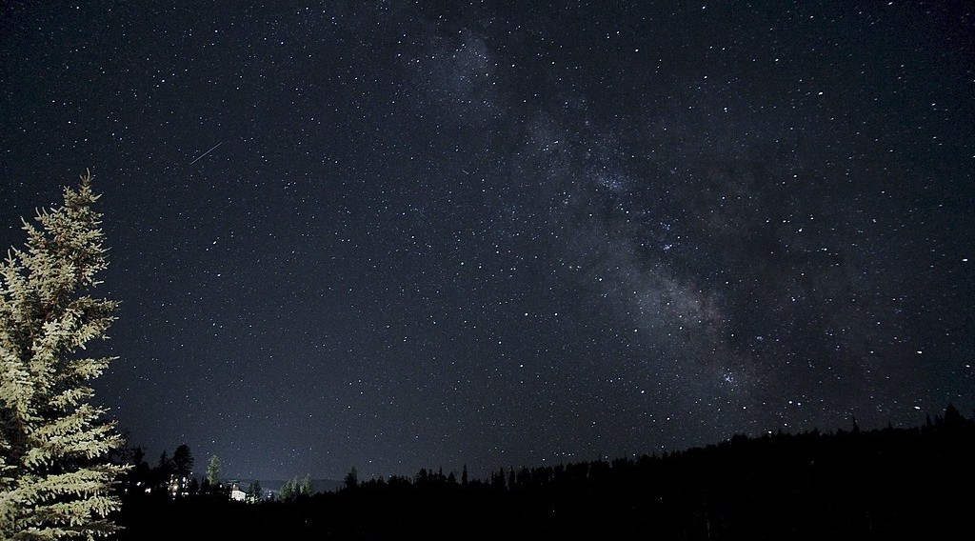
1. THE UNIVERSE
Activity 1
The Milky Way at night.
Notes:
Activity 1. Look carefully at this picture: the Milky Way at night. Observe every detail before I ask the question.

Slide 20
1. THE UNIVERSE
Activity 1: Question
This band of light is made of billions of stars. What is it called?
Notes:
Here is the question for Activity 1: This band of light is made of billions of stars. What is it called? Take one minute to think and write your answer in your rough notebook.

Slide 21
1. THE UNIVERSE
Activity 1: Answer
The Milky Way, our galaxy.
Notes:
Let us check the answer together. The Milky Way, our galaxy.

Slide 22
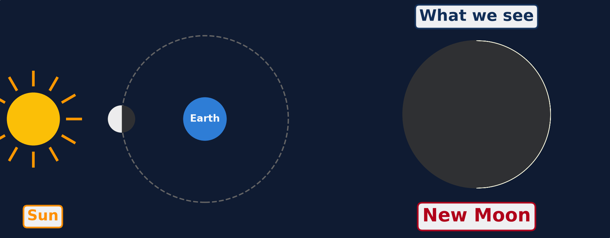
2. THE PHASES OF THE MOON
Activity 2
Animation: the Moon moves around the Earth.
Notes:
Activity 2. Look carefully at this animation: animation: the Moon moves around the Earth. Watch the animation to the end; it will play again.

Slide 23
2. THE PHASES OF THE MOON
Activity 2: Question
Why does the shape of the Moon seem to change?
Notes:
Here is the question for Activity 2: Why does the shape of the Moon seem to change? Take one minute to think and write your answer in your rough notebook.

Slide 24
2. THE PHASES OF THE MOON
Activity 2: Answer
The Sun lights half of the Moon, and we see a different part of this lit half as the Moon moves around the Earth.
Notes:
Let us check the answer together. The Sun lights half of the Moon, and we see a different part of this lit half as the Moon moves around the Earth.

Slide 25
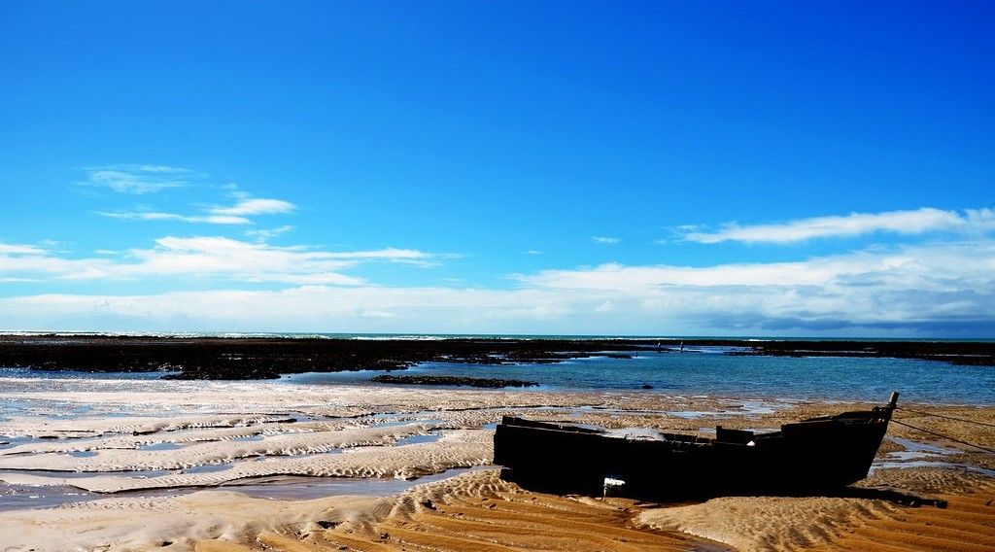
3. IMPACTS OF THE MOON
Activity 3
Boats on the sand when the sea is low.
Notes:
Activity 3. Look carefully at this picture: boats on the sand when the sea is low. Observe every detail before I ask the question.

Slide 26
3. IMPACTS OF THE MOON
Activity 3: Question 1
Why are these boats on the sand?
Notes:
Here is the question for Activity 3: Why are these boats on the sand? Take one minute to think and write your answer in your rough notebook.

Slide 27
3. IMPACTS OF THE MOON
Activity 3: Answer 1
The sea has gone down: it is low tide.
Notes:
Let us check the answer together. The sea has gone down: it is low tide.

Slide 28
3. IMPACTS OF THE MOON
Activity 3: Question 2
What causes this movement of the sea?
Notes:
Here is the next question: What causes this movement of the sea? Take one minute to think and write your answer in your rough notebook.

Slide 29
3. IMPACTS OF THE MOON
Activity 3: Answer 2
The pull (gravity) of the Moon.
Notes:
Let us check the answer together. The pull (gravity) of the Moon.

Slide 30
BOARD SUMMARY
Board Summary
Topic: The Earth as a Planet in the Solar System
Sub-topic: The Earth as a Planet of the Solar System
Further Study 1: The Universe and the Moon
Notes:
Now we are going to copy the board summary. Write the title and the headings neatly in your notebooks. I will give you enough time for each slide, so do not rush.

Slide 31
BOARD SUMMARY
DEFINITIONS
The key terms of this lesson are defined as follows:
Universe: It is all of space and everything in it: stars, planets, gases and dust.
Galaxy: It is a huge group of stars, gas and dust held together by gravity.
Notes:
Let us copy the definitions. The key terms of this lesson are defined as follows. On this slide we have Universe and Galaxy. Write each point on a new line, with the key term first, and explain it in your own words when we revise. When you finish, we go to the next slide.

Slide 32
BOARD SUMMARY
DEFINITIONS (continued)
Satellite: It is a body that moves around a planet.
Phases of the Moon: They are the different shapes of the lit part of the Moon that we see during a month.
Notes:
We continue with the definitions. On this slide we have Satellite and Phases of the Moon. Write each point on a new line, with the key term first, and explain it in your own words when we revise.

Slide 33
BOARD SUMMARY
1. The Universe
A) Composition of the Universe
The universe is made up of the following elements:
Galaxies: There are billions of galaxies, and our galaxy is the Milky Way.
Illustration: the Milky Way
Notes:
Let us copy Composition of the Universe. The universe is made up of the following elements. Copy the point on Galaxies on the left, then draw the diagram on the right: the Milky Way. Give it a title and label it clearly.

Slide 34
BOARD SUMMARY
1. The Universe
A) Composition of the Universe
Stars: Stars are huge balls of burning gas, and the Sun is our nearest star.
Notes:
We continue with Composition of the Universe. On this slide we have Stars. Write each point on a new line, with the key term first, and explain it in your own words when we revise.

Slide 35
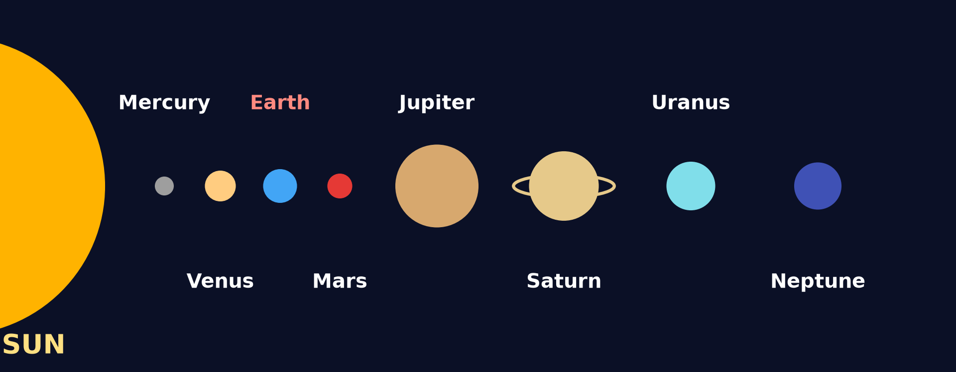
BOARD SUMMARY
1. The Universe
A) Composition of the Universe
The solar system: It is the Sun with the eight planets and their satellites that move around it.
Illustration: the solar system
Notes:
Copy the point on The solar system on the left, then draw the diagram on the right: the solar system. Give it a title and label it clearly.

Slide 36
BOARD SUMMARY
1. The Universe
A) Composition of the Universe
Other bodies: Asteroids, comets, gases and dust are also found in space.
Notes:
We continue with Composition of the Universe. On this slide we have Other bodies. Write each point on a new line, with the key term first, and explain it in your own words when we revise.

Slide 37
BOARD SUMMARY
1. The Universe
B) Links with the Planet Earth
The Earth is linked to the rest of the universe as follows:
Light and heat: The Sun gives the Earth the light and heat that make life possible.
Movements: The Earth turns around the Sun, which gives the year and the seasons.
Notes:
Let us copy Links with the Planet Earth. The Earth is linked to the rest of the universe as follows. On this slide we have Light and heat and Movements. Write each point on a new line, with the key term first, and explain it in your own words when we revise. When you finish, we go to the next slide.

Slide 38
BOARD SUMMARY
1. The Universe
B) Links with the Planet Earth (continued)
Gravity: The Sun and the Moon pull the Earth, and this causes the tides.
The place of the Earth: The Earth is the third planet from the Sun and the only one known to have life.
Notes:
We continue with Links with the Planet Earth. On this slide we have Gravity and The place of the Earth. Write each point on a new line, with the key term first, and explain it in your own words when we revise.

Slide 39
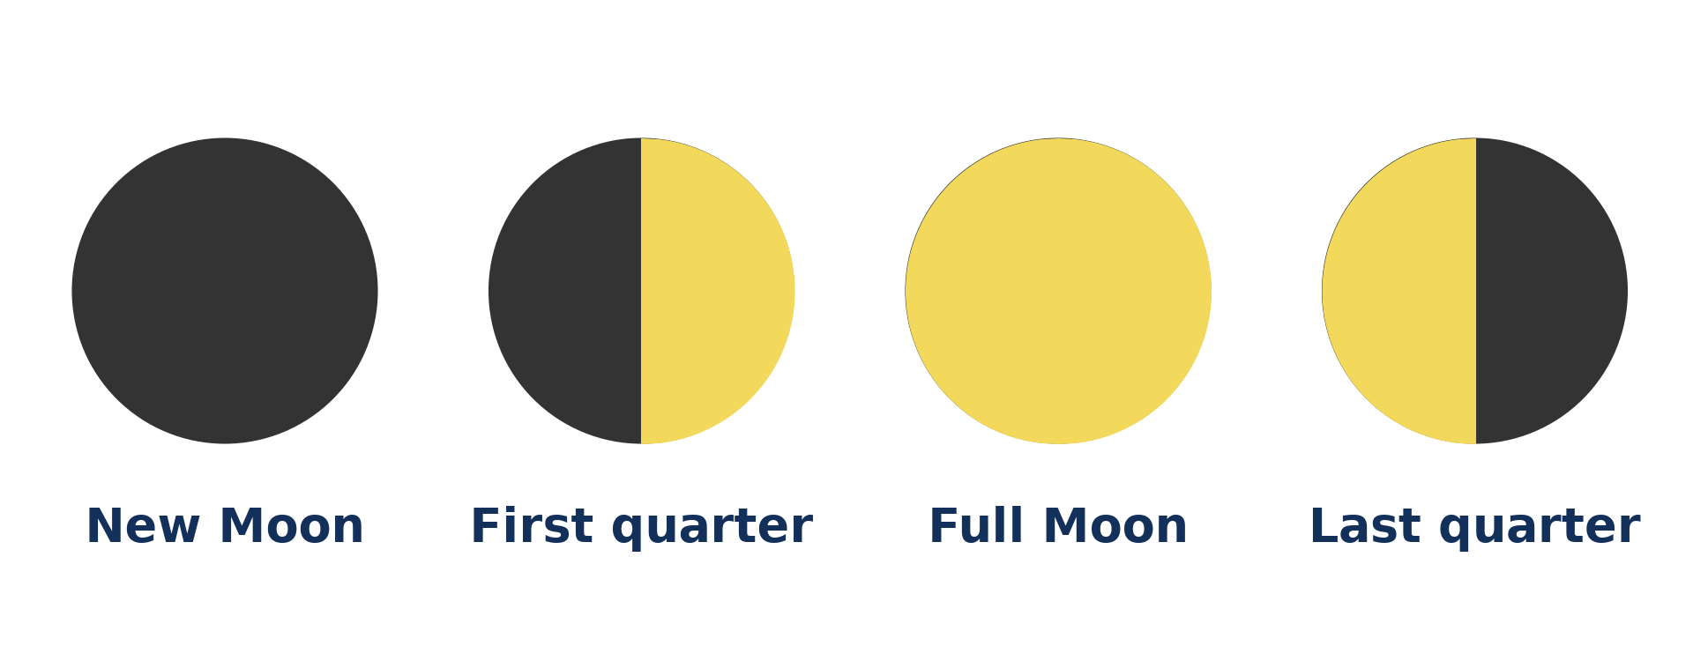
BOARD SUMMARY
2. The Moon, Satellite of the Earth
A) The Phases of the Moon
The Moon shows the following phases during a month of about 29½ days:
New Moon: The lit side of the Moon faces away from the Earth, so we do not see it.
Illustration: the phases of the Moon
Notes:
Let us copy The Phases of the Moon. The Moon shows the following phases during a month of about 29½ days. Copy the point on New Moon on the left, then draw the diagram on the right: the phases of the Moon. Give it a title and label it clearly.

Slide 40
BOARD SUMMARY
2. The Moon, Satellite of the Earth
A) The Phases of the Moon
First quarter: We see the right half of the Moon lit by the Sun.
Full Moon: The whole lit face of the Moon faces the Earth, so we see a full circle.
Last quarter: We see the left half of the Moon lit by the Sun.
Notes:
We continue with The Phases of the Moon. On this slide we have First quarter, Full Moon and Last quarter. Write each point on a new line, with the key term first, and explain it in your own words when we revise.

Slide 41
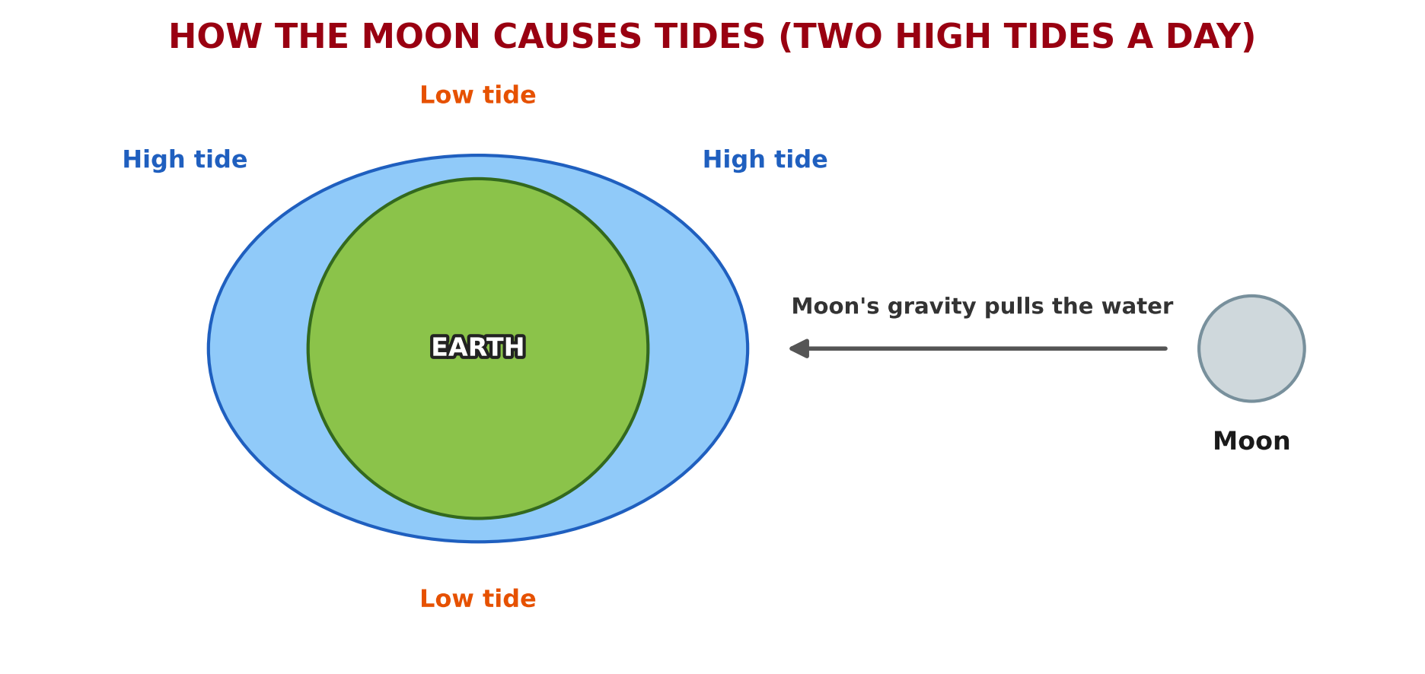
BOARD SUMMARY
2. The Moon, Satellite of the Earth
B) Impacts on the Natural Environment
The Moon affects the natural environment as follows:
Tides: The pull of the Moon makes the sea rise and fall twice a day.
Illustration: how the Moon causes tides
Notes:
Let us copy Impacts on the Natural Environment. The Moon affects the natural environment as follows. Copy the point on Tides on the left, then draw the diagram on the right: how the Moon causes tides. Give it a title and label it clearly.

Slide 42
BOARD SUMMARY
2. The Moon, Satellite of the Earth
B) Impacts on the Natural Environment
Spring and neap tides: At new Moon and full Moon, tides are very high (spring tides), and at the quarters they are low (neap tides).
Notes:
We continue with Impacts on the Natural Environment. On this slide we have Spring and neap tides. Write each point on a new line, with the key term first, and explain it in your own words when we revise. When you finish, we go to the next slide.

Slide 43
BOARD SUMMARY
2. The Moon, Satellite of the Earth
B) Impacts on the Natural Environment (continued)
Light at night: The full Moon lights the night, and many animals hunt or move by moonlight.
Eclipses: The Moon can hide the Sun (solar eclipse) or enter the shadow of the Earth (lunar eclipse).
Notes:
We continue with Impacts on the Natural Environment. On this slide we have Light at night and Eclipses. Write each point on a new line, with the key term first, and explain it in your own words when we revise.

Slide 44
BOARD SUMMARY
2. The Moon, Satellite of the Earth
C) Impacts on Human Activities
The Moon affects human socio-economic activities as follows:
Fishing: Fishermen go out and come back with the tides, and some fish at night with the full Moon.
Illustration: boats at low tide
Notes:
Let us copy Impacts on Human Activities. The Moon affects human socio-economic activities as follows. Copy the point on Fishing on the left, then draw the diagram on the right: boats at low tide. Give it a title and label it clearly.

Slide 45
BOARD SUMMARY
2. The Moon, Satellite of the Earth
C) Impacts on Human Activities
Navigation and ports: Big ships enter shallow ports such as Douala at high tide.
Calendars and feasts: Some calendars and feasts, such as Ramadan, follow the phases of the Moon.
Notes:
We continue with Impacts on Human Activities. On this slide we have Navigation and ports and Calendars and feasts. Write each point on a new line, with the key term first, and explain it in your own words when we revise. When you finish, we go to the next slide.

Slide 46
BOARD SUMMARY
2. The Moon, Satellite of the Earth
C) Impacts on Human Activities (continued)
Farming and tradition: In some villages, people plant or harvest according to the phases of the Moon.
Notes:
We continue with Impacts on Human Activities. On this slide we have Farming and tradition. Write each point on a new line, with the key term first, and explain it in your own words when we revise.

Slide 47
FORMATIVE EVALUATION
Evaluation 1
What is a galaxy? Name our galaxy.
Notes:
Now let us check what you have understood. Question 1: What is a galaxy? Name our galaxy. Answer in your exercise book.

Slide 48
FORMATIVE EVALUATION
Expected Answer
A huge group of stars. Ours is the Milky Way.
Notes:
The expected answer is: a huge group of stars. Ours is the Milky Way. If you got it right, well done.

Slide 49
FORMATIVE EVALUATION
Evaluation 2
What causes the tides?
Notes:
Now let us check what you have understood. Question 2: What causes the tides? Answer in your exercise book.

Slide 50
FORMATIVE EVALUATION
Expected Answer
The pull (gravity) of the Moon.
Notes:
The expected answer is: the pull (gravity) of the Moon. If you got it right, well done.

Slide 51
REMEDIATION
Remediation
Fill in the blanks:
Our galaxy is called the ______ Way.
When we see the whole Moon, it is the ______ Moon.
The rise and fall of the sea are called ______.
Notes:
For those who need more practice, fill in the blanks in your exercise book. The answers are: number 1, Milky; number 2, Full; number 3, tides.

Slide 52
HOMEWORK
Homework
Give the value of the Equator and of the Greenwich Meridian.
Notes:
For your homework: Give the value of the Equator and of the Greenwich Meridian. We shall correct it at the beginning of our next lesson.

Slide 53
NEXT LESSON
Next Lesson
Our next lesson will be on:
Lesson 2: Earth Divisions: Latitudes and Longitudes
Notes:
Our next lesson will be on Lesson 2: Earth Divisions: Latitudes and Longitudes. Thank you for your attention, and see you next time.

Slide 54
BILINGUAL GAME
Bilingual Game (Jeu Bilingue)
English | Français
Universe | L'univers
Galaxy | La galaxie
Star | L'étoile
Satellite | Le satellite
Full Moon | La pleine lune
New Moon | La nouvelle lune
Tide | La marée
Gravity | La gravité
Notes:
Let us play the bilingual game. I say a word in English, and you give me the French word. Then we do the reverse.

Slide 55
LOGBOOK
Official Logbook (1/2)
Module / Topic | The Earth as a Planet in the Solar System
Lesson Title | Further Study 1: The Universe and the Moon
Expected Learning Outcomes | Define the universe and a galaxy, and describe the place of the Earth in the universe. Describe the phases of the Moon. Explain the impacts of the Moon on the natural environment and on human activities.
Competence | Learners are able to recognise the phases of the Moon and to explain how the Moon affects tides, calendars and daily activities.
Notes:
I record this information in the official logbook of the class after the lesson.

Slide 56
LOGBOOK
Official Logbook (2/2)
Matter Taught | DEFINITIONS; Composition of the Universe; Links with the Planet Earth; The Phases of the Moon; Impacts on the Natural Environment; Impacts on Human Activities.
Evaluation | Formative evaluation and remediation exercise.
Homework | Give the value of the Equator and of the Greenwich Meridian.
Enrolment / Present / Absent | ____ / ____ / ____
Achievement | To be completed after the lesson.
Notes:
I complete the second page of the logbook: the matter taught, the evaluation, the homework and the attendance.

Slide 57
TEACHER'S NOTE
Teacher's Note
Timing: Homework correction, plan, objectives 4 min | Recall, situation, action 6 min | 3 activities 12 min | Board summary (copying) 15 min | Evaluation, remediation 5 min | Homework, next lesson 3 min | Logbook 5 min
Activity 2 is an animation (GIF): it plays automatically in slide-show mode.
Without the projector (Activity 1): ask learners to look at the night sky far from town lights.
Without the projector (Activity 2): move a ball around a learner's head in front of a torch.
Without the projector (Activity 3): describe the beach at Kribi in the morning and in the evening.
Notes:
This slide is for me, the teacher: it gives the timing of the lesson and what to do if the projector is not available.

Slide 58
REFERENCES
References
National Geography Syllabus (MINESEC), Form 4 — The Earth as a Planet in the Solar System.
Teacher's lesson notes (Form 4), checked and corrected where necessary.
Photo, Activity 1: “Telluride Milky Way Night Sky With Satellite Streak” by wienotfilms, CC BY-NC 2.0, via Flickr (https://www.flickr.com/photos/76583523@N05/14781116206)
Photo, Activity 3: “Praia de Itapororoca” by Rodrigo_Soldon, CC BY-ND 2.0, via Flickr (https://www.flickr.com/photos/8865243@N02/10838180494)
Diagrams and animations: drawn for this lesson (Geography Department).
Notes:
These are the references and picture credits used to prepare this lesson.

