Slide 1
FORM 4
GEOGRAPHY
Lesson 11
Volcanoes
Notes:
Good morning, class, and welcome to our geography lesson. I am your geography teacher, Mr Kamdem. Today we are starting Lesson 11: Volcanoes.

Slide 2
CLASS INFO
Class, Chapter and Duration
Class | Form 4
Chapter | The Structure of the Earth: Building Processes and Impacts on Man — Volcanoes
Duration | 50 minutes
Notes:
This lesson is for Form 4. It belongs to The Structure of the Earth: Building Processes and Impacts on Man — Volcanoes. We shall need 50 minutes to cover it.

Slide 3
IDENTIFICATION
Lesson Identification
Topic | The Structure of the Earth: Building Processes and Impacts on Man
Sub-topic | Volcanoes
Lesson | Lesson 11: Volcanoes
Notions / Concepts | Volcanicity, magma, lava, vent, crater.
Syllabus focus | Definition and origin; types of volcanoes; processes and general structure of a volcano.
Competence | Learners are able to draw and label a volcano, and to recognise volcanic landforms in Cameroon.
Notes:
Our topic is The Structure of the Earth: Building Processes and Impacts on Man, and the sub-topic is Volcanoes. The key notions we shall use today are: volcanicity, magma, lava, vent, crater. At the end, you should be able to do this: learners are able to draw and label a volcano, and to recognise volcanic landforms in Cameroon.

Slide 4

HOMEWORK CORRECTION
Correction of the Homework
Question (Lesson 10: Plate Tectonics):
Name one active volcano of Cameroon.
Notes:
Before we start the new lesson, let us correct the homework I gave you at the end of Lesson 10: Plate Tectonics. The question was: Name one active volcano of Cameroon. Take out your exercise books.

Slide 5
HOMEWORK CORRECTION
Correction: Possible Answer
Mount Cameroon.
Notes:
Here is a good answer. Mount Cameroon. Compare it with your own answer and correct your work in red.

Slide 6
LESSON PLAN
Lesson Plan
Correction of the homework
Objectives and recall
Real-life situation and action to take
Learning activities
Board summary
Evaluation, remediation and homework
Notes:
Here is the plan of our lesson today. First, we shall correct the homework. Then we shall look at the objectives and recall what you already know. After that, we shall study a situation from real life and the action to take, and do the learning activities. Finally, we shall copy the board summary, do the evaluation and the remediation, and I will give you the homework.

Slide 7
OBJECTIVES
Objectives
By the end of this lesson, you should be able to:
Define a volcano and explain its origin.
Classify the types of volcanoes.
Describe the processes and the general structure of a volcano.
Notes:
By the end of this lesson, you should be able to do three things. Number 1: define a volcano and explain its origin. Number 2: classify the types of volcanoes. Number 3: describe the processes and the general structure of a volcano.

Slide 8
PREVIOUS KNOWLEDGE
Previous Knowledge
The plates move at their margins.
Magma rises at constructive margins and at subduction zones.
Mount Cameroon is an active volcano.
Notes:
Let us first remember what you already know. The plates move at their margins. Magma rises at constructive margins and at subduction zones. Mount Cameroon is an active volcano. Keep this in mind, because we shall build on it today.

Slide 9
REAL-LIFE SITUATION
Situation in Real Life
Mount Cameroon, near Buea, is a high mountain and an active volcano: in 1999 and 2000, lava flowed down its sides. Yet the dark soils around it are very fertile, and many people live there. Pupils from Buea ask: "What exactly is a volcano, and how is it built?"
Notes:
Listen carefully to this situation from real life. Mount Cameroon, near Buea, is a high mountain and an active volcano: in 1999 and 2000, lava flowed down its sides. Yet the dark soils around it are very fertile, and many people live there. Pupils from Buea ask: "What exactly is a volcano, and how is it built?" Think about it, because I am going to ask you some questions.

Slide 10
REAL-LIFE SITUATION
Situation: Question 1
What is the problem in the situation?
Notes:
Question 1: What is the problem in the situation? Think for a moment, then raise your hand to answer.

Slide 11
REAL-LIFE SITUATION
Answer
The pupils do not know what a volcano is or how it is built.
Notes:
Good. The pupils do not know what a volcano is or how it is built.

Slide 12
REAL-LIFE SITUATION
Situation: Question 2
What came out of Mount Cameroon in 2000?
Notes:
Question 2: What came out of Mount Cameroon in 2000? Think for a moment, then raise your hand to answer.

Slide 13
REAL-LIFE SITUATION
Answer
Lava.
Notes:
Good. Lava.

Slide 14
REAL-LIFE SITUATION
Situation: Question 3
Is Mount Cameroon active, dormant or extinct?
Notes:
Question 3: Is Mount Cameroon active, dormant or extinct? Think for a moment, then raise your hand to answer.

Slide 15
REAL-LIFE SITUATION
Possible Answer
Active: it has erupted recently.
Notes:
Good. Active: it has erupted recently.

Slide 16
ACTION TO TAKE
Action to Take
Know the volcanoes of Cameroon and respect safety rules near them.
Notes:
From this situation, the action we are working towards in this lesson is the following: know the volcanoes of Cameroon and respect safety rules near them.

Slide 17
JUSTIFICATION
Justification of the Lesson
This lesson helps us to know volcanoes and their parts.
Notes:
Why is this lesson important for you? This lesson helps us to know volcanoes and their parts.

Slide 18

1. ORIGIN OF VOLCANOES
Activity 1
A volcano erupts.
Notes:
Activity 1. Look carefully at this picture: a volcano erupts. Observe every detail before I ask the question.

Slide 19
1. ORIGIN OF VOLCANOES
Activity 1: Question
What comes out of a volcano during an eruption?
Notes:
Here is the question for Activity 1: What comes out of a volcano during an eruption? Take one minute to think and write your answer in your rough notebook.

Slide 20
1. ORIGIN OF VOLCANOES
Activity 1: Answer
Lava, gases and ash.
Notes:
Let us check the answer together. Lava, gases and ash.

Slide 21
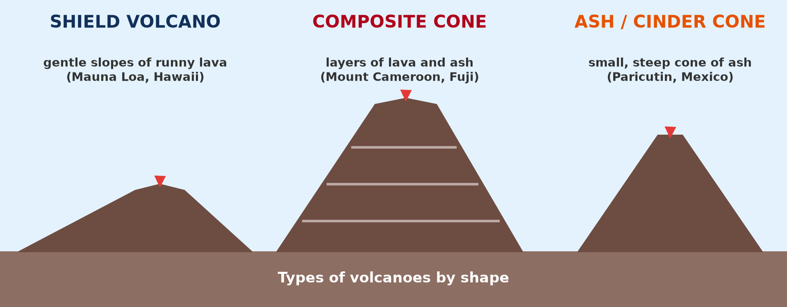
2. TYPES OF VOLCANOES
Activity 2
Types of volcanoes by shape.
Notes:
Activity 2. Look carefully at this diagram: types of volcanoes by shape. Observe every detail before I ask the question.

Slide 22
2. TYPES OF VOLCANOES
Activity 2: Question
Which type of volcano has gentle slopes made of runny lava?
Notes:
Here is the question for Activity 2: Which type of volcano has gentle slopes made of runny lava? Take one minute to think and write your answer in your rough notebook.

Slide 23
2. TYPES OF VOLCANOES
Activity 2: Answer
The shield volcano.
Notes:
Let us check the answer together. The shield volcano.

Slide 24

4. GENERAL STRUCTURE
Activity 3
The parts of a volcano.
Notes:
Activity 3. Look carefully at this diagram: the parts of a volcano. Observe every detail before I ask the question.

Slide 25
4. GENERAL STRUCTURE
Activity 3: Question 1
Where is magma stored under a volcano?
Notes:
Here is the question for Activity 3: Where is magma stored under a volcano? Take one minute to think and write your answer in your rough notebook.

Slide 26
4. GENERAL STRUCTURE
Activity 3: Answer 1
In the magma chamber.
Notes:
Let us check the answer together. In the magma chamber.

Slide 27
4. GENERAL STRUCTURE
Activity 3: Question 2
Through which part does it rise?
Notes:
Here is the next question: Through which part does it rise? Take one minute to think and write your answer in your rough notebook.

Slide 28
4. GENERAL STRUCTURE
Activity 3: Answer 2
Through the vent (pipe).
Notes:
Let us check the answer together. Through the vent (pipe).

Slide 29
BOARD SUMMARY
Board Summary
Topic: The Structure of the Earth: Building Processes and Impacts on Man
Sub-topic: Volcanoes
Lesson 11: Volcanoes
Notes:
Now we are going to copy the board summary. Write the title and the headings neatly in your notebooks. I will give you enough time for each slide, so do not rush.

Slide 30
BOARD SUMMARY
DEFINITIONS
The key terms of this lesson are defined as follows:
Volcano: It is an opening in the crust through which magma, gases and ash come out onto the surface.
Notes:
Let us copy the definitions. The key terms of this lesson are defined as follows. On this slide we have Volcano. Write each point on a new line, with the key term first, and explain it in your own words when we revise. When you finish, we go to the next slide.

Slide 31
BOARD SUMMARY
DEFINITIONS (continued)
Volcanicity: It is all the processes by which magma rises into the crust or onto the surface.
Magma: It is molten rock under the ground.
Lava: It is magma that comes out onto the surface.
Notes:
We continue with the definitions. On this slide we have Volcanicity, Magma and Lava. Write each point on a new line, with the key term first, and explain it in your own words when we revise.

Slide 32
BOARD SUMMARY
1. Origin of Volcanoes
Volcanoes are found in the following places:
Constructive plate margins: Where plates move apart, magma rises through the gap, as in Iceland and the East African Rift.
Destructive plate margins: Where one plate sinks and melts, magma rises to the surface, as around the Pacific Ocean.
Notes:
Let us copy Origin of Volcanoes. Volcanoes are found in the following places. On this slide we have Constructive plate margins and Destructive plate margins. Write each point on a new line, with the key term first, and explain it in your own words when we revise. When you finish, we go to the next slide.

Slide 33
BOARD SUMMARY
1. Origin of Volcanoes (continued)
Hot spots: In some places, hot magma rises from deep in the mantle in the middle of a plate, as in Hawaii.
Notes:
We continue with Origin of Volcanoes. On this slide we have Hot spots. Write each point on a new line, with the key term first, and explain it in your own words when we revise.

Slide 34
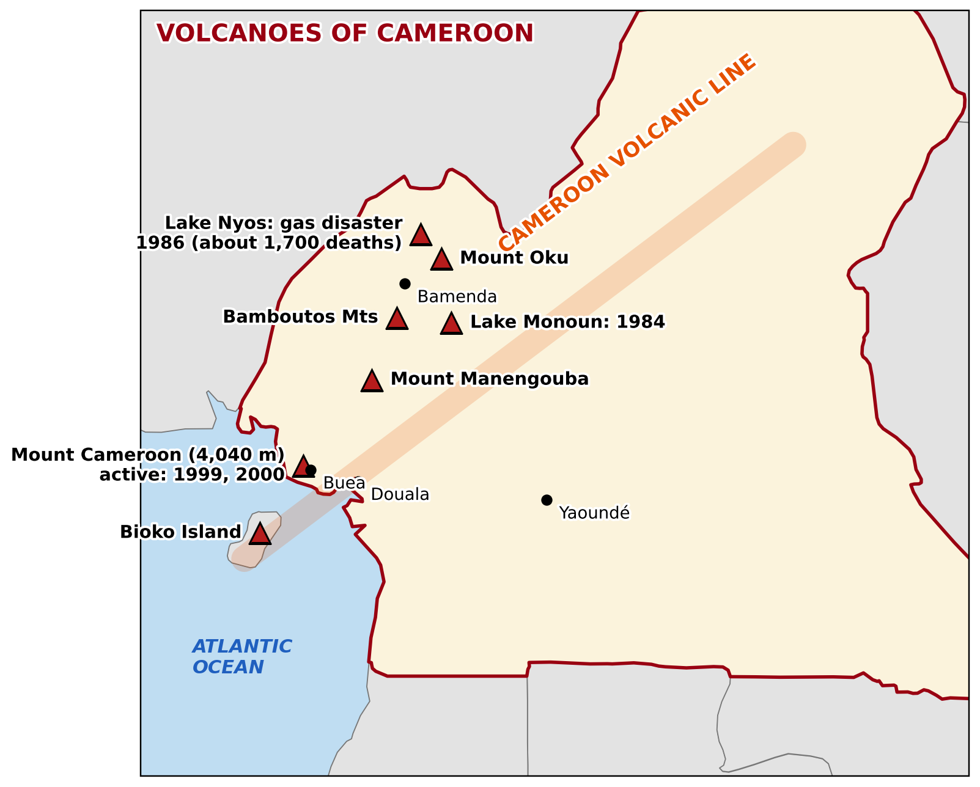
BOARD SUMMARY
1. Origin of Volcanoes
Lines of weakness: Magma rises along cracks in the crust, as on the Cameroon Volcanic Line.
Illustration: volcanoes of Cameroon
Notes:
Copy the point on Lines of weakness on the left, then draw the diagram on the right: volcanoes of Cameroon. Give it a title and label it clearly.

Slide 35

BOARD SUMMARY
2. Types of Volcanoes
A) According to Activity
Volcanoes are classified according to their activity as follows:
Active volcano: It erupts now or has erupted recently, like Mount Cameroon.
Illustration: Mount Cameroon
Notes:
Let us copy According to Activity. Volcanoes are classified according to their activity as follows. Copy the point on Active volcano on the left, then draw the diagram on the right: mount Cameroon. Give it a title and label it clearly.

Slide 36
BOARD SUMMARY
2. Types of Volcanoes
A) According to Activity
Dormant volcano: It has not erupted for a long time but can erupt again.
Extinct volcano: It will never erupt again, like Mount Manengouba.
Notes:
We continue with According to Activity. On this slide we have Dormant volcano and Extinct volcano. Write each point on a new line, with the key term first, and explain it in your own words when we revise.

Slide 37
BOARD SUMMARY
2. Types of Volcanoes
B) According to Shape
Volcanoes are classified according to their shape as follows:
Shield volcano: It has gentle slopes built by runny lava, like Mauna Loa in Hawaii.
Illustration: types of volcanoes by shape
Notes:
Let us copy According to Shape. Volcanoes are classified according to their shape as follows. Copy the point on Shield volcano on the left, then draw the diagram on the right: types of volcanoes by shape. Give it a title and label it clearly.

Slide 38
BOARD SUMMARY
2. Types of Volcanoes
B) According to Shape
Composite cone: It is a high, steep cone built of layers of lava and ash, like Mount Cameroon.
Ash and cinder cone: It is a small, steep cone built of ash and cinders.
Notes:
We continue with According to Shape. On this slide we have Composite cone and Ash and cinder cone. Write each point on a new line, with the key term first, and explain it in your own words when we revise.

Slide 39
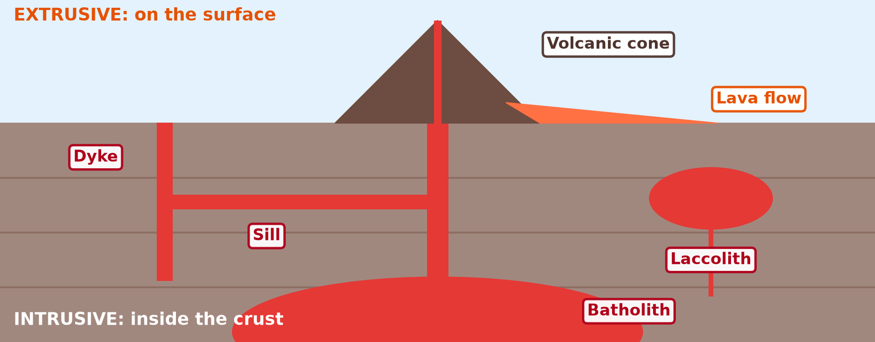
BOARD SUMMARY
3. Processes of Volcanicity
Magma moves by two processes:
Intrusion: Magma cools inside the crust and forms dykes, sills, laccoliths and batholiths.
Illustration: intrusive and extrusive features
Notes:
Let us copy Processes of Volcanicity. Magma moves by two processes. Copy the point on Intrusion on the left, then draw the diagram on the right: intrusive and extrusive features. Give it a title and label it clearly.

Slide 40
BOARD SUMMARY
3. Processes of Volcanicity
Extrusion: Magma comes out as lava, ash and gases and builds cones and lava plateaux.
Notes:
We continue with Processes of Volcanicity. On this slide we have Extrusion. Write each point on a new line, with the key term first, and explain it in your own words when we revise.

Slide 41
BOARD SUMMARY
4. General Structure of a Volcano
A volcano has the following parts:
Magma chamber: It is the store of molten rock under the volcano.
Illustration: the structure of a volcano
Notes:
Let us copy General Structure of a Volcano. A volcano has the following parts. Copy the point on Magma chamber on the left, then draw the diagram on the right: the structure of a volcano. Give it a title and label it clearly.

Slide 42
BOARD SUMMARY
4. General Structure of a Volcano
Vent (pipe): It is the channel through which magma rises.
Cone: It is the mountain built by layers of lava and ash.
Notes:
We continue with General Structure of a Volcano. On this slide we have Vent (pipe) and Cone. Write each point on a new line, with the key term first, and explain it in your own words when we revise.

Slide 43

BOARD SUMMARY
4. General Structure of a Volcano
Crater: It is the round hollow at the top of the vent.
Illustration: a crater
Notes:
Copy the point on Crater on the left, then draw the diagram on the right: a crater. Give it a title and label it clearly.

Slide 44
BOARD SUMMARY
4. General Structure of a Volcano
Secondary cone: It is a small cone on the side of the volcano, fed by a side vent.
Notes:
We continue with General Structure of a Volcano. On this slide we have Secondary cone. Write each point on a new line, with the key term first, and explain it in your own words when we revise.

Slide 45
FORMATIVE EVALUATION
Evaluation 1
What is a volcano?
Notes:
Now let us check what you have understood. Question 1: What is a volcano? Answer in your exercise book.

Slide 46
FORMATIVE EVALUATION
Expected Answer
An opening in the crust where magma comes out.
Notes:
The expected answer is: an opening in the crust where magma comes out. If you got it right, well done.

Slide 47
FORMATIVE EVALUATION
Evaluation 2
Is Mount Cameroon active, dormant or extinct?
Notes:
Now let us check what you have understood. Question 2: Is Mount Cameroon active, dormant or extinct? Answer in your exercise book.

Slide 48
FORMATIVE EVALUATION
Expected Answer
Active: it erupted in 1999 and 2000.
Notes:
The expected answer is: active: it erupted in 1999 and 2000. If you got it right, well done.

Slide 49
REMEDIATION
Remediation
Fill in the blanks:
Magma on the surface is called ______.
The pipe of a volcano is the ______.
A volcano that erupts now is ______.
Notes:
For those who need more practice, fill in the blanks in your exercise book. The answers are: number 1, lava; number 2, vent; number 3, active.

Slide 50
HOMEWORK
Homework
Give one danger and one advantage of volcanoes.
Notes:
For your homework: Give one danger and one advantage of volcanoes. We shall correct it at the beginning of our next lesson.

Slide 51
NEXT LESSON
Next Lesson
Our next lesson will be on:
Lesson 12: The Impact of Volcanicity on Man
Notes:
Our next lesson will be on Lesson 12: The Impact of Volcanicity on Man. Thank you for your attention, and see you next time.

Slide 52
BILINGUAL GAME
Bilingual Game (Jeu Bilingue)
English | Français
Volcano | Le volcan
Magma | Le magma
Lava | La lave
Crater | Le cratère
Vent | La cheminée
Eruption | L'éruption
Dyke | Le dyke
Active volcano | Le volcan actif
Notes:
Let us play the bilingual game. I say a word in English, and you give me the French word. Then we do the reverse.

Slide 53
LOGBOOK
Official Logbook (1/2)
Module / Topic | The Structure of the Earth: Building Processes and Impacts on Man
Lesson Title | Lesson 11: Volcanoes
Expected Learning Outcomes | Define a volcano and explain its origin. Classify the types of volcanoes. Describe the processes and the general structure of a volcano.
Competence | Learners are able to draw and label a volcano, and to recognise volcanic landforms in Cameroon.
Notes:
I record this information in the official logbook of the class after the lesson.

Slide 54
LOGBOOK
Official Logbook (2/2)
Matter Taught | DEFINITIONS; Origin of Volcanoes; According to Activity; According to Shape; Processes of Volcanicity; General Structure of a Volcano.
Evaluation | Formative evaluation and remediation exercise.
Homework | Give one danger and one advantage of volcanoes.
Enrolment / Present / Absent | ____ / ____ / ____
Achievement | To be completed after the lesson.
Notes:
I complete the second page of the logbook: the matter taught, the evaluation, the homework and the attendance.

Slide 55
TEACHER'S NOTE
Teacher's Note
Timing: Homework correction, plan, objectives 4 min | Recall, situation, action 6 min | 3 activities 12 min | Board summary (copying) 15 min | Evaluation, remediation 5 min | Homework, next lesson 3 min | Logbook 5 min
Without the projector (Activity 1): describe the 2000 eruption of Mount Cameroon.
Without the projector (Activity 2): draw the three shapes on the board.
Without the projector (Activity 3): draw a simple volcano on the board.
Notes:
This slide is for me, the teacher: it gives the timing of the lesson and what to do if the projector is not available.

Slide 56
REFERENCES
References
National Geography Syllabus (MINESEC), Form 4 — The Structure of the Earth: Building Processes and Impacts on Man.
Teacher's lesson notes (Form 4), checked and corrected where necessary.
Global Volcanism Program (Smithsonian): Mount Cameroon.
Photo, Activity 1: “Happy Anniversary Hawaii” by U.S. Geological Survey, CC0 1.0, via Flickr (https://www.flickr.com/photos/27784370@N05/14802198589)
Photo, board summary (Active volcano): “Mount Cameroon” by John & Mel Kots, CC BY-NC-ND 2.0, via Flickr (https://www.flickr.com/photos/26745817@N00/2347261849)
Photo, board summary (Crater): “Taal Lake and Volcano, Tagaytay, Philippines” by Ray in Manila, CC BY 2.0, via Flickr (https://www.flickr.com/photos/21186555@N07/28260012661)
Diagrams and animations: drawn for this lesson (Geography Department).
Notes:
These are the references and picture credits used to prepare this lesson.

