Slide 1
FORM 4
GEOGRAPHY
Lesson 16
Physical Weathering Processes and Products
Notes:
Good morning, class, and welcome to our geography lesson. I am your geography teacher, Mr Kamdem. Today we are starting Lesson 16: Physical Weathering Processes and Products.

Slide 2
CLASS INFO
Class, Chapter and Duration
Class | Form 4
Chapter | Denudation Processes, Landforms and Impacts on Man — Weathering Processes: The Products and Impacts on Man
Duration | 50 minutes
Notes:
This lesson is for Form 4. It belongs to Denudation Processes, Landforms and Impacts on Man — Weathering Processes: The Products and Impacts on Man. We shall need 50 minutes to cover it.

Slide 3
IDENTIFICATION
Lesson Identification
Topic | Denudation Processes, Landforms and Impacts on Man
Sub-topic | Weathering Processes: The Products and Impacts on Man
Lesson | Lesson 16: Physical Weathering Processes and Products
Notions / Concepts | Temperature changes, frost action, slaking, unloading.
Syllabus focus | Thermal shattering; frost shattering; alternate wetting and drying; pressure release; physically induced biological weathering.
Competence | Learners are able to explain why rocks and walls crack in the sun or break under roots, and to protect buildings from these effects.
Notes:
Our topic is Denudation Processes, Landforms and Impacts on Man, and the sub-topic is Weathering Processes: The Products and Impacts on Man. The key notions we shall use today are: temperature changes, frost action, slaking, unloading. At the end, you should be able to do this: learners are able to explain why rocks and walls crack in the sun or break under roots, and to protect buildings from these effects.

Slide 4

HOMEWORK CORRECTION
Correction of the Homework
Question (Lesson 15: Weathering):
Name two processes of physical weathering.
Notes:
Before we start the new lesson, let us correct the homework I gave you at the end of Lesson 15: Weathering. The question was: Name two processes of physical weathering. Take out your exercise books.

Slide 5
HOMEWORK CORRECTION
Correction: Possible Answer
Thermal shattering and frost shattering (also wetting and drying, pressure release).
Notes:
Here is a good answer. Thermal shattering and frost shattering (also wetting and drying, pressure release). Compare it with your own answer and correct your work in red.

Slide 6
LESSON PLAN
Lesson Plan
Correction of the homework
Objectives and recall
Real-life situation and action to take
Learning activities
Board summary
Evaluation, remediation and homework
Notes:
Here is the plan of our lesson today. First, we shall correct the homework. Then we shall look at the objectives and recall what you already know. After that, we shall study a situation from real life and the action to take, and do the learning activities. Finally, we shall copy the board summary, do the evaluation and the remediation, and I will give you the homework.

Slide 7
OBJECTIVES
Objectives
By the end of this lesson, you should be able to:
Define physical weathering.
Explain the processes of physical weathering.
Name the products of each process.
Notes:
By the end of this lesson, you should be able to do three things. Number 1: define physical weathering. Number 2: explain the processes of physical weathering. Number 3: name the products of each process.

Slide 8
PREVIOUS KNOWLEDGE
Previous Knowledge
Weathering is the breaking down of rocks in their place.
Physical weathering breaks rocks without changing their minerals.
Climate is the main factor of weathering.
Notes:
Let us first remember what you already know. Weathering is the breaking down of rocks in their place. Physical weathering breaks rocks without changing their minerals. Climate is the main factor of weathering. Keep this in mind, because we shall build on it today.

Slide 9
REAL-LIFE SITUATION
Situation in Real Life
In the dry season, Yaya walks past a big granite rock. At midday it is too hot to touch, and at night it is cool; its outer surface peels off in thin layers, like an onion. He asks: "How can the Sun alone break such a hard rock?"
Notes:
Listen carefully to this situation from real life. In the dry season, Yaya walks past a big granite rock. At midday it is too hot to touch, and at night it is cool; its outer surface peels off in thin layers, like an onion. He asks: "How can the Sun alone break such a hard rock?" Think about it, because I am going to ask you some questions.

Slide 10
REAL-LIFE SITUATION
Situation: Question 1
What is the problem in the situation?
Notes:
Question 1: What is the problem in the situation? Think for a moment, then raise your hand to answer.

Slide 11
REAL-LIFE SITUATION
Answer
Yaya does not understand how a hard rock breaks without being carried away.
Notes:
Good. Yaya does not understand how a hard rock breaks without being carried away.

Slide 12
REAL-LIFE SITUATION
Situation: Question 2
What happens to the outer surface of the rock?
Notes:
Question 2: What happens to the outer surface of the rock? Think for a moment, then raise your hand to answer.

Slide 13
REAL-LIFE SITUATION
Answer
It peels off in thin layers.
Notes:
Good. It peels off in thin layers.

Slide 14
REAL-LIFE SITUATION
Situation: Question 3
What changes between midday and night?
Notes:
Question 3: What changes between midday and night? Think for a moment, then raise your hand to answer.

Slide 15
REAL-LIFE SITUATION
Possible Answer
The temperature: the rock is hot by day and cool at night.
Notes:
Good. The temperature: the rock is hot by day and cool at night.

Slide 16
ACTION TO TAKE
Action to Take
Recognise the products of physical weathering around us.
Notes:
From this situation, the action we are working towards in this lesson is the following: recognise the products of physical weathering around us.

Slide 17
JUSTIFICATION
Justification of the Lesson
This lesson helps us to know how rocks break into pieces.
Notes:
Why is this lesson important for you? This lesson helps us to know how rocks break into pieces.

Slide 18
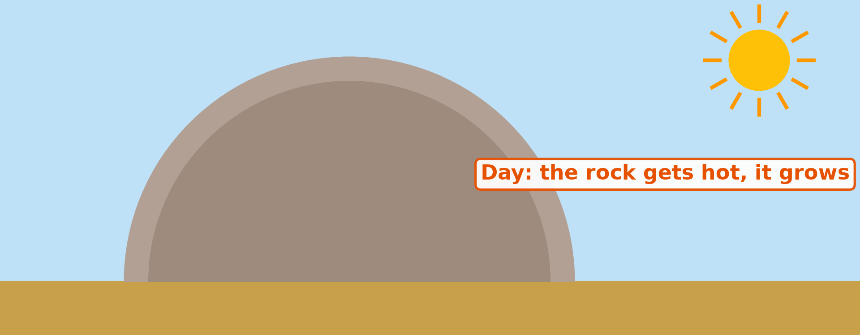
1. THERMAL SHATTERING
Activity 1
Animation: heating by day, cooling by night.
Notes:
Activity 1. Look carefully at this animation: animation: heating by day, cooling by night. Watch the animation to the end; it will play again.

Slide 19
1. THERMAL SHATTERING
Activity 1: Question
What happens to the outer layer of the rock after many days and nights?
Notes:
Here is the question for Activity 1: What happens to the outer layer of the rock after many days and nights? Take one minute to think and write your answer in your rough notebook.

Slide 20
1. THERMAL SHATTERING
Activity 1: Answer
It cracks and peels off.
Notes:
Let us check the answer together. It cracks and peels off.

Slide 21

1. THERMAL SHATTERING
Activity 2
Rounded granite rocks.
Notes:
Activity 2. Look carefully at this picture: rounded granite rocks. Observe every detail before I ask the question.

Slide 22
1. THERMAL SHATTERING
Activity 2: Question
What do we call this peeling of rock in curved layers?
Notes:
Here is the question for Activity 2: What do we call this peeling of rock in curved layers? Take one minute to think and write your answer in your rough notebook.

Slide 23
1. THERMAL SHATTERING
Activity 2: Answer
Exfoliation (onion weathering).
Notes:
Let us check the answer together. Exfoliation (onion weathering).

Slide 24

5. PHYSICALLY INDUCED BIOLOGICAL WEATHERING
Activity 3
Roots in a rock.
Notes:
Activity 3. Look carefully at this picture: roots in a rock. Observe every detail before I ask the question.

Slide 25
5. PHYSICALLY INDUCED BIOLOGICAL WEATHERING
Activity 3: Question
How do the roots break the rock?
Notes:
Here is the question for Activity 3: How do the roots break the rock? Take one minute to think and write your answer in your rough notebook.

Slide 26
5. PHYSICALLY INDUCED BIOLOGICAL WEATHERING
Activity 3: Answer
They grow bigger in the cracks and push the rock apart.
Notes:
Let us check the answer together. They grow bigger in the cracks and push the rock apart.

Slide 27
BOARD SUMMARY
Board Summary
Topic: Denudation Processes, Landforms and Impacts on Man
Sub-topic: Weathering Processes: The Products and Impacts on Man
Lesson 16: Physical Weathering Processes and Products
Notes:
Now we are going to copy the board summary. Write the title and the headings neatly in your notebooks. I will give you enough time for each slide, so do not rush.

Slide 28
BOARD SUMMARY
DEFINITIONS
The key terms of this lesson are defined as follows:
Physical weathering: It is the breaking of rocks into smaller pieces without any change in their minerals.
Notes:
Let us copy the definitions. The key terms of this lesson are defined as follows. On this slide we have Physical weathering. Write each point on a new line, with the key term first, and explain it in your own words when we revise. When you finish, we go to the next slide.

Slide 29
BOARD SUMMARY
DEFINITIONS (continued)
Exfoliation: It is the peeling of rock in thin, curved layers, like the layers of an onion.
Notes:
We continue with the definitions. On this slide we have Exfoliation. Write each point on a new line, with the key term first, and explain it in your own words when we revise.

Slide 30
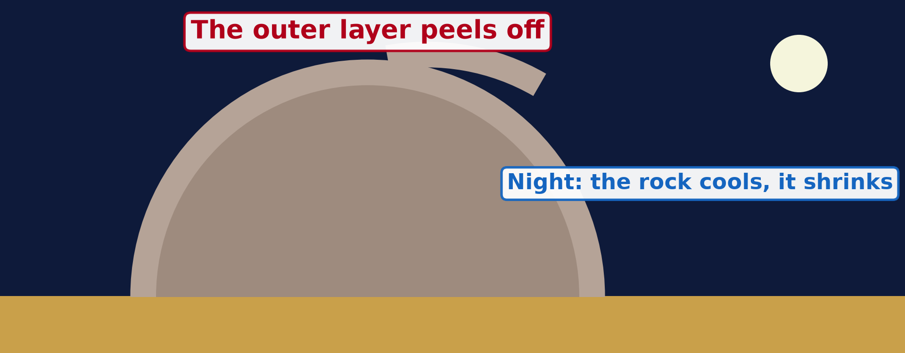
BOARD SUMMARY
1. Thermal Shattering
Thermal shattering works as follows:
Process: By day the Sun heats the outer layer of the rock, which expands, and at night it cools and contracts. After many years, the outer layer cracks and peels off.
Illustration: exfoliation
Notes:
Let us copy Thermal Shattering. Thermal shattering works as follows. Copy the point on Process on the left, then draw the diagram on the right: exfoliation. Give it a title and label it clearly.

Slide 31
BOARD SUMMARY
1. Thermal Shattering
Products: Curved sheets of rock (exfoliation), rounded rocks called exfoliation domes, and angular pieces (block disintegration).
Illustration: rounded granite rocks
Notes:
Copy the point on Products on the left, then draw the diagram on the right: rounded granite rocks. Give it a title and label it clearly.

Slide 32
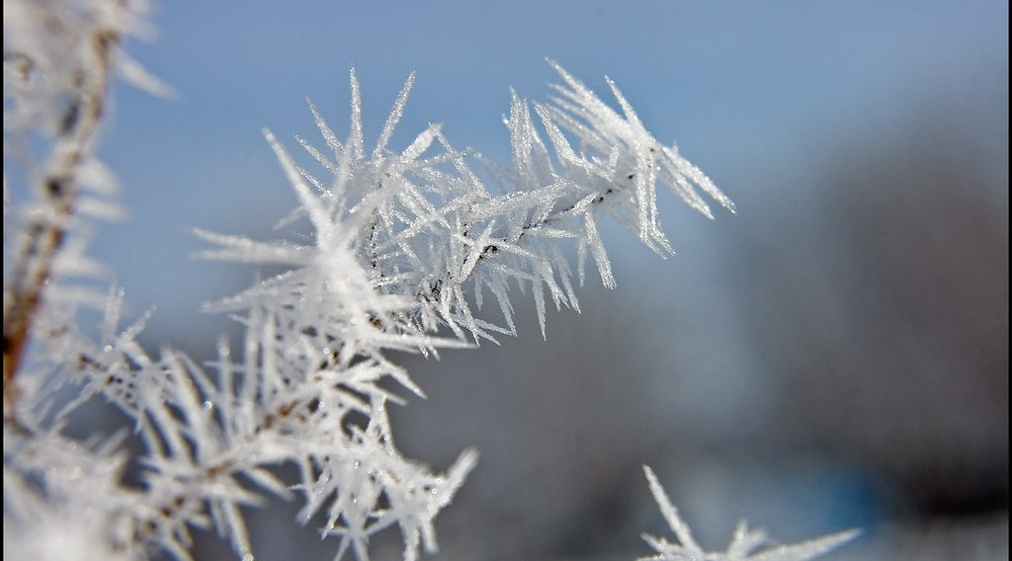
BOARD SUMMARY
2. Frost Shattering
Frost shattering works as follows:
Process: Water enters cracks and freezes at night; ice takes more space than water, so it widens the cracks until the rock breaks.
Illustration: frost on rock
Notes:
Let us copy Frost Shattering. Frost shattering works as follows. Copy the point on Process on the left, then draw the diagram on the right: frost on rock. Give it a title and label it clearly.

Slide 33
BOARD SUMMARY
2. Frost Shattering
Products: Sharp, angular pieces of rock that collect at the foot of slopes as scree, in cold mountains.
Notes:
We continue with Frost Shattering. On this slide we have Products. Write each point on a new line, with the key term first, and explain it in your own words when we revise.

Slide 34
BOARD SUMMARY
3. Alternate Wetting and Drying (Slaking)
Alternate wetting and drying works as follows:
Process: Clay rocks swell when they are wet and shrink when they dry, so they crack.
Notes:
Let us copy Alternate Wetting and Drying (Slaking). Alternate wetting and drying works as follows. On this slide we have Process. Write each point on a new line, with the key term first, and explain it in your own words when we revise.

Slide 35

BOARD SUMMARY
3. Alternate Wetting and Drying (Slaking)
Products: Crumbled clay and deep cracks, as in the black soils of the Far North in the dry season.
Illustration: cracked soil
Notes:
Copy the point on Products on the left, then draw the diagram on the right: cracked soil. Give it a title and label it clearly.

Slide 36
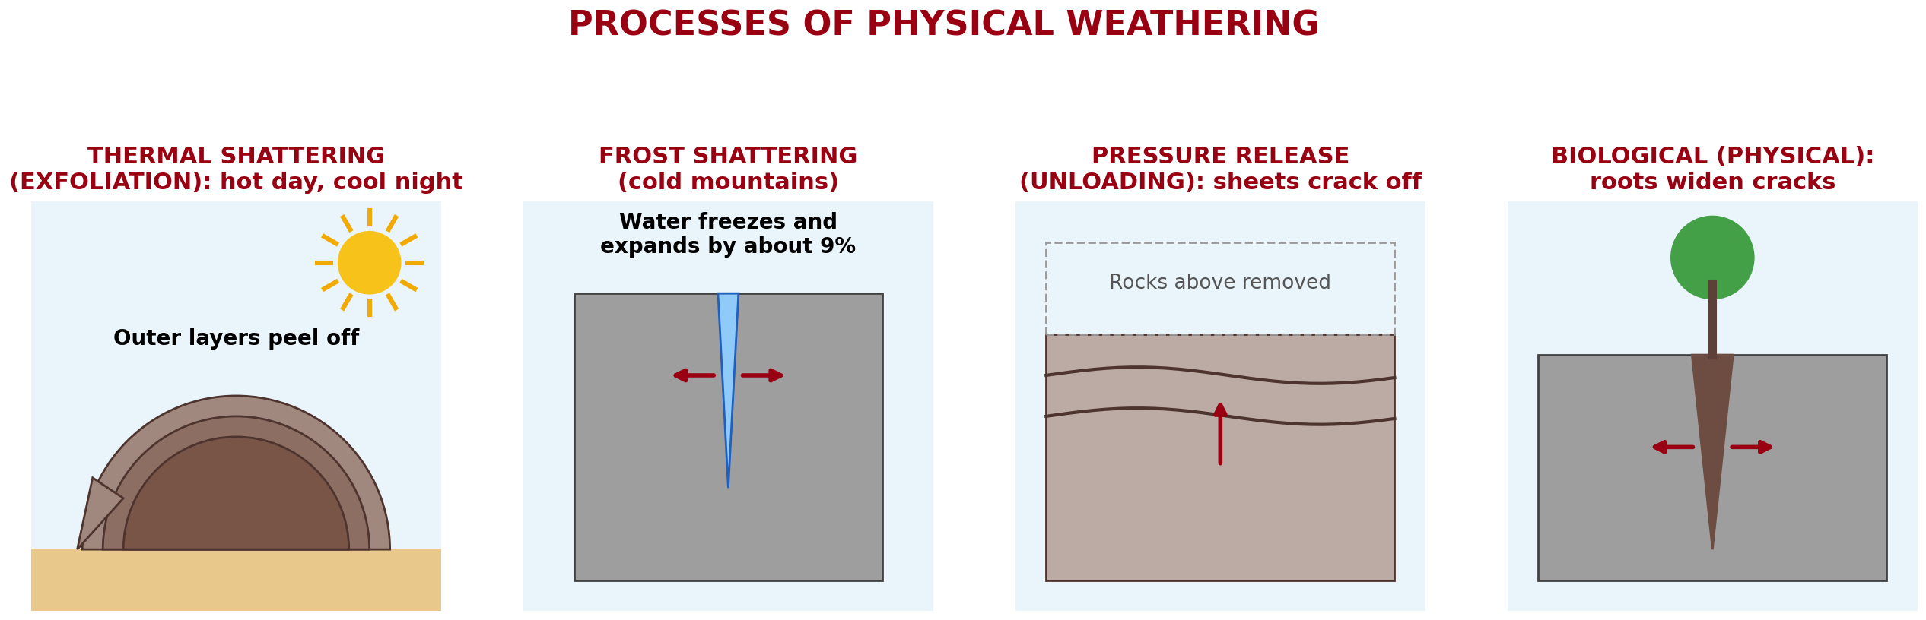
BOARD SUMMARY
4. Pressure Release (Unloading)
Pressure release works as follows:
Process: When the rocks above are removed by erosion, the rock below expands and cracks in sheets parallel to the surface.
Illustration: processes of physical weathering
Notes:
Let us copy Pressure Release (Unloading). Pressure release works as follows. Copy the point on Process on the left, then draw the diagram on the right: processes of physical weathering. Give it a title and label it clearly.

Slide 37
BOARD SUMMARY
4. Pressure Release (Unloading)
Products: Sheets of rock and dome-shaped hills such as inselbergs.
Notes:
We continue with Pressure Release (Unloading). On this slide we have Products. Write each point on a new line, with the key term first, and explain it in your own words when we revise.

Slide 38
BOARD SUMMARY
5. Physically Induced Biological Weathering
Living things break rocks physically as follows:
Plant roots: Roots grow in cracks, become thicker and push the rock apart.
Illustration: roots in a rock
Notes:
Let us copy Physically Induced Biological Weathering. Living things break rocks physically as follows. Copy the point on Plant roots on the left, then draw the diagram on the right: roots in a rock. Give it a title and label it clearly.

Slide 39
BOARD SUMMARY
5. Physically Induced Biological Weathering
Burrowing animals: Termites, worms and rodents dig holes and bring broken rock to the surface.
Products: Broken blocks of rock and loose, crumbly material.
Notes:
We continue with Physically Induced Biological Weathering. On this slide we have Burrowing animals and Products. Write each point on a new line, with the key term first, and explain it in your own words when we revise.

Slide 40
FORMATIVE EVALUATION
Evaluation 1
Why does granite peel off in hot deserts?
Notes:
Now let us check what you have understood. Question 1: Why does granite peel off in hot deserts? Answer in your exercise book.

Slide 41
FORMATIVE EVALUATION
Expected Answer
It gets hot by day and cold at night, again and again.
Notes:
The expected answer is: it gets hot by day and cold at night, again and again. If you got it right, well done.

Slide 42
FORMATIVE EVALUATION
Evaluation 2
How do roots break rocks?
Notes:
Now let us check what you have understood. Question 2: How do roots break rocks? Answer in your exercise book.

Slide 43
FORMATIVE EVALUATION
Expected Answer
They grow in cracks and push the rock apart.
Notes:
The expected answer is: they grow in cracks and push the rock apart. If you got it right, well done.

Slide 44
REMEDIATION
Remediation
Fill in the blanks:
The peeling of rock like an onion is ______.
Water that freezes in cracks causes ______ shattering.
Notes:
Take your time to copy this part; we will continue together.

Slide 45
REMEDIATION
Remediation (continued)
Physical weathering does not change the ______ of the rock.
Notes:
For those who need more practice, fill in the blanks in your exercise book. The answers are: number 1, exfoliation; number 2, frost; number 3, minerals.

Slide 46
HOMEWORK
Homework
Name two processes of chemical weathering.
Notes:
For your homework: Name two processes of chemical weathering. We shall correct it at the beginning of our next lesson.

Slide 47
NEXT LESSON
Next Lesson
Our next lesson will be on:
Lesson 17: Chemical Weathering Processes and Products
Notes:
Our next lesson will be on Lesson 17: Chemical Weathering Processes and Products. Thank you for your attention, and see you next time.

Slide 48
BILINGUAL GAME
Bilingual Game (Jeu Bilingue)
English | Français
Exfoliation | L'exfoliation / la desquamation
Frost | Le gel
Crack | La fissure
To expand | Se dilater
To contract | Se contracter
Scree | L'éboulis
Root | La racine
Pressure release | La décompression
Notes:
Let us play the bilingual game. I say a word in English, and you give me the French word. Then we do the reverse.

Slide 49
LOGBOOK
Official Logbook (1/2)
Module / Topic | Denudation Processes, Landforms and Impacts on Man
Lesson Title | Lesson 16: Physical Weathering Processes and Products
Expected Learning Outcomes | Define physical weathering. Explain the processes of physical weathering. Name the products of each process.
Competence | Learners are able to explain why rocks and walls crack in the sun or break under roots, and to protect buildings from these effects.
Notes:
I record this information in the official logbook of the class after the lesson.

Slide 50
LOGBOOK
Official Logbook (2/2)
Matter Taught | DEFINITIONS; Thermal Shattering; Frost Shattering; Alternate Wetting and Drying (Slaking); Pressure Release (Unloading); Physically Induced Biological Weathering.
Evaluation | Formative evaluation and remediation exercise.
Homework | Name two processes of chemical weathering.
Enrolment / Present / Absent | ____ / ____ / ____
Achievement | To be completed after the lesson.
Notes:
I complete the second page of the logbook: the matter taught, the evaluation, the homework and the attendance.

Slide 51
TEACHER'S NOTE
Teacher's Note
Timing: Homework correction, plan, objectives 4 min | Recall, situation, action 6 min | 3 activities 12 min | Board summary (copying) 15 min | Evaluation, remediation 5 min | Homework, next lesson 3 min | Logbook 5 min
Activity 1 is an animation (GIF): it plays automatically in slide-show mode.
Without the projector (Activity 1): draw a rock with curved layers peeling off.
Without the projector (Activity 2): describe the rocks of Mount Tinguelin.
Without the projector (Activity 3): show a tree root lifting a pavement.
Notes:
This slide is for me, the teacher: it gives the timing of the lesson and what to do if the projector is not available.

Slide 52
REFERENCES
References
National Geography Syllabus (MINESEC), Form 4 — Denudation Processes, Landforms and Impacts on Man.
Teacher's lesson notes (Form 4), checked and corrected where necessary.
Photo, Activity 2: “Sunset over Pyramid Rock” by Mark Wassell, CC BY-NC-ND 2.0, via Flickr (https://www.flickr.com/photos/61520356@N07/6515411027)
Photo, Activity 3: “Stones 'n' Roots” by erix!, CC BY 2.0, via Flickr (https://www.flickr.com/photos/68387408@N00/55692423)
Photo, board summary (Process): “Frosty Morning” by Tom Gill., CC BY-NC-ND 2.0, via Flickr (https://www.flickr.com/photos/10199807@N00/4283143427)
Photo, board summary (Products): “Cracked Earth” by Aleatoric Consonance, CC BY 2.0, via Flickr (https://www.flickr.com/photos/93921318@N00/3772011444)
Diagrams and animations: drawn for this lesson (Geography Department).
Notes:
These are the references and picture credits used to prepare this lesson.

