Slide 1
FORM 4
GEOGRAPHY
Lesson 10
The Tropical Hot Desert Biome
Notes:
Good morning, class, and welcome to our geography lesson. I am your geography teacher, Mr Kamdem. Today we are starting Lesson 10: The Tropical Hot Desert Biome.

Slide 2
CLASS INFO
Class, Chapter and Duration
Class | Form 4
Chapter | Module I: Ecological Systems and their Resources
Duration | 2 periods (2 × 50 minutes)
Notes:
This lesson is for Form 4. It belongs to Module I: Ecological Systems and their Resources. We shall need 2 periods to cover it.

Slide 3
IDENTIFICATION
Lesson Identification
Topic | Conservation of World's Biomes and Resources
Sub-topic | Tropical Biomes and their Significance
Lesson | Lesson 10: The Tropical Hot Desert Biome
Notions / Concepts | Aridity, xerophytes, illuviation, desertification.
Syllabus focus | Location; characteristics (climate, vegetation, soils, animal life); human activities.
Competence | Learners are able to describe the hot desert biome and its human activities.
Notes:
Our topic is Conservation of World's Biomes and Resources, and the sub-topic is Tropical Biomes and their Significance. The key notions we shall use today are: aridity, xerophytes, illuviation, desertification. At the end, you should be able to do this: learners are able to describe the hot desert biome and its human activities.

Slide 4

HOMEWORK CORRECTION
Correction of the Homework
Question (Lesson 9: The Tropical Monsoon Biome):
Compare the monsoon of India with the rainy season of Garoua: give one similarity and one difference.
Notes:
Before we start the new lesson, let us correct the homework I gave you at the end of Lesson 9: The Tropical Monsoon Biome. The question was: Compare the monsoon of India with the rainy season of Garoua: give one similarity and one difference. Take out your exercise books.

Slide 5
HOMEWORK CORRECTION
Correction: Possible Answer
Similarity: both have a wet season brought by a moist wind from the sea. Difference: the Indian monsoon brings much more rain.
Notes:
Here is a good answer. Similarity: both have a wet season brought by a moist wind from the sea. Difference: the Indian monsoon brings much more rain. Compare it with your own answer and correct your work in red.

Slide 6
LESSON PLAN
Lesson Plan
Correction of the homework
Objectives and recall
Real-life situation and action to take
Learning activities
Board summary
Evaluation, remediation and homework
Notes:
Here is the plan of our lesson today. First, we shall correct the homework. Then we shall look at the objectives and recall what you already know. After that, we shall study a situation from real life and the action to take, and do the learning activities. Finally, we shall copy the board summary, do the evaluation and the remediation, and I will give you the homework.

Slide 7
OBJECTIVES
Objectives
By the end of this lesson, you should be able to:
Locate the hot desert biome.
Describe its climate, vegetation, soils and animal life.
Describe its human activities.
Notes:
By the end of this lesson, you should be able to do three things. Number 1: locate the hot desert biome. Number 2: describe its climate, vegetation, soils and animal life. Number 3: describe its human activities.

Slide 8
PREVIOUS KNOWLEDGE
Previous Knowledge
Deserts receive very little rain.
The Sahara is north of Cameroon.
Camels live in the desert.
Notes:
Let us first remember what you already know. Deserts receive very little rain. The Sahara is north of Cameroon. Camels live in the desert. Keep this in mind, because we shall build on it today.

Slide 9
REAL-LIFE SITUATION
Situation in Real Life
The Sahara is spreading south. In the Far North of Cameroon, some farms are covered by sand, and herders must travel farther to find grass and water.
Notes:
Listen carefully to this situation from real life. The Sahara is spreading south. In the Far North of Cameroon, some farms are covered by sand, and herders must travel farther to find grass and water. Think about it, because I am going to ask you some questions.

Slide 10
REAL-LIFE SITUATION
Situation: Question 1
What is the problem in the situation?
Notes:
Question 1: What is the problem in the situation? Think for a moment, then raise your hand to answer.

Slide 11
REAL-LIFE SITUATION
Answer
The desert is spreading south.
Notes:
Good. The desert is spreading south.

Slide 12
REAL-LIFE SITUATION
Situation: Question 2
What covers some farms?
Notes:
Question 2: What covers some farms? Think for a moment, then raise your hand to answer.

Slide 13
REAL-LIFE SITUATION
Answer
Sand.
Notes:
Good. Sand.

Slide 14
REAL-LIFE SITUATION
Situation: Question 3
What is this spreading called?
Notes:
Question 3: What is this spreading called? Think for a moment, then raise your hand to answer.

Slide 15
REAL-LIFE SITUATION
Possible Answer
Desertification.
Notes:
Good. Desertification.

Slide 16
ACTION TO TAKE
Action to Take
Plant trees and save water to fight desertification.
Notes:
From this situation, the action we are working towards in this lesson is the following: plant trees and save water to fight desertification.

Slide 17
JUSTIFICATION
Justification of the Lesson
This lesson helps us to understand the desert and how to stop it spreading.
Notes:
Why is this lesson important for you? This lesson helps us to understand the desert and how to stop it spreading.

Slide 18

1. LOCATION
Activity 1
Hot deserts of the world.
Notes:
Activity 1. Look carefully at this diagram: hot deserts of the world. Observe every detail before I ask the question.

Slide 19
1. LOCATION
Activity 1: Question
Name three hot deserts and their continents.
Notes:
Here is the question for Activity 1: Name three hot deserts and their continents. Take one minute to think and write your answer in your rough notebook.

Slide 20
1. LOCATION
Activity 1: Answer
Sahara (Africa), Arabian Desert (Asia), Great Australian Desert (Australia).
Notes:
Let us check the answer together. Sahara (Africa), Arabian Desert (Asia), Great Australian Desert (Australia).

Slide 21
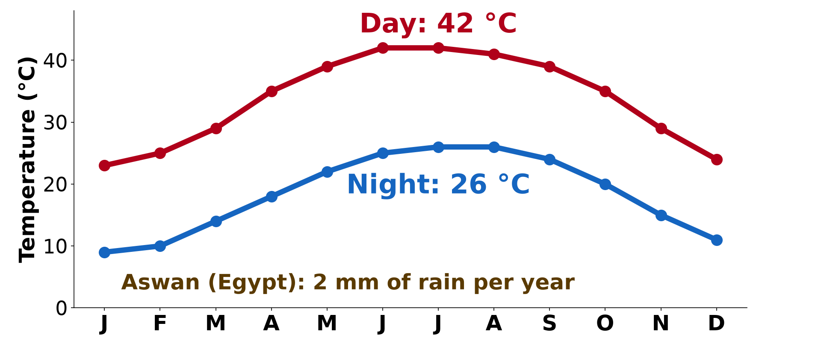
2. CLIMATE
Activity 2
Temperatures at Aswan.
Notes:
Activity 2. Look carefully at this diagram: temperatures at Aswan. Observe every detail before I ask the question.

Slide 22
2. CLIMATE
Activity 2: Question
Describe the desert climate.
Notes:
Here is the question for Activity 2: Describe the desert climate. Take one minute to think and write your answer in your rough notebook.

Slide 23
2. CLIMATE
Activity 2: Answer
Less than 250 mm of rain, very hot days and cold nights (aridity).
Notes:
Let us check the answer together. Less than 250 mm of rain, very hot days and cold nights (aridity).

Slide 24
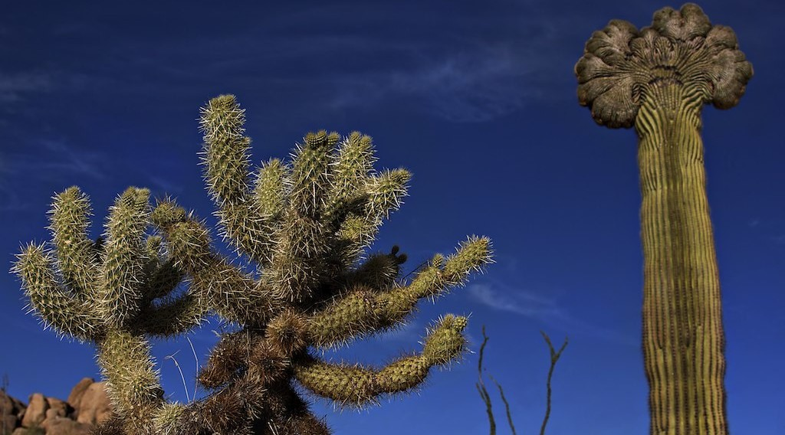
2. VEGETATION
Activity 3
A cactus.
Notes:
Activity 3. Look carefully at this picture: a cactus. Observe every detail before I ask the question.

Slide 25
2. VEGETATION
Activity 3: Question
How are desert plants (xerophytes) adapted?
Notes:
Here is the question for Activity 3: How are desert plants (xerophytes) adapted? Take one minute to think and write your answer in your rough notebook.

Slide 26
2. VEGETATION
Activity 3: Answer
They store water, have small leaves or spines and long roots.
Notes:
Let us check the answer together. They store water, have small leaves or spines and long roots.

Slide 27
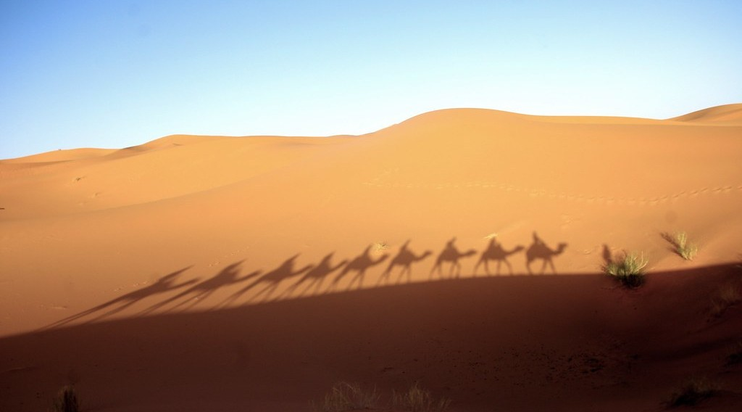
2. ANIMAL LIFE
Activity 4
Camels.
Notes:
Activity 4. Look carefully at this picture: camels. Observe every detail before I ask the question.

Slide 28
2. ANIMAL LIFE
Activity 4: Question
Why is the camel adapted to the desert?
Notes:
Here is the question for Activity 4: Why is the camel adapted to the desert? Take one minute to think and write your answer in your rough notebook.

Slide 29
2. ANIMAL LIFE
Activity 4: Answer
It can travel for days without water and walk on sand.
Notes:
Let us check the answer together. It can travel for days without water and walk on sand.

Slide 30
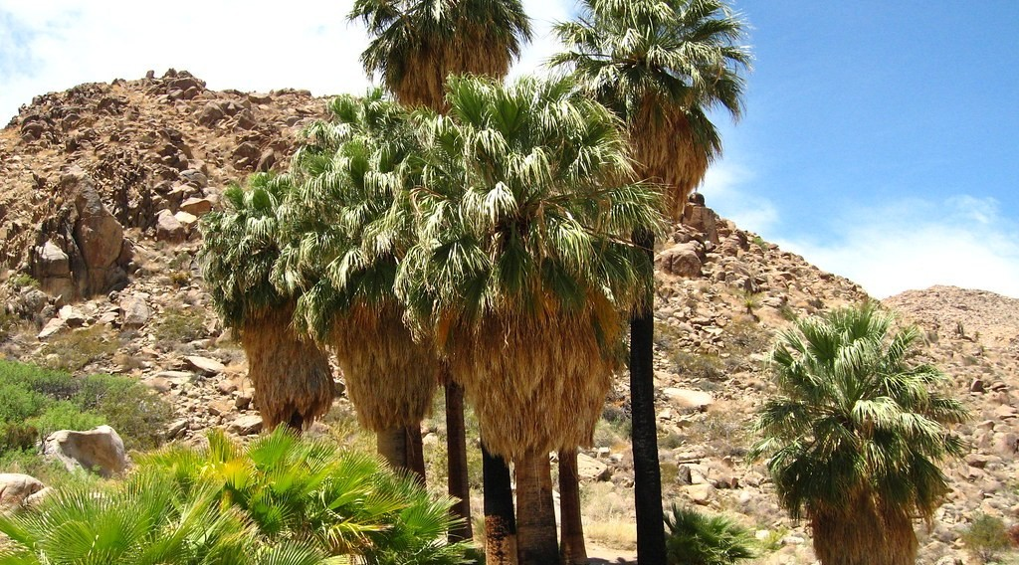
3. HUMAN ACTIVITIES
Activity 5
An oasis.
Notes:
Activity 5. Look carefully at this picture: an oasis. Observe every detail before I ask the question.

Slide 31
3. HUMAN ACTIVITIES
Activity 5: Question
Give three human activities in the desert.
Notes:
Here is the question for Activity 5: Give three human activities in the desert. Take one minute to think and write your answer in your rough notebook.

Slide 32
3. HUMAN ACTIVITIES
Activity 5: Answer
Nomadic herding, oasis farming and oil mining (also tourism).
Notes:
Let us check the answer together. Nomadic herding, oasis farming and oil mining (also tourism).

Slide 33
BOARD SUMMARY
Board Summary
Topic: Conservation of World's Biomes and Resources
Sub-topic: Tropical Biomes and their Significance
Lesson 10: The Tropical Hot Desert Biome
Notes:
Now we are going to copy the board summary. Write the title and the headings neatly in your notebooks. I will give you enough time for each slide, so do not rush.

Slide 34
BOARD SUMMARY
1. Location
Hot deserts are located as follows:
Location: They lie near the tropics, such as the Sahara, the Kalahari, the Arabian and the Australian deserts.
Notes:
Let us copy Location. Hot deserts are located as follows. On this slide we have Location. Write each point on a new line, with the key term first, and explain it in your own words when we revise.

Slide 35
BOARD SUMMARY
1. Location
Illustration: hot deserts of the world
Notes:
Now draw this illustration in your notebook: hot deserts of the world. Give it a title and label it clearly.

Slide 36
BOARD SUMMARY
2. Characteristics
Hot deserts have the following characteristics:
Climate: It is arid, with less than 250 mm of rain, very hot days and cold nights.
Vegetation: Few xerophytes such as cacti and acacias grow there.
Notes:
Let us copy Characteristics. Hot deserts have the following characteristics. On this slide we have Climate and Vegetation. Write each point on a new line, with the key term first, and explain it in your own words when we revise. When you finish, we go to the next slide.

Slide 37
BOARD SUMMARY
2. Characteristics (continued)
Soils: The soils are sandy or stony, poor in humus and often salty.
Animal life: Camels, lizards, snakes and scorpions are adapted to dryness.
Notes:
We continue with Characteristics. On this slide we have Soils and Animal life. Write each point on a new line, with the key term first, and explain it in your own words when we revise.

Slide 38
BOARD SUMMARY
3. Human Activities
People carry out the following activities:
Nomadic herding: Nomads move with camels, goats and sheep.
Oasis farming: Farmers grow dates and vegetables with irrigation.
Mining: Oil, gas and uranium are extracted.
Notes:
Let us copy Human Activities. People carry out the following activities. On this slide we have Nomadic herding, Oasis farming and Mining. Write each point on a new line, with the key term first, and explain it in your own words when we revise. When you finish, we go to the next slide.

Slide 39
BOARD SUMMARY
3. Human Activities (continued)
Desertification: Overgrazing and tree cutting make the desert spread.
Notes:
We continue with Human Activities. On this slide we have Desertification. Write each point on a new line, with the key term first, and explain it in your own words when we revise.

Slide 40
FORMATIVE EVALUATION
Evaluation 1
What are xerophytes?
Notes:
Now let us check what you have understood. Question 1: What are xerophytes? Answer in your exercise book.

Slide 41
FORMATIVE EVALUATION
Expected Answer
Plants adapted to very dry conditions.
Notes:
The expected answer is: plants adapted to very dry conditions. If you got it right, well done.

Slide 42
FORMATIVE EVALUATION
Evaluation 2
Give two human activities of the desert.
Notes:
Now let us check what you have understood. Question 2: Give two human activities of the desert. Answer in your exercise book.

Slide 43
FORMATIVE EVALUATION
Expected Answer
Nomadic herding and oasis farming.
Notes:
The expected answer is: nomadic herding and oasis farming. If you got it right, well done.

Slide 44
REMEDIATION
Remediation
Fill in the blanks:
Very dry conditions are called ______.
The spreading of the desert is ______.
A green place with water in the desert is an ______.
Notes:
For those who need more practice, fill in the blanks in your exercise book. The answers are: number 1, aridity; number 2, desertification; number 3, oasis.

Slide 45
HOMEWORK
Homework
Give three actions that can stop desertification in the Far North of Cameroon.
Notes:
For your homework: Give three actions that can stop desertification in the Far North of Cameroon. We shall correct it at the beginning of our next lesson.

Slide 46
NEXT LESSON
Next Lesson
Our next lesson will be on:
Lesson 11: The Mediterranean Biome
Notes:
Our next lesson will be on Lesson 11: The Mediterranean Biome. Thank you for your attention, and see you next time.

Slide 47
BILINGUAL GAME
Bilingual Game (Jeu Bilingue)
English | Français
Desert | Le désert
Sand | Le sable
Camel | Le chameau
Cactus | Le cactus
Aridity | L'aridité
Desertification | La désertification
Notes:
Let us play the bilingual game. I say a word in English, and you give me the French word. Then we do the reverse.

Slide 48
LOGBOOK
Official Logbook (1/2)
Module / Topic | Conservation of World's Biomes and Resources
Lesson Title | Lesson 10: The Tropical Hot Desert Biome
Expected Learning Outcomes | Locate the hot desert biome. Describe its climate, vegetation, soils and animal life. Describe its human activities.
Competence | Learners are able to describe the hot desert biome and its human activities.
Notes:
I record this information in the official logbook of the class after the lesson.

Slide 49
LOGBOOK
Official Logbook (2/2)
Matter Taught | Location; Characteristics; Human Activities.
Evaluation | Formative evaluation and remediation exercise.
Homework | Give three actions that can stop desertification in the Far North of Cameroon.
Enrolment / Present / Absent | ____ / ____ / ____
Achievement | To be completed after the lesson.
Notes:
I complete the second page of the logbook: the matter taught, the evaluation, the homework and the attendance.

Slide 50
TEACHER'S NOTE
Teacher's Note
Timing: Homework correction, plan, objectives 8 min | Recall, situation, action 10 min | 5 activities 30 min | Board summary (copying) 30 min | Evaluation, remediation 10 min | Homework, next lesson 5 min | Logbook 7 min
Without the projector (Activity 1): use the atlas.
Without the projector (Activity 2): read the data.
Without the projector (Activity 3): describe desert plants.
Without the projector (Activity 4): list desert animals.
Without the projector (Activity 5): discuss life in the Sahara.
Notes:
This slide is for me, the teacher: it gives the timing of the lesson and what to do if the projector is not available.

Slide 51
REFERENCES
References
Geography Syllabus, Forms I–V, MINESEC (2023) — Form 4, Module I: Ecological Systems and their Resources.
Photo, Activity 3: “Crested Saguaro” by CEBImagery.com, CC BY-NC 2.0, via Flickr (https://www.flickr.com/photos/53098051@N02/5626437842)
Photo, Activity 4: “Merzouga desert, Morocco” by Mycroyance, CC BY-ND 2.0, via Flickr (https://www.flickr.com/photos/91155980@N07/13157027505)
Photo, Activity 5: “49 Palms Oasis; Twentynine Palms, CA” by Joshua Tree National Park, Public domain 1.0, via Flickr (https://www.flickr.com/photos/115357548@N08/12525367563)
Diagrams and animations: drawn for this lesson (Geography Department).
Notes:
These are the references and picture credits used to prepare this lesson.

