Slide 1
FORM 4
GEOGRAPHY
Lesson 11
The Mediterranean Biome
Notes:
Good morning, class, and welcome to our geography lesson. I am your geography teacher, Mr Kamdem. Today we are starting Lesson 11: The Mediterranean Biome.

Slide 2
CLASS INFO
Class, Chapter and Duration
Class | Form 4
Chapter | Module I: Ecological Systems and their Resources
Duration | 2 periods (2 × 50 minutes)
Notes:
This lesson is for Form 4. It belongs to Module I: Ecological Systems and their Resources. We shall need 2 periods to cover it.

Slide 3
IDENTIFICATION
Lesson Identification
Topic | Conservation of World's Biomes and Resources
Sub-topic | Temperate Biomes and their Significance
Lesson | Lesson 11: The Mediterranean Biome
Notions / Concepts | Mediterranean climate, woodland, viticulture, pastoral farming.
Syllabus focus | Location; characteristics (climate, vegetation, soils, animal life); human activities.
Competence | Learners are able to describe the Mediterranean biome and its human activities.
Notes:
Our topic is Conservation of World's Biomes and Resources, and the sub-topic is Temperate Biomes and their Significance. The key notions we shall use today are: mediterranean climate, woodland, viticulture, pastoral farming. At the end, you should be able to do this: learners are able to describe the Mediterranean biome and its human activities.

Slide 4

HOMEWORK CORRECTION
Correction of the Homework
Question (Lesson 10: The Tropical Hot Desert Biome):
Give three actions that can stop desertification in the Far North of Cameroon.
Notes:
Before we start the new lesson, let us correct the homework I gave you at the end of Lesson 10: The Tropical Hot Desert Biome. The question was: Give three actions that can stop desertification in the Far North of Cameroon. Take out your exercise books.

Slide 5
HOMEWORK CORRECTION
Correction: Possible Answer
Plant trees (Green Wall, Sahel Vert), control grazing, and use improved stoves to reduce tree cutting.
Notes:
Here is a good answer. Plant trees (Green Wall, Sahel Vert), control grazing, and use improved stoves to reduce tree cutting. Compare it with your own answer and correct your work in red.

Slide 6
LESSON PLAN
Lesson Plan
Correction of the homework
Objectives and recall
Real-life situation and action to take
Learning activities
Board summary
Evaluation, remediation and homework
Notes:
Here is the plan of our lesson today. First, we shall correct the homework. Then we shall look at the objectives and recall what you already know. After that, we shall study a situation from real life and the action to take, and do the learning activities. Finally, we shall copy the board summary, do the evaluation and the remediation, and I will give you the homework.

Slide 7
OBJECTIVES
Objectives
By the end of this lesson, you should be able to:
Locate the Mediterranean biome.
Describe its climate, vegetation, soils and animal life.
Describe its human activities.
Notes:
By the end of this lesson, you should be able to do three things. Number 1: locate the Mediterranean biome. Number 2: describe its climate, vegetation, soils and animal life. Number 3: describe its human activities.

Slide 8
PREVIOUS KNOWLEDGE
Previous Knowledge
Temperate regions have four seasons.
Olive oil and grapes come from Europe.
The Mediterranean Sea is north of Africa.
Notes:
Let us first remember what you already know. Temperate regions have four seasons. Olive oil and grapes come from Europe. The Mediterranean Sea is north of Africa. Keep this in mind, because we shall build on it today.

Slide 9
REAL-LIFE SITUATION
Situation in Real Life
Awa's uncle lives in Tunisia. He says that summers there are hot and dry, winters are mild and rainy, and farmers grow olives, grapes and oranges.
Notes:
Listen carefully to this situation from real life. Awa's uncle lives in Tunisia. He says that summers there are hot and dry, winters are mild and rainy, and farmers grow olives, grapes and oranges. Think about it, because I am going to ask you some questions.

Slide 10
REAL-LIFE SITUATION
Situation: Question 1
What is the problem in the situation?
Notes:
Question 1: What is the problem in the situation? Think for a moment, then raise your hand to answer.

Slide 11
REAL-LIFE SITUATION
Answer
We want to know the climate and activities of Mediterranean lands.
Notes:
Good. We want to know the climate and activities of Mediterranean lands.

Slide 12
REAL-LIFE SITUATION
Situation: Question 2
How are summers?
Notes:
Question 2: How are summers? Think for a moment, then raise your hand to answer.

Slide 13
REAL-LIFE SITUATION
Answer
Hot and dry.
Notes:
Good. Hot and dry.

Slide 14
REAL-LIFE SITUATION
Situation: Question 3
Name two crops.
Notes:
Question 3: Name two crops. Think for a moment, then raise your hand to answer.

Slide 15
REAL-LIFE SITUATION
Possible Answer
Olives and grapes (also oranges).
Notes:
Good. Olives and grapes (also oranges).

Slide 16
ACTION TO TAKE
Action to Take
Compare the Mediterranean seasons with those of Cameroon.
Notes:
From this situation, the action we are working towards in this lesson is the following: compare the Mediterranean seasons with those of Cameroon.

Slide 17
JUSTIFICATION
Justification of the Lesson
This lesson helps us to know a temperate biome with a special climate.
Notes:
Why is this lesson important for you? This lesson helps us to know a temperate biome with a special climate.

Slide 18

1. LOCATION
Activity 1
Biomes of the world.
Notes:
Activity 1. Look carefully at this diagram: biomes of the world. Observe every detail before I ask the question.

Slide 19
1. LOCATION
Activity 1: Question
Where is the Mediterranean biome found?
Notes:
Here is the question for Activity 1: Where is the Mediterranean biome found? Take one minute to think and write your answer in your rough notebook.

Slide 20
1. LOCATION
Activity 1: Answer
Around the Mediterranean Sea, and in California, central Chile, the Cape (South Africa) and south-west Australia.
Notes:
Let us check the answer together. Around the Mediterranean Sea, and in California, central Chile, the Cape (South Africa) and south-west Australia.

Slide 21
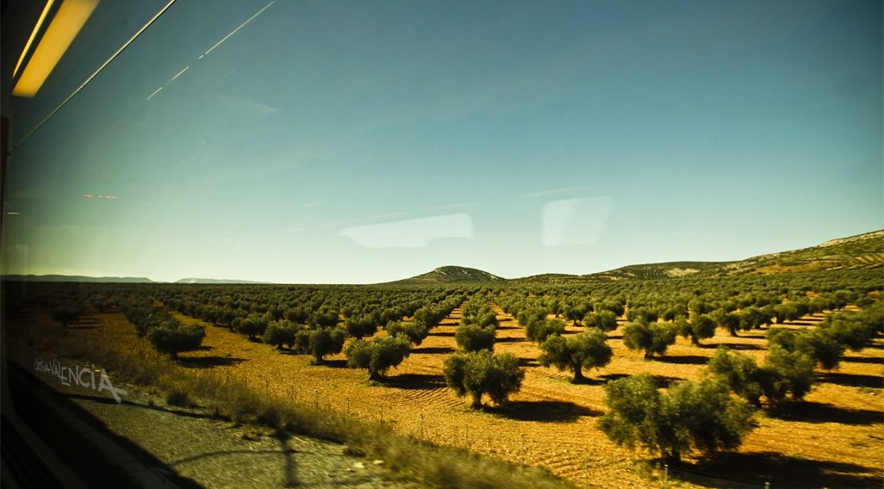
2. CLIMATE
Activity 2
A Mediterranean landscape.
Notes:
Activity 2. Look carefully at this picture: a Mediterranean landscape. Observe every detail before I ask the question.

Slide 22
2. CLIMATE
Activity 2: Question
Describe the Mediterranean climate.
Notes:
Here is the question for Activity 2: Describe the Mediterranean climate. Take one minute to think and write your answer in your rough notebook.

Slide 23
2. CLIMATE
Activity 2: Answer
Hot, dry summers and mild, wet winters.
Notes:
Let us check the answer together. Hot, dry summers and mild, wet winters.

Slide 24
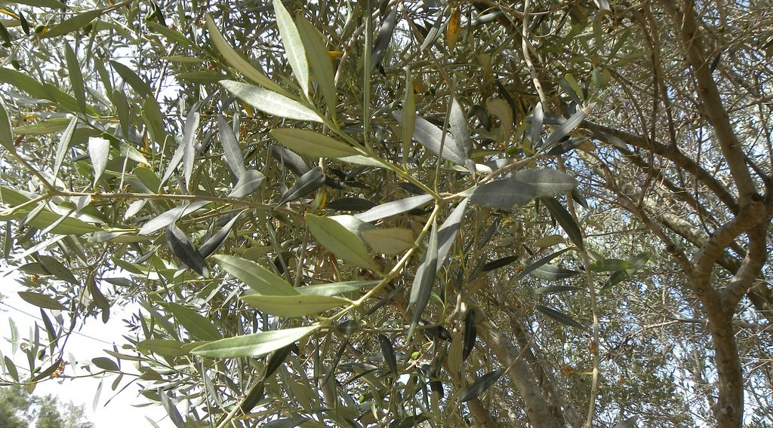
2. VEGETATION
Activity 3
An olive tree.
Notes:
Activity 3. Look carefully at this picture: an olive tree. Observe every detail before I ask the question.

Slide 25
2. VEGETATION
Activity 3: Question
How are Mediterranean plants adapted to the dry summer?
Notes:
Here is the question for Activity 3: How are Mediterranean plants adapted to the dry summer? Take one minute to think and write your answer in your rough notebook.

Slide 26
2. VEGETATION
Activity 3: Answer
They have small, hard, waxy leaves and deep roots.
Notes:
Let us check the answer together. They have small, hard, waxy leaves and deep roots.

Slide 27
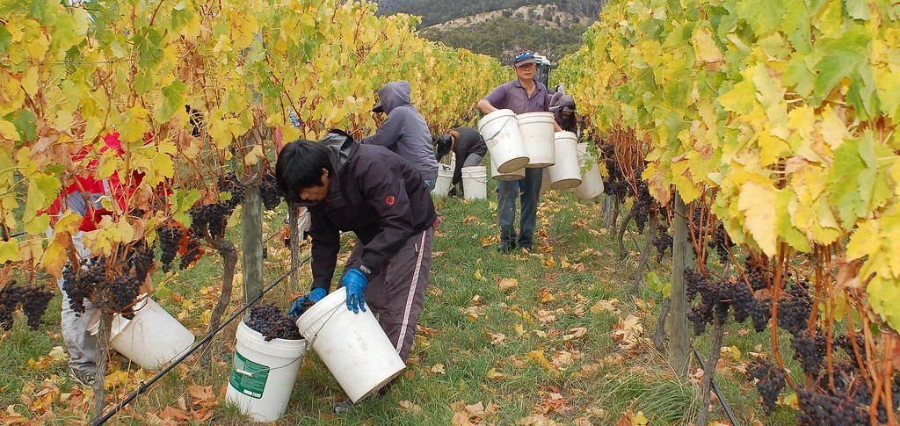
3. VITICULTURE
Activity 4
A vineyard.
Notes:
Activity 4. Look carefully at this picture: a vineyard. Observe every detail before I ask the question.

Slide 28
3. VITICULTURE
Activity 4: Question
What is viticulture?
Notes:
Here is the question for Activity 4: What is viticulture? Take one minute to think and write your answer in your rough notebook.

Slide 29
3. VITICULTURE
Activity 4: Answer
The growing of grapes (vines).
Notes:
Let us check the answer together. The growing of grapes (vines).

Slide 30

3. OTHER ACTIVITIES
Activity 5
A crowded beach.
Notes:
Activity 5. Look carefully at this picture: a crowded beach. Observe every detail before I ask the question.

Slide 31
3. OTHER ACTIVITIES
Activity 5: Question
Give two other activities of Mediterranean lands.
Notes:
Here is the question for Activity 5: Give two other activities of Mediterranean lands. Take one minute to think and write your answer in your rough notebook.

Slide 32
3. OTHER ACTIVITIES
Activity 5: Answer
Tourism and pastoral farming of sheep and goats (also fishing).
Notes:
Let us check the answer together. Tourism and pastoral farming of sheep and goats (also fishing).

Slide 33
BOARD SUMMARY
Board Summary
Topic: Conservation of World's Biomes and Resources
Sub-topic: Temperate Biomes and their Significance
Lesson 11: The Mediterranean Biome
Notes:
Now we are going to copy the board summary. Write the title and the headings neatly in your notebooks. I will give you enough time for each slide, so do not rush.

Slide 34
BOARD SUMMARY
1. Location
The Mediterranean biome is located as follows:
Location: It lies around the Mediterranean Sea and in California, central Chile, the Cape and south-west Australia, between about 30° and 40°.
Notes:
Let us copy Location. The Mediterranean biome is located as follows. On this slide we have Location. Write each point on a new line, with the key term first, and explain it in your own words when we revise.

Slide 35
BOARD SUMMARY
2. Characteristics
The Mediterranean biome has the following characteristics:
Climate: Summers are hot and dry and winters are mild and wet.
Vegetation: It is woodland and scrub of olive, cork oak and pine with small, hard leaves.
Notes:
Let us copy Characteristics. The Mediterranean biome has the following characteristics. On this slide we have Climate and Vegetation. Write each point on a new line, with the key term first, and explain it in your own words when we revise. When you finish, we go to the next slide.

Slide 36
BOARD SUMMARY
2. Characteristics (continued)
Soils: The soils are thin red soils, eroded on slopes.
Animal life: Goats, sheep, lizards and birds live there.
Notes:
We continue with Characteristics. On this slide we have Soils and Animal life. Write each point on a new line, with the key term first, and explain it in your own words when we revise.

Slide 37
BOARD SUMMARY
3. Human Activities
People carry out the following activities:
Viticulture and fruit farming: Farmers grow grapes, olives, oranges and lemons.
Pastoral farming: Herders rear sheep and goats.
Notes:
Let us copy Human Activities. People carry out the following activities. On this slide we have Viticulture and fruit farming and Pastoral farming. Write each point on a new line, with the key term first, and explain it in your own words when we revise. When you finish, we go to the next slide.

Slide 38
BOARD SUMMARY
3. Human Activities (continued)
Tourism: Millions of tourists visit the sunny beaches.
Notes:
We continue with Human Activities. On this slide we have Tourism. Write each point on a new line, with the key term first, and explain it in your own words when we revise.

Slide 39
FORMATIVE EVALUATION
Evaluation 1
Describe the Mediterranean climate.
Notes:
Now let us check what you have understood. Question 1: Describe the Mediterranean climate. Answer in your exercise book.

Slide 40
FORMATIVE EVALUATION
Expected Answer
Hot, dry summers and mild, wet winters.
Notes:
The expected answer is: hot, dry summers and mild, wet winters. If you got it right, well done.

Slide 41
FORMATIVE EVALUATION
Evaluation 2
What is viticulture?
Notes:
Now let us check what you have understood. Question 2: What is viticulture? Answer in your exercise book.

Slide 42
FORMATIVE EVALUATION
Expected Answer
The growing of grapes.
Notes:
The expected answer is: the growing of grapes. If you got it right, well done.

Slide 43
REMEDIATION
Remediation
Fill in the blanks:
The growing of grapes is ______.
Mediterranean summers are hot and ______.
A typical tree of this biome is the ______.
Notes:
For those who need more practice, fill in the blanks in your exercise book. The answers are: number 1, viticulture; number 2, dry; number 3, olive.

Slide 44
HOMEWORK
Homework
List three products from Mediterranean lands sold in Cameroon.
Notes:
For your homework: List three products from Mediterranean lands sold in Cameroon. We shall correct it at the beginning of our next lesson.

Slide 45
NEXT LESSON
Next Lesson
Our next lesson will be on:
Lesson 12: The Situation of Cameroon
Notes:
Our next lesson will be on Lesson 12: The Situation of Cameroon. Thank you for your attention, and see you next time.

Slide 46
BILINGUAL GAME
Bilingual Game (Jeu Bilingue)
English | Français
Olive | L'olive
Grape | Le raisin
Vineyard | Le vignoble
Summer | L'été
Winter | L'hiver
Tourism | Le tourisme
Notes:
Let us play the bilingual game. I say a word in English, and you give me the French word. Then we do the reverse.

Slide 47
LOGBOOK
Official Logbook (1/2)
Module / Topic | Conservation of World's Biomes and Resources
Lesson Title | Lesson 11: The Mediterranean Biome
Expected Learning Outcomes | Locate the Mediterranean biome. Describe its climate, vegetation, soils and animal life. Describe its human activities.
Competence | Learners are able to describe the Mediterranean biome and its human activities.
Notes:
I record this information in the official logbook of the class after the lesson.

Slide 48
LOGBOOK
Official Logbook (2/2)
Matter Taught | Location; Characteristics; Human Activities.
Evaluation | Formative evaluation and remediation exercise.
Homework | List three products from Mediterranean lands sold in Cameroon.
Enrolment / Present / Absent | ____ / ____ / ____
Achievement | To be completed after the lesson.
Notes:
I complete the second page of the logbook: the matter taught, the evaluation, the homework and the attendance.

Slide 49
TEACHER'S NOTE
Teacher's Note
Timing: Homework correction, plan, objectives 8 min | Recall, situation, action 10 min | 5 activities 30 min | Board summary (copying) 30 min | Evaluation, remediation 10 min | Homework, next lesson 5 min | Logbook 7 min
Without the projector (Activity 1): use the atlas.
Without the projector (Activity 2): compare with Garoua.
Without the projector (Activity 3): describe an olive tree.
Without the projector (Activity 4): name fruits from Mediterranean lands.
Without the projector (Activity 5): discuss tourism.
Notes:
This slide is for me, the teacher: it gives the timing of the lesson and what to do if the projector is not available.

Slide 50
REFERENCES
References
Geography Syllabus, Forms I–V, MINESEC (2023) — Form 4, Module I: Ecological Systems and their Resources.
Photo, Activity 2: “Oro Mediterraneo / Mediterranean Gold” by Cristy Valencia, CC BY 2.0, via Flickr (https://www.flickr.com/photos/24522216@N03/5927925845)
Photo, Activity 3: “Close up of an Olive Tree” by Ian W Scott, CC BY-SA 2.0, via Flickr (https://www.flickr.com/photos/38000818@N06/5767827378)
Photo, Activity 4: “Stefano Lubiana Wines Tasmania harvest panorama” by stefano lubiana wines, CC BY 2.0, via Flickr (https://www.flickr.com/photos/50979249@N06/4688372740)
Photo, Activity 5: “Crowded Sunny Beach, Bulgaria” by phototouring, CC BY-NC-SA 2.0, via Flickr (https://www.flickr.com/photos/19054742@N00/1557605901)
Diagrams and animations: drawn for this lesson (Geography Department).
Notes:
These are the references and picture credits used to prepare this lesson.

