Slide 1
FORM 4
GEOGRAPHY
Lesson 13
The Relief of Cameroon
Notes:
Good morning, class, and welcome to our geography lesson. I am your geography teacher, Mr Kamdem. Today we are starting Lesson 13: The Relief of Cameroon.

Slide 2
CLASS INFO
Class, Chapter and Duration
Class | Form 4
Chapter | Module I: Ecological Systems and their Resources
Duration | 2 periods (2 × 50 minutes)
Notes:
This lesson is for Form 4. It belongs to Module I: Ecological Systems and their Resources. We shall need 2 periods to cover it.

Slide 3
IDENTIFICATION
Lesson Identification
Topic | The Physical Geography of Cameroon
Sub-topic | Background of Cameroon
Lesson | Lesson 13: The Relief of Cameroon
Notions / Concepts | Relief, plateau, lowland, mountain, highland.
Syllabus focus | Main relief units: location; main relief characteristics.
Competence | Learners are able to locate and describe the main relief units of Cameroon.
Notes:
Our topic is The Physical Geography of Cameroon, and the sub-topic is Background of Cameroon. The key notions we shall use today are: relief, plateau, lowland, mountain, highland. At the end, you should be able to do this: learners are able to locate and describe the main relief units of Cameroon.

Slide 4

HOMEWORK CORRECTION
Correction of the Homework
Question (Lesson 12: The Situation of Cameroon):
Draw a sketch map of Cameroon and name its neighbours.
Notes:
Before we start the new lesson, let us correct the homework I gave you at the end of Lesson 12: The Situation of Cameroon. The question was: Draw a sketch map of Cameroon and name its neighbours. Take out your exercise books.

Slide 5
HOMEWORK CORRECTION
Correction: Possible Answer
The sketch shows Nigeria (west), Chad (north-east), CAR (east), Congo, Gabon and Equatorial Guinea (south) and the Atlantic Ocean (south-west).
Notes:
Here is a good answer. The sketch shows Nigeria (west), Chad (north-east), CAR (east), Congo, Gabon and Equatorial Guinea (south) and the Atlantic Ocean (south-west). Compare it with your own answer and correct your work in red.

Slide 6
LESSON PLAN
Lesson Plan
Correction of the homework
Objectives and recall
Real-life situation and action to take
Learning activities
Board summary
Evaluation, remediation and homework
Notes:
Here is the plan of our lesson today. First, we shall correct the homework. Then we shall look at the objectives and recall what you already know. After that, we shall study a situation from real life and the action to take, and do the learning activities. Finally, we shall copy the board summary, do the evaluation and the remediation, and I will give you the homework.

Slide 7
OBJECTIVES
Objectives
By the end of this lesson, you should be able to:
Identify the main relief units of Cameroon.
Locate them on a map.
Describe their characteristics.
Notes:
By the end of this lesson, you should be able to do three things. Number 1: identify the main relief units of Cameroon. Number 2: locate them on a map. Number 3: describe their characteristics.

Slide 8
PREVIOUS KNOWLEDGE
Previous Knowledge
Relief is the shape of the land.
Mount Cameroon is a volcano.
Ngaoundéré is on a high plateau.
Notes:
Let us first remember what you already know. Relief is the shape of the land. Mount Cameroon is a volcano. Ngaoundéré is on a high plateau. Keep this in mind, because we shall build on it today.

Slide 9
REAL-LIFE SITUATION
Situation in Real Life
On the road from Garoua to Ngaoundéré, the bus climbs a very steep slope called the Adamawa cliff. At Ngaoundéré the air is cooler than in Garoua.
Notes:
Listen carefully to this situation from real life. On the road from Garoua to Ngaoundéré, the bus climbs a very steep slope called the Adamawa cliff. At Ngaoundéré the air is cooler than in Garoua. Think about it, because I am going to ask you some questions.

Slide 10
REAL-LIFE SITUATION
Situation: Question 1
What is the problem in the situation?
Notes:
Question 1: What is the problem in the situation? Think for a moment, then raise your hand to answer.

Slide 11
REAL-LIFE SITUATION
Answer
We want to know the relief units of Cameroon.
Notes:
Good. We want to know the relief units of Cameroon.

Slide 12
REAL-LIFE SITUATION
Situation: Question 2
Which relief unit is Ngaoundéré on?
Notes:
Question 2: Which relief unit is Ngaoundéré on? Think for a moment, then raise your hand to answer.

Slide 13
REAL-LIFE SITUATION
Answer
The Adamawa Plateau.
Notes:
Good. The Adamawa Plateau.

Slide 14
REAL-LIFE SITUATION
Situation: Question 3
Why is it cooler there?
Notes:
Question 3: Why is it cooler there? Think for a moment, then raise your hand to answer.

Slide 15
REAL-LIFE SITUATION
Possible Answer
Because of the high altitude.
Notes:
Good. Because of the high altitude.

Slide 16
ACTION TO TAKE
Action to Take
Read a relief map of Cameroon and locate the main highlands and lowlands.
Notes:
From this situation, the action we are working towards in this lesson is the following: read a relief map of Cameroon and locate the main highlands and lowlands.

Slide 17
JUSTIFICATION
Justification of the Lesson
This lesson helps us to know the landforms of our country.
Notes:
Why is this lesson important for you? This lesson helps us to know the landforms of our country.

Slide 18

1. RELIEF UNITS
Activity 1
The relief of Cameroon.
Notes:
Activity 1. Look carefully at this diagram: the relief of Cameroon. Observe every detail before I ask the question.

Slide 19
1. RELIEF UNITS
Activity 1: Question
Name four relief units of Cameroon.
Notes:
Here is the question for Activity 1: Name four relief units of Cameroon. Take one minute to think and write your answer in your rough notebook.

Slide 20
1. RELIEF UNITS
Activity 1: Answer
The Adamawa Plateau, the Western Highlands, the coastal lowlands and the Chad Plain (also Mandara Mountains, South Cameroon Plateau, Benue lowland).
Notes:
Let us check the answer together. The Adamawa Plateau, the Western Highlands, the coastal lowlands and the Chad Plain (also Mandara Mountains, South Cameroon Plateau, Benue lowland).

Slide 21

2. HIGHLANDS
Activity 2
Mount Cameroon.
Notes:
Activity 2. Look carefully at this picture: mount Cameroon. Observe every detail before I ask the question.

Slide 22
2. HIGHLANDS
Activity 2: Question
What is the highest point of Cameroon?
Notes:
Here is the question for Activity 2: What is the highest point of Cameroon? Take one minute to think and write your answer in your rough notebook.

Slide 23
2. HIGHLANDS
Activity 2: Answer
Mount Cameroon (4,095 m), an active volcano.
Notes:
Let us check the answer together. Mount Cameroon (4,095 m), an active volcano.

Slide 24

2. HIGHLANDS
Activity 3
The Mandara Mountains.
Notes:
Activity 3. Look carefully at this picture: the Mandara Mountains. Observe every detail before I ask the question.

Slide 25
2. HIGHLANDS
Activity 3: Question
Where are the Mandara Mountains?
Notes:
Here is the question for Activity 3: Where are the Mandara Mountains? Take one minute to think and write your answer in your rough notebook.

Slide 26
2. HIGHLANDS
Activity 3: Answer
In the Far North, along the border with Nigeria.
Notes:
Let us check the answer together. In the Far North, along the border with Nigeria.

Slide 27
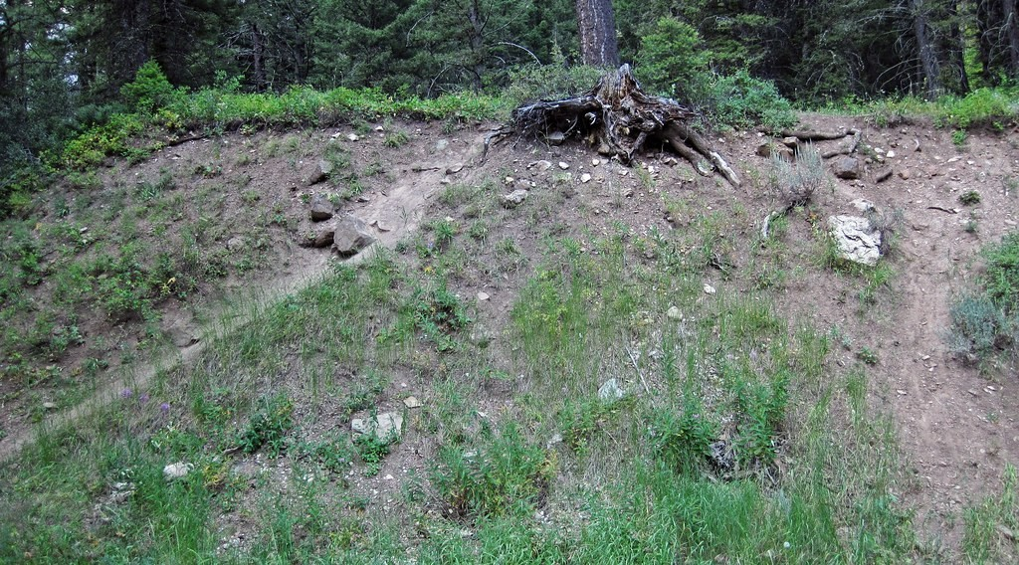
2. PLATEAUX
Activity 4
A steep escarpment.
Notes:
Activity 4. Look carefully at this picture: a steep escarpment. Observe every detail before I ask the question.

Slide 28
2. PLATEAUX
Activity 4: Question
Describe the Adamawa Plateau.
Notes:
Here is the question for Activity 4: Describe the Adamawa Plateau. Take one minute to think and write your answer in your rough notebook.

Slide 29
2. PLATEAUX
Activity 4: Answer
A high plateau (about 1,000–1,500 m) in the centre, which separates the north from the south.
Notes:
Let us check the answer together. A high plateau (about 1,000–1,500 m) in the centre, which separates the north from the south.

Slide 30

2. LOWLANDS
Activity 5
The Benue lowland.
Notes:
Activity 5. Look carefully at this picture: the Benue lowland. Observe every detail before I ask the question.

Slide 31
2. LOWLANDS
Activity 5: Question
Name two lowlands of Cameroon.
Notes:
Here is the question for Activity 5: Name two lowlands of Cameroon. Take one minute to think and write your answer in your rough notebook.

Slide 32
2. LOWLANDS
Activity 5: Answer
The coastal lowlands and the Benue lowland (also the Chad Plain).
Notes:
Let us check the answer together. The coastal lowlands and the Benue lowland (also the Chad Plain).

Slide 33
BOARD SUMMARY
Board Summary
Topic: The Physical Geography of Cameroon
Sub-topic: Background of Cameroon
Lesson 13: The Relief of Cameroon
Notes:
Now we are going to copy the board summary. Write the title and the headings neatly in your notebooks. I will give you enough time for each slide, so do not rush.

Slide 34
BOARD SUMMARY
DEFINITIONS
The key terms of this lesson are defined as follows:
Relief: It is the shape of the land surface: its highlands and lowlands.
Notes:
Let us copy the definitions. The key terms of this lesson are defined as follows. On this slide we have Relief. Write each point on a new line, with the key term first, and explain it in your own words when we revise.

Slide 35
BOARD SUMMARY
1. Highlands
Cameroon has the following highlands:
Western Highlands: They include Mount Cameroon (4,095 m), the highest point, and the Bamenda and Bamboutos highlands.
Adamawa Plateau: It is a high plateau of 1,000 to 1,500 m in the centre of the country.
Notes:
Let us copy Highlands. Cameroon has the following highlands. On this slide we have Western Highlands and Adamawa Plateau. Write each point on a new line, with the key term first, and explain it in your own words when we revise. When you finish, we go to the next slide.

Slide 36
BOARD SUMMARY
1. Highlands (continued)
Mandara Mountains: They lie in the Far North along the Nigerian border.
South Cameroon Plateau: It is a plateau of about 600 to 900 m in the south and east.
Notes:
We continue with Highlands. On this slide we have Mandara Mountains and South Cameroon Plateau. Write each point on a new line, with the key term first, and explain it in your own words when we revise.

Slide 37
BOARD SUMMARY
1. Highlands
Illustration: the relief of Cameroon
Notes:
Now draw this illustration in your notebook: the relief of Cameroon. Give it a title and label it clearly.

Slide 38
BOARD SUMMARY
2. Lowlands
Cameroon has the following lowlands:
Coastal lowlands: They lie along the Atlantic Ocean around Douala and Kribi.
Benue lowland: It lies around Garoua in the valley of the Benue.
Notes:
Let us copy Lowlands. Cameroon has the following lowlands. On this slide we have Coastal lowlands and Benue lowland. Write each point on a new line, with the key term first, and explain it in your own words when we revise. When you finish, we go to the next slide.

Slide 39
BOARD SUMMARY
2. Lowlands (continued)
Chad Plain: It is a flat plain in the Far North around Lake Chad.
Notes:
We continue with Lowlands. On this slide we have Chad Plain. Write each point on a new line, with the key term first, and explain it in your own words when we revise.

Slide 40
FORMATIVE EVALUATION
Evaluation 1
Name two highlands and two lowlands of Cameroon.
Notes:
Now let us check what you have understood. Question 1: Name two highlands and two lowlands of Cameroon. Answer in your exercise book.

Slide 41
FORMATIVE EVALUATION
Expected Answer
Highlands: Adamawa Plateau, Western Highlands. Lowlands: coastal lowlands, Chad Plain.
Notes:
The expected answer is: highlands: Adamawa Plateau, Western Highlands. Lowlands: coastal lowlands, Chad Plain. If you got it right, well done.

Slide 42
FORMATIVE EVALUATION
Evaluation 2
What is the highest point of Cameroon?
Notes:
Now let us check what you have understood. Question 2: What is the highest point of Cameroon? Answer in your exercise book.

Slide 43
FORMATIVE EVALUATION
Expected Answer
Mount Cameroon (4,095 m).
Notes:
The expected answer is: mount Cameroon (4,095 m). If you got it right, well done.

Slide 44
REMEDIATION
Remediation
Fill in the blanks:
The highest point of Cameroon is Mount ______.
Ngaoundéré is on the ______ Plateau.
Garoua is in the ______ lowland.
Notes:
For those who need more practice, fill in the blanks in your exercise book. The answers are: number 1, Cameroon; number 2, Adamawa; number 3, Benue.

Slide 45
HOMEWORK
Homework
Draw a sketch map of the main relief units of Cameroon.
Notes:
For your homework: Draw a sketch map of the main relief units of Cameroon. We shall correct it at the beginning of our next lesson.

Slide 46
NEXT LESSON
Next Lesson
Our next lesson will be on:
Lesson 14: The Drainage of Cameroon
Notes:
Our next lesson will be on Lesson 14: The Drainage of Cameroon. Thank you for your attention, and see you next time.

Slide 47
BILINGUAL GAME
Bilingual Game (Jeu Bilingue)
English | Français
Relief | Le relief
Plateau | Le plateau
Mountain | La montagne
Lowland | La plaine
Highland | Le haut plateau
Altitude | L'altitude
Notes:
Let us play the bilingual game. I say a word in English, and you give me the French word. Then we do the reverse.

Slide 48
LOGBOOK
Official Logbook (1/2)
Module / Topic | The Physical Geography of Cameroon
Lesson Title | Lesson 13: The Relief of Cameroon
Expected Learning Outcomes | Identify the main relief units of Cameroon. Locate them on a map. Describe their characteristics.
Competence | Learners are able to locate and describe the main relief units of Cameroon.
Notes:
I record this information in the official logbook of the class after the lesson.

Slide 49
LOGBOOK
Official Logbook (2/2)
Matter Taught | DEFINITIONS; Highlands; Lowlands.
Evaluation | Formative evaluation and remediation exercise.
Homework | Draw a sketch map of the main relief units of Cameroon.
Enrolment / Present / Absent | ____ / ____ / ____
Achievement | To be completed after the lesson.
Notes:
I complete the second page of the logbook: the matter taught, the evaluation, the homework and the attendance.

Slide 50
TEACHER'S NOTE
Teacher's Note
Timing: Homework correction, plan, objectives 8 min | Recall, situation, action 10 min | 5 activities 30 min | Board summary (copying) 30 min | Evaluation, remediation 10 min | Homework, next lesson 5 min | Logbook 7 min
Without the projector (Activity 1): draw the map.
Without the projector (Activity 2): locate it.
Without the projector (Activity 3): locate them.
Without the projector (Activity 4): describe the road to Ngaoundéré.
Without the projector (Activity 5): describe the land around Garoua.
Notes:
This slide is for me, the teacher: it gives the timing of the lesson and what to do if the projector is not available.

Slide 51
REFERENCES
References
Geography Syllabus, Forms I–V, MINESEC (2023) — Form 4, Module I: Ecological Systems and their Resources.
Photo, Activity 2: “Mount Cameroon” by John & Mel Kots, CC BY-NC-ND 2.0, via Flickr (https://www.flickr.com/photos/26745817@N00/2347261849)
Photo, Activity 3: “Rhumsiki peak, North Cameroon” by krishna.naudin, CC BY-SA 2.0, via Flickr (https://www.flickr.com/photos/141297921@N05/25989204581)
Photo, Activity 4: “1959 Hebgen Lake Earthquake fault scarp (Cabin Creek, Gallatin County,” by James St. John, CC BY 2.0, via Flickr (https://www.flickr.com/photos/47445767@N05/45610123392)
Photo, Activity 5: “Niamey, Niger” by LenDog64, CC BY-ND 2.0, via Flickr (https://www.flickr.com/photos/45968460@N03/4422209893)
Diagrams and animations: drawn for this lesson (Geography Department).
Notes:
These are the references and picture credits used to prepare this lesson.

