Slide 1
FORM 4
GEOGRAPHY
Lesson 16
The Vegetation of Cameroon
Notes:
Good morning, class, and welcome to our geography lesson. I am your geography teacher, Mr Kamdem. Today we are starting Lesson 16: The Vegetation of Cameroon.

Slide 2
CLASS INFO
Class, Chapter and Duration
Class | Form 4
Chapter | Module I: Ecological Systems and their Resources
Duration | 2 periods (2 × 50 minutes)
Notes:
This lesson is for Form 4. It belongs to Module I: Ecological Systems and their Resources. We shall need 2 periods to cover it.

Slide 3
IDENTIFICATION
Lesson Identification
Topic | The Physical Geography of Cameroon
Sub-topic | The Bio-geographical Characteristics of Cameroon
Lesson | Lesson 16: The Vegetation of Cameroon
Notions / Concepts | Rainforest, savannah, montane vegetation, mangrove, steppe.
Syllabus focus | Identification and location of main types; main characteristics of each type.
Competence | Learners are able to locate and describe the vegetation types of Cameroon.
Notes:
Our topic is The Physical Geography of Cameroon, and the sub-topic is The Bio-geographical Characteristics of Cameroon. The key notions we shall use today are: rainforest, savannah, montane vegetation, mangrove, steppe. At the end, you should be able to do this: learners are able to locate and describe the vegetation types of Cameroon.

Slide 4

HOMEWORK CORRECTION
Correction of the Homework
Question (Lesson 15: The Climate of Cameroon):
Compare the climographs of Yaoundé and Garoua in three sentences.
Notes:
Before we start the new lesson, let us correct the homework I gave you at the end of Lesson 15: The Climate of Cameroon. The question was: Compare the climographs of Yaoundé and Garoua in three sentences. Take out your exercise books.

Slide 5
HOMEWORK CORRECTION
Correction: Possible Answer
Yaoundé has rain in almost every month with two peaks; Garoua has one rainy season from May to October; Garoua is hotter and has a larger temperature range.
Notes:
Here is a good answer. Yaoundé has rain in almost every month with two peaks; Garoua has one rainy season from May to October; Garoua is hotter and has a larger temperature range. Compare it with your own answer and correct your work in red.

Slide 6
LESSON PLAN
Lesson Plan
Correction of the homework
Objectives and recall
Real-life situation and action to take
Learning activities
Board summary
Evaluation, remediation and homework
Notes:
Here is the plan of our lesson today. First, we shall correct the homework. Then we shall look at the objectives and recall what you already know. After that, we shall study a situation from real life and the action to take, and do the learning activities. Finally, we shall copy the board summary, do the evaluation and the remediation, and I will give you the homework.

Slide 7
OBJECTIVES
Objectives
By the end of this lesson, you should be able to:
Identify and locate the vegetation types of Cameroon.
Describe the characteristics of each type.
Relate vegetation to climate.
Notes:
By the end of this lesson, you should be able to do three things. Number 1: identify and locate the vegetation types of Cameroon. Number 2: describe the characteristics of each type. Number 3: relate vegetation to climate.

Slide 8
PREVIOUS KNOWLEDGE
Previous Knowledge
The south is hot and wet.
The north has a long dry season.
Mountains are cooler.
Notes:
Let us first remember what you already know. The south is hot and wet. The north has a long dry season. Mountains are cooler. Keep this in mind, because we shall build on it today.

Slide 9
REAL-LIFE SITUATION
Situation in Real Life
Travelling from Kribi to Kousseri, a traveller sees mangroves on the coast, a dense forest, then savanna and finally short grass with thorny bushes near Lake Chad.
Notes:
Listen carefully to this situation from real life. Travelling from Kribi to Kousseri, a traveller sees mangroves on the coast, a dense forest, then savanna and finally short grass with thorny bushes near Lake Chad. Think about it, because I am going to ask you some questions.

Slide 10
REAL-LIFE SITUATION
Situation: Question 1
What is the problem in the situation?
Notes:
Question 1: What is the problem in the situation? Think for a moment, then raise your hand to answer.

Slide 11
REAL-LIFE SITUATION
Answer
We want to know why vegetation changes across Cameroon.
Notes:
Good. We want to know why vegetation changes across Cameroon.

Slide 12
REAL-LIFE SITUATION
Situation: Question 2
What vegetation is found on the coast?
Notes:
Question 2: What vegetation is found on the coast? Think for a moment, then raise your hand to answer.

Slide 13
REAL-LIFE SITUATION
Answer
Mangroves.
Notes:
Good. Mangroves.

Slide 14
REAL-LIFE SITUATION
Situation: Question 3
What is found near Lake Chad?
Notes:
Question 3: What is found near Lake Chad? Think for a moment, then raise your hand to answer.

Slide 15
REAL-LIFE SITUATION
Possible Answer
Short grass and thorny bushes (steppe).
Notes:
Good. Short grass and thorny bushes (steppe).

Slide 16
ACTION TO TAKE
Action to Take
Protect the vegetation of your region.
Notes:
From this situation, the action we are working towards in this lesson is the following: protect the vegetation of your region.

Slide 17
JUSTIFICATION
Justification of the Lesson
This lesson helps us to know and protect the vegetation of Cameroon.
Notes:
Why is this lesson important for you? This lesson helps us to know and protect the vegetation of Cameroon.

Slide 18

1. TYPES
Activity 1
The vegetation of Cameroon.
Notes:
Activity 1. Look carefully at this diagram: the vegetation of Cameroon. Observe every detail before I ask the question.

Slide 19
1. TYPES
Activity 1: Question
Name four vegetation types of Cameroon.
Notes:
Here is the question for Activity 1: Name four vegetation types of Cameroon. Take one minute to think and write your answer in your rough notebook.

Slide 20
1. TYPES
Activity 1: Answer
Dense rainforest, mangrove, savanna and steppe (also montane vegetation).
Notes:
Let us check the answer together. Dense rainforest, mangrove, savanna and steppe (also montane vegetation).

Slide 21

2. RAINFOREST
Activity 2
The dense rainforest.
Notes:
Activity 2. Look carefully at this picture: the dense rainforest. Observe every detail before I ask the question.

Slide 22
2. RAINFOREST
Activity 2: Question
Describe the rainforest of the south.
Notes:
Here is the question for Activity 2: Describe the rainforest of the south. Take one minute to think and write your answer in your rough notebook.

Slide 23
2. RAINFOREST
Activity 2: Answer
Tall evergreen trees in layers, very dense.
Notes:
Let us check the answer together. Tall evergreen trees in layers, very dense.

Slide 24

2. MANGROVE
Activity 3
Mangroves.
Notes:
Activity 3. Look carefully at this picture: mangroves. Observe every detail before I ask the question.

Slide 25
2. MANGROVE
Activity 3: Question
Where are mangroves found?
Notes:
Here is the question for Activity 3: Where are mangroves found? Take one minute to think and write your answer in your rough notebook.

Slide 26
2. MANGROVE
Activity 3: Answer
Along the coast, in salty water, around Douala and Limbe.
Notes:
Let us check the answer together. Along the coast, in salty water, around Douala and Limbe.

Slide 27

2. SAVANNA
Activity 4
The savanna.
Notes:
Activity 4. Look carefully at this picture: the savanna. Observe every detail before I ask the question.

Slide 28
2. SAVANNA
Activity 4: Question
Describe the savanna of the north.
Notes:
Here is the question for Activity 4: Describe the savanna of the north. Take one minute to think and write your answer in your rough notebook.

Slide 29
2. SAVANNA
Activity 4: Answer
Grass with scattered trees that lose their leaves in the dry season.
Notes:
Let us check the answer together. Grass with scattered trees that lose their leaves in the dry season.

Slide 30
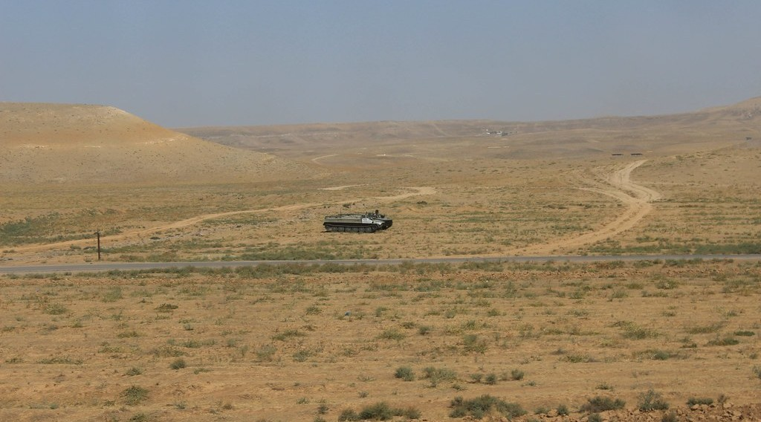
2. STEPPE AND MONTANE
Activity 5
Steppe in a dry area.
Notes:
Activity 5. Look carefully at this picture: steppe in a dry area. Observe every detail before I ask the question.

Slide 31
2. STEPPE AND MONTANE
Activity 5: Question
Describe the steppe of the Far North.
Notes:
Here is the question for Activity 5: Describe the steppe of the Far North. Take one minute to think and write your answer in your rough notebook.

Slide 32
2. STEPPE AND MONTANE
Activity 5: Answer
Short grass and thorny bushes adapted to dryness.
Notes:
Let us check the answer together. Short grass and thorny bushes adapted to dryness.

Slide 33
BOARD SUMMARY
Board Summary
Topic: The Physical Geography of Cameroon
Sub-topic: The Bio-geographical Characteristics of Cameroon
Lesson 16: The Vegetation of Cameroon
Notes:
Now we are going to copy the board summary. Write the title and the headings neatly in your notebooks. I will give you enough time for each slide, so do not rush.

Slide 34
BOARD SUMMARY
1. Main Vegetation Types
Cameroon has the following vegetation types:
Dense rainforest: It covers the south and east with tall evergreen trees.
Mangrove: It grows in salty water along the coast near Douala and Limbe.
Notes:
Let us copy Main Vegetation Types. Cameroon has the following vegetation types. On this slide we have Dense rainforest and Mangrove. Write each point on a new line, with the key term first, and explain it in your own words when we revise. When you finish, we go to the next slide.

Slide 35
BOARD SUMMARY
1. Main Vegetation Types (continued)
Montane vegetation: Montane forest and grassland cover the Western Highlands.
Savanna: Grass with scattered trees covers Adamawa and the North.
Steppe: Short grass and thorny bushes cover the Far North.
Notes:
We continue with Main Vegetation Types. On this slide we have Montane vegetation, Savanna and Steppe. Write each point on a new line, with the key term first, and explain it in your own words when we revise.

Slide 36
BOARD SUMMARY
1. Main Vegetation Types
Illustration: the vegetation of Cameroon
Notes:
Now draw this illustration in your notebook: the vegetation of Cameroon. Give it a title and label it clearly.

Slide 37
FORMATIVE EVALUATION
Evaluation 1
Name four vegetation types of Cameroon.
Notes:
Now let us check what you have understood. Question 1: Name four vegetation types of Cameroon. Answer in your exercise book.

Slide 38
FORMATIVE EVALUATION
Expected Answer
Rainforest, mangrove, savanna and steppe.
Notes:
The expected answer is: rainforest, mangrove, savanna and steppe. If you got it right, well done.

Slide 39
FORMATIVE EVALUATION
Evaluation 2
Where is the steppe found?
Notes:
Now let us check what you have understood. Question 2: Where is the steppe found? Answer in your exercise book.

Slide 40
FORMATIVE EVALUATION
Expected Answer
In the Far North.
Notes:
The expected answer is: in the Far North. If you got it right, well done.

Slide 41
REMEDIATION
Remediation
Fill in the blanks:
Forest in salty coastal water is ______.
The vegetation of Garoua is ______.
The vegetation of the Far North is ______.
Notes:
For those who need more practice, fill in the blanks in your exercise book. The answers are: number 1, mangrove; number 2, savanna; number 3, steppe.

Slide 42
HOMEWORK
Homework
Draw a sketch map of the vegetation of Cameroon with a key.
Notes:
For your homework: Draw a sketch map of the vegetation of Cameroon with a key. We shall correct it at the beginning of our next lesson.

Slide 43
NEXT LESSON
Next Lesson
Our next lesson will be on:
Lesson 17: The Soils of Cameroon
Notes:
Our next lesson will be on Lesson 17: The Soils of Cameroon. Thank you for your attention, and see you next time.

Slide 44
BILINGUAL GAME
Bilingual Game (Jeu Bilingue)
English | Français
Vegetation | La végétation
Forest | La forêt
Mangrove | La mangrove
Savanna | La savane
Steppe | La steppe
Tree | L'arbre
Notes:
Let us play the bilingual game. I say a word in English, and you give me the French word. Then we do the reverse.

Slide 45
LOGBOOK
Official Logbook (1/2)
Module / Topic | The Physical Geography of Cameroon
Lesson Title | Lesson 16: The Vegetation of Cameroon
Expected Learning Outcomes | Identify and locate the vegetation types of Cameroon. Describe the characteristics of each type. Relate vegetation to climate.
Competence | Learners are able to locate and describe the vegetation types of Cameroon.
Notes:
I record this information in the official logbook of the class after the lesson.

Slide 46
LOGBOOK
Official Logbook (2/2)
Matter Taught | Main Vegetation Types.
Evaluation | Formative evaluation and remediation exercise.
Homework | Draw a sketch map of the vegetation of Cameroon with a key.
Enrolment / Present / Absent | ____ / ____ / ____
Achievement | To be completed after the lesson.
Notes:
I complete the second page of the logbook: the matter taught, the evaluation, the homework and the attendance.

Slide 47
TEACHER'S NOTE
Teacher's Note
Timing: Homework correction, plan, objectives 8 min | Recall, situation, action 10 min | 5 activities 30 min | Board summary (copying) 30 min | Evaluation, remediation 10 min | Homework, next lesson 5 min | Logbook 7 min
Without the projector (Activity 1): draw the map.
Without the projector (Activity 2): describe the South.
Without the projector (Activity 3): describe the Wouri estuary.
Without the projector (Activity 4): describe Garoua.
Without the projector (Activity 5): describe the Far North.
Notes:
This slide is for me, the teacher: it gives the timing of the lesson and what to do if the projector is not available.

Slide 48
REFERENCES
References
Geography Syllabus, Forms I–V, MINESEC (2023) — Form 4, Module I: Ecological Systems and their Resources.
Photo, Activity 2: “Amazon 11” by CIAT International Center for Tropical Agriculture, CC BY-SA 2.0, via Flickr (https://www.flickr.com/photos/38476503@N08/5641587148)
Photo, Activity 3: “Pitchavaram waterway - Mangrove forest” by Balaji.B Photography, CC BY 2.0, via Flickr (https://www.flickr.com/photos/81073027@N00/1745978833)
Photo, Activity 4: “Blue Wildebeest in the Lowveld” by Martin_Heigan, CC BY-NC-ND 2.0, via Flickr (https://www.flickr.com/photos/97303475@N00/2089079933)
Photo, Activity 5: “Tank on the Kazakh steppe” by Timon91, CC BY-NC-SA 2.0, via Flickr (https://www.flickr.com/photos/52250985@N06/30964503402)
Diagrams and animations: drawn for this lesson (Geography Department).
Notes:
These are the references and picture credits used to prepare this lesson.

