Slide 1
FORM 4
GEOGRAPHY
Practical Work 9
Description of Drainage on Maps
Notes:
Good morning, class, and welcome to our geography lesson. I am your geography teacher, Mr Kamdem. Today we are starting Practical Work 9: Description of Drainage on Maps.

Slide 2
CLASS INFO
Class, Chapter and Duration
Class | Form 4
Chapter | Module I: Ecological Systems and their Resources
Duration | 2 periods (2 × 50 minutes)
Notes:
This lesson is for Form 4. It belongs to Module I: Ecological Systems and their Resources. We shall need 2 periods to cover it.

Slide 3
IDENTIFICATION
Lesson Identification
Topic | Initiation to Map Analysis
Sub-topic | Map Interpretation
Lesson | Practical Work 9: Description of Drainage on Maps
Notions / Concepts | Drainage, main river, tributary, confluence, drainage pattern, direction of flow.
Syllabus focus | Description of drainage on maps.
Competence | Learners are able to describe the drainage of a map extract.
Notes:
Our topic is Initiation to Map Analysis, and the sub-topic is Map Interpretation. The key notions we shall use today are: drainage, main river, tributary, confluence, drainage pattern, direction of flow. At the end, you should be able to do this: learners are able to describe the drainage of a map extract.

Slide 4

HOMEWORK CORRECTION
Correction of the Homework
Question (Practical Work 8: Description of Relief and Sketching of Relief Areas from Maps):
Draw a sketch map of the relief regions of a map extract and describe one region.
Notes:
Before we start the new lesson, let us correct the homework I gave you at the end of Practical Work 8: Description of Relief and Sketching of Relief Areas from Maps. The question was: Draw a sketch map of the relief regions of a map extract and describe one region. Take out your exercise books.

Slide 5
HOMEWORK CORRECTION
Correction: Possible Answer
A good answer shows a framed sketch with titled, keyed relief regions and a description such as: "The highland in the NW rises above 400 m (spot height 452 at 123 456) with steep slopes."
Notes:
Here is a good answer. A good answer shows a framed sketch with titled, keyed relief regions and a description such as: "The highland in the NW rises above 400 m (spot height 452 at 123 456) with steep slopes.". Compare it with your own answer and correct your work in red.

Slide 6
LESSON PLAN
Lesson Plan
Correction of the homework
Objectives and recall
Real-life situation and action to take
Learning activities
Board summary
Evaluation, remediation and homework
Notes:
Here is the plan of our lesson today. First, we shall correct the homework. Then we shall look at the objectives and recall what you already know. After that, we shall study a situation from real life and the action to take, and do the learning activities. Finally, we shall copy the board summary, do the evaluation and the remediation, and I will give you the homework.

Slide 7
OBJECTIVES
Objectives
By the end of this lesson, you should be able to:
Identify drainage features on a map.
Find the direction of flow of rivers.
Describe drainage patterns and density.
Notes:
By the end of this lesson, you should be able to do three things. Number 1: identify drainage features on a map. Number 2: find the direction of flow of rivers. Number 3: describe drainage patterns and density.

Slide 8
PREVIOUS KNOWLEDGE
Previous Knowledge
Rivers are shown in blue.
Rivers flow from high to low land.
Contours show height.
Notes:
Let us first remember what you already know. Rivers are shown in blue. Rivers flow from high to low land. Contours show height. Keep this in mind, because we shall build on it today.

Slide 9
REAL-LIFE SITUATION
Situation in Real Life
On a map extract, the teacher asks the class to describe the rivers: where they flow, how many tributaries they have and what pattern they form.
Notes:
Listen carefully to this situation from real life. On a map extract, the teacher asks the class to describe the rivers: where they flow, how many tributaries they have and what pattern they form. Think about it, because I am going to ask you some questions.

Slide 10
REAL-LIFE SITUATION
Situation: Question 1
What is the problem in the situation?
Notes:
Question 1: What is the problem in the situation? Think for a moment, then raise your hand to answer.

Slide 11
REAL-LIFE SITUATION
Answer
The class must describe the drainage of the map.
Notes:
Good. The class must describe the drainage of the map.

Slide 12
REAL-LIFE SITUATION
Situation: Question 2
How are rivers shown?
Notes:
Question 2: How are rivers shown? Think for a moment, then raise your hand to answer.

Slide 13
REAL-LIFE SITUATION
Answer
By blue lines.
Notes:
Good. By blue lines.

Slide 14
REAL-LIFE SITUATION
Situation: Question 3
How do we know where a river flows?
Notes:
Question 3: How do we know where a river flows? Think for a moment, then raise your hand to answer.

Slide 15
REAL-LIFE SITUATION
Possible Answer
From higher to lower contours.
Notes:
Good. From higher to lower contours.

Slide 16
ACTION TO TAKE
Action to Take
Give evidence such as grid references and contour heights when describing rivers.
Notes:
From this situation, the action we are working towards in this lesson is the following: give evidence such as grid references and contour heights when describing rivers.

Slide 17
JUSTIFICATION
Justification of the Lesson
This practical work helps us to describe rivers from maps.
Notes:
Why is this lesson important for you? This practical work helps us to describe rivers from maps.

Slide 18
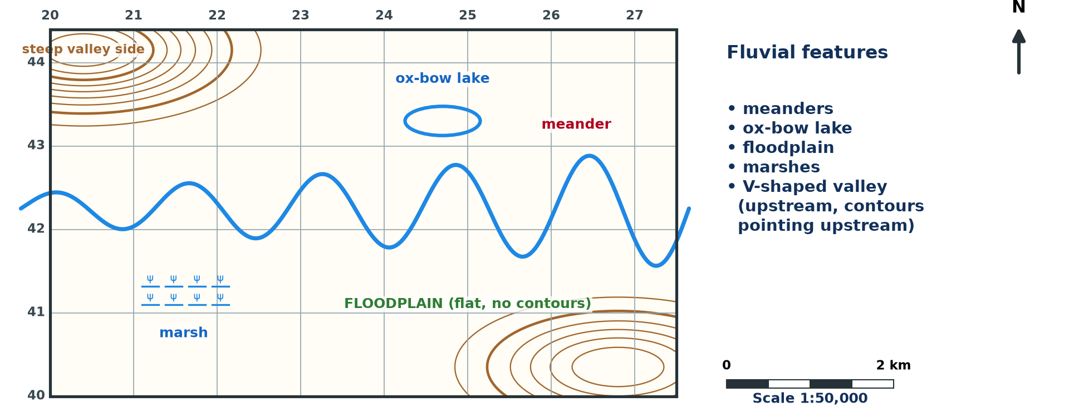
1. DRAINAGE FEATURES
Activity 1
River features on a map (invented).
Notes:
Activity 1. Look carefully at this diagram: river features on a map (invented). Observe every detail before I ask the question.

Slide 19
1. DRAINAGE FEATURES
Activity 1: Question
Name three drainage features on a map.
Notes:
Here is the question for Activity 1: Name three drainage features on a map. Take one minute to think and write your answer in your rough notebook.

Slide 20
1. DRAINAGE FEATURES
Activity 1: Answer
Rivers, lakes and swamps (also waterfalls, confluences).
Notes:
Let us check the answer together. Rivers, lakes and swamps (also waterfalls, confluences).

Slide 21

2. DIRECTION OF FLOW
Activity 2
A river crossing contours.
Notes:
Activity 2. Look carefully at this diagram: a river crossing contours. Observe every detail before I ask the question.

Slide 22
2. DIRECTION OF FLOW
Activity 2: Question
How do we find the direction of flow of a river?
Notes:
Here is the question for Activity 2: How do we find the direction of flow of a river? Take one minute to think and write your answer in your rough notebook.

Slide 23
2. DIRECTION OF FLOW
Activity 2: Answer
The river flows from higher to lower contours; tributaries join in the direction of flow.
Notes:
Let us check the answer together. The river flows from higher to lower contours; tributaries join in the direction of flow.

Slide 24
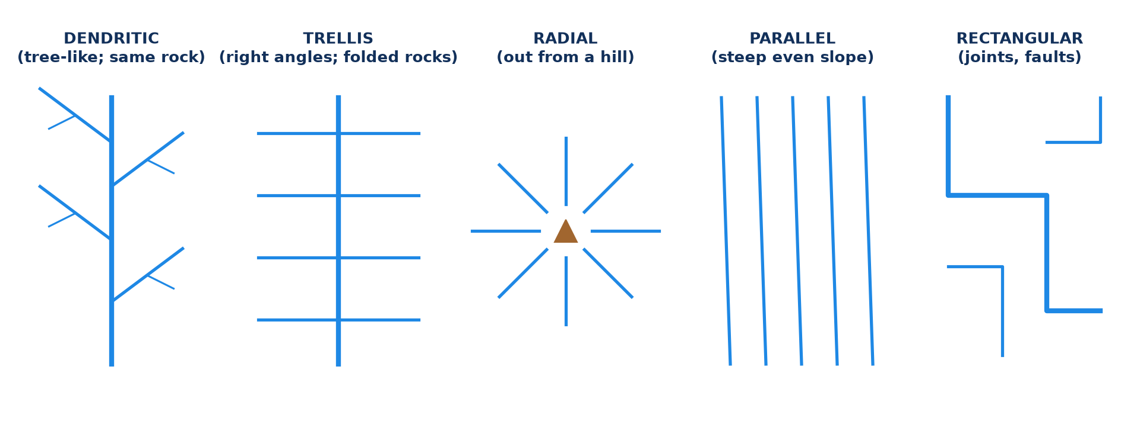
3. DRAINAGE PATTERNS
Activity 3
Drainage patterns.
Notes:
Activity 3. Look carefully at this diagram: drainage patterns. Observe every detail before I ask the question.

Slide 25
3. DRAINAGE PATTERNS
Activity 3: Question
Name three drainage patterns.
Notes:
Here is the question for Activity 3: Name three drainage patterns. Take one minute to think and write your answer in your rough notebook.

Slide 26
3. DRAINAGE PATTERNS
Activity 3: Answer
Dendritic, radial and trellis (also parallel).
Notes:
Let us check the answer together. Dendritic, radial and trellis (also parallel).

Slide 27
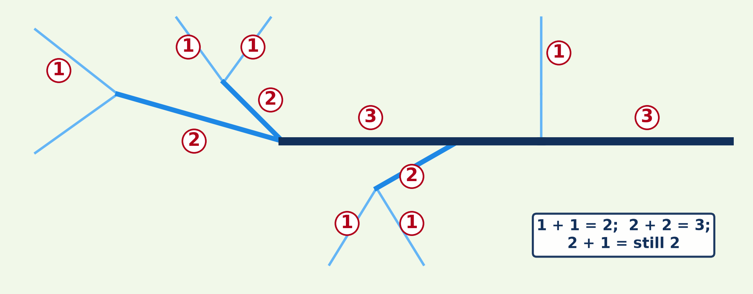
3. DRAINAGE DENSITY
Activity 4
Stream ordering.
Notes:
Activity 4. Look carefully at this diagram: stream ordering. Observe every detail before I ask the question.

Slide 28
3. DRAINAGE DENSITY
Activity 4: Question
What does high drainage density show?
Notes:
Here is the question for Activity 4: What does high drainage density show? Take one minute to think and write your answer in your rough notebook.

Slide 29
3. DRAINAGE DENSITY
Activity 4: Answer
Many rivers per km², often on impermeable rocks or steep slopes.
Notes:
Let us check the answer together. Many rivers per km², often on impermeable rocks or steep slopes.

Slide 30
4. DESCRIPTION
Activity 5
A river on a map.
Notes:
Activity 5. Look carefully at this diagram: a river on a map. Observe every detail before I ask the question.

Slide 31
4. DESCRIPTION
Activity 5: Question
Describe the main river of this extract.
Notes:
Here is the question for Activity 5: Describe the main river of this extract. Take one minute to think and write your answer in your rough notebook.

Slide 32
4. DESCRIPTION
Activity 5: Answer
It flows across the map with meanders, an ox-bow lake and swamps on its floodplain.
Notes:
Let us check the answer together. It flows across the map with meanders, an ox-bow lake and swamps on its floodplain.

Slide 33
BOARD SUMMARY
Board Summary
Topic: Initiation to Map Analysis
Sub-topic: Map Interpretation
Practical Work 9: Description of Drainage on Maps
Notes:
Now we are going to copy the board summary. Write the title and the headings neatly in your notebooks. I will give you enough time for each slide, so do not rush.

Slide 34
BOARD SUMMARY
DEFINITIONS
The key terms of this lesson are defined as follows:
Drainage: It is all the rivers, lakes and swamps of an area.
Drainage pattern: It is the shape formed by a river and its tributaries.
Notes:
Let us copy the definitions. The key terms of this lesson are defined as follows. On this slide we have Drainage and Drainage pattern. Write each point on a new line, with the key term first, and explain it in your own words when we revise.

Slide 35
BOARD SUMMARY
1. Describing Drainage
Drainage is described with the following elements:
Features: We name the main river, its tributaries, lakes, swamps and waterfalls.
Direction of flow: Rivers flow from higher to lower contours.
Notes:
Let us copy Describing Drainage. Drainage is described with the following elements. On this slide we have Features and Direction of flow. Write each point on a new line, with the key term first, and explain it in your own words when we revise. When you finish, we go to the next slide.

Slide 36
BOARD SUMMARY
1. Describing Drainage (continued)
Density: We say whether there are many or few rivers in the area.
Notes:
We continue with Describing Drainage. On this slide we have Density. Write each point on a new line, with the key term first, and explain it in your own words when we revise.

Slide 37
BOARD SUMMARY
2. Drainage Patterns
Rivers form the following patterns:
Dendritic: It looks like the branches of a tree on uniform rock.
Radial: Rivers flow outwards from a central hill or volcano.
Notes:
Let us copy Drainage Patterns. Rivers form the following patterns. On this slide we have Dendritic and Radial. Write each point on a new line, with the key term first, and explain it in your own words when we revise. When you finish, we go to the next slide.

Slide 38
BOARD SUMMARY
2. Drainage Patterns (continued)
Trellis: Tributaries join the main river at right angles.
Notes:
We continue with Drainage Patterns. On this slide we have Trellis. Write each point on a new line, with the key term first, and explain it in your own words when we revise.

Slide 39
BOARD SUMMARY
2. Drainage Patterns
Illustration: drainage patterns
Notes:
Now draw this illustration in your notebook: drainage patterns. Give it a title and label it clearly.

Slide 40
FORMATIVE EVALUATION
Evaluation 1
How do we find the direction of flow of a river?
Notes:
Now let us check what you have understood. Question 1: How do we find the direction of flow of a river? Answer in your exercise book.

Slide 41
FORMATIVE EVALUATION
Expected Answer
It flows from higher to lower contours.
Notes:
The expected answer is: it flows from higher to lower contours. If you got it right, well done.

Slide 42
FORMATIVE EVALUATION
Evaluation 2
Name three drainage patterns.
Notes:
Now let us check what you have understood. Question 2: Name three drainage patterns. Answer in your exercise book.

Slide 43
FORMATIVE EVALUATION
Expected Answer
Dendritic, radial and trellis.
Notes:
The expected answer is: dendritic, radial and trellis. If you got it right, well done.

Slide 44
REMEDIATION
Remediation
Fill in the blanks:
A river joining a bigger one is a ______.
A tree-like pattern is ______.
Rivers flowing out from a volcano form a ______ pattern.
Notes:
For those who need more practice, fill in the blanks in your exercise book. The answers are: number 1, tributary; number 2, dendritic; number 3, radial.

Slide 45
HOMEWORK
Homework
Describe the drainage of a map extract in five sentences.
Notes:
For your homework: Describe the drainage of a map extract in five sentences. We shall correct it at the beginning of our next lesson.

Slide 46
NEXT LESSON
Next Lesson
Our next lesson will be on:
Lesson 18: The Notion of Development
Notes:
Our next lesson will be on Lesson 18: The Notion of Development. Thank you for your attention, and see you next time.

Slide 47
BILINGUAL GAME
Bilingual Game (Jeu Bilingue)
English | Français
Drainage | L'hydrographie
Tributary | L'affluent
Confluence | La confluence
Pattern | Le réseau
Swamp | Le marécage
Flow | L'écoulement
Notes:
Let us play the bilingual game. I say a word in English, and you give me the French word. Then we do the reverse.

Slide 48
LOGBOOK
Official Logbook (1/2)
Module / Topic | Initiation to Map Analysis
Lesson Title | Practical Work 9: Description of Drainage on Maps
Expected Learning Outcomes | Identify drainage features on a map. Find the direction of flow of rivers. Describe drainage patterns and density.
Competence | Learners are able to describe the drainage of a map extract.
Notes:
I record this information in the official logbook of the class after the lesson.

Slide 49
LOGBOOK
Official Logbook (2/2)
Matter Taught | DEFINITIONS; Describing Drainage; Drainage Patterns.
Evaluation | Formative evaluation and remediation exercise.
Homework | Describe the drainage of a map extract in five sentences.
Enrolment / Present / Absent | ____ / ____ / ____
Achievement | To be completed after the lesson.
Notes:
I complete the second page of the logbook: the matter taught, the evaluation, the homework and the attendance.

Slide 50
TEACHER'S NOTE
Teacher's Note
Timing: Homework correction, plan, objectives 8 min | Recall, situation, action 10 min | 5 activities 30 min | Board summary (copying) 30 min | Evaluation, remediation 10 min | Homework, next lesson 5 min | Logbook 7 min
Without the projector (Activity 1): use a map.
Without the projector (Activity 2): practise on a map.
Without the projector (Activity 3): draw the patterns.
Without the projector (Activity 4): compare two areas.
Without the projector (Activity 5): describe orally.
Notes:
This slide is for me, the teacher: it gives the timing of the lesson and what to do if the projector is not available.

Slide 51
REFERENCES
References
Geography Syllabus, Forms I–V, MINESEC (2023) — Form 4, Module I: Ecological Systems and their Resources.
Diagrams and animations: drawn for this lesson (Geography Department).
Notes:
These are the references and picture credits used to prepare this lesson.

