Slide 1
FORM 4
GEOGRAPHY
Lesson 20
Classification of Countries in Terms of Development Levels
Notes:
Good morning, class, and welcome to our geography lesson. I am your geography teacher, Mr Kamdem. Today we are starting Lesson 20: Classification of Countries in Terms of Development Levels.

Slide 2
CLASS INFO
Class, Chapter and Duration
Class | Form 4
Chapter | Module II: Development and the Management of Primary Resources
Duration | 2 periods (2 × 50 minutes)
Notes:
This lesson is for Form 4. It belongs to Module II: Development and the Management of Primary Resources. We shall need 2 periods to cover it.

Slide 3
IDENTIFICATION
Lesson Identification
Topic | The Process of Development
Sub-topic | Challenges of Development and Fight against Underdevelopment
Lesson | Lesson 20: Classification of Countries in Terms of Development Levels
Notions / Concepts | Least Industrialised Countries (LICs), Newly Industrialised Countries (NICs), Advanced Industrialised Countries (AICs), industrialisation.
Syllabus focus | Least Industrialised Countries; Newly Industrialised Countries; Advanced Industrialised Countries.
Competence | Learners are able to classify countries by level of development.
Notes:
Our topic is The Process of Development, and the sub-topic is Challenges of Development and Fight against Underdevelopment. The key notions we shall use today are: least Industrialised Countries (LICs), Newly Industrialised Countries (NICs), Advanced Industrialised Countries (AICs), industrialisation. At the end, you should be able to do this: learners are able to classify countries by level of development.

Slide 4

HOMEWORK CORRECTION
Correction of the Homework
Question (Lesson 19: Indicators of Development):
Compare Cameroon and one developed country using two indicators.
Notes:
Before we start the new lesson, let us correct the homework I gave you at the end of Lesson 19: Indicators of Development. The question was: Compare Cameroon and one developed country using two indicators. Take out your exercise books.

Slide 5
HOMEWORK CORRECTION
Correction: Possible Answer
Example: life expectancy about 61 years in Cameroon vs 83 in France; per capita income about 1,600 US$ vs about 40,000 US$.
Notes:
Here is a good answer. Example: life expectancy about 61 years in Cameroon vs 83 in France; per capita income about 1,600 US$ vs about 40,000 US$. Compare it with your own answer and correct your work in red.

Slide 6
LESSON PLAN
Lesson Plan
Correction of the homework
Objectives and recall
Real-life situation and action to take
Learning activities
Board summary
Evaluation, remediation and homework
Notes:
Here is the plan of our lesson today. First, we shall correct the homework. Then we shall look at the objectives and recall what you already know. After that, we shall study a situation from real life and the action to take, and do the learning activities. Finally, we shall copy the board summary, do the evaluation and the remediation, and I will give you the homework.

Slide 7
OBJECTIVES
Objectives
By the end of this lesson, you should be able to:
Define LICs, NICs and AICs.
Give examples of each group.
Give the characteristics of each group.
Notes:
By the end of this lesson, you should be able to do three things. Number 1: define LICs, NICs and AICs. Number 2: give examples of each group. Number 3: give the characteristics of each group.

Slide 8
PREVIOUS KNOWLEDGE
Previous Knowledge
Indicators measure development.
Some countries have many factories.
Cameroon exports raw materials.
Notes:
Let us first remember what you already know. Indicators measure development. Some countries have many factories. Cameroon exports raw materials. Keep this in mind, because we shall build on it today.

Slide 9
REAL-LIFE SITUATION
Situation in Real Life
In the market, Aminatou sees phones made in China, cars made in Japan and cocoa from Cameroon. She wonders why some countries make machines and others sell raw materials.
Notes:
Listen carefully to this situation from real life. In the market, Aminatou sees phones made in China, cars made in Japan and cocoa from Cameroon. She wonders why some countries make machines and others sell raw materials. Think about it, because I am going to ask you some questions.

Slide 10
REAL-LIFE SITUATION
Situation: Question 1
What is the problem in the situation?
Notes:
Question 1: What is the problem in the situation? Think for a moment, then raise your hand to answer.

Slide 11
REAL-LIFE SITUATION
Answer
Countries have different levels of industrialisation.
Notes:
Good. Countries have different levels of industrialisation.

Slide 12
REAL-LIFE SITUATION
Situation: Question 2
Which country sells raw materials?
Notes:
Question 2: Which country sells raw materials? Think for a moment, then raise your hand to answer.

Slide 13
REAL-LIFE SITUATION
Answer
Cameroon.
Notes:
Good. Cameroon.

Slide 14
REAL-LIFE SITUATION
Situation: Question 3
Which countries make machines?
Notes:
Question 3: Which countries make machines? Think for a moment, then raise your hand to answer.

Slide 15
REAL-LIFE SITUATION
Possible Answer
China and Japan.
Notes:
Good. China and Japan.

Slide 16
ACTION TO TAKE
Action to Take
Support local processing of raw materials.
Notes:
From this situation, the action we are working towards in this lesson is the following: support local processing of raw materials.

Slide 17
JUSTIFICATION
Justification of the Lesson
This lesson helps us to classify countries and understand where Cameroon stands.
Notes:
Why is this lesson important for you? This lesson helps us to classify countries and understand where Cameroon stands.

Slide 18
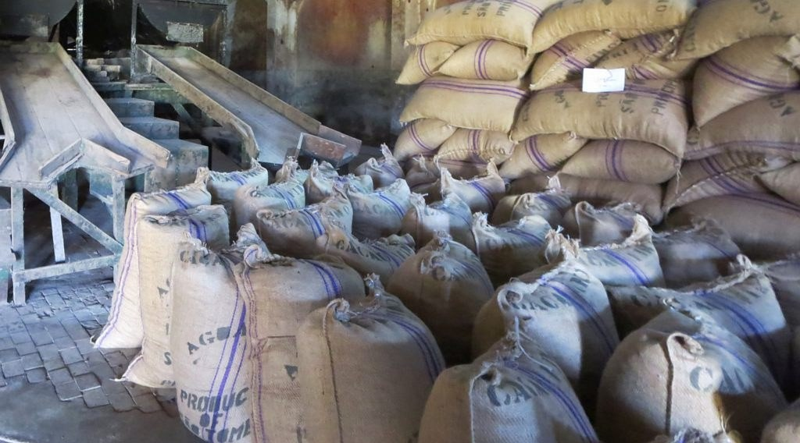
1. LICs
Activity 1
Sacks of cocoa for export.
Notes:
Activity 1. Look carefully at this picture: sacks of cocoa for export. Observe every detail before I ask the question.

Slide 19
1. LICs
Activity 1: Question
What are Least Industrialised Countries? Give two examples.
Notes:
Here is the question for Activity 1: What are Least Industrialised Countries? Give two examples. Take one minute to think and write your answer in your rough notebook.

Slide 20
1. LICs
Activity 1: Answer
Poor countries that mainly export raw materials, such as Chad and Niger (Cameroon is close to this group).
Notes:
Let us check the answer together. Poor countries that mainly export raw materials, such as Chad and Niger (Cameroon is close to this group).

Slide 21

2. NICs
Activity 2
Singapore.
Notes:
Activity 2. Look carefully at this picture: singapore. Observe every detail before I ask the question.

Slide 22
2. NICs
Activity 2: Question
What are Newly Industrialised Countries? Give two examples.
Notes:
Here is the question for Activity 2: What are Newly Industrialised Countries? Give two examples. Take one minute to think and write your answer in your rough notebook.

Slide 23
2. NICs
Activity 2: Answer
Countries that industrialised quickly since the 1960s, such as South Korea and Singapore (also China, Brazil).
Notes:
Let us check the answer together. Countries that industrialised quickly since the 1960s, such as South Korea and Singapore (also China, Brazil).

Slide 24
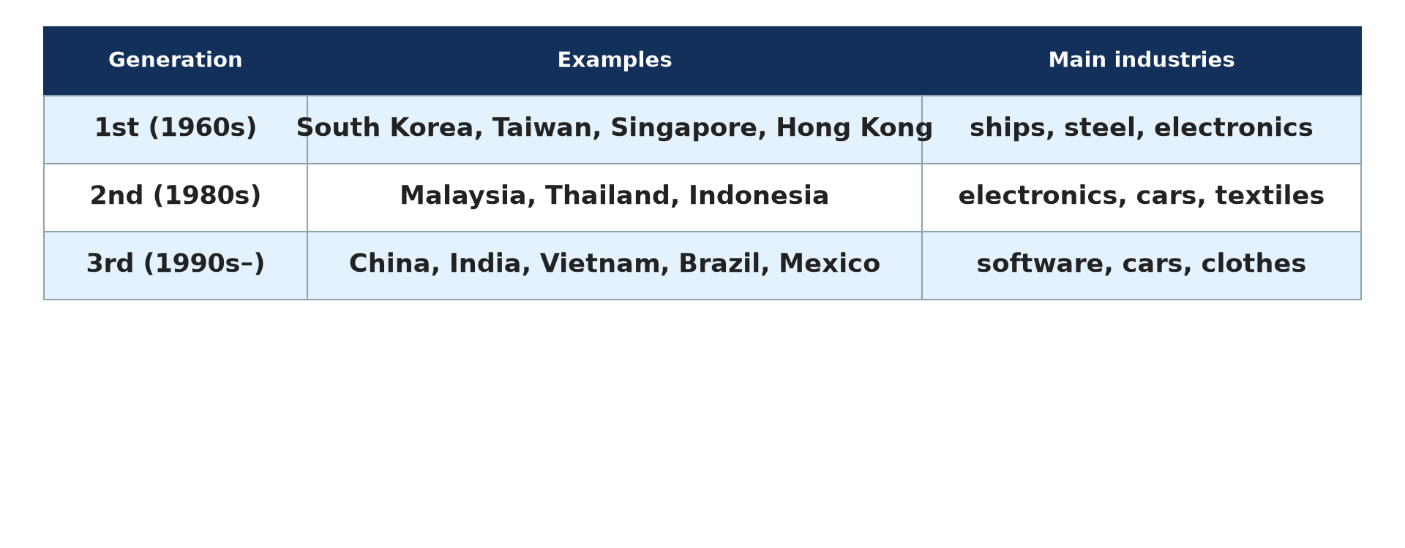
2. NICs
Activity 3
Generations of NICs.
Notes:
Activity 3. Look carefully at this diagram: generations of NICs. Observe every detail before I ask the question.

Slide 25
2. NICs
Activity 3: Question
Name the four Asian tigers.
Notes:
Here is the question for Activity 3: Name the four Asian tigers. Take one minute to think and write your answer in your rough notebook.

Slide 26
2. NICs
Activity 3: Answer
South Korea, Taiwan, Singapore and Hong Kong.
Notes:
Let us check the answer together. South Korea, Taiwan, Singapore and Hong Kong.

Slide 27

3. AICs
Activity 4
A car factory.
Notes:
Activity 4. Look carefully at this picture: a car factory. Observe every detail before I ask the question.

Slide 28
3. AICs
Activity 4: Question
What are Advanced Industrialised Countries? Give two examples.
Notes:
Here is the question for Activity 4: What are Advanced Industrialised Countries? Give two examples. Take one minute to think and write your answer in your rough notebook.

Slide 29
3. AICs
Activity 4: Answer
Rich countries with many industries and services, such as the USA and Germany (also Japan, France).
Notes:
Let us check the answer together. Rich countries with many industries and services, such as the USA and Germany (also Japan, France).

Slide 30

3. COMPARISON
Activity 5
Industrial regions of the world.
Notes:
Activity 5. Look carefully at this diagram: industrial regions of the world. Observe every detail before I ask the question.

Slide 31
3. COMPARISON
Activity 5: Question
Where are most AICs and NICs located?
Notes:
Here is the question for Activity 5: Where are most AICs and NICs located? Take one minute to think and write your answer in your rough notebook.

Slide 32
3. COMPARISON
Activity 5: Answer
AICs in North America, Europe and Japan; NICs mainly in East Asia and Latin America.
Notes:
Let us check the answer together. AICs in North America, Europe and Japan; NICs mainly in East Asia and Latin America.

Slide 33
BOARD SUMMARY
Board Summary
Topic: The Process of Development
Sub-topic: Challenges of Development and Fight against Underdevelopment
Lesson 20: Classification of Countries in Terms of Development Levels
Notes:
Now we are going to copy the board summary. Write the title and the headings neatly in your notebooks. I will give you enough time for each slide, so do not rush.

Slide 34
BOARD SUMMARY
DEFINITIONS
The key terms of this lesson are defined as follows:
Industrialisation: It is the growth of industries in a country.
Notes:
Let us copy the definitions. The key terms of this lesson are defined as follows. On this slide we have Industrialisation. Write each point on a new line, with the key term first, and explain it in your own words when we revise.

Slide 35
BOARD SUMMARY
1. Classification of Countries
Countries are classified into the following groups:
Least Industrialised Countries: They are poor, depend on farming and export raw materials, such as Chad and Niger.
Notes:
Let us copy Classification of Countries. Countries are classified into the following groups. On this slide we have Least Industrialised Countries. Write each point on a new line, with the key term first, and explain it in your own words when we revise. When you finish, we go to the next slide.

Slide 36
BOARD SUMMARY
1. Classification of Countries (continued)
Newly Industrialised Countries: They industrialised quickly since the 1960s, such as South Korea, Singapore, China and Brazil.
Advanced Industrialised Countries: They are rich and have many industries and services, such as the USA, Germany and Japan.
Notes:
We continue with Classification of Countries. On this slide we have Newly Industrialised Countries and Advanced Industrialised Countries. Write each point on a new line, with the key term first, and explain it in your own words when we revise.

Slide 37
BOARD SUMMARY
1. Classification of Countries
Illustration: industrial regions of the world
Notes:
Now draw this illustration in your notebook: industrial regions of the world. Give it a title and label it clearly.

Slide 38
BOARD SUMMARY
2. Characteristics
The groups have the following characteristics:
LICs: They have high birth rates, low incomes and poor services.
NICs: They have fast-growing industries and exports of manufactured goods.
Notes:
Let us copy Characteristics. The groups have the following characteristics. On this slide we have LICs and NICs. Write each point on a new line, with the key term first, and explain it in your own words when we revise. When you finish, we go to the next slide.

Slide 39
BOARD SUMMARY
2. Characteristics (continued)
AICs: They have high incomes, long life expectancy and advanced technology.
Notes:
We continue with Characteristics. On this slide we have AICs. Write each point on a new line, with the key term first, and explain it in your own words when we revise.

Slide 40
FORMATIVE EVALUATION
Evaluation 1
Give one example of an LIC, an NIC and an AIC.
Notes:
Now let us check what you have understood. Question 1: Give one example of an LIC, an NIC and an AIC. Answer in your exercise book.

Slide 41
FORMATIVE EVALUATION
Expected Answer
Chad, South Korea and the USA.
Notes:
The expected answer is: chad, South Korea and the USA. If you got it right, well done.

Slide 42
FORMATIVE EVALUATION
Evaluation 2
Give one characteristic of NICs.
Notes:
Now let us check what you have understood. Question 2: Give one characteristic of NICs. Answer in your exercise book.

Slide 43
FORMATIVE EVALUATION
Expected Answer
Rapid growth of industries and exports.
Notes:
The expected answer is: rapid growth of industries and exports. If you got it right, well done.

Slide 44
REMEDIATION
Remediation
Fill in the blanks:
South Korea is a ______.
Countries that export raw materials are mostly ______.
Japan is an ______.
Notes:
For those who need more practice, fill in the blanks in your exercise book. The answers are: number 1, NIC; number 2, LICs; number 3, AIC.

Slide 45
HOMEWORK
Homework
Find the country of origin of five manufactured goods at home and classify the countries.
Notes:
For your homework: Find the country of origin of five manufactured goods at home and classify the countries. We shall correct it at the beginning of our next lesson.

Slide 46
NEXT LESSON
Next Lesson
Our next lesson will be on:
Lesson 21: Rostow's Model of Economic Growth
Notes:
Our next lesson will be on Lesson 21: Rostow's Model of Economic Growth. Thank you for your attention, and see you next time.

Slide 47
BILINGUAL GAME
Bilingual Game (Jeu Bilingue)
English | Français
Industry | L'industrie
Raw material | La matière première
Export | L'exportation
Rich | Riche
Poor | Pauvre
Factory | L'usine
Notes:
Let us play the bilingual game. I say a word in English, and you give me the French word. Then we do the reverse.

Slide 48
LOGBOOK
Official Logbook (1/2)
Module / Topic | The Process of Development
Lesson Title | Lesson 20: Classification of Countries in Terms of Development Levels
Expected Learning Outcomes | Define LICs, NICs and AICs. Give examples of each group. Give the characteristics of each group.
Competence | Learners are able to classify countries by level of development.
Notes:
I record this information in the official logbook of the class after the lesson.

Slide 49
LOGBOOK
Official Logbook (2/2)
Matter Taught | DEFINITIONS; Classification of Countries; Characteristics.
Evaluation | Formative evaluation and remediation exercise.
Homework | Find the country of origin of five manufactured goods at home and classify the countries.
Enrolment / Present / Absent | ____ / ____ / ____
Achievement | To be completed after the lesson.
Notes:
I complete the second page of the logbook: the matter taught, the evaluation, the homework and the attendance.

Slide 50
TEACHER'S NOTE
Teacher's Note
Timing: Homework correction, plan, objectives 8 min | Recall, situation, action 10 min | 5 activities 30 min | Board summary (copying) 30 min | Evaluation, remediation 10 min | Homework, next lesson 5 min | Logbook 7 min
Without the projector (Activity 1): list exports of Cameroon.
Without the projector (Activity 2): list goods from Asia.
Without the projector (Activity 3): use the atlas.
Without the projector (Activity 4): list rich countries.
Without the projector (Activity 5): use the map.
Notes:
This slide is for me, the teacher: it gives the timing of the lesson and what to do if the projector is not available.

Slide 51
REFERENCES
References
Geography Syllabus, Forms I–V, MINESEC (2023) — Form 4, Module II: Development and the Management of Primary Resources.
Photo, Activity 1: “Sacks of Cocoa Beans” by D-Stanley, CC BY 2.0, via Flickr (https://www.flickr.com/photos/79721788@N00/20795057229)
Photo, Activity 2: “Singapore” by Christopher Chan, CC BY-NC-ND 2.0, via Flickr (https://www.flickr.com/photos/17751217@N00/8909326546)
Photo, Activity 4: “rover 200 framing line” by spencer_cooper, CC BY-ND 2.0, via Flickr (https://www.flickr.com/photos/80889122@N06/7481166880)
Diagrams and animations: drawn for this lesson (Geography Department).
Notes:
These are the references and picture credits used to prepare this lesson.

