Slide 1
FORM 4
GEOGRAPHY
Lesson 22
Challenges of Development
Notes:
Good morning, class, and welcome to our geography lesson. I am your geography teacher, Mr Kamdem. Today we are starting Lesson 22: Challenges of Development.

Slide 2
CLASS INFO
Class, Chapter and Duration
Class | Form 4
Chapter | Module II: Development and the Management of Primary Resources
Duration | 2 periods (2 × 50 minutes)
Notes:
This lesson is for Form 4. It belongs to Module II: Development and the Management of Primary Resources. We shall need 2 periods to cover it.

Slide 3
IDENTIFICATION
Lesson Identification
Topic | The Process of Development
Sub-topic | Challenges of Development and Fight against Underdevelopment
Lesson | Lesson 22: Challenges of Development
Notions / Concepts | Poverty, poverty cycle, underdevelopment.
Syllabus focus | Definition of poverty and the poverty cycle; causes of poverty and underdevelopment; solutions.
Competence | Learners are able to explain the poverty cycle and propose solutions to underdevelopment.
Notes:
Our topic is The Process of Development, and the sub-topic is Challenges of Development and Fight against Underdevelopment. The key notions we shall use today are: poverty, poverty cycle, underdevelopment. At the end, you should be able to do this: learners are able to explain the poverty cycle and propose solutions to underdevelopment.

Slide 4

HOMEWORK CORRECTION
Correction of the Homework
Question (Lesson 21: Rostow's Model of Economic Growth):
At which stage of Rostow's model is Cameroon? Give two reasons.
Notes:
Before we start the new lesson, let us correct the homework I gave you at the end of Lesson 21: Rostow's Model of Economic Growth. The question was: At which stage of Rostow's model is Cameroon? Give two reasons. Take out your exercise books.

Slide 5
HOMEWORK CORRECTION
Correction: Possible Answer
At the preconditions for take-off: roads, schools and commercial farming are developing, but industries are still few and exports are mainly raw materials.
Notes:
Here is a good answer. At the preconditions for take-off: roads, schools and commercial farming are developing, but industries are still few and exports are mainly raw materials. Compare it with your own answer and correct your work in red.

Slide 6
LESSON PLAN
Lesson Plan
Correction of the homework
Objectives and recall
Real-life situation and action to take
Learning activities
Board summary
Evaluation, remediation and homework
Notes:
Here is the plan of our lesson today. First, we shall correct the homework. Then we shall look at the objectives and recall what you already know. After that, we shall study a situation from real life and the action to take, and do the learning activities. Finally, we shall copy the board summary, do the evaluation and the remediation, and I will give you the homework.

Slide 7
OBJECTIVES
Objectives
By the end of this lesson, you should be able to:
Define poverty and the poverty cycle.
Explain the causes of poverty and underdevelopment.
Propose solutions.
Notes:
By the end of this lesson, you should be able to do three things. Number 1: define poverty and the poverty cycle. Number 2: explain the causes of poverty and underdevelopment. Number 3: propose solutions.

Slide 8
PREVIOUS KNOWLEDGE
Previous Knowledge
Many people in Africa are poor.
Education helps people get jobs.
Corruption slows development.
Notes:
Let us first remember what you already know. Many people in Africa are poor. Education helps people get jobs. Corruption slows development. Keep this in mind, because we shall build on it today.

Slide 9
REAL-LIFE SITUATION
Situation in Real Life
A poor farmer earns little, so he cannot buy fertiliser or send his children to school. His harvests stay low, his children cannot find good jobs, and the family stays poor.
Notes:
Listen carefully to this situation from real life. A poor farmer earns little, so he cannot buy fertiliser or send his children to school. His harvests stay low, his children cannot find good jobs, and the family stays poor. Think about it, because I am going to ask you some questions.

Slide 10
REAL-LIFE SITUATION
Situation: Question 1
What is the problem in the situation?
Notes:
Question 1: What is the problem in the situation? Think for a moment, then raise your hand to answer.

Slide 11
REAL-LIFE SITUATION
Answer
The family is trapped in poverty.
Notes:
Good. The family is trapped in poverty.

Slide 12
REAL-LIFE SITUATION
Situation: Question 2
Why do harvests stay low?
Notes:
Question 2: Why do harvests stay low? Think for a moment, then raise your hand to answer.

Slide 13
REAL-LIFE SITUATION
Answer
He cannot buy fertiliser.
Notes:
Good. He cannot buy fertiliser.

Slide 14
REAL-LIFE SITUATION
Situation: Question 3
What is this repeated situation called?
Notes:
Question 3: What is this repeated situation called? Think for a moment, then raise your hand to answer.

Slide 15
REAL-LIFE SITUATION
Possible Answer
The poverty cycle.
Notes:
Good. The poverty cycle.

Slide 16
ACTION TO TAKE
Action to Take
Value education and hard work to break the poverty cycle.
Notes:
From this situation, the action we are working towards in this lesson is the following: value education and hard work to break the poverty cycle.

Slide 17
JUSTIFICATION
Justification of the Lesson
This lesson helps us to understand poverty and how to break it.
Notes:
Why is this lesson important for you? This lesson helps us to understand poverty and how to break it.

Slide 18

1. MEANING
Activity 1
A poor neighbourhood.
Notes:
Activity 1. Look carefully at this picture: a poor neighbourhood. Observe every detail before I ask the question.

Slide 19
1. MEANING
Activity 1: Question
What is poverty?
Notes:
Here is the question for Activity 1: What is poverty? Take one minute to think and write your answer in your rough notebook.

Slide 20
1. MEANING
Activity 1: Answer
A situation where people cannot meet their basic needs: food, housing, health and education.
Notes:
Let us check the answer together. A situation where people cannot meet their basic needs: food, housing, health and education.

Slide 21
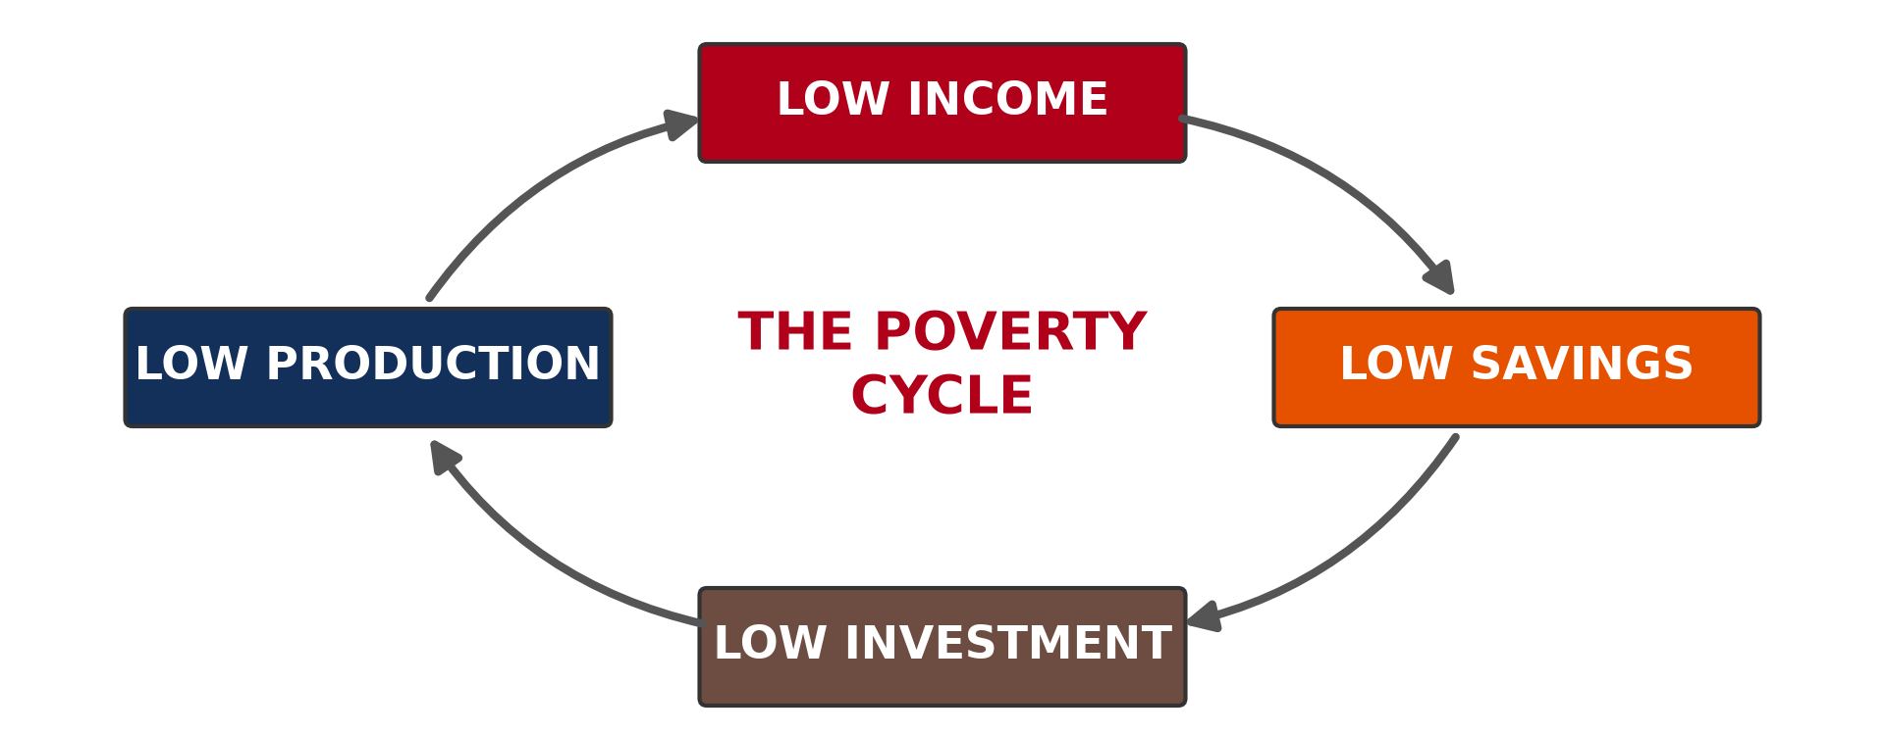
1. THE POVERTY CYCLE
Activity 2
The poverty cycle.
Notes:
Activity 2. Look carefully at this diagram: the poverty cycle. Observe every detail before I ask the question.

Slide 22
1. THE POVERTY CYCLE
Activity 2: Question
Describe the poverty cycle.
Notes:
Here is the question for Activity 2: Describe the poverty cycle. Take one minute to think and write your answer in your rough notebook.

Slide 23
1. THE POVERTY CYCLE
Activity 2: Answer
Low income → low savings → low investment → low production → low income again.
Notes:
Let us check the answer together. Low income → low savings → low investment → low production → low income again.

Slide 24
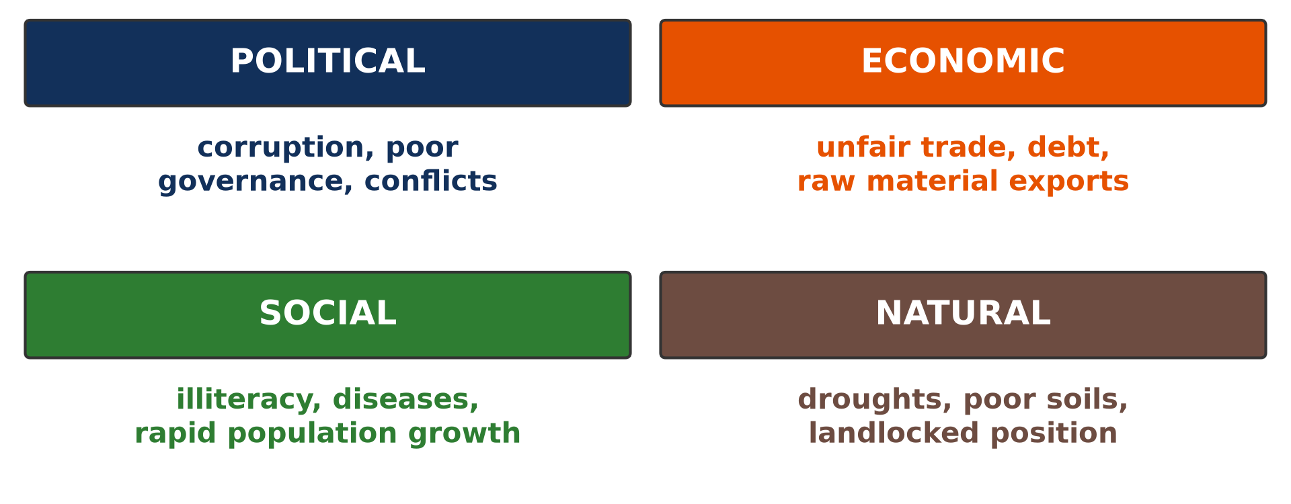
2. CAUSES
Activity 3
Causes of underdevelopment.
Notes:
Activity 3. Look carefully at this diagram: causes of underdevelopment. Observe every detail before I ask the question.

Slide 25
2. CAUSES
Activity 3: Question
Give three causes of underdevelopment.
Notes:
Here is the question for Activity 3: Give three causes of underdevelopment. Take one minute to think and write your answer in your rough notebook.

Slide 26
2. CAUSES
Activity 3: Answer
Poor governance and corruption, rapid population growth and conflicts (also unfair trade, debt).
Notes:
Let us check the answer together. Poor governance and corruption, rapid population growth and conflicts (also unfair trade, debt).

Slide 27

3. SOLUTIONS
Activity 4
Education.
Notes:
Activity 4. Look carefully at this picture: education. Observe every detail before I ask the question.

Slide 28
3. SOLUTIONS
Activity 4: Question
Give two solutions to poverty.
Notes:
Here is the question for Activity 4: Give two solutions to poverty. Take one minute to think and write your answer in your rough notebook.

Slide 29
3. SOLUTIONS
Activity 4: Answer
Education and job creation (also good governance, health care).
Notes:
Let us check the answer together. Education and job creation (also good governance, health care).

Slide 30

3. SOLUTIONS
Activity 5
Mobile money.
Notes:
Activity 5. Look carefully at this picture: mobile money. Observe every detail before I ask the question.

Slide 31
3. SOLUTIONS
Activity 5: Question
How can small loans and savings help the poor?
Notes:
Here is the question for Activity 5: How can small loans and savings help the poor? Take one minute to think and write your answer in your rough notebook.

Slide 32
3. SOLUTIONS
Activity 5: Answer
They allow poor people to start small businesses and earn income.
Notes:
Let us check the answer together. They allow poor people to start small businesses and earn income.

Slide 33
BOARD SUMMARY
Board Summary
Topic: The Process of Development
Sub-topic: Challenges of Development and Fight against Underdevelopment
Lesson 22: Challenges of Development
Notes:
Now we are going to copy the board summary. Write the title and the headings neatly in your notebooks. I will give you enough time for each slide, so do not rush.

Slide 34
BOARD SUMMARY
DEFINITIONS
The key terms of this lesson are defined as follows:
Poverty: It is a situation where people cannot meet their basic needs.
Poverty cycle: It is a chain in which low income leads to low savings, low investment and again low income.
Notes:
Let us copy the definitions. The key terms of this lesson are defined as follows. On this slide we have Poverty and Poverty cycle. Write each point on a new line, with the key term first, and explain it in your own words when we revise.

Slide 35
BOARD SUMMARY
1. Causes of Poverty and Underdevelopment
Poverty and underdevelopment have the following causes:
Political causes: Poor governance, corruption and conflicts slow development.
Economic causes: Unfair trade, debt and dependence on raw materials keep countries poor.
Notes:
Let us copy Causes of Poverty and Underdevelopment. Poverty and underdevelopment have the following causes. On this slide we have Political causes and Economic causes. Write each point on a new line, with the key term first, and explain it in your own words when we revise. When you finish, we go to the next slide.

Slide 36
BOARD SUMMARY
1. Causes of Poverty and Underdevelopment (continued)
Social causes: Illiteracy, diseases and rapid population growth reduce progress.
Notes:
We continue with Causes of Poverty and Underdevelopment. On this slide we have Social causes. Write each point on a new line, with the key term first, and explain it in your own words when we revise.

Slide 37
BOARD SUMMARY
2. Solutions to Poverty and Underdevelopment
Poverty can be reduced by the following solutions:
Education and health: Schools and hospitals give people skills and strength to work.
Jobs and investment: Industries, farming and small loans create income.
Notes:
Let us copy Solutions to Poverty and Underdevelopment. Poverty can be reduced by the following solutions. On this slide we have Education and health and Jobs and investment. Write each point on a new line, with the key term first, and explain it in your own words when we revise. When you finish, we go to the next slide.

Slide 38
BOARD SUMMARY
2. Solutions to Poverty and Underdevelopment (continued)
Good governance: Fighting corruption and keeping peace help development.
Notes:
We continue with Solutions to Poverty and Underdevelopment. On this slide we have Good governance. Write each point on a new line, with the key term first, and explain it in your own words when we revise.

Slide 39
FORMATIVE EVALUATION
Evaluation 1
What is the poverty cycle?
Notes:
Now let us check what you have understood. Question 1: What is the poverty cycle? Answer in your exercise book.

Slide 40
FORMATIVE EVALUATION
Expected Answer
Low income → low savings → low investment → low income.
Notes:
The expected answer is: low income → low savings → low investment → low income. If you got it right, well done.

Slide 41
FORMATIVE EVALUATION
Evaluation 2
Give two causes of underdevelopment.
Notes:
Now let us check what you have understood. Question 2: Give two causes of underdevelopment. Answer in your exercise book.

Slide 42
FORMATIVE EVALUATION
Expected Answer
Corruption and illiteracy.
Notes:
The expected answer is: corruption and illiteracy. If you got it right, well done.

Slide 43
REMEDIATION
Remediation
Fill in the blanks:
Not meeting basic needs is ______.
Stealing public money is ______.
Education helps to break the poverty ______.
Notes:
For those who need more practice, fill in the blanks in your exercise book. The answers are: number 1, poverty; number 2, corruption; number 3, cycle.

Slide 44
HOMEWORK
Homework
Draw the poverty cycle and show where education can break it.
Notes:
For your homework: Draw the poverty cycle and show where education can break it. We shall correct it at the beginning of our next lesson.

Slide 45
NEXT LESSON
Next Lesson
Our next lesson will be on:
Lesson 23: Global Solutions to Poverty and Underdevelopment
Notes:
Our next lesson will be on Lesson 23: Global Solutions to Poverty and Underdevelopment. Thank you for your attention, and see you next time.

Slide 46
BILINGUAL GAME
Bilingual Game (Jeu Bilingue)
English | Français
Poverty | La pauvreté
Cycle | Le cercle vicieux
Savings | L'épargne
Corruption | La corruption
Debt | La dette
Job | L'emploi
Notes:
Let us play the bilingual game. I say a word in English, and you give me the French word. Then we do the reverse.

Slide 47
LOGBOOK
Official Logbook (1/2)
Module / Topic | The Process of Development
Lesson Title | Lesson 22: Challenges of Development
Expected Learning Outcomes | Define poverty and the poverty cycle. Explain the causes of poverty and underdevelopment. Propose solutions.
Competence | Learners are able to explain the poverty cycle and propose solutions to underdevelopment.
Notes:
I record this information in the official logbook of the class after the lesson.

Slide 48
LOGBOOK
Official Logbook (2/2)
Matter Taught | DEFINITIONS; Causes of Poverty and Underdevelopment; Solutions to Poverty and Underdevelopment.
Evaluation | Formative evaluation and remediation exercise.
Homework | Draw the poverty cycle and show where education can break it.
Enrolment / Present / Absent | ____ / ____ / ____
Achievement | To be completed after the lesson.
Notes:
I complete the second page of the logbook: the matter taught, the evaluation, the homework and the attendance.

Slide 49
TEACHER'S NOTE
Teacher's Note
Timing: Homework correction, plan, objectives 8 min | Recall, situation, action 10 min | 5 activities 30 min | Board summary (copying) 30 min | Evaluation, remediation 10 min | Homework, next lesson 5 min | Logbook 7 min
Without the projector (Activity 1): list basic needs.
Without the projector (Activity 2): draw the cycle.
Without the projector (Activity 3): discuss causes.
Without the projector (Activity 4): list solutions.
Without the projector (Activity 5): discuss njangi (tontines).
Notes:
This slide is for me, the teacher: it gives the timing of the lesson and what to do if the projector is not available.

Slide 50
REFERENCES
References
Geography Syllabus, Forms I–V, MINESEC (2023) — Form 4, Module II: Development and the Management of Primary Resources.
Photo, Activity 1: “Mathare” by Book Aid International, CC BY-NC-ND 2.0, via Flickr (https://www.flickr.com/photos/45024905@N07/4135561707)
Photo, Activity 4: “Students in Primary Seven at Zanaki Primary School” by World Bank Photo Collection, CC BY-NC-ND 2.0, via Flickr (https://www.flickr.com/photos/10816734@N03/33423887921)
Photo, Activity 5: “Scenes from Rwanda” by International Monetary Fund, CC BY-NC-ND 2.0, via Flickr (https://www.flickr.com/photos/38851430@N07/52660758172)
Diagrams and animations: drawn for this lesson (Geography Department).
Notes:
These are the references and picture credits used to prepare this lesson.

