Slide 1
FORM 4
GEOGRAPHY
Lesson 25
Economic Activities
Notes:
Good morning, class, and welcome to our geography lesson. I am your geography teacher, Mr Kamdem. Today we are starting Lesson 25: Economic Activities.

Slide 2
CLASS INFO
Class, Chapter and Duration
Class | Form 4
Chapter | Module II: Development and the Management of Primary Resources
Duration | 2 periods (2 × 50 minutes)
Notes:
This lesson is for Form 4. It belongs to Module II: Development and the Management of Primary Resources. We shall need 2 periods to cover it.

Slide 3
IDENTIFICATION
Lesson Identification
Topic | Managing Resources for Development through Economic Activities
Sub-topic | Notion of Economic Activity
Lesson | Lesson 25: Economic Activities
Notions / Concepts | Economic activity, primary, secondary, tertiary, quaternary sectors.
Syllabus focus | Meaning; classification of economic activities into sectors.
Competence | Learners are able to classify economic activities into sectors.
Notes:
Our topic is Managing Resources for Development through Economic Activities, and the sub-topic is Notion of Economic Activity. The key notions we shall use today are: economic activity, primary, secondary, tertiary, quaternary sectors. At the end, you should be able to do this: learners are able to classify economic activities into sectors.

Slide 4

HOMEWORK CORRECTION
Correction of the Homework
Question (Lesson 24: Strategies for the Emergence of the NICs):
Compare South Korea and Cameroon in 1960 and today using two indicators.
Notes:
Before we start the new lesson, let us correct the homework I gave you at the end of Lesson 24: Strategies for the Emergence of the NICs. The question was: Compare South Korea and Cameroon in 1960 and today using two indicators. Take out your exercise books.

Slide 5
HOMEWORK CORRECTION
Correction: Possible Answer
In 1960 both had low incomes (under 200 US$ per person). Today South Korea has over 30,000 US$ and exports cars and electronics; Cameroon has about 1,600 US$ and exports raw materials.
Notes:
Here is a good answer. In 1960 both had low incomes (under 200 US$ per person). Today South Korea has over 30,000 US$ and exports cars and electronics; Cameroon has about 1,600 US$ and exports raw materials. Compare it with your own answer and correct your work in red.

Slide 6
LESSON PLAN
Lesson Plan
Correction of the homework
Objectives and recall
Real-life situation and action to take
Learning activities
Board summary
Evaluation, remediation and homework
Notes:
Here is the plan of our lesson today. First, we shall correct the homework. Then we shall look at the objectives and recall what you already know. After that, we shall study a situation from real life and the action to take, and do the learning activities. Finally, we shall copy the board summary, do the evaluation and the remediation, and I will give you the homework.

Slide 7
OBJECTIVES
Objectives
By the end of this lesson, you should be able to:
Define an economic activity.
Classify economic activities into four sectors.
Give examples from Cameroon.
Notes:
By the end of this lesson, you should be able to do three things. Number 1: define an economic activity. Number 2: classify economic activities into four sectors. Number 3: give examples from Cameroon.

Slide 8
PREVIOUS KNOWLEDGE
Previous Knowledge
People work to earn money.
Farmers grow crops and factories make goods.
Teachers and doctors give services.
Notes:
Let us first remember what you already know. People work to earn money. Farmers grow crops and factories make goods. Teachers and doctors give services. Keep this in mind, because we shall build on it today.

Slide 9
REAL-LIFE SITUATION
Situation in Real Life
In Garoua, Moussa's father grows cotton, his uncle works at the CICAM textile factory, his aunt sells cloth in the market and his cousin does research at IRAD.
Notes:
Listen carefully to this situation from real life. In Garoua, Moussa's father grows cotton, his uncle works at the CICAM textile factory, his aunt sells cloth in the market and his cousin does research at IRAD. Think about it, because I am going to ask you some questions.

Slide 10
REAL-LIFE SITUATION
Situation: Question 1
What is the problem in the situation?
Notes:
Question 1: What is the problem in the situation? Think for a moment, then raise your hand to answer.

Slide 11
REAL-LIFE SITUATION
Answer
We want to classify the jobs of the family.
Notes:
Good. We want to classify the jobs of the family.

Slide 12
REAL-LIFE SITUATION
Situation: Question 2
Which job takes a product from nature?
Notes:
Question 2: Which job takes a product from nature? Think for a moment, then raise your hand to answer.

Slide 13
REAL-LIFE SITUATION
Answer
Growing cotton.
Notes:
Good. Growing cotton.

Slide 14
REAL-LIFE SITUATION
Situation: Question 3
Which job makes goods?
Notes:
Question 3: Which job makes goods? Think for a moment, then raise your hand to answer.

Slide 15
REAL-LIFE SITUATION
Possible Answer
Working at the textile factory.
Notes:
Good. Working at the textile factory.

Slide 16
ACTION TO TAKE
Action to Take
Value all jobs, because the sectors depend on each other.
Notes:
From this situation, the action we are working towards in this lesson is the following: value all jobs, because the sectors depend on each other.

Slide 17
JUSTIFICATION
Justification of the Lesson
This lesson helps us to understand how people earn a living.
Notes:
Why is this lesson important for you? This lesson helps us to understand how people earn a living.

Slide 18

1. MEANING
Activity 1
A busy market.
Notes:
Activity 1. Look carefully at this picture: a busy market. Observe every detail before I ask the question.

Slide 19
1. MEANING
Activity 1: Question
What is an economic activity?
Notes:
Here is the question for Activity 1: What is an economic activity? Take one minute to think and write your answer in your rough notebook.

Slide 20
1. MEANING
Activity 1: Answer
Any activity people do to produce goods or services and earn money.
Notes:
Let us check the answer together. Any activity people do to produce goods or services and earn money.

Slide 21

2. PRIMARY SECTOR
Activity 2
Cotton harvest.
Notes:
Activity 2. Look carefully at this picture: cotton harvest. Observe every detail before I ask the question.

Slide 22
2. PRIMARY SECTOR
Activity 2: Question
What is the primary sector? Give two examples.
Notes:
Here is the question for Activity 2: What is the primary sector? Give two examples. Take one minute to think and write your answer in your rough notebook.

Slide 23
2. PRIMARY SECTOR
Activity 2: Answer
Activities that take products from nature: farming and fishing (also mining, forestry).
Notes:
Let us check the answer together. Activities that take products from nature: farming and fishing (also mining, forestry).

Slide 24

2. SECONDARY SECTOR
Activity 3
A textile factory.
Notes:
Activity 3. Look carefully at this picture: a textile factory. Observe every detail before I ask the question.

Slide 25
2. SECONDARY SECTOR
Activity 3: Question
What is the secondary sector?
Notes:
Here is the question for Activity 3: What is the secondary sector? Take one minute to think and write your answer in your rough notebook.

Slide 26
2. SECONDARY SECTOR
Activity 3: Answer
Activities that transform raw materials into goods, such as factories and crafts.
Notes:
Let us check the answer together. Activities that transform raw materials into goods, such as factories and crafts.

Slide 27
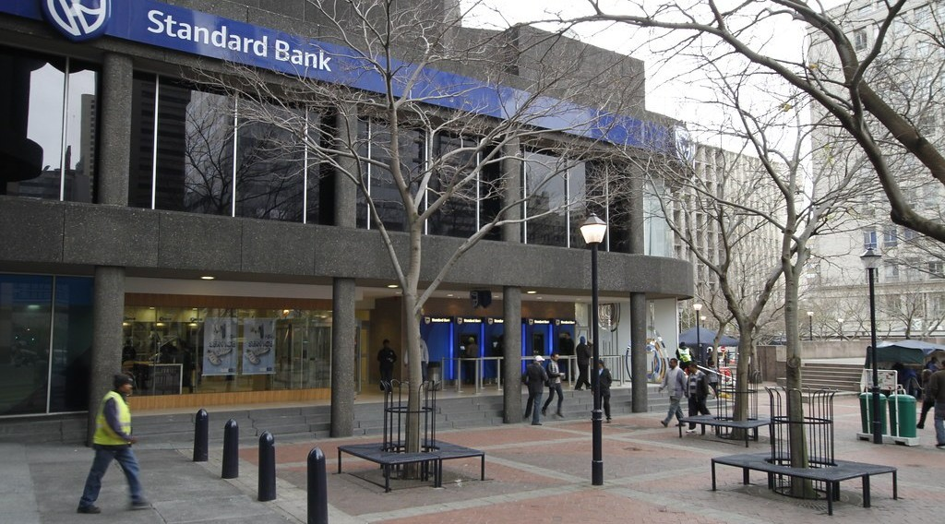
2. TERTIARY SECTOR
Activity 4
A bank.
Notes:
Activity 4. Look carefully at this picture: a bank. Observe every detail before I ask the question.

Slide 28
2. TERTIARY SECTOR
Activity 4: Question
What is the tertiary sector?
Notes:
Here is the question for Activity 4: What is the tertiary sector? Take one minute to think and write your answer in your rough notebook.

Slide 29
2. TERTIARY SECTOR
Activity 4: Answer
Activities that provide services, such as trade, transport, banks and schools.
Notes:
Let us check the answer together. Activities that provide services, such as trade, transport, banks and schools.

Slide 30
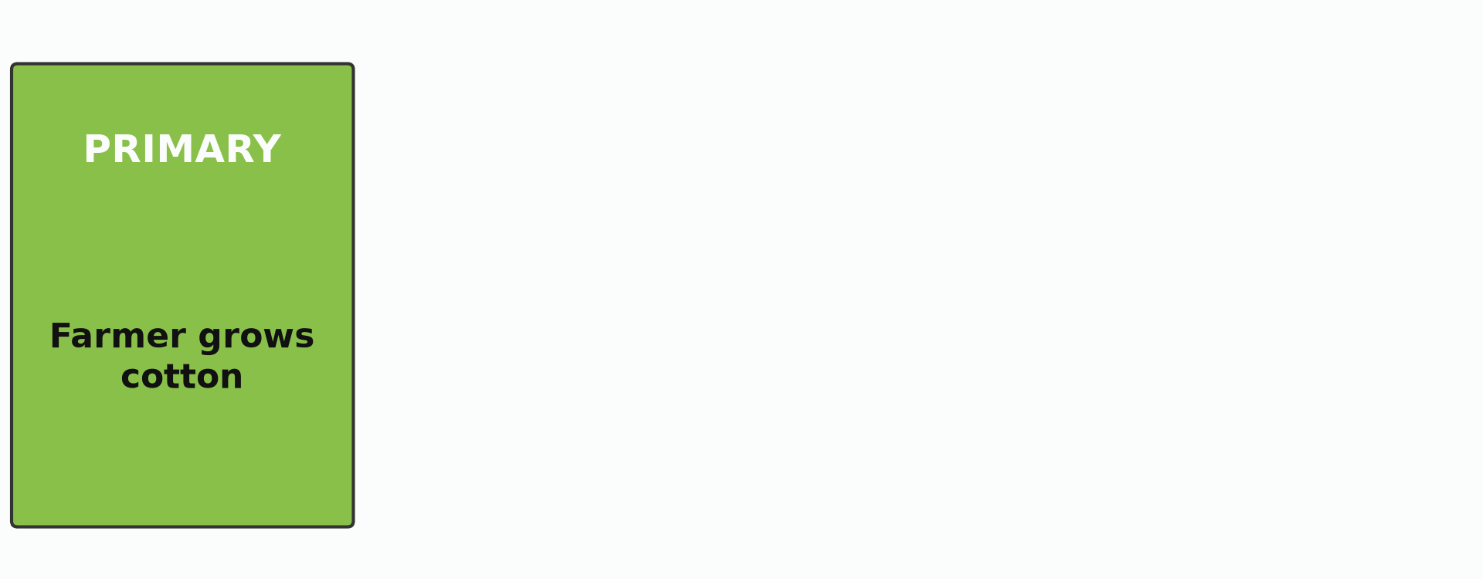
2. QUATERNARY SECTOR
Activity 5
Animation: the journey of cotton through the sectors.
Notes:
Activity 5. Look carefully at this animation: animation: the journey of cotton through the sectors. Watch the animation to the end; it will play again.

Slide 31
2. QUATERNARY SECTOR
Activity 5: Question
What is the quaternary sector?
Notes:
Here is the question for Activity 5: What is the quaternary sector? Take one minute to think and write your answer in your rough notebook.

Slide 32
2. QUATERNARY SECTOR
Activity 5: Answer
Activities of knowledge and research, such as IRAD and ICT.
Notes:
Let us check the answer together. Activities of knowledge and research, such as IRAD and ICT.

Slide 33
BOARD SUMMARY
Board Summary
Topic: Managing Resources for Development through Economic Activities
Sub-topic: Notion of Economic Activity
Lesson 25: Economic Activities
Notes:
Now we are going to copy the board summary. Write the title and the headings neatly in your notebooks. I will give you enough time for each slide, so do not rush.

Slide 34
BOARD SUMMARY
DEFINITIONS
The key terms of this lesson are defined as follows:
Economic activity: It is any activity people do to produce goods or services and earn money.
Notes:
Let us copy the definitions. The key terms of this lesson are defined as follows. On this slide we have Economic activity. Write each point on a new line, with the key term first, and explain it in your own words when we revise.

Slide 35
BOARD SUMMARY
1. Classification of Economic Activities
Economic activities are classified into four sectors:
Primary sector: It takes products from nature, such as farming, fishing, forestry and mining.
Notes:
Let us copy Classification of Economic Activities. Economic activities are classified into four sectors. On this slide we have Primary sector. Write each point on a new line, with the key term first, and explain it in your own words when we revise. When you finish, we go to the next slide.

Slide 36
BOARD SUMMARY
1. Classification of Economic Activities (continued)
Secondary sector: It transforms raw materials into goods, such as factories and crafts.
Tertiary sector: It provides services, such as trade, transport, health and education.
Quaternary sector: It produces knowledge, such as research and ICT.
Notes:
We continue with Classification of Economic Activities. On this slide we have Secondary sector, Tertiary sector and Quaternary sector. Write each point on a new line, with the key term first, and explain it in your own words when we revise.

Slide 37
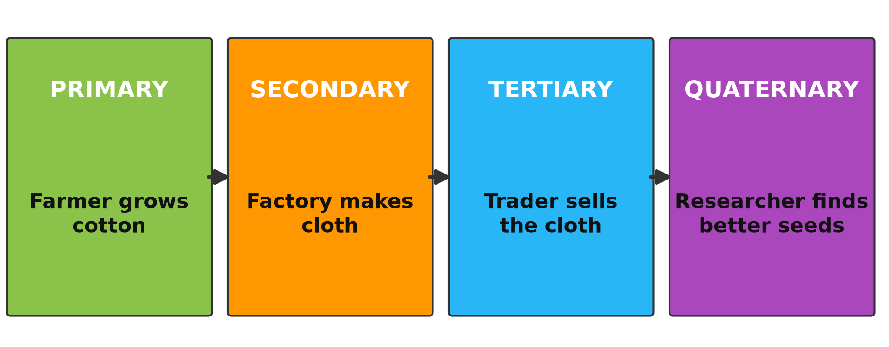
BOARD SUMMARY
1. Classification of Economic Activities
Illustration: the four sectors of the economy
Notes:
Now draw this illustration in your notebook: the four sectors of the economy. Give it a title and label it clearly.

Slide 38
FORMATIVE EVALUATION
Evaluation 1
Name the four sectors of the economy.
Notes:
Now let us check what you have understood. Question 1: Name the four sectors of the economy. Answer in your exercise book.

Slide 39
FORMATIVE EVALUATION
Expected Answer
Primary, secondary, tertiary and quaternary.
Notes:
The expected answer is: primary, secondary, tertiary and quaternary. If you got it right, well done.

Slide 40
FORMATIVE EVALUATION
Evaluation 2
Classify: fishing, teaching, weaving.
Notes:
Now let us check what you have understood. Question 2: Classify: fishing, teaching, weaving. Answer in your exercise book.

Slide 41
FORMATIVE EVALUATION
Expected Answer
Primary, tertiary, secondary.
Notes:
The expected answer is: primary, tertiary, secondary. If you got it right, well done.

Slide 42
REMEDIATION
Remediation
Fill in the blanks:
Farming belongs to the ______ sector.
Factories belong to the ______ sector.
Research belongs to the ______ sector.
Notes:
For those who need more practice, fill in the blanks in your exercise book. The answers are: number 1, primary; number 2, secondary; number 3, quaternary.

Slide 43
HOMEWORK
Homework
List the jobs of five people you know and classify them into sectors.
Notes:
For your homework: List the jobs of five people you know and classify them into sectors. We shall correct it at the beginning of our next lesson.

Slide 44
NEXT LESSON
Next Lesson
Our next lesson will be on:
Lesson 26: Agriculture
Notes:
Our next lesson will be on Lesson 26: Agriculture. Thank you for your attention, and see you next time.

Slide 45
BILINGUAL GAME
Bilingual Game (Jeu Bilingue)
English | Français
Sector | Le secteur
Primary | Primaire
Service | Le service
Goods | Les biens
Research | La recherche
Job | L'emploi
Notes:
Let us play the bilingual game. I say a word in English, and you give me the French word. Then we do the reverse.

Slide 46
LOGBOOK
Official Logbook (1/2)
Module / Topic | Managing Resources for Development through Economic Activities
Lesson Title | Lesson 25: Economic Activities
Expected Learning Outcomes | Define an economic activity. Classify economic activities into four sectors. Give examples from Cameroon.
Competence | Learners are able to classify economic activities into sectors.
Notes:
I record this information in the official logbook of the class after the lesson.

Slide 47
LOGBOOK
Official Logbook (2/2)
Matter Taught | DEFINITIONS; Classification of Economic Activities.
Evaluation | Formative evaluation and remediation exercise.
Homework | List the jobs of five people you know and classify them into sectors.
Enrolment / Present / Absent | ____ / ____ / ____
Achievement | To be completed after the lesson.
Notes:
I complete the second page of the logbook: the matter taught, the evaluation, the homework and the attendance.

Slide 48
TEACHER'S NOTE
Teacher's Note
Timing: Homework correction, plan, objectives 8 min | Recall, situation, action 10 min | 5 activities 30 min | Board summary (copying) 30 min | Evaluation, remediation 10 min | Homework, next lesson 5 min | Logbook 7 min
Activity 5 is an animation (GIF): it plays automatically in slide-show mode.
Without the projector (Activity 1): list jobs of parents.
Without the projector (Activity 2): list primary jobs.
Without the projector (Activity 3): list factories of Cameroon.
Without the projector (Activity 4): list services.
Without the projector (Activity 5): follow cotton through the sectors.
Notes:
This slide is for me, the teacher: it gives the timing of the lesson and what to do if the projector is not available.

Slide 49
REFERENCES
References
Geography Syllabus, Forms I–V, MINESEC (2023) — Form 4, Module II: Development and the Management of Primary Resources.
Photo, Activity 1: “Sandga Market in Douala, Cameroon” by The Advocacy Project, CC BY-NC-SA 2.0, via Flickr (https://www.flickr.com/photos/42487558@N00/3636438732)
Photo, Activity 2: “Cotton harvest” by CIFOR, CC BY-NC-ND 2.0, via Flickr (https://www.flickr.com/photos/45423546@N07/35706862552)
Photo, Activity 3: “Lowell Massachusetts - Boott Cotton Mills Museum Weave Room” by Onasill ~ Bill- 81M views, CC BY-NC-SA 2.0, via Flickr (https://www.flickr.com/photos/7156765@N05/43677799854)
Photo, Activity 4: “Thibault Square, Cape Town” by World Bank Photo Collection, CC BY-NC-ND 2.0, via Flickr (https://www.flickr.com/photos/10816734@N03/7825576852)
Diagrams and animations: drawn for this lesson (Geography Department).
Notes:
These are the references and picture credits used to prepare this lesson.

