Slide 1
FORM 4
GEOGRAPHY
Lesson 28
Intensive and Extensive Agriculture
Notes:
Good morning, class, and welcome to our geography lesson. I am your geography teacher, Mr Kamdem. Today we are starting Lesson 28: Intensive and Extensive Agriculture.

Slide 2
CLASS INFO
Class, Chapter and Duration
Class | Form 4
Chapter | Module II: Development and the Management of Primary Resources
Duration | 2 periods (2 × 50 minutes)
Notes:
This lesson is for Form 4. It belongs to Module II: Development and the Management of Primary Resources. We shall need 2 periods to cover it.

Slide 3
IDENTIFICATION
Lesson Identification
Topic | Managing Resources for Development through Economic Activities
Sub-topic | Agriculture as an Economic Activity of the Primary Sector
Lesson | Lesson 28: Intensive and Extensive Agriculture
Notions / Concepts | Market gardening, mixed farming, dairy farming, viticulture, shifting cultivation, bush fallowing, pastoral nomadism, plantation farming.
Syllabus focus | For each type: definition only; where commonly practised.
Competence | Learners are able to define the main types of intensive and extensive agriculture and locate them.
Notes:
Our topic is Managing Resources for Development through Economic Activities, and the sub-topic is Agriculture as an Economic Activity of the Primary Sector. The key notions we shall use today are: market gardening, mixed farming, dairy farming, viticulture, shifting cultivation, bush fallowing, pastoral nomadism, plantation farming. At the end, you should be able to do this: learners are able to define the main types of intensive and extensive agriculture and locate them.

Slide 4

HOMEWORK CORRECTION
Correction of the Homework
Question (Lesson 27: Agricultural Systems):
Classify three farms of your area as intensive or extensive and justify.
Notes:
Before we start the new lesson, let us correct the homework I gave you at the end of Lesson 27: Agricultural Systems. The question was: Classify three farms of your area as intensive or extensive and justify. Take out your exercise books.

Slide 5
HOMEWORK CORRECTION
Correction: Possible Answer
Example: onion gardens by the Benue – intensive (much labour and water on small plots); cotton fields – semi-intensive; cattle herding – extensive (large areas, few inputs).
Notes:
Here is a good answer. Example: onion gardens by the Benue – intensive (much labour and water on small plots); cotton fields – semi-intensive; cattle herding – extensive (large areas, few inputs). Compare it with your own answer and correct your work in red.

Slide 6
LESSON PLAN
Lesson Plan
Correction of the homework
Objectives and recall
Real-life situation and action to take
Learning activities
Board summary
Evaluation, remediation and homework
Notes:
Here is the plan of our lesson today. First, we shall correct the homework. Then we shall look at the objectives and recall what you already know. After that, we shall study a situation from real life and the action to take, and do the learning activities. Finally, we shall copy the board summary, do the evaluation and the remediation, and I will give you the homework.

Slide 7
OBJECTIVES
Objectives
By the end of this lesson, you should be able to:
Define the main types of intensive agriculture.
Define the main types of extensive agriculture.
Notes:
Take your time to copy this part; we will continue together.

Slide 8
OBJECTIVES
Objectives (continued)
Locate where each type is practised.
Notes:
By the end of this lesson, you should be able to do three things. Number 1: define the main types of intensive agriculture. Number 2: define the main types of extensive agriculture. Number 3: locate where each type is practised.

Slide 9
PREVIOUS KNOWLEDGE
Previous Knowledge
Intensive farming uses many inputs.
Extensive farming uses large areas.
Cameroon has plantations.
Notes:
Let us first remember what you already know. Intensive farming uses many inputs. Extensive farming uses large areas. Cameroon has plantations. Keep this in mind, because we shall build on it today.

Slide 10
REAL-LIFE SITUATION
Situation in Real Life
A documentary shows vegetable gardens in Holland, vineyards in France, shifting cultivation in the Congo forest and cattle herds in the Sahel.
Notes:
Listen carefully to this situation from real life. A documentary shows vegetable gardens in Holland, vineyards in France, shifting cultivation in the Congo forest and cattle herds in the Sahel. Think about it, because I am going to ask you some questions.

Slide 11
REAL-LIFE SITUATION
Situation: Question 1
What is the problem in the situation?
Notes:
Question 1: What is the problem in the situation? Think for a moment, then raise your hand to answer.

Slide 12
REAL-LIFE SITUATION
Answer
We want to name and locate farming types.
Notes:
Good. We want to name and locate farming types.

Slide 13
REAL-LIFE SITUATION
Situation: Question 2
Which type is shown in France?
Notes:
Question 2: Which type is shown in France? Think for a moment, then raise your hand to answer.

Slide 14
REAL-LIFE SITUATION
Answer
Viticulture.
Notes:
Good. Viticulture.

Slide 15
REAL-LIFE SITUATION
Situation: Question 3
Which type is shown in the Sahel?
Notes:
Question 3: Which type is shown in the Sahel? Think for a moment, then raise your hand to answer.

Slide 16
REAL-LIFE SITUATION
Possible Answer
Pastoral nomadism.
Notes:
Good. Pastoral nomadism.

Slide 17
ACTION TO TAKE
Action to Take
Recognise the farming types around you.
Notes:
From this situation, the action we are working towards in this lesson is the following: recognise the farming types around you.

Slide 18
JUSTIFICATION
Justification of the Lesson
This lesson helps us to know the main farming types of the world.
Notes:
Why is this lesson important for you? This lesson helps us to know the main farming types of the world.

Slide 19
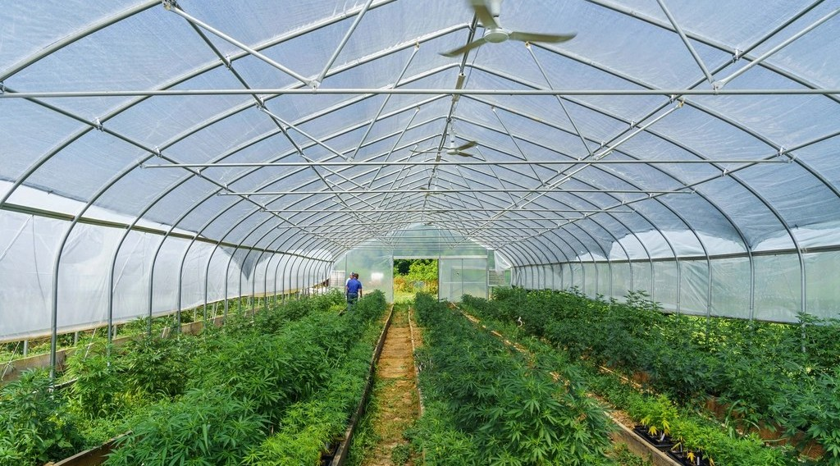
1. MARKET GARDENING
Activity 1
Vegetables in a greenhouse.
Notes:
Activity 1. Look carefully at this picture: vegetables in a greenhouse. Observe every detail before I ask the question.

Slide 20
1. MARKET GARDENING
Activity 1: Question
What is market gardening and where is it practised?
Notes:
Here is the question for Activity 1: What is market gardening and where is it practised? Take one minute to think and write your answer in your rough notebook.

Slide 21
1. MARKET GARDENING
Activity 1: Answer
Growing vegetables and fruits for nearby towns; around big cities and in the Netherlands (also near Garoua).
Notes:
Let us check the answer together. Growing vegetables and fruits for nearby towns; around big cities and in the Netherlands (also near Garoua).

Slide 22
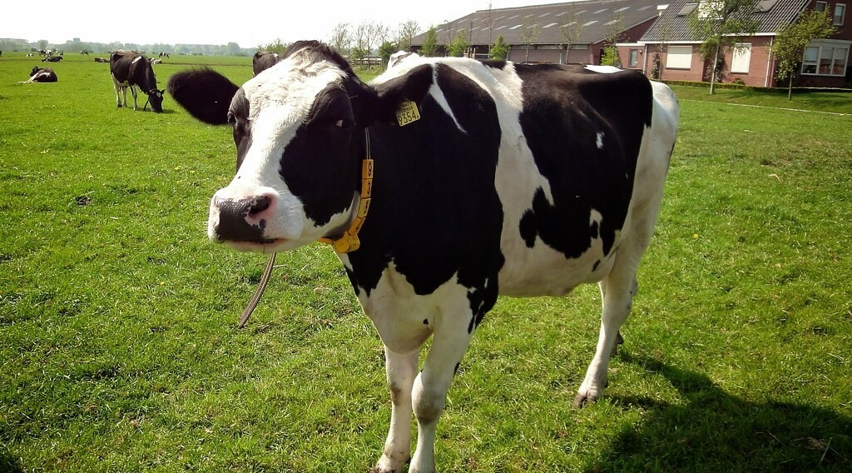
1. MIXED AND DAIRY FARMING
Activity 2
A dairy cow.
Notes:
Activity 2. Look carefully at this picture: a dairy cow. Observe every detail before I ask the question.

Slide 23
1. MIXED AND DAIRY FARMING
Activity 2: Question
Define mixed farming and dairy farming.
Notes:
Here is the question for Activity 2: Define mixed farming and dairy farming. Take one minute to think and write your answer in your rough notebook.

Slide 24
1. MIXED AND DAIRY FARMING
Activity 2: Answer
Mixed: crops and animals on one farm (Europe). Dairy: rearing cows for milk (Netherlands, Denmark).
Notes:
Let us check the answer together. Mixed: crops and animals on one farm (Europe). Dairy: rearing cows for milk (Netherlands, Denmark).

Slide 25

1. VITICULTURE AND PLANTATIONS
Activity 3
An oil palm plantation.
Notes:
Activity 3. Look carefully at this picture: an oil palm plantation. Observe every detail before I ask the question.

Slide 26
1. VITICULTURE AND PLANTATIONS
Activity 3: Question
Define plantation farming and give an example in Cameroon.
Notes:
Here is the question for Activity 3: Define plantation farming and give an example in Cameroon. Take one minute to think and write your answer in your rough notebook.

Slide 27
1. VITICULTURE AND PLANTATIONS
Activity 3: Answer
A large farm growing one cash crop for export, such as the oil palm and rubber of the CDC.
Notes:
Let us check the answer together. A large farm growing one cash crop for export, such as the oil palm and rubber of the CDC.

Slide 28

2. SHIFTING CULTIVATION AND BUSH FALLOWING
Activity 4
A cleared plot.
Notes:
Activity 4. Look carefully at this picture: a cleared plot. Observe every detail before I ask the question.

Slide 29
2. SHIFTING CULTIVATION AND BUSH FALLOWING
Activity 4: Question
Where are shifting cultivation and bush fallowing practised?
Notes:
Here is the question for Activity 4: Where are shifting cultivation and bush fallowing practised? Take one minute to think and write your answer in your rough notebook.

Slide 30
2. SHIFTING CULTIVATION AND BUSH FALLOWING
Activity 4: Answer
In the tropical forests of Africa, the Amazon and South-East Asia.
Notes:
Let us check the answer together. In the tropical forests of Africa, the Amazon and South-East Asia.

Slide 31
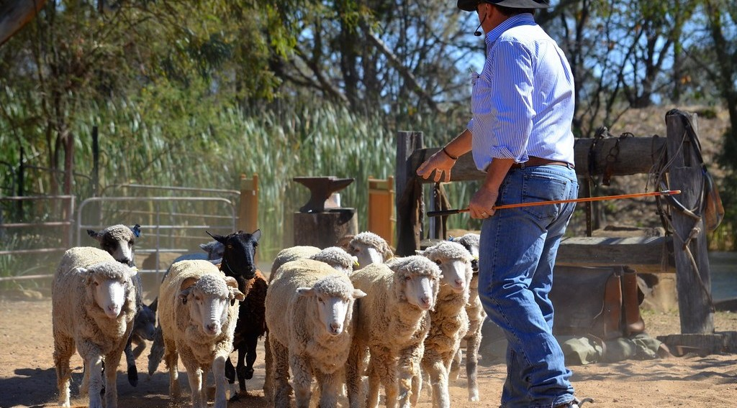
2. PASTORAL NOMADISM AND RANCHING
Activity 5
A ranch.
Notes:
Activity 5. Look carefully at this picture: a ranch. Observe every detail before I ask the question.

Slide 32
2. PASTORAL NOMADISM AND RANCHING
Activity 5: Question
Distinguish pastoral nomadism and ranching.
Notes:
Here is the question for Activity 5: Distinguish pastoral nomadism and ranching. Take one minute to think and write your answer in your rough notebook.

Slide 33
2. PASTORAL NOMADISM AND RANCHING
Activity 5: Answer
Nomadism: moving with herds (Sahel). Ranching: keeping animals on a large fenced farm (Argentina, Adamawa).
Notes:
Let us check the answer together. Nomadism: moving with herds (Sahel). Ranching: keeping animals on a large fenced farm (Argentina, Adamawa).

Slide 34
BOARD SUMMARY
Board Summary
Topic: Managing Resources for Development through Economic Activities
Sub-topic: Agriculture as an Economic Activity of the Primary Sector
Lesson 28: Intensive and Extensive Agriculture
Notes:
Now we are going to copy the board summary. Write the title and the headings neatly in your notebooks. I will give you enough time for each slide, so do not rush.

Slide 35
BOARD SUMMARY
1. Intensive Agriculture
The main intensive types are the following:
Market gardening: It is growing vegetables and fruits for nearby towns, as around big cities and in the Netherlands.
Mixed farming: It is growing crops and rearing animals on the same farm, as in Western Europe.
Notes:
Let us copy Intensive Agriculture. The main intensive types are the following. On this slide we have Market gardening and Mixed farming. Write each point on a new line, with the key term first, and explain it in your own words when we revise. When you finish, we go to the next slide.

Slide 36
BOARD SUMMARY
1. Intensive Agriculture (continued)
Dairy farming: It is rearing cows for milk, as in the Netherlands and Denmark.
Viticulture: It is growing grapes, as in France and Italy.
Plantation farming: It is growing one cash crop on a large estate, as oil palm in Cameroon.
Notes:
We continue with Intensive Agriculture. On this slide we have Dairy farming, Viticulture and Plantation farming. Write each point on a new line, with the key term first, and explain it in your own words when we revise.

Slide 37
BOARD SUMMARY
2. Extensive Agriculture
The main extensive types are the following:
Shifting cultivation: Farmers clear a plot, farm it and move on, as in the Congo Basin.
Bush fallowing: Farmers leave land to rest and return to it later, as in West Africa.
Notes:
Let us copy Extensive Agriculture. The main extensive types are the following. On this slide we have Shifting cultivation and Bush fallowing. Write each point on a new line, with the key term first, and explain it in your own words when we revise. When you finish, we go to the next slide.

Slide 38
BOARD SUMMARY
2. Extensive Agriculture (continued)
Pastoral nomadism: Herders move with animals to find grass and water, as in the Sahel.
Ranching and grain farming: Large farms rear cattle or grow wheat, as in Argentina and Canada.
Notes:
We continue with Extensive Agriculture. On this slide we have Pastoral nomadism and Ranching and grain farming. Write each point on a new line, with the key term first, and explain it in your own words when we revise.

Slide 39
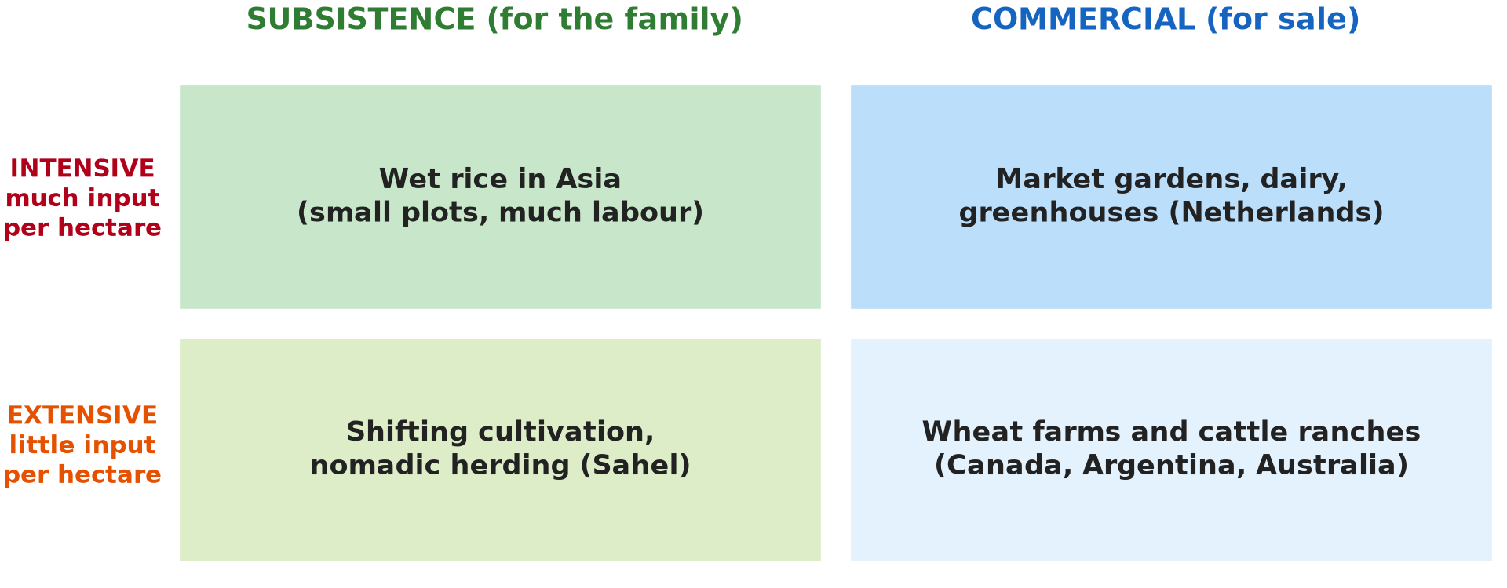
BOARD SUMMARY
2. Extensive Agriculture
Illustration: types of agriculture
Notes:
Now draw this illustration in your notebook: types of agriculture. Give it a title and label it clearly.

Slide 40
FORMATIVE EVALUATION
Evaluation 1
Define market gardening.
Notes:
Now let us check what you have understood. Question 1: Define market gardening. Answer in your exercise book.

Slide 41
FORMATIVE EVALUATION
Expected Answer
Growing vegetables and fruits for nearby towns.
Notes:
The expected answer is: growing vegetables and fruits for nearby towns. If you got it right, well done.

Slide 42
FORMATIVE EVALUATION
Evaluation 2
Where is pastoral nomadism practised?
Notes:
Now let us check what you have understood. Question 2: Where is pastoral nomadism practised? Answer in your exercise book.

Slide 43
FORMATIVE EVALUATION
Expected Answer
In the Sahel (also East Africa).
Notes:
The expected answer is: in the Sahel (also East Africa). If you got it right, well done.

Slide 44
REMEDIATION
Remediation
Fill in the blanks:
Growing grapes is ______.
Leaving land to rest is bush ______.
A large farm with one cash crop is a ______.
Notes:
For those who need more practice, fill in the blanks in your exercise book. The answers are: number 1, viticulture; number 2, fallowing; number 3, plantation.

Slide 45
HOMEWORK
Homework
Name one type of intensive and one type of extensive farming practised in Cameroon and where.
Notes:
For your homework: Name one type of intensive and one type of extensive farming practised in Cameroon and where. We shall correct it at the beginning of our next lesson.

Slide 46
NEXT LESSON
Next Lesson
Our next lesson will be on:
Lesson 29: The Green Revolution
Notes:
Our next lesson will be on Lesson 29: The Green Revolution. Thank you for your attention, and see you next time.

Slide 47
BILINGUAL GAME
Bilingual Game (Jeu Bilingue)
English | Français
Market gardening | Le maraîchage
Dairy | La laiterie
Plantation | La plantation
Ranch | Le ranch
Nomadism | Le nomadisme
Vine | La vigne
Notes:
Let us play the bilingual game. I say a word in English, and you give me the French word. Then we do the reverse.

Slide 48
LOGBOOK
Official Logbook (1/2)
Module / Topic | Managing Resources for Development through Economic Activities
Lesson Title | Lesson 28: Intensive and Extensive Agriculture
Expected Learning Outcomes | Define the main types of intensive agriculture. Define the main types of extensive agriculture. Locate where each type is practised.
Competence | Learners are able to define the main types of intensive and extensive agriculture and locate them.
Notes:
I record this information in the official logbook of the class after the lesson.

Slide 49
LOGBOOK
Official Logbook (2/2)
Matter Taught | Intensive Agriculture; Extensive Agriculture.
Evaluation | Formative evaluation and remediation exercise.
Homework | Name one type of intensive and one type of extensive farming practised in Cameroon and where.
Enrolment / Present / Absent | ____ / ____ / ____
Achievement | To be completed after the lesson.
Notes:
I complete the second page of the logbook: the matter taught, the evaluation, the homework and the attendance.

Slide 50
TEACHER'S NOTE
Teacher's Note
Timing: Homework correction, plan, objectives 8 min | Recall, situation, action 10 min | 5 activities 30 min | Board summary (copying) 30 min | Evaluation, remediation 10 min | Homework, next lesson 5 min | Logbook 7 min
Without the projector (Activity 1): describe onion gardens.
Without the projector (Activity 2): list milk products.
Without the projector (Activity 3): name plantations.
Without the projector (Activity 4): describe farming in the South.
Without the projector (Activity 5): describe herding.
Notes:
This slide is for me, the teacher: it gives the timing of the lesson and what to do if the projector is not available.

Slide 51
REFERENCES
References
Geography Syllabus, Forms I–V, MINESEC (2023) — Form 4, Module II: Development and the Management of Primary Resources.
Photo, Activity 1: “Organic farming, vegetable patch” by U.S. Department of Agriculture, CC0 1.0, via rawpixel (https://www.rawpixel.com/image/10995692/organic-farming-vegetable-patch)
Photo, Activity 2: “Koe 9354” by ednl, CC BY 2.0, via Flickr (https://www.flickr.com/photos/31392863@N04/5640329871)
Photo, Activity 3: “Aerial view of oil palm plantation” by CIFOR, CC BY-NC-ND 2.0, via Flickr (https://www.flickr.com/photos/45423546@N07/38802487905)
Photo, Activity 4: “Slash and burn agriculture in the Amazon” by Matt-Zimmerman, CC BY 2.0, via Flickr (https://www.flickr.com/photos/16725630@N00/1524189000)
Photo, Activity 5: “The Flock” by seefit, CC BY 2.0, via Flickr (https://www.flickr.com/photos/76574551@N00/20928299362)
Diagrams and animations: drawn for this lesson (Geography Department).
Notes:
These are the references and picture credits used to prepare this lesson.

