Slide 1
FORM 4
GEOGRAPHY
Lesson 29
The Green Revolution
Notes:
Good morning, class, and welcome to our geography lesson. I am your geography teacher, Mr Kamdem. Today we are starting Lesson 29: The Green Revolution.

Slide 2
CLASS INFO
Class, Chapter and Duration
Class | Form 4
Chapter | Module II: Development and the Management of Primary Resources
Duration | 2 periods (2 × 50 minutes)
Notes:
This lesson is for Form 4. It belongs to Module II: Development and the Management of Primary Resources. We shall need 2 periods to cover it.

Slide 3
IDENTIFICATION
Lesson Identification
Topic | Managing Resources for Development through Economic Activities
Sub-topic | Agriculture as an Economic Activity of the Primary Sector
Lesson | Lesson 29: The Green Revolution
Notions / Concepts | Green Revolution, high-yielding varieties, fertiliser, irrigation.
Syllabus focus | Meaning and aspects; significance; weaknesses.
Competence | Learners are able to explain the Green Revolution and judge its effects.
Notes:
Our topic is Managing Resources for Development through Economic Activities, and the sub-topic is Agriculture as an Economic Activity of the Primary Sector. The key notions we shall use today are: green Revolution, high-yielding varieties, fertiliser, irrigation. At the end, you should be able to do this: learners are able to explain the Green Revolution and judge its effects.

Slide 4

HOMEWORK CORRECTION
Correction of the Homework
Question (Lesson 28: Intensive and Extensive Agriculture):
Name one type of intensive and one type of extensive farming practised in Cameroon and where.
Notes:
Before we start the new lesson, let us correct the homework I gave you at the end of Lesson 28: Intensive and Extensive Agriculture. The question was: Name one type of intensive and one type of extensive farming practised in Cameroon and where. Take out your exercise books.

Slide 5
HOMEWORK CORRECTION
Correction: Possible Answer
Intensive: market gardening around Garoua and Yaoundé (or plantations near Limbe). Extensive: pastoral nomadism in the Far North (or shifting cultivation in the South).
Notes:
Here is a good answer. Intensive: market gardening around Garoua and Yaoundé (or plantations near Limbe). Extensive: pastoral nomadism in the Far North (or shifting cultivation in the South). Compare it with your own answer and correct your work in red.

Slide 6
LESSON PLAN
Lesson Plan
Correction of the homework
Objectives and recall
Real-life situation and action to take
Learning activities
Board summary
Evaluation, remediation and homework
Notes:
Here is the plan of our lesson today. First, we shall correct the homework. Then we shall look at the objectives and recall what you already know. After that, we shall study a situation from real life and the action to take, and do the learning activities. Finally, we shall copy the board summary, do the evaluation and the remediation, and I will give you the homework.

Slide 7
OBJECTIVES
Objectives
By the end of this lesson, you should be able to:
Define the Green Revolution and its aspects.
Explain its significance.
Explain its weaknesses.
Notes:
By the end of this lesson, you should be able to do three things. Number 1: define the Green Revolution and its aspects. Number 2: explain its significance. Number 3: explain its weaknesses.

Slide 8
PREVIOUS KNOWLEDGE
Previous Knowledge
Population grows quickly.
Farmers need more food.
Fertilisers increase yields.
Notes:
Let us first remember what you already know. Population grows quickly. Farmers need more food. Fertilisers increase yields. Keep this in mind, because we shall build on it today.

Slide 9
REAL-LIFE SITUATION
Situation in Real Life
In the 1960s, India faced famine. Farmers began to use new rice and wheat seeds, fertilisers and irrigation. Within a few years, India produced enough food to feed its people.
Notes:
Listen carefully to this situation from real life. In the 1960s, India faced famine. Farmers began to use new rice and wheat seeds, fertilisers and irrigation. Within a few years, India produced enough food to feed its people. Think about it, because I am going to ask you some questions.

Slide 10
REAL-LIFE SITUATION
Situation: Question 1
What is the problem in the situation?
Notes:
Question 1: What is the problem in the situation? Think for a moment, then raise your hand to answer.

Slide 11
REAL-LIFE SITUATION
Answer
India needed more food.
Notes:
Good. India needed more food.

Slide 12
REAL-LIFE SITUATION
Situation: Question 2
What did farmers use?
Notes:
Question 2: What did farmers use? Think for a moment, then raise your hand to answer.

Slide 13
REAL-LIFE SITUATION
Answer
New seeds, fertilisers and irrigation.
Notes:
Good. New seeds, fertilisers and irrigation.

Slide 14
REAL-LIFE SITUATION
Situation: Question 3
What was the result?
Notes:
Question 3: What was the result? Think for a moment, then raise your hand to answer.

Slide 15
REAL-LIFE SITUATION
Possible Answer
Food production increased.
Notes:
Good. Food production increased.

Slide 16
ACTION TO TAKE
Action to Take
Use improved seeds carefully and protect the environment.
Notes:
From this situation, the action we are working towards in this lesson is the following: use improved seeds carefully and protect the environment.

Slide 17
JUSTIFICATION
Justification of the Lesson
This lesson helps us to understand how science increased food production.
Notes:
Why is this lesson important for you? This lesson helps us to understand how science increased food production.

Slide 18
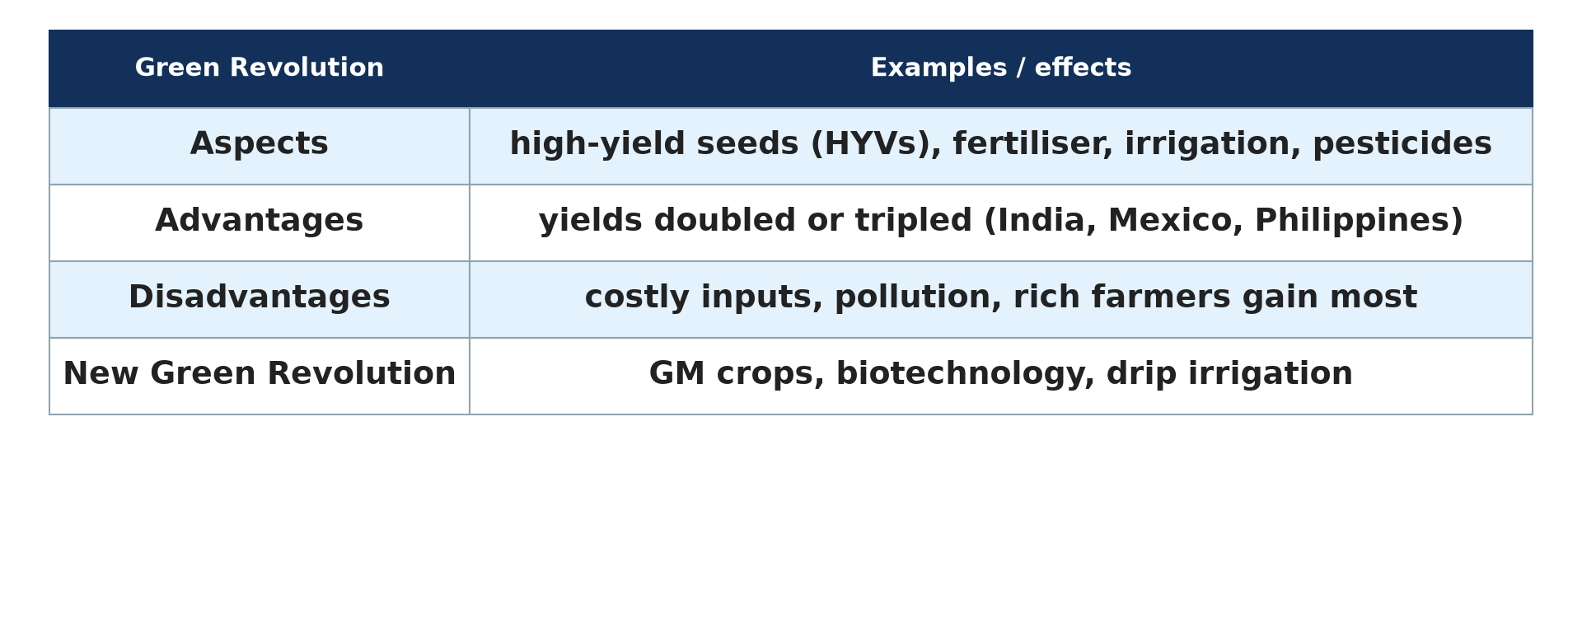
1. MEANING
Activity 1
The Green Revolution.
Notes:
Activity 1. Look carefully at this diagram: the Green Revolution. Observe every detail before I ask the question.

Slide 19
1. MEANING
Activity 1: Question
What is the Green Revolution?
Notes:
Here is the question for Activity 1: What is the Green Revolution? Take one minute to think and write your answer in your rough notebook.

Slide 20
1. MEANING
Activity 1: Answer
The great increase in food production since the 1960s thanks to new seeds, fertilisers and irrigation.
Notes:
Let us check the answer together. The great increase in food production since the 1960s thanks to new seeds, fertilisers and irrigation.

Slide 21

1. ASPECTS
Activity 2
Rice harvest.
Notes:
Activity 2. Look carefully at this picture: rice harvest. Observe every detail before I ask the question.

Slide 22
1. ASPECTS
Activity 2: Question
Name three aspects of the Green Revolution.
Notes:
Here is the question for Activity 2: Name three aspects of the Green Revolution. Take one minute to think and write your answer in your rough notebook.

Slide 23
1. ASPECTS
Activity 2: Answer
High-yielding seeds, fertilisers and pesticides, and irrigation (also machines).
Notes:
Let us check the answer together. High-yielding seeds, fertilisers and pesticides, and irrigation (also machines).

Slide 24
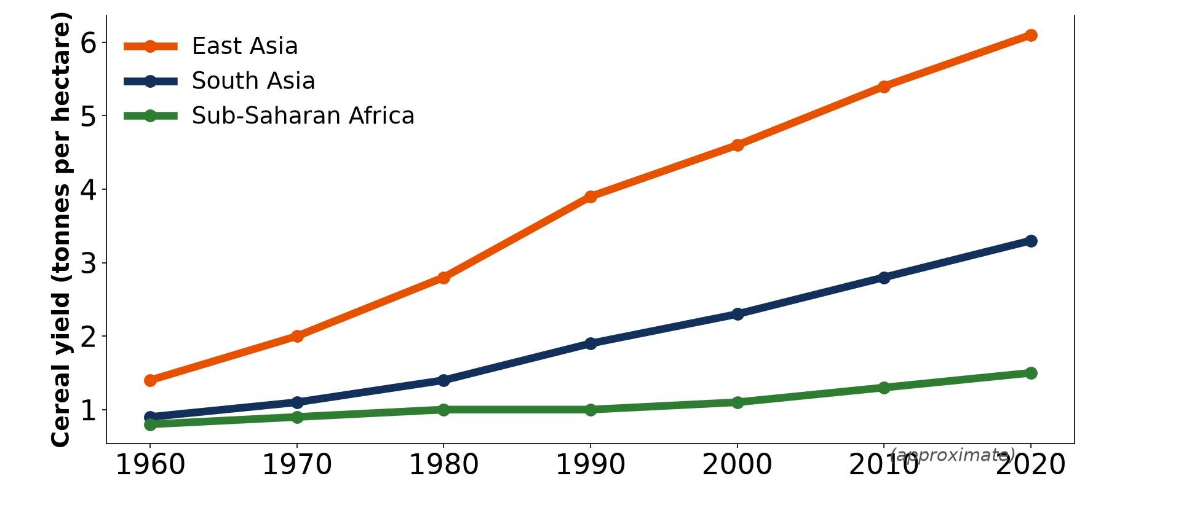
2. SIGNIFICANCE
Activity 3
Cereal yields.
Notes:
Activity 3. Look carefully at this diagram: cereal yields. Observe every detail before I ask the question.

Slide 25
2. SIGNIFICANCE
Activity 3: Question
Give two positive effects.
Notes:
Here is the question for Activity 3: Give two positive effects. Take one minute to think and write your answer in your rough notebook.

Slide 26
2. SIGNIFICANCE
Activity 3: Answer
Yields doubled or tripled and famine was reduced in Asia.
Notes:
Let us check the answer together. Yields doubled or tripled and famine was reduced in Asia.

Slide 27

3. WEAKNESSES
Activity 4
Spraying chemicals.
Notes:
Activity 4. Look carefully at this picture: spraying chemicals. Observe every detail before I ask the question.

Slide 28
3. WEAKNESSES
Activity 4: Question
Give two weaknesses.
Notes:
Here is the question for Activity 4: Give two weaknesses. Take one minute to think and write your answer in your rough notebook.

Slide 29
3. WEAKNESSES
Activity 4: Answer
Costly inputs that poor farmers cannot buy and pollution by chemicals.
Notes:
Let us check the answer together. Costly inputs that poor farmers cannot buy and pollution by chemicals.

Slide 30

3. AFRICA
Activity 5
A field trial of improved seeds.
Notes:
Activity 5. Look carefully at this picture: a field trial of improved seeds. Observe every detail before I ask the question.

Slide 31
3. AFRICA
Activity 5: Question
Why did the Green Revolution have less success in Africa?
Notes:
Here is the question for Activity 5: Why did the Green Revolution have less success in Africa? Take one minute to think and write your answer in your rough notebook.

Slide 32
3. AFRICA
Activity 5: Answer
Many crops were not improved, irrigation is limited and inputs are costly.
Notes:
Let us check the answer together. Many crops were not improved, irrigation is limited and inputs are costly.

Slide 33
BOARD SUMMARY
Board Summary
Topic: Managing Resources for Development through Economic Activities
Sub-topic: Agriculture as an Economic Activity of the Primary Sector
Lesson 29: The Green Revolution
Notes:
Now we are going to copy the board summary. Write the title and the headings neatly in your notebooks. I will give you enough time for each slide, so do not rush.

Slide 34
BOARD SUMMARY
DEFINITIONS
The key terms of this lesson are defined as follows:
Green Revolution: It is the great increase in food production since the 1960s through science and new inputs.
Notes:
Let us copy the definitions. The key terms of this lesson are defined as follows. On this slide we have Green Revolution. Write each point on a new line, with the key term first, and explain it in your own words when we revise.

Slide 35
BOARD SUMMARY
1. Aspects
The Green Revolution has the following aspects:
High-yielding varieties: New seeds of rice, wheat and maize give much higher yields.
Fertilisers and pesticides: Chemicals feed the crops and kill pests.
Notes:
Let us copy Aspects. The Green Revolution has the following aspects. On this slide we have High-yielding varieties and Fertilisers and pesticides. Write each point on a new line, with the key term first, and explain it in your own words when we revise. When you finish, we go to the next slide.

Slide 36
BOARD SUMMARY
1. Aspects (continued)
Irrigation and machines: Water and machines allow two or three harvests a year.
Notes:
We continue with Aspects. On this slide we have Irrigation and machines. Write each point on a new line, with the key term first, and explain it in your own words when we revise.

Slide 37
BOARD SUMMARY
1. Aspects
Illustration: the Green Revolution
Notes:
Now draw this illustration in your notebook: the Green Revolution. Give it a title and label it clearly.

Slide 38
BOARD SUMMARY
2. Significance
The Green Revolution has the following significance:
Food production: Yields doubled or tripled in India, Mexico and the Philippines.
Famine: It reduced hunger and famine in Asia.
Notes:
Let us copy Significance. The Green Revolution has the following significance. On this slide we have Food production and Famine. Write each point on a new line, with the key term first, and explain it in your own words when we revise.

Slide 39
BOARD SUMMARY
3. Weaknesses
The Green Revolution has the following weaknesses:
Cost: Inputs are costly, so rich farmers gain more than poor ones.
Environment: Chemicals pollute soils and water, and irrigation overuses water.
Notes:
Let us copy Weaknesses. The Green Revolution has the following weaknesses. On this slide we have Cost and Environment. Write each point on a new line, with the key term first, and explain it in your own words when we revise. When you finish, we go to the next slide.

Slide 40
BOARD SUMMARY
3. Weaknesses (continued)
Africa: It had limited success in Africa.
Notes:
We continue with Weaknesses. On this slide we have Africa. Write each point on a new line, with the key term first, and explain it in your own words when we revise.

Slide 41
FORMATIVE EVALUATION
Evaluation 1
Give three aspects of the Green Revolution.
Notes:
Now let us check what you have understood. Question 1: Give three aspects of the Green Revolution. Answer in your exercise book.

Slide 42
FORMATIVE EVALUATION
Expected Answer
New seeds, fertilisers and irrigation.
Notes:
The expected answer is: new seeds, fertilisers and irrigation. If you got it right, well done.

Slide 43
FORMATIVE EVALUATION
Evaluation 2
Give one weakness.
Notes:
Now let us check what you have understood. Question 2: Give one weakness. Answer in your exercise book.

Slide 44
FORMATIVE EVALUATION
Expected Answer
Inputs are costly.
Notes:
The expected answer is: inputs are costly. If you got it right, well done.

Slide 45
REMEDIATION
Remediation
Fill in the blanks:
New seeds giving more food are high-______ varieties.
The Green Revolution began in the ______.
Chemicals can ______ the environment.
Notes:
For those who need more practice, fill in the blanks in your exercise book. The answers are: number 1, yielding; number 2, 1960s; number 3, pollute.

Slide 46
HOMEWORK
Homework
Ask a farmer whether he uses improved seeds or fertilisers and what results he gets.
Notes:
For your homework: Ask a farmer whether he uses improved seeds or fertilisers and what results he gets. We shall correct it at the beginning of our next lesson.

Slide 47
NEXT LESSON
Next Lesson
Our next lesson will be on:
Lesson 30: The Impact of Agriculture
Notes:
Our next lesson will be on Lesson 30: The Impact of Agriculture. Thank you for your attention, and see you next time.

Slide 48
BILINGUAL GAME
Bilingual Game (Jeu Bilingue)
English | Français
Yield | Le rendement
Seed | La semence
Fertiliser | L'engrais
Pesticide | Le pesticide
Irrigation | L'irrigation
Famine | La famine
Notes:
Let us play the bilingual game. I say a word in English, and you give me the French word. Then we do the reverse.

Slide 49
LOGBOOK
Official Logbook (1/2)
Module / Topic | Managing Resources for Development through Economic Activities
Lesson Title | Lesson 29: The Green Revolution
Expected Learning Outcomes | Define the Green Revolution and its aspects. Explain its significance. Explain its weaknesses.
Competence | Learners are able to explain the Green Revolution and judge its effects.
Notes:
I record this information in the official logbook of the class after the lesson.

Slide 50
LOGBOOK
Official Logbook (2/2)
Matter Taught | DEFINITIONS; Aspects; Significance; Weaknesses.
Evaluation | Formative evaluation and remediation exercise.
Homework | Ask a farmer whether he uses improved seeds or fertilisers and what results he gets.
Enrolment / Present / Absent | ____ / ____ / ____
Achievement | To be completed after the lesson.
Notes:
I complete the second page of the logbook: the matter taught, the evaluation, the homework and the attendance.

Slide 51
TEACHER'S NOTE
Teacher's Note
Timing: Homework correction, plan, objectives 8 min | Recall, situation, action 10 min | 5 activities 30 min | Board summary (copying) 30 min | Evaluation, remediation 10 min | Homework, next lesson 5 min | Logbook 7 min
Without the projector (Activity 1): explain the name.
Without the projector (Activity 2): list inputs.
Without the projector (Activity 3): read the graph.
Without the projector (Activity 4): discuss chemicals.
Without the projector (Activity 5): discuss IRAD seeds.
Notes:
This slide is for me, the teacher: it gives the timing of the lesson and what to do if the projector is not available.

Slide 52
REFERENCES
References
Geography Syllabus, Forms I–V, MINESEC (2023) — Form 4, Module II: Development and the Management of Primary Resources.
Photo, Activity 2: “A woman harvesting rice, Barotse floodplain, Zambia. Photo by Georgina” by WorldFish, CC BY-NC-ND 2.0, via Flickr (https://www.flickr.com/photos/61545321@N06/7848727138)
Photo, Activity 4: “k4817-4” by USDAgov, CC BY 2.0, via Flickr (https://www.flickr.com/photos/41284017@N08/8497812386)
Photo, Activity 5: “CIMMYT international wheat nurseries growing in Ecuador” by CIMMYT, CC BY-NC-SA 2.0, via Flickr (https://www.flickr.com/photos/44760652@N05/5958068839)
Diagrams and animations: drawn for this lesson (Geography Department).
Notes:
These are the references and picture credits used to prepare this lesson.

