Slide 1
FORM 4
GEOGRAPHY
Lesson 33
Spatial Patterns of Agriculture: Von Thünen's Model of Agricultural Land Use
Notes:
Good morning, class, and welcome to our geography lesson. I am your geography teacher, Mr Kamdem. Today we are starting Lesson 33: Spatial Patterns of Agriculture: Von Thünen's Model of Agricultural Land Use.

Slide 2
CLASS INFO
Class, Chapter and Duration
Class | Form 4
Chapter | Module II: Development and the Management of Primary Resources
Duration | 2 periods (2 × 50 minutes)
Notes:
This lesson is for Form 4. It belongs to Module II: Development and the Management of Primary Resources. We shall need 2 periods to cover it.

Slide 3
IDENTIFICATION
Lesson Identification
Topic | Managing Resources for Development through Economic Activities
Sub-topic | Agriculture as an Economic Activity of the Primary Sector
Lesson | Lesson 33: Spatial Patterns of Agriculture: Von Thünen's Model of Agricultural Land Use
Notions / Concepts | Land use pattern, locational rent, isolated state.
Syllabus focus | Principle (locational rent); three main assumptions; conclusions and spatial outcome diagram; some areas where applicable.
Competence | Learners are able to explain Von Thünen's model and apply it to real areas.
Notes:
Our topic is Managing Resources for Development through Economic Activities, and the sub-topic is Agriculture as an Economic Activity of the Primary Sector. The key notions we shall use today are: land use pattern, locational rent, isolated state. At the end, you should be able to do this: learners are able to explain Von Thünen's model and apply it to real areas.

Slide 4

HOMEWORK CORRECTION
Correction of the Homework
Question (Lesson 32: Climate-Smart Agriculture):
Propose three climate-smart techniques for a farm near Garoua.
Notes:
Before we start the new lesson, let us correct the homework I gave you at the end of Lesson 32: Climate-Smart Agriculture. The question was: Propose three climate-smart techniques for a farm near Garoua. Take out your exercise books.

Slide 5
HOMEWORK CORRECTION
Correction: Possible Answer
Plant drought-resistant sorghum, dig zaï pits or contour ridges to catch rain, and mulch the soil with crop residues.
Notes:
Here is a good answer. Plant drought-resistant sorghum, dig zaï pits or contour ridges to catch rain, and mulch the soil with crop residues. Compare it with your own answer and correct your work in red.

Slide 6
LESSON PLAN
Lesson Plan
Correction of the homework
Objectives and recall
Real-life situation and action to take
Learning activities
Board summary
Evaluation, remediation and homework
Notes:
Here is the plan of our lesson today. First, we shall correct the homework. Then we shall look at the objectives and recall what you already know. After that, we shall study a situation from real life and the action to take, and do the learning activities. Finally, we shall copy the board summary, do the evaluation and the remediation, and I will give you the homework.

Slide 7
OBJECTIVES
Objectives
By the end of this lesson, you should be able to:
State the principle of locational rent.
Give the main assumptions of the model.
Draw the spatial outcome and give examples.
Notes:
By the end of this lesson, you should be able to do three things. Number 1: state the principle of locational rent. Number 2: give the main assumptions of the model. Number 3: draw the spatial outcome and give examples.

Slide 8
PREVIOUS KNOWLEDGE
Previous Knowledge
Farmers sell in town markets.
Transport costs money.
Some products spoil quickly.
Notes:
Let us first remember what you already know. Farmers sell in town markets. Transport costs money. Some products spoil quickly. Keep this in mind, because we shall build on it today.

Slide 9
REAL-LIFE SITUATION
Situation in Real Life
Around Garoua, vegetable gardens are close to the town, maize fields are farther away and cattle graze far out in the bush. Rachid asks why farming is organised like this.
Notes:
Listen carefully to this situation from real life. Around Garoua, vegetable gardens are close to the town, maize fields are farther away and cattle graze far out in the bush. Rachid asks why farming is organised like this. Think about it, because I am going to ask you some questions.

Slide 10
REAL-LIFE SITUATION
Situation: Question 1
What is the problem in the situation?
Notes:
Question 1: What is the problem in the situation? Think for a moment, then raise your hand to answer.

Slide 11
REAL-LIFE SITUATION
Answer
We want to explain the pattern of farming around a town.
Notes:
Good. We want to explain the pattern of farming around a town.

Slide 12
REAL-LIFE SITUATION
Situation: Question 2
What is closest to the town?
Notes:
Question 2: What is closest to the town? Think for a moment, then raise your hand to answer.

Slide 13
REAL-LIFE SITUATION
Answer
Vegetable gardens.
Notes:
Good. Vegetable gardens.

Slide 14
REAL-LIFE SITUATION
Situation: Question 3
What is farthest?
Notes:
Question 3: What is farthest? Think for a moment, then raise your hand to answer.

Slide 15
REAL-LIFE SITUATION
Possible Answer
Cattle grazing.
Notes:
Good. Cattle grazing.

Slide 16
ACTION TO TAKE
Action to Take
Observe how land use changes around your town.
Notes:
From this situation, the action we are working towards in this lesson is the following: observe how land use changes around your town.

Slide 17
JUSTIFICATION
Justification of the Lesson
This lesson helps us to understand why farming changes with distance from the market.
Notes:
Why is this lesson important for you? This lesson helps us to understand why farming changes with distance from the market.

Slide 18
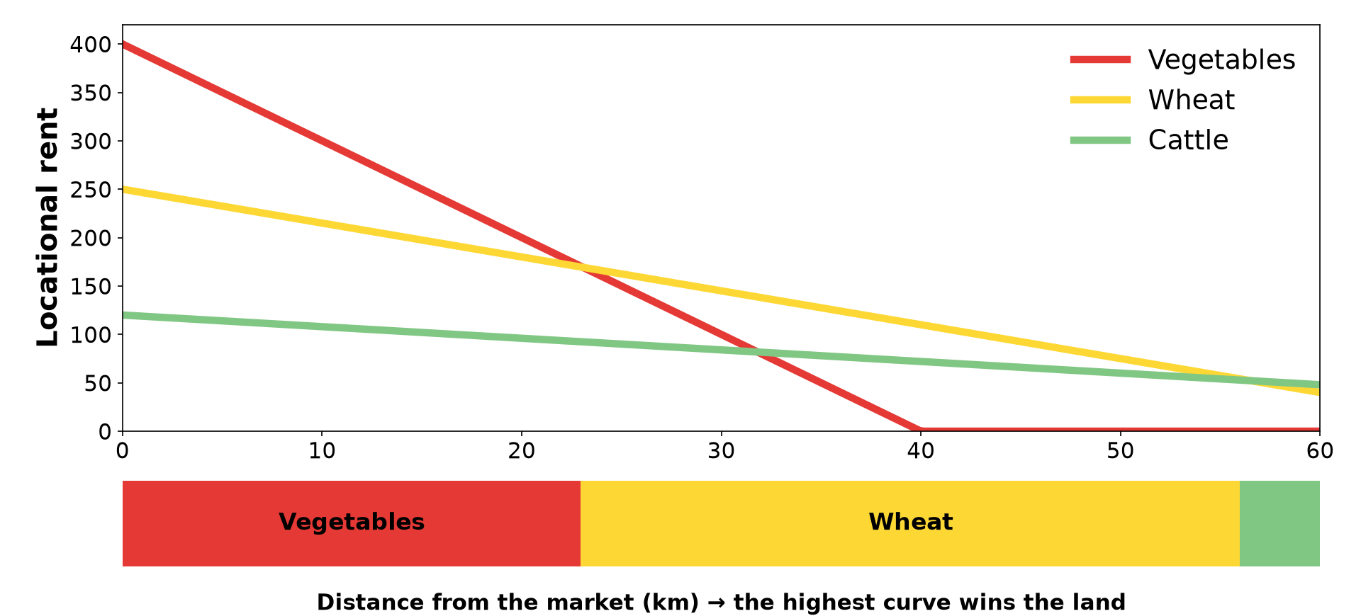
1. PRINCIPLE
Activity 1
Locational rent curves.
Notes:
Activity 1. Look carefully at this diagram: locational rent curves. Observe every detail before I ask the question.

Slide 19
1. PRINCIPLE
Activity 1: Question
What is locational rent?
Notes:
Here is the question for Activity 1: What is locational rent? Take one minute to think and write your answer in your rough notebook.

Slide 20
1. PRINCIPLE
Activity 1: Answer
The profit from a piece of land after production and transport costs; it falls with distance from the market.
Notes:
Let us check the answer together. The profit from a piece of land after production and transport costs; it falls with distance from the market.

Slide 21

2. ASSUMPTIONS
Activity 2
Von Thünen's model.
Notes:
Activity 2. Look carefully at this diagram: von Thünen's model. Observe every detail before I ask the question.

Slide 22
2. ASSUMPTIONS
Activity 2: Question
Give three assumptions of the model.
Notes:
Here is the question for Activity 2: Give three assumptions of the model. Take one minute to think and write your answer in your rough notebook.

Slide 23
2. ASSUMPTIONS
Activity 2: Answer
An isolated state with one central market, flat land of equal fertility, and transport costs that rise with distance.
Notes:
Let us check the answer together. An isolated state with one central market, flat land of equal fertility, and transport costs that rise with distance.

Slide 24
3. SPATIAL OUTCOME
Activity 3
The rings of land use.
Notes:
Activity 3. Look carefully at this diagram: the rings of land use. Observe every detail before I ask the question.

Slide 25
3. SPATIAL OUTCOME
Activity 3: Question
Name the four rings from the centre.
Notes:
Here is the question for Activity 3: Name the four rings from the centre. Take one minute to think and write your answer in your rough notebook.

Slide 26
3. SPATIAL OUTCOME
Activity 3: Answer
Market gardening and dairy, forestry, arable crops, livestock ranching.
Notes:
Let us check the answer together. Market gardening and dairy, forestry, arable crops, livestock ranching.

Slide 27

3. CONCLUSION
Activity 4
A town market.
Notes:
Activity 4. Look carefully at this picture: a town market. Observe every detail before I ask the question.

Slide 28
3. CONCLUSION
Activity 4: Question
Why are vegetables grown near the town?
Notes:
Here is the question for Activity 4: Why are vegetables grown near the town? Take one minute to think and write your answer in your rough notebook.

Slide 29
3. CONCLUSION
Activity 4: Answer
They are perishable and heavy to transport, so they give high rent near the market.
Notes:
Let us check the answer together. They are perishable and heavy to transport, so they give high rent near the market.

Slide 30
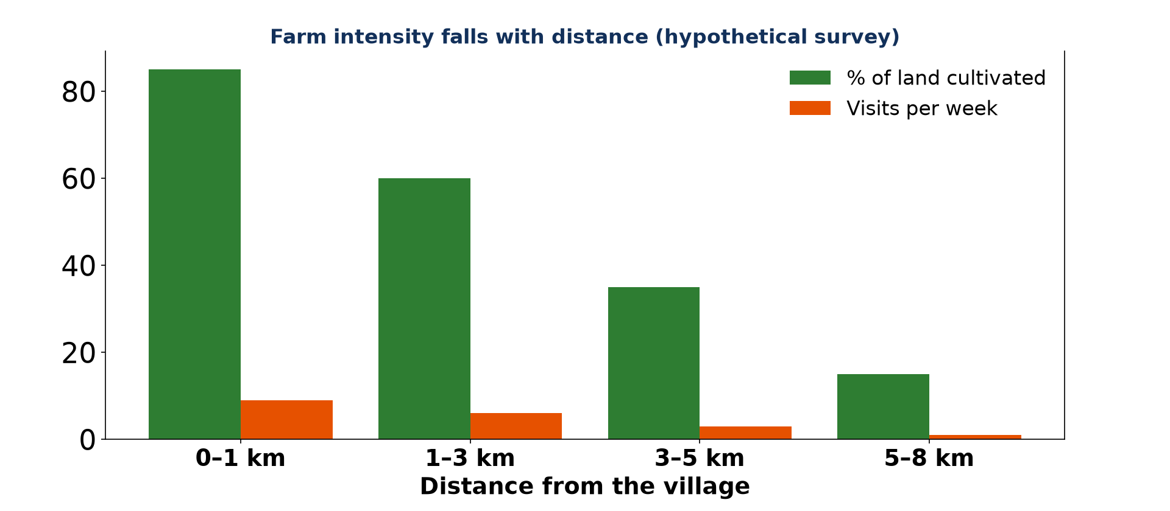
4. APPLICATION
Activity 5
Farm intensity and distance.
Notes:
Activity 5. Look carefully at this diagram: farm intensity and distance. Observe every detail before I ask the question.

Slide 31
4. APPLICATION
Activity 5: Question
Where can the model be applied?
Notes:
Here is the question for Activity 5: Where can the model be applied? Take one minute to think and write your answer in your rough notebook.

Slide 32
4. APPLICATION
Activity 5: Answer
Around towns in Africa, such as Garoua, and around villages (farm intensity falls with distance).
Notes:
Let us check the answer together. Around towns in Africa, such as Garoua, and around villages (farm intensity falls with distance).

Slide 33
BOARD SUMMARY
Board Summary
Topic: Managing Resources for Development through Economic Activities
Sub-topic: Agriculture as an Economic Activity of the Primary Sector
Lesson 33: Spatial Patterns of Agriculture: Von Thünen's Model of Agricultural Land Use
Notes:
Now we are going to copy the board summary. Write the title and the headings neatly in your notebooks. I will give you enough time for each slide, so do not rush.

Slide 34
BOARD SUMMARY
DEFINITIONS
The key terms of this lesson are defined as follows:
Locational rent: It is the profit from land after production and transport costs are paid.
Notes:
Let us copy the definitions. The key terms of this lesson are defined as follows. On this slide we have Locational rent. Write each point on a new line, with the key term first, and explain it in your own words when we revise.

Slide 35
BOARD SUMMARY
1. Principle and Assumptions
Von Thünen (1826) based his model on the following ideas:
Principle: Locational rent falls as the distance from the market increases.
Isolated state: There is one central market town and no trade with the outside.
Notes:
Let us copy Principle and Assumptions. Von Thünen (1826) based his model on the following ideas. On this slide we have Principle and Isolated state. Write each point on a new line, with the key term first, and explain it in your own words when we revise. When you finish, we go to the next slide.

Slide 36
BOARD SUMMARY
1. Principle and Assumptions (continued)
Uniform land: The land is flat and equally fertile everywhere.
Transport: Transport costs rise with distance and farmers seek maximum profit.
Notes:
We continue with Principle and Assumptions. On this slide we have Uniform land and Transport. Write each point on a new line, with the key term first, and explain it in your own words when we revise.

Slide 37
BOARD SUMMARY
2. Conclusions and Spatial Outcome
Land use forms rings around the market:
Ring 1: Market gardening and dairy farming near the town.
Ring 2: Forestry for firewood and timber.
Ring 3: Arable crops such as cereals.
Notes:
Let us copy Conclusions and Spatial Outcome. Land use forms rings around the market. On this slide we have Ring 1, Ring 2 and Ring 3. Write each point on a new line, with the key term first, and explain it in your own words when we revise. When you finish, we go to the next slide.

Slide 38
BOARD SUMMARY
2. Conclusions and Spatial Outcome (continued)
Ring 4: Livestock ranching far from the town.
Notes:
We continue with Conclusions and Spatial Outcome. On this slide we have Ring 4. Write each point on a new line, with the key term first, and explain it in your own words when we revise.

Slide 39
BOARD SUMMARY
2. Conclusions and Spatial Outcome
Illustration: Von Thünen's rings
Notes:
Now draw this illustration in your notebook: von Thünen's rings. Give it a title and label it clearly.

Slide 40
BOARD SUMMARY
3. Areas where Applicable
The model applies in the following areas:
Examples: Rings of land use can be seen around African towns such as Garoua and around villages.
Notes:
Let us copy Areas where Applicable. The model applies in the following areas. On this slide we have Examples. Write each point on a new line, with the key term first, and explain it in your own words when we revise.

Slide 41
FORMATIVE EVALUATION
Evaluation 1
What is locational rent?
Notes:
Now let us check what you have understood. Question 1: What is locational rent? Answer in your exercise book.

Slide 42
FORMATIVE EVALUATION
Expected Answer
Profit from land after production and transport costs.
Notes:
The expected answer is: profit from land after production and transport costs. If you got it right, well done.

Slide 43
FORMATIVE EVALUATION
Evaluation 2
Name the four rings of Von Thünen's model.
Notes:
Now let us check what you have understood. Question 2: Name the four rings of Von Thünen's model. Answer in your exercise book.

Slide 44
FORMATIVE EVALUATION
Expected Answer
Market gardening/dairy, forestry, arable, ranching.
Notes:
The expected answer is: market gardening/dairy, forestry, arable, ranching. If you got it right, well done.

Slide 45
REMEDIATION
Remediation
Fill in the blanks:
Von Thünen's model has ______ rings.
The first ring is market ______.
Rent ______ with distance from the market.
Notes:
For those who need more practice, fill in the blanks in your exercise book. The answers are: number 1, four; number 2, gardening; number 3, falls.

Slide 46
HOMEWORK
Homework
Draw the land use around your town or village and compare it with Von Thünen's rings.
Notes:
For your homework: Draw the land use around your town or village and compare it with Von Thünen's rings. We shall correct it at the beginning of our next lesson.

Slide 47
NEXT LESSON
Next Lesson
Our next lesson will be on:
Lesson 34: Arable Agriculture in Cameroon
Notes:
Our next lesson will be on Lesson 34: Arable Agriculture in Cameroon. Thank you for your attention, and see you next time.

Slide 48
BILINGUAL GAME
Bilingual Game (Jeu Bilingue)
English | Français
Land use | L'utilisation du sol
Rent | La rente
Ring | L'anneau
Market | Le marché
Distance | La distance
Model | Le modèle
Notes:
Let us play the bilingual game. I say a word in English, and you give me the French word. Then we do the reverse.

Slide 49
LOGBOOK
Official Logbook (1/2)
Module / Topic | Managing Resources for Development through Economic Activities
Lesson Title | Lesson 33: Spatial Patterns of Agriculture: Von Thünen's Model of Agricultural Land Use
Expected Learning Outcomes | State the principle of locational rent. Give the main assumptions of the model. Draw the spatial outcome and give examples.
Competence | Learners are able to explain Von Thünen's model and apply it to real areas.
Notes:
I record this information in the official logbook of the class after the lesson.

Slide 50
LOGBOOK
Official Logbook (2/2)
Matter Taught | DEFINITIONS; Principle and Assumptions; Conclusions and Spatial Outcome; Areas where Applicable.
Evaluation | Formative evaluation and remediation exercise.
Homework | Draw the land use around your town or village and compare it with Von Thünen's rings.
Enrolment / Present / Absent | ____ / ____ / ____
Achievement | To be completed after the lesson.
Notes:
I complete the second page of the logbook: the matter taught, the evaluation, the homework and the attendance.

Slide 51
TEACHER'S NOTE
Teacher's Note
Timing: Homework correction, plan, objectives 8 min | Recall, situation, action 10 min | 5 activities 30 min | Board summary (copying) 30 min | Evaluation, remediation 10 min | Homework, next lesson 5 min | Logbook 7 min
Without the projector (Activity 1): explain with an example.
Without the projector (Activity 2): list assumptions.
Without the projector (Activity 3): draw the rings.
Without the projector (Activity 4): discuss vegetables of Garoua.
Without the projector (Activity 5): map farming around Garoua.
Notes:
This slide is for me, the teacher: it gives the timing of the lesson and what to do if the projector is not available.

Slide 52
REFERENCES
References
Geography Syllabus, Forms I–V, MINESEC (2023) — Form 4, Module II: Development and the Management of Primary Resources.
Photo, Activity 4: “Sandga Market in Douala, Cameroon” by The Advocacy Project, CC BY-NC-SA 2.0, via Flickr (https://www.flickr.com/photos/42487558@N00/3636438732)
Diagrams and animations: drawn for this lesson (Geography Department).
Notes:
These are the references and picture credits used to prepare this lesson.

