Slide 1
FORM 4
GEOGRAPHY
Lesson 41
Fish Resources and their Management
Notes:
Good morning, class, and welcome to our geography lesson. I am your geography teacher, Mr Kamdem. Today we are starting Lesson 41: Fish Resources and their Management.

Slide 2
CLASS INFO
Class, Chapter and Duration
Class | Form 4
Chapter | Module II: Development and the Management of Primary Resources
Duration | 2 periods (2 × 50 minutes)
Notes:
This lesson is for Form 4. It belongs to Module II: Development and the Management of Primary Resources. We shall need 2 periods to cover it.

Slide 3
IDENTIFICATION
Lesson Identification
Topic | Management of Primary Resources
Sub-topic | Forestry, Fishing and Mining as Economic Activities of the Primary Sector
Lesson | Lesson 41: Fish Resources and their Management
Notions / Concepts | Fishing ground, pisciculture, refrigeration, overfishing.
Syllabus focus | Meaning; global stock and distribution of major fishing grounds; importance of fish resources to the economy; conservation of fish resources.
Competence | Learners are able to locate major fishing grounds and explain the conservation of fish resources.
Notes:
Our topic is Management of Primary Resources, and the sub-topic is Forestry, Fishing and Mining as Economic Activities of the Primary Sector. The key notions we shall use today are: fishing ground, pisciculture, refrigeration, overfishing. At the end, you should be able to do this: learners are able to locate major fishing grounds and explain the conservation of fish resources.

Slide 4

HOMEWORK CORRECTION
Correction of the Homework
Question (Practical Work 10: Description of Vegetation on Maps):
Describe the vegetation of a map extract and give two reasons for its pattern.
Notes:
Before we start the new lesson, let us correct the homework I gave you at the end of Practical Work 10: Description of Vegetation on Maps. The question was: Describe the vegetation of a map extract and give two reasons for its pattern. Take out your exercise books.

Slide 5
HOMEWORK CORRECTION
Correction: Possible Answer
A good answer locates each vegetation type with grid references and directions and explains it by relief (forest on steep slopes), drainage (swamp on low wet land) or human activity (clearing near villages).
Notes:
Here is a good answer. A good answer locates each vegetation type with grid references and directions and explains it by relief (forest on steep slopes), drainage (swamp on low wet land) or human activity (clearing near villages). Compare it with your own answer and correct your work in red.

Slide 6
LESSON PLAN
Lesson Plan
Correction of the homework
Objectives and recall
Real-life situation and action to take
Learning activities
Board summary
Evaluation, remediation and homework
Notes:
Here is the plan of our lesson today. First, we shall correct the homework. Then we shall look at the objectives and recall what you already know. After that, we shall study a situation from real life and the action to take, and do the learning activities. Finally, we shall copy the board summary, do the evaluation and the remediation, and I will give you the homework.

Slide 7
OBJECTIVES
Objectives
By the end of this lesson, you should be able to:
Define fish resources and fishing grounds.
Locate the major fishing grounds of the world.
Notes:
Take your time to copy this part; we will continue together.

Slide 8
OBJECTIVES
Objectives (continued)
Explain the importance and conservation of fish resources.
Notes:
By the end of this lesson, you should be able to do three things. Number 1: define fish resources and fishing grounds. Number 2: locate the major fishing grounds of the world. Number 3: explain the importance and conservation of fish resources.

Slide 9
PREVIOUS KNOWLEDGE
Previous Knowledge
People eat fish from rivers and the sea.
Cold ocean currents bring plankton.
Too much fishing reduces fish.
Notes:
Let us first remember what you already know. People eat fish from rivers and the sea. Cold ocean currents bring plankton. Too much fishing reduces fish. Keep this in mind, because we shall build on it today.

Slide 10
REAL-LIFE SITUATION
Situation in Real Life
Big foreign trawlers fish near the coast of West Africa. Local fishermen in canoes say they catch fewer fish every year.
Notes:
Listen carefully to this situation from real life. Big foreign trawlers fish near the coast of West Africa. Local fishermen in canoes say they catch fewer fish every year. Think about it, because I am going to ask you some questions.

Slide 11
REAL-LIFE SITUATION
Situation: Question 1
What is the problem in the situation?
Notes:
Question 1: What is the problem in the situation? Think for a moment, then raise your hand to answer.

Slide 12
REAL-LIFE SITUATION
Answer
Fish are becoming scarce.
Notes:
Good. Fish are becoming scarce.

Slide 13
REAL-LIFE SITUATION
Situation: Question 2
Who catches the most fish?
Notes:
Question 2: Who catches the most fish? Think for a moment, then raise your hand to answer.

Slide 14
REAL-LIFE SITUATION
Answer
Big foreign trawlers.
Notes:
Good. Big foreign trawlers.

Slide 15
REAL-LIFE SITUATION
Situation: Question 3
What is too much fishing called?
Notes:
Question 3: What is too much fishing called? Think for a moment, then raise your hand to answer.

Slide 16
REAL-LIFE SITUATION
Possible Answer
Overfishing.
Notes:
Good. Overfishing.

Slide 17
ACTION TO TAKE
Action to Take
Respect fishing seasons and net sizes.
Notes:
From this situation, the action we are working towards in this lesson is the following: respect fishing seasons and net sizes.

Slide 18
JUSTIFICATION
Justification of the Lesson
This lesson helps us to understand and protect fish resources.
Notes:
Why is this lesson important for you? This lesson helps us to understand and protect fish resources.

Slide 19

1. MEANING
Activity 1
Fishermen in canoes.
Notes:
Activity 1. Look carefully at this picture: fishermen in canoes. Observe every detail before I ask the question.

Slide 20
1. MEANING
Activity 1: Question
What is a fishing ground?
Notes:
Here is the question for Activity 1: What is a fishing ground? Take one minute to think and write your answer in your rough notebook.

Slide 21
1. MEANING
Activity 1: Answer
An area of sea or inland water where many fish are caught.
Notes:
Let us check the answer together. An area of sea or inland water where many fish are caught.

Slide 22

2. MAJOR FISHING GROUNDS
Activity 2
Ocean currents.
Notes:
Activity 2. Look carefully at this diagram: ocean currents. Observe every detail before I ask the question.

Slide 23
2. MAJOR FISHING GROUNDS
Activity 2: Question
Name three major fishing grounds of the world.
Notes:
Here is the question for Activity 2: Name three major fishing grounds of the world. Take one minute to think and write your answer in your rough notebook.

Slide 24
2. MAJOR FISHING GROUNDS
Activity 2: Answer
The North-West Atlantic (Newfoundland), the North-East Atlantic (North Sea) and the North-West Pacific (Japan) (also Peru).
Notes:
Let us check the answer together. The North-West Atlantic (Newfoundland), the North-East Atlantic (North Sea) and the North-West Pacific (Japan) (also Peru).

Slide 25
2. WHY THERE?
Activity 3
Meeting of warm and cold currents.
Notes:
Activity 3. Look carefully at this diagram: meeting of warm and cold currents. Observe every detail before I ask the question.

Slide 26
2. WHY THERE?
Activity 3: Question
Why are these areas rich in fish?
Notes:
Here is the question for Activity 3: Why are these areas rich in fish? Take one minute to think and write your answer in your rough notebook.

Slide 27
2. WHY THERE?
Activity 3: Answer
Shallow continental shelves and meeting of warm and cold currents bring much plankton.
Notes:
Let us check the answer together. Shallow continental shelves and meeting of warm and cold currents bring much plankton.

Slide 28

3. IMPORTANCE
Activity 4
A fish market.
Notes:
Activity 4. Look carefully at this picture: a fish market. Observe every detail before I ask the question.

Slide 29
3. IMPORTANCE
Activity 4: Question
Give two importance of fish resources.
Notes:
Here is the question for Activity 4: Give two importance of fish resources. Take one minute to think and write your answer in your rough notebook.

Slide 30
3. IMPORTANCE
Activity 4: Answer
Food rich in protein and jobs for fishermen and traders (also exports).
Notes:
Let us check the answer together. Food rich in protein and jobs for fishermen and traders (also exports).

Slide 31
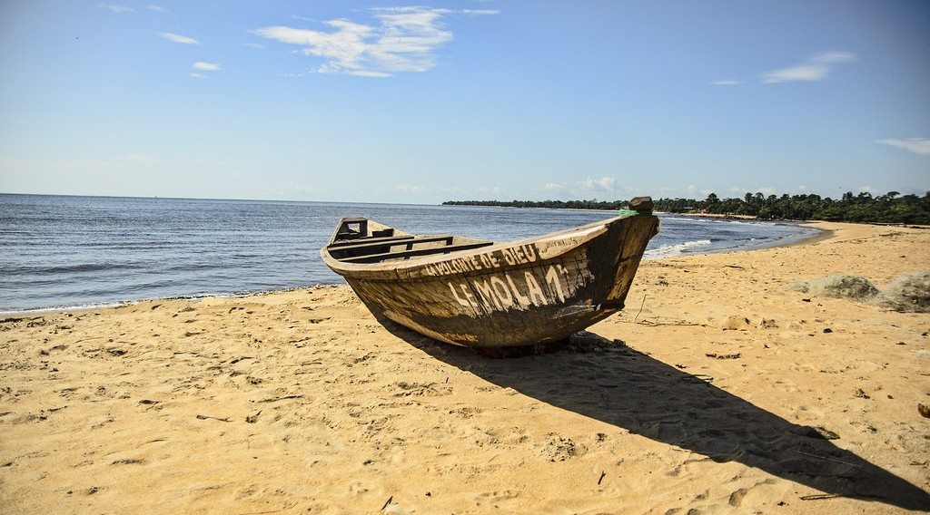
4. CONSERVATION
Activity 5
A fishing boat on the beach.
Notes:
Activity 5. Look carefully at this picture: a fishing boat on the beach. Observe every detail before I ask the question.

Slide 32
4. CONSERVATION
Activity 5: Question
Give three ways to conserve fish resources.
Notes:
Here is the question for Activity 5: Give three ways to conserve fish resources. Take one minute to think and write your answer in your rough notebook.

Slide 33
4. CONSERVATION
Activity 5: Answer
Fishing seasons and quotas, control of net sizes and fish farming (pisciculture).
Notes:
Let us check the answer together. Fishing seasons and quotas, control of net sizes and fish farming (pisciculture).

Slide 34
BOARD SUMMARY
Board Summary
Topic: Management of Primary Resources
Sub-topic: Forestry, Fishing and Mining as Economic Activities of the Primary Sector
Lesson 41: Fish Resources and their Management
Notes:
Now we are going to copy the board summary. Write the title and the headings neatly in your notebooks. I will give you enough time for each slide, so do not rush.

Slide 35
BOARD SUMMARY
DEFINITIONS
The key terms of this lesson are defined as follows:
Fishing ground: It is an area of water where many fish are caught.
Pisciculture: It is the rearing of fish in ponds.
Notes:
Let us copy the definitions. The key terms of this lesson are defined as follows. On this slide we have Fishing ground and Pisciculture. Write each point on a new line, with the key term first, and explain it in your own words when we revise.

Slide 36
BOARD SUMMARY
1. Major Fishing Grounds
The major fishing grounds of the world are the following:
North-West Atlantic: It includes the Grand Banks of Newfoundland.
North-East Atlantic: It includes the North Sea and the coasts of Norway.
Notes:
Let us copy Major Fishing Grounds. The major fishing grounds of the world are the following. On this slide we have North-West Atlantic and North-East Atlantic. Write each point on a new line, with the key term first, and explain it in your own words when we revise. When you finish, we go to the next slide.

Slide 37
BOARD SUMMARY
1. Major Fishing Grounds (continued)
North-West Pacific and Peru: They include the seas around Japan and the Peruvian coast.
Reasons: Shallow continental shelves and cold currents bring much plankton.
Notes:
We continue with Major Fishing Grounds. On this slide we have North-West Pacific and Peru and Reasons. Write each point on a new line, with the key term first, and explain it in your own words when we revise.

Slide 38
BOARD SUMMARY
1. Major Fishing Grounds
Illustration: ocean currents
Notes:
Now draw this illustration in your notebook: ocean currents. Give it a title and label it clearly.

Slide 39
BOARD SUMMARY
2. Importance and Conservation
Fish resources are important and must be conserved:
Importance: Fish is a cheap source of protein and gives jobs and export income.
Conservation: Fishing seasons, quotas, control of net sizes, refrigeration and pisciculture protect fish stocks.
Notes:
Let us copy Importance and Conservation. Fish resources are important and must be conserved. On this slide we have Importance and Conservation. Write each point on a new line, with the key term first, and explain it in your own words when we revise.

Slide 40
FORMATIVE EVALUATION
Evaluation 1
Name two major fishing grounds.
Notes:
Now let us check what you have understood. Question 1: Name two major fishing grounds. Answer in your exercise book.

Slide 41
FORMATIVE EVALUATION
Expected Answer
The North Sea and the Grand Banks of Newfoundland.
Notes:
The expected answer is: the North Sea and the Grand Banks of Newfoundland. If you got it right, well done.

Slide 42
FORMATIVE EVALUATION
Evaluation 2
Give two conservation measures.
Notes:
Now let us check what you have understood. Question 2: Give two conservation measures. Answer in your exercise book.

Slide 43
FORMATIVE EVALUATION
Expected Answer
Quotas and control of net sizes.
Notes:
The expected answer is: quotas and control of net sizes. If you got it right, well done.

Slide 44
REMEDIATION
Remediation
Fill in the blanks:
Fish feed on tiny organisms called ______.
Rearing fish in ponds is ______.
Catching too many fish is ______.
Notes:
For those who need more practice, fill in the blanks in your exercise book. The answers are: number 1, plankton; number 2, pisciculture; number 3, overfishing.

Slide 45
HOMEWORK
Homework
List three places in Cameroon where people fish.
Notes:
For your homework: List three places in Cameroon where people fish. We shall correct it at the beginning of our next lesson.

Slide 46
NEXT LESSON
Next Lesson
Our next lesson will be on:
Lesson 42: The Management of Fish Resources in Cameroon
Notes:
Our next lesson will be on Lesson 42: The Management of Fish Resources in Cameroon. Thank you for your attention, and see you next time.

Slide 47
BILINGUAL GAME
Bilingual Game (Jeu Bilingue)
English | Français
Fish | Le poisson
Fishing | La pêche
Net | Le filet
Trawler | Le chalutier
Fish farming | La pisciculture
Current | Le courant
Notes:
Let us play the bilingual game. I say a word in English, and you give me the French word. Then we do the reverse.

Slide 48
LOGBOOK
Official Logbook (1/2)
Module / Topic | Management of Primary Resources
Lesson Title | Lesson 41: Fish Resources and their Management
Expected Learning Outcomes | Define fish resources and fishing grounds. Locate the major fishing grounds of the world. Explain the importance and conservation of fish resources.
Competence | Learners are able to locate major fishing grounds and explain the conservation of fish resources.
Notes:
I record this information in the official logbook of the class after the lesson.

Slide 49
LOGBOOK
Official Logbook (2/2)
Matter Taught | DEFINITIONS; Major Fishing Grounds; Importance and Conservation.
Evaluation | Formative evaluation and remediation exercise.
Homework | List three places in Cameroon where people fish.
Enrolment / Present / Absent | ____ / ____ / ____
Achievement | To be completed after the lesson.
Notes:
I complete the second page of the logbook: the matter taught, the evaluation, the homework and the attendance.

Slide 50
TEACHER'S NOTE
Teacher's Note
Timing: Homework correction, plan, objectives 8 min | Recall, situation, action 10 min | 5 activities 30 min | Board summary (copying) 30 min | Evaluation, remediation 10 min | Homework, next lesson 5 min | Logbook 7 min
Without the projector (Activity 1): name local fishing places.
Without the projector (Activity 2): use the atlas.
Without the projector (Activity 3): discuss.
Without the projector (Activity 4): discuss.
Without the projector (Activity 5): list measures.
Notes:
This slide is for me, the teacher: it gives the timing of the lesson and what to do if the projector is not available.

Slide 51
REFERENCES
References
Geography Syllabus, Forms I–V, MINESEC (2023) — Form 4, Module II: Development and the Management of Primary Resources.
Photo, Activity 1: “Fishermen, Lake Tana” by A.Davey, CC BY 2.0, via Flickr (https://www.flickr.com/photos/40595948@N00/2260748777)
Photo, Activity 4: “Kenyan food, farming and landscapes” by CGIAR Climate, CC BY-NC-SA 2.0, via Flickr (https://www.flickr.com/photos/55227776@N04/14310899853)
Photo, Activity 5: “Empty beaches” by ludwig.troller, CC BY-NC 2.0, via Flickr (https://www.flickr.com/photos/124845120@N03/14285811155)
Diagrams and animations: drawn for this lesson (Geography Department).
Notes:
These are the references and picture credits used to prepare this lesson.

