Slide 1
FORM 4
GEOGRAPHY
Lesson 43
Mineral Resources and their Management
Notes:
Good morning, class, and welcome to our geography lesson. I am your geography teacher, Mr Kamdem. Today we are starting Lesson 43: Mineral Resources and their Management.

Slide 2
CLASS INFO
Class, Chapter and Duration
Class | Form 4
Chapter | Module II: Development and the Management of Primary Resources
Duration | 2 periods (2 × 50 minutes)
Notes:
This lesson is for Form 4. It belongs to Module II: Development and the Management of Primary Resources. We shall need 2 periods to cover it.

Slide 3
IDENTIFICATION
Lesson Identification
Topic | Management of Primary Resources
Sub-topic | Forestry, Fishing and Mining as Economic Activities of the Primary Sector
Lesson | Lesson 43: Mineral Resources and their Management
Notions / Concepts | Mineral, metallic minerals, non-metallic minerals, conservation.
Syllabus focus | Meaning; global stock and distribution; importance to the economy; conservation of mineral resources.
Competence | Learners are able to classify minerals, locate them and explain their conservation.
Notes:
Our topic is Management of Primary Resources, and the sub-topic is Forestry, Fishing and Mining as Economic Activities of the Primary Sector. The key notions we shall use today are: mineral, metallic minerals, non-metallic minerals, conservation. At the end, you should be able to do this: learners are able to classify minerals, locate them and explain their conservation.

Slide 4

HOMEWORK CORRECTION
Correction of the Homework
Question (Lesson 42: The Management of Fish Resources in Cameroon):
Visit a fish market and write the types of fish sold and where they come from.
Notes:
Before we start the new lesson, let us correct the homework I gave you at the end of Lesson 42: The Management of Fish Resources in Cameroon. The question was: Visit a fish market and write the types of fish sold and where they come from. Take out your exercise books.

Slide 5
HOMEWORK CORRECTION
Correction: Possible Answer
Answers vary. Example: tilapia and catfish from Lagdo and the Benue; frozen mackerel from the sea (often imported).
Notes:
Here is a good answer. Answers vary. Example: tilapia and catfish from Lagdo and the Benue; frozen mackerel from the sea (often imported). Compare it with your own answer and correct your work in red.

Slide 6
LESSON PLAN
Lesson Plan
Correction of the homework
Objectives and recall
Real-life situation and action to take
Learning activities
Board summary
Evaluation, remediation and homework
Notes:
Here is the plan of our lesson today. First, we shall correct the homework. Then we shall look at the objectives and recall what you already know. After that, we shall study a situation from real life and the action to take, and do the learning activities. Finally, we shall copy the board summary, do the evaluation and the remediation, and I will give you the homework.

Slide 7
OBJECTIVES
Objectives
By the end of this lesson, you should be able to:
Define and classify mineral resources.
Describe their global distribution.
Explain their importance and conservation.
Notes:
By the end of this lesson, you should be able to do three things. Number 1: define and classify mineral resources. Number 2: describe their global distribution. Number 3: explain their importance and conservation.

Slide 8
PREVIOUS KNOWLEDGE
Previous Knowledge
Minerals come from the ground.
Iron is used to make tools.
Minerals do not renew.
Notes:
Let us first remember what you already know. Minerals come from the ground. Iron is used to make tools. Minerals do not renew. Keep this in mind, because we shall build on it today.

Slide 9
REAL-LIFE SITUATION
Situation in Real Life
Phones, cars and roofing sheets are made from metals dug from the ground. Experts warn that some minerals may run out in the future.
Notes:
Listen carefully to this situation from real life. Phones, cars and roofing sheets are made from metals dug from the ground. Experts warn that some minerals may run out in the future. Think about it, because I am going to ask you some questions.

Slide 10
REAL-LIFE SITUATION
Situation: Question 1
What is the problem in the situation?
Notes:
Question 1: What is the problem in the situation? Think for a moment, then raise your hand to answer.

Slide 11
REAL-LIFE SITUATION
Answer
Minerals are useful but can run out.
Notes:
Good. Minerals are useful but can run out.

Slide 12
REAL-LIFE SITUATION
Situation: Question 2
Name one metal used in daily life.
Notes:
Question 2: Name one metal used in daily life. Think for a moment, then raise your hand to answer.

Slide 13
REAL-LIFE SITUATION
Answer
Iron (also aluminium, copper).
Notes:
Good. Iron (also aluminium, copper).

Slide 14
REAL-LIFE SITUATION
Situation: Question 3
Why can minerals run out?
Notes:
Question 3: Why can minerals run out? Think for a moment, then raise your hand to answer.

Slide 15
REAL-LIFE SITUATION
Possible Answer
They are non-renewable.
Notes:
Good. They are non-renewable.

Slide 16
ACTION TO TAKE
Action to Take
Reuse and recycle metals.
Notes:
From this situation, the action we are working towards in this lesson is the following: reuse and recycle metals.

Slide 17
JUSTIFICATION
Justification of the Lesson
This lesson helps us to know mineral resources and use them wisely.
Notes:
Why is this lesson important for you? This lesson helps us to know mineral resources and use them wisely.

Slide 18
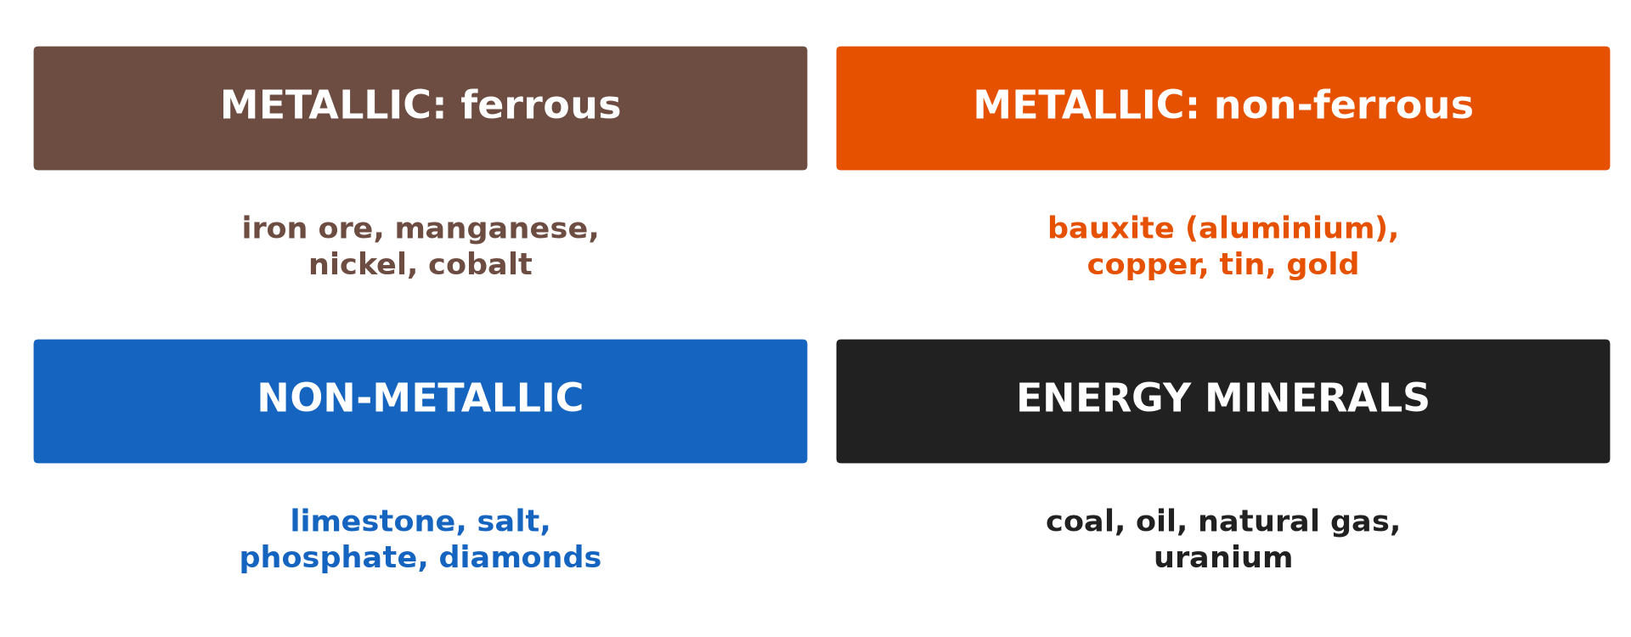
1. MEANING AND CLASSIFICATION
Activity 1
Classification of minerals.
Notes:
Activity 1. Look carefully at this diagram: classification of minerals. Observe every detail before I ask the question.

Slide 19
1. MEANING AND CLASSIFICATION
Activity 1: Question
Distinguish metallic and non-metallic minerals.
Notes:
Here is the question for Activity 1: Distinguish metallic and non-metallic minerals. Take one minute to think and write your answer in your rough notebook.

Slide 20
1. MEANING AND CLASSIFICATION
Activity 1: Answer
Metallic minerals give metals (iron, bauxite, gold); non-metallic do not (limestone, salt).
Notes:
Let us check the answer together. Metallic minerals give metals (iron, bauxite, gold); non-metallic do not (limestone, salt).

Slide 21

2. DISTRIBUTION
Activity 2
An open-pit mine.
Notes:
Activity 2. Look carefully at this picture: an open-pit mine. Observe every detail before I ask the question.

Slide 22
2. DISTRIBUTION
Activity 2: Question
Name two big producers of iron ore and bauxite.
Notes:
Here is the question for Activity 2: Name two big producers of iron ore and bauxite. Take one minute to think and write your answer in your rough notebook.

Slide 23
2. DISTRIBUTION
Activity 2: Answer
Iron ore: Australia and Brazil. Bauxite: Australia and Guinea.
Notes:
Let us check the answer together. Iron ore: Australia and Brazil. Bauxite: Australia and Guinea.

Slide 24

3. IMPORTANCE
Activity 3
A steel works.
Notes:
Activity 3. Look carefully at this picture: a steel works. Observe every detail before I ask the question.

Slide 25
3. IMPORTANCE
Activity 3: Question
Give two importance of minerals.
Notes:
Here is the question for Activity 3: Give two importance of minerals. Take one minute to think and write your answer in your rough notebook.

Slide 26
3. IMPORTANCE
Activity 3: Answer
Raw materials for industry and export income (also jobs).
Notes:
Let us check the answer together. Raw materials for industry and export income (also jobs).

Slide 27
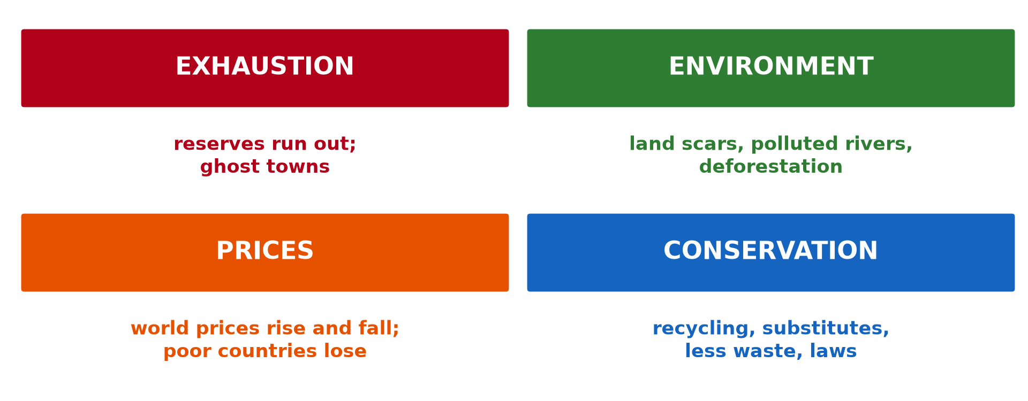
4. CONSERVATION
Activity 4
Problems and conservation.
Notes:
Activity 4. Look carefully at this diagram: problems and conservation. Observe every detail before I ask the question.

Slide 28
4. CONSERVATION
Activity 4: Question
Give three ways to conserve minerals.
Notes:
Here is the question for Activity 4: Give three ways to conserve minerals. Take one minute to think and write your answer in your rough notebook.

Slide 29
4. CONSERVATION
Activity 4: Answer
Recycling, substitution and efficient use (also controlled mining).
Notes:
Let us check the answer together. Recycling, substitution and efficient use (also controlled mining).

Slide 30
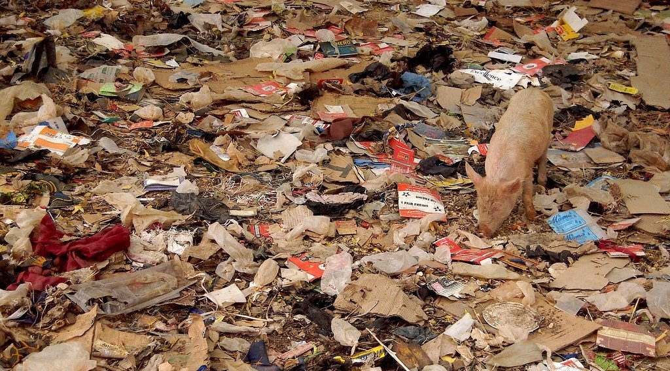
4. CONSERVATION
Activity 5
Scrap and waste.
Notes:
Activity 5. Look carefully at this picture: scrap and waste. Observe every detail before I ask the question.

Slide 31
4. CONSERVATION
Activity 5: Question
How does recycling save minerals?
Notes:
Here is the question for Activity 5: How does recycling save minerals? Take one minute to think and write your answer in your rough notebook.

Slide 32
4. CONSERVATION
Activity 5: Answer
Old metals are melted and reused, so less ore is dug.
Notes:
Let us check the answer together. Old metals are melted and reused, so less ore is dug.

Slide 33
BOARD SUMMARY
Board Summary
Topic: Management of Primary Resources
Sub-topic: Forestry, Fishing and Mining as Economic Activities of the Primary Sector
Lesson 43: Mineral Resources and their Management
Notes:
Now we are going to copy the board summary. Write the title and the headings neatly in your notebooks. I will give you enough time for each slide, so do not rush.

Slide 34
BOARD SUMMARY
DEFINITIONS
The key terms of this lesson are defined as follows:
Mineral: It is a natural substance found in the Earth's crust.
Notes:
Let us copy the definitions. The key terms of this lesson are defined as follows. On this slide we have Mineral. Write each point on a new line, with the key term first, and explain it in your own words when we revise.

Slide 35
BOARD SUMMARY
1. Classification and Distribution
Minerals are classified and distributed as follows:
Metallic minerals: They give metals such as iron, aluminium (bauxite), copper and gold.
Non-metallic minerals: They include limestone, salt, phosphate and diamonds.
Notes:
Let us copy Classification and Distribution. Minerals are classified and distributed as follows. On this slide we have Metallic minerals and Non-metallic minerals. Write each point on a new line, with the key term first, and explain it in your own words when we revise. When you finish, we go to the next slide.

Slide 36
BOARD SUMMARY
1. Classification and Distribution (continued)
Distribution: Australia, Brazil, Guinea, South Africa, Russia and China are major producers.
Notes:
We continue with Classification and Distribution. On this slide we have Distribution. Write each point on a new line, with the key term first, and explain it in your own words when we revise.

Slide 37
BOARD SUMMARY
1. Classification and Distribution
Illustration: classification of minerals
Notes:
Now draw this illustration in your notebook: classification of minerals. Give it a title and label it clearly.

Slide 38
BOARD SUMMARY
2. Importance and Conservation
Minerals are important and must be conserved:
Importance: They are raw materials for industry and bring jobs and export income.
Conservation: Recycling, substitution, efficient use and controlled mining make minerals last.
Notes:
Let us copy Importance and Conservation. Minerals are important and must be conserved. On this slide we have Importance and Conservation. Write each point on a new line, with the key term first, and explain it in your own words when we revise.

Slide 39
FORMATIVE EVALUATION
Evaluation 1
Give two metallic and two non-metallic minerals.
Notes:
Now let us check what you have understood. Question 1: Give two metallic and two non-metallic minerals. Answer in your exercise book.

Slide 40
FORMATIVE EVALUATION
Expected Answer
Iron, gold; limestone, salt.
Notes:
The expected answer is: iron, gold; limestone, salt. If you got it right, well done.

Slide 41
FORMATIVE EVALUATION
Evaluation 2
Give two ways to conserve minerals.
Notes:
Now let us check what you have understood. Question 2: Give two ways to conserve minerals. Answer in your exercise book.

Slide 42
FORMATIVE EVALUATION
Expected Answer
Recycling and substitution.
Notes:
The expected answer is: recycling and substitution. If you got it right, well done.

Slide 43
REMEDIATION
Remediation
Fill in the blanks:
Aluminium is made from ______.
Limestone is a ______ mineral.
Reusing old metals is ______.
Notes:
For those who need more practice, fill in the blanks in your exercise book. The answers are: number 1, bauxite; number 2, non-metallic; number 3, recycling.

Slide 44
HOMEWORK
Homework
List five objects at home made from minerals and name the mineral.
Notes:
For your homework: List five objects at home made from minerals and name the mineral. We shall correct it at the beginning of our next lesson.

Slide 45
NEXT LESSON
Next Lesson
Our next lesson will be on:
Lesson 44: The Management of Mineral Resources in Cameroon
Notes:
Our next lesson will be on Lesson 44: The Management of Mineral Resources in Cameroon. Thank you for your attention, and see you next time.

Slide 46
BILINGUAL GAME
Bilingual Game (Jeu Bilingue)
English | Français
Mineral | Le minerai
Metal | Le métal
Mine | La mine
Iron | Le fer
Gold | L'or
Recycling | Le recyclage
Notes:
Let us play the bilingual game. I say a word in English, and you give me the French word. Then we do the reverse.

Slide 47
LOGBOOK
Official Logbook (1/2)
Module / Topic | Management of Primary Resources
Lesson Title | Lesson 43: Mineral Resources and their Management
Expected Learning Outcomes | Define and classify mineral resources. Describe their global distribution. Explain their importance and conservation.
Competence | Learners are able to classify minerals, locate them and explain their conservation.
Notes:
I record this information in the official logbook of the class after the lesson.

Slide 48
LOGBOOK
Official Logbook (2/2)
Matter Taught | DEFINITIONS; Classification and Distribution; Importance and Conservation.
Evaluation | Formative evaluation and remediation exercise.
Homework | List five objects at home made from minerals and name the mineral.
Enrolment / Present / Absent | ____ / ____ / ____
Achievement | To be completed after the lesson.
Notes:
I complete the second page of the logbook: the matter taught, the evaluation, the homework and the attendance.

Slide 49
TEACHER'S NOTE
Teacher's Note
Timing: Homework correction, plan, objectives 8 min | Recall, situation, action 10 min | 5 activities 30 min | Board summary (copying) 30 min | Evaluation, remediation 10 min | Homework, next lesson 5 min | Logbook 7 min
Without the projector (Activity 1): list minerals.
Without the projector (Activity 2): use the atlas.
Without the projector (Activity 3): discuss.
Without the projector (Activity 4): list ways.
Without the projector (Activity 5): collect cans.
Notes:
This slide is for me, the teacher: it gives the timing of the lesson and what to do if the projector is not available.

Slide 50
REFERENCES
References
Geography Syllabus, Forms I–V, MINESEC (2023) — Form 4, Module II: Development and the Management of Primary Resources.
Photo, Activity 2: “2017-91-06” by Community Archives of Belleville & Hastings County, CC0 1.0, via Flickr (https://www.flickr.com/photos/134017397@N03/37070933734)
Photo, Activity 3: “Belval steel works, Luxembourg, May 1995” by sludgegulper, CC BY-SA 2.0, via Flickr (https://www.flickr.com/photos/28179929@N08/4991135732)
Photo, Activity 5: “Do the evolution” by Marco Bellucci, CC BY 2.0, via Flickr (https://www.flickr.com/photos/50451886@N00/3382099741)
Diagrams and animations: drawn for this lesson (Geography Department).
Notes:
These are the references and picture credits used to prepare this lesson.

