Slide 1
FORM 5
GEOGRAPHY
Practical Work 1
Location of Economic Activities and Description of Land Use
Notes:
Good morning, class, and welcome to our geography lesson. I am your geography teacher, Mr Kamdem. Today we are starting Practical Work 1: Location of Economic Activities and Description of Land Use.

Slide 2
CLASS INFO
Class, Chapter and Duration
Class | Form 5
Chapter | Module I: Management of Manufacturing and Tertiary Activities
Duration | 2 periods (2 × 50 minutes)
Notes:
This lesson is for Form 5. It belongs to Module I: Management of Manufacturing and Tertiary Activities. We shall need 2 periods to cover it.

Slide 3
IDENTIFICATION
Lesson Identification
Topic | Initiation to Map Analysis
Sub-topic | Map Interpretation
Lesson | Practical Work 1: Location of Economic Activities and Description of Land Use
Notions / Concepts | Land use, economic activity, map evidence, sketch map.
Syllabus focus | Identify, describe and explain types of land use and economic activities; draw a sketch map to illustrate the distribution of physical and human activities and land uses.
Competence | Learners are able to identify, describe and explain land uses on a map and draw a sketch map.
Notes:
Our topic is Initiation to Map Analysis, and the sub-topic is Map Interpretation. The key notions we shall use today are: land use, economic activity, map evidence, sketch map. At the end, you should be able to do this: learners are able to identify, describe and explain land uses on a map and draw a sketch map.

Slide 4

HOMEWORK CORRECTION
Correction of the Homework
Question (Lesson 6: Secondary (Manufacturing) Industries in Cameroon):
Draw a sketch map of the industrial regions of Cameroon and name two industries in each.
Notes:
Before we start the new lesson, let us correct the homework I gave you at the end of Lesson 6: Secondary (Manufacturing) Industries in Cameroon. The question was: Draw a sketch map of the industrial regions of Cameroon and name two industries in each. Take out your exercise books.

Slide 5
HOMEWORK CORRECTION
Correction: Possible Answer
Coastal: ALUCAM (Edéa), SONARA (Limbe); Centre: breweries and printing (Yaoundé); West: coffee processing (Bafoussam); North: CICAM (Garoua), CIMENCAM (Figuil).
Notes:
Here is a good answer. Coastal: ALUCAM (Edéa), SONARA (Limbe); Centre: breweries and printing (Yaoundé); West: coffee processing (Bafoussam); North: CICAM (Garoua), CIMENCAM (Figuil). Compare it with your own answer and correct your work in red.

Slide 6
LESSON PLAN
Lesson Plan
Correction of the homework
Objectives and recall
Real-life situation and action to take
Learning activities
Board summary
Evaluation, remediation and homework
Notes:
Here is the plan of our lesson today. First, we shall correct the homework. Then we shall look at the objectives and recall what you already know. After that, we shall study a situation from real life and the action to take, and do the learning activities. Finally, we shall copy the board summary, do the evaluation and the remediation, and I will give you the homework.

Slide 7
OBJECTIVES
Objectives
By the end of this lesson, you should be able to:
Identify types of land use and economic activities on a map.
Describe and explain their distribution.
Draw a sketch map of land uses.
Notes:
By the end of this lesson, you should be able to do three things. Number 1: identify types of land use and economic activities on a map. Number 2: describe and explain their distribution. Number 3: draw a sketch map of land uses.

Slide 8
PREVIOUS KNOWLEDGE
Previous Knowledge
Maps show roads, settlements and vegetation.
Economic activities use land.
A sketch map needs a frame, title and key.
Notes:
Let us first remember what you already know. Maps show roads, settlements and vegetation. Economic activities use land. A sketch map needs a frame, title and key. Keep this in mind, because we shall build on it today.

Slide 9
REAL-LIFE SITUATION
Situation in Real Life
On a map extract, the class sees plantations, a factory near a river, a quarry on a hill and a forest reserve. They must describe and explain these land uses.
Notes:
Listen carefully to this situation from real life. On a map extract, the class sees plantations, a factory near a river, a quarry on a hill and a forest reserve. They must describe and explain these land uses. Think about it, because I am going to ask you some questions.

Slide 10
REAL-LIFE SITUATION
Situation: Question 1
What is the problem in the situation?
Notes:
Question 1: What is the problem in the situation? Think for a moment, then raise your hand to answer.

Slide 11
REAL-LIFE SITUATION
Answer
The class must describe land use on a map.
Notes:
Good. The class must describe land use on a map.

Slide 12
REAL-LIFE SITUATION
Situation: Question 2
Name two land uses on the map.
Notes:
Question 2: Name two land uses on the map. Think for a moment, then raise your hand to answer.

Slide 13
REAL-LIFE SITUATION
Answer
Plantations and a factory (also quarry, forest reserve).
Notes:
Good. Plantations and a factory (also quarry, forest reserve).

Slide 14
REAL-LIFE SITUATION
Situation: Question 3
What evidence do we need?
Notes:
Question 3: What evidence do we need? Think for a moment, then raise your hand to answer.

Slide 15
REAL-LIFE SITUATION
Possible Answer
Symbols, names and grid references.
Notes:
Good. Symbols, names and grid references.

Slide 16
ACTION TO TAKE
Action to Take
Always support land use descriptions with map evidence.
Notes:
From this situation, the action we are working towards in this lesson is the following: always support land use descriptions with map evidence.

Slide 17
JUSTIFICATION
Justification of the Lesson
This practical work helps us to read human activities on maps.
Notes:
Why is this lesson important for you? This practical work helps us to read human activities on maps.

Slide 18
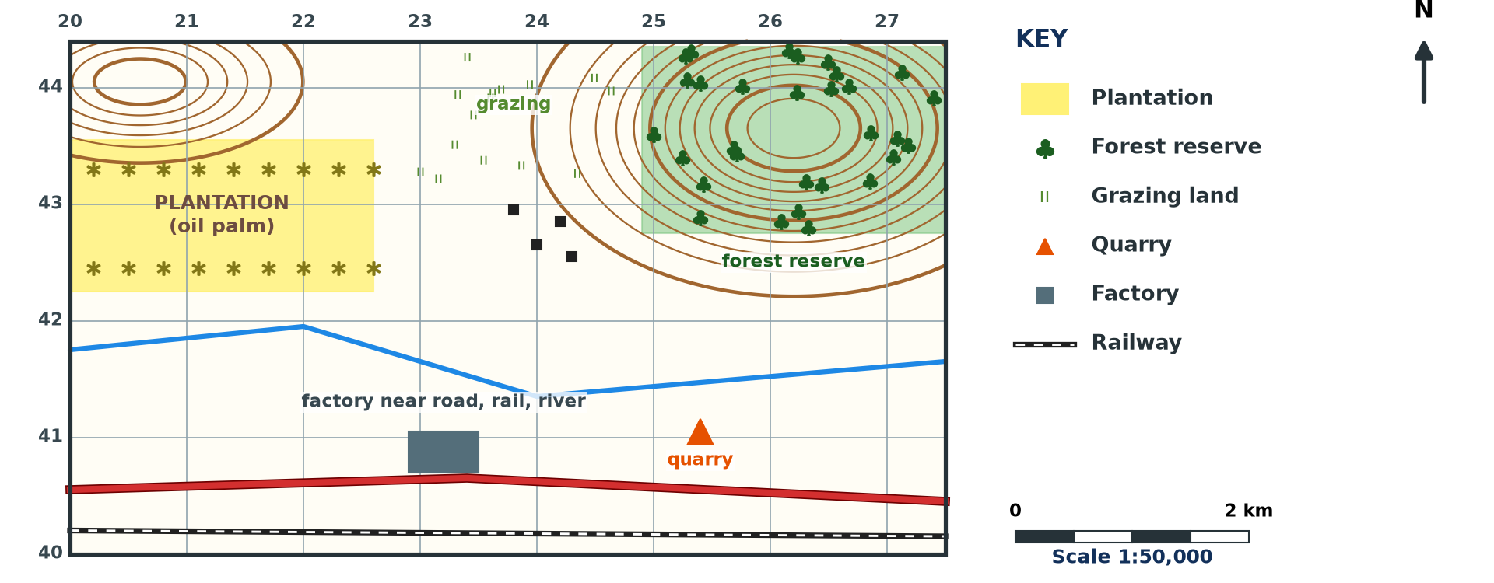
1. IDENTIFICATION
Activity 1
Land use on a map (invented).
Notes:
Activity 1. Look carefully at this diagram: land use on a map (invented). Observe every detail before I ask the question.

Slide 19
1. IDENTIFICATION
Activity 1: Question
Name four land uses on the extract.
Notes:
Here is the question for Activity 1: Name four land uses on the extract. Take one minute to think and write your answer in your rough notebook.

Slide 20
1. IDENTIFICATION
Activity 1: Answer
Plantation, forest reserve, quarry and factory (also grazing, settlements).
Notes:
Let us check the answer together. Plantation, forest reserve, quarry and factory (also grazing, settlements).

Slide 21
2. DESCRIPTION
Activity 2
Describing land use.
Notes:
Activity 2. Look carefully at this diagram: describing land use. Observe every detail before I ask the question.

Slide 22
2. DESCRIPTION
Activity 2: Question
What map evidence shows plantation agriculture?
Notes:
Here is the question for Activity 2: What map evidence shows plantation agriculture? Take one minute to think and write your answer in your rough notebook.

Slide 23
2. DESCRIPTION
Activity 2: Answer
Regular symbols over a large area and names such as "oil palm estate".
Notes:
Let us check the answer together. Regular symbols over a large area and names such as "oil palm estate".

Slide 24
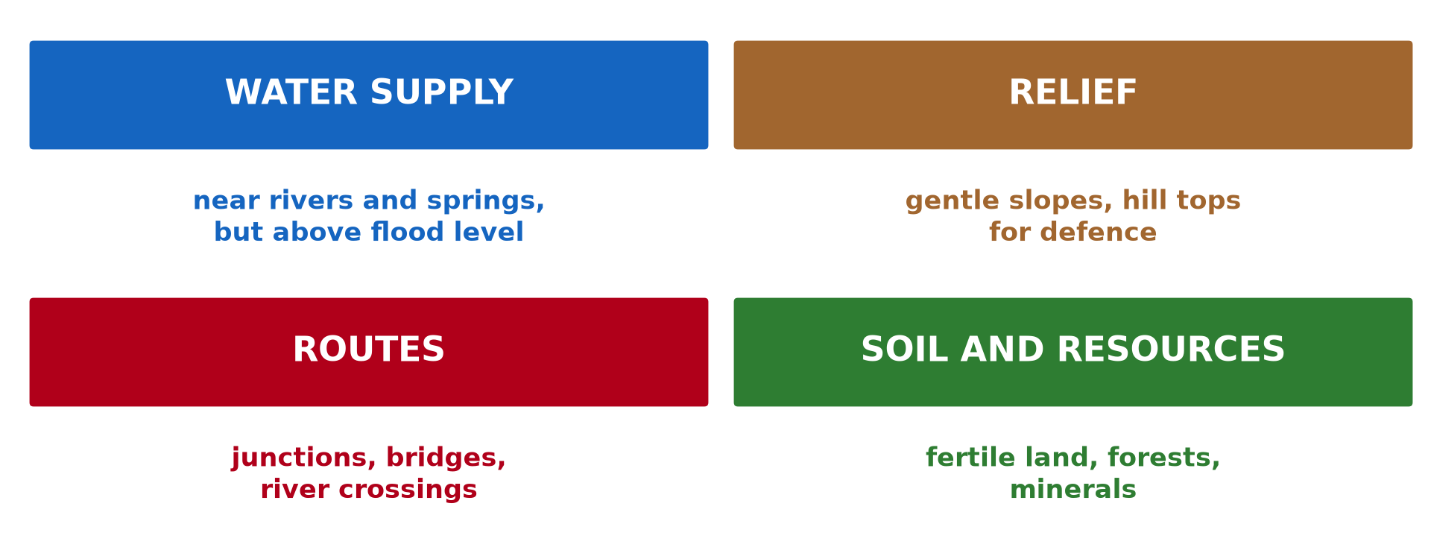
3. EXPLANATION
Activity 3
Physical factors of land use.
Notes:
Activity 3. Look carefully at this diagram: physical factors of land use. Observe every detail before I ask the question.

Slide 25
3. EXPLANATION
Activity 3: Question
Explain the location of the factory near the river and road.
Notes:
Here is the question for Activity 3: Explain the location of the factory near the river and road. Take one minute to think and write your answer in your rough notebook.

Slide 26
3. EXPLANATION
Activity 3: Answer
The river gives water and the road and railway give transport.
Notes:
Let us check the answer together. The river gives water and the road and railway give transport.

Slide 27

3. EXPLANATION
Activity 4
Slopes.
Notes:
Activity 4. Look carefully at this picture: slopes. Observe every detail before I ask the question.

Slide 28
3. EXPLANATION
Activity 4: Question
Why are forest reserves often on hills?
Notes:
Here is the question for Activity 4: Why are forest reserves often on hills? Take one minute to think and write your answer in your rough notebook.

Slide 29
3. EXPLANATION
Activity 4: Answer
Steep slopes are poor for farming and trees protect the soil.
Notes:
Let us check the answer together. Steep slopes are poor for farming and trees protect the soil.

Slide 30

4. SKETCH MAP
Activity 5
Elements of a sketch map.
Notes:
Activity 5. Look carefully at this diagram: elements of a sketch map. Observe every detail before I ask the question.

Slide 31
4. SKETCH MAP
Activity 5: Question
What must a land use sketch map include?
Notes:
Here is the question for Activity 5: What must a land use sketch map include? Take one minute to think and write your answer in your rough notebook.

Slide 32
4. SKETCH MAP
Activity 5: Answer
Frame, title, key, scale, north arrow and the land use zones.
Notes:
Let us check the answer together. Frame, title, key, scale, north arrow and the land use zones.

Slide 33
BOARD SUMMARY
Board Summary
Topic: Initiation to Map Analysis
Sub-topic: Map Interpretation
Practical Work 1: Location of Economic Activities and Description of Land Use
Notes:
Now we are going to copy the board summary. Write the title and the headings neatly in your notebooks. I will give you enough time for each slide, so do not rush.

Slide 34
BOARD SUMMARY
DEFINITIONS
The key terms of this lesson are defined as follows:
Land use: It is the way people use an area of land, such as farming, industry or settlement.
Notes:
Let us copy the definitions. The key terms of this lesson are defined as follows. On this slide we have Land use. Write each point on a new line, with the key term first, and explain it in your own words when we revise.

Slide 35
BOARD SUMMARY
1. Identification and Description
Land uses are identified and described as follows:
Agriculture: Plantations, farms and grazing land are shown by symbols and names.
Industry and mining: Factories, quarries and mines are shown by symbols.
Notes:
Let us copy Identification and Description. Land uses are identified and described as follows. On this slide we have Agriculture and Industry and mining. Write each point on a new line, with the key term first, and explain it in your own words when we revise. When you finish, we go to the next slide.

Slide 36
BOARD SUMMARY
1. Identification and Description (continued)
Other uses: Forest reserves, settlements and recreation areas are also shown.
Evidence: We use symbols, names, grid references and directions.
Notes:
We continue with Identification and Description. On this slide we have Other uses and Evidence. Write each point on a new line, with the key term first, and explain it in your own words when we revise.

Slide 37
BOARD SUMMARY
1. Identification and Description
Illustration: land use on a map
Notes:
Now draw this illustration in your notebook: land use on a map. Give it a title and label it clearly.

Slide 38
BOARD SUMMARY
2. Explanation and Sketch Map
Land uses are explained and drawn as follows:
Relief: Flat land is farmed and built on, while steep slopes are left to forest.
Drainage and transport: Rivers, roads and railways attract factories and settlements.
Notes:
Let us copy Explanation and Sketch Map. Land uses are explained and drawn as follows. On this slide we have Relief and Drainage and transport. Write each point on a new line, with the key term first, and explain it in your own words when we revise. When you finish, we go to the next slide.

Slide 39
BOARD SUMMARY
2. Explanation and Sketch Map (continued)
Sketch map: We draw the land use zones with a frame, title, key, scale and north arrow.
Notes:
We continue with Explanation and Sketch Map. On this slide we have Sketch map. Write each point on a new line, with the key term first, and explain it in your own words when we revise.

Slide 40
FORMATIVE EVALUATION
Evaluation 1
Give two land uses and their map evidence.
Notes:
Now let us check what you have understood. Question 1: Give two land uses and their map evidence. Answer in your exercise book.

Slide 41
FORMATIVE EVALUATION
Expected Answer
Plantation (regular symbols, name); quarry (quarry symbol).
Notes:
The expected answer is: plantation (regular symbols, name); quarry (quarry symbol). If you got it right, well done.

Slide 42
FORMATIVE EVALUATION
Evaluation 2
Explain the location of a factory near a river.
Notes:
Now let us check what you have understood. Question 2: Explain the location of a factory near a river. Answer in your exercise book.

Slide 43
FORMATIVE EVALUATION
Expected Answer
The river supplies water and transport.
Notes:
The expected answer is: the river supplies water and transport. If you got it right, well done.

Slide 44
REMEDIATION
Remediation
Fill in the blanks:
The way people use land is land ______.
Forests on hills protect the ______.
A sketch map needs a ______.
Notes:
For those who need more practice, fill in the blanks in your exercise book. The answers are: number 1, use; number 2, soil; number 3, key (or title, frame).

Slide 45
HOMEWORK
Homework
Draw a sketch map of the land uses of a map extract.
Notes:
For your homework: Draw a sketch map of the land uses of a map extract. We shall correct it at the beginning of our next lesson.

Slide 46
NEXT LESSON
Next Lesson
Our next lesson will be on:
Lesson 7: Communication
Notes:
Our next lesson will be on Lesson 7: Communication. Thank you for your attention, and see you next time.

Slide 47
BILINGUAL GAME
Bilingual Game (Jeu Bilingue)
English | Français
Land use | L'utilisation du sol
Quarry | La carrière
Plantation | La plantation
Factory | L'usine
Sketch map | Le croquis
Evidence | La preuve
Notes:
Let us play the bilingual game. I say a word in English, and you give me the French word. Then we do the reverse.

Slide 48
LOGBOOK
Official Logbook (1/2)
Module / Topic | Initiation to Map Analysis
Lesson Title | Practical Work 1: Location of Economic Activities and Description of Land Use
Expected Learning Outcomes | Identify types of land use and economic activities on a map. Describe and explain their distribution. Draw a sketch map of land uses.
Competence | Learners are able to identify, describe and explain land uses on a map and draw a sketch map.
Notes:
I record this information in the official logbook of the class after the lesson.

Slide 49
LOGBOOK
Official Logbook (2/2)
Matter Taught | DEFINITIONS; Identification and Description; Explanation and Sketch Map.
Evaluation | Formative evaluation and remediation exercise.
Homework | Draw a sketch map of the land uses of a map extract.
Enrolment / Present / Absent | ____ / ____ / ____
Achievement | To be completed after the lesson.
Notes:
I complete the second page of the logbook: the matter taught, the evaluation, the homework and the attendance.

Slide 50
TEACHER'S NOTE
Teacher's Note
Timing: Homework correction, plan, objectives 8 min | Recall, situation, action 10 min | 5 activities 30 min | Board summary (copying) 30 min | Evaluation, remediation 10 min | Homework, next lesson 5 min | Logbook 7 min
Without the projector (Activity 1): use a map.
Without the projector (Activity 2): describe.
Without the projector (Activity 3): discuss.
Without the projector (Activity 4): discuss.
Without the projector (Activity 5): draw a frame.
Notes:
This slide is for me, the teacher: it gives the timing of the lesson and what to do if the projector is not available.

Slide 51
REFERENCES
References
Geography Syllabus, Forms I–V, MINESEC (2023) — Form 5, Module I: Management of Manufacturing and Tertiary Activities.
Photo, Activity 4: “Terraced Hillside” by AdamCohn, CC BY-NC-ND 2.0, via Flickr (https://www.flickr.com/photos/96142515@N00/6311042523)
Diagrams and animations: drawn for this lesson (Geography Department).
Notes:
These are the references and picture credits used to prepare this lesson.

