Slide 1
FORM 5
GEOGRAPHY
Lesson 14
Globalisation
Notes:
Good morning, class, and welcome to our geography lesson. I am your geography teacher, Mr Kamdem. Today we are starting Lesson 14: Globalisation.

Slide 2
CLASS INFO
Class, Chapter and Duration
Class | Form 5
Chapter | Module I: Management of Manufacturing and Tertiary Activities
Duration | 2 periods (2 × 50 minutes)
Notes:
This lesson is for Form 5. It belongs to Module I: Management of Manufacturing and Tertiary Activities. We shall need 2 periods to cover it.

Slide 3
IDENTIFICATION
Lesson Identification
Topic | Managing Resources for Development through Economic Activities
Sub-topic | World Communication
Lesson | Lesson 14: Globalisation
Notions / Concepts | Globalisation, multinational companies, global village.
Syllabus focus | Definition; main characteristics; advantages and disadvantages.
Competence | Learners are able to explain globalisation and assess its effects.
Notes:
Our topic is Managing Resources for Development through Economic Activities, and the sub-topic is World Communication. The key notions we shall use today are: globalisation, multinational companies, global village. At the end, you should be able to do this: learners are able to explain globalisation and assess its effects.

Slide 4

HOMEWORK CORRECTION
Correction of the Homework
Question (Lesson 13: Pipelines):
Draw a sketch map of the Chad–Cameroon pipeline.
Notes:
Before we start the new lesson, let us correct the homework I gave you at the end of Lesson 13: Pipelines. The question was: Draw a sketch map of the Chad–Cameroon pipeline. Take out your exercise books.

Slide 5
HOMEWORK CORRECTION
Correction: Possible Answer
A sketch showing Doba (Chad) linked through Ngaoundéré (Adamawa) and Belabo to Kribi, with a title, key and north arrow.
Notes:
Here is a good answer. A sketch showing Doba (Chad) linked through Ngaoundéré (Adamawa) and Belabo to Kribi, with a title, key and north arrow. Compare it with your own answer and correct your work in red.

Slide 6
LESSON PLAN
Lesson Plan
Correction of the homework
Objectives and recall
Real-life situation and action to take
Learning activities
Board summary
Evaluation, remediation and homework
Notes:
Here is the plan of our lesson today. First, we shall correct the homework. Then we shall look at the objectives and recall what you already know. After that, we shall study a situation from real life and the action to take, and do the learning activities. Finally, we shall copy the board summary, do the evaluation and the remediation, and I will give you the homework.

Slide 7
OBJECTIVES
Objectives
By the end of this lesson, you should be able to:
Define globalisation.
Describe its main characteristics.
Give its advantages and disadvantages.
Notes:
By the end of this lesson, you should be able to do three things. Number 1: define globalisation. Number 2: describe its main characteristics. Number 3: give its advantages and disadvantages.

Slide 8
PREVIOUS KNOWLEDGE
Previous Knowledge
Transport and telecommunication link the world.
Countries trade with each other.
Some companies work in many countries.
Notes:
Let us first remember what you already know. Transport and telecommunication link the world. Countries trade with each other. Some companies work in many countries. Keep this in mind, because we shall build on it today.

Slide 9
REAL-LIFE SITUATION
Situation in Real Life
A pupil in Garoua wears shoes made in China, watches a football match played in Spain live and uses a phone designed in the USA. His teacher says the world has become a global village.
Notes:
Listen carefully to this situation from real life. A pupil in Garoua wears shoes made in China, watches a football match played in Spain live and uses a phone designed in the USA. His teacher says the world has become a global village. Think about it, because I am going to ask you some questions.

Slide 10
REAL-LIFE SITUATION
Situation: Question 1
What is the problem in the situation?
Notes:
Question 1: What is the problem in the situation? Think for a moment, then raise your hand to answer.

Slide 11
REAL-LIFE SITUATION
Answer
We want to understand globalisation.
Notes:
Good. We want to understand globalisation.

Slide 12
REAL-LIFE SITUATION
Situation: Question 2
Where were the shoes made?
Notes:
Question 2: Where were the shoes made? Think for a moment, then raise your hand to answer.

Slide 13
REAL-LIFE SITUATION
Answer
In China.
Notes:
Good. In China.

Slide 14
REAL-LIFE SITUATION
Situation: Question 3
What makes the world a global village?
Notes:
Question 3: What makes the world a global village? Think for a moment, then raise your hand to answer.

Slide 15
REAL-LIFE SITUATION
Possible Answer
Trade, transport and telecommunication.
Notes:
Good. Trade, transport and telecommunication.

Slide 16
ACTION TO TAKE
Action to Take
Use global opportunities while supporting local products and culture.
Notes:
From this situation, the action we are working towards in this lesson is the following: use global opportunities while supporting local products and culture.

Slide 17
JUSTIFICATION
Justification of the Lesson
This lesson helps us to understand how the world is linked.
Notes:
Why is this lesson important for you? This lesson helps us to understand how the world is linked.

Slide 18
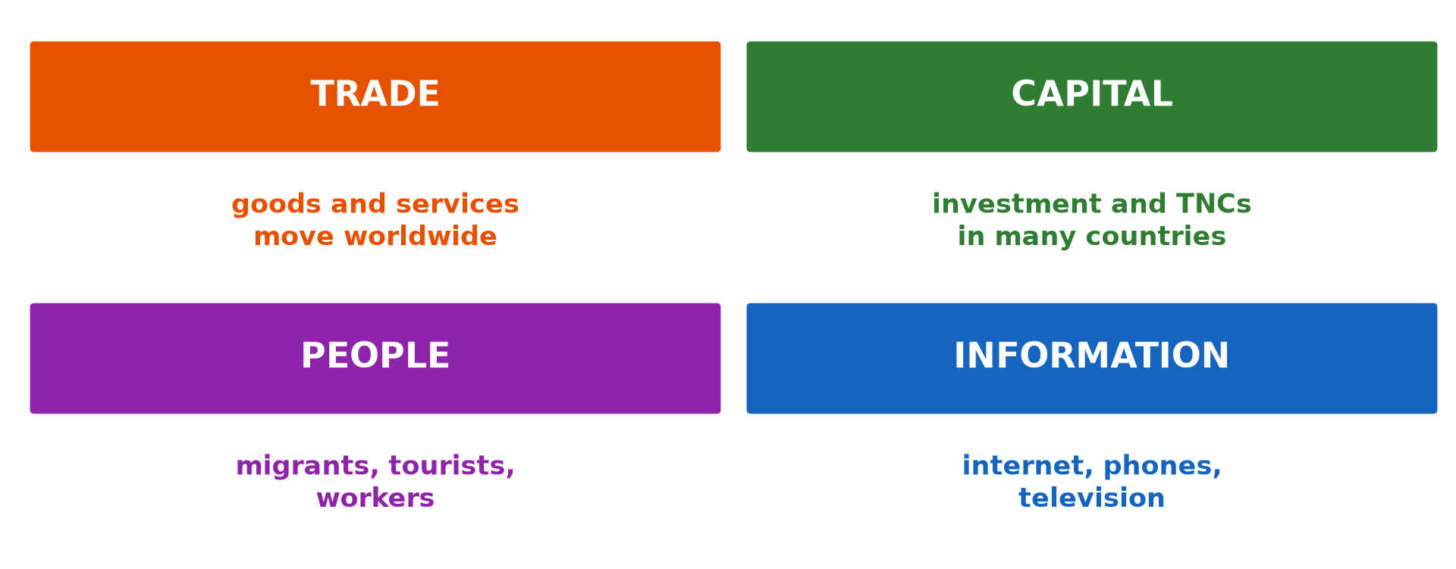
1. DEFINITION
Activity 1
Components of globalisation.
Notes:
Activity 1. Look carefully at this diagram: components of globalisation. Observe every detail before I ask the question.

Slide 19
1. DEFINITION
Activity 1: Question
What is globalisation?
Notes:
Here is the question for Activity 1: What is globalisation? Take one minute to think and write your answer in your rough notebook.

Slide 20
1. DEFINITION
Activity 1: Answer
The growing links between countries through trade, investment, technology and culture.
Notes:
Let us check the answer together. The growing links between countries through trade, investment, technology and culture.

Slide 21

2. CHARACTERISTICS
Activity 2
World trade.
Notes:
Activity 2. Look carefully at this picture: world trade. Observe every detail before I ask the question.

Slide 22
2. CHARACTERISTICS
Activity 2: Question
Give two characteristics of globalisation.
Notes:
Here is the question for Activity 2: Give two characteristics of globalisation. Take one minute to think and write your answer in your rough notebook.

Slide 23
2. CHARACTERISTICS
Activity 2: Answer
Growth of world trade and of multinational companies.
Notes:
Let us check the answer together. Growth of world trade and of multinational companies.

Slide 24
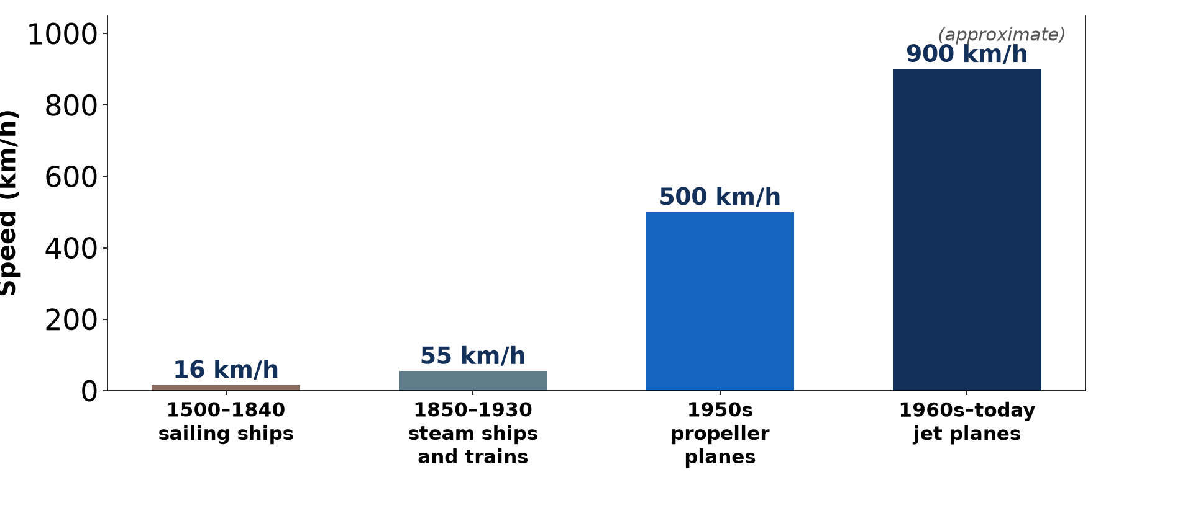
2. CHARACTERISTICS
Activity 3
The shrinking world.
Notes:
Activity 3. Look carefully at this diagram: the shrinking world. Observe every detail before I ask the question.

Slide 25
2. CHARACTERISTICS
Activity 3: Question
How do transport and communication support globalisation?
Notes:
Here is the question for Activity 3: How do transport and communication support globalisation? Take one minute to think and write your answer in your rough notebook.

Slide 26
2. CHARACTERISTICS
Activity 3: Answer
They move goods and information quickly around the world.
Notes:
Let us check the answer together. They move goods and information quickly around the world.

Slide 27
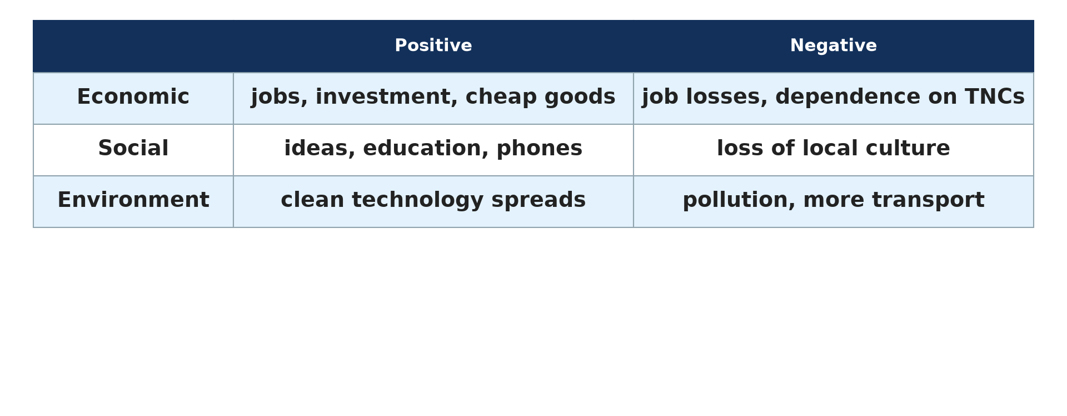
3. ADVANTAGES
Activity 4
Impacts of globalisation.
Notes:
Activity 4. Look carefully at this diagram: impacts of globalisation. Observe every detail before I ask the question.

Slide 28
3. ADVANTAGES
Activity 4: Question
Give two advantages of globalisation.
Notes:
Here is the question for Activity 4: Give two advantages of globalisation. Take one minute to think and write your answer in your rough notebook.

Slide 29
3. ADVANTAGES
Activity 4: Answer
Access to technology and cheaper goods (also investment and jobs).
Notes:
Let us check the answer together. Access to technology and cheaper goods (also investment and jobs).

Slide 30
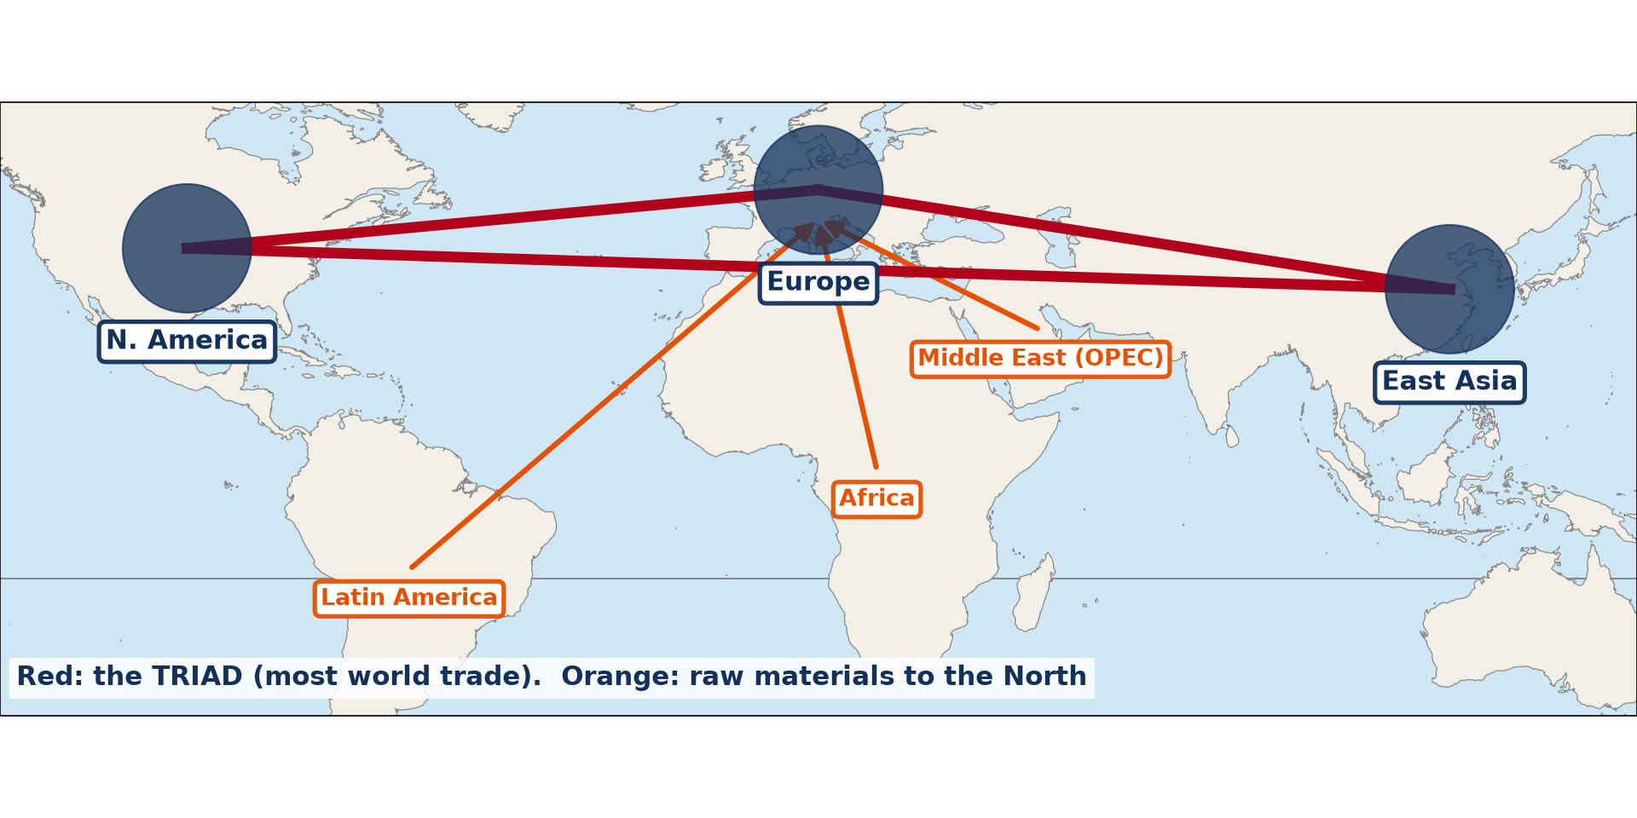
3. DISADVANTAGES
Activity 5
The world economic triad.
Notes:
Activity 5. Look carefully at this diagram: the world economic triad. Observe every detail before I ask the question.

Slide 31
3. DISADVANTAGES
Activity 5: Question
Give two disadvantages of globalisation.
Notes:
Here is the question for Activity 5: Give two disadvantages of globalisation. Take one minute to think and write your answer in your rough notebook.

Slide 32
3. DISADVANTAGES
Activity 5: Answer
Unfair competition for local industries and loss of local culture.
Notes:
Let us check the answer together. Unfair competition for local industries and loss of local culture.

Slide 33
BOARD SUMMARY
Board Summary
Topic: Managing Resources for Development through Economic Activities
Sub-topic: World Communication
Lesson 14: Globalisation
Notes:
Now we are going to copy the board summary. Write the title and the headings neatly in your notebooks. I will give you enough time for each slide, so do not rush.

Slide 34
BOARD SUMMARY
DEFINITIONS
The key terms of this lesson are defined as follows:
Globalisation: It is the growing links between countries through trade, investment, technology and culture.
Notes:
Let us copy the definitions. The key terms of this lesson are defined as follows. On this slide we have Globalisation. Write each point on a new line, with the key term first, and explain it in your own words when we revise.

Slide 35
BOARD SUMMARY
1. Main Characteristics
Globalisation has the following characteristics:
World trade: Goods and services are traded all over the world.
Multinational companies: Big firms produce and sell in many countries.
Notes:
Let us copy Main Characteristics. Globalisation has the following characteristics. On this slide we have World trade and Multinational companies. Write each point on a new line, with the key term first, and explain it in your own words when we revise. When you finish, we go to the next slide.

Slide 36
BOARD SUMMARY
1. Main Characteristics (continued)
Fast communication: Transport, internet and media link people instantly.
Cultural exchange: Music, sport, food and fashion spread around the world.
Notes:
We continue with Main Characteristics. On this slide we have Fast communication and Cultural exchange. Write each point on a new line, with the key term first, and explain it in your own words when we revise.

Slide 37
BOARD SUMMARY
1. Main Characteristics
Illustration: components of globalisation
Notes:
Now draw this illustration in your notebook: components of globalisation. Give it a title and label it clearly.

Slide 38
BOARD SUMMARY
2. Advantages and Disadvantages
Globalisation has the following advantages and disadvantages:
Advantages: It brings investment, technology, jobs and cheaper goods.
Disadvantages: Local industries face unfair competition and rich countries gain most.
Notes:
Let us copy Advantages and Disadvantages. Globalisation has the following advantages and disadvantages. On this slide we have Advantages and Disadvantages. Write each point on a new line, with the key term first, and explain it in your own words when we revise. When you finish, we go to the next slide.

Slide 39
BOARD SUMMARY
2. Advantages and Disadvantages (continued)
Cultural effects: Local languages and traditions may be lost.
Notes:
We continue with Advantages and Disadvantages. On this slide we have Cultural effects. Write each point on a new line, with the key term first, and explain it in your own words when we revise.

Slide 40
FORMATIVE EVALUATION
Evaluation 1
Define globalisation.
Notes:
Now let us check what you have understood. Question 1: Define globalisation. Answer in your exercise book.

Slide 41
FORMATIVE EVALUATION
Expected Answer
Growing links between countries through trade, technology and culture.
Notes:
The expected answer is: growing links between countries through trade, technology and culture. If you got it right, well done.

Slide 42
FORMATIVE EVALUATION
Evaluation 2
Give one advantage and one disadvantage.
Notes:
Now let us check what you have understood. Question 2: Give one advantage and one disadvantage. Answer in your exercise book.

Slide 43
FORMATIVE EVALUATION
Expected Answer
Cheaper goods; unfair competition.
Notes:
The expected answer is: cheaper goods; unfair competition. If you got it right, well done.

Slide 44
REMEDIATION
Remediation
Fill in the blanks:
Firms working in many countries are ______ companies.
The world linked by communication is a global ______.
Notes:
Take your time to copy this part; we will continue together.

Slide 45
REMEDIATION
Remediation (continued)
Loss of local traditions is a ______ effect of globalisation.
Notes:
For those who need more practice, fill in the blanks in your exercise book. The answers are: number 1, multinational; number 2, village; number 3, cultural.

Slide 46
HOMEWORK
Homework
List five foreign products used in your home and their countries of origin.
Notes:
For your homework: List five foreign products used in your home and their countries of origin. We shall correct it at the beginning of our next lesson.

Slide 47
NEXT LESSON
Next Lesson
Our next lesson will be on:
Lesson 15: Telecommunication (Internet Communication)
Notes:
Our next lesson will be on Lesson 15: Telecommunication (Internet Communication). Thank you for your attention, and see you next time.

Slide 48
BILINGUAL GAME
Bilingual Game (Jeu Bilingue)
English | Français
Globalisation | La mondialisation
Multinational company | La multinationale
Investment | L'investissement
Culture | La culture
Global village | Le village planétaire
Competition | La concurrence
Notes:
Let us play the bilingual game. I say a word in English, and you give me the French word. Then we do the reverse.

Slide 49
LOGBOOK
Official Logbook (1/2)
Module / Topic | Managing Resources for Development through Economic Activities
Lesson Title | Lesson 14: Globalisation
Expected Learning Outcomes | Define globalisation. Describe its main characteristics. Give its advantages and disadvantages.
Competence | Learners are able to explain globalisation and assess its effects.
Notes:
I record this information in the official logbook of the class after the lesson.

Slide 50
LOGBOOK
Official Logbook (2/2)
Matter Taught | DEFINITIONS; Main Characteristics; Advantages and Disadvantages.
Evaluation | Formative evaluation and remediation exercise.
Homework | List five foreign products used in your home and their countries of origin.
Enrolment / Present / Absent | ____ / ____ / ____
Achievement | To be completed after the lesson.
Notes:
I complete the second page of the logbook: the matter taught, the evaluation, the homework and the attendance.

Slide 51
TEACHER'S NOTE
Teacher's Note
Timing: Homework correction, plan, objectives 8 min | Recall, situation, action 10 min | 5 activities 30 min | Board summary (copying) 30 min | Evaluation, remediation 10 min | Homework, next lesson 5 min | Logbook 7 min
Without the projector (Activity 1): discuss.
Without the projector (Activity 2): list.
Without the projector (Activity 3): discuss.
Without the projector (Activity 4): list.
Without the projector (Activity 5): list.
Notes:
This slide is for me, the teacher: it gives the timing of the lesson and what to do if the projector is not available.

Slide 52
REFERENCES
References
Geography Syllabus, Forms I–V, MINESEC (2023) — Form 5, Module I: Management of Manufacturing and Tertiary Activities.
Photo, Activity 2: “Container Ships @ Port of Oakland” by jdnx, CC BY 2.0, via Flickr (https://www.flickr.com/photos/21442511@N08/3464243881)
Diagrams and animations: drawn for this lesson (Geography Department).
Notes:
These are the references and picture credits used to prepare this lesson.

