Slide 1
FORM 5
GEOGRAPHY
Lesson 20
General Effects of Tourism
Notes:
Good morning, class, and welcome to our geography lesson. I am your geography teacher, Mr Kamdem. Today we are starting Lesson 20: General Effects of Tourism.

Slide 2
CLASS INFO
Class, Chapter and Duration
Class | Form 5
Chapter | Module I: Management of Manufacturing and Tertiary Activities
Duration | 2 periods (2 × 50 minutes)
Notes:
This lesson is for Form 5. It belongs to Module I: Management of Manufacturing and Tertiary Activities. We shall need 2 periods to cover it.

Slide 3
IDENTIFICATION
Lesson Identification
Topic | Managing Resources for Development through Economic Activities
Sub-topic | Global Tourism
Lesson | Lesson 20: General Effects of Tourism
Notions / Concepts | Positive effects, negative effects, sustainable tourism.
Syllabus focus | Positive and negative effects of tourism on the people, the economy and the environment.
Competence | Learners are able to assess the effects of tourism.
Notes:
Our topic is Managing Resources for Development through Economic Activities, and the sub-topic is Global Tourism. The key notions we shall use today are: positive effects, negative effects, sustainable tourism. At the end, you should be able to do this: learners are able to assess the effects of tourism.

Slide 4

HOMEWORK CORRECTION
Correction of the Homework
Question (Lesson 19: Tourism):
List five tourist attractions in Cameroon and classify them as natural or cultural.
Notes:
Before we start the new lesson, let us correct the homework I gave you at the end of Lesson 19: Tourism. The question was: List five tourist attractions in Cameroon and classify them as natural or cultural. Take out your exercise books.

Slide 5
HOMEWORK CORRECTION
Correction: Possible Answer
Natural: Mount Cameroon, Waza Park, Kribi beaches (Lobé Falls); cultural: Foumban palace, Rhumsiki landscape and villages (Ngondo festival).
Notes:
Here is a good answer. Natural: Mount Cameroon, Waza Park, Kribi beaches (Lobé Falls); cultural: Foumban palace, Rhumsiki landscape and villages (Ngondo festival). Compare it with your own answer and correct your work in red.

Slide 6
LESSON PLAN
Lesson Plan
Correction of the homework
Objectives and recall
Real-life situation and action to take
Learning activities
Board summary
Evaluation, remediation and homework
Notes:
Here is the plan of our lesson today. First, we shall correct the homework. Then we shall look at the objectives and recall what you already know. After that, we shall study a situation from real life and the action to take, and do the learning activities. Finally, we shall copy the board summary, do the evaluation and the remediation, and I will give you the homework.

Slide 7
OBJECTIVES
Objectives
By the end of this lesson, you should be able to:
Explain the effects of tourism on the people.
Explain the effects on the economy.
Explain the effects on the environment.
Notes:
By the end of this lesson, you should be able to do three things. Number 1: explain the effects of tourism on the people. Number 2: explain the effects on the economy. Number 3: explain the effects on the environment.

Slide 8
PREVIOUS KNOWLEDGE
Previous Knowledge
Tourism is travel for leisure.
Tourists spend money.
Many tourists visit beaches and parks.
Notes:
Let us first remember what you already know. Tourism is travel for leisure. Tourists spend money. Many tourists visit beaches and parks. Keep this in mind, because we shall build on it today.

Slide 9
REAL-LIFE SITUATION
Situation in Real Life
In a coastal town, new hotels create jobs and bring money, but the beach is full of waste and local traditions are changing.
Notes:
Listen carefully to this situation from real life. In a coastal town, new hotels create jobs and bring money, but the beach is full of waste and local traditions are changing. Think about it, because I am going to ask you some questions.

Slide 10
REAL-LIFE SITUATION
Situation: Question 1
What is the problem in the situation?
Notes:
Question 1: What is the problem in the situation? Think for a moment, then raise your hand to answer.

Slide 11
REAL-LIFE SITUATION
Answer
Tourism has both good and bad effects.
Notes:
Good. Tourism has both good and bad effects.

Slide 12
REAL-LIFE SITUATION
Situation: Question 2
Give one positive effect.
Notes:
Question 2: Give one positive effect. Think for a moment, then raise your hand to answer.

Slide 13
REAL-LIFE SITUATION
Answer
Jobs and money.
Notes:
Good. Jobs and money.

Slide 14
REAL-LIFE SITUATION
Situation: Question 3
Give one negative effect.
Notes:
Question 3: Give one negative effect. Think for a moment, then raise your hand to answer.

Slide 15
REAL-LIFE SITUATION
Possible Answer
Waste on the beach (also loss of traditions).
Notes:
Good. Waste on the beach (also loss of traditions).

Slide 16
ACTION TO TAKE
Action to Take
Clean up tourist sites and respect local cultures.
Notes:
From this situation, the action we are working towards in this lesson is the following: clean up tourist sites and respect local cultures.

Slide 17
JUSTIFICATION
Justification of the Lesson
This lesson helps us to manage tourism for sustainable development.
Notes:
Why is this lesson important for you? This lesson helps us to manage tourism for sustainable development.

Slide 18
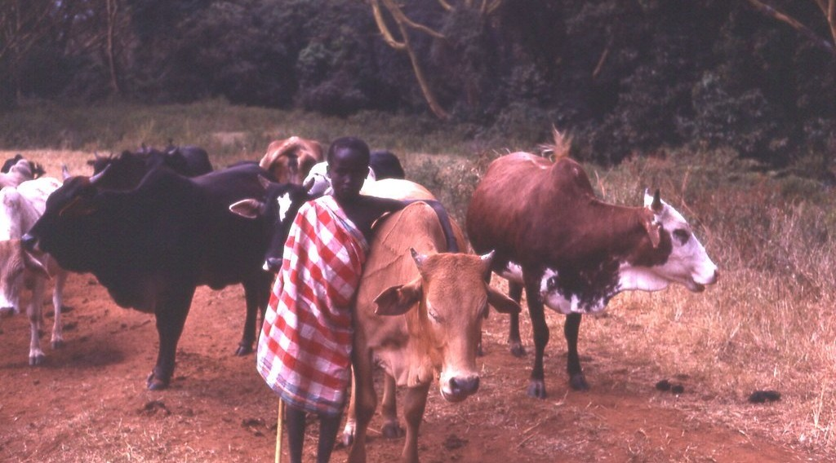
1. EFFECTS ON THE PEOPLE
Activity 1
Local culture.
Notes:
Activity 1. Look carefully at this picture: local culture. Observe every detail before I ask the question.

Slide 19
1. EFFECTS ON THE PEOPLE
Activity 1: Question
Give one positive and one negative effect of tourism on the people.
Notes:
Here is the question for Activity 1: Give one positive and one negative effect of tourism on the people. Take one minute to think and write your answer in your rough notebook.

Slide 20
1. EFFECTS ON THE PEOPLE
Activity 1: Answer
Jobs and cultural exchange; loss of traditions and crime.
Notes:
Let us check the answer together. Jobs and cultural exchange; loss of traditions and crime.

Slide 21
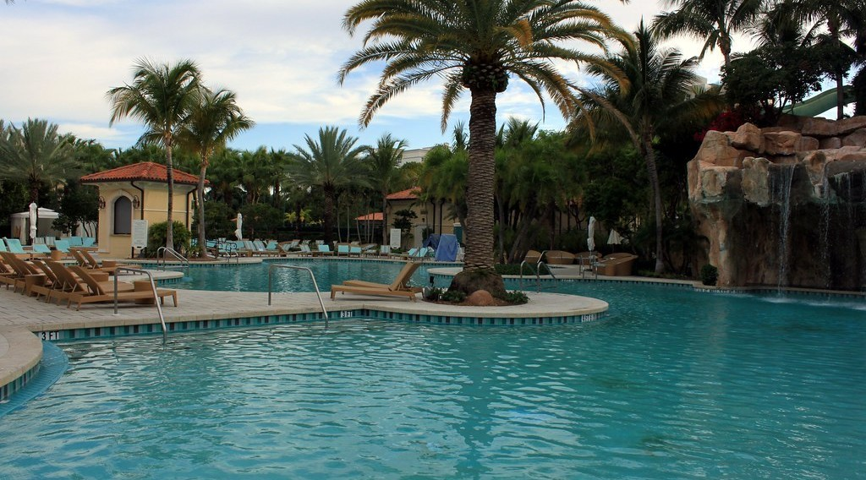
2. EFFECTS ON THE ECONOMY
Activity 2
A hotel.
Notes:
Activity 2. Look carefully at this picture: a hotel. Observe every detail before I ask the question.

Slide 22
2. EFFECTS ON THE ECONOMY
Activity 2: Question
Give two positive effects on the economy.
Notes:
Here is the question for Activity 2: Give two positive effects on the economy. Take one minute to think and write your answer in your rough notebook.

Slide 23
2. EFFECTS ON THE ECONOMY
Activity 2: Answer
Foreign currency and jobs (also infrastructure).
Notes:
Let us check the answer together. Foreign currency and jobs (also infrastructure).

Slide 24
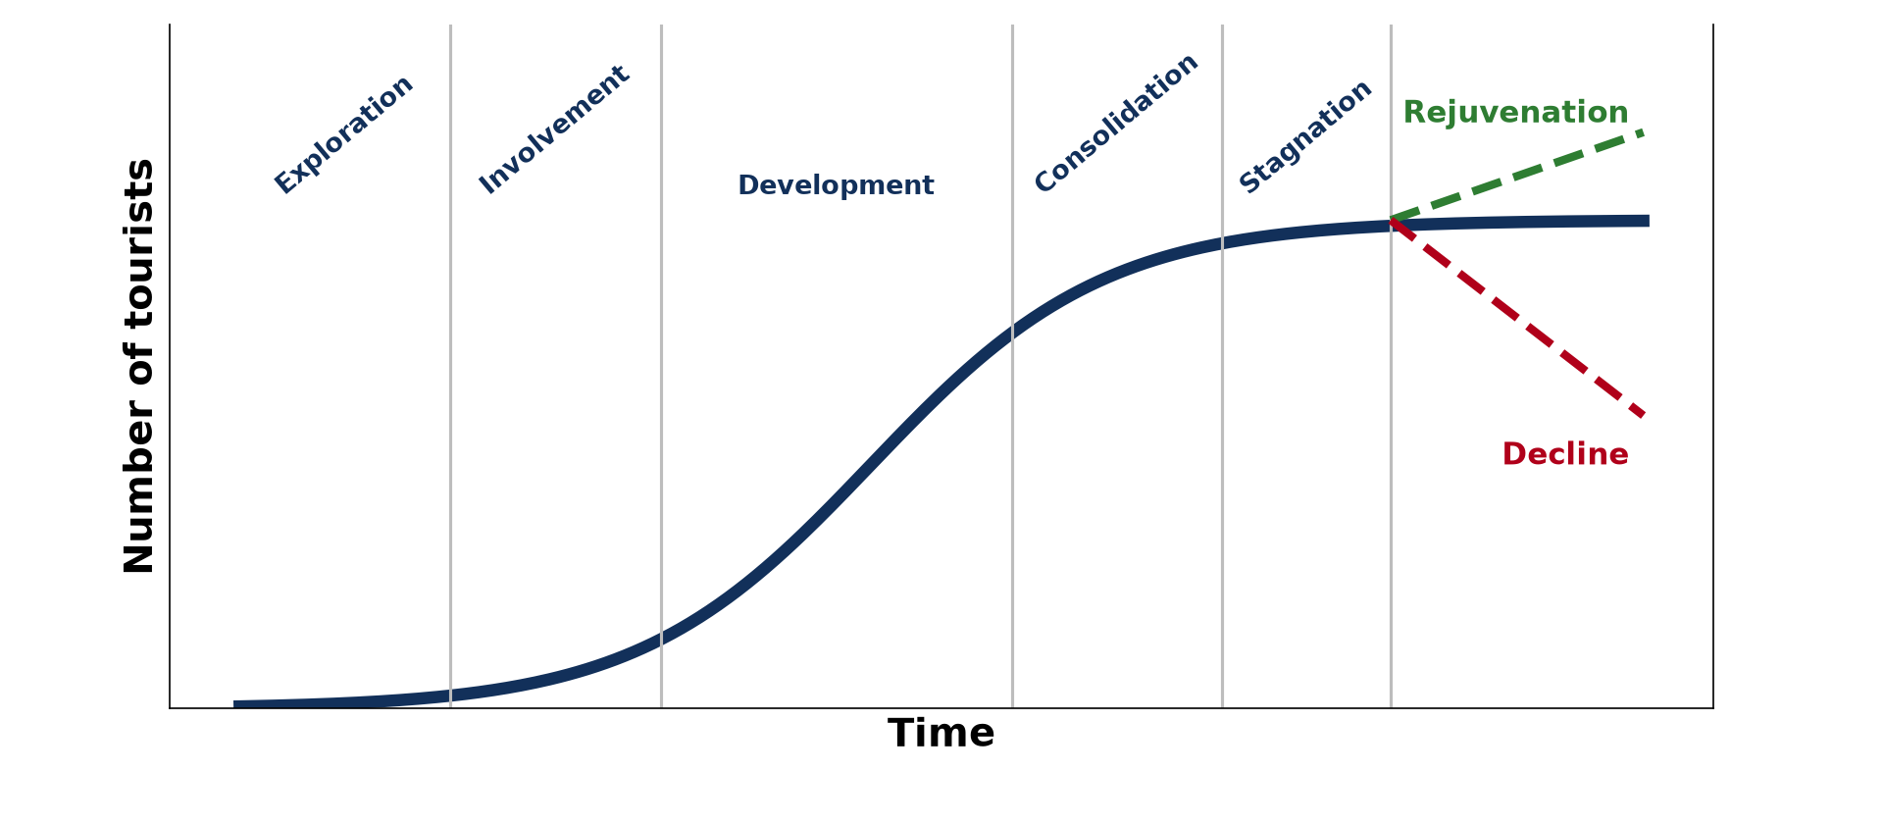
2. EFFECTS ON THE ECONOMY
Activity 3
The Butler model.
Notes:
Activity 3. Look carefully at this diagram: the Butler model. Observe every detail before I ask the question.

Slide 25
2. EFFECTS ON THE ECONOMY
Activity 3: Question
Give one negative effect on the economy.
Notes:
Here is the question for Activity 3: Give one negative effect on the economy. Take one minute to think and write your answer in your rough notebook.

Slide 26
2. EFFECTS ON THE ECONOMY
Activity 3: Answer
Profits leave the country and jobs are seasonal (also rising prices).
Notes:
Let us check the answer together. Profits leave the country and jobs are seasonal (also rising prices).

Slide 27
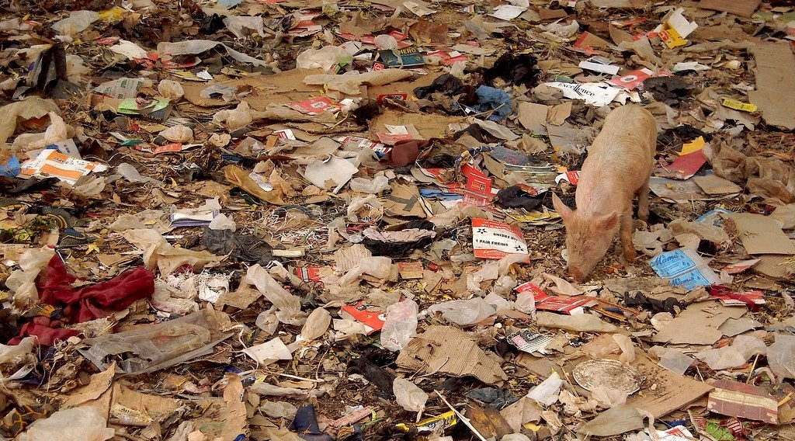
3. EFFECTS ON THE ENVIRONMENT
Activity 4
Litter.
Notes:
Activity 4. Look carefully at this picture: litter. Observe every detail before I ask the question.

Slide 28
3. EFFECTS ON THE ENVIRONMENT
Activity 4: Question
Give two negative effects on the environment.
Notes:
Here is the question for Activity 4: Give two negative effects on the environment. Take one minute to think and write your answer in your rough notebook.

Slide 29
3. EFFECTS ON THE ENVIRONMENT
Activity 4: Answer
Pollution and destruction of habitats.
Notes:
Let us check the answer together. Pollution and destruction of habitats.

Slide 30
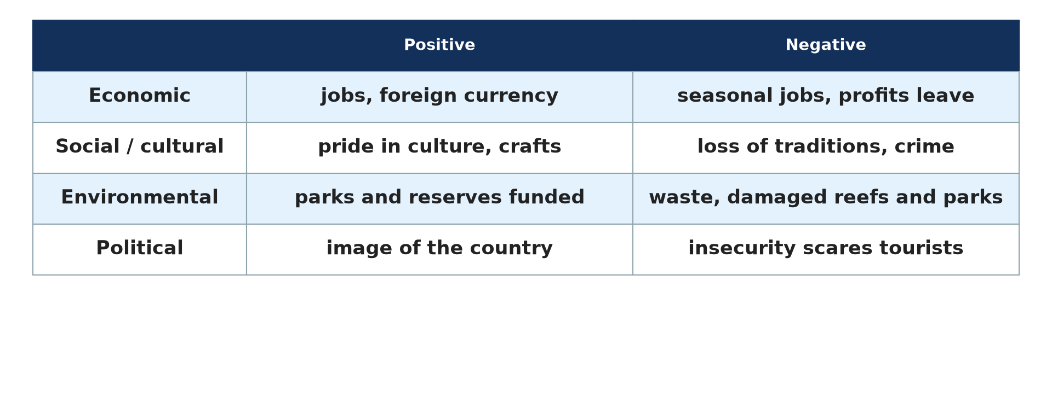
3. EFFECTS ON THE ENVIRONMENT
Activity 5
Impacts of tourism.
Notes:
Activity 5. Look carefully at this diagram: impacts of tourism. Observe every detail before I ask the question.

Slide 31
3. EFFECTS ON THE ENVIRONMENT
Activity 5: Question
Give one positive effect on the environment.
Notes:
Here is the question for Activity 5: Give one positive effect on the environment. Take one minute to think and write your answer in your rough notebook.

Slide 32
3. EFFECTS ON THE ENVIRONMENT
Activity 5: Answer
Tourism money is used to protect parks and wildlife.
Notes:
Let us check the answer together. Tourism money is used to protect parks and wildlife.

Slide 33
BOARD SUMMARY
Board Summary
Topic: Managing Resources for Development through Economic Activities
Sub-topic: Global Tourism
Lesson 20: General Effects of Tourism
Notes:
Now we are going to copy the board summary. Write the title and the headings neatly in your notebooks. I will give you enough time for each slide, so do not rush.

Slide 34
BOARD SUMMARY
1. Effects on the People
Tourism affects the people as follows:
Positive: It creates jobs and promotes cultural exchange.
Negative: It can bring crime, drugs and the loss of local traditions.
Notes:
Let us copy Effects on the People. Tourism affects the people as follows. On this slide we have Positive and Negative. Write each point on a new line, with the key term first, and explain it in your own words when we revise.

Slide 35
BOARD SUMMARY
2. Effects on the Economy
Tourism affects the economy as follows:
Positive: It brings foreign currency, jobs and new infrastructure.
Negative: Profits often go to foreign companies and jobs are seasonal.
Notes:
Let us copy Effects on the Economy. Tourism affects the economy as follows. On this slide we have Positive and Negative. Write each point on a new line, with the key term first, and explain it in your own words when we revise.

Slide 36
BOARD SUMMARY
3. Effects on the Environment
Tourism affects the environment as follows:
Positive: Money from tourism helps to protect parks and monuments.
Negative: It causes pollution, erosion and the destruction of habitats.
Notes:
Let us copy Effects on the Environment. Tourism affects the environment as follows. On this slide we have Positive and Negative. Write each point on a new line, with the key term first, and explain it in your own words when we revise.

Slide 37
BOARD SUMMARY
3. Effects on the Environment
Illustration: impacts of tourism
Notes:
Now draw this illustration in your notebook: impacts of tourism. Give it a title and label it clearly.

Slide 38
FORMATIVE EVALUATION
Evaluation 1
Give one positive effect of tourism on the economy.
Notes:
Now let us check what you have understood. Question 1: Give one positive effect of tourism on the economy. Answer in your exercise book.

Slide 39
FORMATIVE EVALUATION
Expected Answer
It brings foreign currency.
Notes:
The expected answer is: it brings foreign currency. If you got it right, well done.

Slide 40
FORMATIVE EVALUATION
Evaluation 2
Give one negative effect on the environment.
Notes:
Now let us check what you have understood. Question 2: Give one negative effect on the environment. Answer in your exercise book.

Slide 41
FORMATIVE EVALUATION
Expected Answer
Pollution of beaches.
Notes:
The expected answer is: pollution of beaches. If you got it right, well done.

Slide 42
REMEDIATION
Remediation
Fill in the blanks:
Tourism brings foreign ______.
Jobs that exist only during holidays are ______.
Tourism that protects nature is ______ tourism.
Notes:
For those who need more practice, fill in the blanks in your exercise book. The answers are: number 1, currency; number 2, seasonal; number 3, sustainable (eco-).

Slide 43
HOMEWORK
Homework
Give two positive and two negative effects of tourism at Kribi.
Notes:
For your homework: Give two positive and two negative effects of tourism at Kribi. We shall correct it at the beginning of our next lesson.

Slide 44
NEXT LESSON
Next Lesson
Our next lesson will be on:
Lesson 21: Development of Tourism in Cameroon
Notes:
Our next lesson will be on Lesson 21: Development of Tourism in Cameroon. Thank you for your attention, and see you next time.

Slide 45
BILINGUAL GAME
Bilingual Game (Jeu Bilingue)
English | Français
Effect | L'effet
Foreign currency | Les devises
Hotel | L'hôtel
Habitat | L'habitat
Tradition | La tradition
Sustainable tourism | Le tourisme durable
Notes:
Let us play the bilingual game. I say a word in English, and you give me the French word. Then we do the reverse.

Slide 46
LOGBOOK
Official Logbook (1/2)
Module / Topic | Managing Resources for Development through Economic Activities
Lesson Title | Lesson 20: General Effects of Tourism
Expected Learning Outcomes | Explain the effects of tourism on the people. Explain the effects on the economy. Explain the effects on the environment.
Competence | Learners are able to assess the effects of tourism.
Notes:
I record this information in the official logbook of the class after the lesson.

Slide 47
LOGBOOK
Official Logbook (2/2)
Matter Taught | Effects on the People; Effects on the Economy; Effects on the Environment.
Evaluation | Formative evaluation and remediation exercise.
Homework | Give two positive and two negative effects of tourism at Kribi.
Enrolment / Present / Absent | ____ / ____ / ____
Achievement | To be completed after the lesson.
Notes:
I complete the second page of the logbook: the matter taught, the evaluation, the homework and the attendance.

Slide 48
TEACHER'S NOTE
Teacher's Note
Timing: Homework correction, plan, objectives 8 min | Recall, situation, action 10 min | 5 activities 30 min | Board summary (copying) 30 min | Evaluation, remediation 10 min | Homework, next lesson 5 min | Logbook 7 min
Without the projector (Activity 1): discuss.
Without the projector (Activity 2): discuss.
Without the projector (Activity 3): discuss.
Without the projector (Activity 4): discuss.
Without the projector (Activity 5): discuss.
Notes:
This slide is for me, the teacher: it gives the timing of the lesson and what to do if the projector is not available.

Slide 49
REFERENCES
References
Geography Syllabus, Forms I–V, MINESEC (2023) — Form 5, Module I: Management of Manufacturing and Tertiary Activities.
Photo, Activity 1: “Young Maasai herder, Kenya, 1979” by gbaku, CC BY-SA 2.0, via Flickr (https://www.flickr.com/photos/72105154@N00/482990998)
Photo, Activity 2: “Laguna Pool” by Prayitno / Thank you for (12 millions +) view, CC BY 2.0, via Flickr (https://www.flickr.com/photos/34128007@N04/14216582552)
Photo, Activity 4: “Do the evolution” by Marco Bellucci, CC BY 2.0, via Flickr (https://www.flickr.com/photos/50451886@N00/3382099741)
Diagrams and animations: drawn for this lesson (Geography Department).
Notes:
These are the references and picture credits used to prepare this lesson.

