Slide 1
FORM 5
GEOGRAPHY
Lesson 21
Development of Tourism in Cameroon
Notes:
Good morning, class, and welcome to our geography lesson. I am your geography teacher, Mr Kamdem. Today we are starting Lesson 21: Development of Tourism in Cameroon.

Slide 2
CLASS INFO
Class, Chapter and Duration
Class | Form 5
Chapter | Module I: Management of Manufacturing and Tertiary Activities
Duration | 2 periods (2 × 50 minutes)
Notes:
This lesson is for Form 5. It belongs to Module I: Management of Manufacturing and Tertiary Activities. We shall need 2 periods to cover it.

Slide 3
IDENTIFICATION
Lesson Identification
Topic | Managing Resources for Development through Economic Activities
Sub-topic | Economic Development Potentials of Cameroon
Lesson | Lesson 21: Development of Tourism in Cameroon
Notions / Concepts | Tourist attractions, national parks, cultural sites.
Syllabus focus | Identification and location of attractions; distribution of attractions; problems of tourism; effects on the environment, the people (culture) and the economy; government effort to promote tourism.
Competence | Learners are able to locate tourist attractions in Cameroon and propose ways to develop tourism.
Notes:
Our topic is Managing Resources for Development through Economic Activities, and the sub-topic is Economic Development Potentials of Cameroon. The key notions we shall use today are: tourist attractions, national parks, cultural sites. At the end, you should be able to do this: learners are able to locate tourist attractions in Cameroon and propose ways to develop tourism.

Slide 4

HOMEWORK CORRECTION
Correction of the Homework
Question (Lesson 20: General Effects of Tourism):
Give two positive and two negative effects of tourism at Kribi.
Notes:
Before we start the new lesson, let us correct the homework I gave you at the end of Lesson 20: General Effects of Tourism. The question was: Give two positive and two negative effects of tourism at Kribi. Take out your exercise books.

Slide 5
HOMEWORK CORRECTION
Correction: Possible Answer
Positive: jobs in hotels and restaurants, income for fishermen and craftsmen; negative: waste on beaches, rising prices and pressure on the Lobé Falls site.
Notes:
Here is a good answer. Positive: jobs in hotels and restaurants, income for fishermen and craftsmen; negative: waste on beaches, rising prices and pressure on the Lobé Falls site. Compare it with your own answer and correct your work in red.

Slide 6
LESSON PLAN
Lesson Plan
Correction of the homework
Objectives and recall
Real-life situation and action to take
Learning activities
Board summary
Evaluation, remediation and homework
Notes:
Here is the plan of our lesson today. First, we shall correct the homework. Then we shall look at the objectives and recall what you already know. After that, we shall study a situation from real life and the action to take, and do the learning activities. Finally, we shall copy the board summary, do the evaluation and the remediation, and I will give you the homework.

Slide 7
OBJECTIVES
Objectives
By the end of this lesson, you should be able to:
Identify and locate tourist attractions in Cameroon.
Explain the problems and effects of tourism in Cameroon.
Notes:
Take your time to copy this part; we will continue together.

Slide 8
OBJECTIVES
Objectives (continued)
Describe government efforts to promote tourism.
Notes:
By the end of this lesson, you should be able to do three things. Number 1: identify and locate tourist attractions in Cameroon. Number 2: explain the problems and effects of tourism in Cameroon. Number 3: describe government efforts to promote tourism.

Slide 9
PREVIOUS KNOWLEDGE
Previous Knowledge
Cameroon is called Africa in miniature.
Waza is a national park.
Tourism brings foreign currency.
Notes:
Let us first remember what you already know. Cameroon is called Africa in miniature. Waza is a national park. Tourism brings foreign currency. Keep this in mind, because we shall build on it today.

Slide 10
REAL-LIFE SITUATION
Situation in Real Life
Cameroon has beaches, mountains, parks and rich cultures, but it receives few tourists compared with Kenya. Visitors complain about bad roads and insecurity.
Notes:
Listen carefully to this situation from real life. Cameroon has beaches, mountains, parks and rich cultures, but it receives few tourists compared with Kenya. Visitors complain about bad roads and insecurity. Think about it, because I am going to ask you some questions.

Slide 11
REAL-LIFE SITUATION
Situation: Question 1
What is the problem in the situation?
Notes:
Question 1: What is the problem in the situation? Think for a moment, then raise your hand to answer.

Slide 12
REAL-LIFE SITUATION
Answer
Cameroon receives few tourists despite its attractions.
Notes:
Good. Cameroon receives few tourists despite its attractions.

Slide 13
REAL-LIFE SITUATION
Situation: Question 2
Name two attractions of Cameroon.
Notes:
Question 2: Name two attractions of Cameroon. Think for a moment, then raise your hand to answer.

Slide 14
REAL-LIFE SITUATION
Answer
Beaches and national parks.
Notes:
Good. Beaches and national parks.

Slide 15
REAL-LIFE SITUATION
Situation: Question 3
What do visitors complain about?
Notes:
Question 3: What do visitors complain about? Think for a moment, then raise your hand to answer.

Slide 16
REAL-LIFE SITUATION
Possible Answer
Bad roads and insecurity.
Notes:
Good. Bad roads and insecurity.

Slide 17
ACTION TO TAKE
Action to Take
Use tourist guides, produce works of art and denounce harassment of tourists.
Notes:
From this situation, the action we are working towards in this lesson is the following: use tourist guides, produce works of art and denounce harassment of tourists.

Slide 18
JUSTIFICATION
Justification of the Lesson
This lesson helps us to value the tourist potential of our country.
Notes:
Why is this lesson important for you? This lesson helps us to value the tourist potential of our country.

Slide 19
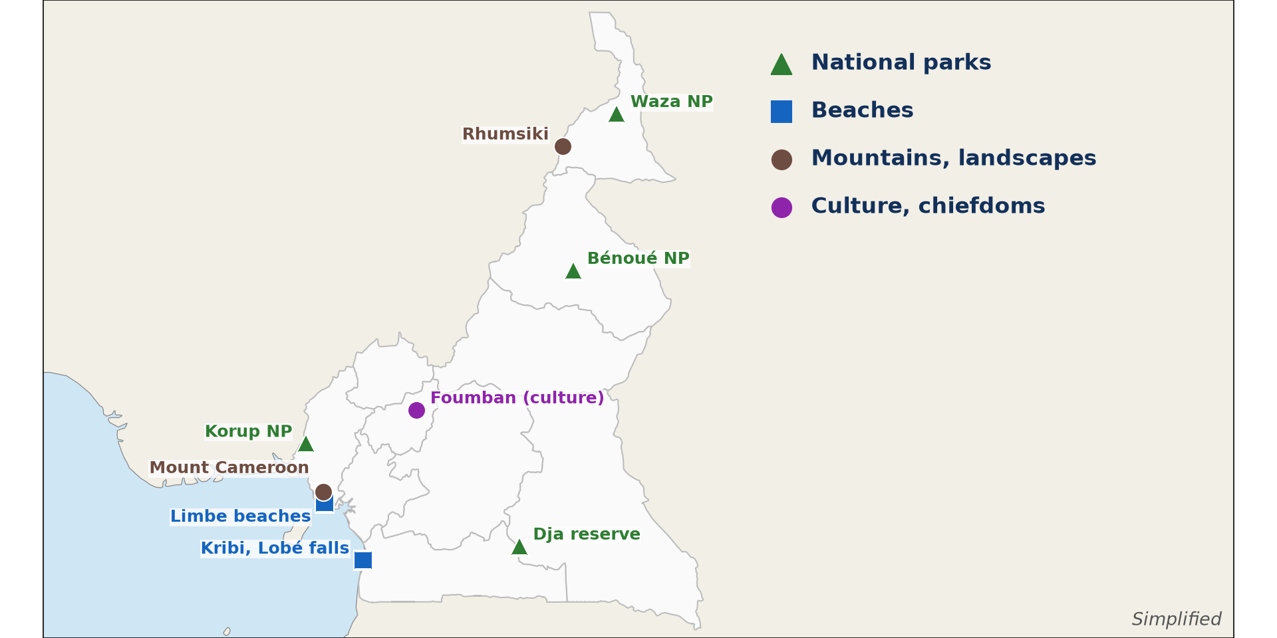
1. ATTRACTIONS: NATURAL
Activity 1
Tourist attractions of Cameroon.
Notes:
Activity 1. Look carefully at this diagram: tourist attractions of Cameroon. Observe every detail before I ask the question.

Slide 20
1. ATTRACTIONS: NATURAL
Activity 1: Question
Name and locate three natural attractions.
Notes:
Here is the question for Activity 1: Name and locate three natural attractions. Take one minute to think and write your answer in your rough notebook.

Slide 21
1. ATTRACTIONS: NATURAL
Activity 1: Answer
Waza Park (Far North), Mount Cameroon (South West) and Kribi beaches (South).
Notes:
Let us check the answer together. Waza Park (Far North), Mount Cameroon (South West) and Kribi beaches (South).

Slide 22

1. ATTRACTIONS: CULTURAL
Activity 2
The Mandara Mountains.
Notes:
Activity 2. Look carefully at this picture: the Mandara Mountains. Observe every detail before I ask the question.

Slide 23
1. ATTRACTIONS: CULTURAL
Activity 2: Question
Name two cultural attractions.
Notes:
Here is the question for Activity 2: Name two cultural attractions. Take one minute to think and write your answer in your rough notebook.

Slide 24
1. ATTRACTIONS: CULTURAL
Activity 2: Answer
The Foumban palace and the Rhumsiki villages (also the Ngondo festival).
Notes:
Let us check the answer together. The Foumban palace and the Rhumsiki villages (also the Ngondo festival).

Slide 25
2. DISTRIBUTION
Activity 3
Distribution of attractions.
Notes:
Activity 3. Look carefully at this diagram: distribution of attractions. Observe every detail before I ask the question.

Slide 26
2. DISTRIBUTION
Activity 3: Question
Describe the distribution of attractions.
Notes:
Here is the question for Activity 3: Describe the distribution of attractions. Take one minute to think and write your answer in your rough notebook.

Slide 27
2. DISTRIBUTION
Activity 3: Answer
Wildlife parks are in the North, mountains and cultures in the West, and beaches on the coast.
Notes:
Let us check the answer together. Wildlife parks are in the North, mountains and cultures in the West, and beaches on the coast.

Slide 28

3. PROBLEMS AND EFFECTS
Activity 4
A bad road.
Notes:
Activity 4. Look carefully at this picture: a bad road. Observe every detail before I ask the question.

Slide 29
3. PROBLEMS AND EFFECTS
Activity 4: Question
Give three problems of tourism in Cameroon.
Notes:
Here is the question for Activity 4: Give three problems of tourism in Cameroon. Take one minute to think and write your answer in your rough notebook.

Slide 30
3. PROBLEMS AND EFFECTS
Activity 4: Answer
Bad roads, insecurity and poor hotels (also high costs and poor advertising).
Notes:
Let us check the answer together. Bad roads, insecurity and poor hotels (also high costs and poor advertising).

Slide 31
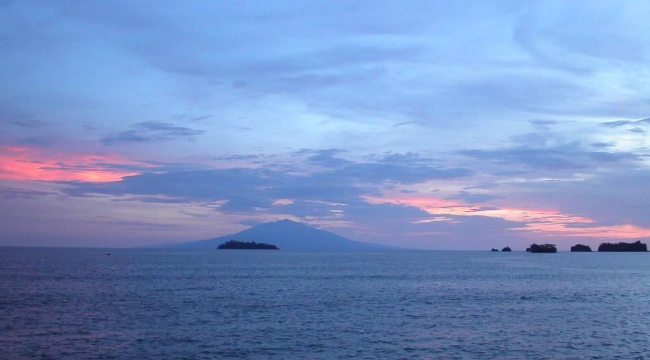
4. GOVERNMENT EFFORTS
Activity 5
Limbe.
Notes:
Activity 5. Look carefully at this picture: limbe. Observe every detail before I ask the question.

Slide 32
4. GOVERNMENT EFFORTS
Activity 5: Question
Give two government efforts to promote tourism.
Notes:
Here is the question for Activity 5: Give two government efforts to promote tourism. Take one minute to think and write your answer in your rough notebook.

Slide 33
4. GOVERNMENT EFFORTS
Activity 5: Answer
Creating national parks and training tourism workers (also building roads and hotels).
Notes:
Let us check the answer together. Creating national parks and training tourism workers (also building roads and hotels).

Slide 34
BOARD SUMMARY
Board Summary
Topic: Managing Resources for Development through Economic Activities
Sub-topic: Economic Development Potentials of Cameroon
Lesson 21: Development of Tourism in Cameroon
Notes:
Now we are going to copy the board summary. Write the title and the headings neatly in your notebooks. I will give you enough time for each slide, so do not rush.

Slide 35
BOARD SUMMARY
1. Identification, Location and Distribution of Attractions
The tourist attractions of Cameroon are distributed as follows:
North: Waza, Benue and Bouba Ndjida parks and the Rhumsiki landscape attract visitors.
West: The Foumban palace, crater lakes and highland cultures attract visitors.
Notes:
Let us copy Identification, Location and Distribution of Attractions. The tourist attractions of Cameroon are distributed as follows. On this slide we have North and West. Write each point on a new line, with the key term first, and explain it in your own words when we revise. When you finish, we go to the next slide.

Slide 36
BOARD SUMMARY
1. Identification, Location and Distribution of Attractions (continued)
Coast: The beaches of Kribi and Limbe, the Lobé Falls and Mount Cameroon attract visitors.
South and East: Dja and Lobéké reserves protect forests and gorillas.
Notes:
We continue with Identification, Location and Distribution of Attractions. On this slide we have Coast and South and East. Write each point on a new line, with the key term first, and explain it in your own words when we revise.

Slide 37
BOARD SUMMARY
1. Identification, Location and Distribution of Attractions
Illustration: tourist attractions of Cameroon
Notes:
Now draw this illustration in your notebook: tourist attractions of Cameroon. Give it a title and label it clearly.

Slide 38
BOARD SUMMARY
2. Problems and Effects of Tourism
Tourism in Cameroon faces the following problems and effects:
Problems: Bad roads, insecurity, poor hotels, harassment and weak advertising limit tourism.
Effects on the economy: Tourism brings foreign currency and jobs.
Notes:
Let us copy Problems and Effects of Tourism. Tourism in Cameroon faces the following problems and effects. On this slide we have Problems and Effects on the economy. Write each point on a new line, with the key term first, and explain it in your own words when we revise. When you finish, we go to the next slide.

Slide 39
BOARD SUMMARY
2. Problems and Effects of Tourism (continued)
Effects on the people and environment: It promotes local crafts but can pollute sites and change cultures.
Notes:
We continue with Problems and Effects of Tourism. On this slide we have Effects on the people and environment. Write each point on a new line, with the key term first, and explain it in your own words when we revise.

Slide 40
BOARD SUMMARY
3. Government Efforts to Promote Tourism
The government promotes tourism in the following ways:
Protection of sites: National parks and reserves are created and guarded.
Infrastructure: Roads, airports and hotels are built and improved.
Notes:
Let us copy Government Efforts to Promote Tourism. The government promotes tourism in the following ways. On this slide we have Protection of sites and Infrastructure. Write each point on a new line, with the key term first, and explain it in your own words when we revise. When you finish, we go to the next slide.

Slide 41
BOARD SUMMARY
3. Government Efforts to Promote Tourism (continued)
Training and promotion: Tourism schools train workers and fairs advertise Cameroon.
Notes:
We continue with Government Efforts to Promote Tourism. On this slide we have Training and promotion. Write each point on a new line, with the key term first, and explain it in your own words when we revise.

Slide 42
FORMATIVE EVALUATION
Evaluation 1
Name and locate two tourist attractions in Cameroon.
Notes:
Now let us check what you have understood. Question 1: Name and locate two tourist attractions in Cameroon. Answer in your exercise book.

Slide 43
FORMATIVE EVALUATION
Expected Answer
Waza Park (Far North) and Kribi beaches (South).
Notes:
The expected answer is: waza Park (Far North) and Kribi beaches (South). If you got it right, well done.

Slide 44
FORMATIVE EVALUATION
Evaluation 2
Give two problems of tourism in Cameroon.
Notes:
Now let us check what you have understood. Question 2: Give two problems of tourism in Cameroon. Answer in your exercise book.

Slide 45
FORMATIVE EVALUATION
Expected Answer
Bad roads and insecurity.
Notes:
The expected answer is: bad roads and insecurity. If you got it right, well done.

Slide 46
REMEDIATION
Remediation
Fill in the blanks:
Cameroon is called Africa in ______.
The famous palace in the West is at ______.
The Lobé Falls are near ______.
Notes:
For those who need more practice, fill in the blanks in your exercise book. The answers are: number 1, miniature; number 2, Foumban; number 3, Kribi.

Slide 47
HOMEWORK
Homework
Draw a sketch map of Cameroon showing six tourist attractions.
Notes:
For your homework: Draw a sketch map of Cameroon showing six tourist attractions. We shall correct it at the beginning of our next lesson.

Slide 48
NEXT LESSON
Next Lesson
Our next lesson will be on:
Lesson 22: Economic Growth of Cameroon
Notes:
Our next lesson will be on Lesson 22: Economic Growth of Cameroon. Thank you for your attention, and see you next time.

Slide 49
BILINGUAL GAME
Bilingual Game (Jeu Bilingue)
English | Français
National park | Le parc national
Tourist guide | Le guide touristique
Craft | L'artisanat
Palace | Le palais
Waterfall | La chute
Harassment | Le harcèlement
Notes:
Let us play the bilingual game. I say a word in English, and you give me the French word. Then we do the reverse.

Slide 50
LOGBOOK
Official Logbook (1/2)
Module / Topic | Managing Resources for Development through Economic Activities
Lesson Title | Lesson 21: Development of Tourism in Cameroon
Expected Learning Outcomes | Identify and locate tourist attractions in Cameroon. Explain the problems and effects of tourism in Cameroon. Describe government efforts to promote tourism.
Competence | Learners are able to locate tourist attractions in Cameroon and propose ways to develop tourism.
Notes:
I record this information in the official logbook of the class after the lesson.

Slide 51
LOGBOOK
Official Logbook (2/2)
Matter Taught | Identification, Location and Distribution of Attractions; Problems and Effects of Tourism; Government Efforts to Promote Tourism.
Evaluation | Formative evaluation and remediation exercise.
Homework | Draw a sketch map of Cameroon showing six tourist attractions.
Enrolment / Present / Absent | ____ / ____ / ____
Achievement | To be completed after the lesson.
Notes:
I complete the second page of the logbook: the matter taught, the evaluation, the homework and the attendance.

Slide 52
TEACHER'S NOTE
Teacher's Note
Timing: Homework correction, plan, objectives 8 min | Recall, situation, action 10 min | 5 activities 30 min | Board summary (copying) 30 min | Evaluation, remediation 10 min | Homework, next lesson 5 min | Logbook 7 min
Without the projector (Activity 1): use the map.
Without the projector (Activity 2): list.
Without the projector (Activity 3): describe.
Without the projector (Activity 4): discuss.
Without the projector (Activity 5): list.
Notes:
This slide is for me, the teacher: it gives the timing of the lesson and what to do if the projector is not available.

Slide 53
REFERENCES
References
Geography Syllabus, Forms I–V, MINESEC (2023) — Form 5, Module I: Management of Manufacturing and Tertiary Activities.
Photo, Activity 2: “Rhumsiki peak, North Cameroon” by krishna.naudin, CC BY-SA 2.0, via Flickr (https://www.flickr.com/photos/141297921@N05/25989204581)
Photo, Activity 4: “Cameroon - UN Women's Gender Road Project” by UN Women Gallery, CC BY-NC-ND 2.0, via Flickr (https://www.flickr.com/photos/51431730@N04/40672356003)
Photo, Activity 5: “Sunset in Limbe” by visulogik, CC BY 2.0, via Flickr (https://www.flickr.com/photos/55671677@N00/2202334428)
Diagrams and animations: drawn for this lesson (Geography Department).
Notes:
These are the references and picture credits used to prepare this lesson.

