Slide 1
FORM 5
GEOGRAPHY
Lesson 23
Land Reclamation
Notes:
Good morning, class, and welcome to our geography lesson. I am your geography teacher, Mr Kamdem. Today we are starting Lesson 23: Land Reclamation.

Slide 2
CLASS INFO
Class, Chapter and Duration
Class | Form 5
Chapter | Module II: Preservation of the Natural Environment
Duration | 2 periods (2 × 50 minutes)
Notes:
This lesson is for Form 5. It belongs to Module II: Preservation of the Natural Environment. We shall need 2 periods to cover it.

Slide 3
IDENTIFICATION
Lesson Identification
Topic | Development Projects and Environmental Management
Sub-topic | Development Projects
Lesson | Lesson 23: Land Reclamation
Notions / Concepts | Land reclamation, landfill, dykes, irrigation, poldering, drainage.
Syllabus focus | Meaning; examples; advantages and disadvantages of land reclamation schemes; challenges of land reclamation.
Competence | Learners are able to explain land reclamation and assess reclamation schemes.
Notes:
Our topic is Development Projects and Environmental Management, and the sub-topic is Development Projects. The key notions we shall use today are: land reclamation, landfill, dykes, irrigation, poldering, drainage. At the end, you should be able to do this: learners are able to explain land reclamation and assess reclamation schemes.

Slide 4

HOMEWORK CORRECTION
Correction of the Homework
Question (Lesson 22: Economic Growth of Cameroon):
Suggest three actions young people can take to help Cameroon reach emergence.
Notes:
Before we start the new lesson, let us correct the homework I gave you at the end of Lesson 22: Economic Growth of Cameroon. The question was: Suggest three actions young people can take to help Cameroon reach emergence. Take out your exercise books.

Slide 5
HOMEWORK CORRECTION
Correction: Possible Answer
Learn technical skills, create small businesses or cooperatives, buy local products, and refuse corruption (also take part in community work).
Notes:
Here is a good answer. Learn technical skills, create small businesses or cooperatives, buy local products, and refuse corruption (also take part in community work). Compare it with your own answer and correct your work in red.

Slide 6
LESSON PLAN
Lesson Plan
Correction of the homework
Objectives and recall
Real-life situation and action to take
Learning activities
Board summary
Evaluation, remediation and homework
Notes:
Here is the plan of our lesson today. First, we shall correct the homework. Then we shall look at the objectives and recall what you already know. After that, we shall study a situation from real life and the action to take, and do the learning activities. Finally, we shall copy the board summary, do the evaluation and the remediation, and I will give you the homework.

Slide 7
OBJECTIVES
Objectives
By the end of this lesson, you should be able to:
Define land reclamation.
Give examples of land reclamation schemes.
Assess their advantages, disadvantages and challenges.
Notes:
By the end of this lesson, you should be able to do three things. Number 1: define land reclamation. Number 2: give examples of land reclamation schemes. Number 3: assess their advantages, disadvantages and challenges.

Slide 8
PREVIOUS KNOWLEDGE
Previous Knowledge
Some lands are too wet, too dry or eroded to be used.
The Netherlands is a low country.
Irrigation brings water to dry land.
Notes:
Let us first remember what you already know. Some lands are too wet, too dry or eroded to be used. The Netherlands is a low country. Irrigation brings water to dry land. Keep this in mind, because we shall build on it today.

Slide 9
REAL-LIFE SITUATION
Situation in Real Life
In the Netherlands, people built dykes and pumped water out of the sea to create farmland. In the Far North of Cameroon, farmers irrigate dry land to grow rice.
Notes:
Listen carefully to this situation from real life. In the Netherlands, people built dykes and pumped water out of the sea to create farmland. In the Far North of Cameroon, farmers irrigate dry land to grow rice. Think about it, because I am going to ask you some questions.

Slide 10
REAL-LIFE SITUATION
Situation: Question 1
What is the problem in the situation?
Notes:
Question 1: What is the problem in the situation? Think for a moment, then raise your hand to answer.

Slide 11
REAL-LIFE SITUATION
Answer
We want to know how people make unused land useful.
Notes:
Good. We want to know how people make unused land useful.

Slide 12
REAL-LIFE SITUATION
Situation: Question 2
How did the Dutch gain land?
Notes:
Question 2: How did the Dutch gain land? Think for a moment, then raise your hand to answer.

Slide 13
REAL-LIFE SITUATION
Answer
By building dykes and pumping out water.
Notes:
Good. By building dykes and pumping out water.

Slide 14
REAL-LIFE SITUATION
Situation: Question 3
How is dry land used in the Far North?
Notes:
Question 3: How is dry land used in the Far North? Think for a moment, then raise your hand to answer.

Slide 15
REAL-LIFE SITUATION
Possible Answer
By irrigation.
Notes:
Good. By irrigation.

Slide 16
ACTION TO TAKE
Action to Take
Use manures, terraces and tree planting to restore degraded land.
Notes:
From this situation, the action we are working towards in this lesson is the following: use manures, terraces and tree planting to restore degraded land.

Slide 17
JUSTIFICATION
Justification of the Lesson
This lesson helps us to understand how people improve difficult environments.
Notes:
Why is this lesson important for you? This lesson helps us to understand how people improve difficult environments.

Slide 18
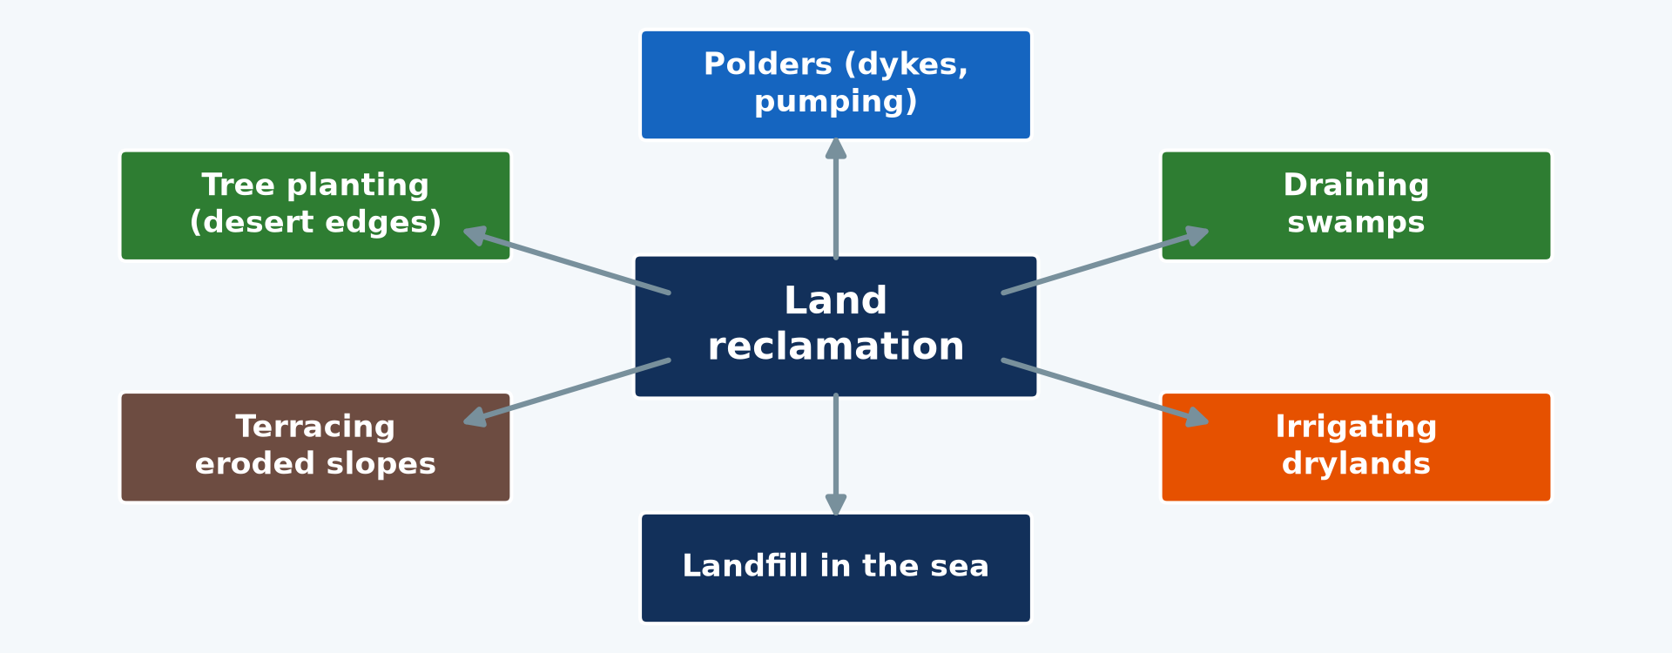
1. MEANING
Activity 1
Methods of land reclamation.
Notes:
Activity 1. Look carefully at this diagram: methods of land reclamation. Observe every detail before I ask the question.

Slide 19
1. MEANING
Activity 1: Question
What is land reclamation?
Notes:
Here is the question for Activity 1: What is land reclamation? Take one minute to think and write your answer in your rough notebook.

Slide 20
1. MEANING
Activity 1: Answer
Making unused or degraded land usable for farming, settlement or industry.
Notes:
Let us check the answer together. Making unused or degraded land usable for farming, settlement or industry.

Slide 21
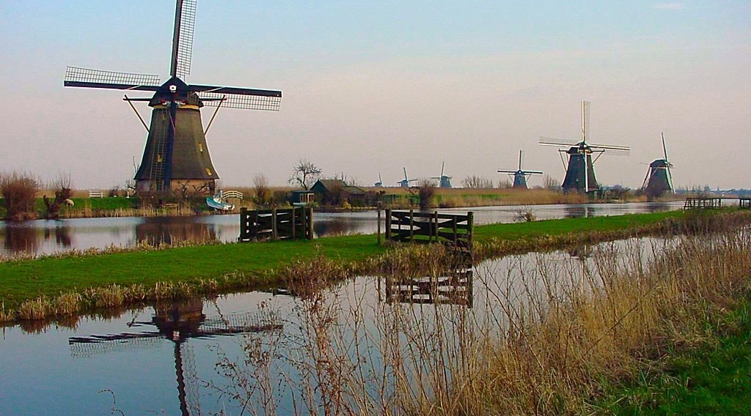
2. EXAMPLES: POLDERS
Activity 2
A polder in the Netherlands.
Notes:
Activity 2. Look carefully at this picture: a polder in the Netherlands. Observe every detail before I ask the question.

Slide 22
2. EXAMPLES: POLDERS
Activity 2: Question
What is a polder?
Notes:
Here is the question for Activity 2: What is a polder? Take one minute to think and write your answer in your rough notebook.

Slide 23
2. EXAMPLES: POLDERS
Activity 2: Answer
Land taken from the sea or a lake by building dykes and pumping out the water.
Notes:
Let us check the answer together. Land taken from the sea or a lake by building dykes and pumping out the water.

Slide 24
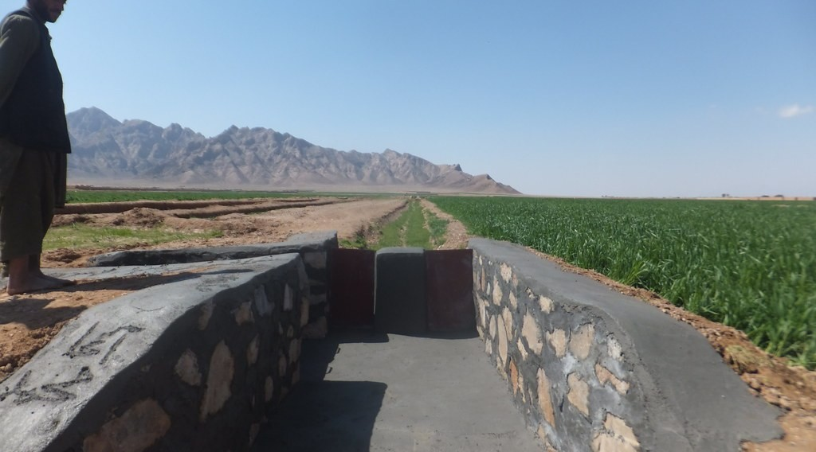
2. EXAMPLES: DRYLANDS AND COASTS
Activity 3
Irrigation canals.
Notes:
Activity 3. Look carefully at this picture: irrigation canals. Observe every detail before I ask the question.

Slide 25
2. EXAMPLES: DRYLANDS AND COASTS
Activity 3: Question
Give two other examples of land reclamation.
Notes:
Here is the question for Activity 3: Give two other examples of land reclamation. Take one minute to think and write your answer in your rough notebook.

Slide 26
2. EXAMPLES: DRYLANDS AND COASTS
Activity 3: Answer
Irrigation of drylands and landfill on coasts (Singapore, Dubai).
Notes:
Let us check the answer together. Irrigation of drylands and landfill on coasts (Singapore, Dubai).

Slide 27
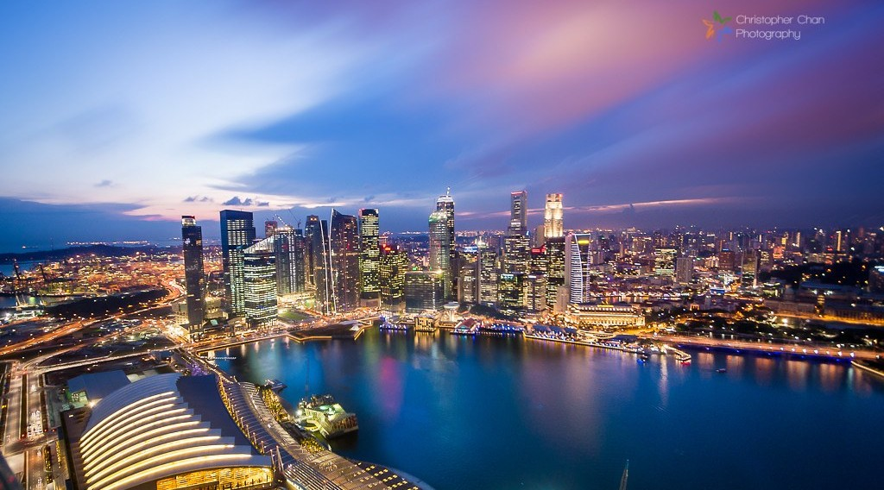
3. ADVANTAGES AND DISADVANTAGES
Activity 4
Singapore, built partly on reclaimed land.
Notes:
Activity 4. Look carefully at this picture: singapore, built partly on reclaimed land. Observe every detail before I ask the question.

Slide 28
3. ADVANTAGES AND DISADVANTAGES
Activity 4: Question
Give one advantage and one disadvantage of land reclamation.
Notes:
Here is the question for Activity 4: Give one advantage and one disadvantage of land reclamation. Take one minute to think and write your answer in your rough notebook.

Slide 29
3. ADVANTAGES AND DISADVANTAGES
Activity 4: Answer
More land for farming or building; destruction of wetlands and high costs.
Notes:
Let us check the answer together. More land for farming or building; destruction of wetlands and high costs.

Slide 30

4. CHALLENGES
Activity 5
A flood.
Notes:
Activity 5. Look carefully at this picture: a flood. Observe every detail before I ask the question.

Slide 31
4. CHALLENGES
Activity 5: Question
Give two challenges of land reclamation.
Notes:
Here is the question for Activity 5: Give two challenges of land reclamation. Take one minute to think and write your answer in your rough notebook.

Slide 32
4. CHALLENGES
Activity 5: Answer
High costs and the risk of floods or salinisation.
Notes:
Let us check the answer together. High costs and the risk of floods or salinisation.

Slide 33
BOARD SUMMARY
Board Summary
Topic: Development Projects and Environmental Management
Sub-topic: Development Projects
Lesson 23: Land Reclamation
Notes:
Now we are going to copy the board summary. Write the title and the headings neatly in your notebooks. I will give you enough time for each slide, so do not rush.

Slide 34
BOARD SUMMARY
DEFINITIONS
The key terms of this lesson are defined as follows:
Land reclamation: It is the process of making unused or degraded land usable.
Notes:
Let us copy the definitions. The key terms of this lesson are defined as follows. On this slide we have Land reclamation. Write each point on a new line, with the key term first, and explain it in your own words when we revise.

Slide 35
BOARD SUMMARY
1. Examples of Land Reclamation Schemes
Land is reclaimed in the following ways:
Poldering: Dykes are built and water is pumped out, as in the Netherlands.
Drainage and landfill: Swamps are drained and coasts are filled, as in Singapore.
Notes:
Let us copy Examples of Land Reclamation Schemes. Land is reclaimed in the following ways. On this slide we have Poldering and Drainage and landfill. Write each point on a new line, with the key term first, and explain it in your own words when we revise. When you finish, we go to the next slide.

Slide 36
BOARD SUMMARY
1. Examples of Land Reclamation Schemes (continued)
Irrigation: Dry lands are watered, as at SEMRY in the Far North of Cameroon.
Soil restoration: Terraces, manures and trees restore eroded land.
Notes:
We continue with Examples of Land Reclamation Schemes. On this slide we have Irrigation and Soil restoration. Write each point on a new line, with the key term first, and explain it in your own words when we revise.

Slide 37
BOARD SUMMARY
1. Examples of Land Reclamation Schemes
Illustration: methods of land reclamation
Notes:
Now draw this illustration in your notebook: methods of land reclamation. Give it a title and label it clearly.

Slide 38
BOARD SUMMARY
2. Advantages, Disadvantages and Challenges
Land reclamation has the following effects and challenges:
Advantages: It gives more land for farming, settlement and industry.
Disadvantages: It destroys wetlands and habitats and can cause salinisation.
Notes:
Let us copy Advantages, Disadvantages and Challenges. Land reclamation has the following effects and challenges. On this slide we have Advantages and Disadvantages. Write each point on a new line, with the key term first, and explain it in your own words when we revise. When you finish, we go to the next slide.

Slide 39
BOARD SUMMARY
2. Advantages, Disadvantages and Challenges (continued)
Challenges: It needs much capital, technology and maintenance.
Notes:
We continue with Advantages, Disadvantages and Challenges. On this slide we have Challenges. Write each point on a new line, with the key term first, and explain it in your own words when we revise.

Slide 40
FORMATIVE EVALUATION
Evaluation 1
What is a polder?
Notes:
Now let us check what you have understood. Question 1: What is a polder? Answer in your exercise book.

Slide 41
FORMATIVE EVALUATION
Expected Answer
Land taken from the sea by dykes and pumping.
Notes:
The expected answer is: land taken from the sea by dykes and pumping. If you got it right, well done.

Slide 42
FORMATIVE EVALUATION
Evaluation 2
Give one advantage and one challenge of land reclamation.
Notes:
Now let us check what you have understood. Question 2: Give one advantage and one challenge of land reclamation. Answer in your exercise book.

Slide 43
FORMATIVE EVALUATION
Expected Answer
More farmland; high costs.
Notes:
The expected answer is: more farmland; high costs. If you got it right, well done.

Slide 44
REMEDIATION
Remediation
Fill in the blanks:
Land taken from the sea is a ______.
Walls built to hold back water are ______.
Watering dry land is ______.
Notes:
For those who need more practice, fill in the blanks in your exercise book. The answers are: number 1, polder; number 2, dykes; number 3, irrigation.

Slide 45
HOMEWORK
Homework
Propose three ways to reclaim degraded land in the North of Cameroon.
Notes:
For your homework: Propose three ways to reclaim degraded land in the North of Cameroon. We shall correct it at the beginning of our next lesson.

Slide 46
NEXT LESSON
Next Lesson
Our next lesson will be on:
Lesson 24: Multipurpose River Development Project (MRDP)
Notes:
Our next lesson will be on Lesson 24: Multipurpose River Development Project (MRDP). Thank you for your attention, and see you next time.

Slide 47
BILINGUAL GAME
Bilingual Game (Jeu Bilingue)
English | Français
Land reclamation | La mise en valeur des terres
Polder | Le polder
Dyke | La digue
Drainage | Le drainage
Landfill | Le remblai
Salinisation | La salinisation
Notes:
Let us play the bilingual game. I say a word in English, and you give me the French word. Then we do the reverse.

Slide 48
LOGBOOK
Official Logbook (1/2)
Module / Topic | Development Projects and Environmental Management
Lesson Title | Lesson 23: Land Reclamation
Expected Learning Outcomes | Define land reclamation. Give examples of land reclamation schemes. Assess their advantages, disadvantages and challenges.
Competence | Learners are able to explain land reclamation and assess reclamation schemes.
Notes:
I record this information in the official logbook of the class after the lesson.

Slide 49
LOGBOOK
Official Logbook (2/2)
Matter Taught | DEFINITIONS; Examples of Land Reclamation Schemes; Advantages, Disadvantages and Challenges.
Evaluation | Formative evaluation and remediation exercise.
Homework | Propose three ways to reclaim degraded land in the North of Cameroon.
Enrolment / Present / Absent | ____ / ____ / ____
Achievement | To be completed after the lesson.
Notes:
I complete the second page of the logbook: the matter taught, the evaluation, the homework and the attendance.

Slide 50
TEACHER'S NOTE
Teacher's Note
Timing: Homework correction, plan, objectives 8 min | Recall, situation, action 10 min | 5 activities 30 min | Board summary (copying) 30 min | Evaluation, remediation 10 min | Homework, next lesson 5 min | Logbook 7 min
Without the projector (Activity 1): discuss.
Without the projector (Activity 2): describe.
Without the projector (Activity 3): list.
Without the projector (Activity 4): discuss.
Without the projector (Activity 5): discuss.
Notes:
This slide is for me, the teacher: it gives the timing of the lesson and what to do if the projector is not available.

Slide 51
REFERENCES
References
Geography Syllabus, Forms I–V, MINESEC (2023) — Form 5, Module II: Preservation of the Natural Environment.
Photo, Activity 2: “Mills Kinderdijk, Holland - 3632” by HereIsTom, CC BY-NC-ND 2.0, via Flickr (https://www.flickr.com/photos/47035764@N03/8141380736)
Photo, Activity 3: “Irrigation Canals in Farah Province Afgahnistan” by USAID_IMAGES, CC BY-NC-ND 2.0, via Flickr (https://www.flickr.com/photos/46658241@N06/14784748647)
Photo, Activity 4: “Singapore” by Christopher Chan, CC BY-NC-ND 2.0, via Flickr (https://www.flickr.com/photos/17751217@N00/8909326546)
Photo, Activity 5: “Flood in Accra” by Stig Nygaard, CC BY 2.0, via Flickr (https://www.flickr.com/photos/10259776@N00/181742000)
Diagrams and animations: drawn for this lesson (Geography Department).
Notes:
These are the references and picture credits used to prepare this lesson.

