Slide 1
FORM 5
GEOGRAPHY
Lesson 27
Pollution
Notes:
Good morning, class, and welcome to our geography lesson. I am your geography teacher, Mr Kamdem. Today we are starting Lesson 27: Pollution.

Slide 2
CLASS INFO
Class, Chapter and Duration
Class | Form 5
Chapter | Module II: Preservation of the Natural Environment
Duration | 2 periods (2 × 50 minutes)
Notes:
This lesson is for Form 5. It belongs to Module II: Preservation of the Natural Environment. We shall need 2 periods to cover it.

Slide 3
IDENTIFICATION
Lesson Identification
Topic | Development Projects and Environmental Management
Sub-topic | Environmental Degradation
Lesson | Lesson 27: Pollution
Notions / Concepts | Pollution, pollutant, air, water, soil and noise pollution.
Syllabus focus | Definition; types; causes and sources of each type; consequences and solutions of each type; adaptation strategies.
Competence | Learners are able to explain the types of pollution and propose solutions and adaptation strategies.
Notes:
Our topic is Development Projects and Environmental Management, and the sub-topic is Environmental Degradation. The key notions we shall use today are: pollution, pollutant, air, water, soil and noise pollution. At the end, you should be able to do this: learners are able to explain the types of pollution and propose solutions and adaptation strategies.

Slide 4

HOMEWORK CORRECTION
Correction of the Homework
Question (Lesson 26: Problems of Waste Management):
Describe how waste is managed in your quarter and propose three improvements.
Notes:
Before we start the new lesson, let us correct the homework I gave you at the end of Lesson 26: Problems of Waste Management. The question was: Describe how waste is managed in your quarter and propose three improvements. Take out your exercise books.

Slide 5
HOMEWORK CORRECTION
Correction: Possible Answer
Example: waste is burnt or dumped in gutters; provide bins, organise collection with HYSACAM or the council, and sort plastics for recycling.
Notes:
Here is a good answer. Example: waste is burnt or dumped in gutters; provide bins, organise collection with HYSACAM or the council, and sort plastics for recycling. Compare it with your own answer and correct your work in red.

Slide 6
LESSON PLAN
Lesson Plan
Correction of the homework
Objectives and recall
Real-life situation and action to take
Learning activities
Board summary
Evaluation, remediation and homework
Notes:
Here is the plan of our lesson today. First, we shall correct the homework. Then we shall look at the objectives and recall what you already know. After that, we shall study a situation from real life and the action to take, and do the learning activities. Finally, we shall copy the board summary, do the evaluation and the remediation, and I will give you the homework.

Slide 7
OBJECTIVES
Objectives
By the end of this lesson, you should be able to:
Define pollution and give its types.
Explain the causes and sources of each type.
Notes:
Take your time to copy this part; we will continue together.

Slide 8
OBJECTIVES
Objectives (continued)
Explain the consequences, solutions and adaptation strategies.
Notes:
By the end of this lesson, you should be able to do three things. Number 1: define pollution and give its types. Number 2: explain the causes and sources of each type. Number 3: explain the consequences, solutions and adaptation strategies.

Slide 9
PREVIOUS KNOWLEDGE
Previous Knowledge
Waste pollutes the environment.
Cars produce smoke.
Dirty water causes diseases.
Notes:
Let us first remember what you already know. Waste pollutes the environment. Cars produce smoke. Dirty water causes diseases. Keep this in mind, because we shall build on it today.

Slide 10
REAL-LIFE SITUATION
Situation in Real Life
In a town, factories and old cars release thick smoke, a river is full of waste and loud music disturbs the neighbours every night.
Notes:
Listen carefully to this situation from real life. In a town, factories and old cars release thick smoke, a river is full of waste and loud music disturbs the neighbours every night. Think about it, because I am going to ask you some questions.

Slide 11
REAL-LIFE SITUATION
Situation: Question 1
What is the problem in the situation?
Notes:
Question 1: What is the problem in the situation? Think for a moment, then raise your hand to answer.

Slide 12
REAL-LIFE SITUATION
Answer
The town suffers from pollution.
Notes:
Good. The town suffers from pollution.

Slide 13
REAL-LIFE SITUATION
Situation: Question 2
Name two sources of pollution.
Notes:
Question 2: Name two sources of pollution. Think for a moment, then raise your hand to answer.

Slide 14
REAL-LIFE SITUATION
Answer
Factories and cars.
Notes:
Good. Factories and cars.

Slide 15
REAL-LIFE SITUATION
Situation: Question 3
Name the types of pollution in the situation.
Notes:
Question 3: Name the types of pollution in the situation. Think for a moment, then raise your hand to answer.

Slide 16
REAL-LIFE SITUATION
Possible Answer
Air, water and noise pollution.
Notes:
Good. Air, water and noise pollution.

Slide 17
ACTION TO TAKE
Action to Take
Denounce polluters, plant trees and reduce noise and waste.
Notes:
From this situation, the action we are working towards in this lesson is the following: denounce polluters, plant trees and reduce noise and waste.

Slide 18
JUSTIFICATION
Justification of the Lesson
This lesson helps us to protect our health and our environment.
Notes:
Why is this lesson important for you? This lesson helps us to protect our health and our environment.

Slide 19
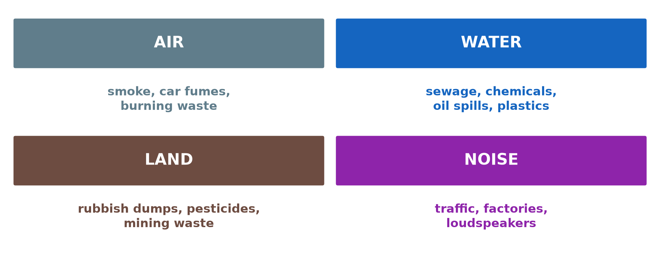
1. DEFINITION AND TYPES
Activity 1
Types of pollution.
Notes:
Activity 1. Look carefully at this diagram: types of pollution. Observe every detail before I ask the question.

Slide 20
1. DEFINITION AND TYPES
Activity 1: Question
What is pollution?
Notes:
Here is the question for Activity 1: What is pollution? Take one minute to think and write your answer in your rough notebook.

Slide 21
1. DEFINITION AND TYPES
Activity 1: Answer
The introduction of harmful substances or energy into the environment.
Notes:
Let us check the answer together. The introduction of harmful substances or energy into the environment.

Slide 22

2. AIR POLLUTION
Activity 2
Smog in a city.
Notes:
Activity 2. Look carefully at this picture: smog in a city. Observe every detail before I ask the question.

Slide 23
2. AIR POLLUTION
Activity 2: Question
Give two sources and one consequence of air pollution.
Notes:
Here is the question for Activity 2: Give two sources and one consequence of air pollution. Take one minute to think and write your answer in your rough notebook.

Slide 24
2. AIR POLLUTION
Activity 2: Answer
Factories and vehicles; respiratory diseases (also acid rain).
Notes:
Let us check the answer together. Factories and vehicles; respiratory diseases (also acid rain).

Slide 25
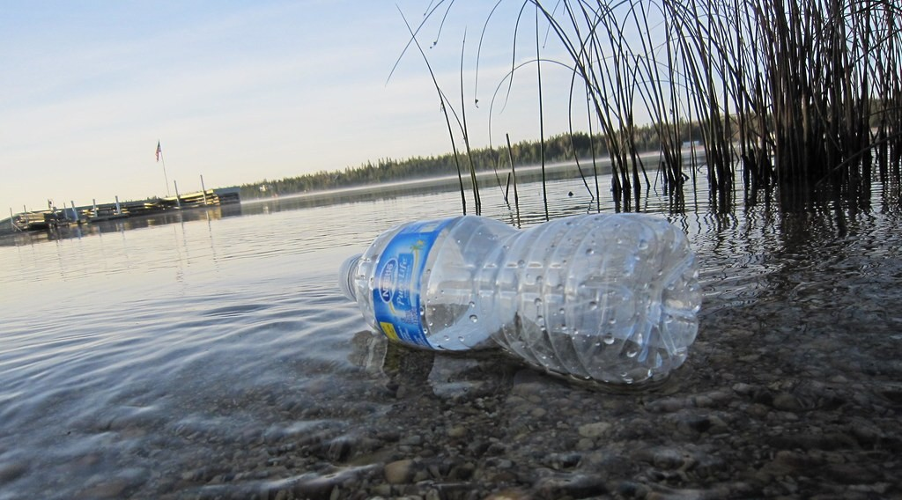
2. WATER POLLUTION
Activity 3
Plastic in water.
Notes:
Activity 3. Look carefully at this picture: plastic in water. Observe every detail before I ask the question.

Slide 26
2. WATER POLLUTION
Activity 3: Question
Give two sources and one consequence of water pollution.
Notes:
Here is the question for Activity 3: Give two sources and one consequence of water pollution. Take one minute to think and write your answer in your rough notebook.

Slide 27
2. WATER POLLUTION
Activity 3: Answer
Household waste and chemicals; waterborne diseases.
Notes:
Let us check the answer together. Household waste and chemicals; waterborne diseases.

Slide 28

2. SOIL AND NOISE POLLUTION
Activity 4
Spraying chemicals.
Notes:
Activity 4. Look carefully at this picture: spraying chemicals. Observe every detail before I ask the question.

Slide 29
2. SOIL AND NOISE POLLUTION
Activity 4: Question
Give one source each of soil and noise pollution.
Notes:
Here is the question for Activity 4: Give one source each of soil and noise pollution. Take one minute to think and write your answer in your rough notebook.

Slide 30
2. SOIL AND NOISE POLLUTION
Activity 4: Answer
Pesticides and plastics pollute soil; traffic and loud music cause noise.
Notes:
Let us check the answer together. Pesticides and plastics pollute soil; traffic and loud music cause noise.

Slide 31
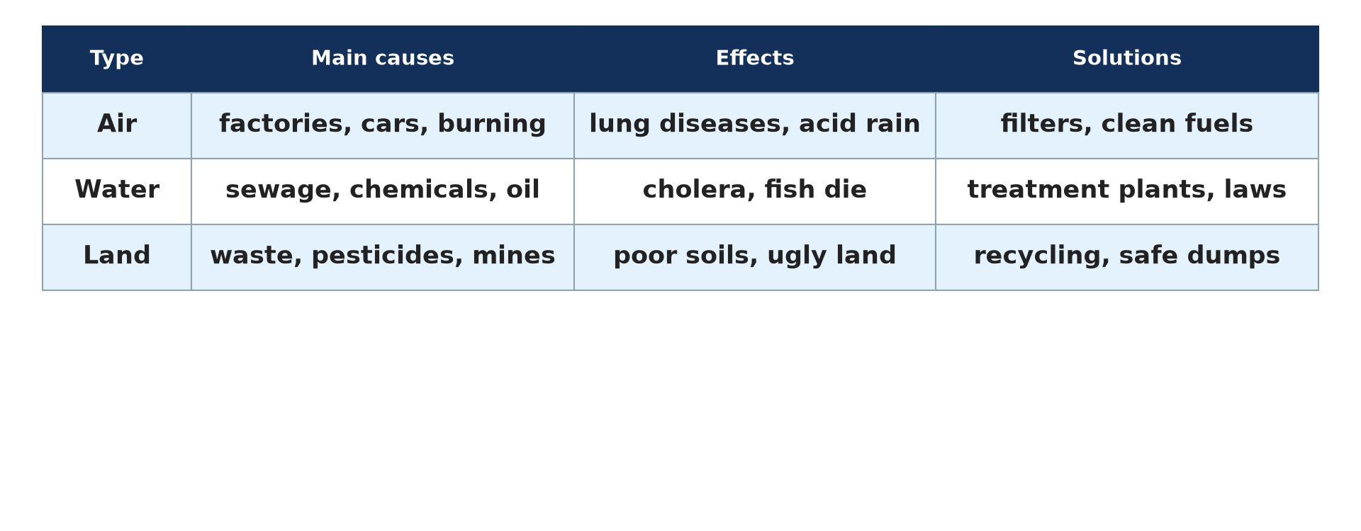
3. SOLUTIONS AND ADAPTATION
Activity 5
Pollution: causes and solutions.
Notes:
Activity 5. Look carefully at this diagram: pollution: causes and solutions. Observe every detail before I ask the question.

Slide 32
3. SOLUTIONS AND ADAPTATION
Activity 5: Question
Give two solutions and one adaptation strategy.
Notes:
Here is the question for Activity 5: Give two solutions and one adaptation strategy. Take one minute to think and write your answer in your rough notebook.

Slide 33
3. SOLUTIONS AND ADAPTATION
Activity 5: Answer
Laws and clean technology; wearing masks or boiling water.
Notes:
Let us check the answer together. Laws and clean technology; wearing masks or boiling water.

Slide 34
BOARD SUMMARY
Board Summary
Topic: Development Projects and Environmental Management
Sub-topic: Environmental Degradation
Lesson 27: Pollution
Notes:
Now we are going to copy the board summary. Write the title and the headings neatly in your notebooks. I will give you enough time for each slide, so do not rush.

Slide 35
BOARD SUMMARY
DEFINITIONS
The key terms of this lesson are defined as follows:
Pollution: It is the introduction of harmful substances or energy into the environment.
Notes:
Let us copy the definitions. The key terms of this lesson are defined as follows. On this slide we have Pollution. Write each point on a new line, with the key term first, and explain it in your own words when we revise.

Slide 36
BOARD SUMMARY
1. Types, Causes and Sources
The types of pollution and their sources are the following:
Air pollution: It comes from factories, vehicles, burning waste and bush fires.
Water pollution: It comes from sewage, household waste, chemicals and oil spills.
Notes:
Let us copy Types, Causes and Sources. The types of pollution and their sources are the following. On this slide we have Air pollution and Water pollution. Write each point on a new line, with the key term first, and explain it in your own words when we revise. When you finish, we go to the next slide.

Slide 37
BOARD SUMMARY
1. Types, Causes and Sources (continued)
Soil pollution: It comes from pesticides, fertilisers, plastics and mining waste.
Noise pollution: It comes from traffic, machines, aircraft and loud music.
Notes:
We continue with Types, Causes and Sources. On this slide we have Soil pollution and Noise pollution. Write each point on a new line, with the key term first, and explain it in your own words when we revise.

Slide 38
BOARD SUMMARY
1. Types, Causes and Sources
Illustration: types of pollution
Notes:
Now draw this illustration in your notebook: types of pollution. Give it a title and label it clearly.

Slide 39
BOARD SUMMARY
2. Consequences and Solutions
Pollution has the following consequences, solutions and adaptation strategies:
Consequences: It causes diseases, acid rain, death of plants and animals, and stress.
Solutions: Laws, clean technology, waste treatment and tree planting reduce pollution.
Notes:
Let us copy Consequences and Solutions. Pollution has the following consequences, solutions and adaptation strategies. On this slide we have Consequences and Solutions. Write each point on a new line, with the key term first, and explain it in your own words when we revise. When you finish, we go to the next slide.

Slide 40
BOARD SUMMARY
2. Consequences and Solutions (continued)
Adaptation strategies: People wear masks, boil or filter water and plant trees around homes.
Notes:
We continue with Consequences and Solutions. On this slide we have Adaptation strategies. Write each point on a new line, with the key term first, and explain it in your own words when we revise.

Slide 41
FORMATIVE EVALUATION
Evaluation 1
Define pollution.
Notes:
Now let us check what you have understood. Question 1: Define pollution. Answer in your exercise book.

Slide 42
FORMATIVE EVALUATION
Expected Answer
The introduction of harmful substances or energy into the environment.
Notes:
The expected answer is: the introduction of harmful substances or energy into the environment. If you got it right, well done.

Slide 43
FORMATIVE EVALUATION
Evaluation 2
Give one source and one solution for air pollution.
Notes:
Now let us check what you have understood. Question 2: Give one source and one solution for air pollution. Answer in your exercise book.

Slide 44
FORMATIVE EVALUATION
Expected Answer
Vehicles; clean technology (also tree planting).
Notes:
The expected answer is: vehicles; clean technology (also tree planting). If you got it right, well done.

Slide 45
REMEDIATION
Remediation
Fill in the blanks:
Loud sounds cause ______ pollution.
Oil spills cause ______ pollution.
Rain made acid by gases is acid ______.
Notes:
For those who need more practice, fill in the blanks in your exercise book. The answers are: number 1, noise; number 2, water; number 3, rain.

Slide 46
HOMEWORK
Homework
Identify two types of pollution in your town, their sources and one solution for each.
Notes:
For your homework: Identify two types of pollution in your town, their sources and one solution for each. We shall correct it at the beginning of our next lesson.

Slide 47
NEXT LESSON
Next Lesson
Our next lesson will be on:
Lesson 28: Basic Notions on Population
Notes:
Our next lesson will be on Lesson 28: Basic Notions on Population. Thank you for your attention, and see you next time.

Slide 48
BILINGUAL GAME
Bilingual Game (Jeu Bilingue)
English | Français
Pollution | La pollution
Pollutant | Le polluant
Smoke | La fumée
Noise | Le bruit
Sewage | Les eaux usées
Acid rain | La pluie acide
Notes:
Let us play the bilingual game. I say a word in English, and you give me the French word. Then we do the reverse.

Slide 49
LOGBOOK
Official Logbook (1/2)
Module / Topic | Development Projects and Environmental Management
Lesson Title | Lesson 27: Pollution
Expected Learning Outcomes | Define pollution and give its types. Explain the causes and sources of each type. Explain the consequences, solutions and adaptation strategies.
Competence | Learners are able to explain the types of pollution and propose solutions and adaptation strategies.
Notes:
I record this information in the official logbook of the class after the lesson.

Slide 50
LOGBOOK
Official Logbook (2/2)
Matter Taught | DEFINITIONS; Types, Causes and Sources; Consequences and Solutions.
Evaluation | Formative evaluation and remediation exercise.
Homework | Identify two types of pollution in your town, their sources and one solution for each.
Enrolment / Present / Absent | ____ / ____ / ____
Achievement | To be completed after the lesson.
Notes:
I complete the second page of the logbook: the matter taught, the evaluation, the homework and the attendance.

Slide 51
TEACHER'S NOTE
Teacher's Note
Timing: Homework correction, plan, objectives 8 min | Recall, situation, action 10 min | 5 activities 30 min | Board summary (copying) 30 min | Evaluation, remediation 10 min | Homework, next lesson 5 min | Logbook 7 min
Without the projector (Activity 1): list types.
Without the projector (Activity 2): discuss.
Without the projector (Activity 3): discuss.
Without the projector (Activity 4): discuss.
Without the projector (Activity 5): list.
Notes:
This slide is for me, the teacher: it gives the timing of the lesson and what to do if the projector is not available.

Slide 52
REFERENCES
References
Geography Syllabus, Forms I–V, MINESEC (2023) — Form 5, Module II: Preservation of the Natural Environment.
Photo, Activity 2: “Beijing smog” by kevin dooley, CC BY 2.0, via Flickr (https://www.flickr.com/photos/12836528@N00/386198516)
Photo, Activity 3: “Thank God men cannot fly, and lay waste the sky as well as the earth. ” by katerha, CC BY 2.0, via Flickr (https://www.flickr.com/photos/8489692@N03/5107788414)
Photo, Activity 4: “k4817-4” by USDAgov, CC BY 2.0, via Flickr (https://www.flickr.com/photos/41284017@N08/8497812386)
Diagrams and animations: drawn for this lesson (Geography Department).
Notes:
These are the references and picture credits used to prepare this lesson.

